Slide 1
Analysis of repeated measures

Slide 2
Repeated measures:
Related methods/analyses
Key aspect
Before vs after, baseline vs. follow up
Repeated measures / repeated measures ANOVA (rmANOVA)
Longitudinal data
Growth-curve model (psychology)
Difference in differences (economics)
Multiple measurements over time on the on the same individual/experimental unit/site/plot/etc

Slide 3
Time series
Data collected over time on the same thing (weather, population size, GDP) but not the same individuals measured each time
Typically (very) long periods of time
Typically different methods than repeated measures

Slide 4
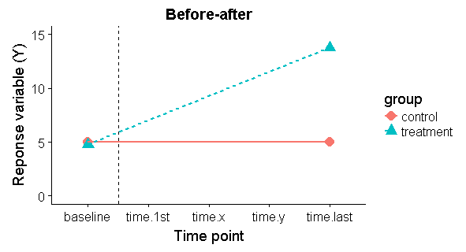
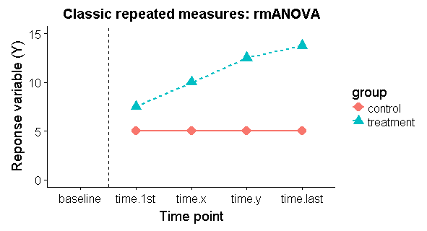
Before-after
-initial baseline measurement before treatment applied / experiment begun
-follow up measurement made at end of study
Classic repeated measures
-multiple measurements taken
-1st measurement typically occurs after experiment begins
-can take baseline and use as covariate
Before treatment
After
treatment
Before treatment
After
treatment

Slide 5
Analysis of before-after experiments: not so good approaches
1)End-point analysis
2) Separate analyses for each treatment
After
treatment
Treatment: Before vs. after
Control: Before vs. after
-Simple to do: 2-sample t-test, but
…but wastes information
…if groups had initial differences results in confounding of baseline level & treatment effect
(intial difference could occur due to small sample size, bad randomization, bad luck during randomization)
(Niewenhuis et al 2011 Erroneous analyses of interactions in neuroscience: a problem of significance)
-1st Paired t-test for control group
-2nd paired t-test for treatment
-If fail to reject Ho for control, but do reject Ho for treatment, researchers frequently conclude control ≠ treatment
-wrong!

Slide 6
Analysis of before-after experiments: not so good approach 3
3)End-point analysis
After
treatment
-Separate 2-sample t-tests on baseline (contrl vs. treatment) and post-treatment (control vs. treatment)
-assumes that change from a “Non-significant” to “significant difference” between the treatments also implies a significant change over time
-this isn’t necessarily true, thanks to the magic of p-values!
-similar problem arises with standard 2x2 factorial ANOVA
(Niewenhuis et al 2011 Erroneous analyses of interactions in neuroscience: a problem of significance)

Slide 7
Analysis of before-after experiments: Some good approaches
4a)Change score: an ok option
2-sample t-test
t.test((Y.time.last – Y.baseline) ~ group)
4b)Percentage change:
Intuitive, but reduces power!
t.test((Y.time.last – Y.baseline)/Y.base.line ~ group)
4c)ANCOVA: preferred by some
Treats initial measurement of response variable as “covariate”
Initial value is then “controlled for” by using it as a predictor
Vickers (2005) argues that this is more intuitive
lm(response.var.last ~ response.var.1st)
4d)Repeated measures ANOVA (rmANOVA): preferred by others…
Treats initial measurement as a response variable
Vickers (2005) argues that this is more complex and output is harder to interpret
aov(Y ~ time*treatment + Error(Individual))
lme(Y ~ time*treatment, random = ~1|Individual))
4)Use all data
Before treatment
After
treatment
-can provide different results!
-subtle differences interpretation!
-when there is a true baseline measurement take b/f experimental treatments, ANOCVA appears to be best (Coffman et al 2016)

Slide 8
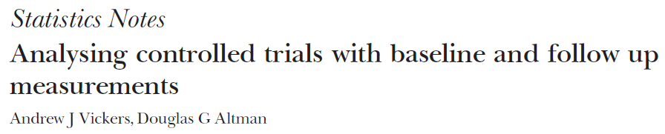
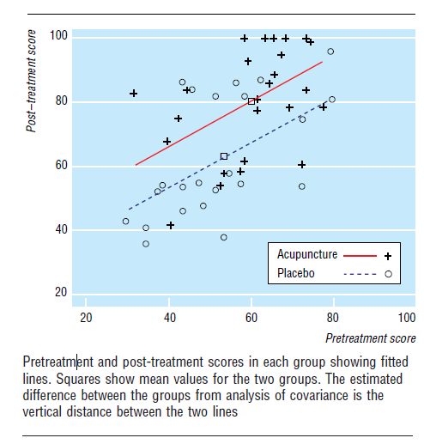
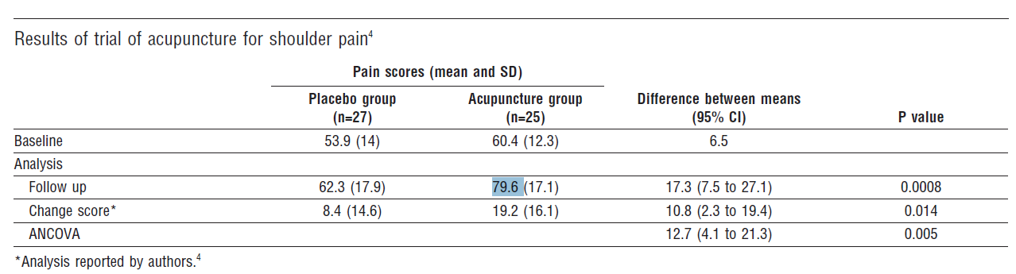

“Follow up” = end point

Slide 9
-multiple time points (3+)
-1st measurement taken after treatment given, so can’t use it as a baseline (though some people will, which is probably bad)
-variation over time indicated by significant “time*treatment” effect, which
Classic formulation (must be balanced)
aov(Y ~ time*treatment + Error(Individual))
Modern formulation (can be unbalanced, have missing data)
lme(Y ~ time*treatment, random = ~1|Individual))

Slide 10
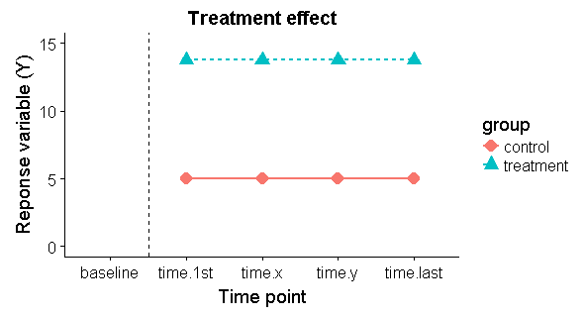
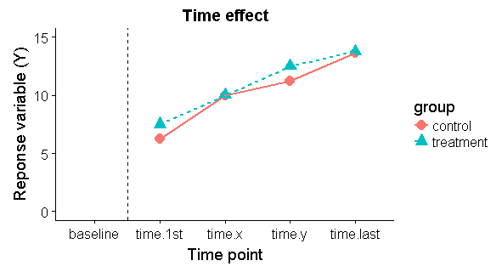
Treatment x time effect, treatment x time interaction

Slide 11
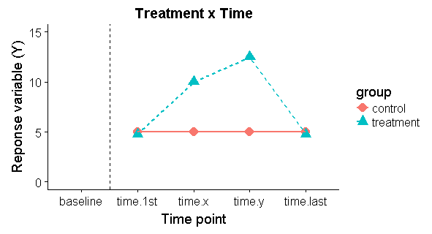
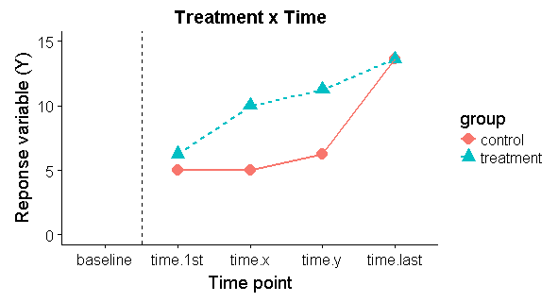
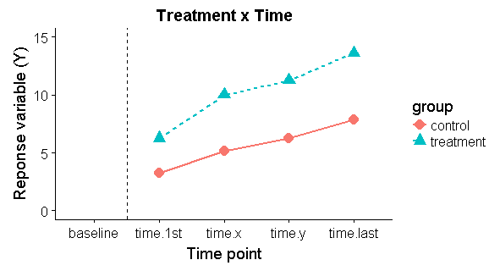
Interpreting a significant “time*treatment interaction”….

Slide 12
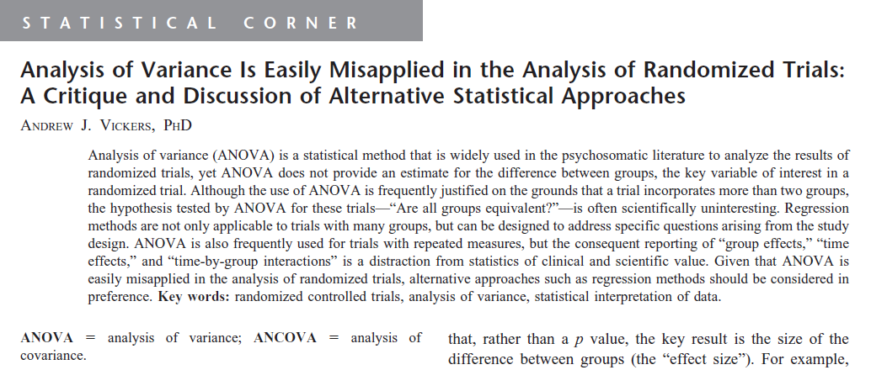
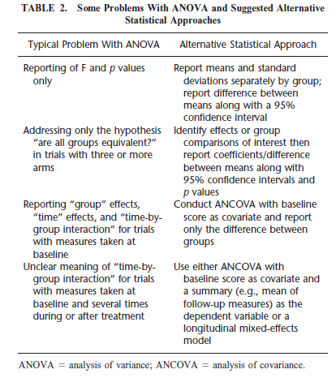
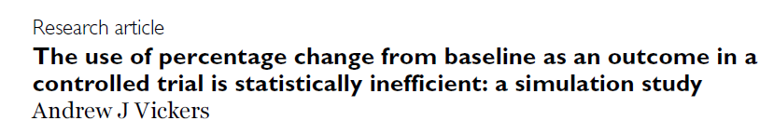
General problems with rmANOVA: hard to interpret

Slide 13
Follow up tests with repeated measures
Pairwise comparisons within each time interval
You can end up doing a lot of these…
Trend test
(usually in the “polynomial contrasts” sections of stats books…)
Biologist-friendly intro:
Guerevitch & Chester 1986 Analysis of repeated measures experiments. Ecology 67.

Slide 14
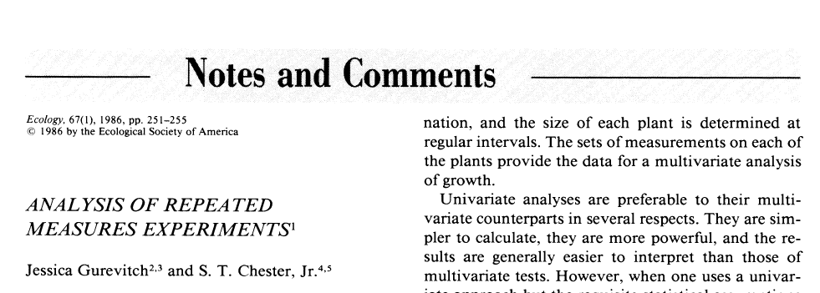

Slide 15
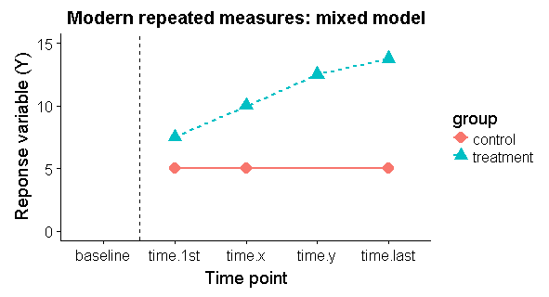
Modern methods: lack of balance & missing data
Traditional mixed models / rmANOVA
Only work (work well?) when all each individual / experimental unit measured each time
That is no “missing data” (NAs)
aka only “complete cases”
(MANOVA cannot be run on data w/Nas)
You can do “missing data imputation” to fill in NAs, but this can be problematic.
Modern likelihood-based methods work perfectly fine with missing data

Slide 16
Modern methods: individual-based trends via “random slopes”
-When trends are fairly linear you can use mixed models to fit “random slopes” to each individual data
-treats time as a continuous variable, not discrete
“random slopes model”
“random coefficients model”
“random regression”

Slide 17
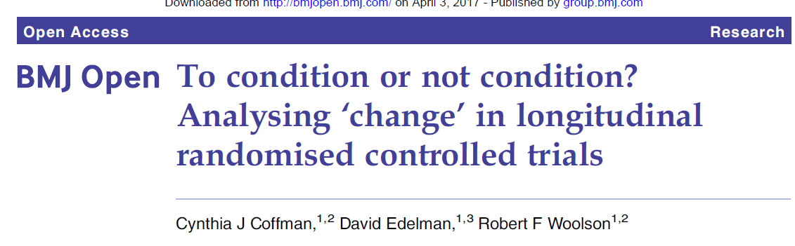
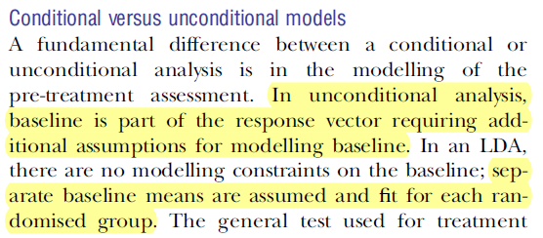
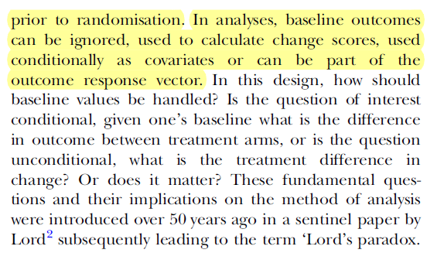
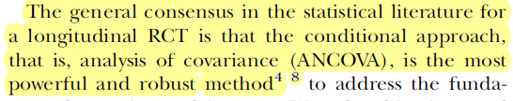
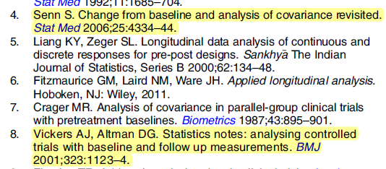
ANCOVA and ANCOVA related repeated measures best

