Slide 1
A crash course in non-normal data and generalized linear models

Slide 2

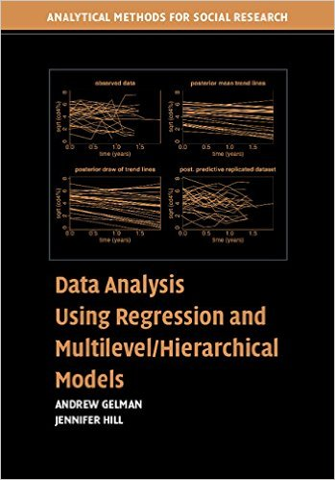


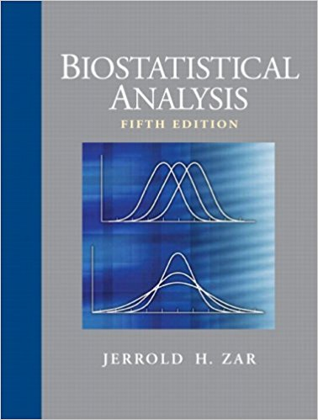


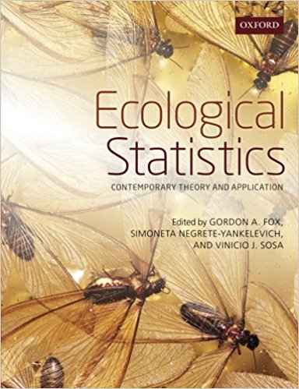

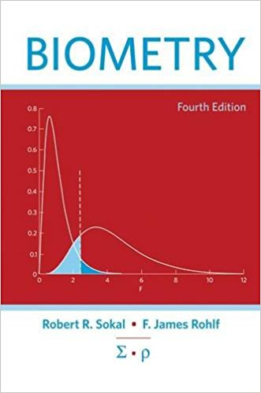
Approaches to applied bio/eco statistics
Old school
“statistical tests”
1970s(?)-early 2000s
Zar Biostatistical Analysis
Sokal & Rohlf Biometry
New-ish school
“statistical models 1.0”
late- 1990s-present
Gotelli & Ellison Primer of Eco. Stats.
Frontier school
“statistical models 2.0”
Mid-2000s-present
Gelman & Hill
Data
Regression-like
Continuous
As old school, but “everything is a special case of regression…”
Continuous
Discrete
Count
*(Poisson)
Binomial
*Logistic regression
Other

Slide 3
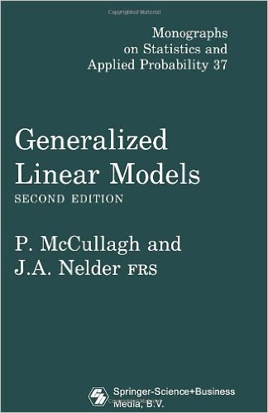
How it all began – but beware!

Slide 4
Approaches to applied bio/eco statistics
Old school
“statistical tests”
1970s(?)-early 2000s
Zar Biostatistical Analysis
Sokal & Rohlf Biometry
New-ish school
“statistical models 1.0”
late- 1990s-present
Gotelli & Ellison Primer of Eco. Stats.
Frontier school
“statistical models 2.0”
Mid-2000s-present
Gelman & Hill
Data
Data
Data
Continuous
*t-test
*ANOVA
*ANCOVA
*Regression
*Mult. regression
*use log, sqrt etc for %s & counts
Transformations don’t work?
Use rank-based non-parametric tests (ie Wilcox sign-rank)
Regression-like
Other
Categorical
*Chi-squared test
*G-test
Continuous
*Linear model (LM) / general linear model (GLM)
Continuous
As old school, but “everything is a special case of regression…”
Categorical
*As old school
Count data
*Poisson, Negbin GLM
Binomial
*Binomial test
*Fisher’s exact test
Multivariate
*As old school
Binomial
*Logistic GLM
Discrete
Categorical
*Multinomial logit GLM
*Ordered logit GLM
Multivariate
*MANOVA
*PCA
*NMDS
Count
*(Poisson)
Binomial
*Logistic regression
Other
Multivariate
*Multivariate GLMs

Slide 5
Notes: Problems with old-school methods for dealing with non-normal data
Why transformation sucks
Why rank-based non-parametric methods suck*
Confidence intervals: tricky with log and square root transformations (see Gelman & Hill for advice)
log+1 transformation: necessary for count data b/c there is no log(o); parameters therefore not directly interpretable
Can’t really do it with binomial data (so people do weird ad hoc things)
Can be less powerful than appropriate GLM
Can have higher false-positive rate (Type I error)
Only provide p-values, means, effect sizes etc: reduce the problem to just hypothesis testing
Lower power
Assumptions are actually more restrictive than most people believe (and older books let on)
Only work for simple designs (t-test, simple ANOVA; no random effects)
*ie, Wilcoxon sign-rank test

Slide 6
Notes: Advantages of old-school approaches
Transformations
Rank-based non-parametric methods
Everything you know about t-test, regression, ANOVA etc applies
Model can always be fit
No obscure output
I frequently use log+1 transformation for count data when developing code for complex mixed modela.
None
(seriously, there really aren’t any)
I never have and probably never will use a rank-based non-parametric method.
Alternatives: “bootstrapping”, “randomization test”

Slide 7
Why GLMs suck
parameters (intercepts, slopes) from summary() need to be back-transformed from “link scale” to original scale with “inverse link” to be interpreted
Logistic regression: odds, log odds
Poisson regression: rates, rate ratios
standard errors (SEs) from summary() can only be interpreted on “link scale”
confidence intervals (CIs) need to be back transformed
Residuals harder to understand / harder to plot diagnostics (See Gelman & Hill for advice)
Overdispersion frequently necessities using a more complex model
Problems fitting model: occasionally get error
Generalized linear mixed models (GLMMs) much trickier than LMMs: warnings, errors, traps common
R^2 harder to define & interpret

Slide 8
Types of Data
Continuous / Numeric
*takes on any value (1.1 g, 1.2 g…)
*height, mass, weight
Normal / Gaussian; log-normal
lm(y~x)
Counts
*lower bound = 0
*takes on only discrete values (0, 1 ,2 3)
*variance typically increases w/mean
Poisson / negative binomial
glm(counts ~ x,
family = poisson)
Binomial / dichotomous
*Yes/No, alive/dead, sick/well
Binomial (logit link)
glm(event ~ x,
family = binomial)
Binomial proportions
*# of events/trials
*ie, (# seeds germinated /
# seeds in petri dish
*can be expressed as a %, but can only take on certain values b/c the denominator is a fixed whole number
Binomial (logit link), w/specified trials
glm(cbind(events,trials) ~ x,
family = binomial)
Percentages/proportions
*Continuous values from 0-100%
*Can take on any value
*ie, % of tumor removed
Logit transformation of %; beta
lm(logit(%)~x)

Slide 9
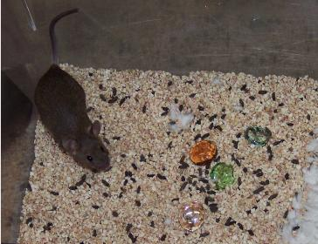

Example data: Rat marble burying model of anxiety/OCD
https://en.wikipedia.org/wiki/Marble_burying

Slide 10
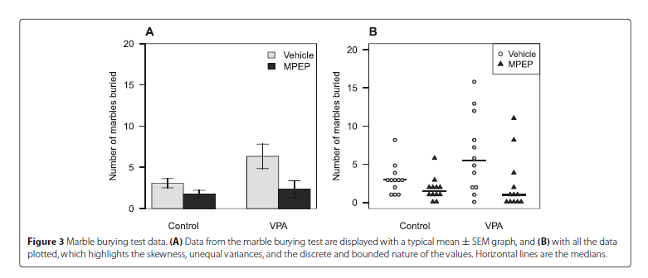
Example data: Rat marble burying model of anxiety/OCD

Slide 11
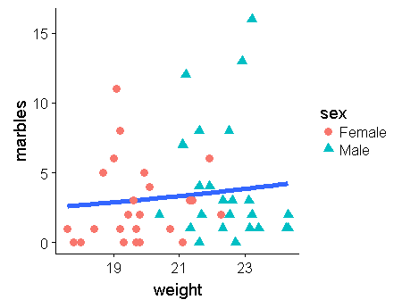
Marble burying assay

Slide 12
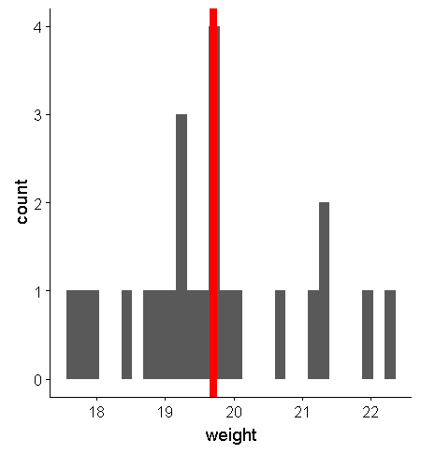
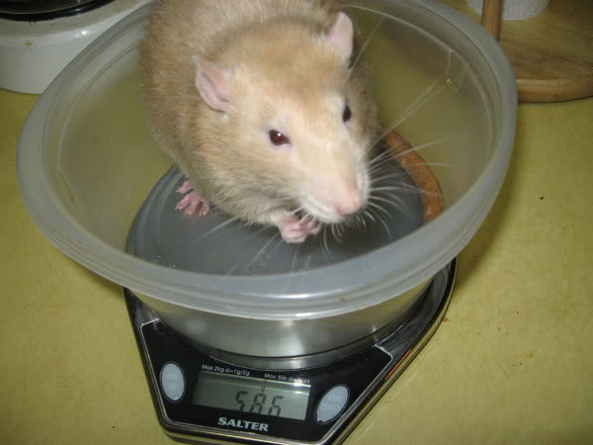
Continuous data: Distribution of female rat mass (Lazic 2015)
Mean = 19.71
SD = 1.24

Slide 13
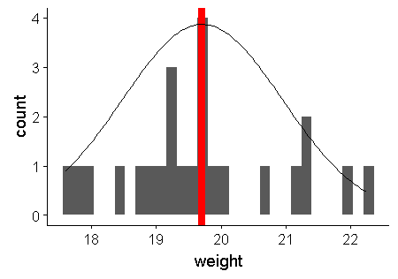
Continuous data w/ normal distribution: Distribution of female rat mass Lazic 2015
Mean = 19.71
SD = 1.24

Slide 14
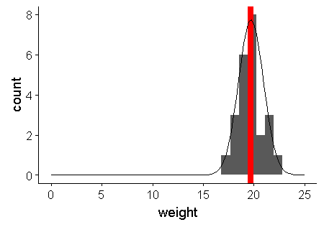
Continuous data w/ normal distribution: Distribution of female rat mass Lazic 2015
Normal distribution is a continuous distribution that extends to infinity in both direction!
Not a problem for this data set, but can be when values are near zero: results in nonsensical confidence intervals/ predictions
Continuous data: log transformation can fix this problem.
Count data: counts of zero are common, so analyzing count data w/ a linear model (regression, ANOVA, etc; anything w/ lm() will always have this problem.
Proportion data / %: frequently near 0% or 100%

Slide 15
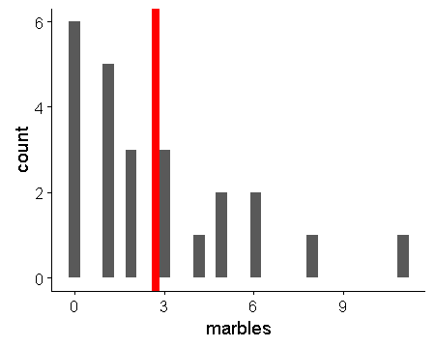

Poisson distribution
Normal distribution
Mean = 2.7
SD = 2.8
var = 8.3
Poisson distribution
Mean = 2.7
var = 2.7
Can’t have negative counts
Cannot be less than 0
Data discrete:
Takes on only integer values
(no 0.5, 0.75 etc)
Mean = 2.7
Not discrete!

Slide 16
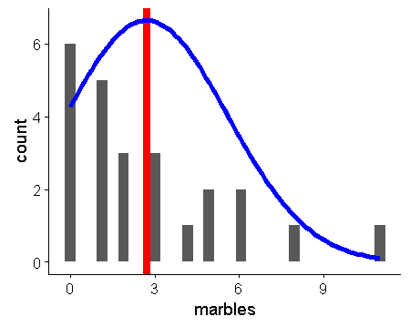
Using normal distribution w/ count data
Normal distribution
Mean = 2.7
SD = 2.8
var = 8.3

Slide 17
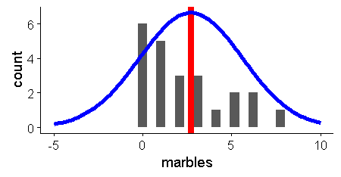
Using normal distribution w/ count data
Normal distribution
Mean = 2.7
SD = 2.8
var = 8.3

Slide 18
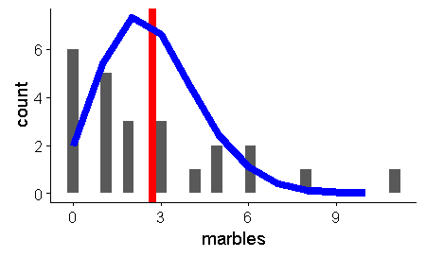
Poison distribution
Poor fit to data due to “over-dispersion”
*common in count data
*we aren’t using any info on experiment as predictors – this would help
Trails off at end nicely
Bounded by zero-good!

Slide 19
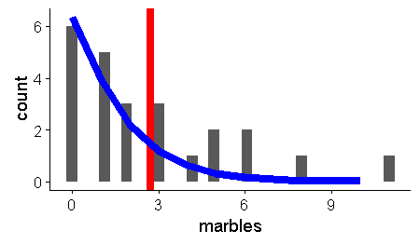
Negative binomial distribution
Poisson just has 1 parameter (lambda = mean = var) – not vary flexible
Negbin has “shape parameter” theta)
Negative binomial distribution fits data
nicely

Slide 20

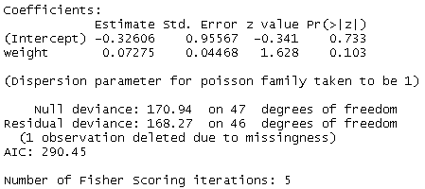
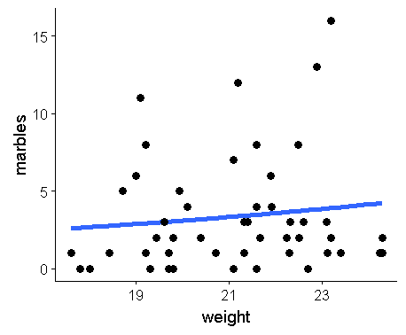
Poission GLM
Family:
Type of regression / distribution of the residuals
Parameter estimates
Link function; usually omitted, i.e.
“…,family = poisson)”
Note: no R^2; tricky to define for mos GLMs
Deviance:
Indications of fit; Used for significance test and investigating overdispersion.
Better models have great difference between Null and Residual Deviance
Dispersion parameter:
Poisson regression assumes there is no overdispersion. Can estimate by diving Resid devianceby df ; this parameter is allowed to vary with quasi-poison and negative binomial models

Slide 21

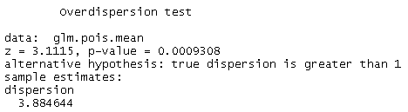
Checking for overdisperion with a Poission GLM
Calculating the dispersion parameter theta
Poisson regression assumes there is no overdispersion. Dispersion parameter therefore fixed at 1. Estimated dispersion parameter is actually 3.66.
168.27/46 = 3.66
3.66 > 1
Testing hypothesis that theta = 1.0
Reject hypothesis that dispersion parameter theta = 1.0; there is overdispersion

Slide 22


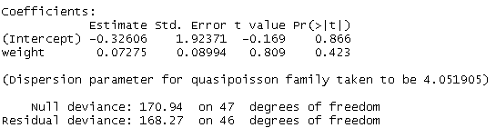
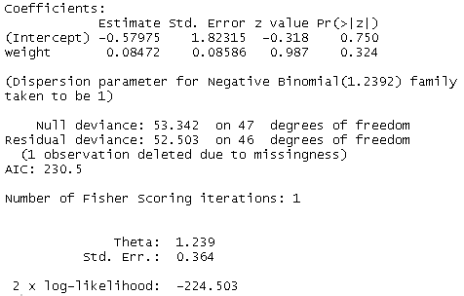
Accommodating overdisperion
Quasi-poisson:
glm(…, family = quasipoisson)
Estimates dispersion parameter 1/theta
Negative binomial (negbin)
library(MASS)
glm.nb(…)
*Both approaches estimates the dispersion parameter theta (note: other software use 1/theta).
*Negbin output is misleading; “taken to be 1” relates to how the model is fitted.
*note that for negbin, we use glm.nb() with no family argument.
*The models have different intercepts but almost identical slopes for “weight”
*poisson and negbin models can be compared w/AIC; quasi-poisson however cannot be compared to them

Slide 23

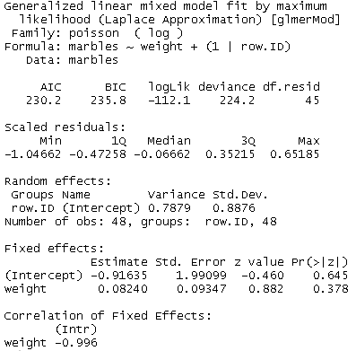
Accommodating overdisperion
Poisson model with “individual random effect”
glmer(… + (1|row.id), family = poisson)
*Another way to deal with overdispersion is to fit an “individual-level random effect”
*Technically this results in a “poisson-normal” model (dunno why)
*The intercept term is different from both quasi-poisson and negative binomial, but slope similar
*This approach is general and can be applied to complex mixed model
*Negative binomial models can be fit with glmer.nb but does not work well
*The package glmmADMB can do negbingmodels somewhat better
*The individual-level random effect approach appears to work the best for complex models, at least in terms of the model actually working (converges, produces output)
*For GLMs there is evidence that this approach works wellHarrison 2014 Using observation-level random effects to model overdispersion in count data in ecology and evolution. PeerJ.
*Dunno for GLMMs, but I do it anyway : )
Create unique ID for each row of data
Random effect
Random effect – not interpretable?

Slide 24



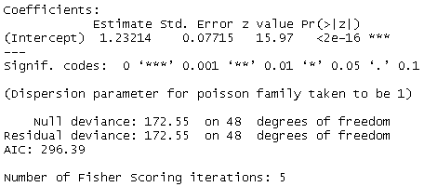

Poisson regression: the overall mean using “intercept-only” models
Overall mean with lm()
Overall mean with glm(…, family = poisson)
Intercept only gives
Overall mean
R’s output is on the log scale! (the link scale)
Using inverse link to convert from link scale to original count scale
= 3.4286

Slide 25
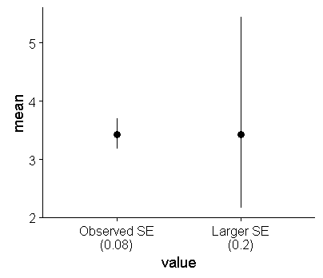

Standard errors and poisson regression
Overall mean with glm(…, family = poisson)
Mean and the standard error are both on link scale
Note: SE can only be used directly on the link scale: exp(SE) is meaningless!
To get SE of the mean, need to work in terms of the limits of the error bars, ie mean + 1 SE) and (mean – 1 SE)
= 3,18 and 7.7
Wrong: exp(1.23)+exp(0.07)
Asymmetric error bars:
Due to how the log scale works, the large the SE gets, the more asymmetric the error bars get. Similarly, confidence intervals are also often asymmetric

Slide 26





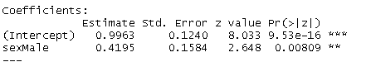
Poisson regression: t-test-ish analysis
Raw means
Intercept = mean of females (baseline)
Intercept + treatment effect = mean of males
2.71+1.41 = 4.12
Poisson output on log scale:
Female mean =
exp(0.99) = 2.71
Male mean =
exp(0.996+0.42) = 4.12
Coefficients from linear model
Coefficients from poisson glm
What does the male parameter mean?
1)Consider the Ratio of male to female marbles:
(2.7+1.4)/(2.7) = 4.2/2.7 = 1.52
Therefore, Males buried marbles at rate 1.5x greater than females
2) The male parameter of 0.42 from the Poisson model is a “log rate ratio”
exp(0.42) = 1.52
Conversly, log((2.7+1.4)/(2.7)) = 0.42

Slide 27
Poisson regression: regression type analysis
*Similar issues as already discussed apply to models with continuous predictor variables
*Interpretation of slope and interaction coefficients can be tricky – not necessarily the same as for linear regression
*exponentiating a slope parameter hard (impossible?) to interpret
*Generally use whole regression equation to plot regression curves

Slide 28
Poisson regression diagnostics
https://stats.stackexchange.com/questions/70558/diagnostic-plots-for-count-regression
Read all comments – the highest rank post apparently has some errors

Slide 29
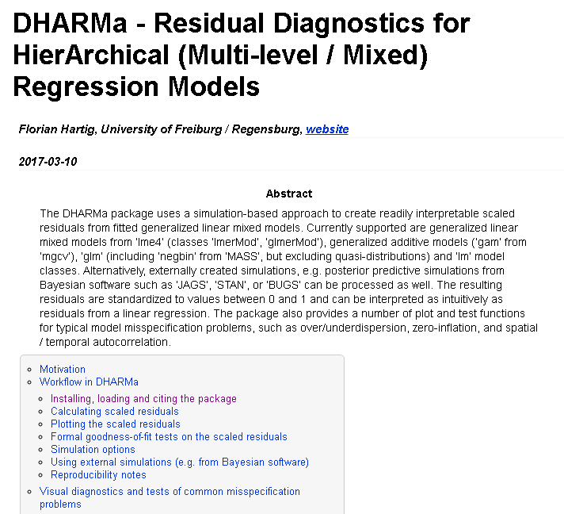
Residuals are hard with GLMs, esp. logistic regression; new package helps

Slide 30
Negative binomial notes
General: http://stats.idre.ucla.edu/r/dae/negative-binomial-regression/
On why glm.nb says “overdisperion parameter taken to be 1” https://stats.stackexchange.com/questions/10985/dispersion-parameter-of-negbin-distribution

Slide 32
Logistic regression

Slide 33
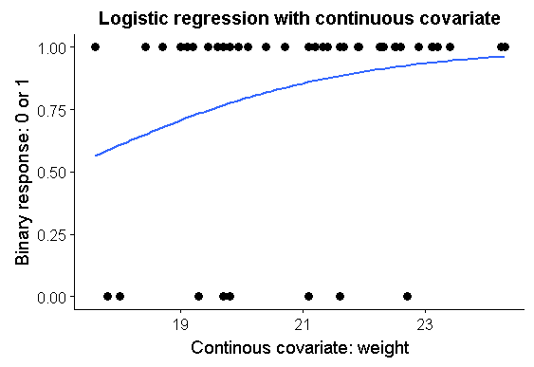
Logistic regression: was at least 1 marble buried?
1+ marbles buried
No marbles buried

Slide 34
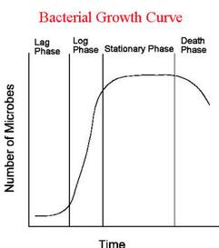
Logistic regression: function that describes regression line related to “logistic population growth”

Slide 35
Logistic regression:
What would a flat line mean?

Slide 36

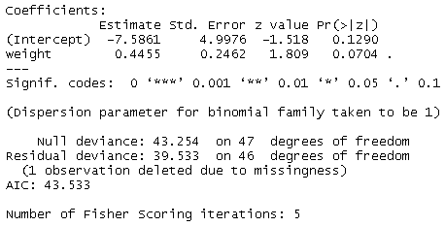
Logistic regression output
Family = sets the distribution
The link does not need to be specified if you are using the standard “canonical” link for a family.(for logistic regression = “logit link”
Link-scale parameters
*Raw logistic regression parameters are on the log-odds scale.
*Otherwise, standard regression concepts largely apply.
*”weight” coefficient = 0.45
Therefore, bigger rats had higher probability of burying at least 1 marble
*Link-scale parameters can be converted to the real scale using the inverse-link function (inverse logit)
*Coefficients for categorical variables easier to interpret directly than those continuous variables
*You need to be mindful of what you are doing when converting SEs and CIs from the link to real scale.
Dispersion parameter
Assumed to be 1 for binomial models
Deviance
Basis for hypothesis testing

Slide 37

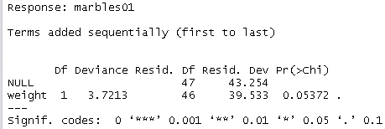

Hypothesis test
Logistic regression: inference and confidence intervals
Logistic regression hypothesis testing
Specify chi-squared test (equivalent to “=LRT” for likelihood ratio test)
Note p-value is smaller than t-test value from summary();
z-test in summary() is not reliable with glms (?)
Logistic regression: confidence intervals for parameters
Notes:
T-test vs. Chi-squared test vs. Likelihood ratio test (LRT)
stats.stackexchange.com/questions/144603/why-do-my-p-values-differ-between-logistic-regression-output-chi-squared-test?rq=1
stats.idre.ucla.edu/other/mult-pkg/faq/general/faqhow-are-the-likelihood-ratio-wald-and-lagrange-multiplier-score-tests-different-andor-similar/

Slide 38
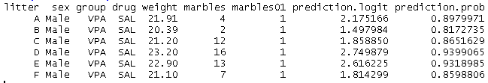
Logistic regression: predictions from fitting model
A key but frequently neglected step in understanding GLMs is to generate predictions from the fitted model to visualize the regression line and plot it against the raw data.
Fitted glm model
Default: Predictions on link scale (logit) = log odds
Scale you want predictions on (default is “link”
Predictions on “response” or “real” scale = probabilities
Link scale: Log odds
Real scale: probability
Most people prefer probabilities; some people in medicine like log odds and odds. There are useful as an effects size.
exp(1.814) = 6.13 = an odds ratio
Pr(bury a marble)/Pr(won’t bury a marble) = 0.859/(1-0.859) = 6.13
arm:inv.logit(1.814) = 0.859
The arm packages has an function for the inverse logit

Slide 39

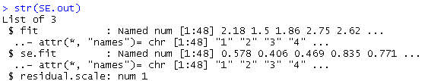

Logistic regression: Error bars
To get confidence intervals we need to
1)Get SE on the link scale
2)Lower error bar: invlogit(prediction on link scale-SE),
Upper error bar: invlogit(prediction on link scale+SE
Recall – there is not an SE on the probability/real/predictor scale!
se.fit produces SEs for each predicted value
For some reason predict() produces a list with se.fit as one object in the list
Add standard errors to dataframe, using $ to access the se.fit part of list
Exponentiate prediction on logit scale +/- 1SE

Slide 40
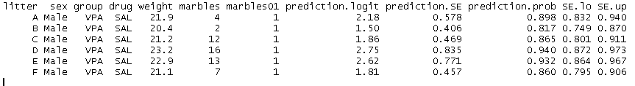
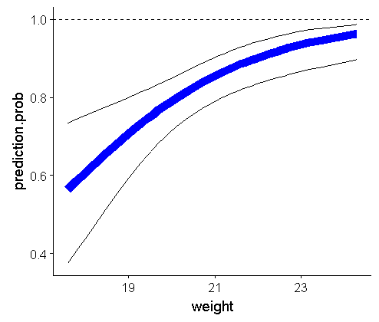
Logistic regression: Error bars continued
Predicted probability
+/- 1 SE around prediction

Slide 41
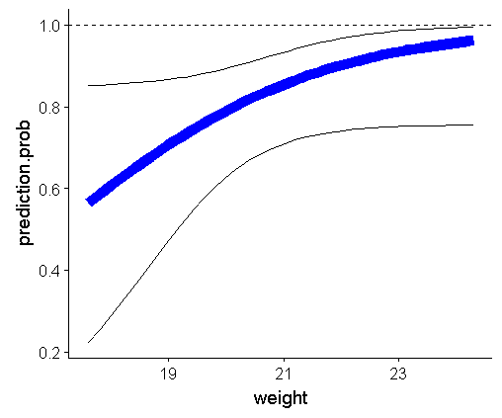
Logistic regression: Confidence intervals
invlogit(prediction +/- 1.96*SE)
Standard errors
95% confidence interval

Slide 43

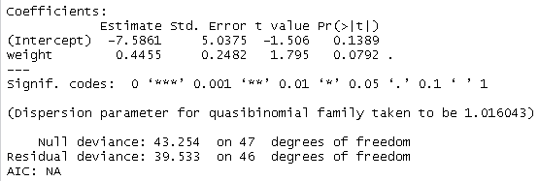
Overdispersion with logistic regression:
Quasi-binomial
NoAIC!
anova(…) doensn’t work, but confint() does

Slide 44
T-test vs. Chi-squared test vs. Likelihood ratio test (LRT)
stats.stackexchange.com/questions/144603/why-do-my-p-values-differ-between-logistic-regression-output-chi-squared-test?rq=1
stats.idre.ucla.edu/other/mult-pkg/faq/general/faqhow-are-the-likelihood-ratio-wald-and-lagrange-multiplier-score-tests-different-andor-similar/

Slide 45
Abbreviations / Vocab
LM = linear model
Typically refers to regression
GLM = general linear model, generalized linear model
Logistic regression, poisson, etc
GLiM = generalized linear model
As for GLM
LME = linear mixed model
GLMM = general(ized) linear mixed model
Pois = poisson
Logit = logit link, logistic regression
Negbin = negative binomial

Slide 46
Vocab
Linear predictor = the “y = mx+b” part of the model, ie glm(y~x)
Link = mathematical function that translates between …
Link scale = the scale that the link function produces; ie, log scale for Poisson regression.
Poisson = log (natural log, ln)
Binomial (logistic regression) = logit (mathematically, a ratio of 2 logs)
Negative binomial: log-log?
Inverse link = function that converts from the link scale to the original scale of data
Poisson = Exponentiation: exp()
Binomial (Logistic regression) = Inverse Logit: car::inv.logit
Negative binomial: ???
Canonical link = standard or default link (ie, logit for binomial, log for Poisson)
Alternative link = other options for links; usually used for specific types of analyses; rarely used in ecology. Can be deinfed as “glm(…, family = fam(link = “the.link”))
Binomial: probit, clog-log
Error distribution: how residuals (“errors”) from model are distributed; for linear regression residuals are assumed to follow a normal distribution (note: residuals are assumed normal, not the raw data). Defined by the “family = …” part of the glm function. “The error distribution describes how the variation which is not explained as part of the linear predictor is distributed” (Buckley)
Maximum likelihood = alternative to least-squares that can be generalized to many statistical problems beyond numeric data
Quasi-likelihood = modification of likelihood approach that accommodates overdispersion.
Overdispersion = A generally hard concept; almost always is present; occurs when the variance in the data is greater than is assumed by the error distribution
Rank-based non-parametric method = raw numeric data converted to relative rank (ie, 1, 1.2, 5.75, 6 converted to 1, 2, 3, 4)
Binned residuals = technique for visualizing residuals from logistic regression; See Gelman & Hill
Continuous distribution = distribution that can take on any numeric value (1.1, 1.2, etc); Normal/Guassian, beta, (but bounded by 0, 1), gamma (bounded by 1).

Slide 47
Dealing with overdispersion
“Quasi-models”
quasibinomial
quasipoisson
Count data: try alternative error distribution / modeling approach
Negative binomial: glm.nb() [NB: glmm.nb is a bear, try glmmADMB]
Zero-inflated models (ZIP, ZINB)
Add covariates
Add random effects
Add “observation-level random effect”

Slide 48
Yvonne Buckley
“In some cases the transformed data with Normal errors may lead to a better fitting, or simple model thatn a GLM” (132)
“If we handled count, binary and proportion data improperly, our results can be biased, underpowered, or difficult to interpret” (133)
“misspecified error distributions can bias the parameter estiamtes, standard errors, and subsequent statistical tests (133)
“Proportion, binary and count data by their very nature tend to have fundamentally non-linear relationships with explanatory variables”
“Count data have a number of properties tha we need to account for in models: many zeros, bounded at zero, non-linearity, and non-homogenous variance” (141)
“There is assumed to be a strong (for Poisson, exact) relationship between the mean and the variance in both distributions.” (143)
“The (residual) deviance is the GLM equivalent of the residual sum of squares” (146).

Slide 49
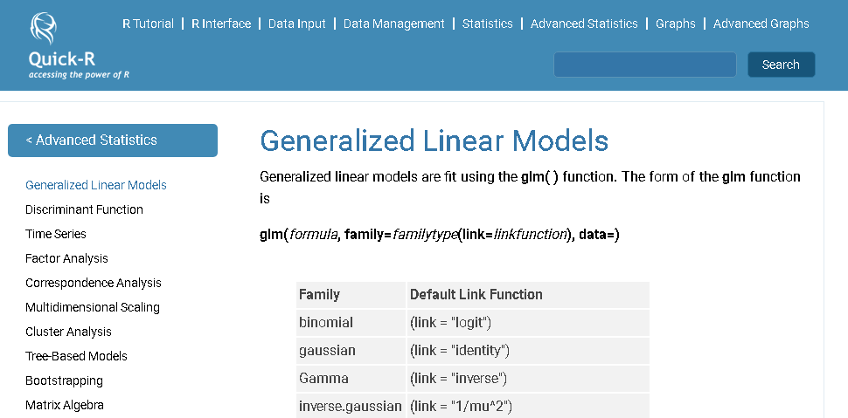
Quick-R: Generalized Linear Models
http://www.statmethods.net/advstats/glm.html

