Slide 1
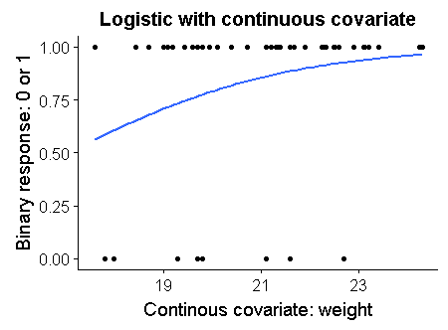
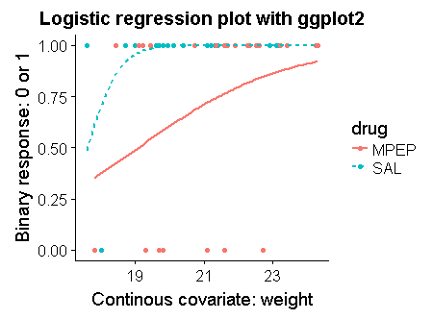
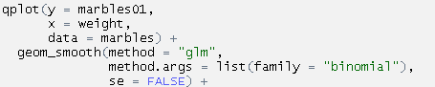
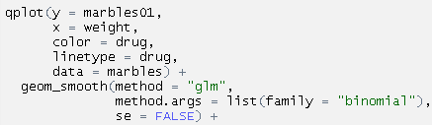
Plotting logistic regression with ggplot:
For simple logistic regressions ggplot can run the model on the fly and plot the output.
These data show whether an animal in a behavior assay did (1) or did not (0) bury a marble. The y axis is continuous but can only take on 2 values. The fitted line shows how the probability that a marble is buried increases as the animal gets larger.
One continuous covariate (x variable)
Continuous & Categorical variable w/ interaction
Response variable: Needs to be a numeric variable, not factor. IF this was a factor I could convert it like this “as.numeric(marbles01)-1”. (The “-1” is needed because factors have a min. value of 1 when converted to numeric data)
Plotting interactions: Y ~ weight*drug
When color and/or linetype are specified, ggplot splits the data into subgroups and runs a separate model for each. This yields parameters equivalent to a model with a continuous*categorical variable interaction.
Type of linear model Would be “lm” if you wanted a straight line through normal data.
color & linetype:
Remove standard errors (SE)
Specification for logistic regression
Could also do “poisson”, etc
Original count data from:
Mehta et al. 2011. mGluR5-antagonist mediated reversal of elevated stereotyped, repetitive behaviors in the VPA model of autism. PLoS One.
Lazic 2015. Analytical strategies for the marble burying test: avoiding impossible predictions and impossible p-values. BMC Research Notes

Slide 2

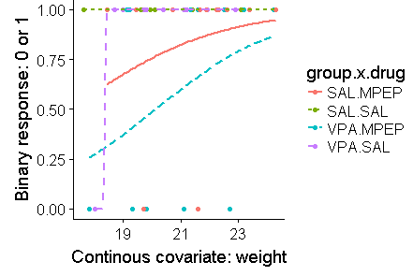
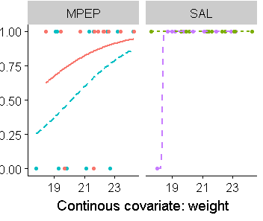
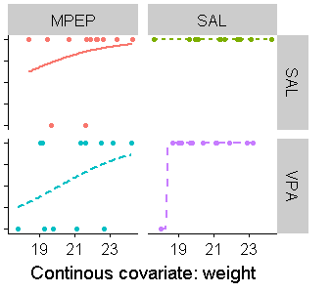
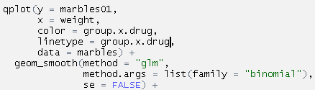
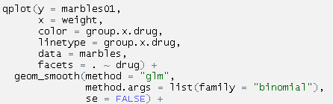
Plotting interactions with multiple factors
y ~ weight*drug*group
By creating a new categorical variable that combines two separate ones, we can define more complex interactions. Note that in in this case, the data is becoming too sparse to actually carry out the analysis.
Single plot
Faceting by one variable
Faceting by two variables
New categorical variable “group.x.drug”
Facets can be used to make separate plots.
Faceting by 2 variables produces 4 panels:

