Slide 1
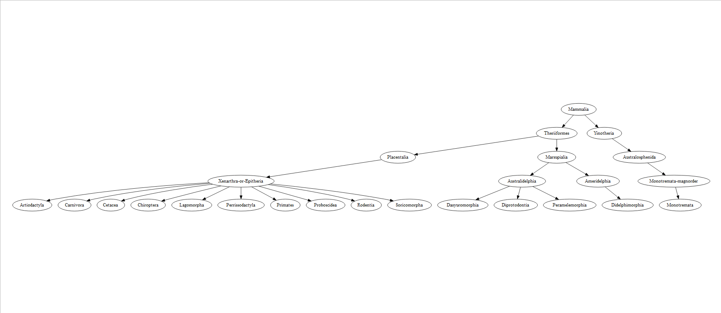
Appendix 5: Study diagram

