Slide 1
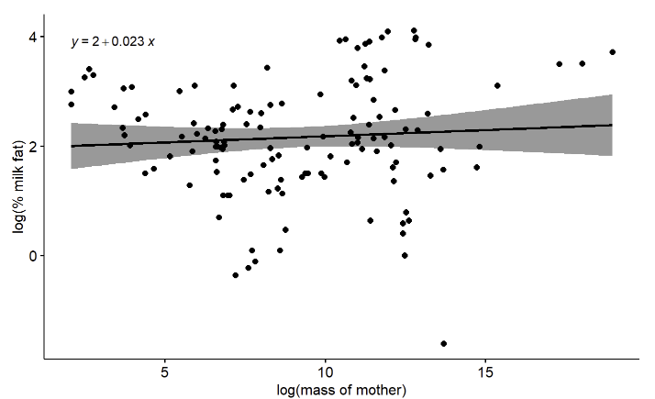
Figure 1: Relationship between maternal mass (grams) and percent milk fat for 130 mammals fit using linear regression with no phylogenetic correction. Both axes are natural-log transformed. P = 0.41, R^2 = 0.005. Error bands is a 95% confidence interval.

