Slide 1
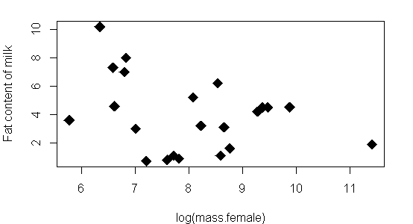
Regression (aka linear regression, linear model)
Lecture 24-ish
November 11, 2016

Slide 2
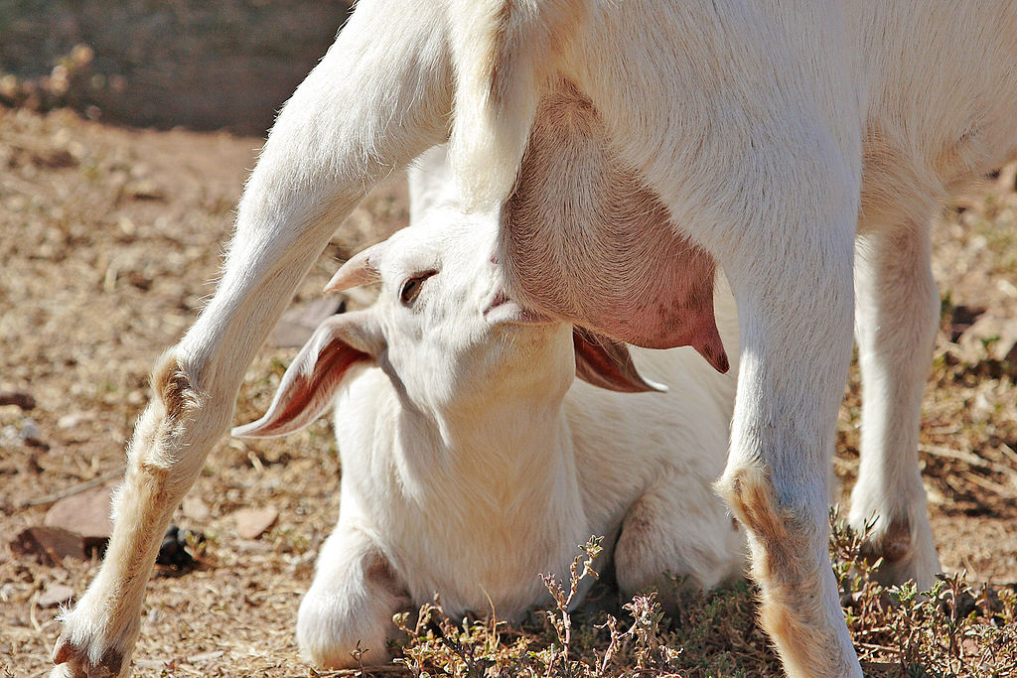
Example – fat content of mammal milk

Slide 3

Common situations in research: Is there a relationship between 2 numeric variables?
Size of mom vs. fat content of her milk
Fat content of milk
(%)
Fatty
Lean
Female Size
log(mass)

Slide 4
Common situations in research: Is there a relationship between 2 numeric variables?
Size of mom vs. fat content of her milk
Fat content of milk
(%)
Female Size
log(mass)

Slide 5
Common situations in research: Is there a relationship between 2 numeric variables?
Size of mom vs. fat content of her milk
Fat content of milk
(%)
Regression Analysis:
Can transform BOTH
Response (fat %)
AND predictor (mass)
Female Size
log(mass)

Slide 6
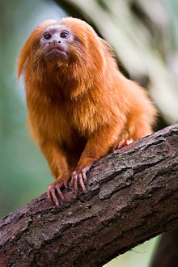
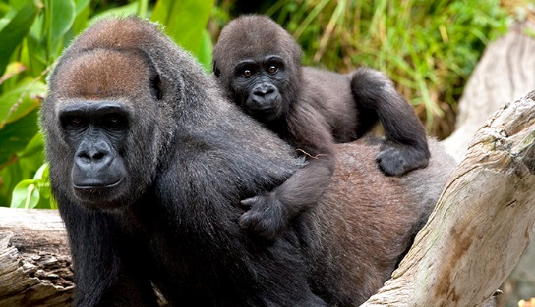
Common situations in research: Is there a relationship between 2 numeric variables?
Size of mom vs. fat content of her milk
Fat content of milk
(%)
Female Size
log(mass)

Slide 7
Common situations in research: Is there a relationship between 2 numeric variables?
Size of mom vs. fat content of her milk
Tamarin –
Fatty
milk
Fat content of milk
(%)
Gorillas –
lean milk
(not much fat)
Female Size
log(mass)

Slide 8
Common situations in research: Is there a relationship between 2 numeric variables?
Size of mom vs. fat content of her milk
Tamarin –
Fatty milk
Fat content of milk
(%)
Gorillas –
lean milk
(not much fat)
Female Size
log(mass)

Slide 9
Common situations in research: Is there a relationship between 2 numeric variables?
Size of mom vs. fat content of her milk
Tamarin –
Fatty milk
Fat content of milk
(%)
Gorillas –
lean milk
(not much fat)
Female Size
log(mass)

Slide 10
Common situations in research: Is there a relationship between 2 numeric variables?
2 complementary methods
Correlation (Ch 16)
1)is there a relationship?
2)is it positive or negative
3)how strong is it?
4)does NOT assume directionality
5)Only works w/ 2 variables, x1 & x2
6)only works w/numeric data
Regression (Ch 17)
1-3)same as correlation
4)assumes / tests directionality or causality
5)Simplest case: y ~ x
6)can be generalized to all forms of data

Slide 11
Common situations in research: Is there a relationship between 2 numeric variables?
2 complementary methods
Correlation (Ch 16)
1)is there a relationship?
2)is it positive or negative
3)how strong is it?
4)does NOT assume directionality
5)Only works w/ 2 variables, x1 & x2
6)only works w/numeric data
Regression (Ch 17)
1-3)same as correlation
4)assumes / tests directionality or causality
5)Simplest case: y ~ x
6)can be generalized to all forms of data

Slide 12
Common situations in research: Is there a relationship between 2 numeric variables?
2 complementary methods
Correlation (Ch 16)
1)is there a relationship?
2)is it positive or negative
3)how strong is it?
4)does NOT assume directionality
5)Only works w/ 2 variables, x1 & x2
6)only works w/numeric data
Regression (Ch 17)
1-3)same as correlation
4)assumes / tests directionality or causality
5)Simplest case: y ~ x
6)can be generalized to all forms of data

Slide 13
Common situations in research: Is there a relationship between 2 numeric variables?
2 complementary methods
Correlation (Ch 16)
1)is there a relationship?
2)is it positive or negative
3)how strong is it?
4)does NOT assume directionality
5)Only works w/ 2 variables, x1 & x2
6)only works w/numeric data
Regression (Ch 17)
1-3)same as correlation
4)assumes / tests directionality or causality
5)Simplest case: y ~ x
6)can be generalized to all forms of data

Slide 14
Common situations in research: Is there a relationship between 2 numeric variables?
2 complementary methods
Correlation (Ch 16)
1)is there a relationship?
2)is it positive or negative
3)how strong is it?
4)does NOT assume directionality
5)Only works w/ 2 variables, x1 & x2
6)only works w/numeric data
Regression (Ch 17)
1-3)same as correlation
4)assumes / tests directionality or causality
5)Simplest case: y ~ x
6)can be generalized to all forms of data

Slide 15
Common situations in research: Is there a relationship between 2 numeric variables?
2 complementary methods
Correlation (Ch 16)
1)is there a relationship?
2)is it positive or negative
3)how strong is it?
4)does NOT assume directionality
5)Only works w/ 2 variables, x1 & x2
6)only works w/numeric data
Regression (Ch 17)
1-3)same as correlation
4)assumes / tests directionality or causality
5)Simplest case: y ~ x
6)can be generalized to all forms of data

Slide 16
Common situations in research: Is there a relationship between 2 numeric variables?
2 complementary methods
Correlation (Ch 16)
1)is there a relationship?
2)is it positive or negative
3)how strong is it?
4)does NOT assume directionality
5)Only works w/ 2 variables, x1 & x2x2
6)only works w/numeric data
Regression (Ch 17)
1-3)same as correlation
4)assumes / tests directionality or causality
5)Simplest case: y ~ x
6)can be generalized to all forms of data

Slide 17
Common situations in research: Is there a relationship between 2 numeric variables?
2 complementary methods
Correlation (Ch 16)
1)is there a relationship?
2)is it positive or negative
3)how strong is it?
4)does NOT assume directionality
5)Only works w/ 2 variables, x1 & x2
6)only works w/numeric data
Regression (Ch 17)
1-3)same as correlation
4)assumes / tests directionality or causality
5)Simplest case: y ~ x
6)can be generalized to all forms of data

Slide 18
Common situations in research: Is there a relationship between 2 numeric variables?
2 complementary methods
Correlation (Ch 16)
1)is there a relationship?
2)is it positive or negative
3)how strong is it?
4)does NOT assume directionality
5)Only works w/ 2 variables, x1 & x2
6)only works w/numeric data
Regression (Ch 17)
1-3)same as correlation
4)assumes / tests directionality or causality
5)Simplest case: y ~ x
6)can be generalized to all forms of data

Slide 19
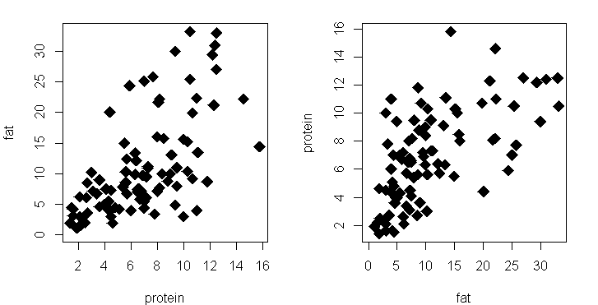
Correlation: does NOT assume directionality
Protein in milk (%)
Fat in milk (%)
Protein in milk (%)
Fat in milk (%)

Slide 20
Correlation: does NOT assume directionality
Protein in milk (%)
Fat in milk (%)
Protein in milk (%)
Fat in milk (%)

Slide 21
Correlation: does NOT assume directionality
Protein in milk (%)
Fat in milk (%)
Protein in milk (%)
Fat in milk (%)

Slide 22
Correlation: does NOT assume directionality
Protein in milk (%)
Fat in milk (%)
Protein in milk (%)
Fat in milk (%)

Slide 23
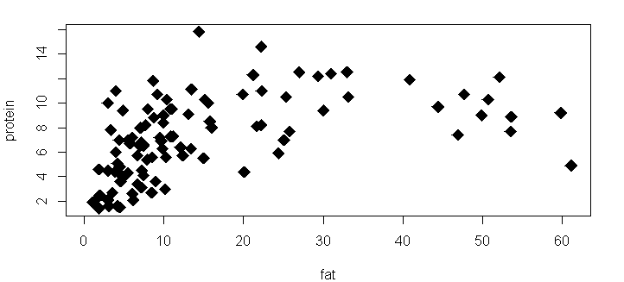
Limitation of correlation: only simple relationship
Protein in milk (%)
Fat in milk (%)

Slide 24
Limitation of correlation: only simple relationship
Protein in milk (%)
Fat in milk (%)

Slide 25
Limitation of correlation: only simple relationship
Protein in milk (%)
Fat in milk (%)

Slide 26
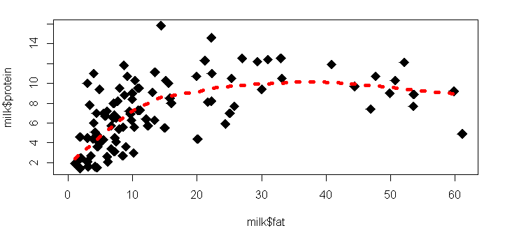
Limitation of correlation: only simple relationship
Protein in milk (%)
Fat in milk (%)

Slide 27
Limitation of correlation: only simple relationship
“smoother”
Protein in milk (%)
Fat in milk (%)

Slide 28
Limitation of correlation: only simple relationship
“smoother”
Protein in milk (%)
Fat in milk (%)

Slide 29
Common situations in research: Is there a relationship between 2 numeric variables?
2 complementary methods
Correlation (Ch 16)
1)is there a relationship?
2)is it positive or negative
3)how strong is it?
4)does NOT assume directionality
5)Only works w/ 2 variables, x1 & x2
6)only works w/numeric data
Regression (Ch 17)
1-3)same as correlation
4)assumes / tests directionality or causality
5)Simplest case: y ~ x
6)can be generalized to all forms of data

Slide 30
Common situations in research: Is there a relationship between 2 numeric variables?
2 complementary methods
Correlation (Ch 16)
1)is there a relationship?
2)is it positive or negative
3)how strong is it?
4)does NOT assume directionality
5)Only works w/ 2 variables, x1 & x2
6)only works w/numeric data
Regression (Ch 17)
1-3)same as correlation
4)assumes / implies directionality or even causality
5)Simplest case: y ~ x
6)can be generalized to all forms of data

Slide 31
“Directionality” & “Causality”
“Directionality”
“Causality”
1-way direction of impact or interaction
The virus HIV causes the disease AIDS
The disease AIDS does not cause the virus HIV to occur
Reason, cause, mechanism
HIV is the causal agent of AIDS
Nothing else causes AIDS
Without HIV, there is not AIDS
Having HIV is a strong predictor of having AIDS (though less so now)

Slide 32
“Directionality” & “Causality”
“Directionality”
“Causality”
1-way direction of impact or interaction
The virus HIV causes the disease AIDS
The disease AIDS does not cause the virus HIV to occur
Reason, cause, mechanism
HIV is the causal agent of AIDS
Nothing else causes AIDS
Without HIV, there is not AIDS
Having HIV is a strong predictor of having AIDS (though less so now)

Slide 33
“Directionality” & “Causality”
“Directionality”
“Causality”
1-way direction of impact or interaction
The virus HIV causes the disease AIDS
The disease AIDS does not cause the virus HIV to occur
Reason, cause, mechanism
HIV is the causal agent of AIDS
Nothing else causes AIDS
Without HIV, there is not AIDS
Having HIV is a strong predictor of having AIDS (though less so now)

Slide 34
“Directionality” & “Causality”
“Directionality”
“Causality”
1-way direction of impact or interaction
The virus HIV causes the disease AIDS
The disease AIDS does not cause the virus HIV to occur
Reason, cause, mechanism
HIV is the causal agent of AIDS
Nothing else causes AIDS
Without HIV, there is not AIDS
Having HIV is a strong predictor of having AIDS (though less so now)
Correlation analysis does not / cannot address these issues

Slide 35
Common situations in research: Is there a relationship between 2 numeric variables?
2 complementary methods
Regression (Ch 17)
1-3)same as correlation
4)assumes / tests directionality or causality
5) Simplest case: y ~ x
6) can be generalized to
all forms of data
7) Powerful for prediction
Correlation (Ch 16)
1)is there a relationship?
2)is it positive or negative
3)how strong is it?
4)does NOT assume directionality
5)Only works w/ 2 variables, x1 & x2
6)only works w/numeric data

Slide 36
Common situations in research: Is there a relationship between 2 numeric variables?
2 complementary methods
Regression (Ch 17)
1-3)same as correlation
4)assumes / tests directionality or causality
5) Simplest case: y ~ x
6) can be generalized to
all forms of data
7) Powerful for prediction
Correlation (Ch 16)
1)is there a relationship?
2)is it positive or negative
3)how strong is it?
4)does NOT assume directionality
5)Only works w/ 2 variables, x1 & x2
6)only works w/numeric data

Slide 37
Common situations in research: Is there a relationship between 2 numeric variables?
2 complementary methods
Regression (Ch 17)
1-3)same as correlation
4)assumes / tests directionality or causality
5) Simplest case: y ~ x
6) can be generalized to
all forms of data
7) Powerful for prediction
Correlation (Ch 16)
1)is there a relationship?
2)is it positive or negative
3)how strong is it?
4)does NOT assume directionality
5)Only works w/ 2 variables, x1 & x2
6)only works w/numeric data

Slide 38
Common situations in research: Is there a relationship between 2 numeric variables?
2 complementary methods
Regression (Ch 17)
1-3)same as correlation
4)assumes / tests directionality or causality
5) Simplest case: y ~ x
6) can be generalized to
all forms of data
7) Powerful for prediction
Logistics “regression”
ANOVA = regression
T-test = regression

Slide 39
Common situations in research: Is there a relationship between 2 numeric variables?
2 complementary methods
Regression (Ch 17)
1-3)same as correlation
4)assumes / tests directionality or causality
5) Simplest case: y ~ x
6) can be generalized to
all forms of data
7) Powerful for prediction
Correlation (Ch 16)
1)is there a relationship?
2)is it positive or negative
3)how strong is it?
4)does NOT assume directionality
5)Only works w/ 2 variables, x1 & x2
6)only works w/numeric data

Slide 40
“Directionality” & “Causality”
“Correlation”
“Regression”
Once there is a high density of HIV virion, AIDS symptoms are severe
When AIDS symptoms are severe, there is a high density of HIV virions
We can predict the severity of AIDS symptoms based on abundance of HIV

Slide 41
“Directionality” & “Causality”
“Correlation”
“Regression”
Once there is a high density of HIV virion, AIDS symptoms are severe
When AIDS symptoms are severe, there is a high density of HIV virions
We can predict the severity of AIDS symptoms based on abundance of HIV

Slide 42
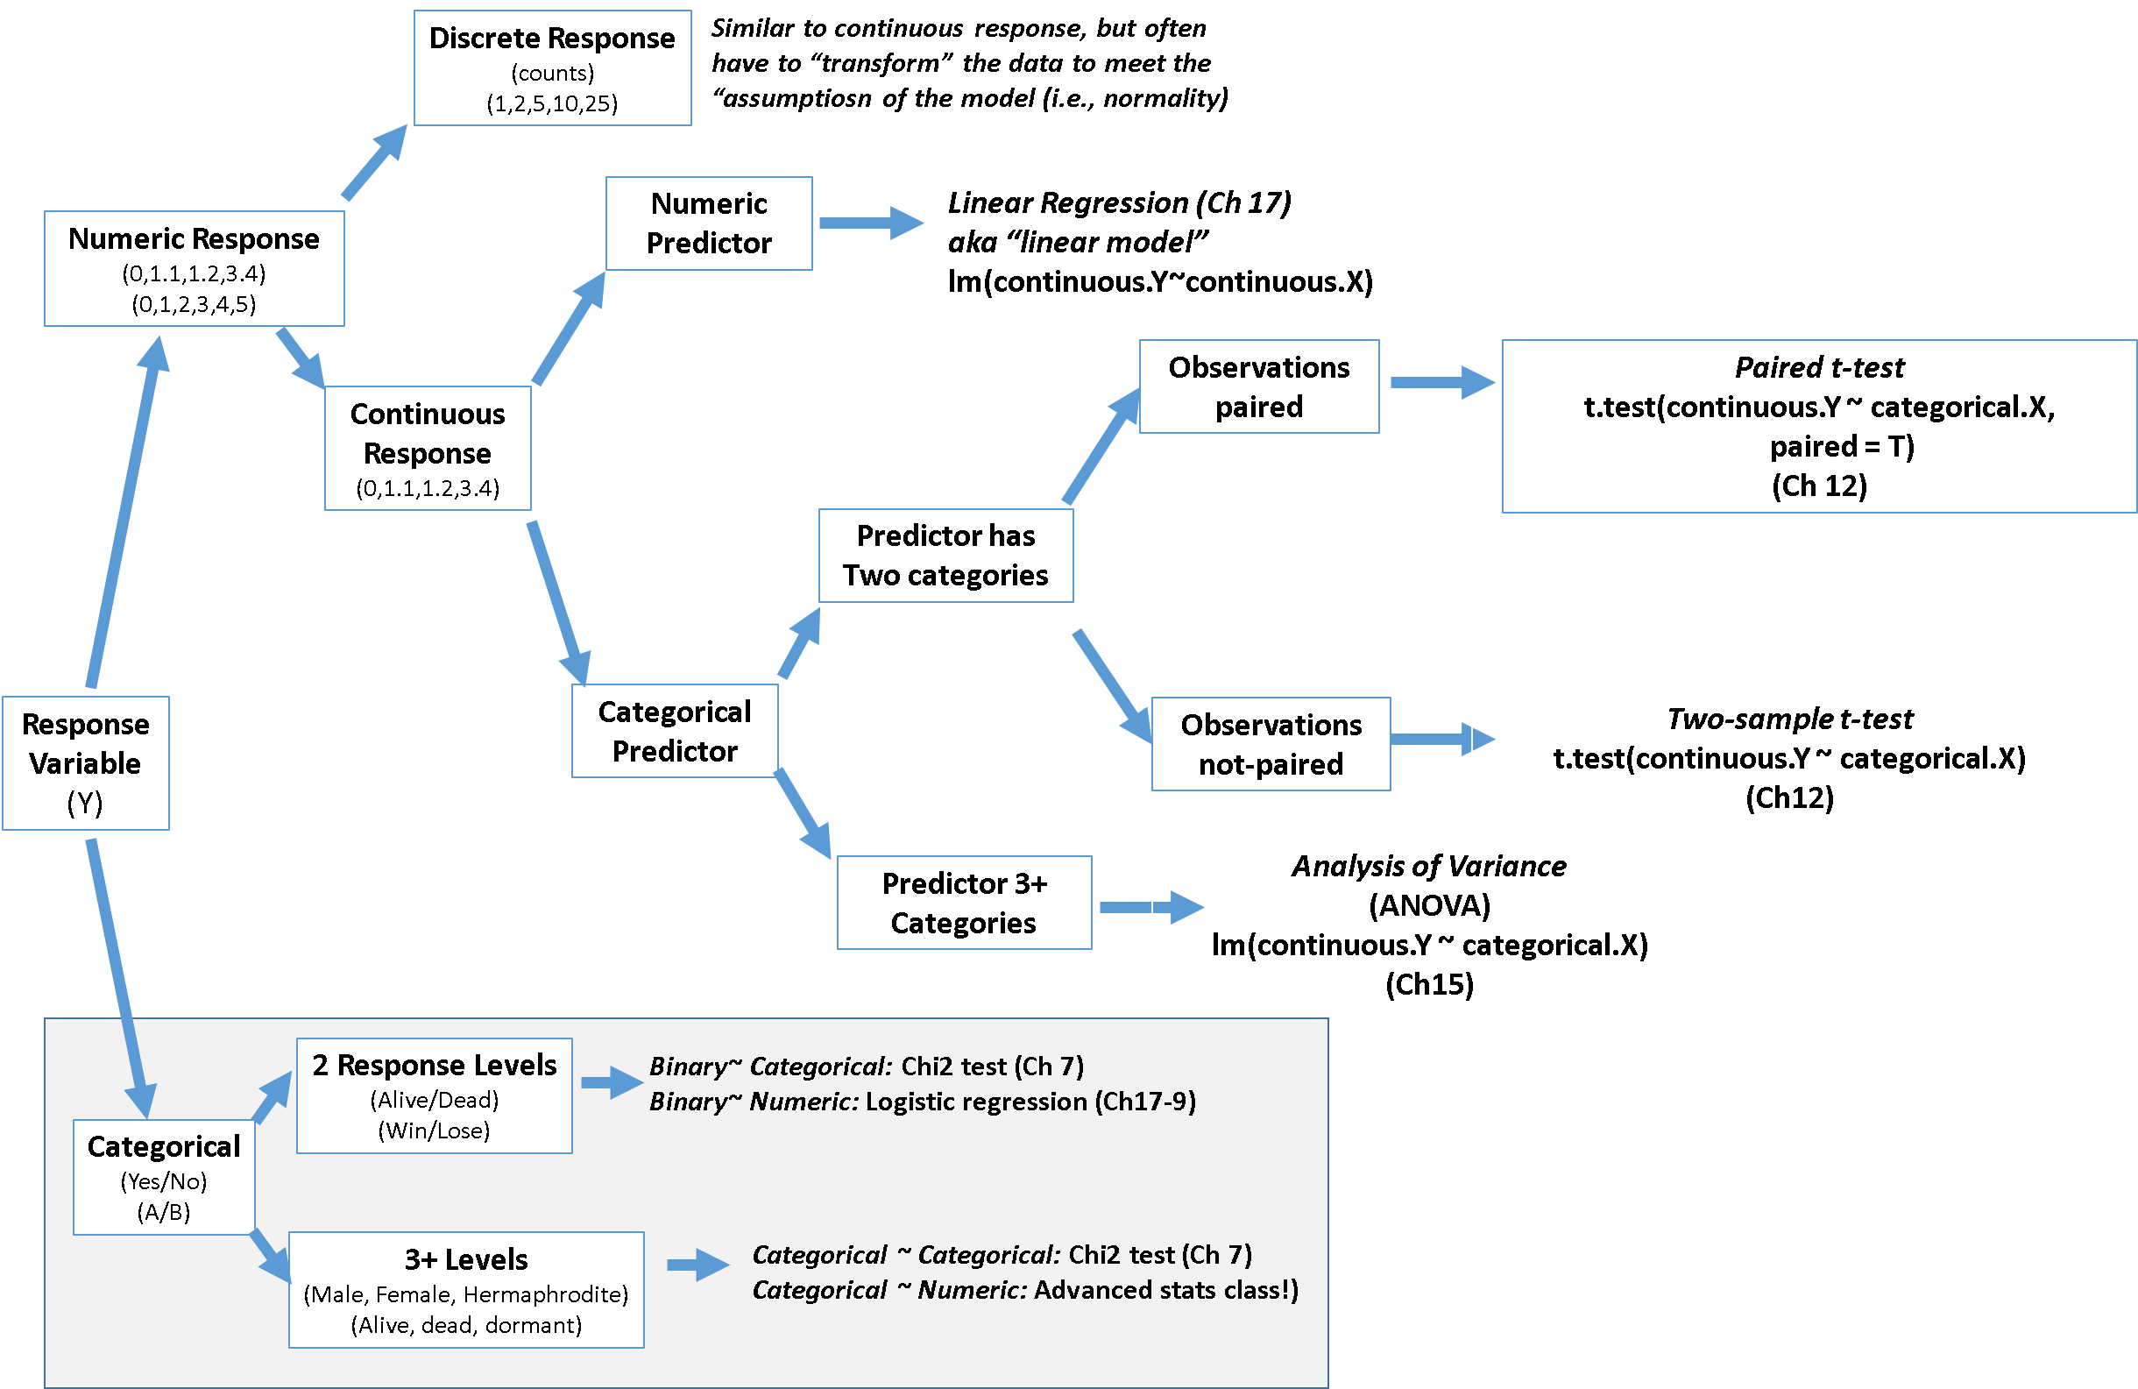
Types of analyses for different combinations of response and predictor variables

Slide 43
Types of analyses for different combinations of response and predictor variables

Slide 44
Types of analyses for different combinations of response and predictor variables

Slide 45
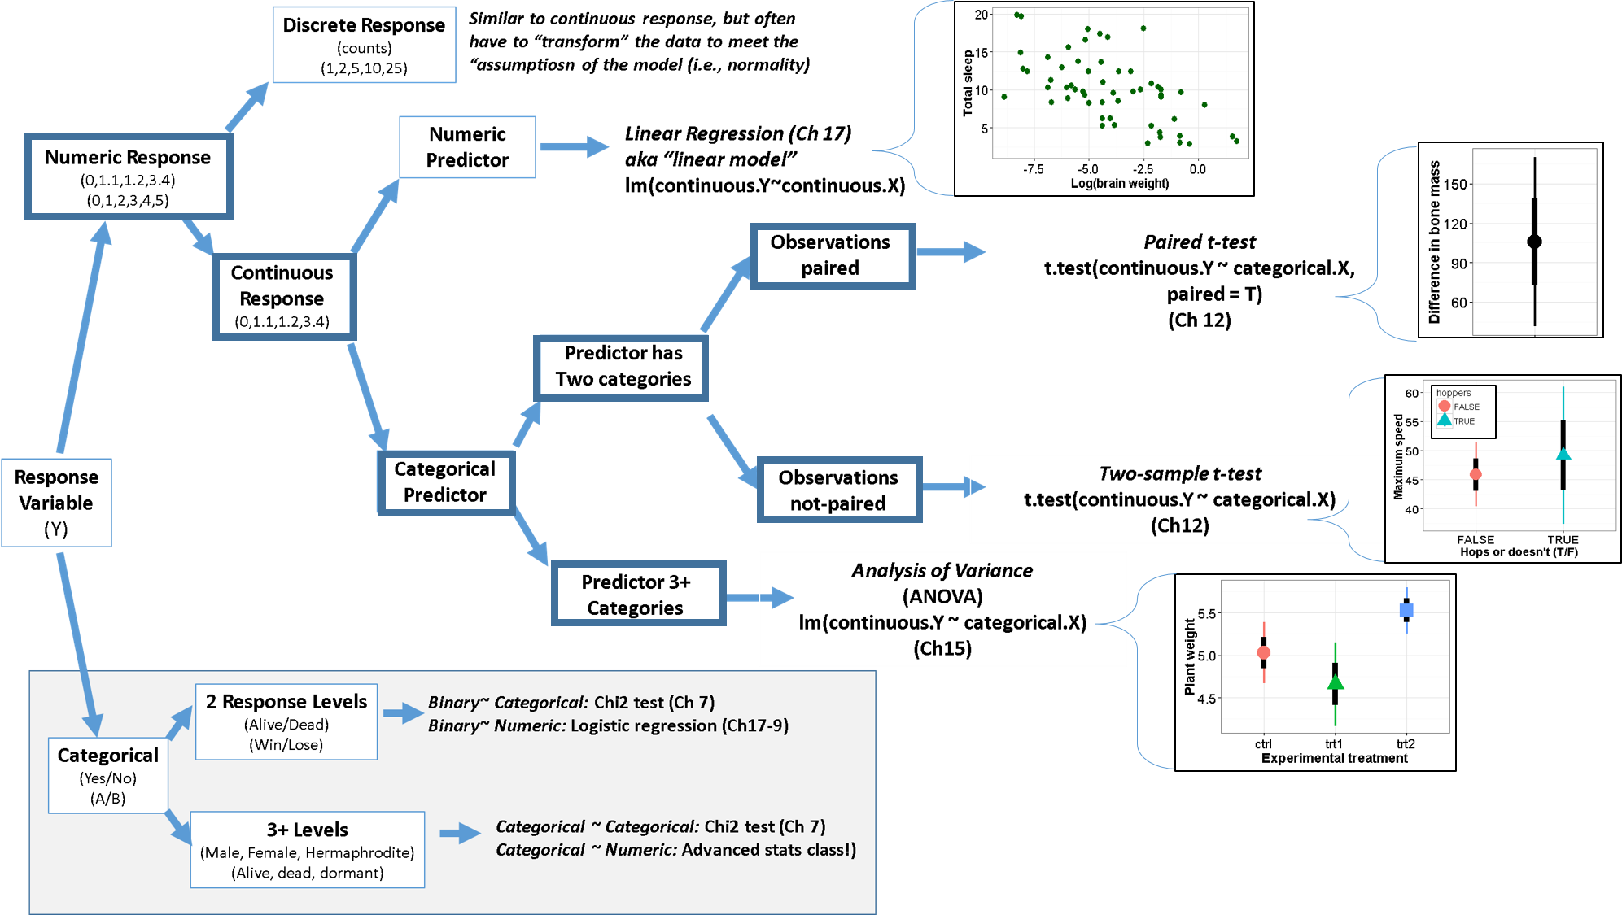

Slide 46
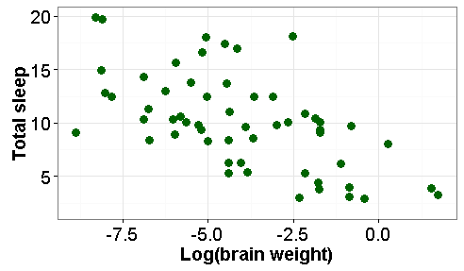

Slide 48


Uses of regression:
Size of mom vs. fat content of her milk
Prediction
2) Understand causality
/ test hypotheses
Fat content of milk
(%)
Female Size
log(mass)
Milk: does evolution of larger bodies result in evolution of lower % milk fat

Slide 49
Uses of regression:
Size of mom vs. fat content of her milk
Prediction
* Given x, predict y …
… while accounting for
uncertainty / error
2) Understand causality
/ test hypotheses
* Does x cause y?
Fat content of milk
(%)
Female Size
log(mass)
Milk: does evolution of larger bodies result in evolution of lower % milk fat

Slide 50
Uses of regression:
Size of mom vs. fat content of her milk
Prediction
* Given x, predict y …
… while accounting for
uncertainty / error
2) Understand causality
/ test hypotheses
* Does x cause y?
Fat content of milk
(%)
Female Size
log(mass)
Milk: does evolution of larger bodies result in evolution of lower % milk fat

Slide 51
Uses of regression:
Size of mom vs. fat content of her milk
Prediction
* Given x, predict y …
… while accounting for
uncertainty / error
2) Understand causality
/ test hypotheses
* Does x cause y?
Fat content of milk
(%)
Female Size
log(mass)
Milk: does evolution of larger bodies result in evolution of lower % milk fat

Slide 52
Uses of regression:
Size of mom vs. fat content of her milk
Prediction
* Given x, predict y …
… while accounting for
uncertainty / error
2) Understand causality
/ test hypotheses
* Does x cause y?
Fat content of milk
(%)
Female Size
log(mass)
Milk: does evolution of larger bodies result in evolution of lower % milk fat

Slide 53
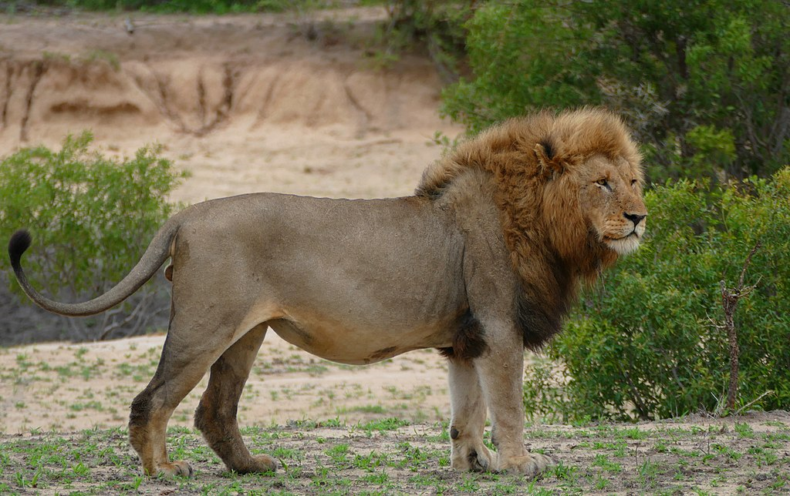

Slide 56
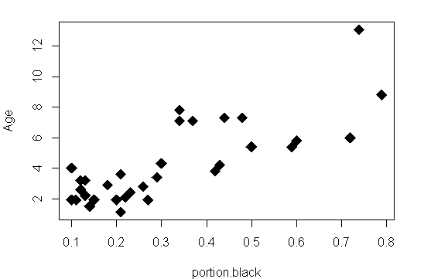
Regression for prediction Lion age, noses & trophy hunting
Known age of lion
(y)
Portion of nose black (x)

Slide 57
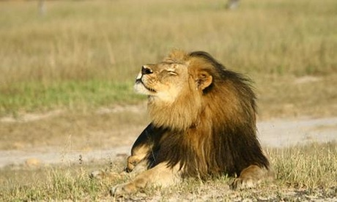

Regression for prediction Lion age, noses & trophy hunting
Known age of lion
(y)
Portion of nose black

Slide 58

Regression for prediction Lion age, noses & trophy hunting
Known age of lion
(y)
Portion of nose black

Slide 59
Regression for prediction Lion age, noses & trophy hunting
“Line of best fit”
Line estimated with:
“least squares”
Known age of lion
(y)
Portion of nose black (x)

Slide 60
Regression for prediction Lion age, noses & trophy hunting
* “Line of best fit”
* y ~ x
*
Line estimated with:
“least squares”
Known age of lion
(y)
Portion of nose black (x)

Slide 61
Regression for prediction Lion age, noses & trophy hunting
* “Line of best fit”
* y ~ x
* age ~ portion of nose black
Line estimated with:
“least squares”
Known age of lion
(y)
Portion of nose black (x)

Slide 62
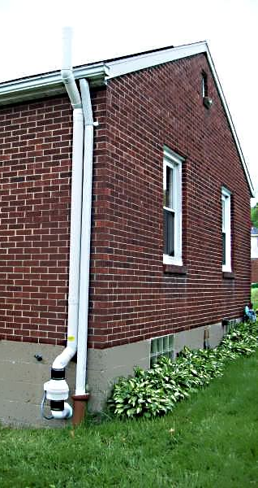
Regression for understanding causality
Radon

Slide 63
Uses of regression:
Prediction
* Given x, predict y …
… while accounting for
uncertainty / error
2) Understand causality
/ test hypotheses
* Does x cause y?
Milk: does evolution of larger bodies result in evolution of lower % milk fat

Slide 64
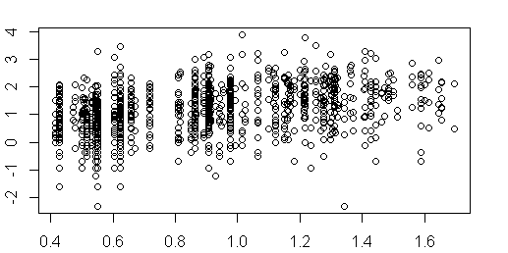
Regression for Hypothesis testing Soil uranium & Radon in MN
Radon Sensor Index
(log)
ppm soil uranium

Slide 65
Regression for Hypothesis testing Soil uranium & Radon in MN
Radon Sensor Index
(log)
ppm soil uranium

Slide 66
Regression for Hypothesis testing Soil uranium & Radon in MN
Radon Sensor Index
(log)
ppm soil uranium

Slide 67
Regression for Hypothesis testing Soil uranium & Radon in MN
Radon Sensor Index
(log)
ppm soil uranium

Slide 68
Regression for Hypothesis testing Soil uranium & Radon in MN
Line of best fit
Radon Sensor Index
(log)
ppm soil uranium

Slide 69
Regression for Hypothesis testing Soil uranium & Radon in MN
Line of best fit
“least squares”
Radon Sensor Index
(log)
ppm soil uranium

Slide 70
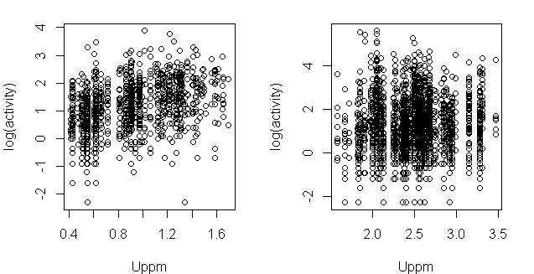
Minnesota
Pennsylvania
Radon Sensor Index (log)
ppm soil uranium

Slide 71
Minnesota
Pennsylvania
Radon Sensor Index (log)
ppm soil uranium

Slide 72
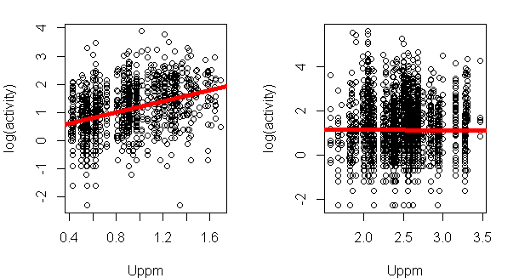
Radon Sensor Index (log)
ppm soil uranium

Slide 73
Radon Sensor Index (log)
ppm soil uranium

Slide 74
“Intercept”
(y-intercept)
ppm soil uranium

Slide 75
“Intercept”
(y-intercept)
ppm soil uranium

Slide 76
“Intercept”
(y-intercept)
“Slope”
ppm soil uranium

Slide 77
“Intercept”
(y-intercept)
“Slope”
“beta” (β)
ppm soil uranium

Slide 78
“Slope” = 0
“Intercept”
(y-intercept)
“Slope”
“beta” (β)
ppm soil uranium

Slide 79
Word equation:
log(radon) ~ uranium
Geometry:
y = mx+b
General R notation
y ~ x
“Intercept”
(y-intercept)
“Slope”
“beta” (β)
ppm soil uranium

Slide 80
Word equation:
log(radon) ~ uranium
Geometry:
y = mx+b
General R notation
y ~ x
“Intercept”
(y-intercept)
“Slope”
“beta” (β)
ppm soil uranium

Slide 81
Word equation:
log(radon) ~ uranium
Geometry:
y = mx+b
General R notation
y ~ x
“Intercept”
(y-intercept)
“Slope”
“beta” (β)
ppm soil uranium

Slide 82
Word equation:
log(radon) ~ uranium
Geometry:
y = mx+b
General R notation
y ~ x
“Intercept”
(y-intercept)
“Slope”
“beta” (β)
ppm soil uranium

Slide 83
Minnesota
Pennsylvania
ppm soil uranium

Slide 84
Which slope is steeper?
ppm soil uranium

Slide 85
Where can soil uranium be used to predict radon?
ppm soil uranium

