Slide 1
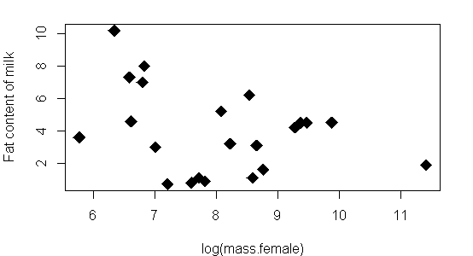
Regression (aka linear regression, linear model)
Lecture 24-ish
November 11, 2016

Slide 2
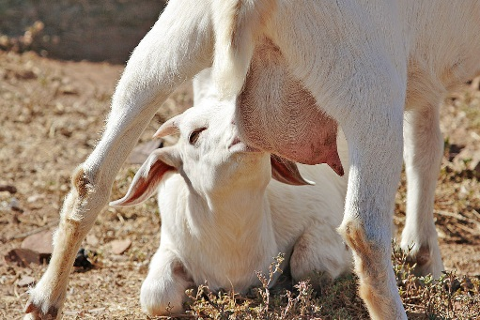
Common situations in research: Is there a relationship between 2 numeric variables?
Size of mom vs. fat content of her milk
Fat content of milk
(%)
Fatty
Lean
Female Size
log(mass)

Slide 3
Common situations in research: Is there a relationship between 2 numeric variables?
Size of mom vs. fat content of her milk
Fat content of milk
(%)
Female Size
log(mass)

Slide 4
Common situations in research: Is there a relationship between 2 numeric variables?
Size of mom vs. fat content of her milk
Fat content of milk
(%)
Regression Analysis:
Can transform BOTH
Response (fat %)
AND predictor (mass)
Female Size
log(mass)

Slide 5
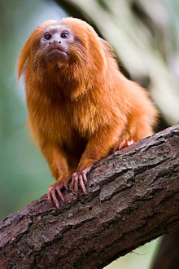
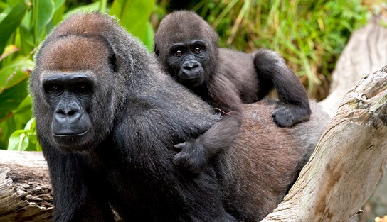
Common situations in research: Is there a relationship between 2 numeric variables?
Size of mom vs. fat content of her milk
Fat content of milk
(%)
Female Size
log(mass)

Slide 6
Common situations in research: Is there a relationship between 2 numeric variables?
2 complementary methods
Correlation (Ch 16)
1)is there a relationship?
2)is it positive or negative
3)how strong is it?
4)does NOT assume directionality
5)Only works w/ 2 variables, x1 & x2
6)only works w/numeric data
Regression (Ch 17)
1-3)same as correlation
4)assumes / tests directionality or causality
5)Simplest case: y ~ x
6)can be generalized to all forms of data

Slide 7
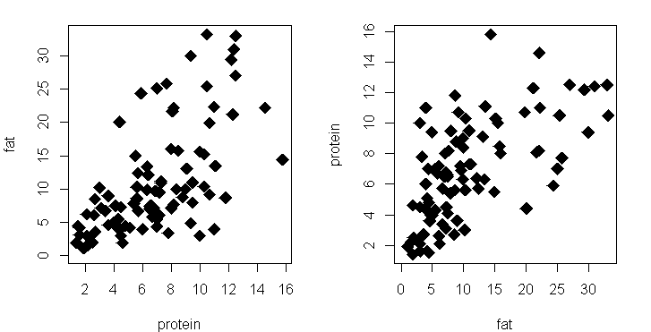
Correlation: does NOT assume directionality
Protein in milk (%)
Fat in milk (%)
Protein in milk (%)
Fat in milk (%)

Slide 8
Correlation: does NOT assume directionality
Protein in milk (%)
Fat in milk (%)
Protein in milk (%)
Fat in milk (%)

Slide 9
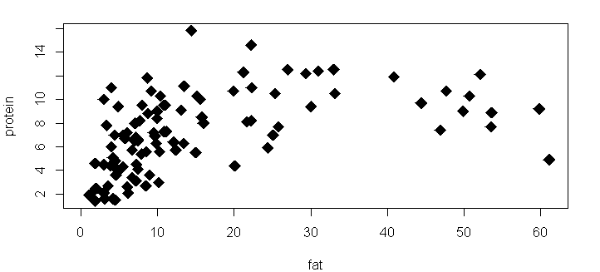
Limitation of correlation: only simple relationship
Protein in milk (%)
Fat in milk (%)

Slide 10
Limitation of correlation: only simple relationship
Protein in milk (%)
Fat in milk (%)

Slide 11
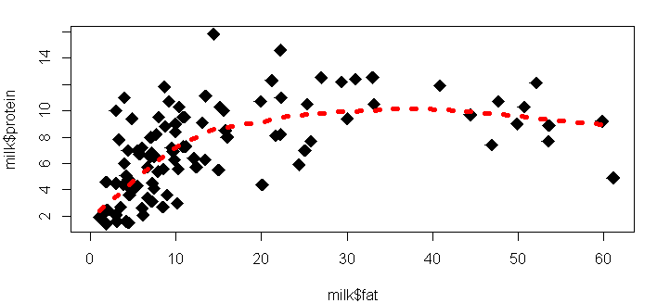
Limitation of correlation: only simple relationship
“smoother”
Protein in milk (%)
Fat in milk (%)

Slide 12
Common situations in research: Is there a relationship between 2 numeric variables?
2 complementary methods
Correlation (Ch 16)
1)is there a relationship?
2)is it positive or negative
3)how strong is it?
4)does NOT assume directionality
5)Only works w/ 2 variables, x1 & x2
6)only works w/numeric data
Regression (Ch 17)
1-3)same as correlation
4)assumes / tests directionality or causality
5)Simplest case: y ~ x
6)can be generalized to all forms of data

Slide 13
“Directionality” & “Causality”
“Directionality”
“Causality”
1-way direction of impact or interaction
The virus HIV causes the disease AIDS
The disease AIDS does not cause the virus HIV to occur
Reason, cause, mechanism
HIV is the causal agent of AIDS
Nothing else causes AIDS
Without HIV, there is not AIDS
Having HIV is a strong predictor of having AIDS (though less so now)

Slide 14
Common situations in research: Is there a relationship between 2 numeric variables?
2 complementary methods
Regression (Ch 17)
1-3)same as correlation
4)assumes / tests directionality or causality
5) Simplest case: y ~ x
6) can be generalized to
all forms of data
7) Powerful for prediction
Correlation (Ch 16)
1)is there a relationship?
2)is it positive or negative
3)how strong is it?
4)does NOT assume directionality
5)Only works w/ 2 variables, x1 & x2
6)only works w/numeric data

Slide 15
“Directionality” & “Causality”
“Correlation”
“Regression”
Once there is a high density of HIV virion, AIDS symptoms are severe
When AIDS symptoms are severe, there is a high density of HIV virions
We can predict the severity of AIDS symptoms based on abundance of HIV

Slide 16
“Directionality” & “Causality”
“Correlation”
“Regression”
Once there is a high density of HIV virion, AIDS symptoms are severe
When AIDS symptoms are severe, there is a high density of HIV virions
We can predict the severity of AIDS symptoms based on abundance of HIV

Slide 17
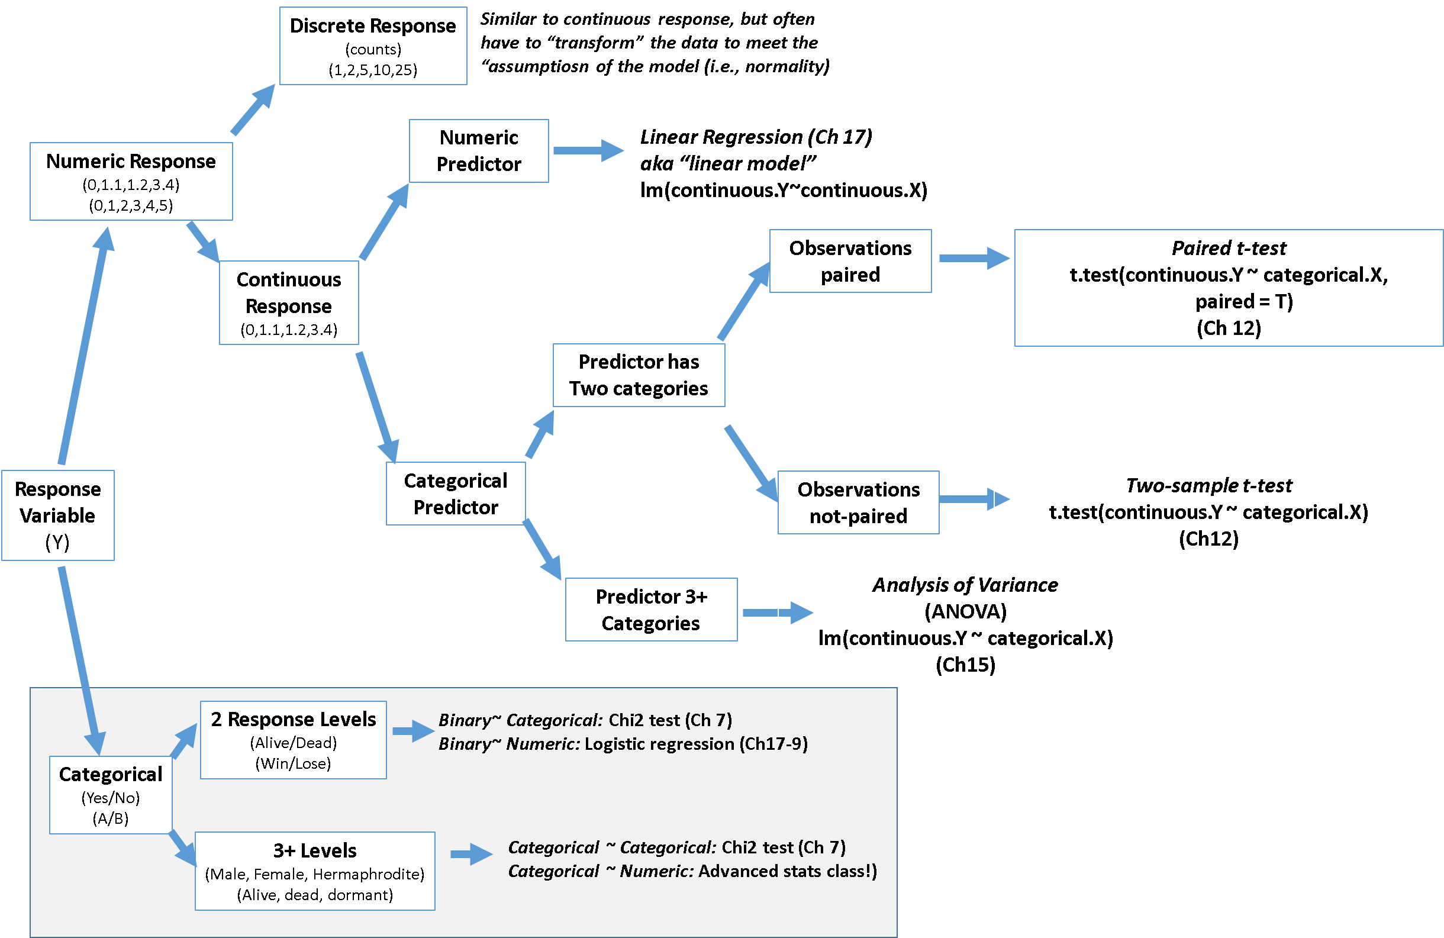
Types of analyses for different combinations of response and predictor variables

Slide 18
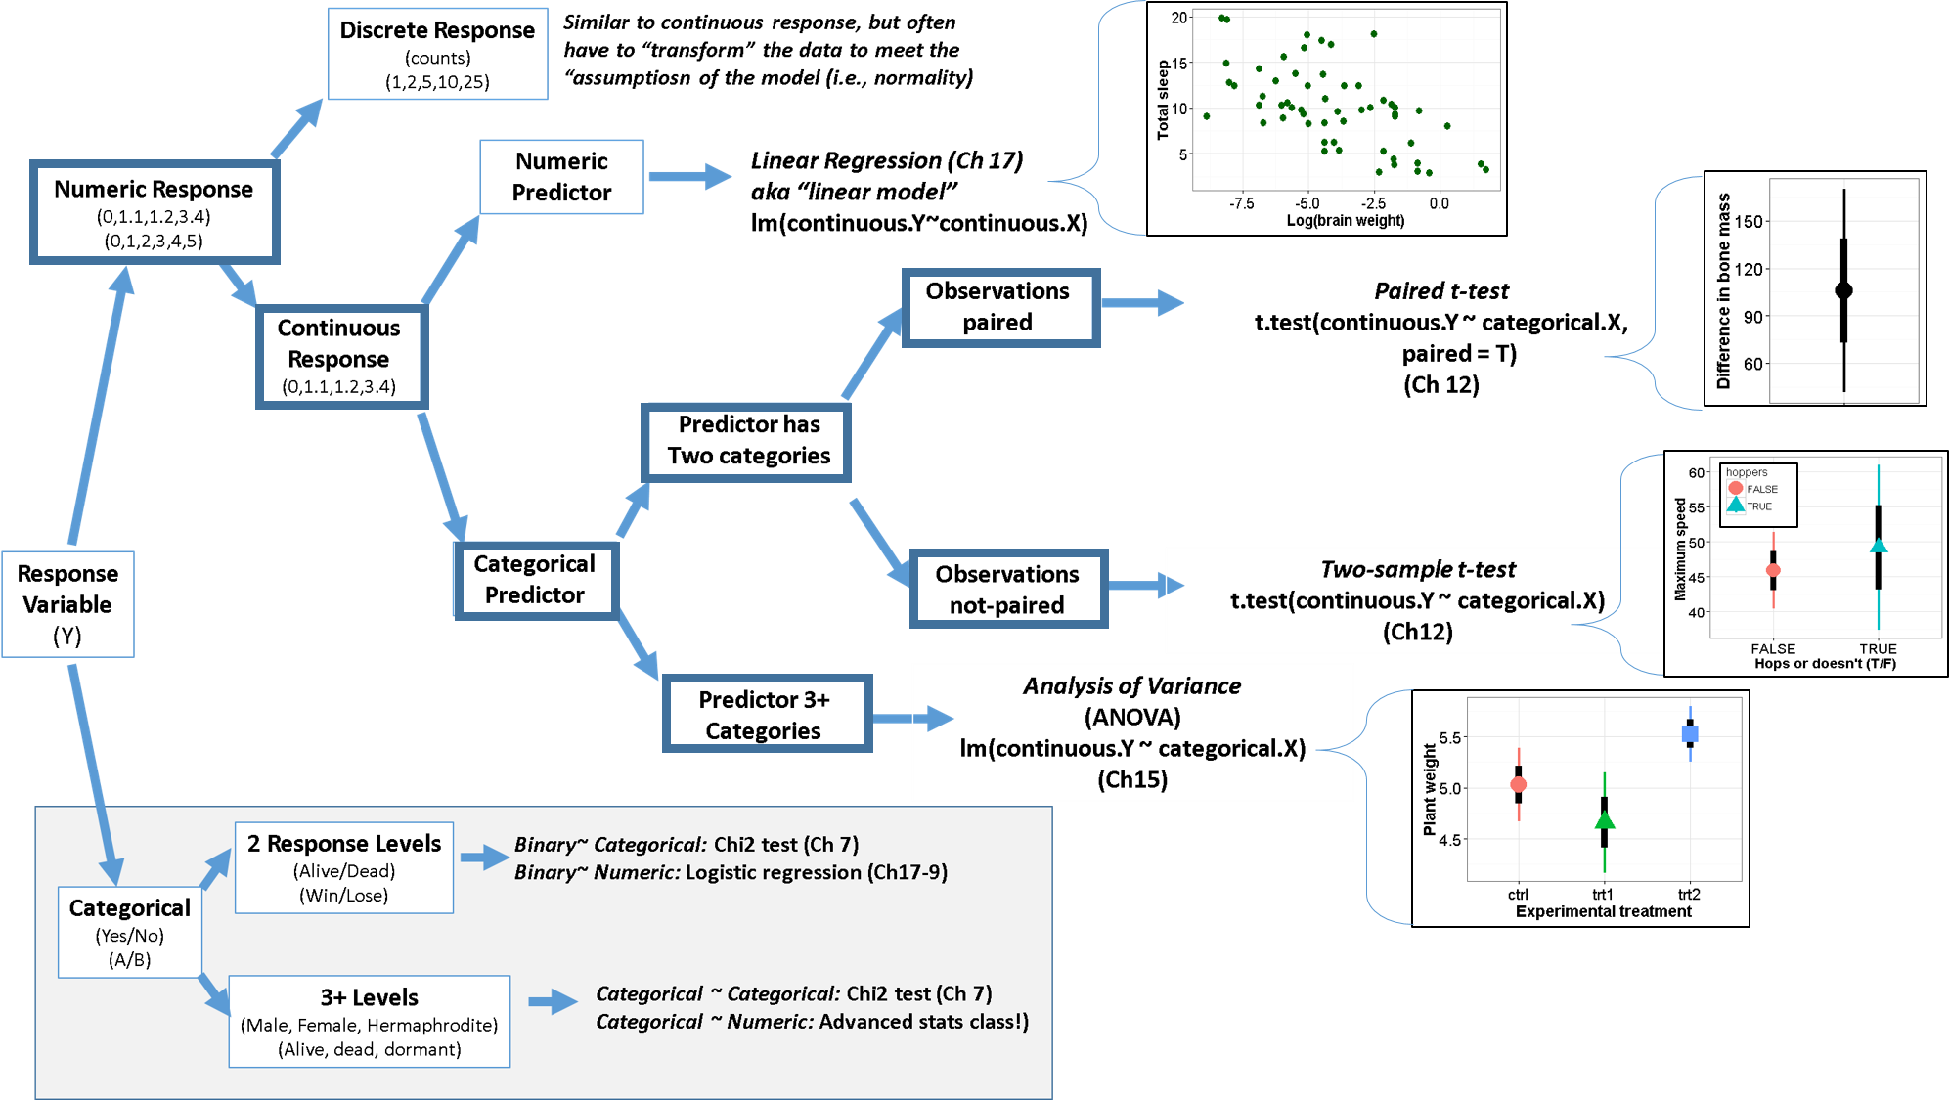
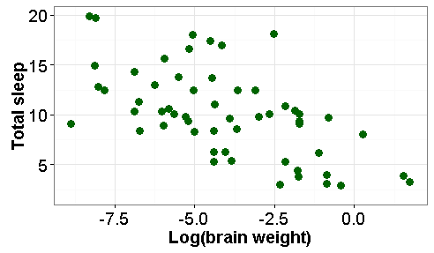

Slide 19


Uses of regression:
Size of mom vs. fat content of her milk
Prediction
2) Understand causality
/ test hypotheses
Fat content of milk
(%)
Female Size
log(mass)
Milk: does evolution of larger bodies result in evolution of lower % milk fat

Slide 20
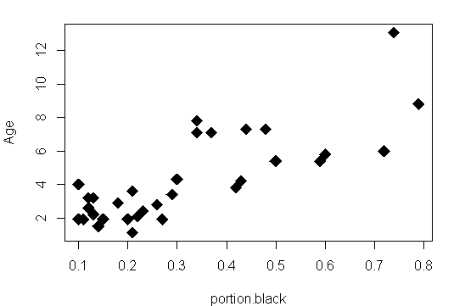
Regression for prediction Lion age, noses & trophy hunting
Known age of lion
(y)
Portion of nose black (x)

Slide 21
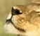
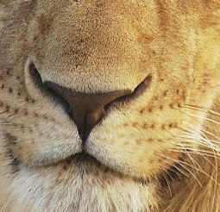
Regression for prediction Lion age, noses & trophy hunting
“Line of best fit”
Line estimated with:
“least squares”
Known age of lion
(y)
Portion of nose black (x)

Slide 22
Uses of regression:
Prediction
* Given x, predict y …
… while accounting for
uncertainty / error
2) Understand causality
/ test hypotheses
* Does x cause y?
Milk: does evolution of larger bodies result in evolution of lower % milk fat

Slide 23
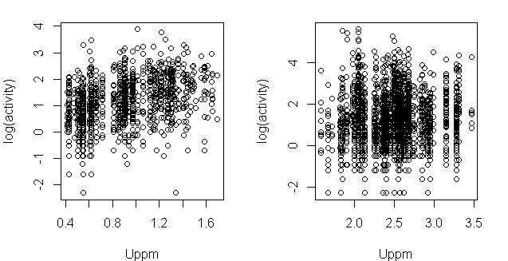
Minnesota
Pennsylvania
Radon Sensor Index (log)
ppm soil uranium

Slide 24
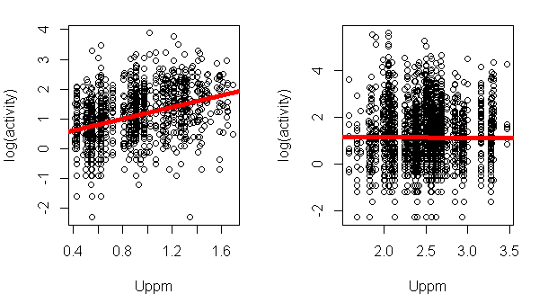
Word equation:
log(radon) ~ uranium
Geometry:
y = mx+b
General R notation
y ~ x
“Intercept”
(y-intercept)
“Slope”
“beta” (β)
ppm soil uranium

Slide 25
Minnesota
Pennsylvania
ppm soil uranium

Slide 26
Which slope is steeper?
ppm soil uranium

