Slide 1
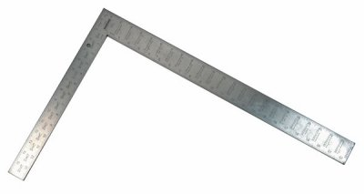
Regression Lecture 2: Model fitting with Least Squares
November 29 2017

Slide 2
3 Major steps in regression analysis
1)Model fitting
2)Significance testing
3)Model Checking
What line fits the model best?
This class: “least squares”
Advanced regression: “maximum likelihood”
Calculate 2 things:
Intercept of line
Slope of line
There are equations that provide the exact solution
We did by hand w/ruler just for illustration
Is the line any different from a flat line?
The slope of flat line = 0
Slope of 0 = no change in y as x changes
Calcualte: Standard errors (SE), confidence intervals (CI) t-statistics, F-statistic, p-values
aka “residual analysis”
aka“ “model diagnostics”
Do the data meet the assumptions of the model
Random & Independent sampling, Normality, constant variance
Requires plotting the residuals (errors)

Slide 3
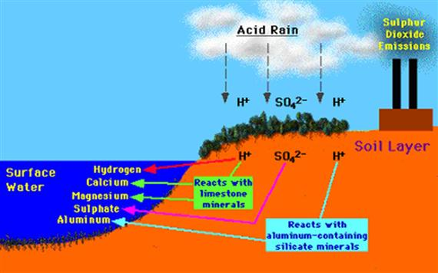
Example: Impacts of Aluminum of plant growth
tankonyvtar.hu/en/tartalom/tamop425/0032_vizkeszletgazdalkodas_es_vizminoseg/ch07s04.html

Slide 4


Control
(No AL)
Aluminum addition
Height
Time

Slide 5
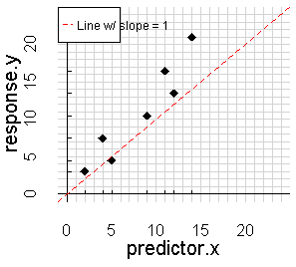
1)Model fitting
What line fits the data best?
This class: “least squares”
Advanced regression: “maximum likelihood”
Calculate 2 things:
Intercept of line
Slope of line
There are equations that provide the exact solution
We did by hand w/ruler just for illustration

Slide 6
Slope > 1
1)Model fitting
Slope = 1
What line fits the data best?
This class: “least squares”
Advanced regression: “maximum likelihood”
Calculate 2 things:
Intercept of line
Slope of line
There are equations that provide the exact solution
Wedid by hand w/ruler just for illustration
Slope = 0

Slide 7
“Intercept”
“y-intercept”
“b” in y = mx + b

Slide 8
y = m*x + b
“Rise”
= 16
“Run”
= 14

Slide 9
How do we determine if our line is actually a good “fit” for the data?

Slide 10
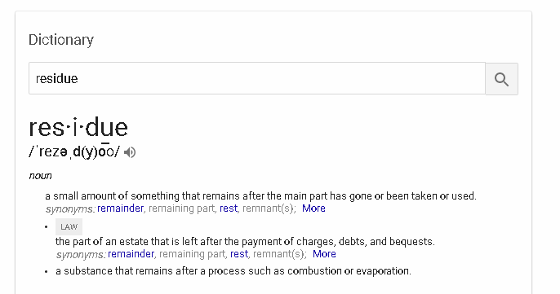

Slide 11
How do we determine if our line is actually a good “fit” for the data?
Calculate “residuals”

Slide 12
How do we determine if our line is actually a good “fit” for the data?
Calculate “residuals”
+2.0
+1.0
-3.2
-0.1
-2.8
-4.2
-2.3

Slide 13
+2.0
Add up all the
Residuals
The line w/
The smallest
Residuals
Has the best
fit
Problem:
-2.3 + 2.0
= 0.03
+1.0
-3.2
-0.1
-2.8
-4.2
-2.3

Slide 14
How about this line?
Is this A good fit Or a poor
Fit?

Slide 15
Solution:
+2.0
+1.0
-3.2
-0.1
-2.8
-4.2
-2.3

Slide 16
Solution:
Remove the
Negative sign but keep the overall size
by
Squaring
each residual
2.0²
=4.0
1.0²
=1.0
-0.1²
=0.01
-3.2²
=10.24
-2.8²
=7.8
-4.2²
=17.6
-2.3²
=5.3

Slide 17
Key steps for getting “least squares:
1st,
Square residuals
2nd,
add them up
2.0²
=4.0
1.0²
=1.0
-0.1²
=0.01
-3.2²
=10.24
-2.8²
=7.8
-4.2²
=17.6
-2.3²
=5.3

Slide 18
Key steps for getting “least squares:
1st,
Square residuals
2nd,
add them up
2.0²
=4.0
2.0² = 4.0
1.0² = 1.0
-0.1² = 0.01
-3.2² = 10.24
-2.8² = 7.8
-4.2² = 17.6
-2.3² = 5.3
1.0²
=1.0
-0.1²
=0.01
-3.2²
=10.24
-2.8²
=7.8
-4.2²
=17.6
-2.3²
=5.3

Slide 19
The best fitting line (therefore the best model)
Will have the smallest sum of squared residuals
Poorer-fitting lines will have
Larger residuals & therefore larger
sum of squares

Slide 20
The best fitting line (therefore the best model)
Will have the smallest sum of squared residuals
Poorer-fitting lines will have
Larger residuals & therefore larger
sum of squares

