Slide 1
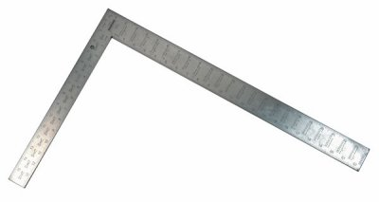
Regression Lecture 2: Model fitting with Least Squares
November 29 2017

Slide 2
3 Major steps in regression analysis
1)Model fitting
2)Significance testing
3)Model Checking
What line fits the model best?
This class: “least squares”
Advanced regression: “maximum likelihood”
Calculate 2 things:
Intercept of line
Slope of line
There are equations that provide the exact solution
We did by hand w/ruler just for illustration
Is the line any different from a flat line?
The slope of flat line = 0
Slope of 0 = no change in y as x changes
Calcualte: Standard errors (SE), confidence intervals (CI) t-statistics, F-statistic, p-values
aka “residual analysis”
aka“ “model diagnostics”
Do the data meet the assumptions of the model
Random & Independent sampling, Normality, constant variance
Requires plotting the residuals (errors)

Slide 3
3 Major steps in regression analysis
1)Model fitting
2)Significance testing
3)Model Checking
What line fits the model best?
This class: “least squares”
Advanced regression: “maximum likelihood”
Calculate 2 things:
Intercept of line
Slope of line
There are equations that provide the exact solution
We did by hand w/ruler just for illustration
Is the line any different from a flat line?
The slope of flat line = 0
Slope of 0 = no change in y as x changes
Calcualte: Standard errors (SE), confidence intervals (CI) t-statistics, F-statistic, p-values
aka “residual analysis”
aka“ “model diagnostics”
Do the data meet the assumptions of the model
Random & Independent sampling, Normality, constant variance
Requires plotting the residuals (errors)

Slide 4
3 Major steps in regression analysis
1)Model fitting
2)Significance testing
3)Model Checking
What line fits the model best?
This class: “least squares”
Advanced regression: “maximum likelihood”
Calculate 2 things:
Intercept of line
Slope of line
There are equations that provide the exact solution
We did by hand w/ruler just for illustration
Is the line any different from a flat line?
The slope of flat line = 0
Slope of 0 = no change in y as x changes
Calcualte: Standard errors (SE), confidence intervals (CI) t-statistics, F-statistic, p-values
aka “residual analysis”
aka“ “model diagnostics”
Do the data meet the assumptions of the model
Random & Independent sampling, Normality, constant variance
Requires plotting the residuals (errors)

Slide 5
3 Major steps in regression analysis
1)Model fitting
2)Significance testing
3)Model Checking
What line fits the model best?
This class: “least squares”
Advanced regression: “maximum likelihood”
Calculate 2 things:
Intercept of line
Slope of line
There are equations that provide the exact solution
We did by hand w/ruler just for illustration
Is the line any different from a flat line?
The slope of flat line = 0
Slope of 0 = no change in y as x changes
Calcualte: Standard errors (SE), confidence intervals (CI) t-statistics, F-statistic, p-values
aka “residual analysis”
aka“ “model diagnostics”
Do the data meet the assumptions of the model
Random & Independent sampling, Normality, constant variance
Requires plotting the residuals (errors)

Slide 6
3 Major steps in regression analysis
1)Model fitting
2)Significance testing
3)Model Checking
What line fits the model best?
This class: “least squares”
Advanced regression: “maximum likelihood”
Calculate 2 things:
Intercept of line
Slope of line
There are equations that provide the exact solution
We did by hand w/ruler just for illustration
Is the line any different from a flat line?
The slope of flat line = 0
Slope of 0 = no change in y as x changes
Calcualte: Standard errors (SE), confidence intervals (CI) t-statistics, F-statistic, p-values
aka “residual analysis”
aka“ “model diagnostics”
Do the data meet the assumptions of the model
Random & Independent sampling, Normality, constant variance
Requires plotting the residuals (errors)
-In Detail Monday
-Lab Tuesday
-Last week
-Review today
-Discuss least squares in detail
-Have done in R to get p-values
-Use anova() & summary()
-In detail Friday

Slide 7
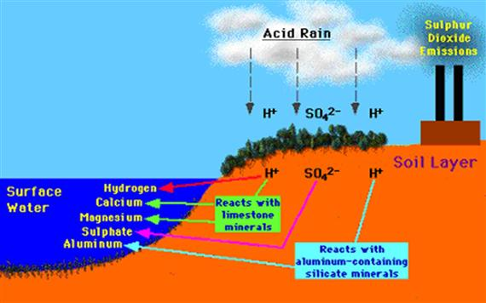
Example: Impacts of Aluminum of plant growth
tankonyvtar.hu/en/tartalom/tamop425/0032_vizkeszletgazdalkodas_es_vizminoseg/ch07s04.html

Slide 8

Height
Time

Slide 9

Control
(No AL)
Aluminum addition
Height
Time

Slide 10
Control
(No AL)
Aluminum addition
Height
Time

Slide 11
Control
(No AL)
Aluminum addition
Height
Time

Slide 12
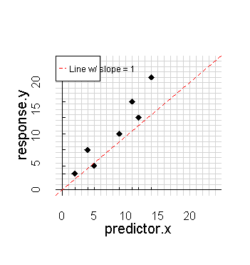
1)Model fitting
What line fits the data best?
This class: “least squares”
Advanced regression: “maximum likelihood”
Calculate 2 things:
Intercept of line
Slope of line
There are equations that provide the exact solution
We did by hand w/ruler just for illustration

Slide 13
Note:
Line w/ slope = 1
Aka “1:1” line
Just for reference/comparison

Slide 14
1)Model fitting
What line fits the data best?
This class: “least squares”
Advanced regression: “maximum likelihood”
Calculate 2 things:
Intercept of line
Slope of line
There are equations that provide the exact solution
We did by hand w/ruler just for illustration

Slide 15
1)Model fitting
What line fits the data best?
This class: “least squares”
Advanced regression: “maximum likelihood”
Calculate 2 things:
Intercept of line
Slope of line
There are equations that provide the exact solution
We did by hand w/ruler just for illustration

Slide 16
1)Model fitting
What line fits the data best?
This class: “least squares”
Advanced regression: “maximum likelihood”
Calculate 2 things:
Intercept of line
Slope of line
There are equations that provide the exact solution
We did by hand w/ruler just for illustration

Slide 17
1)Model fitting
What line fits the data best?
This class: “least squares”
Advanced regression: “maximum likelihood”
Calculate 2 things:
Intercept of line
Slope of line
There are equations that provide the exact solution
We did by hand w/ruler just for illustration

Slide 18
1)Model fitting
What line fits the data best?
This class: “least squares”
Advanced regression: “maximum likelihood”
Calculate 2 things:
Intercept of line
Slope of line
There are equations that provide the exact solution
We did by hand w/ruler just for illustration

Slide 19
1)Model fitting
What line fits the data best?
This class: “least squares”
Advanced regression: “maximum likelihood”
Calculate 2 things:
Intercept of line
Slope of line
There are equations that provide the exact solution
We did by hand w/ruler just for illustration

Slide 20
1)Model fitting
What line fits the data best?
This class: “least squares”
Advanced regression: “maximum likelihood”
Calculate 2 things:
Intercept of line
Slope of line
There are equations that provide the exact solution
We did by hand w/ruler just for illustration

Slide 21
1)Model fitting
What line fits the data best?
This class: “least squares”
Advanced regression: “maximum likelihood”
Calculate 2 things:
Intercept of line
Slope of line
There are equations that provide the exact solution
We did by hand w/ruler just for illustration

Slide 22
1)Model fitting
What line fits the data best?
This class: “least squares”
Advanced regression: “maximum likelihood”
Calculate 2 things:
Intercept of line
Slope of line
There are equations that provide the exact solution
Wedid by hand w/ruler just for illustration

Slide 23
1)Model fitting
What line fits the data best?
This class: “least squares”
Advanced regression: “maximum likelihood”
Calculate 2 things:
Intercept of line
Slope of line
There are equations that provide the exact solution
Wedid by hand w/ruler just for illustration

Slide 24
Slope > 1
1)Model fitting
Slope = 1
What line fits the data best?
This class: “least squares”
Advanced regression: “maximum likelihood”
Calculate 2 things:
Intercept of line
Slope of line
There are equations that provide the exact solution
Wedid by hand w/ruler just for illustration
Slope = 0

Slide 25
Slope > 1
1)Model fitting
Slope = 1
What line fits the data best?
This class: “least squares”
Advanced regression: “maximum likelihood”
Calculate 2 things:
Intercept of line
Slope of line
There are equations that provide the exact solution
Wedid by hand w/ruler just for illustration
Slope = 0

Slide 26
Slope > 1
1)Model fitting
Slope = 1
What line fits the data best?
This class: “least squares”
Advanced regression: “maximum likelihood”
Calculate 2 things:
Intercept of line
Slope of line
There are equations that provide the exact solution
Wedid by hand w/ruler just for illustration
Slope = 0

Slide 27
Slope > 1
1)Model fitting
Slope = 1
What line fits the data best?
This class: “least squares”
Advanced regression: “maximum likelihood”
Calculate 2 things:
Intercept of line
Slope of line
There are equations that provide the exact solution
Wedid by hand w/ruler just for illustration
Slope = 0

Slide 28
There are equations that provide the exact solution
Could do this by hand using a ruler

Slide 30
“Intercept”
“y-intercept”
“b” in y = mx + b

Slide 31
“Intercept”
“y-intercept”
“b” in y = mx + b
= 3

Slide 34
“Rise”
= 16

Slide 35
“Rise”
= 16

Slide 36
“Rise”
= 16
“Run”
= 14

Slide 37
Slope = Rise/Run
= 16/14
= 1.14
“Rise”
= 16
“Run”
= 14

Slide 38
y = m*x + b
“Rise”
= 16
“Run”
= 14

Slide 39
y = m*x + b
y = 1.14*x + 3
“Rise”
= 16
“Run”
= 14

Slide 40
Proposed
“best fit” line
y = 1.14*x + 3
Equation that defines the line through data

Slide 41
Proposed
“best fit” line
y = 1.14*x + 3
Equation that defines the line through data

Slide 42
Proposed
“best fit” line
y = 1.14*x + 3
slope intercept
(“beta”)

Slide 43
How do we determine if our line is actually a good “fit” for the data?

Slide 44
How do we determine if our line is actually a good “fit” for the data?
Calculate “residuals”

Slide 45
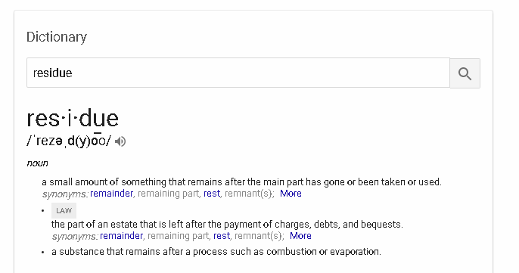

Slide 46
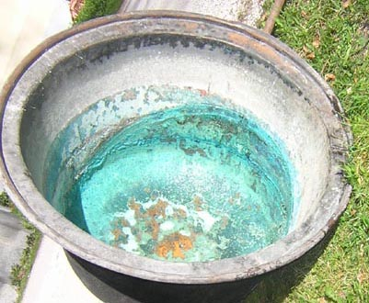

Slide 47
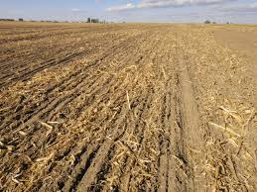
Crop residue

Slide 48
How do we determine if our line is actually a good “fit” for the data?
Calculate “residuals”

Slide 49
How do we determine if our line is actually a good “fit” for the data?
Calculate “residuals”

Slide 50
How do we determine if our line is actually a good “fit” for the data?
Calculate “residuals”
Distance along
y-axis from
regression line to data point

Slide 51
How do we determine if our line is actually a good “fit” for the data?
Calculate “residuals”
Distance along
y-axis from
regression line to data point

Slide 52
How do we determine if our line is actually a good “fit” for the data?
Calculate “residuals”
Distance along
y-axis from
regression line to data point
-4.2

Slide 53
How do we determine if our line is actually a good “fit” for the data?
Calculate “residuals”
+2.0
+1.0
-3.2
-0.1
-2.8
-4.2
-2.3

Slide 54
How do we determine if our line is actually a good “fit” for the data?
Calculate “residuals”
+2.0
Add up all the
Residuals
The line w/
The smallest
Residuals
Has the best
fit
+1.0
-3.2
-0.1
-2.8
-4.2
-2.3

Slide 55
+2.0
Add up all the
Residuals
The line w/
The smallest
Residuals
Has the best
fit
Problem:
+1.0
-3.2
-0.1
-2.8
-4.2
-2.3

Slide 56
+2.0
Add up all the
Residuals
The line w/
The smallest
Residuals
Has the best
fit
Problem:
-2.3 + 2.0
= 0.03
+1.0
-3.2
-0.1
-2.8
-4.2
-2.3

Slide 57
+2.0
Add up all the
Residuals
The line w/
The smallest
Residuals
Has the best
fit
Problem:
-2.3 + 2.0
= 0.03
Positive & negative residuals cancel each other out…
+1.0
-3.2
-0.1
-2.8
-4.2
-2.3

Slide 58
How about this line?
Is this A good fit Or a poor
Fit?

Slide 59
How about this line?
Is this A good fit Or a poor
Fit?
+
=

Slide 60
Solution:
+2.0
+1.0
-3.2
-0.1
-2.8
-4.2
-2.3

Slide 61
Solution:
Remove the
Negative sign but keep the overall size by
Squaring each residual
+2.0
+1.0
-3.2
-0.1
-2.8
-4.2
-2.3

Slide 62
Solution:
Remove the
Negative sign but keep the overall size by
Squaring each residual
+2.0²
+1.0²
-3.2²
-0.1²
-2.8²
-4.2²
-2.3²

Slide 63
Solution:
Remove the
Negative sign but keep the overall size
by
Squaring
each residual
2.0²
=4.0
1.0²
=1.0
-0.1²
=0.01
-3.2²
=10.24
-2.8²
=7.8
-4.2²
=17.6
-2.3²
=5.3

Slide 64
Solution:
Remove the
Negative sign but keep the overall size
by
Squaring
each residual
Regression
Aka
“least squares” regression

Slide 65
Key steps for getting “least squares:
1st,
Square residuals
2nd,
add them up
2.0²
=4.0
1.0²
=1.0
-0.1²
=0.01
-3.2²
=10.24
-2.8²
=7.8
-4.2²
=17.6
-2.3²
=5.3

Slide 66
Key steps for getting “least squares:
1st,
Square residuals
2nd,
add them up
2.0²
=4.0
1.0²
=1.0
-0.1²
=0.01
-3.2²
=10.24
-2.8²
=7.8
-4.2²
=17.6
-2.3²
=5.3

Slide 67
Key steps for getting “least squares:
1st,
Square residuals
2nd,
add them up
2.0²
=4.0
2.0² = 4.0
1.0² = 1.0
-0.1² = 0.01
-3.2² = 10.24
-2.8² = 7.8
-4.2² = 17.6
-2.3² = 5.3
1.0²
=1.0
-0.1²
=0.01
-3.2²
=10.24
-2.8²
=7.8
-4.2²
=17.6
-2.3²
=5.3

Slide 68
Key steps for getting “least squares:
1st,
Square residuals
2nd,
add them up
2.0²
=4.0
2.0² = 4.0
1.0² = 1.0
-0.1² = 0.01
-3.2² = 10.24
-2.8² = 7.8
-4.2² = 17.6
-2.3² = 5.3
1.0²
=1.0
-0.1²
=0.01
-3.2²
=10.24
-2.8²
=7.8
-4.2²
=17.6
-2.3²
=5.3

Slide 69
Key steps for getting “least squares:
1st,
Square residuals
2nd,
add them up
2.0²
=4.0
2.0² = 4.0
1.0² = 1.0
-0.1² = 0.01
-3.2² = 10.24
-2.8² = 7.8
-4.2² = 17.6
-2.3² = 5.3
Sum = 45.95
1.0²
=1.0
-0.1²
=0.01
-3.2²
=10.24
-2.8²
=7.8
-4.2²
=17.6
-2.3²
=5.3

Slide 70
Key steps for getting “least squares:
1st,
Square residuals
2nd,
add them up
2.0²
=4.0
2.0² = 4.0
1.0² = 1.0
-0.1² = 0.01
-3.2² = 10.24
-2.8² = 7.8
-4.2² = 17.6
-2.3² = 5.3
Sum = 45.95
1.0²
=1.0
-0.1²
=0.01
-3.2²
=10.24
-2.8²
=7.8
-4.2²
=17.6
“squares”
-2.3²
=5.3
“sum of squares”
Best fitting line has lowest
sum of squares or “least squares”

Slide 71
Key steps for getting “least squares:
1st,
Square residuals
2nd,
add them up
2.0²
=4.0
2.0² = 4.0
1.0² = 1.0
-0.1² = 0.01
-3.2² = 10.24
-2.8² = 7.8
-4.2² = 17.6
-2.3² = 5.3
Sum = 45.95
1.0²
=1.0
-0.1²
=0.01
-3.2²
=10.24
-2.8²
=7.8
-4.2²
=17.6
“squares”
-2.3²
=5.3
“sum of squares”
Best fitting line has lowest
sum of squares or “least squares”

Slide 72
Key steps for getting “least squares:
1st,
Square residuals
2nd,
add them up
2.0²
=4.0
2.0² = 4.0
1.0² = 1.0
-0.1² = 0.01
-3.2² = 10.24
-2.8² = 7.8
-4.2² = 17.6
-2.3² = 5.3
Sum = 45.95
1.0²
=1.0
-0.1²
=0.01
-3.2²
=10.24
-2.8²
=7.8
-4.2²
=17.6
“squares”
-2.3²
=5.3
“sum of squares”
Best fitting line has lowest
sum of squares or “least squares”

Slide 73
Key steps for getting “least squares:
1st,
Square residuals
2nd,
add them up
2.0²
=4.0
2.0² = 4.0
1.0² = 1.0
-0.1² = 0.01
-3.2² = 10.24
-2.8² = 7.8
-4.2² = 17.6
-2.3² = 5.3
Sum = 45.95
1.0²
=1.0
-0.1²
=0.01
-3.2²
=10.24
-2.8²
=7.8
-4.2²
=17.6
“squares”
-2.3²
=5.3
“sum of squares”
Best fitting line has lowest
sum of squares or “least squares”

Slide 74
Key steps for getting “least squares:
1st,
Square residuals
2nd,
add them up
2.0²
=4.0
2.0² = 4.0
1.0² = 1.0
-0.1² = 0.01
-3.2² = 10.24
-2.8² = 7.8
-4.2² = 17.6
-2.3² = 5.3
Sum = 45.95
1.0²
=1.0
-0.1²
=0.01
-3.2²
=10.24
-2.8²
=7.8
-4.2²
=17.6
“squares”
-2.3²
=5.3
“sum of squares”
Best fitting line has lowest
sum of squares or “least squares”

Slide 75
Best fitting line has
lowest sum of squares
or Lowest sum of squared residuals
or “least squares”

Slide 76
The best fitting line (therefore the best model)
Will have the smallest sum of squared residuals
Poorer-fitting lines will have
Larger residuals & therefore larger
sum of squares

Slide 77
The best fitting line (therefore the best model)
Will have the smallest sum of squared residuals
Poorer-fitting lines will have
Larger residuals & therefore larger
sum of squares

Slide 78
The best fitting line (therefore the best model)
Will have the smallest sum of squared residuals
Poorer-fitting lines will have
Larger residuals & therefore larger
sum of squares

Slide 79
The best fitting line (therefore the best model)
Will have the smallest sum of squared residuals
Poorer-fitting lines will have
Larger residuals & therefore larger
sum of squares

Slide 80
The best fitting line (therefore the best model)
Will have the smallest sum of squared residuals
Poorer-fitting lines will have
Larger residuals & therefore larger
sum of squares

Slide 81
The best fitting line (therefore the best model)
Will have the smallest sum of squared residuals
Poorer-fitting lines will have
Larger residuals & therefore larger
sum of squares

