Slide 1
Lecture 25: Regression Inference

Slide 2
3 Major steps in regression analysis
1)Model fitting
2)Significance testing
3)Model Checking
What line fits the data best?
This class:
“least squares”
Advanced regression: “maximum likelihood”
Calculate 2 things:
Intercept of line
Slope of line
There are equations that provide the exact solution
Can also do with a ruler
Is the line any different from a flat line?
The slope of flat line = 0
Slope of 0 = no change in y as x changes
Calculate: Standard errors (SE), confidence intervals (CI) t-statistics, F-statistic, p-values
aka “residual analysis”
aka“ “model diagnostics”
Do the data meet the assumptions of the model
Random & Independent sampling, Normality, constant variance
Requires plotting the residuals (errors)

Slide 3
3 Major steps in regression analysis
1)Model fitting
2)Significance testing
3)Model Checking
What line fits the data best?
This class:
“least squares”
Advanced regression: “maximum likelihood”
Calculate 2 things:
Intercept of line
Slope of line
There are equations that provide the exact solution
Can also do with a ruler
Is the line any different from a flat line?
The slope of flat line = 0
Slope of 0 = no change in y as x changes
Calculate: Standard errors (SE), confidence intervals (CI) t-statistics, F-statistic, p-values
aka “residual analysis”
aka“ “model diagnostics”
Do the data meet the assumptions of the model
Random & Independent sampling, Normality, constant variance
Requires plotting the residuals (errors)

Slide 4
3 Major steps in regression analysis
“Inference”
1)Model fitting
2)Significance testing
3)Model Checking
What line fits the data best?
This class:
“least squares”
Advanced regression: “maximum likelihood”
Calculate 2 things:
Intercept of line
Slope of line
There are equations that provide the exact solution
Can also do with a ruler
Is the line any different from a flat line?
The slope of flat line = 0
Slope of 0 = no change in y as x changes
Calculate: Standard errors (SE), confidence intervals (CI) t-statistics, F-statistic, p-values
aka “residual analysis”
aka“ “model diagnostics”
Do the data meet the assumptions of the model
Random & Independent sampling, Normality, constant variance
Requires plotting the residuals (errors)

Slide 5
3 Major steps in regression analysis
“Inference”
1)Model fitting
2)Significance testing
3)Model Checking
What line fits the data best?
This class:
“least squares”
Advanced regression: “maximum likelihood”
Calculate 2 things:
Intercept of line
Slope of line
There are equations that provide the exact solution
Can also do with a ruler
Is the line any different from a flat line?
The slope of flat line = 0
Slope of 0 = no change in y as x changes
Calculate: Standard errors (SE), confidence intervals (CI) t-statistics, F-statistic, p-values
aka “residual analysis”
aka“ “model diagnostics”
Do the data meet the assumptions of the model
Random & Independent sampling, Normality, constant variance
Requires plotting the residuals (errors)

Slide 6
3 Major steps in regression analysis
“Inference”
1)Model fitting
2)Significance testing
3)Model Checking
What line fits the data best?
This class:
“least squares”
Advanced regression: “maximum likelihood”
Calculate 2 things:
Intercept of line
Slope of line
There are equations that provide the exact solution
Can also do with a ruler
Is the line any different from a flat line?
The slope of flat line = 0
Slope of 0 = no change in y as x changes
Calculate: Standard errors (SE), confidence intervals (CI) t-statistics, F-statistic, p-values
aka “residual analysis”
aka“ “model diagnostics”
Do the data meet the assumptions of the model
Random & Independent sampling, Normality, constant variance
Requires plotting the residuals (errors)

Slide 7
3 Major steps in regression analysis
“Inference”
1)Model fitting
2)Significance testing
3)Model Checking
What line fits the data best?
This class:
“least squares”
Advanced regression: “maximum likelihood”
Calculate 2 things:
Intercept of line
Slope of line
There are equations that provide the exact solution
Can also do with a ruler
Is the line any different from a flat line?
The slope of flat line = 0
Slope of 0 = no change in y as x changes
Calculate: Standard errors (SE), confidence intervals (CI) t-statistics, F-statistic, p-values
aka “residual analysis”
aka“ “model diagnostics”
Do the data meet the assumptions of the model
Random & Independent sampling, Normality, constant variance
Requires plotting the residuals (errors)

Slide 8
3 Major steps in regression analysis
“Inference”
1)Model fitting
2)Significance testing
3)Model Checking
What line fits the data best?
This class:
“least squares”
Advanced regression: “maximum likelihood”
Calculate 2 things:
Intercept of line
Slope of line
There are equations that provide the exact solution
Can also do with a ruler
Is the line any different from a flat line?
The slope of flat line = 0
Slope of 0 = no change in y as x changes
Calculate: Standard errors (SE), confidence intervals (CI) t-statistics, F-statistic, p-values
aka “residual analysis”
aka“ “model diagnostics”
Do the data meet the assumptions of the model
Random & Independent sampling, Normality, constant variance
Requires plotting the residuals (errors)

Slide 9
3 Major steps in regression analysis
“Inference”
1)Model fitting
2)Significance testing
3)Model Checking
What line fits the data best?
This class:
“least squares”
Advanced regression: “maximum likelihood”
Calculate 2 things:
Intercept of line
Slope of line
There are equations that provide the exact solution
Can also do with a ruler
Is the line any different from a flat line?
The slope of flat line = 0
Slope of 0 = no change in y as x changes
Calculate: Standard errors (SE), confidence intervals (CI) t-statistics, F-statistic, p-values
aka “residual analysis”
aka“ “model diagnostics”
Do the data meet the assumptions of the model
Random & Independent sampling, Normality, constant variance
Requires plotting the residuals (errors)
“Residual analysis”

Slide 10
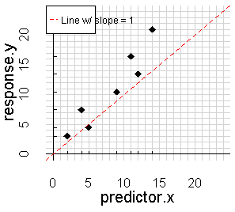
What is the null hypothesis (Ho)?
2)Significance testing
Is the line any different from a flat line?
The slope of flat line = 0
Slope of 0 = no change in y as x changes
Calculate: Standard errors (SE), confidence intervals (CI) t-statistics, F-statistic, p-values

Slide 11


Growth of sugar maple seedlings over time
Height
Time

Slide 12
What is the null hypothesis (Ho)?

Slide 13

What is the null hypothesis (Ho)?

Slide 14
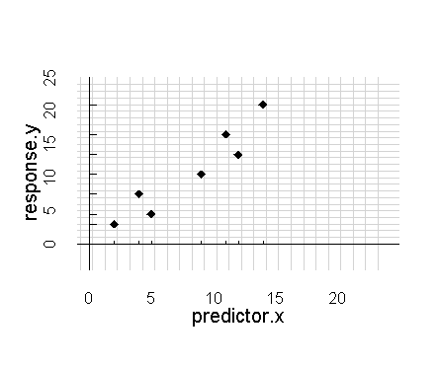
What is the null hypothesis (Ho) when doing regression??
-The null hypothesis is represented by a flat line.
-The slope of a flat line = 0.
-Note: it does NOT matter what the intercept is!
-The null hypothesis doesn’t care what the intercept is.
-For hypothesis testing,
we ignore the intercept
-For prediction, we do look at the intercept

Slide 15
What is the null hypothesis (Ho) when doing regression??
-The null hypothesis is represented by a flat line.
-The slope of a flat line = 0.
-Note: it does NOT matter what the intercept is!
-The null hypothesis doesn’t care what the intercept is.
-For hypothesis testing,
we ignore the intercept
-For prediction, we do look at the intercept
y = 0*x + 12

Slide 16
What is the null hypothesis (Ho) when doing regression??
-The null hypothesis is represented by a flat line.
-The slope of a flat line = 0.
-Note: it does NOT matter what the intercept is!
-The null hypothesis doesn’t care what the intercept is.
-For hypothesis testing,
we ignore the intercept
-For prediction, we do look at the intercept
y = 0*x + 12

Slide 17
What is the null hypothesis (Ho) when doing regression??
-The null hypothesis is represented by a flat line.
-The slope of a flat line = 0.
-Note: it does NOT matter what the intercept is!
-The null hypothesis doesn’t care what the intercept is.
-For hypothesis testing,
we ignore the intercept
-For prediction, we do look at the intercept
y = 0*x + 12

Slide 18
What is the null hypothesis (Ho) when doing regression??
-The null hypothesis is represented by a flat line.
-The slope of a flat line = 0.
-Note: it does NOT matter what the intercept is!
-The null hypothesis doesn’t care what the intercept is.
-For hypothesis testing,
we ignore the intercept
-For prediction, we do look at the intercept
y = 0*x + 12

Slide 19
What is the null hypothesis (Ho) when doing regression??
-The null hypothesis is represented by a flat line.
-The slope of a flat line = 0.
-Note: it does NOT matter what the intercept is!
-The null hypothesis doesn’t care what the intercept is.
-For hypothesis testing,
we ignore the intercept
-For prediction, we do look at the intercept
y = 0*x + 12

Slide 20
What is the null hypothesis (Ho) when doing regression??
-The null hypothesis is represented by a flat line.
-The slope of a flat line = 0.
-Note: it does NOT matter what the intercept is!
-The null hypothesis doesn’t care what the intercept is.
-For hypothesis testing,
we ignore the intercept
-For prediction, we do look at the intercept
y = 0*x + 12

Slide 21
What is the null hypothesis (Ho) when doing regression??
-The null hypothesis is represented by a flat line.
-The slope of a flat line = 0.
-Note: it does NOT matter what the intercept is!
-The null hypothesis doesn’t care what the intercept is.
-For hypothesis testing,
we ignore the intercept
-For prediction, we do look at the intercept
y = 0*x + 12

Slide 22
What is the null hypothesis (Ho) when doing regression??
-The null hypothesis is represented by a flat line.
-The slope of a flat line = 0.
-Note: it does NOT matter what the intercept is!
-The null hypothesis doesn’t care what the intercept is.
-For hypothesis testing,
we ignore the intercept
-For prediction, we do look at the intercept
y = 0*x + 12

Slide 23
What is the null hypothesis (Ho) when doing regression??
-The null hypothesis is represented by a flat line.
-The slope of a flat line = 0.
-Note: it does NOT matter what the intercept is!
-The null hypothesis doesn’t care what the intercept is.
-For hypothesis testing,
we ignore the intercept
-For prediction, we do look at the intercept
y = 0*x + 12

Slide 24
What is the null hypothesis (Ho) when doing regression??
That is, the null hypothesis isn’t really about the intercept, its focus is the slope
Don’t get hung up on what the intercept is – it doesn’t really matter if its “significant” or not
Frequently the intercept will be “significant” but the slope won’t be. This really just means that your data aren’t all zeros
-The null hypothesis is represented by a flat line.
-The slope of a flat line = 0.
-Note: it does NOT matter what the intercept is!
-The null hypothesis doesn’t care what the intercept is.
-For hypothesis testing,
we ignore the intercept
-For prediction, we do look at the intercept
y = 0*x + 12

Slide 25
What is the null hypothesis (Ho) when doing regression??
-The null hypothesis is represented by a flat line.
-The slope of a flat line = 0.
-Note: it does NOT matter what the intercept is!
-The null hypothesis doesn’t care what the intercept is.
-For hypothesis testing,
we ignore the intercept
-For prediction, we do look at the intercept
y = 0*x + 12

Slide 26
What is the null hypothesis (Ho) when doing regression??
-The null hypothesis is represented by a flat line.
-The slope of a flat line = 0.
-Note: it does NOT matter what the intercept is!
-The null hypothesis doesn’t care what the intercept is.
-For hypothesis testing,
we ignore the intercept
-For prediction, we do look at the intercept
y = 0*x + 12

Slide 27
What is the null hypothesis (Ho) when doing regression??
-The null hypothesis is represented by a flat line.
-The slope of a flat line = 0.
-Note: it does NOT matter what the intercept is!
-The null hypothesis doesn’t care what the intercept is.
-For hypothesis testing,
we ignore the intercept
-For prediction, we do look at the intercept
y = 0*x + 12

Slide 28
What is the null hypothesis (Ho) when doing regression??
-The null hypothesis is represented by a flat line.
-The slope of a flat line = 0.
-Note: it does NOT matter what the intercept is!
-The null hypothesis doesn’t care what the intercept is.
-For hypothesis testing,
we ignore the intercept
-For prediction, we do look at the intercept
y = 0*x + 12

Slide 29
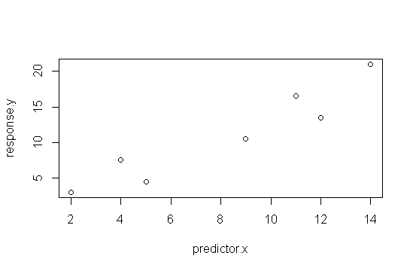
R analysis & hypothesis test of example data
plot(response.y ~ predictor.x, data = df)
ggscatter(y = response.y , x= predictor.x, data = df)

Slide 30
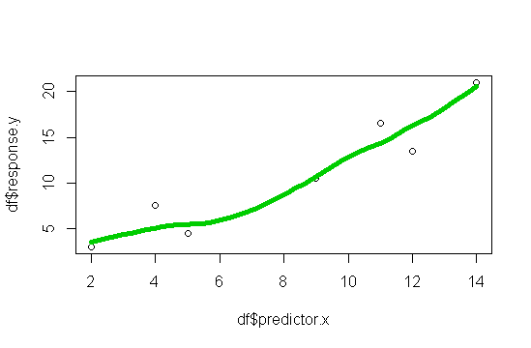
R analysis & hypothesis test of example data
scatter.smooth(df$predictor.x, df$response.y)
ggscatter(…, add = “loess”)
“smoother”
Helps w/ visualization of trends

Slide 31
R analysis & hypothesis test of example data
scatter.smooth(df$predictor.x, df$response.y)
ggscatter(…, add = “loess”)
“smoother”
Helps w/ visualization of trends
“loess” is one of many ways of calculating a smoother

Slide 32
R analysis & hypothesis test of example data
scatter.smooth(df$predictor.x, df$response.y)
ggscatter(…, add = “loess”)
“smoother”
Helps w/ visualization of trends

Slide 33
R analysis & hypothesis test of example data
scatter.smooth(df$predictor.x, df$response.y)
ggscatter(…, add = “loess”)
“smoother”
Helps w/ visualization of trends

Slide 34
R analysis & hypothesis test of example data
scatter.smooth(df$predictor.x, df$response.y)
ggscatter(…, add = “loess”)
“smoother”
Helps w/ visualization of trends
A little curve here, but not much

Slide 35
R analysis & hypothesis test of example data
scatter.smooth(df$predictor.x, df$response.y)
ggscatter(…, add = “loess”)
A smoother with lots of curve indicates a straight line might be a
poor approximation
or “model” of the data
A little curve here, but not much

Slide 36
R analysis & hypothesis test of example data
scatter.smooth(df$predictor.x, df$response.y)
ggscatter(…, add = “loess”)
A smoother with lots of curve indicates a straight line might be a
poor approximation
or “model” of the data
Here, a perfectly straight line isn’t too unrealistic
A little curve here, but not much

Slide 37
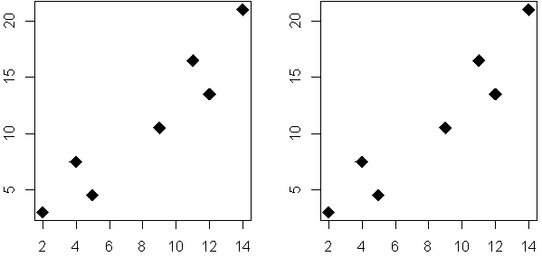
R analysis & hypothesis test of example data
Null hypothesis (Ho):
There is no relationship between y and x
(slope = 0)
Alt hypothesis (Ha):
There is a r between y and x
(slope > 0 or slope < 0)

Slide 38
R analysis & hypothesis test of example data
Null hypothesis (Ho):
There is no relationship between y and x
(slope = 0)
Alt hypothesis (Ha):
There is a r between y and x
(slope > 0 or slope < 0)

Slide 39
R analysis & hypothesis test of example data
Null hypothesis (Ho):
There is no relationship between y and x
(slope = 0)
Alt hypothesis (Ha):
There is a r between y and x
(slope > 0 or slope < 0)
VERY specific

Slide 40
R analysis & hypothesis test of example data
Null hypothesis (Ho):
There is no relationship between y and x
(slope = 0)
Alt hypothesis (Ha):
There is a r between y and x
(slope > 0 or slope < 0)

Slide 41
R analysis & hypothesis test of example data
Null hypothesis (Ho):
There is no relationship between y and x
(slope = 0)
Alt hypothesis (Ha):
There is a r between y and x
(slope > 0 or slope < 0)

Slide 42
R analysis & hypothesis test of example data
Null hypothesis (Ho):
There is no relationship between y and x
(slope = 0)
Alt hypothesis (Ha):
There is a r between y and x
(slope > 0 or slope < 0)

Slide 43
R analysis & hypothesis test of example data
Null hypothesis (Ho):
There is no relationship between y and x
(slope = 0)
Alt hypothesis (Ha):
There is a r between y and x
(slope > 0 or slope < 0)

Slide 44
R analysis & hypothesis test of example data
Null hypothesis (Ho):
There is no relationship between y and x
(slope = 0)
Alt hypothesis (Ha):
There is a r between y and x
(slope > 0 or slope < 0)

Slide 45
Equations:
Null hypothesis (Ho):
There is no relationship between y and x
(slope = 0)
Alt hypothesis (Ha):
There is a r between y and x
(slope > 0 or slope < 0)
y = 0*x + b
y = m*x + b
m≠0

Slide 46
Equations
Null hypothesis (Ho):
There is no relationship between y and x
(slope = 0)
Alt hypothesis (Ha):
There is a r between y and x
(slope > 0 or slope < 0)
y = 0*x + b
y = m*x + b
m≠0

Slide 47
Equations
Null hypothesis (Ho):
There is no relationship between y and x
(slope = 0)
Alt hypothesis (Ha):
There is a r between y and x
(slope > 0 or slope < 0)
y = 0*x + b
y = m*x + b
m≠0

Slide 48

lm( )
anova( )

Slide 49
analysis
Null hypothesis (Ho):
m.null <- lm(y ~ 1, data = dat)
Alt hypothesis (Ha):
m.alt <- lm(y ~ x, data = dat)
anova(m.null, m.alt)
y = 0*x + b
y = m*x + b
m≠0

Slide 50
analysis
Null hypothesis (Ho):
m.null <- lm(y ~ 1, data = dat)
Alt hypothesis (Ha):
m.alt <- lm(y ~ x, data = dat)
anova(m.null, m.alt)
y = 0*x + b
y = m*x + b
m≠0

Slide 51
analysis
Null hypothesis (Ho):
m.null <- lm(y ~ 1, data = dat)
Alt hypothesis (Ha):
m.alt <- lm(y ~ x, data = dat)
anova(m.null, m.alt)
y = 0*x + b
y = m*x + b
m≠0

Slide 52
analysis
Null hypothesis (Ho):
m.null <- lm(y ~ 1, data = dat)
Alt hypothesis (Ha):
m.alt <- lm(y ~ x, data = dat)
anova(m.null, m.alt)
y = 0*x + b
y = m*x + b
m≠0

Slide 53
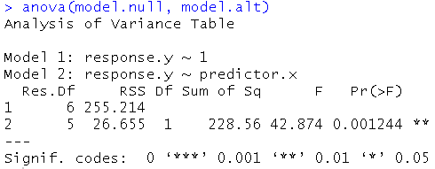
anova() output in R
Our friend F
Test statistic
Ratio of 2 variance
P-value
Is slope significant different than 0?
Stars
“.” marginal
“*” sig
“**” highly sig

Slide 54
anova() output in R
Our friend F
Test statistic
(Ratio of 2 variances)
P-value
Is slope significant different than 0?
Stars
“.” marginal
“*” sig
“**” highly sig

Slide 55
anova() output in R
Our friend F
Test statistic
Ratio of 2 variance
P-value
Is slope significantly different than 0.0?
Stars
“.” marginal
“*” sig
“**” highly sig

Slide 56
anova() output in R
Our friend F
Test statistic
Ratio of 2 variance
P-value
Is slope significant different than 0.0?
Stars
“.” marginal
“*” sig
“**” highly sig

Slide 57
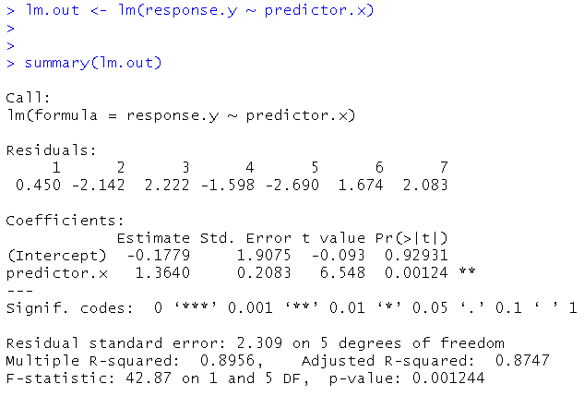
Regression summary() output in R
SE, t, and p:
Is the intercept and/or slope different from zero?
(model.alt)
Coefficients
aka “parameters”
The “m” and “b” of “y = mx + b
y-intercept
slope
df
R²
F statistic

Slide 58
Regression summary() output in R
SE, t, and p:
Is the intercept and/or slope different from zero?
(model.alt)
Coefficients
aka “parameters”
The “m” and “b” of “y = mx + b
y-intercept
slope
df
R²
F statistic

Slide 59
Regression summary() output in R
SE, t, and p:
Is the intercept and/or slope different from zero?
(model.alt)
Coefficients
aka “parameters”
The “m” and “b” of “y = mx + b
y-intercept
slope
df
R²
F statistic

Slide 60
Regression summary() output in R
SE, t, and p:
Is the intercept and/or slope different from zero?
(model.alt)
Coefficients
aka “parameters”
The “m” and “b” of “y = mx + b
y-intercept
slope
df
R²
F statistic

Slide 61
Regression summary() output in R
SE, t, and p:
Is the intercept and/or slope different from zero?
(model.alt)
Coefficients
aka “parameters”
The “m” and “b” of “y = mx + b
y-intercept
slope
df
R²
F statistic

Slide 62
Regression summary() output in R
SE, t, and p:
Is the intercept and/or slope different from zero?
(model.alt)
Coefficients
aka “parameters”
The “m” and “b” of “y = mx + b
y-intercept
slope
df
R²
F statistic

Slide 63
Regression summary() output in R
SE, t, and p:
Is the intercept and/or slope different from zero?
(model.alt)
Coefficients
aka “parameters”
The “m” and “b” of “y = mx + b
y-intercept
slope
df
R²
F statistic
(test statistic)

Slide 64
Regression summary() output in R
SE, t, and p:
Is the intercept and/or slope different from zero?
(model.alt)
Coefficients
aka “parameters”
The “m” and “b” of “y = mx + b
y-intercept
slope
df
R²
F statistic

Slide 65
Regression summary() output in R
SE, t, and p:
Is the intercept and/or slope different from zero?
(model.alt)
Coefficients
aka “parameters”
The “m” and “b” of “y = mx + b
y-intercept
slope
df
R²
F statistic

Slide 66
Regression summary() output in R
SE, t, and p:
Is the intercept and/or slope different from zero?
(model.alt)
Coefficients
aka “parameters”
The “m” and “b” of “y = mx + b
y-intercept
slope
df
R²
F statistic

Slide 67
SE
t
p

Slide 68
SE
t
p
Coefficients
aka “parameters”
The “m” and “b” of “y = mx + b
Information related to significance testing of model & parameters
Equation for this line
(aka, the model we have fit)
y = 1.36*x + -0.18
(note that I rounded!)

Slide 69
SE
t
p
b =
m =
Coefficients
aka “parameters”
The “m” and “b” of “y = mx + b
Information related to significance testing of model & parameters
Equation for this line
(aka, the model we have fit)
y = 1.36*x + -0.18
(note that I rounded!)

Slide 70
SE
t
p
b =
m =
Coefficients
aka “parameters”
The “m” and “b” of “y = mx + b
Information related to significance testing of model & parameters
In particular, we are interested in the information about the SLOPE
Equation for this line
(aka, the model we have fit)
y = 1.36*x + -0.18
(note that I rounded!)

Slide 71
SE
t
p
b =
m =
Coefficients
aka “parameters”
The “m” and “b” of “y = mx + b
Equation for this line
(aka, the model we have fit)
y = 1.36*x + -0.18
(note that I rounded!)

Slide 72
SE
t
p
b =
m =
Coefficients
aka “parameters”
The “m” and “b” of “y = mx + b
Equation for this line
(aka, the model we have fit)
y = 1.36*x + -0.18
(note that I rounded!)

Slide 73
SE
t
p
b =
m =
Coefficients
aka “parameters”
The “m” and “b” of “y = mx + b
Equation for this line
(aka, the model we have fit)
y = 1.36*x + -0.18
(note that I rounded!)

Slide 74
SE
t
p
b =
No very interested in intercept
m =
Coefficients
aka “parameters”
The “m” and “b” of “y = mx + b
Information related to significance testing of model & parameters
In particular, we are interested in the information about the SLOPE
Equation for this line
(aka, the model we have fit)
y = 1.36*x + -0.18
(note that I rounded!)

Slide 75
SE
t
p
b =
No very interested in intercept
m =
Coefficients
aka “parameters”
The “m” and “b” of “y = mx + b
Information related to significance testing of model & parameters
In particular, we are interested in the information about the SLOPE
Equation for this line
(aka, the model we have fit)
y = 1.36*x + -0.18
(note that I rounded!)

Slide 76
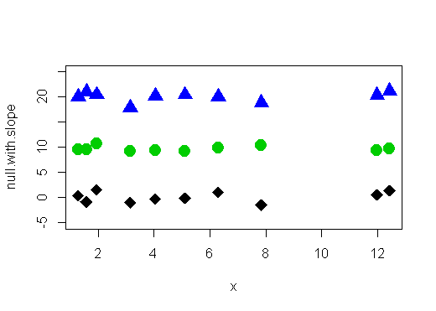
3 sets of data
Would we reject the null for any of them?
y = 0*x + 20
y = 0*x + 10
y = 0*x + 0

Slide 77
3 sets of data
Would we reject the null for any of them?
y = 0*x + 20
y = 0*x + 10
y = 0*x + 0

Slide 78
3 sets of data
Would we reject the null for any of them?
y = 0*x + 20
y = 0*x + 10
y = 0*x + 0

Slide 79
3 sets of data
Would we reject the null for any of them?
y = 0*x + 20
y = 0*x + 10
y = 0*x + 0

Slide 80
3 sets of data
Would we reject the null for any of them?
y = 0*x + 20
y = 0*x + 10
y = 0*x + 0

Slide 81
3 sets of data
Would we reject the null for any of them?
y = 0*x + 20
y = 0*x + 10
y = 0*x + 0

Slide 82
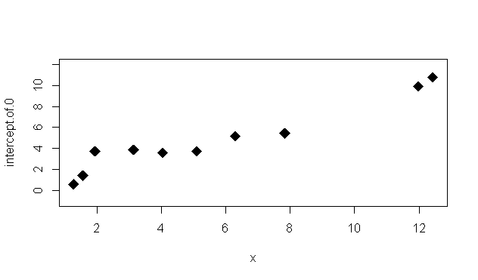
Even if intercept is 0, we reject the null if slope is different from zero

Slide 83
Even if intercept is 0, we reject the null if slope is different from zero

Slide 84
What’s the rest of this stuff for?
SE
t
p
SE for slope:
Tells us about how precise our estimate of the slope is.
t-statistics:
The test statistics
Used to calculate p
p-value for slope:
is it sig different from zero

Slide 85
What’s the rest of this stuff for?
SE
t
p
SE for slope:
Tells us about how precise our estimate of the slope is.
t-statistics:
The test statistics
Used to calculate p
p-value for slope:
is it sig different from zero

Slide 86
What’s the rest of this stuff for?
SE
t
p
Small SE for slope:
We can be confident that the value R is telling is likely close to the real value
(real value = how nature really works)
However – there’s always that chance that our data are not typical of the system!
SE for slope:
Tells us about how precise our estimate of the slope is.
t-statistics:
The test statistics
Used to calculate p
p-value for slope:
is it sig different from zero

Slide 87
What’s the rest of this stuff for?
SE
t
p
1.96*SE = approx. 95% conf. interval
0.21*1.96 = 0.41
1.36 – 0.41 = 0.95
1.36 + 0.41 = 1.77
Non-technical interpretation:
Plausible range for slope: 0.95 to 1.77
SE for slope:
Tells us about how precise our estimate of the slope is.
t-statistics:
The test statistics
Used to calculate p
p-value for slope:
is it sig different from zero

Slide 88
What’s the rest of this stuff for?
SE
t
p
1.96*SE = approx. 95% conf. interval
0.21*1.96 = 0.41
1.36 – 0.41 = 0.95
1.36 + 0.41 = 1.77
Non-technical interpretation:
Plausible range for slope: 0.95 to 1.77
SE for slope:
Tells us about how precise our estimate of the slope is.
t-statistics:
The test statistics
Used to calculate p
p-value for slope:
is it sig different from zero

Slide 89
What’s the rest of this stuff for?
SE
t
p
1.96*SE = approx. 95% conf. interval
0.21*1.96 = 0.41
1.36 – 0.41 = 0.95
1.36 + 0.41 = 1.77
Non-technical interpretation:
Plausible range for slope: 0.95 to 1.77
SE for slope:
Tells us about how precise our estimate of the slope is.
t-statistics:
The test statistics
Used to calculate p
p-value for slope:
is it sig different from zero

Slide 90
What’s the rest of this stuff for?
SE
t
p
1.96*SE = approx. 95% conf. interval
0.21*1.96 = 0.41
1.36 – 0.41 = 0.95
1.36 + 0.41 = 1.77
Non-technical interpretation:
Plausible range for slope: 0.95 to 1.77
SE for slope:
Tells us about how precise our estimate of the slope is.
t-statistics:
The test statistics
Used to calculate p
p-value for slope:
is it sig different from zero

Slide 91
What’s the rest of this stuff for?
SE
t
p
SE for slope:
Tells us about how precise our estimate of the slope is.
t-statistics:
The test statistics
Used to calculate p
p-value for slope:
is it sig different from zero

Slide 92
What’s the rest of this stuff for?
SE
t
p
SE for slope:
Tells us about how precise our estimate of the slope is.
t-statistics:
The test statistics
Used to calculate p
p-value for slope:
is it sig different from zero

Slide 93
What’s the rest of this stuff for?
SE
t
p
SE for slope:
Tells us about how precise our estimate of the slope is.
t-statistics:
The test statistics
Used to calculate p
p-value for slope:
is it sig different from zero?

Slide 94
What’s the rest of this stuff for?
SE
t
p
What is the technical interpretation of p = 0.00124?
p-value for slope:
is it sig different from zero?

Slide 95
What’s the rest of this stuff for?
SE
t
p
What is the technical interpretation of
p = 0.00124?
If the null hypothesis was indeed true,
the probability of getting data with a slope steeper than 1.36 is 0.0012
p-value for slope:
is it sig different from zero?

Slide 96
What’s the rest of this stuff for?
1.36 – 0.41 = 0.95
1.36 + 0.41 = 1.77
SE
2
1
summary() gives you two SEs for the 2 parameters that make up the regression equation
This can be visualized as a point representing the parameter &
error bars around it
0

Slide 97
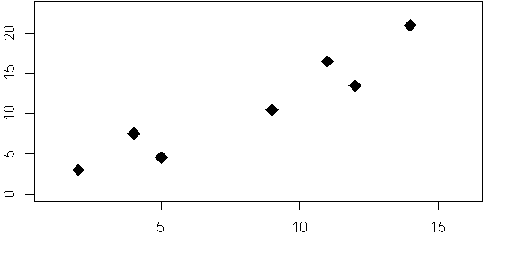
Can also use these 2 separate SE / 95%CI to create a confidence “band” around the entire regression line

Slide 98
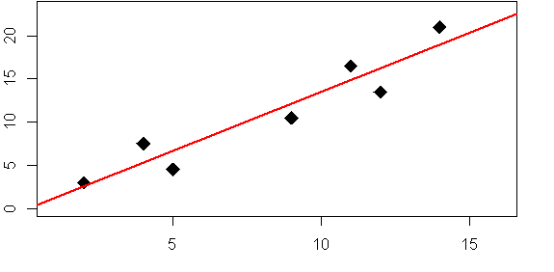
Can also use these 2 separate SE / 95%CI to create a confidence “band” around the entire regression line

Slide 99
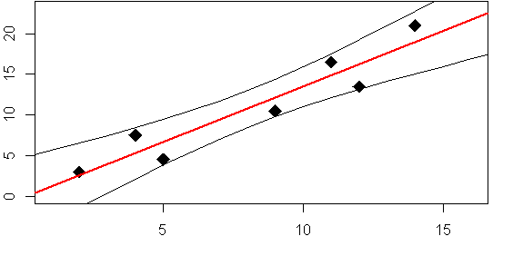

Slide 100
“95% Confidence band”
Plausible region where line representing true relationship should be
Based on SE of slope AND intercept

Slide 101
“95% Confidence band”
Plausible region where line representing true relationship should be
Based on SE of slope AND intercept

Slide 102
“95% Confidence band”
Plausible region where line representing true relationship should be
Based on SE of slope AND intercept

Slide 103
“95% Confidence band”
Plausible region where line representing true relationship should be
Based on SE of slope AND intercept

Slide 104
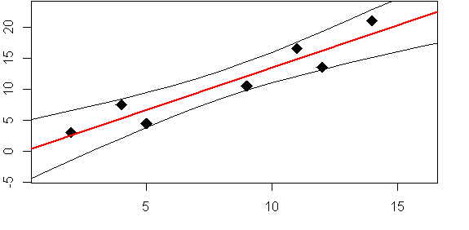
True intercept could be between 5 and -5

Slide 105
True regression line could plausibly be anywhere within this band

Slide 106
True regression line could plausibly be anywhere within this band

Slide 107
True regression line could plausibly be anywhere within this band
…and can’t rule out that the true line is outside of it!

Slide 108
True regression line could plausibly be anywhere within this band
…and can’t rule out that the true line is outside of it!

