Slide 1
Lecture 25: Regression Inference

Slide 2
3 Major steps in regression analysis
1)Model fitting
2)Significance testing
3)Model Checking
What line fits the data best?
This class:
“least squares”
Advanced regression: “maximum likelihood”
Calculate 2 things:
Intercept of line
Slope of line
There are equations that provide the exact solution
Can also do with a ruler
Is the line any different from a flat line?
The slope of flat line = 0
Slope of 0 = no change in y as x changes
Calculate: Standard errors (SE), confidence intervals (CI) t-statistics, F-statistic, p-values
aka “residual analysis”
aka“ “model diagnostics”
Do the data meet the assumptions of the model
Random & Independent sampling, Normality, constant variance
Requires plotting the residuals (errors)

Slide 3
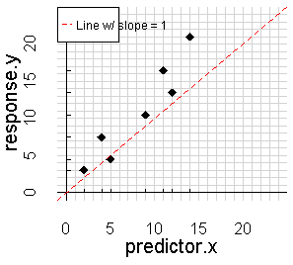
What is the null hypothesis (Ho)?
2)Significance testing
Is the line any different from a flat line?
The slope of flat line = 0
Slope of 0 = no change in y as x changes
Calculate: Standard errors (SE), confidence intervals (CI) t-statistics, F-statistic, p-values

Slide 4
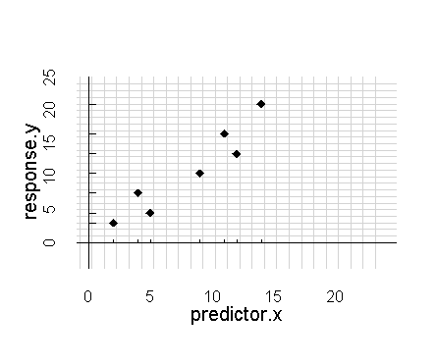
What is the null hypothesis (Ho) when doing regression??
-The null hypothesis is represented by a flat line.
-The slope of a flat line = 0.
-Note: it does NOT matter what the intercept is!
-The null hypothesis doesn’t care what the intercept is.
-For hypothesis testing,
we ignore the intercept
-For prediction, we do look at the intercept

Slide 5
What is the null hypothesis (Ho) when doing regression??
That is, the null hypothesis isn’t really about the intercept, its focus is the slope
Don’t get hung up on what the intercept is – it doesn’t really matter if its “significant” or not
Frequently the intercept will be “significant” but the slope won’t be. This really just means that your data aren’t all zeros
-The null hypothesis is represented by a flat line.
-The slope of a flat line = 0.
-Note: it does NOT matter what the intercept is!
-The null hypothesis doesn’t care what the intercept is.
-For hypothesis testing,
we ignore the intercept
-For prediction, we do look at the intercept
y = 0*x + 12

Slide 6
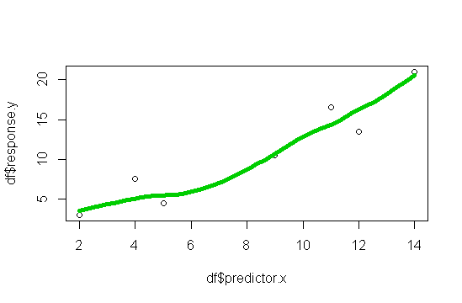
R analysis & hypothesis test of example data
scatter.smooth(df$predictor.x, df$response.y)
ggscatter(…, add = “loess”)
“smoother”
Helps w/ visualization of trends

Slide 7
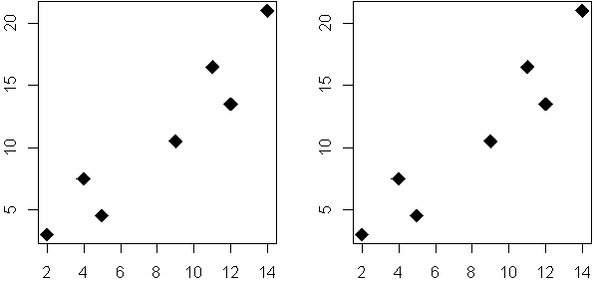
R analysis & hypothesis test of example data
Null hypothesis (Ho):
There is no relationship between y and x
(slope = 0)
Alt hypothesis (Ha):
There is a r between y and x
(slope > 0 or slope < 0)

Slide 8

analysis
Null hypothesis (Ho):
m.null <- lm(y ~ 1, data = dat)
Alt hypothesis (Ha):
m.alt <- lm(y ~ x, data = dat)
anova(m.null, m.alt)
y = 0*x + b
y = m*x + b
m≠0

Slide 9
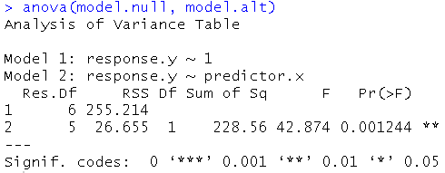
anova() output in R
Our friend F
Test statistic
Ratio of 2 variance
P-value
Is slope significant different than 0?
Stars
“.” marginal
“*” sig
“**” highly sig

Slide 10
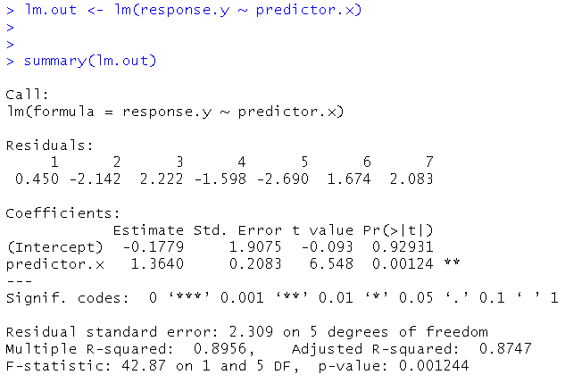
Regression summary() output in R
SE, t, and p:
Is the intercept and/or slope different from zero?
(model.alt)
Coefficients
aka “parameters”
The “m” and “b” of “y = mx + b
y-intercept
slope
df
R²
F statistic

Slide 11
SE
t
p
Coefficients
aka “parameters”
The “m” and “b” of “y = mx + b
Information related to significance testing of model & parameters
Equation for this line
(aka, the model we have fit)
y = 1.36*x + -0.18
(note that I rounded!)

Slide 12
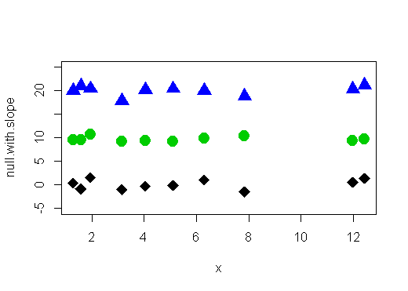
3 sets of data
Would we reject the null for any of them?
y = 0*x + 20
y = 0*x + 10
y = 0*x + 0

Slide 13
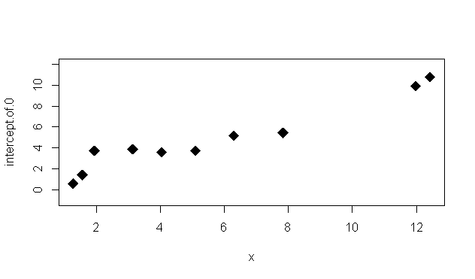
Even if intercept is 0, we reject the null if slope is different from zero

Slide 14
What’s the rest of this stuff for?
SE
t
p
SE for slope:
Tells us about how precise our estimate of the slope is.
t-statistics:
The test statistics
Used to calculate p
p-value for slope:
is it sig different from zero

Slide 15
What’s the rest of this stuff for?
SE
t
p
Small SE for slope:
We can be confident that the value R is telling is likely close to the real value
(real value = how nature really works)
However – there’s always that chance that our data are not typical of the system!
SE for slope:
Tells us about how precise our estimate of the slope is.
t-statistics:
The test statistics
Used to calculate p
p-value for slope:
is it sig different from zero

Slide 16
What’s the rest of this stuff for?
SE
t
p
1.96*SE = approx. 95% conf. interval
0.21*1.96 = 0.41
1.36 – 0.41 = 0.95
1.36 + 0.41 = 1.77
Non-technical interpretation:
Plausible range for slope: 0.95 to 1.77
SE for slope:
Tells us about how precise our estimate of the slope is.
t-statistics:
The test statistics
Used to calculate p
p-value for slope:
is it sig different from zero

Slide 17
What’s the rest of this stuff for?
SE
t
p
SE for slope:
Tells us about how precise our estimate of the slope is.
t-statistics:
The test statistics
Used to calculate p
p-value for slope:
is it sig different from zero

Slide 18
What’s the rest of this stuff for?
SE
t
p
SE for slope:
Tells us about how precise our estimate of the slope is.
t-statistics:
The test statistics
Used to calculate p
p-value for slope:
is it sig different from zero

Slide 19
What’s the rest of this stuff for?
SE
t
p
What is the technical interpretation of p = 0.00124?
p-value for slope:
is it sig different from zero?

Slide 20
What’s the rest of this stuff for?
SE
t
p
What is the technical interpretation of
p = 0.00124?
If the null hypothesis was indeed true,
the probability of getting data with a slope steeper than 1.36 is 0.0012
p-value for slope:
is it sig different from zero?

Slide 21
What’s the rest of this stuff for?
1.36 – 0.41 = 0.95
1.36 + 0.41 = 1.77
SE
2
1
summary() gives you two SEs for the 2 parameters that make up the regression equation
This can be visualized as a point representing the parameter &
error bars around it
0

Slide 22
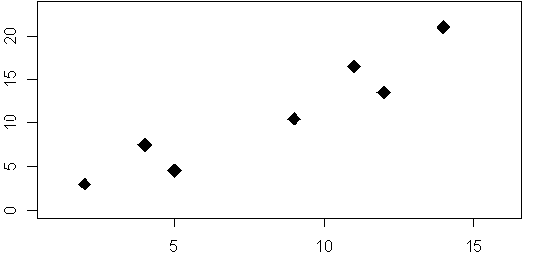
Can also use these 2 separate SE / 95%CI to create a confidence “band” around the entire regression line

Slide 23
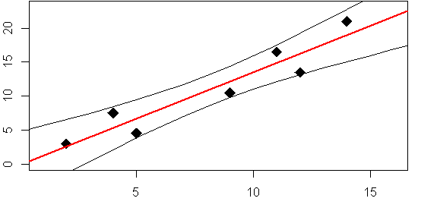
“95% Confidence band”
Plausible region where line representing true relationship should be
Based on SE of slope AND intercept

Slide 24
“95% Confidence band”
Plausible region where line representing true relationship should be
Based on SE of slope AND intercept

Slide 25
“95% Confidence band”
Plausible region where line representing true relationship should be
Based on SE of slope AND intercept

Slide 26
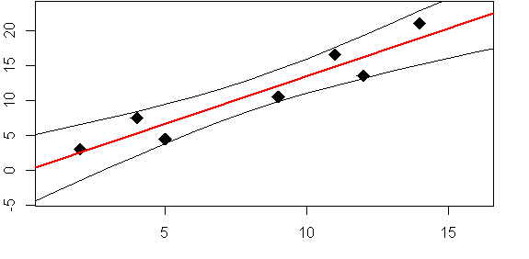
True intercept could be between 5 and -5

Slide 27
True regression line could plausibly be anywhere within this band
…and can’t rule out that the true line is outside of it!

