Slide 1
Lecture: Regression walkthrough & model checking
11/21/2016

Slide 2
3 Major steps in regression analysis
1)Model fitting
2)Significance testing
3)Model Checking
What line fits the model best?
This class: “least squares”
Advanced regression: “maximum likelihood”
Calculate 2 things:
Intercept of line
Slope of line
There are equations that provide the exact solution
We did by hand w/ruler just for illustration
Is the line any different from a flat line?
The slope of flat line = 0
Slope of 0 = no change in y as x changes
Calcualte: Standard errors (SE), confidence intervals (CI) t-statistics, F-statistic, p-values
aka “residual analysis”
aka“ “model diagnostics”
Do the data meet the assumptions of the model
Random & Independent sampling, Normality, constant variance
Requires plotting the residuals (errors)

Slide 3
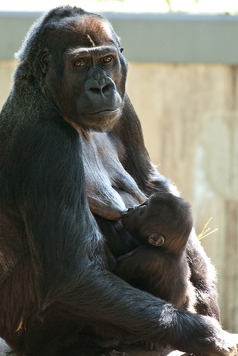
Case Study
Evolution of nutritional value of milk
Does evolutionary change in body size impact fat content of milk

Slide 4

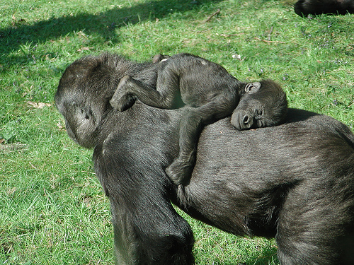
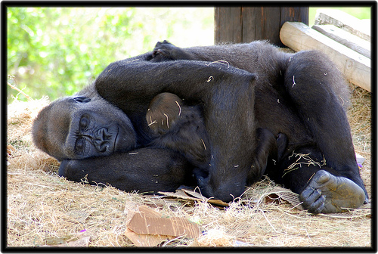
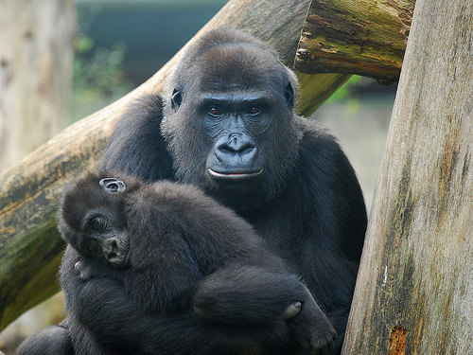

Slide 5
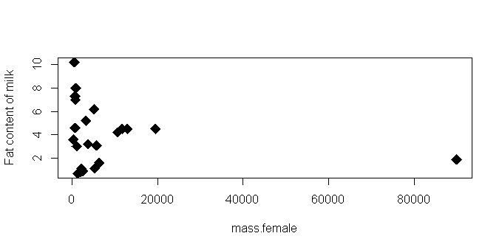
Fat in milk vs mass of primate (raw data)

Slide 6
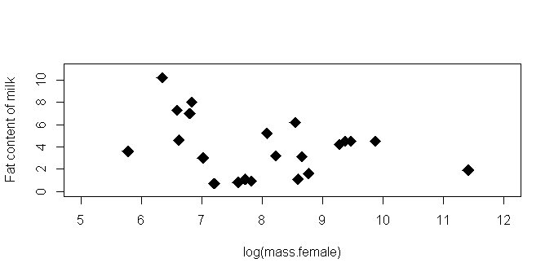
Fat in milk vs log(mass of primate)

Slide 7
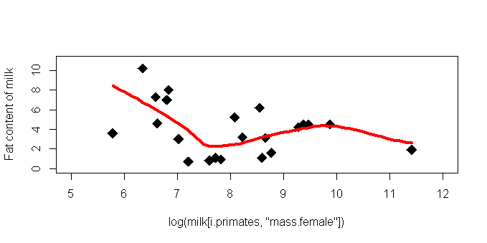

Slide 8
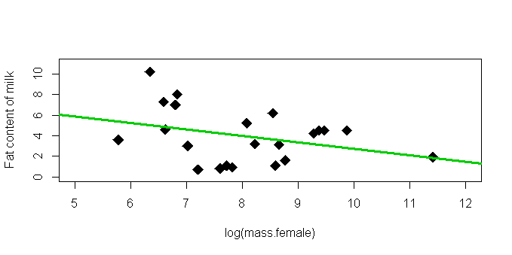

Slide 9
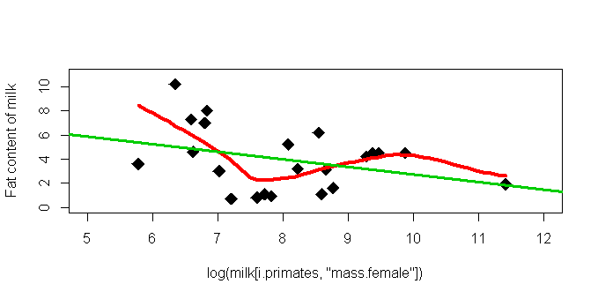

Slide 10
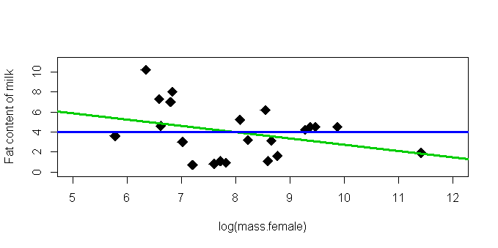

Slide 11
What is an appropriate “word equation” for each line?

Slide 12
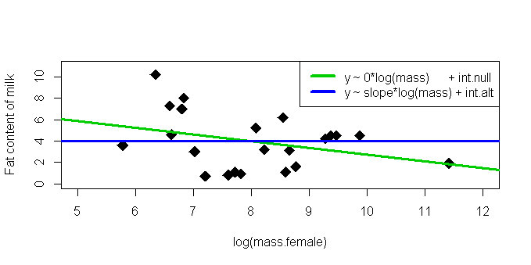
What is an appropriate “word equation” for each line?

Slide 13
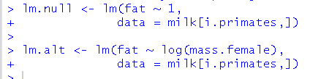
Code to run models

Slide 14
What process in regression modeling is this code doing?

Slide 15
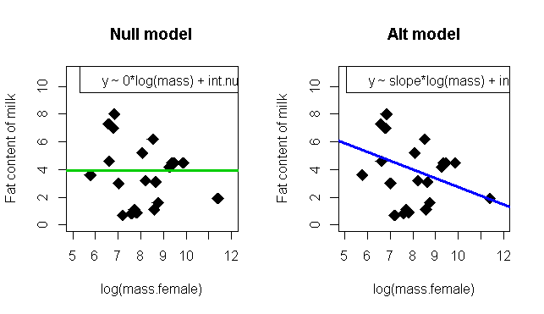

Slide 16
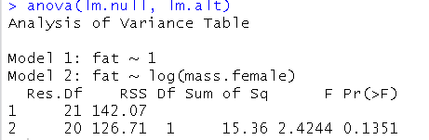

Slide 17
What process in regression modeling is this code doing?

Slide 18
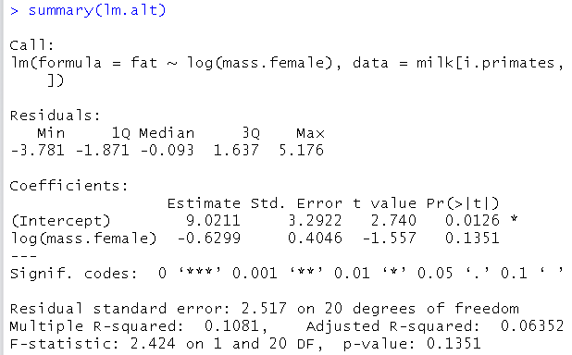

Slide 19
y = slope*log(mass.female) + int.a
y = -0.63*log(mass.female) + 9.02
How do we interpret this equation?
What is the biological mean of the
-intercept?
-slope?

Slide 20
y = slope*log(mass.female) + int.a
y = -0.63*log(mass.female) + 9.02
How do we interpret this equation?
What is the biological mean of the
-intercept?
-slope?

Slide 21
Assumptions of regression: easier version (this will be on the test!) (the harder version will also be on the test!)
1) ___________________
2) The relationship between y and x is __________________
3) V ariance in the response variables (y) _________________
4) The __________of the model are ________________.

Slide 22
Assumptions of regression: easier version (this will be on the test!) (the harder version will also be on the test!)
1) Random sampling
2) The relationship between y and x is fundamentally linear
3) Variance in the response variables (y) does NOT change as x changes
4) The residuals of the model are normally distributed.

Slide 23
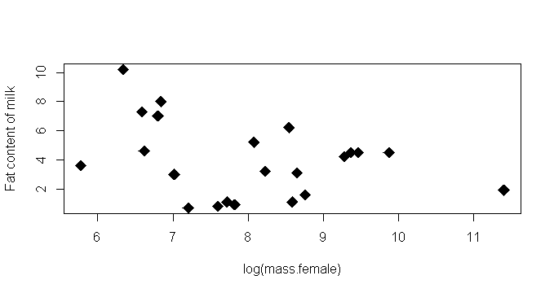

Slide 24
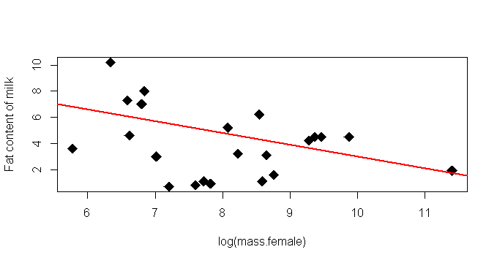

Slide 25
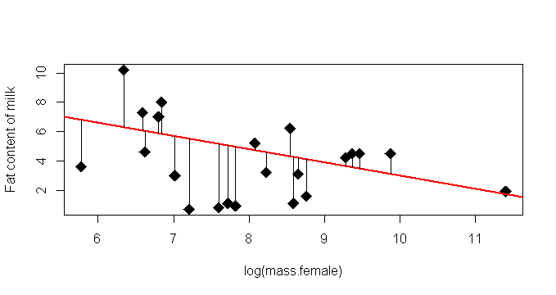

Slide 26
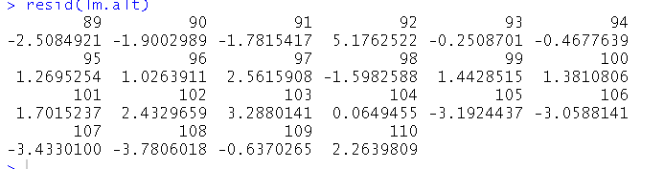
Getting residuals in R

Slide 28
Assumptions of regression: easier version (this will be on the test!) (the harder version will also be on the test!)
3) Variance in the response variables (y) does NOT change as x changes
4) The residuals of the model are normally distributed.

Slide 29
Assumptions of regression: easier version (this will be on the test!) (the harder version will also be on the test!)
3) Variance in the response variables (y) does NOT change as x changes
4) The residuals of the model are normally distributed.

Slide 30
Normality of residuals (I will ask you about this on the test)

Slide 31

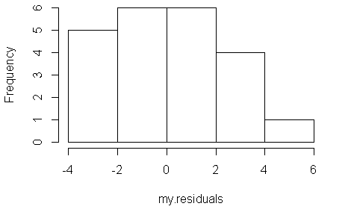
Normality of residuals (I will ask you about this on the test)

Slide 32
Normality of residuals (I will ask you about this on the test)
Where is the mean?
Why does this matter?

Slide 33
What would non-normal residuals look like?

Slide 34
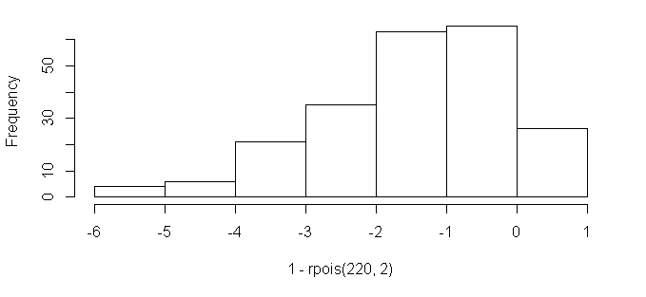
What would non-normal residuals look like?

Slide 35
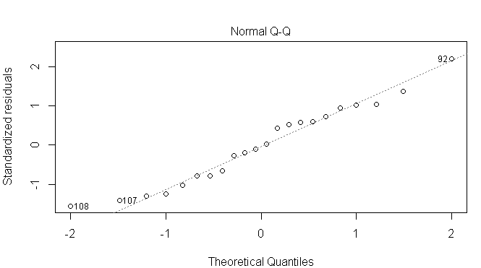
More formal check for normality: QQ plot

Slide 36
What is this step in regression analysis called?

Slide 37
What is this step in regression analysis called?
1)Model fitting
2)Significance testing
3)Model Checking
aka “residual analysis”
aka “model diagnostics”

Slide 38
Assumptions of regression: easier version (this will be on the test!) (the harder version will also be on the test!)
3) Variance in the response variables (y) does NOT change as x changes
4) The residuals of the model are normally distributed.

Slide 39
Assumptions of regression: easier version (this will be on the test!) (the harder version will also be on the test!)
3) Variance in the response variables (y) does NOT change as x changes
4) The residuals of the model are normally distributed.
All things considered, this is NOT the most important assumption
(this WILL be on the test)

Slide 40
Assumptions of regression: easier version (this will be on the test!) (the harder version will also be on the test!)
3) Variance in the response variables (y) does NOT change as x changes
4) The residuals of the model are normally distributed.

Slide 41
Assumptions of regression: easier version (this will be on the test!) (the harder version will also be on the test!)
3) Variance in the response variables (y) does NOT change as x changes
4) The residuals of the model are normally distributed.
THIS IS EXTREMELY IMPORTANT AND OFTEN IGNORED !!!!

Slide 42
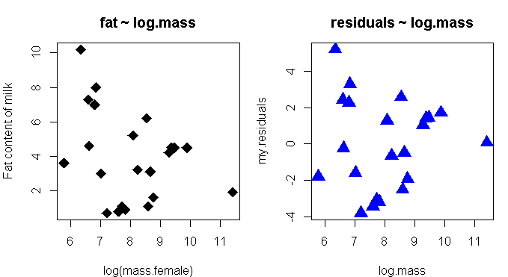

Slide 45
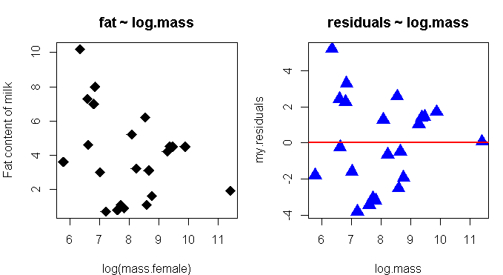

Slide 46
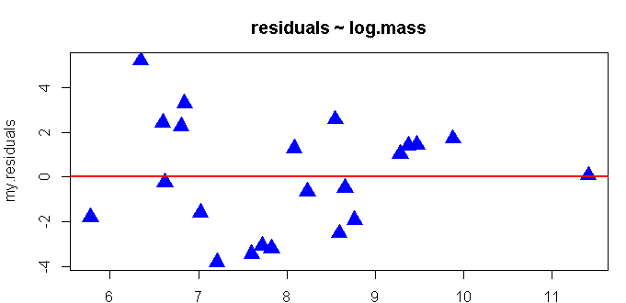
“Variance in the response variables (y) does NOT change as x changes”
(“constancy of variance” assumption)
Residuals
(NOT raw data)
Log(female mass)
(raw data)

Slide 47
“Variance in the response variables (y) does NOT change as x changes”
(“constancy of variance” assumption)
Residuals
(NOT raw data)
Log(female mass)
(raw data)

Slide 48
“Variance in the response variables (y) does NOT change as x changes”
(“constancy of variance” assumption)
Residuals
(NOT raw data)
Log(female mass)
(raw data)

Slide 49
When the variance of y vs. x is not constant, the residuals of the model plotted against y will have a _______________.
Residuals
(NOT raw data)
Log(female mass)
(raw data)

Slide 50
When the variance of y vs. x is not constant, the residuals of the model plotted against y will have a _______________.
Residuals
(NOT raw data)
Log(female mass)
(raw data)

Slide 51
When the variance of y vs. x is not constant, the residuals of the model plotted against y will have a triangle shape.
Residuals
(NOT raw data)
Log(female mass)
(raw data)

Slide 52
When the variance of y vs. x is not constant, the residuals of the model plotted against y will have a triangle shape.
Good test question, huh?
Residuals
(NOT raw data)
Log(female mass)
(raw data)

Slide 53

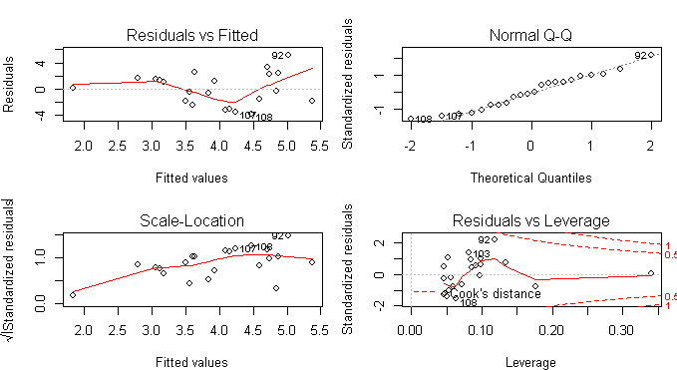
Easy residual plots in R

Slide 54
Easy residual plots in R

Slide 55
Easy residual plots in R

Slide 56
Easy residual plots in R

Slide 57
Easy residual plots in R

Slide 58
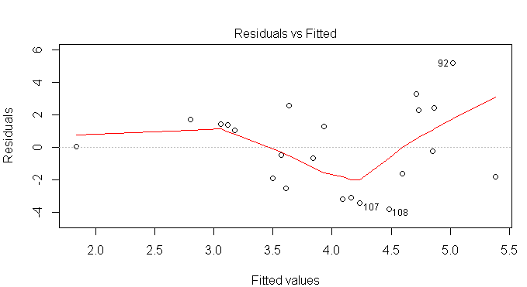
Easy residual plots in R

Slide 59
Easy residual plots in R
“Fitted” values
Aka “predictions from the model equation”

Slide 60
Easy residual plots in R
“Fitted” values
Aka “predictions from the model equation”

Slide 61
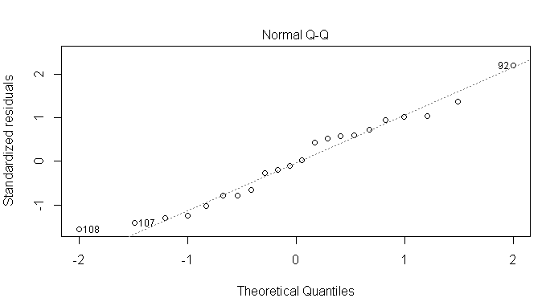
QQ plot: check normality of residuals

Slide 62
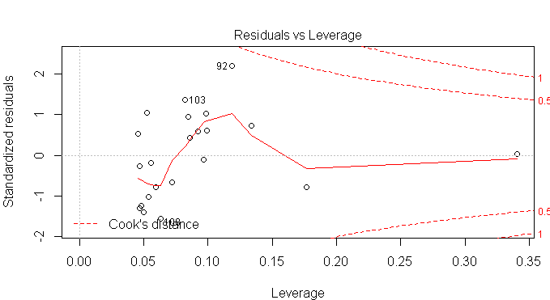
“Leverage” plot: look for outliers & influential points

