Slide 1
The real world
= ?
Conclusion
Biological inference
Statistical inference
Statistical results
Data visualization of model
Question,
Theory,
Hypothesis,
Data need
Can be very different!
Statistical analysis / model
Data visualization of raw data
Experimental design / sampling protocol
Dataframe for analysis
Study system / location
Stuff to measure (components, traits, responses)
Measurements
Datasheets
Spreadsheet
Resolution of instruments
Error
Natural variation
Can’t measure everything

Slide 2

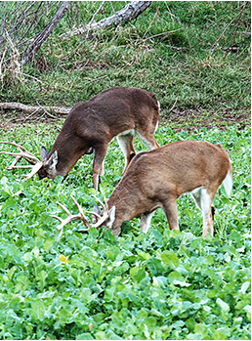
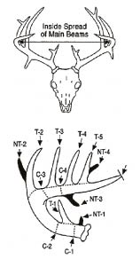
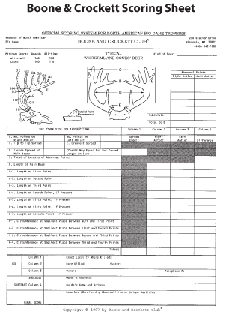


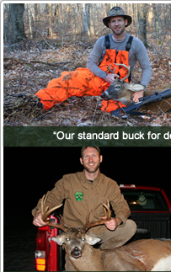
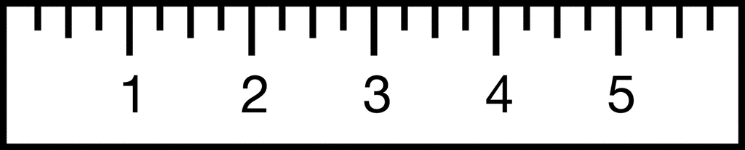
The real world
What we measure
What we record
What we enter
Space
Season
Evolution
Year
-spreadsheet organization
For accurate/fast entry and
Data archiving
-spreadsheet organization for
Moving data into analysis
software
-datasheet organization
For accurate/fast entry and
Data archiving
-accurate data recording
-Converting real world variation
Into linear measurements
-measurement error
-resolution of measurement
-converting continuous variation
To discrete
Experimental/study design
treatments and controls
Positive controls

Slide 3
Ecology + Statistics =
Ecological Statistics
Quantitative Ecology
(G)LMM ecology
Statistical Ecology
Often community ecologists? Legendre
Wildlife ecologists, demographers, biogeographers (Maxent)
Mark recapture
Occupancy analysis
AIC
Maxent (and alternatives)
Burnham & Anderson
21st-century trained ecologists (and their advisors)
What would Ben Bolker Do? Zuur et al 2010. Cronies
A philosophy which I might be the only person to subscribe to

