Slide 2
Sub-sampling

Slide 3
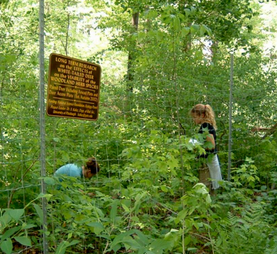
Pseudoreplication

Slide 4
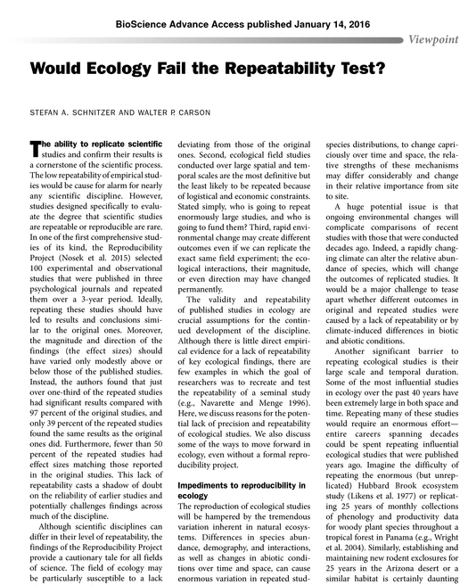
Quasi-replication

