Slide 2
Experimental Context:
How much natural variation?
Survival of fawns to first breeding
In the field
Environmental Variation
In the lab
Biological variation
Ecological
variation
Biological Variation
Field experiment
-cosm

Slide 3
Number of Experimental treatments
Non-experimental, observational
None
One
Many

Slide 4
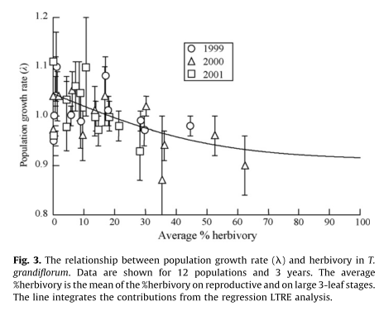
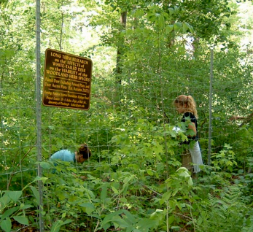
Is causality correct?

