Slide 1
ANOVA & Multiple comparisons with no correction

Slide 2
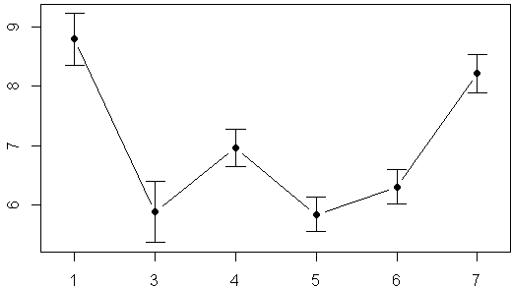
Canopy closure above 6 forest plots
More light
How open is canopy at each plot?
Less light
Error bars = 95%CI
Plot 1
Plot Number

Slide 3
Canopy closure above 7 forest plots
More light
Should I use consider these planned or un-planned?
How open is canopy at each plot?
Less light
Error bars = 95%CI
Plot 1
Plot Number

Slide 4
Canopy closure above 7 forest plots
Should I use consider these planned or un-planned?
1)Experiment was not designed to test this question
2)Am going to carry out all possible comparisons
More light
How open is canopy at each plot?
Less light
Error bars = 95%CI
Plot 1
Plot Number

Slide 5
Example analysis: Canopy openness multiple comparisons
R tools
lm()
anova()
pairwise.t.test()

Slide 6
4 steps
1) Fit models w/ lm()
2) Compare models with anova()
3) Evaluate models (interpret p-value)
4) Pairwise comparisons w/ pairwise.t.test(), p.adjusted = “none”
4a) uncorrected
4b) corrected

Slide 7
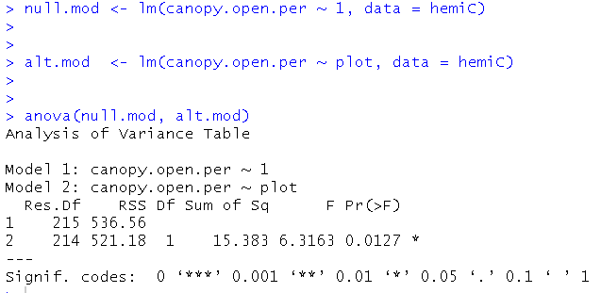
Example analysis: Canopy openness multiple comparisons
Step 3: evaluate models (omnibus test)
3
Interpretation
At least 1 pair of means differ

Slide 8
Example analysis: Canopy openness multiple comparisons
Step 3: evaluate models (omnibus test)
3
Interpretation
At least 1 pair of means differ

Slide 9
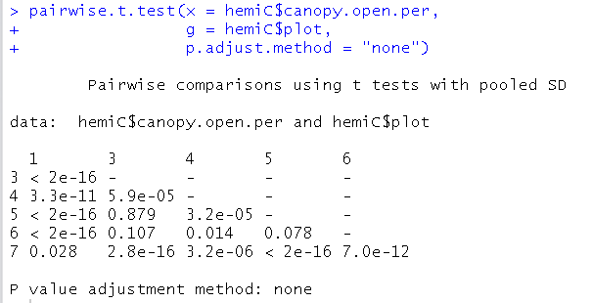
Example analysis: Canopy openness multiple comparisons
Step 4 vs1: pairwise comparisons, NO correction for multiple comparisons
4
X: the numeric data
g: the column
w/grouping
Info it in
p.adjust.method: method for correcting p-values for multiple-comparisons
“none” = “don’t correct”

Slide 10
Example analysis: Canopy openness multiple comparisons
Step 4 vs 1: pairwise comparisons, NO correction for multiple comparisons
-P-values for each & every comparison
-R doesn’t have a way (I know of) of just giving you any planned comparisons
-these are NOT corrected &
therefore we risk a Type I error

Slide 11
Example analysis: Canopy openness multiple comparisons
Step 4 vs 1: pairwise comparisons, NO correction for multiple comparisons
use of the “pooled” SD: makes this a “modified” t-test

