Slide 1
ANOVA & Multiple comparisons with corrections Bonferonni

Slide 2
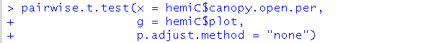
Example analysis: Canopy openness multiple comparisons
Step 4 vs 2: pairwise comparisons, WITH CORRECTION for multiple comparisons

Slide 3
Example analysis: Canopy openness multiple comparisons
Step 4 vs 2: pairwise comparisons, WITH CORRECTION for multiple comparisons
-We could change this setting to one of several methods for adjusting p-values
-But, pairwise.t.test() only gives p-values, not test-statistics or effect sizes
-p-values by themselves do not provide the whole picture
-It also doesn’t allow the method that is used in the book / common in ecology: Tukey-Kramer / Tukey’s HSD

Slide 4

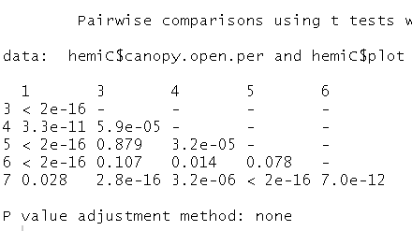
“Bonferonni correction”
(Interleaf 8, pg 457)

Slide 5
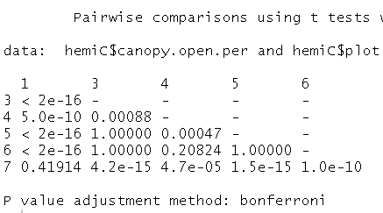

“Bonferonni correction”
(Interleaf 8, pg 457)
-Once very commonly used
-Is VERY conservative
-Can be implemented by
a) ↑ p-values
Fewer are < 0.05, fewer significant
This is what pairwise.t.test() does
b) ↓alpha (α)
New alpha = 0.05 ÷ (# of tests)
Instead of comparing our p values to 0.05, we compare to new alpha
- Eg 0.05 ÷ 17 tests = 0.003

Slide 6
“Bonferonni correction”
(Interleaf 8, pg 457)
-Once very commonly used
-Is VERY conservative
-Can be implemented by
a) ↑ p-values
Fewer are < 0.05, fewer significant
This is what pairwise.t.test() does
b) ↓alpha (α)
New alpha = 0.05 ÷ (# of tests)
Instead of comparing our p values to 0.05, we compare to new alpha
- Eg 0.05 ÷ 17 tests = 0.003

Slide 7
“Bonferonni correction”
(Interleaf 8, pg 457)
-Once very commonly used
-Is VERY conservative
-Can be implemented by
a) ↑ p-values
Fewer are < 0.05, fewer significant
This is what pairwise.t.test() does
b) ↓alpha (α)
New alpha = 0.05 ÷ (# of tests)
Instead of comparing our p values to 0.05, we compare to new alpha
- Eg 0.05 ÷ 17 tests = 0.003

Slide 8
“Bonferonni correction”
(Interleaf 8, pg 457)
-Once very commonly used
-Is VERY conservative
-Can be implemented by
a) ↑ p-values
Fewer are < 0.05, fewer significant
This is what pairwise.t.test() does
b) ↓alpha (α)
New alpha = 0.05 ÷ (# of tests)
Instead of comparing our p values to 0.05, we compare to new alpha
- Eg 0.05 ÷ 17 tests = 0.003

Slide 9
“Bonferonni correction”
(Interleaf 8, pg 457)
-Once very commonly used
-Is VERY conservative
-Can be implemented by
a) ↑ p-values
Fewer are < 0.05, fewer significant
This is what pairwise.t.test() does
b) ↓alpha (α)
New alpha = 0.05 ÷ (# of tests)
Instead of comparing our p values to 0.05, we compare to new alpha
- Eg 0.05 ÷ 17 tests = 0.003

Slide 10
“Bonferonni correction”
(Interleaf 8, pg 457)
-Once very commonly used
-Is VERY conservative
-Can be implemented by
a) ↑ p-values
Fewer are < 0.05, fewer significant
This is what pairwise.t.test() does
b) ↓alpha (α)
New alpha = 0.05 ÷ (# of tests)
Instead of comparing our p values to 0.05, we compare to new alpha
- Eg 0.05 ÷ 17 tests = 0.003

Slide 11
“Bonferonni correction”
(Interleaf 8, pg 457)
-Once very commonly used
-Is VERY conservative
-Can be implemented by
a) ↑ p-values
Fewer are < 0.05, fewer significant
This is what pairwise.t.test() does
b) ↓alpha (α)
New alpha = 0.05 ÷ (# of tests)
Instead of comparing our p values to 0.05, we compare to new alpha
- Eg 0.05 ÷ 17 tests = 0.003

Slide 12
“Bonferonni correction”
(Interleaf 8, pg 457)
-Once very commonly used
-Is VERY conservative
-Can be implemented by
a) ↑ p-values
Fewer are < 0.05, fewer significant
This is what pairwise.t.test() does
b) ↓alpha (α)
New alpha = 0.05 ÷ (# of tests)
Instead of comparing our p values to 0.05, we compare to new alpha
- Eg 0.05 ÷ 17 tests = 0.003

Slide 13
“Bonferonni correction”
(Interleaf 8, pg 457)
-Once very commonly used
-Is VERY conservative
-Can be implemented by
a) ↑ p-values
Fewer are < 0.05, fewer significant
This is what pairwise.t.test() does
b) ↓alpha (α)
New alpha = 0.05 ÷ (# of tests)
Instead of comparing our p values to 0.05, we compare to new alpha
- Eg 0.05 ÷ 17 tests = 0.003

Slide 14
“Bonferonni correction”
(Interleaf 8, pg 457)
-Once very commonly used
-Is VERY conservative
-Can be implemented by
a) ↑ p-values
Fewer are < 0.05, fewer significant
This is what pairwise.t.test() does
b) ↓alpha (α)
New alpha = 0.05 ÷ (# of tests)
Instead of comparing our p values to 0.05, we compare to new alpha
- Eg 0.05 ÷ 17 tests = 0.003

Slide 15
Bonferroni by hand
Say we did 10 pairwise t-test after a “significant” (p<0.05) ANOVA Omnibus test
Original alpha (α) by convention in biology: 0.05
Any p value < 0.05 considered “significant”
Since we are doing a lot of tests we decide to correct for
multiple comparisons to control our Type I Error rate
0.05 ÷ 10 = 0.005
Now, only p values less than 0.005 are considered “significant”
Therefore, it is likely that fewer comparisons will be “significant”
Key: the more comparisons you make, the bigger the change in alpha

Slide 16
Bonferroni by hand
Say we did 10 pairwise t-test after a “significant” (p<0.05) ANOVA Omnibus test
Original alpha (α) by convention in biology: 0.05
Any p value < 0.05 considered “significant”
Since we are doing a lot of tests we decide to correct for
multiple comparisons to control our Type I Error rate
0.05 ÷ 10 = 0.005
Now, only p values less than 0.005 are considered “significant”
Therefore, it is likely that fewer comparisons will be “significant”
Key: the more comparisons you make, the bigger the change in alpha

Slide 17
Bonferroni by hand
Say we did 10 pairwise t-test after a “significant” (p<0.05) ANOVA Omnibus test
Original alpha (α) by convention in biology: 0.05
Any p value < 0.05 considered “significant”
Since we are doing a lot of tests we decide to correct for
multiple comparisons to control our Type I Error rate
0.05 ÷ 10 = 0.005
Now, only p values less than 0.005 are considered “significant”
Therefore, it is likely that fewer comparisons will be “significant”
Key: the more comparisons you make, the bigger the change in alpha

Slide 18
Bonferroni by hand
Say we did 10 pairwise t-test after a “significant” (p<0.05) ANOVA Omnibus test
Original alpha (α) by convention in biology: 0.05
Any p value < 0.05 considered “significant”
Since we are doing a lot of tests we decide to correct for
multiple comparisons to control our Type I Error rate
0.05 ÷ 10 = 0.005
Now, only p values less than 0.005 are considered “significant”
Therefore, it is likely that fewer comparisons will be “significant”
Key: the more comparisons you make, the bigger the change in alpha

Slide 19
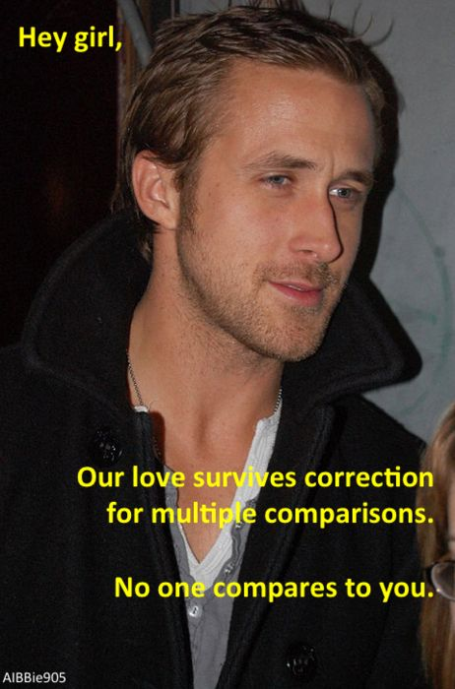
Bonferroni by hand
Say we did 10 pairwise t-test after a “significant” (p<0.05) ANOVA Omnibus test
Original alpha (α) by convention in biology: 0.05
Any p value < 0.05 considered “significant”
Since we are doing a lot of tests we decide to correct for
multiple comparisons to control our Type I Error rate
0.05 ÷ 10 = 0.005
Now, only p values less than 0.005 are considered “significant”
Therefore, it is likely that fewer comparisons will be “significant”
Key: the more comparisons you make, the bigger the change in alpha

Slide 20
Bonferroni by hand
Say we did 10 pairwise t-test after a “significant” (p<0.05) ANOVA Omnibus test
Original alpha (α) by convention in biology: 0.05
Any p value < 0.05 considered “significant”
Since we are doing a lot of tests we decide to correct for
multiple comparisons to control our Type I Error rate
0.05 ÷ 10 = 0.005
Now, only p values less than 0.005 are considered “significant”
Therefore, it is likely that fewer comparisons will be “significant”
Key: the more comparisons you make, the bigger the change in alpha

Slide 21
Bonferroni by hand
Say we did 10 pairwise t-test after a “significant” (p<0.05) ANOVA Omnibus test
Original alpha (α) by convention in biology: 0.05
Any p value < 0.05 considered “significant”
Since we are doing a lot of tests we decide to correct for
multiple comparisons to control our Type I Error rate
0.05 ÷ 10 = 0.005
Now, only p values less than 0.005 are considered “significant”
Therefore, it is likely that fewer comparisons will be “significant”
Key: the more comparisons you make, the bigger the change in alpha

Slide 22
Bonferroni by hand
Say we did 10 pairwise t-test after a “significant” (p<0.05) ANOVA Omnibus test
Original alpha (α) by convention in biology: 0.05
Any p value < 0.05 considered “significant”
Since we are doing a lot of tests we decide to correct for
multiple comparisons to control our Type I Error rate
0.05 ÷ 10 = 0.005
Now, only p values less than 0.005 are considered “significant”
Therefore, it is likely that fewer comparisons will be “significant”
Key: the more comparisons you make, the bigger the change in alpha

Slide 23
Bonferroni by hand
Say we did 10 pairwise t-test after a “significant” (p<0.05) ANOVA Omnibus test
Original alpha (α) by convention in biology: 0.05
Any p value < 0.05 considered “significant”
Since we are doing a lot of tests we decide to correct for
multiple comparisons to control our Type I Error rate
0.05 ÷ 10 = 0.005
Now, only p values less than 0.005 are considered “significant”
Therefore, it is likely that fewer comparisons will be “significant”
Key: the more comparisons you make, the bigger the change in alpha

