Slide 1
ANOVA &
Multiple comparisons with corrections
Tukey

Slide 2
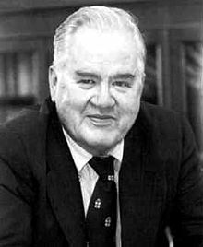
Tukey-Kramer / TukeyHSD in R
Less conservative technique than Bonferrnoi
(what do I mean by conservative: favors the null Ho)
(What do I mean by “favors the null”: less like to reject it
More useful function in R
Emphasized by authors of book
But – both
  The more comparisons you make, the bigger the impact on p values/alpha and confidence intervals
  P values get bigger (more like to be > 0.05)
  Alpha gets smaller (fewer p values less than it)
  Confidence intervals get bigger

Slide 3
Tukey-Kramer / TukeyHSD in R
Less conservative technique than Bonferrnoi
(what do I mean by conservative: favors the null Ho)
(What do I mean by “favors the null”: less like to reject it
More useful function in R
Emphasized by authors of book
But – both
  The more comparisons you make, the bigger the impact on p values/alpha and confidence intervals
  P values get bigger (more like to be > 0.05)
  Alpha gets smaller (fewer p values less than it)
  Confidence intervals get bigger

Slide 4
Tukey-Kramer / TukeyHSD in R
Less conservative technique than Bonferrnoi
(what do I mean by conservative: favors the null Ho)
(What do I mean by “favors the null”: less like to reject it
More useful function in R
Emphasized by authors of book
But – both
  The more comparisons you make, the bigger the impact on p values/alpha and confidence intervals
  P values get bigger (more like to be > 0.05)
  Alpha gets smaller (fewer p values less than it)
  Confidence intervals get bigger

Slide 5
Tukey-Kramer / TukeyHSD in R
Less conservative technique than Bonferrnoi
(what do I mean by conservative: favors the null Ho)
(What do I mean by “favors the null”: less like to reject it
More useful function in R
Emphasized by authors of book
But – both
  The more comparisons you make, the bigger the impact on p values/alpha and confidence intervals
  P values get bigger (more like to be > 0.05)
  Alpha gets smaller (fewer p values less than it)
  Confidence intervals get bigger

Slide 6
Tukey-Kramer / TukeyHSD in R
Less conservative technique than Bonferrnoi
(what do I mean by conservative: favors the null Hoo)
(What do I mean by “favors the null”: less likely to reject it
More useful function in R
Emphasized by authors of book
But – both
  The more comparisons you make, the bigger the impact on p values/alpha and confidence intervals
  P values get bigger (more like to be > 0.05)
  Alpha gets smaller (fewer p values less than it)
  Confidence intervals get bigger

Slide 7

Tukey-Kramer / TukeyHSD in R
Must first “re-fit” our alternative model with the aov() function
(sorry, Kinda annoying…but you MUST know this for the in-class test!)
Use TukeyHSD function on the new R object holding the aov() model
(memorize this one too)

Slide 8
Tukey-Kramer / TukeyHSD in R
Must first “re-fit” our alternative model with the aov() function
(sorry, Kinda annoying…but you MUST know this for the in-class test!)
Use TukeyHSD function on the new R object holding the aov() model
(memorize this one too)

Slide 9
Tukey-Kramer / TukeyHSD in R
Must first “re-fit” our alternative model with the aov() function
(sorry, Kinda annoying…but you MUST know this for the in-class test!)
Use TukeyHSD function on the new R object holding the aov() model
(memorize this one too)

Slide 10
Tukey-Kramer / TukeyHSD in R
Must first “re-fit” our alternative model with the aov() function
(sorry, Kinda annoying…but you MUST know this for the in-class test!)
Use TukeyHSD function on the new R object holding the aov() model
(memorize this one too)

Slide 11
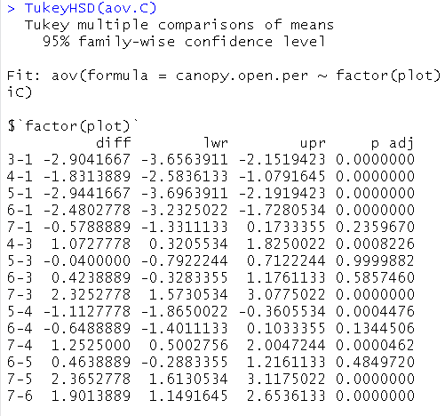
Tukey-Kramer / TukeyHSD in R
“diff” = effect size
= difference between
given pair of means
“lwr”/= adjusted 95% CI
“upr”
These are BIGGER than what t.test() would give you
“p adj” = adjusted p value
These are BIGGER than what pairwise.t.test() or t.test()
would give you
The more differences tested,
the bigger the change!

Slide 12
Tukey-Kramer / TukeyHSD in R
“diff” = effect size
= difference between
given pair of means
“lwr”/= adjusted 95% CI
“upr”
These are BIGGER than what t.test() would give you
“p adj” = adjusted p value
These are BIGGER than what pairwise.t.test() or t.test()
would give you
The more differences tested,
the bigger the change!

Slide 13
Tukey-Kramer / TukeyHSD in R
“diff” = effect size
= difference between
given pair of means
“lwr”/= adjusted 95% CI
“upr”
These are BIGGER than what t.test() would give you
“p adj” = adjusted p value
These are BIGGER than what pairwise.t.test() or t.test()
would give you
The more differences tested,
the bigger the change!

Slide 14
Tukey-Kramer / TukeyHSD in R
“diff” = effect size
= difference between
given pair of means
“lwr”/= adjusted 95% CI
“upr”
These are BIGGER than what t.test() would give you
“p adj” = adjusted p value
These are BIGGER than what pairwise.t.test() or t.test()
would give you
The more differences tested,
the bigger the change!

Slide 15
Tukey-Kramer / TukeyHSD in R
“diff” = effect size
= difference between
given pair of means
“lwr”/= adjusted 95% CI
“upr”
These are BIGGER than what t.test() would give you
“p adj” = adjusted p value
These are BIGGER than what pairwise.t.test() or t.test()
would give you
The more differences tested,
the bigger the change!

Slide 16
Tukey-Kramer / TukeyHSD in R
“diff” = effect size
= difference between
given pair of means
“lwr”/= adjusted 95% CI
“upr”
These are BIGGER than what t.test() would give you
“p adj” = adjusted p value
These are BIGGER than what pairwise.t.test() or t.test()
would give you
The more differences tested,
the bigger the change!

Slide 17
Tukey-Kramer / TukeyHSD in R
“diff” = effect size
= difference between
given pair of means
“lwr”/= adjusted 95% CI
“upr”
These are BIGGER than what t.test() would give you
“p adj” = adjusted p value
These are BIGGER than what pairwise.t.test() or t.test()
would give you
The more differences tested,
the bigger the change!

Slide 18
Tukey-Kramer / TukeyHSD in R
“diff” = effect size
= difference between
given pair of means
“lwr”/= adjusted 95% CI
“upr”
These are BIGGER than what t.test() would give you
“p adj” = adjusted p value
These are BIGGER than what pairwise.t.test() or t.test()
would give you
The more differences tested,
the bigger the change!

Slide 19
“The more differences tested,
the bigger the change!”
Why does Bonferroni and TukeyHSD do this?

Slide 20
“The more differences tested,
the bigger the change!”
Why does Bonferroni and TukeyHSD do this?
This is a penalty for carrying out many un-planned comparisons
Forces you to be more conservative in passing judgement against the null

Slide 21
“The more differences tested,
the bigger the change!”
Why does Bonferrnoi and TukeyHSD do this?
This is a penalty for carrying out many un-planned comparisons
Forces you to be more conservative in passing judgement against the null

