Slide 1
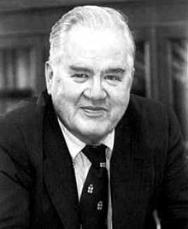
ANOVA & Multiple comparisons with corrections Tukey

Slide 2
Tukey-Kramer / TukeyHSD in R
Less conservative technique than Bonferrnoi
(what do I mean by conservative: favors the null Ho)
(What do I mean by “favors the null”: less like to reject it
More useful function in R
Emphasized by authors of book
But – both
The more comparisons you make, the bigger the impact on p values/alpha and confidence intervals
P values get bigger (more like to be > 0.05)
Alpha gets smaller (fewer p values less than it)
Confidence intervals get bigger

Slide 3

Tukey-Kramer / TukeyHSD in R
Must first “re-fit” our alternative model with the aov() function
(sorry, Kinda annoying…but you MUST know this for the in-class test!)
Use TukeyHSD function on the new R object holding the aov() model
(memorize this one too)

Slide 4
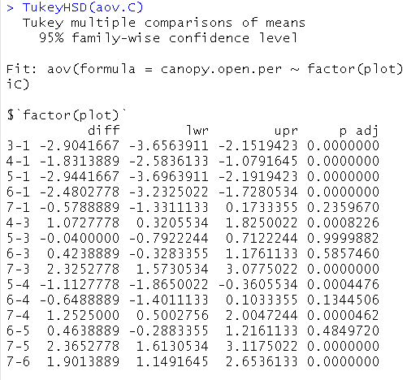
Tukey-Kramer / TukeyHSD in R
“diff” = effect size
= difference between
given pair of means
“lwr”/= adjusted 95% CI
“upr”
These are BIGGER than what t.test() would give you
“p adj” = adjusted p value
These are BIGGER than what pairwise.t.test() or t.test()
would give you
The more differences tested,
the bigger the change!

Slide 5
“The more differences tested,
the bigger the change!”
Why does Bonferroni and TukeyHSD do this?
This is a penalty for carrying out many un-planned comparisons
Forces you to be more conservative in passing judgement against the null

