Slide 1
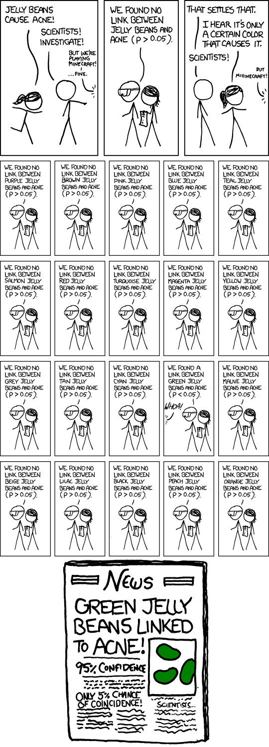
https://xkcd.com/882/

Slide 2
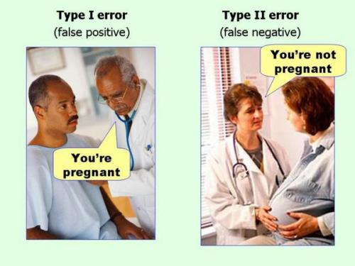
Type I vs Type II error: False Positive vs. False Negative results
Type 1 Error (page 160) “FALSE POSITIVE”
Type 2 Error (page 160) :“FALSE NEGATIVE”
“Type 1 error is rejecting a true null hypothesis. The significance level alpha (α) [the threshold where we say something is “statistically significance”] sets the probability of committing a Type 1 Error.
“if the null hypothesis were true, we would reject it mistakenly one time in 20” (pg 160)
This is sometimes called a “false positive.” We falsely conclude that there is a difference when there isn’t.
“Type 2 error is failing to reject a false null hypothesis”
“If a null hypothesis is false, we need to reject it to get the right answer. Failure to reject a false null hypothesis is a Type 2 error.”
This is sometimes called a “false negative.” We falsely conclude that there is not a difference when there truly is.
“A study that has a low probability of Type 2 error is said to have high power.”

Slide 3
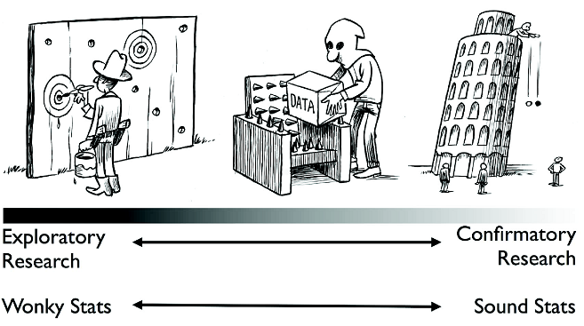
“It should be stressed that the problem is not w/ exploratory research itself. Rather, the problem is w/ dishonesty, that is, pretending that exploratory research was instead confirmatory.”
Eric-Jan Wagenmakers
Figure 1. A continuum of experimental exploration & the corresponding continuum of statistical wonkiness (Wagenmakers et al., 2012). “On the far left of the continuum, researchers find their hypothesis in the data by post hoc [after the fact] theorizing, & the corresponding statistics are ‘wonky’, dramatically overestimating the evidence for the hypothesis. On the far right of the continuum, researchers preregister their studies such that data collection & data analyses leave no room whatsoever for exploration; the corresponding statistics are ‘sound’ in the sense that they are used for their intended purpose. Much empirical research operates somewhere in between these two extremes, although for any specific study the exact location may be impossible to determine. In the grey area of exploration, data are tortured to some extent, & the corresponding statistics are somewhat wonky.” Figure available at http://www.flickr.com/photos/23868780@N00/7374874302, courtesy of Dirk-Jan Hoek, under CC license https://creativecommo ns.org/licenses/by/2.0/.

Slide 4
Type 1 Error (page 160)
“Type 1 error is rejecting a true null hypothesis. The significance level alpha (α) [the threshold where we say something is “statistically significance”] sets the probability of committing a Type 1 Error.
“if the null hypothesis were true, we would reject it mistakenly one time in 20” (pg 160)
This is sometimes called a “false positive.” We falsely conclude that there is a difference when there isn’t.

Slide 5
Type 2 Error (page 160)
“Type 2 error is failing to reject a false null hypothesis”
“If a null hypothesis is false, we need to reject it to get the right answer. Failure to reject a false null hypothesis is a Type 2 error.”
This is sometimes called a “false negative.” We falsely conclude that there is not a difference when there actually is.
“A study that has a low probability of Type 2 error is said to have high power.”

