Slide 1
You should be able to understand the point of this cartoon (email me if you don’t!)

Slide 2
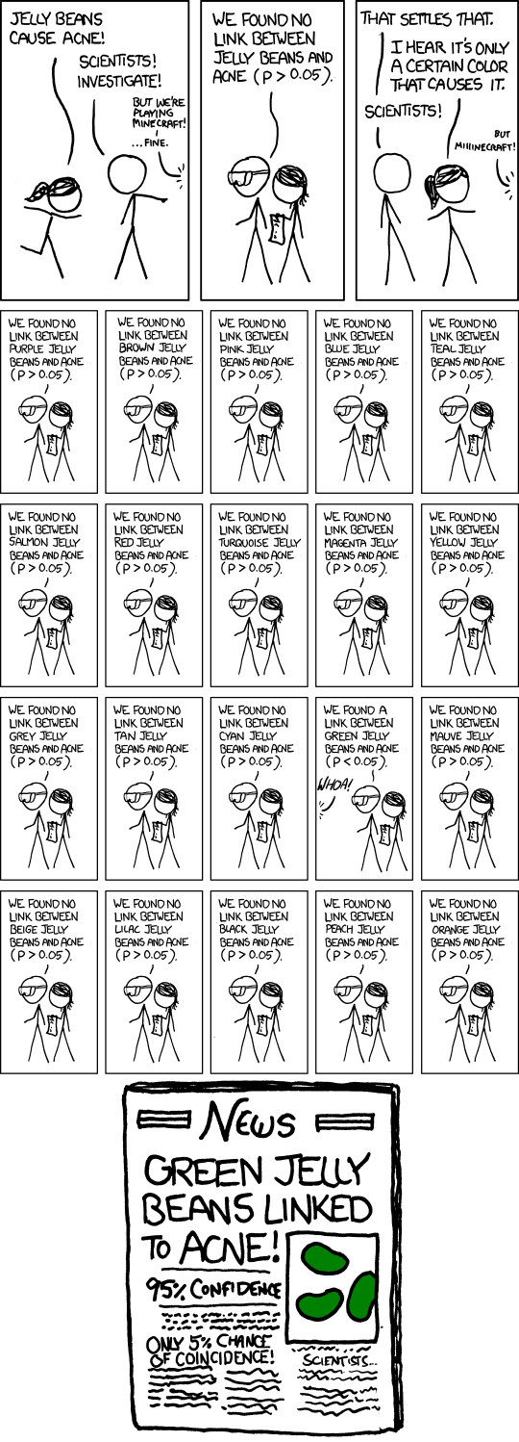
https://xkcd.com/882/

