Slide 1
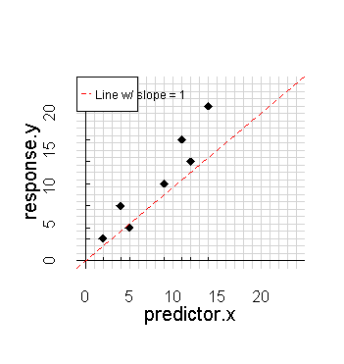
Name: __________________________
Parameters for line Sum of residuals
Attempt Intercept slope resid resid^2
# 1: ________ _______ ________ _______
# 2: ________ _______ ________ _______
# 3: ________ _______ ________ _______
# 4: ________ _______ ________ _______
Correct: ________ _______ ________ _______
Residuals Raw Squared
Point 1: _________ _________
Point 2: _________ _________
Point 3: _________ _________
Point 4: _________ _________
Point 5: _________ _________
Point 6: _________ _________
Point 7: _________ _________
Code to run linear regression:
_____________________________
Equation for line:
_____________________________

