Slide 1
Regression: modeling fitting using least squares
Lecture 25?
Nov 16 2016

Slide 2
Major steps in regression analysis
Model fitting
Significance testing
What line fits the model best?
This class: “least squares”
Advanced regression: “maximum likelihood”
Calculate 2 things:
Intercept of line
Slope of line
Is this line any different from a flat line?
standard errors, confidence intervals, t-statistics, F-statistic, p-values

Slide 3
Major steps in regression analysis
Model fitting
Significance testing
What line fits the model best?
This class: “least squares”
Advanced regression: “maximum likelihood”
Calculate 2 things:
Intercept of line
Slope of line
Is this line any different from a flat line?
standard errors, confidence intervals, t-statistics, F-statistic, p-values

Slide 4
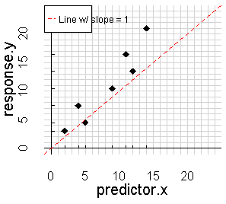

Slide 7
“Intercept”
“y-intercept”
“b” in y = mx + b

Slide 8
“Intercept”
“y-intercept”
“b” in y = mx + b
= 3

Slide 11
“Rise”
= 16

Slide 12
“Rise”
= 16

Slide 13
“Rise”
= 16
“Run”
= 14

Slide 14
Slope = Rise/Run
= 16/14
= 1.14
“Rise”
= 16
“Run”
= 14

Slide 15
Slope = Rise/Run
= 16/14
= 1.14
“Rise”
= 16
3
“Run”
= 14

Slide 16
y = m*x + b
“Rise”
= 16
“Run”
= 14

Slide 17
y = m*x + b
y = 1.14*x + 3
“Rise”
= 16
“Run”
= 14

Slide 18
Proposed
“best fit” line
y = 1.14*x + 3

Slide 19
How do we determine if our line is actually a good “fit” for the data?

Slide 20
How do we determine if our line is actually a good “fit” for the data?
Calculate “residuals”

Slide 21
How do we determine if our line is actually a good “fit” for the data?
Calculate “residuals”

Slide 22
How do we determine if our line is actually a good “fit” for the data?
Calculate “residuals”
2.0
1.0
-3.2
-0.1
-2.8
-4.2
-2.3

Slide 23
How do we determine if our line is actually a good “fit” for the data?
Calculate “residuals”
2.0
Add up all the The line w/
The smallest
Residuals
Has the best
fit
1.0
-3.2
-0.1
-2.8
-4.2
-2.3

Slide 24
Problem:
2.0
1.0
-3.2
-0.1
-2.8
-4.2
-2.3

Slide 25
Problem:
-2.3 + 2.0 = 0.03
2.0
1.0
-3.2
-0.1
-2.8
-4.2
-2.3

Slide 26
Problem:
-2.3 + 2.0 = 0.03
Positive and negative residuals cancel each other out…
2.0
1.0
-3.2
-0.1
-2.8
-4.2
-2.3

Slide 27
Problem:
-2.3 + 2.0 = 0.03
Positive and negative residuals cancel each other out…
Is this line
A good fit
Or a poor
Fit?

Slide 28
Problem:
-2.3 + 2.0 = 0.03
Positive and negative residuals cancel each other out…
Is this line
A good fit
Or a poor
Fit?
Residuals are large….

Slide 29
Is this line
A good fit
Or a poor
Fit?
Residuals are large….
But positive
And negative
Cancel out
Problem:
-2.3 + 2.0 = 0.03
Positive and negative residuals cancel each other out…

Slide 30
Solution:
Remove the
Negative sign but keep the overall size by
Squaring each residual
2.0
1.0
-3.2
-0.1
-2.8
-4.2
-2.3

Slide 31
Solution:
Remove the
Negative sign but keep the overall size by
Squaring each residual
2.0²
1.0²
-3.2²
-0.1²
-2.8²
-4.2²
-2.3²

Slide 32
Solution:
Remove the
Negative sign but keep the overall size by
Squaring each residual
2.0²
=4
1.0²
=1
-3.2²
=10.24
-0.1²
=0.01
-2.8²
=7.8
-4.2²
=17.6
-2.3²
=5.3

Slide 33
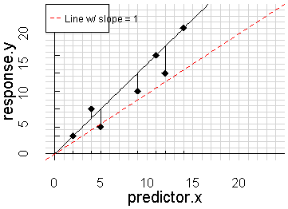

Slide 34
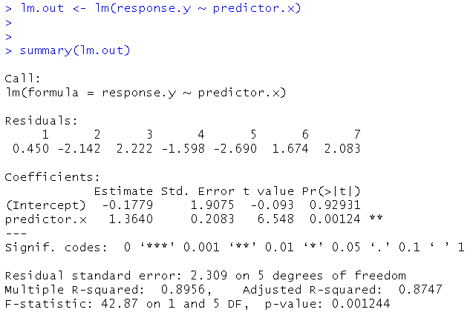
Regression output in R
SE, t, and p:
Is the intercept and/or slope different from zero?
Coefficients
aka “parameters”
The “m” and “b” of “y = mx + b
y-intercept
slope
df
R²
F statistic

Slide 35
Regression output in R
SE, t, and p:
Is the intercept and/or slope different from zero?
Coefficients
aka “parameters”
The “m” and “b” of “y = mx + b
y-intercept
slope
df
R²
F statistic

