Slide 1
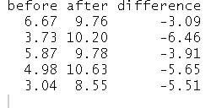
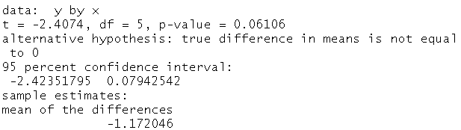
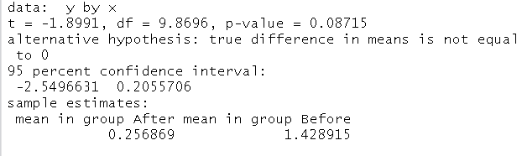
ENS 495 Prelab 7
Week of October 10th, 2016
Name: __________________
3) Below is the output of two separate t-tests. The top is from a paired t-test and the bottom is from a regular t-test.
If I hadn’t told you which was which, there are two clues you could use to determine this yourself. Circle them and explain what they are in the space below.
1)
A paired t-test involves calculating the difference between 2 pairs of values, such as the value of a response variable before a treatment was applied to a subject minus its value after a treatment was applied. The code below caries out the subtraction necessary to do this but is missing a key symbol between the data frame name (df.paired) and the columns. Insert the proper symbol.
df.paired difference <- df.paired before - df.paried after
2)
What would be the sample size for a paired t-test with these data
N = 5 or N = 10? (circle one).
See pages 331-332 in the text book for an example of a paired t-test , with info on determining sample sizes. In particular, look at the number of data points in Table 12.2-1 on page 331 and compare it to the sample size in the calculations on page 332.

