Slide 1
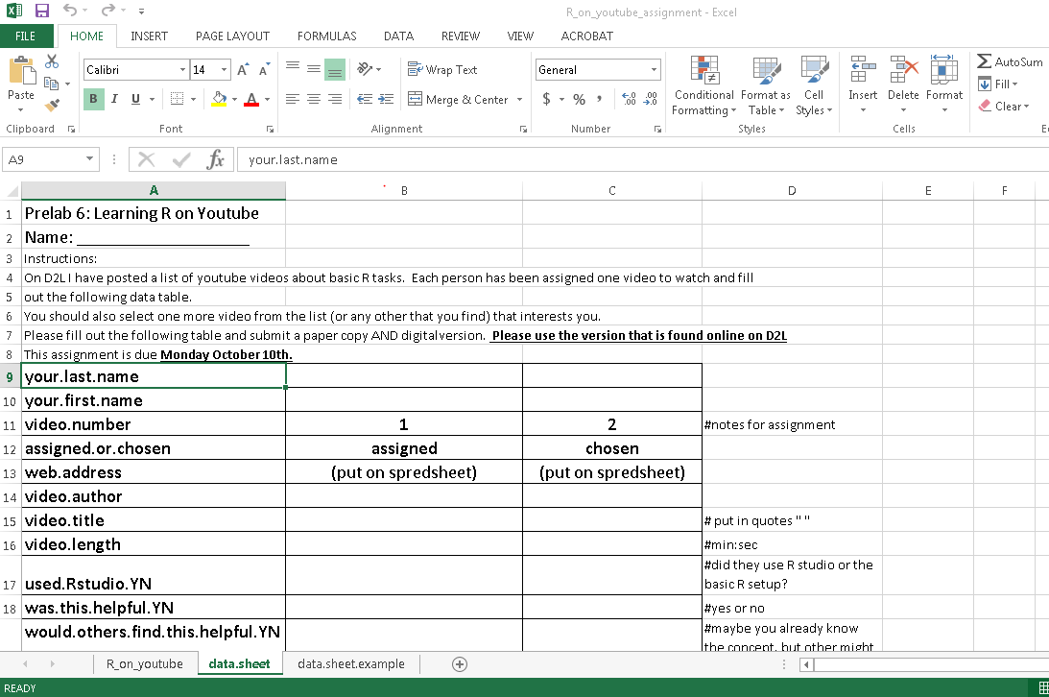
An example of a filled out datasheet
Your assigned videos

