Slide 1

Lab 9: Intro to ANOVA
One-way ANOVA
Part 1: Summary stats & plotting
-explore the data
Part 2: Run the ANOVA
-omnibus ANOVA F-test
Aside: ANOVA exploration
Part 3: pairwise comparisons &
p-values
Part 4: pairwise comparisons & effect sizes w/ TukeyHSD

Slide 2
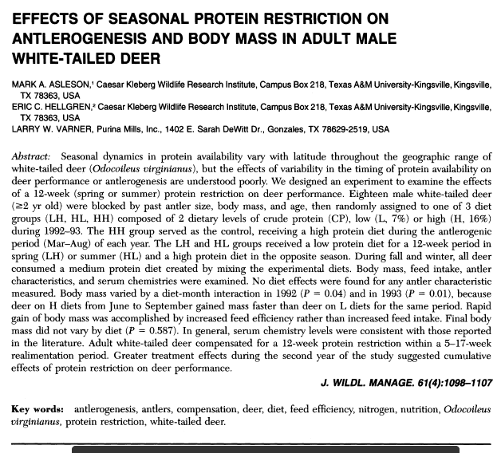

Slide 3
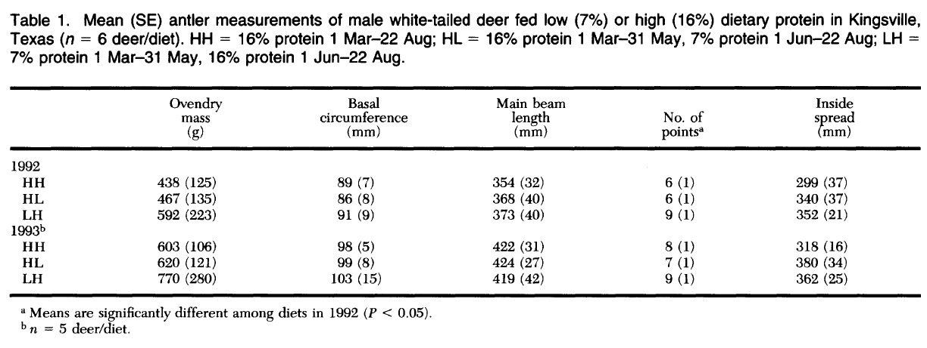
Journal of Wildlife Management
(Asleson et al 1997)

