Slide 1
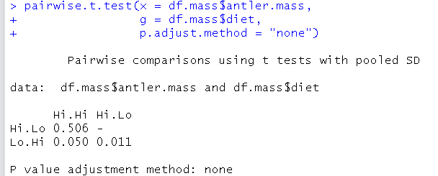
The pairwise.t.test() function
The structure of pairwise.t.test() is a little different than other R functions such as t.test. This is because pairwise.t.test() cannot use “formula notation” to specify the test; that is, it doesn’t understand what a tilde (~) is. What it takes are 2 arguments: “x” for a numeric response variable, and “g” for a grouping variable that defines the categories that the numeric data are grouped into (treatment, population, site etc). pairwise.t.test() can be set to not correct p-values for multiple comparisons, as is often recommended if you are investigating “planned comparisons” of means and have a significant ANOVA Omnibus F-test (eg. Pg xxx Whitlock & Shulter, 2nd ed). If set to “none” it carries out a modified t-test using the pooled standard deviation from the data.
Numeric response variable
Dataframe
Dollar sign $ to specify column in dataframe
Categorical grouping variable
If and how to correct p-values for multiple comparisons.
If set to “none” it uses the pooled SD from all of the data, not just the data specific to each individual pairwise test.
All possible comparisons between pairs of means

Slide 2
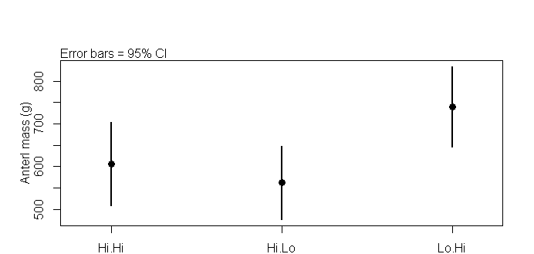
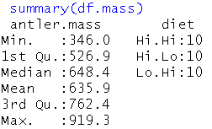
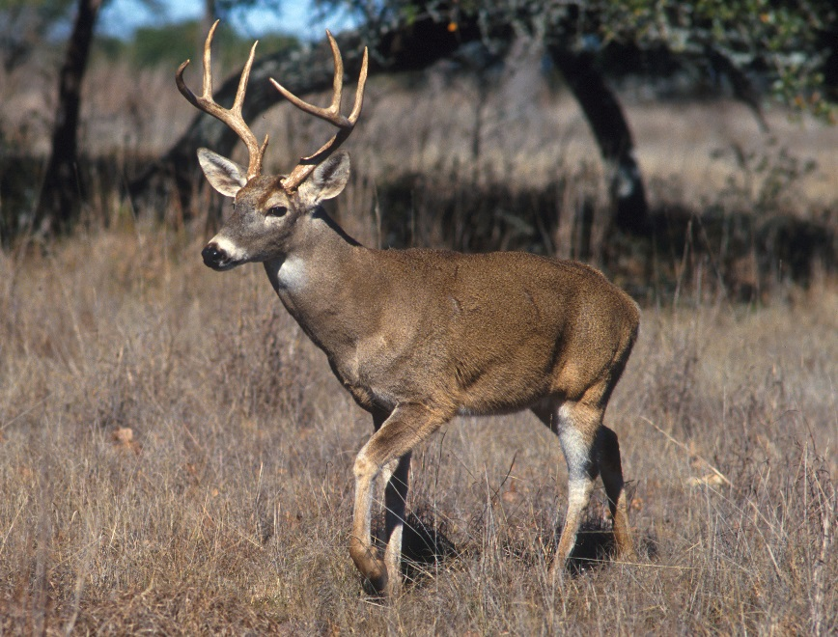
Data used in example
The data used in this example is a dataframe called “df.mass” that has 2 columns. The data are from an experiment on how different peiriods of high and low protein affect anterl growth in white tailed deer. A numeric variable is in the 1st column “antler.mass”, and a categorical variables (“diet”) with 3 groups is in the 2nd column. “Hi.Hi” is a diet with consistently high protein content. The “Hi.Lo” treatment provided high protein followed by a period with a low-protein diet. “Lo.Hi” began with a low protein diet and switched to a high protein diet.

Slide 3
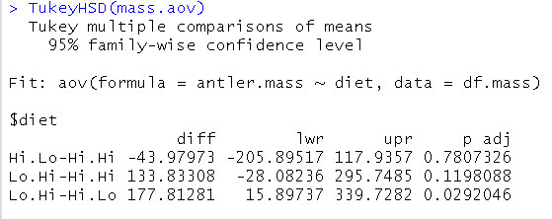
The TukeyHSD() function
TukeyHSD stands for “Tukey’s Honestly Significant Difference”. It is related to a t-test but carries out a correction for multiple comparisons when all possible comparison between groups are being made. It is recommended that this technique (or one like it) be used when carrying out exploratory “unplanned comparisons” that were not specified prior to designing the experiment or gathering the data.
Unlike the pairwise.t.test() function, the TukeyHSD function takes just a single argument, which is the output of the function aov(). aov() stands for analysis of variance and is a way to fit an ANOVA model with a single command in R.
TukeyHSD produces much more output than pairwise.t.test(). In particular, it gives you the difference between the means of each group (“diff”) and a 95% confidence interval (CI) around this difference that has been adjust for multiple comparisons. The more comparisons, the winder the interval becomes, and the large the adjusted p-value (adj) gets)
95% CIs that contain zero will have a p value > 0.05. The hypothesis that the difference between two means is 0 therefore cannot be rejected
aov() function
Numeric response variable
Categorical grouping variables
Difference between group means (effect size)
Lower and upper adjusted 95% confidence intervals (CI)
Adjusted p-value

Slide 4
Data used in example
The data used in this example is a dataframe called “df.mass” that has 2 columns. The data are from an experiment on how different peiriods of high and low protein affect anterl growth in white tailed deer. A numeric variable is in the 1st column “antler.mass”, and a categorical variables (“diet”) with 3 groups is in the 2nd column. “Hi.Hi” is a diet with consistently high protein content. The “Hi.Lo” treatment provided high protein followed by a period with a low-protein diet. “Lo.Hi” began with a low protein diet and switched to a high protein diet.

Slide 6
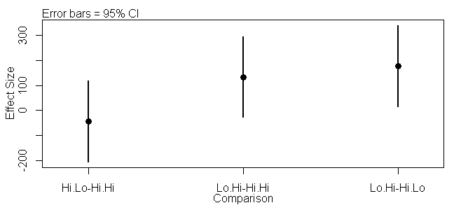
Effect sizes from the TukeyHSD() function
A succinct way to plot the results of a hypothesis test is to plot the difference (effect size) between the means of 2 groups (such as control and treatment groups) and the confidence interval (CI) around this difference. If the means of 2 groups are exactly the same, the difference equals zero. If they are not exactly the same (point A) but their 95% CI contains zero (dashed red line) then the p value for a t-test with the two groups will be > 0.05 and they are considered significantly different.
B
A

Slide 7
Effect sizes from the TukeyHSD() function
A succinct way to plot the results of a hypothesis test is to plot the difference (effect size) between the means of 2 groups (such as control and treatment groups) and the confidence interval (CI) around this difference. If the means of 2 groups are exactly the same, the difference equals zero. If they are not exactly the same (point A) but their 95% CI contains zero (dashed red line) then the p value for a t-test with the two groups will be > 0.05 and they are considered significantly different.
Effect sizes are useful for understanding what is going on when there is no significant differences between groups. Point A , the difference between the Hi.Lo and Hi.Hi groups, is near zero, and its CIs span far above and below zero. Any value within the CI is considered a plausible real value. Since A is almost centered on zero, A could actually be zero, or be greater than zero, or less than zero. This tells us that we really can’t tell whether the Hi.Lo or the Hi.Hi treatment is greater, and its best to just assume for now that they are not different from each other (Hi.Lo – Hi.Hi = 0).
Contrast this with Point B, which has a CI that crosses zero, but most of its CI are positive. We therefore cannot rule out that B is equal to zero. B is almost defiantly not negative, though, and it is very plausible that it is positive and even >100. B is the difference between the Lo.Hi and the Hi.Hi treatments. We therefore cannot rule out the possibility that Lo.Hi and Hi.Hi are the same, but its most likely that Lo.Hi is at least a little – if not a fair bit – bigger than Hi.Hi (Lo.Hi – Hi.Hi > 0).
Finally, point C has CIs that do not cross zero. We can therefore conclude with high confindene (but not certainty!) that C is not equal to zero. C is the difference between the Lo.Hi and the Hi.Lo treatments. Lo.Hi is therefore almost definitely greater than Hi.Lo. But the confidence interval for point C does get fairly close to zero. We therefore cannot rule out the possibility that the differene between the treatments isn’t that big. However, its also plausible that the true difference is as great as 300.
B
A

Slide 9
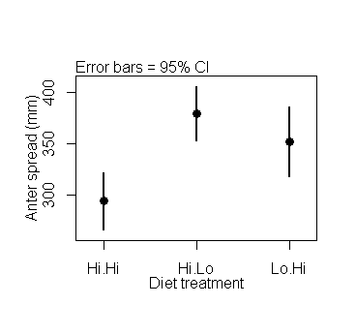
P=0.01
P=0.0004 P=0.20

