Slide 1
Lab 10/10/2017
Task 1: Everyone: Introduce the Breeding Bird Survey (BBS) data in detail
Task 2: Everyone: Introduce t-tests in R
Task 3: If you haven’t completed it: Finish HW 3
Task 4: If you haven’t completed it: Independent Project
Identify Research Question
Write short description of focal question
Write short description of focal data

Slide 2
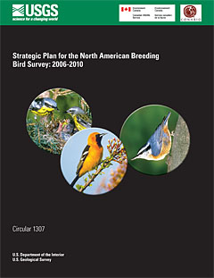

Introduction to BBS data (again…)

Slide 3
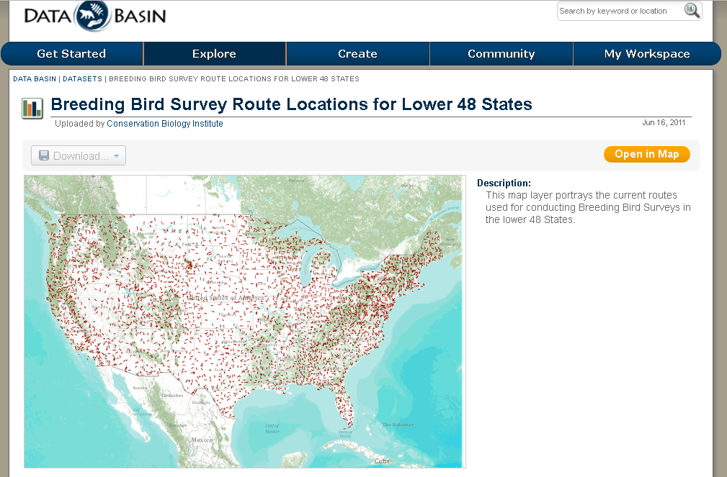
Extent of the BBS around the USA – thousands of
https://databasin.org/datasets/02fe0ebbb1b04111b0ba1579b89b7420

Slide 4
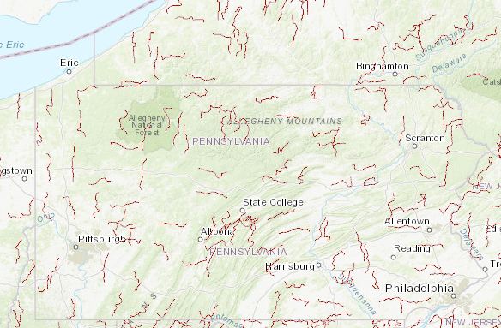
BBS Routes in PA
-each route has 50 “stops”
-all spp observed Or heard at a stop written down
-Spp- Richness = Total number of unique spp. Observed on a route

Slide 5
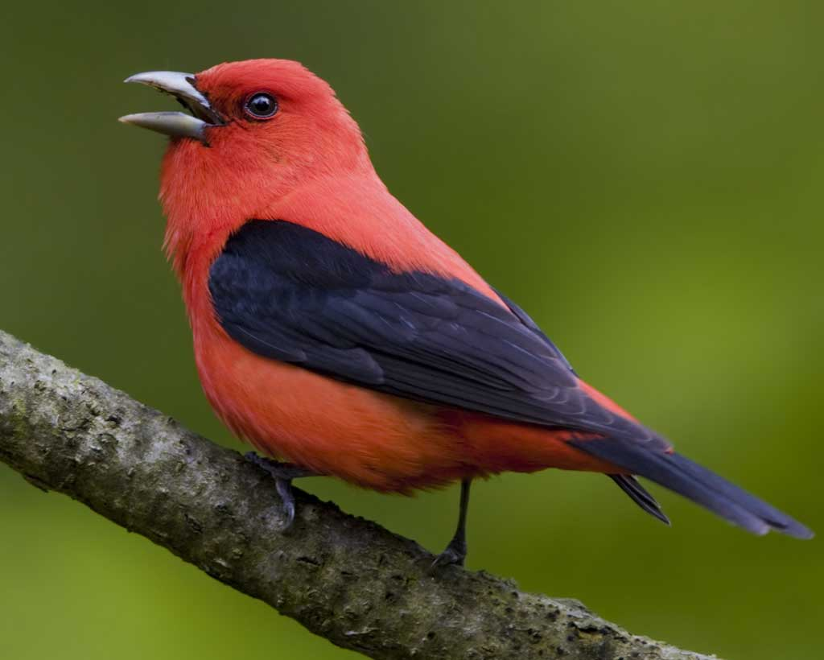
1990: 25 observed

Slide 6
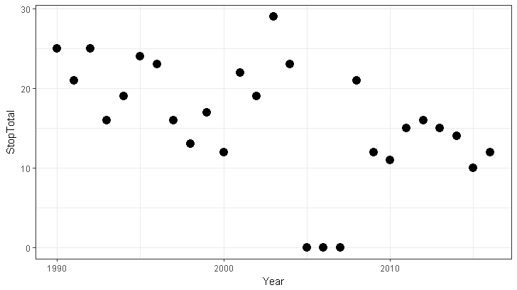
1990: 25 observed
Number of birds

Slide 7
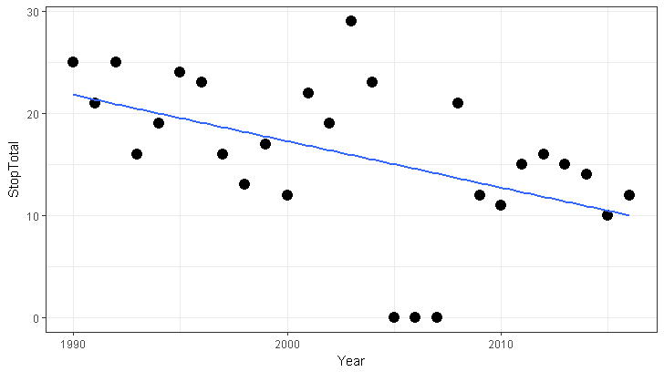
Number of birds

Slide 8
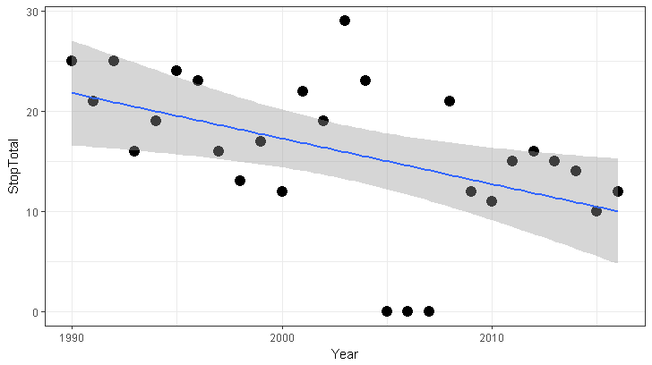

Slide 9
Number of birds

Slide 10
Hypotheses
Ho: Null hypothesis
Ha: Alternative hypothesis
No change
Change over time

Slide 11
Number of birds

Slide 12
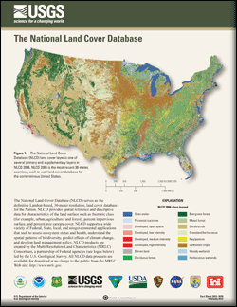
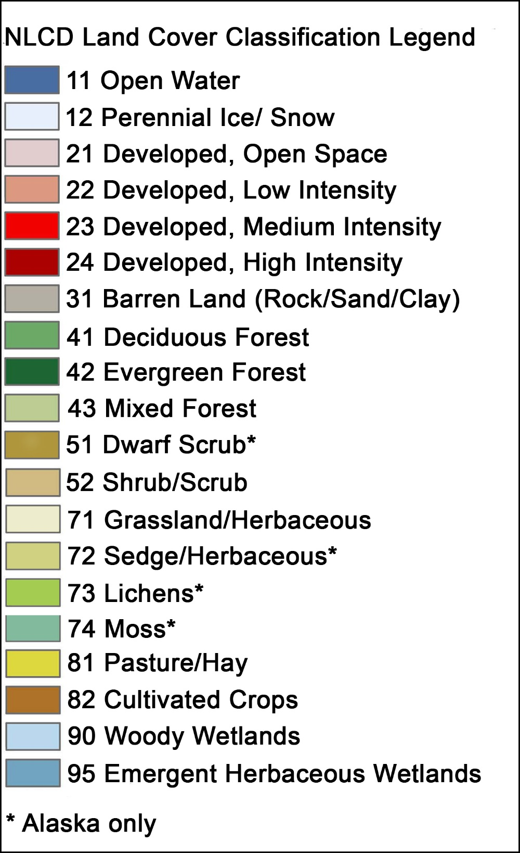

Slide 13
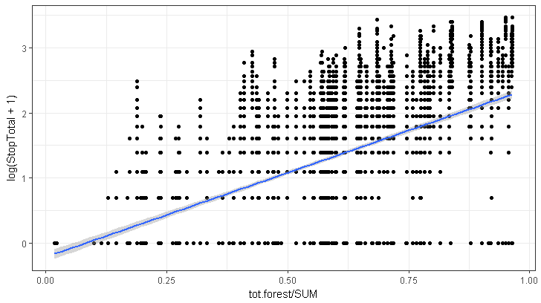
Number of birds
Amount of forest

Slide 14
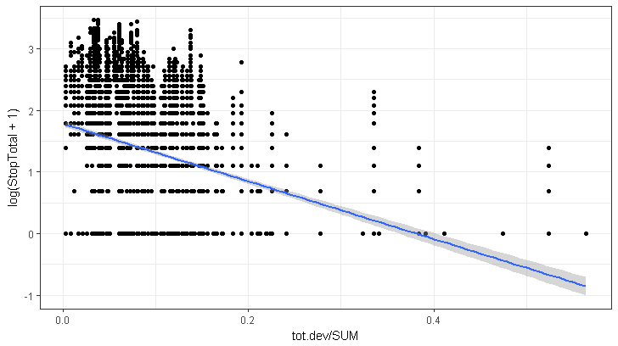
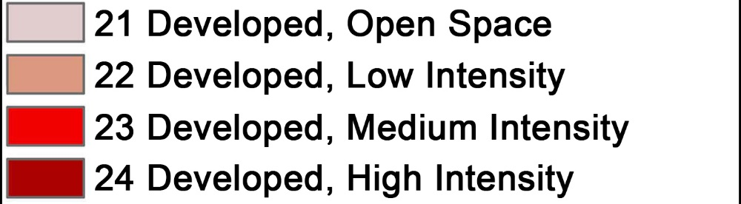
Number of birds
Amount of development

Slide 15

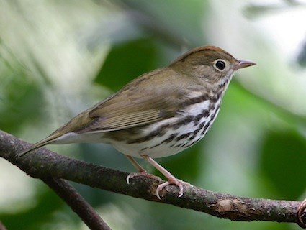
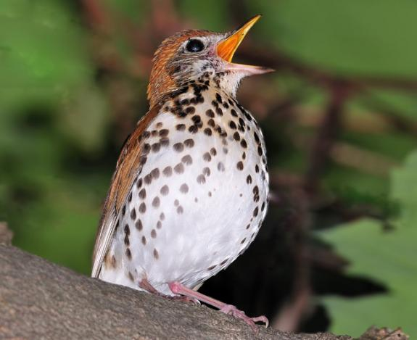
Single focal species
“Population Ecology”
Group of species
“Community Ecology”
Relationship with habitat variation
R: N ~ landcover
Trend over time
R: N ~ time
Whole community
-Species Richness
-Species Diversity (Shannon Diversity)
Guild
-Grassland birds
-Aerial insectivores (Swallows, swifts)
-Warblers

Slide 16
Single focal species
“Population Ecology”
Relationship with habitat variation
R: N ~ landcover
Trend over time
R: N ~ time
Single year
(eg 2016) w/ multiple samples across geographic area
Multiple years
(eg 1990-2016) using total number of birds seen in that area

Slide 17
Group of species
“Community Ecology”
Guild
-Grassland birds
-Aerial insectivores (Swallows, swifts)
-Warblers
Whole community
-Species Richness
-Species Diversity (Shannon Diversity)
One Year
Multiple years
Trend over time
Number of warblers ~ Time
Spp. richness ~ Time
Variation w/
habitat
Richness ~ Forest
“Does spp richness increase in forests?
Variation w/
space
Spp. richness ~ State
“Is WV more diverse than PA?”

