Slide 1
T-test in R: Chemical ecology of “AITC” in the invasive plant garlic mustard

Slide 2

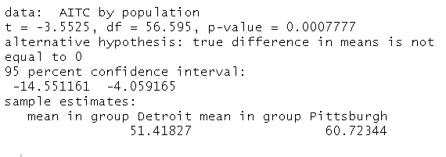
t-test in R
What P-value is indicated by these confidence intervals

Slide 3
t-test in R
What P-value is indicated by these confidence intervals

Slide 4
t-test in R
Y variable
Numeric
Categorical variable
What P-value is indicated by these confidence intervals

Slide 5
t-test in R
Y variable
Numeric
Categorical variable
Tilda
“depends on”
“is a function of”
“varies with”
What P-value is indicated by these confidence intervals

Slide 6
t-test in R

Slide 7
t-test in R

Slide 8
t-test in R
t = “___ - ______” = “____ ______”.
R compares this to a “____ distribution”

Slide 9
t-test in R
t = “t-statistic” = “test statistic”
R compares this to a null distribution

Slide 10
df = _________ ___ _________
n = 30 for Det, n = 30 for PGH
2* 30 = 60

Slide 11
Why df is this not 60?
df = degrees of freedom
n = 30 for Det, n = 30 for PGH
2* 30 = 60

Slide 12
Why df is this not 60?
-Normally df = ____ or ____
-model “________” ________
-subtract more to correct for _______ data
df = degrees of freedom
n = 30 for Det, n = 30 for PGH
2* 30 = 60

Slide 13
Why df ≠ 60?
-Normally df = n-1 or n-2
-model “assumes” normality
-subtract more to correct for non-normal data
df = degrees of freedom
n = 30 for Det, n = 30 for PGH
2* 30 = 60

Slide 14
What is up with this confidence interval?

