Slide 1
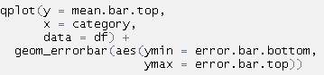
Adding error bars to a plot using ggplot2::qplot()
“+” goes between qplot() and geom_errorbar()
Comma!
Add-on function that makes error bars
Argument aes() to set up the min and max
2 parentheses!
One for aes(),
The other for geom_errorbar()
Nathan Brouwer brouwern@gmail.com

Slide 2
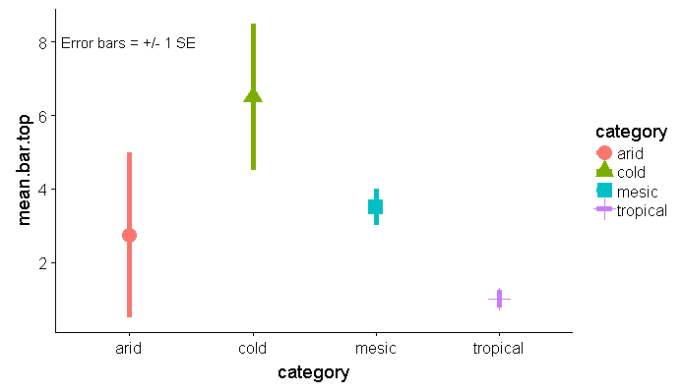
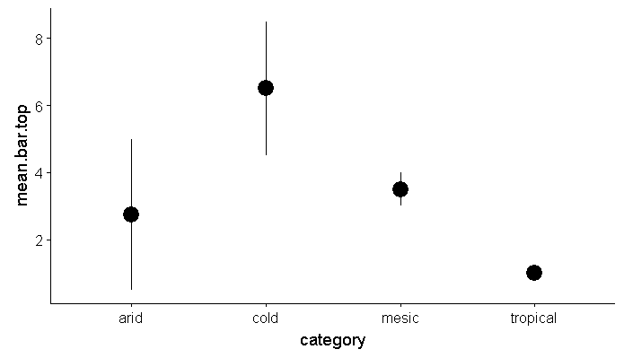
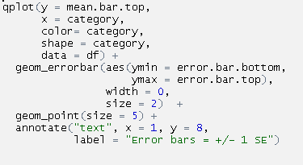
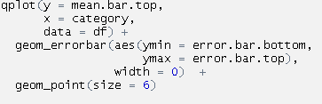
Make points bigger
Make points bigger
“+” goes between qplot() and geom_errorbar()
Change color
Change shape
Another “+”
And another “+”
Another “+”
New geom to modify size of points
Add annotation with in plot with annotate()
Nathan Brouwer brouwern@gmail.com

