Slide 1
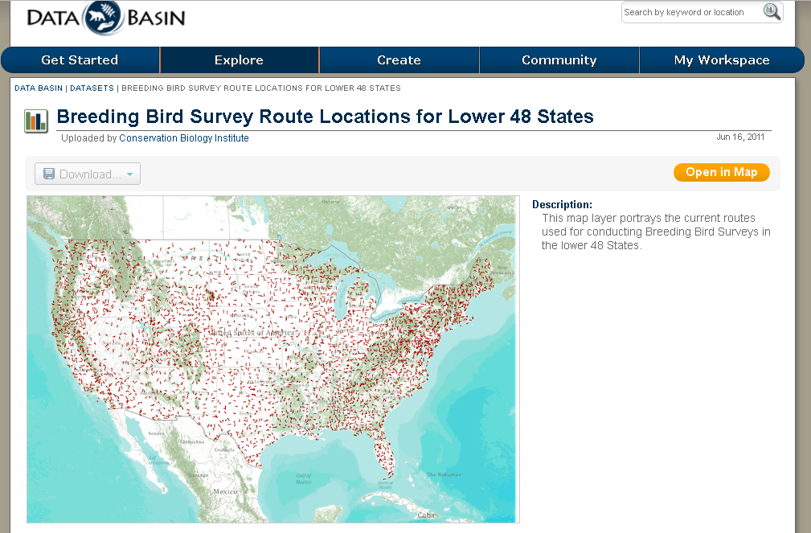
Extent of the BBS around the USA
https://databasin.org/datasets/02fe0ebbb1b04111b0ba1579b89b7420

Slide 2
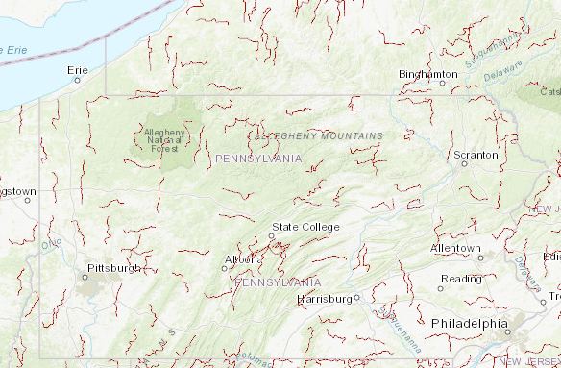
BBS Routes in PA
-each route has 50 “stops”
-all spp observed Or heard at a stop written down
-Spp- Richness = Total number of unique spp. Observed on a route

