Slide 1
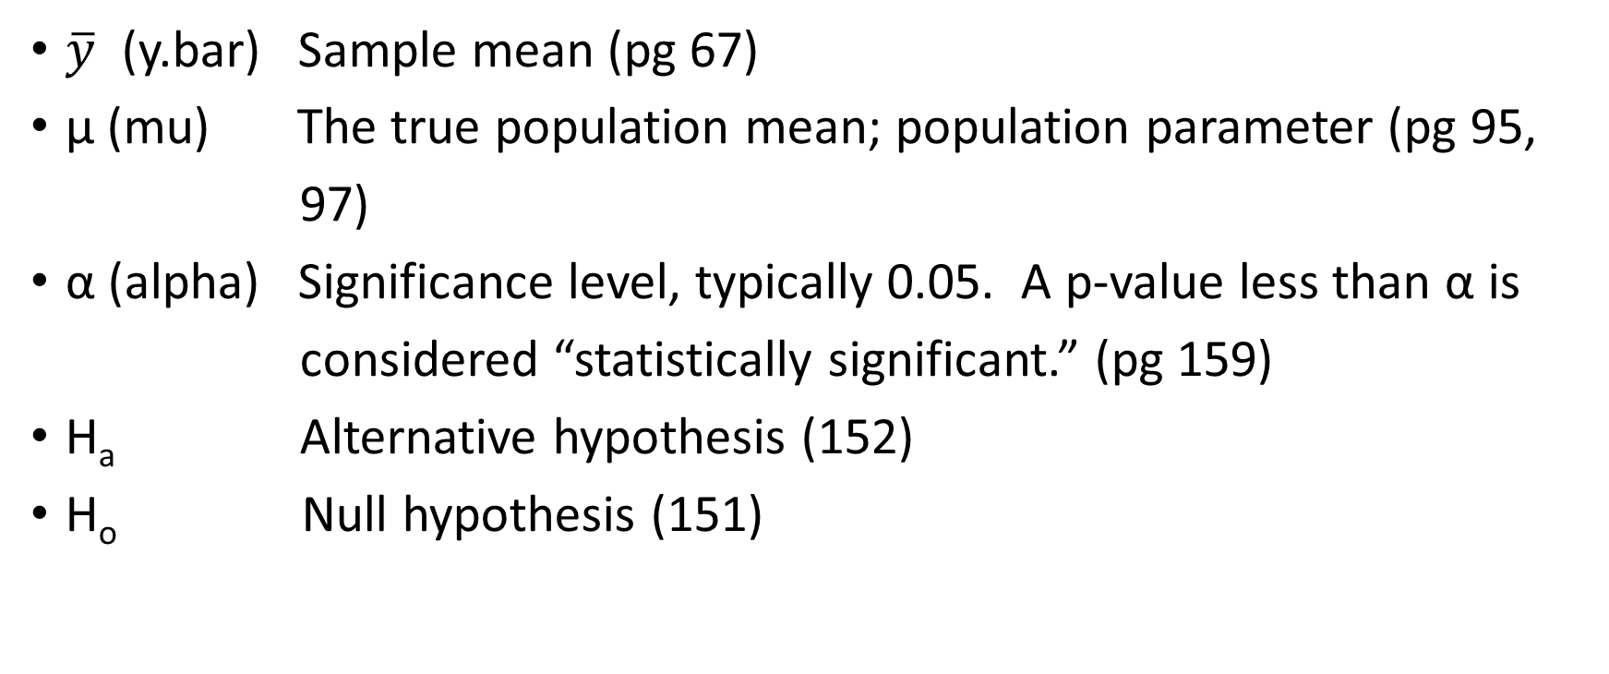
Symbols to know
$\overline{y}$ (y.bar) Sample mean (pg 67)
μ (mu) The true population mean; population parameter (pg 95,
97)
α (alpha) Significance level, typically 0.05. A p-value less than α is
considered “statistically significant.” (pg 159)
H_{a} Alternative hypothesis (152)
H_{o} Null hypothesis (151)

