Slide 1
Subverting The Ideosphere
Broward Horne
http://www.realmeme.com
DefCon 14
Aug 4-6, 2006

Slide 2
13 Versus 14
Comparison of Alexis and Riveria
The Tent
T-Shirt Giveaway (Be In Front Rows!)
Kicked Out Of Alexis? (T-Shirt!)

Slide 3
Expectations
Unconventional Manipulation Of Information
Meme Theory & Shared Context

Slide 4
Expectations
Nebulous Examples
Outrageous Ideas
A Little Black Magic
Some Weird Science
If You’re Lucky… A Few BDSM Jokes!

Slide 5
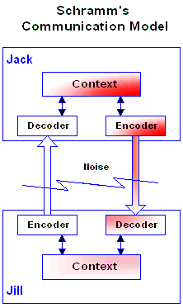
Schramm Model

Slide 6
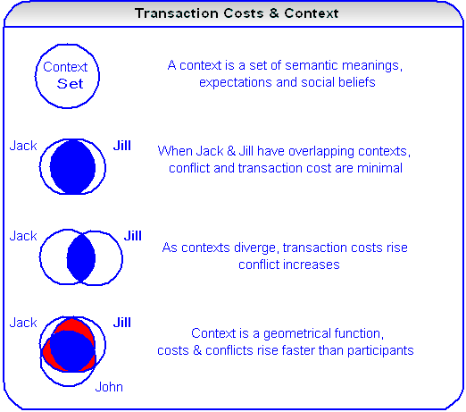
Schramm & Context

Slide 7
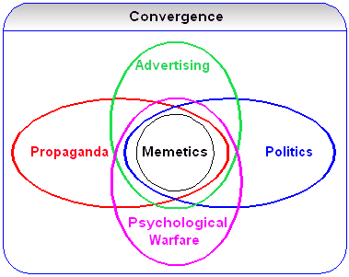
Unconventional Manipulation
Internet Is Quantifiable & Historical
These Guys Are Hacking Your Mind

Slide 8
Unconventional Manipulation
What Is The IdeoSphere? (T-shirt!)
OSI-8 Diagram
EE Majors Response
Physical Layer / Ohm’s Law

Slide 9
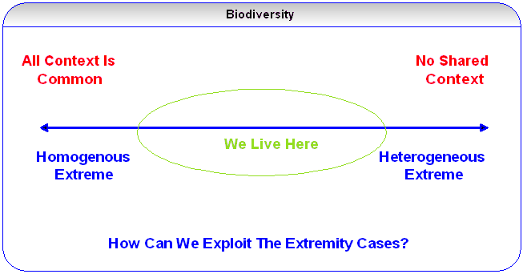
Biodiversity
Apply Biodiversity Principles To Information
Diversity Versus Conformity
Extremity Cases

Slide 10
Biodiversity
Conformity Produces Susceptibility
Absolute Conformity Is Bad!
Diversity Produces Infertility
Americans Love Diversity But…
Infinite Diversity Is Bad, Too!

Slide 11
Meme Miner
DefCon 13 Submission (kinky!)
“Poor Man’s Data-mining Tool”
Was DefCon An Appropriate Venue…

Slide 12
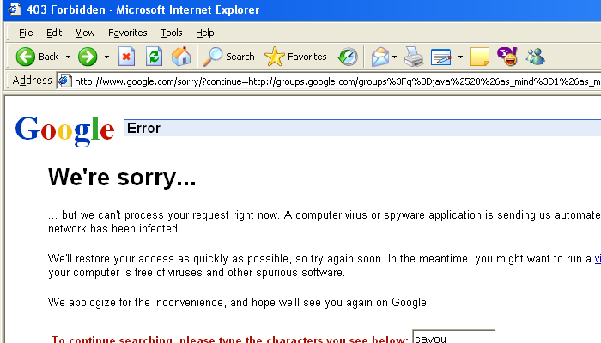
Meme Miner Banned!

Slide 13
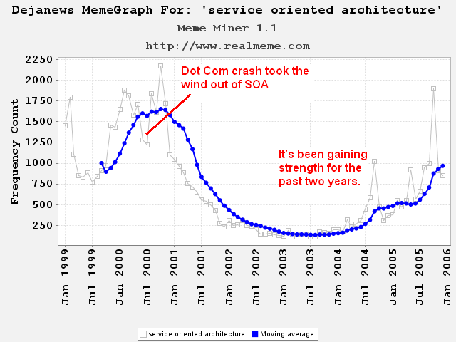
“Service Oriented Architecture”

Slide 14
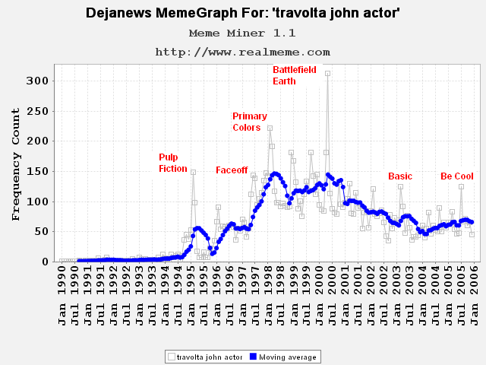
“Travolta” Meme

Slide 15
Why Use Dejanews?
Centralized Hierarchy
Balanced Taxonomy (binary tree)
Long History
Predictable Growth
Can RSS Version Duplicate Results?

Slide 16
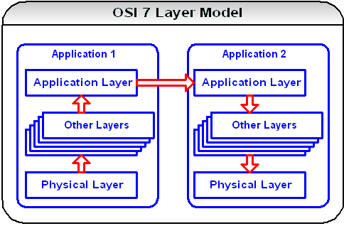
OSI-7 Network Model

Slide 17
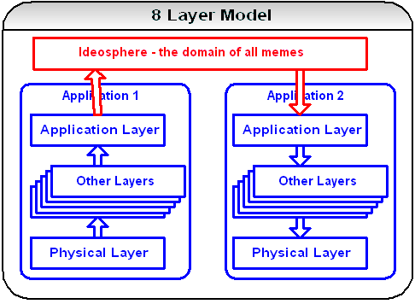
OSI-8 Network Model

Slide 18
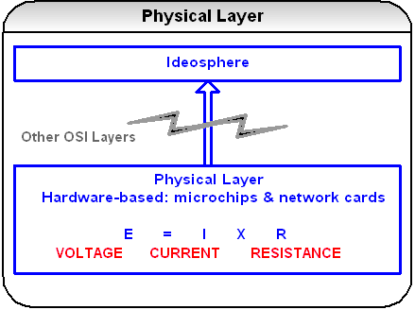
OSI Physical Layer

Slide 19
Meme Miner Expanded
Referenced Back To Physical Layer
Latency (Resistance Analogy)
Sentiment (Voltage Analogy)
Diffraction (Current Analogy)
Cultural Fingerprinting

Slide 20
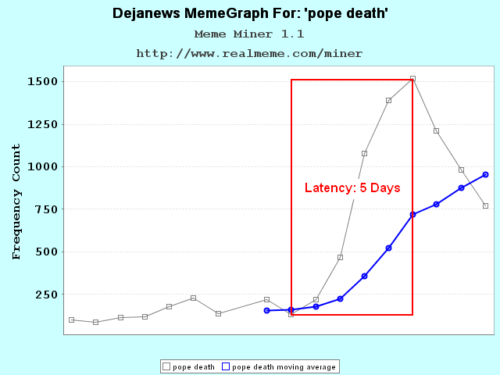
Latency

Slide 21
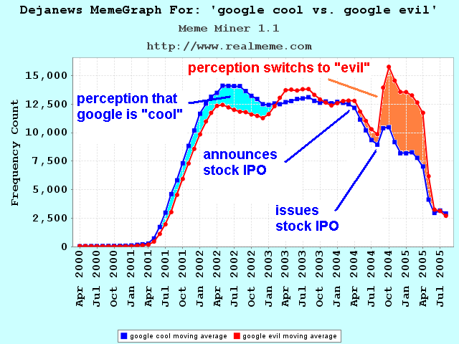
Sentiment

Slide 22
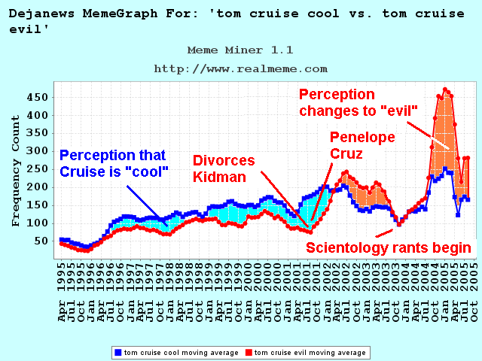
Sentiment

Slide 23
NSA & Data-mining
Quick Examples Of Possibilities
Assumption that cultures are cohesive and uniquely identifiable

Slide 24
Cultural Fingerprinting
Theory – Each culture displays a different memetic fingerprint for events
The Internet allows empirical measurement of each fingerprint

Slide 25
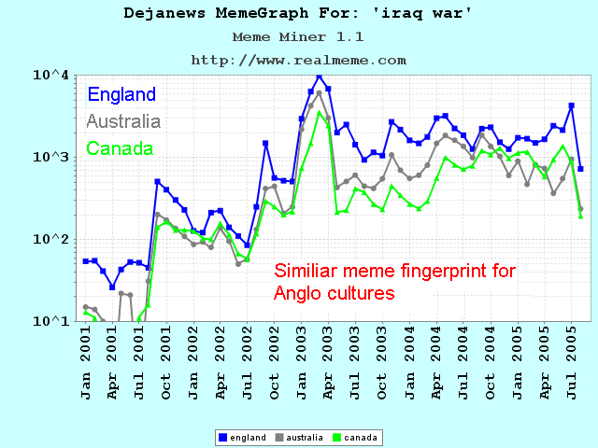
Cultural Fingerprinting

Slide 26
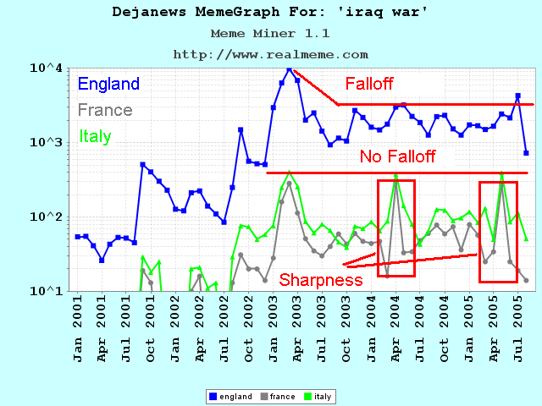
Cultural Fingerprinting

Slide 27
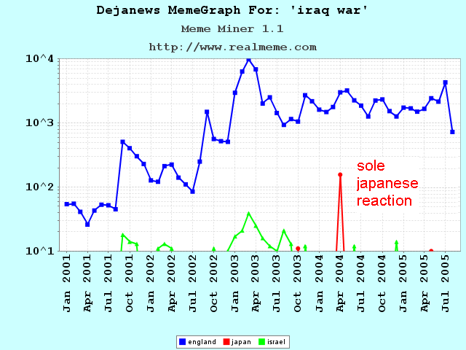
Cultural Fingerprinting

Slide 28
Saleslogix Disruption
Time – 21st Century
Location – The U.S.A.
How To Disrupt An Organization? (T-shirt)

Slide 29
Saleslogix Disruption
TELLING THE TRUTH !!
Government, Realtor, Girlfriend

Slide 30
Saleslogix
Saleslogix Background
Definition of “decimate”
The Disruption Plan

Slide 31
Saleslogix Disruption
This disruption was a function of three factors –
Common context bound by stock options and a central point of communication (Yahoo)
Operational mismanagement of a producing team for political reasons
3) Management issued questionable statements, eroding credibility

Slide 32
Saleslogix Disruption
#1 set the transport, the conduit of attack
(Yahoo financial chat board).
#2 defined the object of attack, the damaged team
(not the stock price).
#3 defined the method of attack - ridicule.
(Example – “You deserve a Pat on the back”)
.

Slide 33
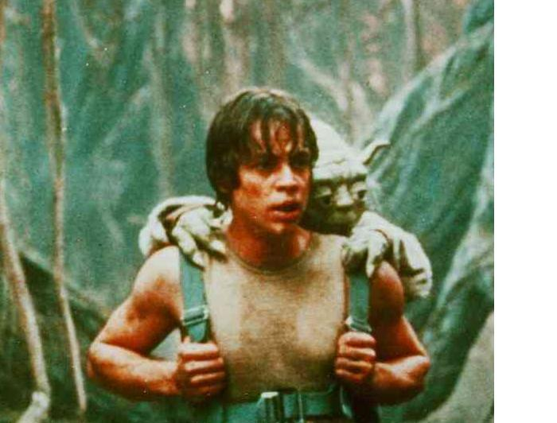
Saleslogix Disruption
.

Slide 34
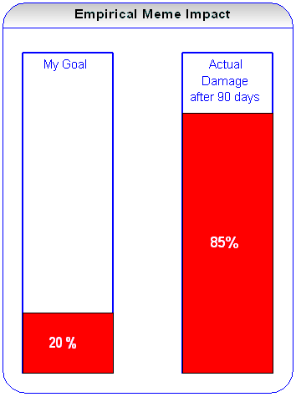
Saleslogix Disruption Results

Slide 35
Saleslogix Disruption Results
CIO Interview in 2003

Slide 36
Meme Devices
Devices For Meme Progagation
Mixed Message Pattern
Meme Injection Map (Virus Vector Analog)

Slide 37
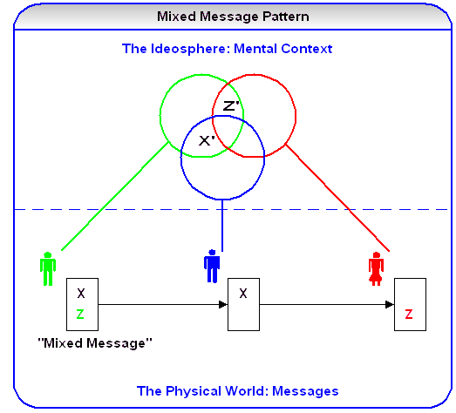
Mixed Message Pattern

Slide 38
Meme Manipulation
Overdriven Meme Example
Personal Knowledge Of Overdriven Memes
Suspicious Graphs
What Is RocketBoom? (T-Shirt!)
Expect To See More Manipulation
(Check time, if 11:35 am+ skip rest of this)

Slide 39
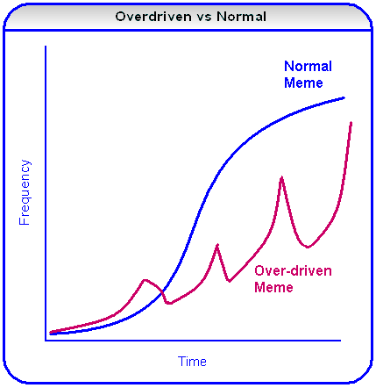
Overdriven Meme

Slide 40
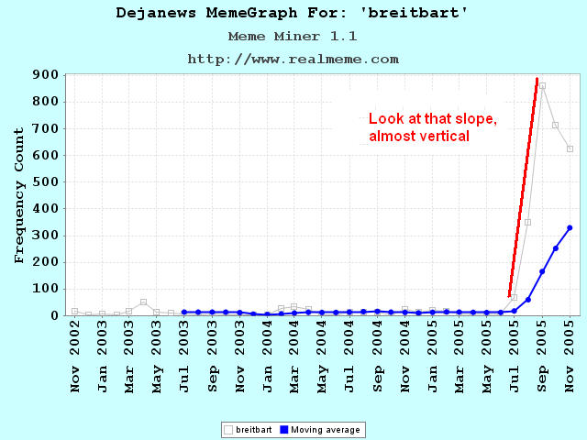
Breitbart Meme (initial)

Slide 41
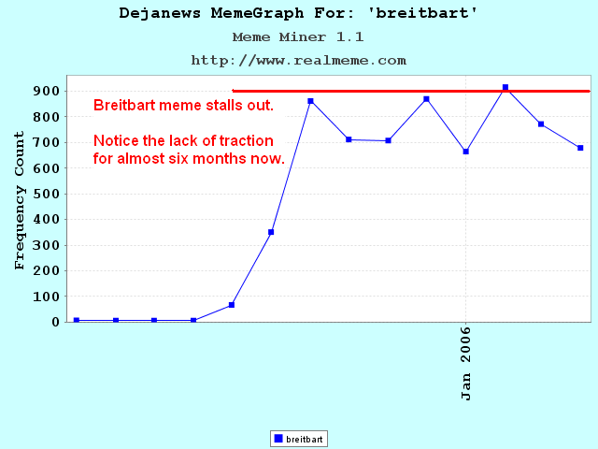
Breitbart Meme

Slide 42
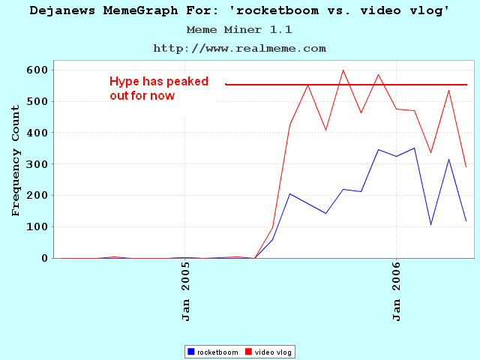
RocketBoom Meme

Slide 43
The Vector Web
Search Engines Already Collect The Data
Add A Vectoring Component
Determine Initial Meme Entry Point
Categorize Meme In A Taxonomy
Record Meme Frequency
Map Propagation Through Web

Slide 44
Cultural Diffusion
Total information grows faster than human population and it's easily duplicated, so the finite space of each skull gets a greater diversity of information than ever in history
If this is true, then a"cultural diffusion" should occur; mainstream culture should shrink as fringe cultures spawn and grow

Slide 45
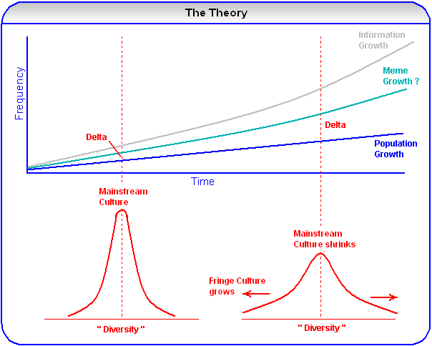
Cultural Diffusion

Slide 46
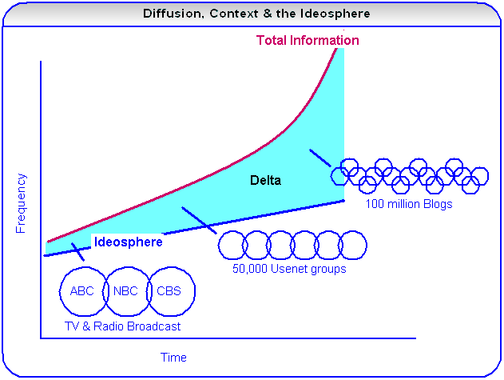
Operational View

Slide 47
Website
http://www.realmeme.com

