Slide 1
Prototyping Visualizations for the Web with Vega and Julia
Mary McGrath
JuliaCon 2019

Slide 2
Overview
Why Vega?
A Case Study
DataVoyager as a shortcut
Julia + Vega == Fast + Easy
Moving to the Web

Slide 3
Why Vega (and Vega-Lite)?
Interactive grammars of graphics developed at the University of Washington
Largely built on top of D3 – very flexible and powerful
VegaLite.jl and DataVoyager.jl
Portability

Slide 4
Case Study
Web Scraping
What are all of these JuliaCon talks about?
Use HTTP.jl and Gumbo.jl to scrape the talk info and descriptions
Tables.jl makes data movement easy
TextAnalysis.jl for basic Natural Language Processing
Now on to the fun stuff (Viz!)

Slide 5
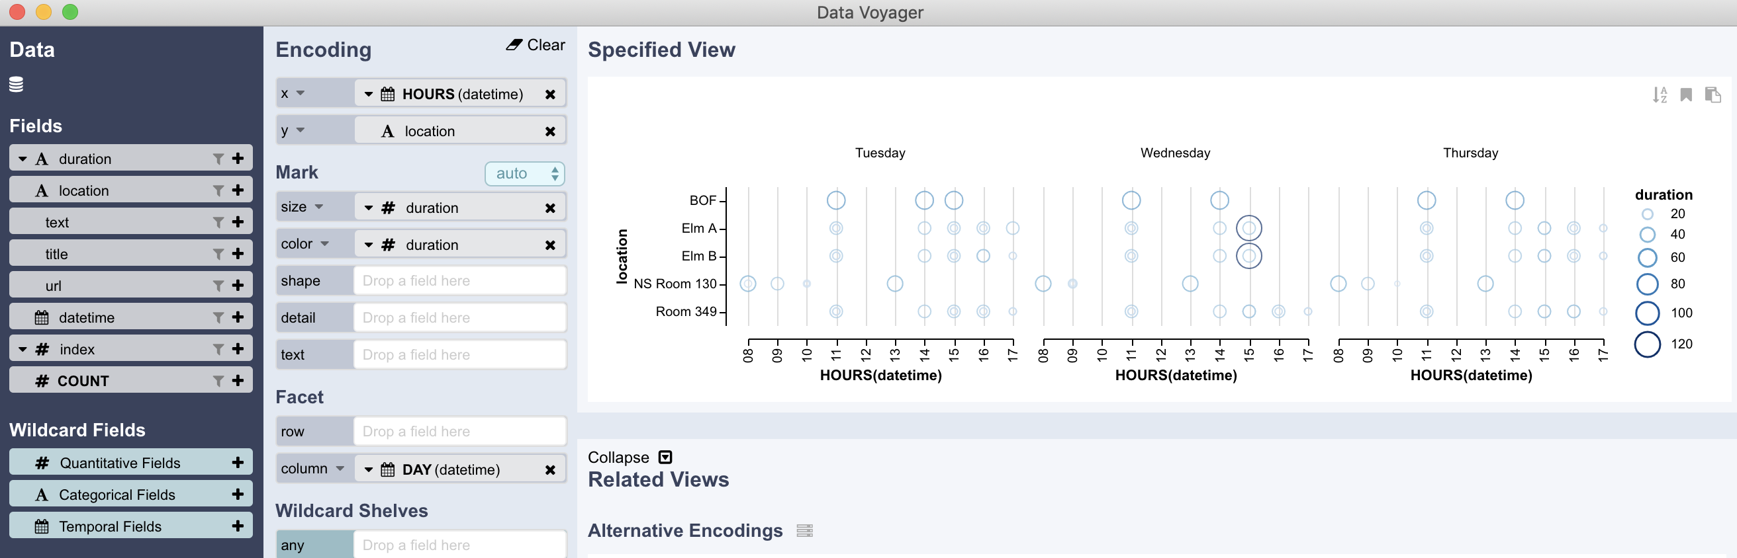
DataVoyager
Feels like cheating
`data |> Voyager()`
The magic button

Slide 6
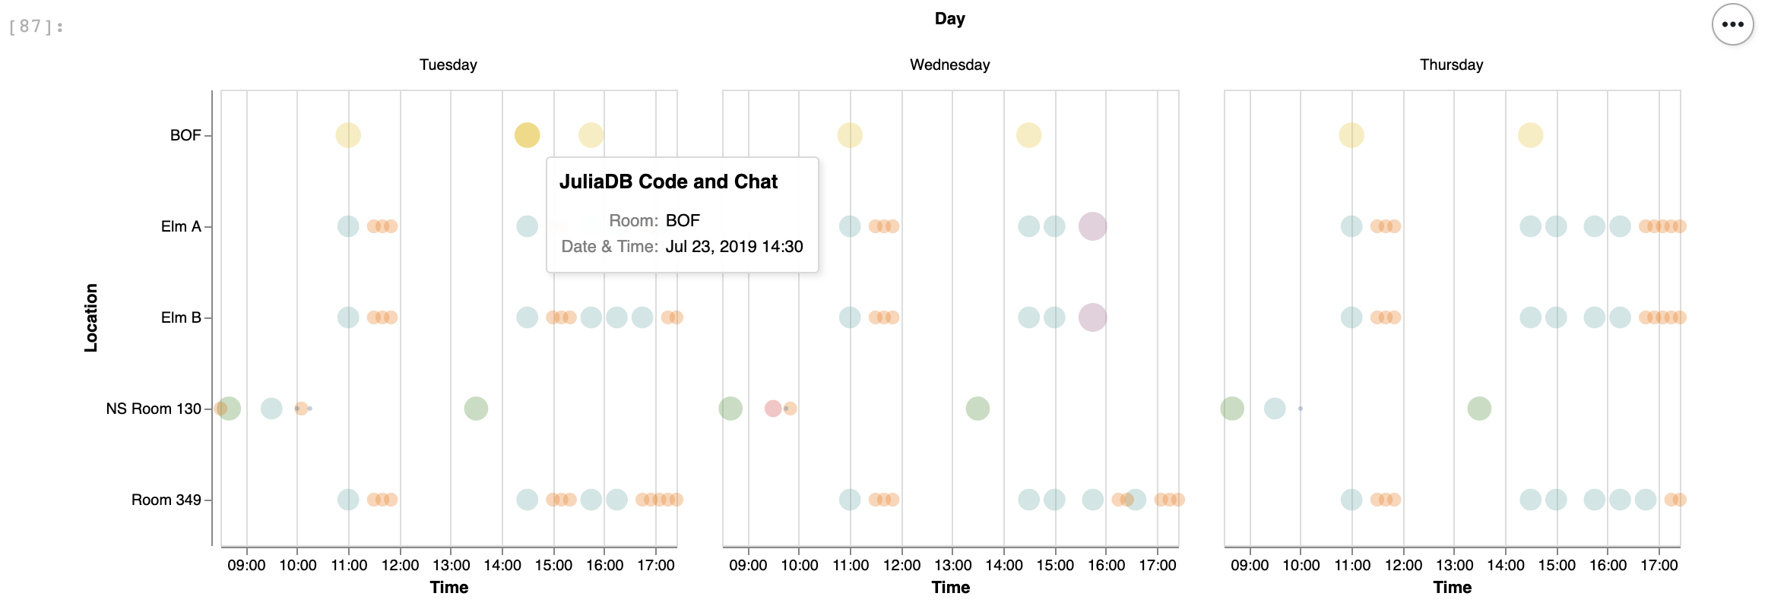
Back To Julia
DataVoyager as a starting point
Iterate using JupyterLab
All of the options in VegaLite available

