Slide 1
MVC
Cody Brown
Notes:
Hey guys. Today, I'm going to talk a little bit about MVC. What it is, how its used, and then I'll show you an example.

Slide 2
What is MVC?
Method of programming
Platform and language agnostic
Separates code by purpose and function
Enables modularity
Model
Data
View
User Interface
Control
Enables Functionality
Links the View and Model
Notes:
MVC is not proprietary to Java. It’s a method of programming. Because of this, it is platform and language agnostic. I actually learned MVC with HTML, PHP, and mySQL. Regardless of the programming or scripting language, the concept and purpose behind it remains the same.
MVC separates code by purpose and function. This enables the code to be modular. Let's look at how the code is broken up by purpose.
The M in MVC stands for Model, which is the stored data of our application
The V stands for View, which is the user interface
And the C stands for control, which enables the functionality of the application, and provides the linkage between the View and the Model

Slide 3
View
User interface
Text or GUI
Formats what the user sees
Enables user interaction
Sends commands to the control in order to:
Update or change Views
Receive and display data from the Model
Send and manipulate data in the Model
Notes:
Let's go ahead and look a little bit deeper at the View
We mentioned earlier that the View is our user interface, but it can be text in the console, or graphical, it doesn't matter.
The View formats what the user sees, and determines how they interact with the application
From the View, users are able to send commands to the Control in order to
Update or change which view the user sees
Request and receive data from the Model
Send data to and edit the data in the Model

Slide 4
Control
Interface between the View and the Model
Receives user commands and input from the View, retrieves data from the Model, forwards the data back to the View
Notes:
Let's look a little bit at the Control
The Control is the interface between the View and the Model

Slide 5
Model
Code that accesses data
Java Class or Bean that contains data for application
Interface to a database
Always called by and sends data back to the Control

Slide 6



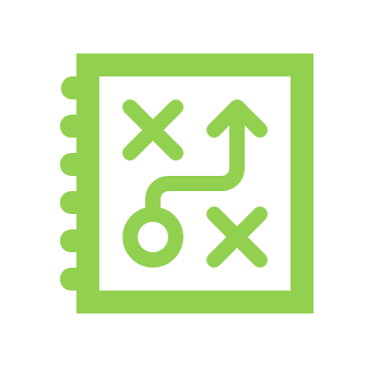
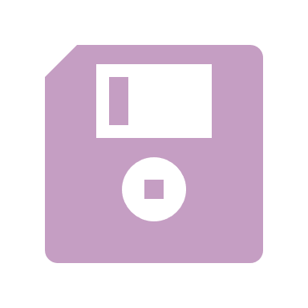
MVC
View
Control
Model

