Slide 1
Welcome to CS123
Mechanics

Slide 2
Your Staff
Professor:
Andy van Dam (avd)
Head TA:
Dave Kilian (dkilian) 2013
Undergraduate TAs:
Alec Lee (al63), 2014
Dave Storch (dstorch), 2013
Ian Strickman (istrickm), 2013
Joel Nackman (jnackman), 2014
Wil Yegelwel (wyegelwe), 2014

Slide 3
Who Should Take CS123?
Juniors or higher
CS15-16, CS17-18, or CS19 and CS32
or equivalent, with strong software engineering skills (OO design and programming, debugging)
Sophomores
did well in intro sequence
consider themselves strong programmers
willing to put in extra time up front

Slide 4
Requirements Info
If you don’t know C++, you CAN take this class
additional time investment required early on
C++ help session TOMORROW at 5:00 PM in Motorola (CIT 165)
CS123 Java to C++ transition tutorial on course website (docs page)
TAs can help you with C++ issues on hours
Linear Algebra (vector and matrix arithmetic, dot and cross products)
help session to review these concepts (later on in the semester)
Consider taking Philip Klein’s CS53: The Matrix in Computer Science
If you’re not sure you should be in CS123 or have not met the prereqs, stay after class and see Dave or email cs123headtas@cs.brown.edu

Slide 5
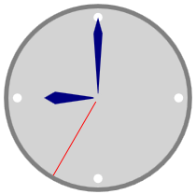

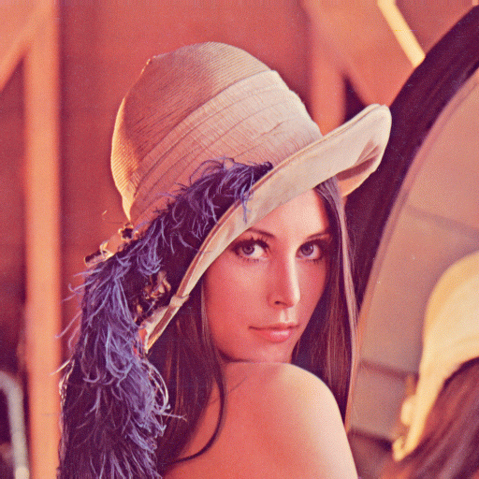
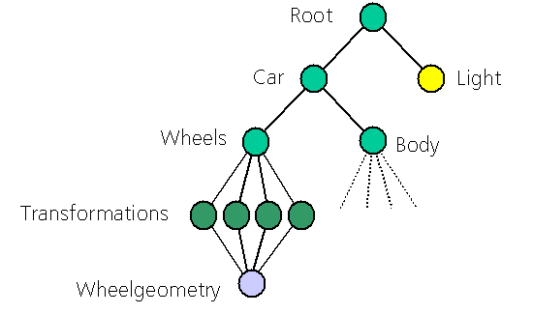
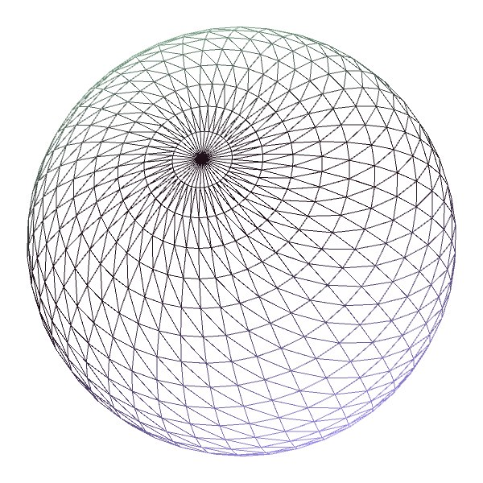
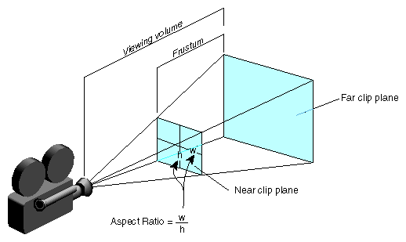
Bird’s Eye View of the Course
Quick start: 2D and 3D graphics with OpenGL
2D raster graphics
2D modeling hierarchy
basic image transformations
Basic 3D scene management
tessellation of curved surfaces
transformations (translation, rotation, scale)
virtual camera model
scenegraph traversal

Slide 6
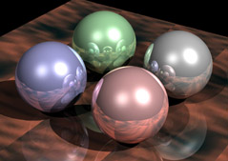
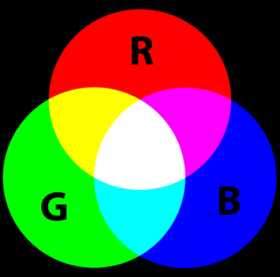
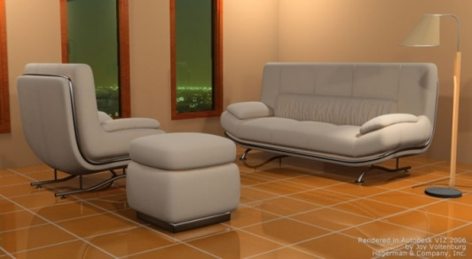
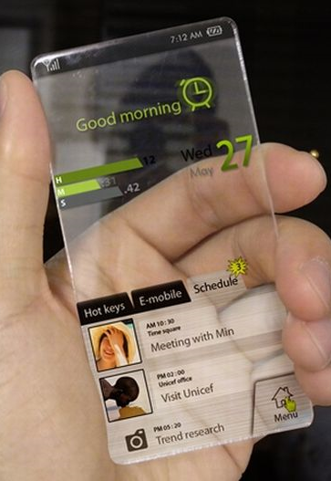
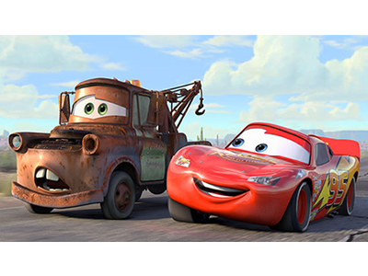
Bird’s Eye View of the Course
Modeling and Rendering
intersecting rays with simple solids
ray tracing
lighting and shadowing of polygonal models
radiosity for photorealistic rendering
hardware rendering (GLSL)
Other Topics
color theory
animation
user interfaces

Slide 7
Workload
We don’t want a killer course but it will be intense
expect 15-20 hours of work per week
Course is front-loaded, lots to learn in the first three weeks
Independent final project
expect to put in a fair amount of time during reading period

Slide 8
Handouts and Hand-ins
Course missive (online)
assignment deadlines and lecture topics are subject to change
responsible for info on course website: http://cs.brown.edu/courses/cs123
mailing list for course updates – mail will be sent to your Brown CS e-mail address
Course guide (online)
Collaboration Policy
read collaboration policy carefully before you sign because it is a contract
we’re consistent with Brown’s academic code: all written work must be your own
acknowledged collaboration on high-level design is permitted; final project may be team work
MOSS – an AI program that is usually correct – we hand-check suspicious similarity

Slide 9
Assignments
7 Programming Projects
Build up to a ray-tracing system
10 Labs
Learn what modern graphics systems can do
Real-time computer graphics and GPU shaders
3D interaction and UI
1 Final Project
Do whatever you want! Could be real time (i.e., cool shader or two) or not (i.e. path tracer), procedural geometry, demoscene, small game…
Work in pairs if you want

Slide 10
First Assignment
First assignment, Brush: warm-up exercise in C++
Out NOW (start early, especially if you’re uncomfortable with C++, bring questions to help session tomorrow)
algorithm assignment due– Sunday, September 9, noon
hand in (on paper) in the cs123 bin on the second floor of the CIT
no late hand-ins accepted, will be graded and returned same day (so you can get started coding right away)
Program due– Wednesday, September 12th, 11:59 pm

Slide 11
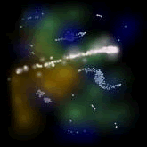
Projects
Brush – a 2d drawing program (intro to C++)
Shapes – procedural geometry
Filter – image processing
Camtrans – build your own OpenGL camera
Sceneview – 3d static scene viewer for OpenGL
Intersect – parametric shapes, ray-shape intersections
Ray – your own 3d rendering engine (demo)
each project is preceded by a short “algo” assignment, which ensures that you understand the concepts behind the project before starting to code
grad credit: you are expected to implement extra credit on every assignment

Slide 12
Labs –Fri 5-7p, Sat 2-4p in SunLab
OpenGL 2D – build a simple pong game
OpenGL 3D – build an archery simulator
Animation – learn how to light and animate scenes with OpenGL
Terrain – generate a natural-looking world environment
GL VBOs – efficient rendering with vertex buffer objects
Particles – render flame, fluid, non-rigid objects
Shaders I – procedural texturing (snow, grass, etc.)
Shaders II – make objects look like glass and metal
Bloom – framebuffer objects and post-processing efects
Modeler – build a UI for composing a scene from primitive shapes
Lab assignments are due (checked off by a TA) before the next week’s lab

Slide 13
Final Project

