Slide 1
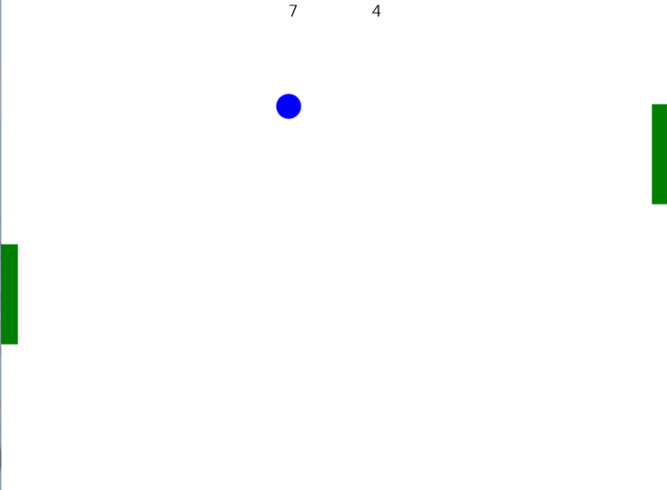
Introduction to 2D Graphics
Using OpenGL

Slide 2
Why Learn About OpenGL?
A well-known industry standard for real-time 2D and 3D computer graphics
Available on most platforms
Desktop operating systems, mobile devices (OpenGL ES), browsers (WebGL)
Older (OpenGL 1.0) API provides features for rapid prototyping; newer API (OpenGL 2.0 and newer) provides more flexibility and control
Many old features available in new API as “deprecated” functionality
Today we will use the old API exclusively
Will use a mix of the old and new APIs in lab

Slide 3
Why Learn 2D first?
A good stepping stone towards 3D – many issues much easier to understand in 2D
no need to simulate lights, cameras, the physics of light interacting with objects, etc.
intro to modeling vs. rendering and other notions
get used to rapid prototyping in OpenGL, both of designs and concepts
2D is still really important and the most common use of computer graphics, e.g. in UI/UX, documents, browsers

Slide 4
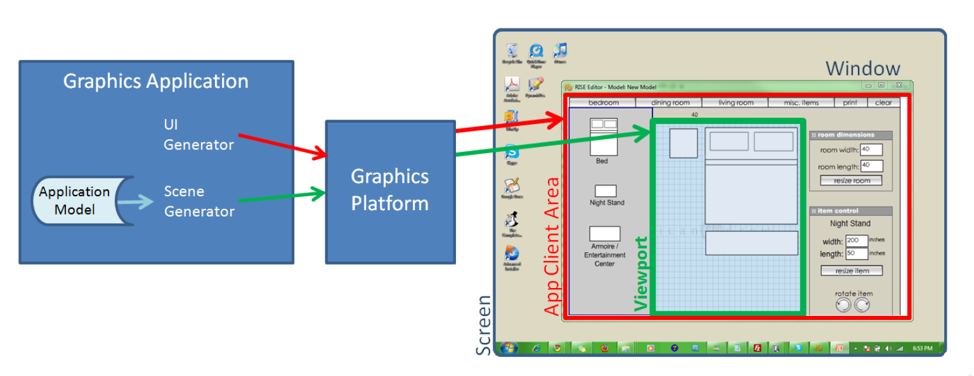
Graphics Platforms (1/4)
Applications that only write pixels are rare
Application Model (AM) is the data being represented by a rendered image
manipulated by user interaction with the application

Slide 5
Graphics Platforms (2/4)
Runs in conjunction with window manager
Determines what section of the screen is allocated to the application
Handles “chrome” (title bar, resize handles); client area is controlled by application

Slide 6
Graphics Platforms (3/4)
Typically, AM uses client area for:
user interface to collect input to the AM
display some representation of AM in the viewport
This is usually called the scene, in the context of both 2D and 3D applications
Scene is rendered by the scene generator, which is typically separate from the UI generator, which renders rest of UI

Slide 7
Graphics Platforms (4/4)
Early raster graphics packages/libraries/platforms
RamTek library 1981, Apple QuickDraw 1984
Microsoft's Graphics Display Interface (GDI 1990, now GDI+), Java.awt.Graphics2D
Earliest packages usually had these characteristics:
geometric primitives/shapes, appearance attributes specified in attribute bundles (a.k.a. ”graphical contexts”/”brushes”),
applied modally rather than in a parameter list for each primitive (too many parameters for that)
integer coordinates map directly to screen pixels on output device
immediate mode (no record kept of display commands)
no built-in functions for applying transforms to primitives
no built-in support for component hierarchy (no composite shapes)
Early packages were little more than assembly languages for display device

Slide 8
Problems with Early Graphics Platforms (1/3)
Geometric Scalability
Integer coordinates mapped to display pixels affects apparent size of image: large on low-res display & small on high-res display
Application needs flexible internal coordinate representation
floating point is essential
float to fixed conversion required; actually a general mapping

Slide 9
Problems with Early Graphics Platforms (2/3)
Display updates
To perform operations on objects in scene, application must keep list of all primitives and their attributes (along with application-specific data)
Some updates are transitory “feedback animations,” only a display change
Consider an interior-design layout application
when user picks up an object and drags to new location, object follows cursor movement
interim movements do not relate to data changes in application model, purely visual changes
application model only updated when user drops object (releases mouse button)
in immediate mode, application must re-specify entire scene each time cursor moves
Alternatively, use a retained mode platform which will store an internal representation of all objects in scene
called a display model to distinguish it from application model

Slide 10
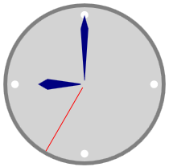
Problems with Early Graphics Platforms (3/3)
Interaction
Consider a simple clock example:
User clicks minute hand, location must be mapped to relevant application object; called pick correlation
Developer responsible for pick correlation (usually some kind of "point-in-bounding box rectangle" test based on pick coordinates)
find top-most object at clicked location
may need to find entire composite object hierarchy from lowest-level primitive to highest level composite
e.g., triangle -> hand -> clock
Solution: retained mode can do pick correlation, as it has a representation of scene

Slide 11
Modern Graphics Platforms (1/2)
Device-independent floating point coordinate system
packages convert “application-space" to "device-space" coordinates
Specification of hierarchy
support building scenes as hierarchy of objects, using transforms (scale, rotate, translate) to place children into parents' coordinate systems
support manipulating composites as coherent objects
Smart Objects (Widgets, etc.)
graphic objects have innate behaviors and interaction responses
e.g. button that automatically highlights itself when cursor is over it

Slide 12
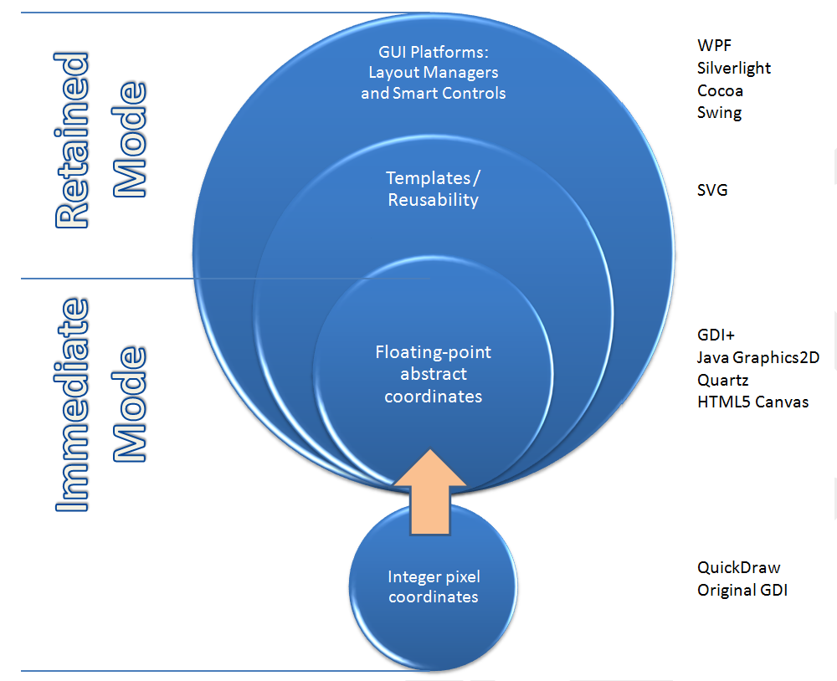
Modern Graphics Platforms (2/2)

Slide 13
Immediate Mode Vs Retained Mode
Immediate Mode (OpenGL, DirectX)
Application model: stores both geometric information and non-geometric information in Application Database.
Platform keeps no record of primitives that compose scene

Slide 14
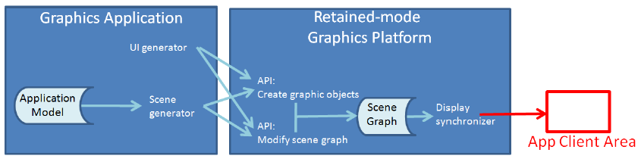
Immediate Mode Vs Retained Mode
Retained Mode (WPF, SVG)
Application model in app and Display model in platform
Display model contains information that defines geometry to be viewed
Display model is a geometric subset of Application model (typically a scene graph)
Simple drawing application does not need Application model (e.g., clock example)
No right answer on which to use – context-dependent tradeoffs (see Chapter 16)

Slide 15

OpenGL (1/3)
Immediate-mode graphics API
No display model, application must direct OpenGL to draw primitives
Implemented in C, also works in C++
Bindings available for many other programming languages
Cross-platform
Also available on mobile (OpenGL ES*) and in the browser (WebGL)
Different platforms provide ‘glue’ code for initializing OpenGL within the desktop manager (e.g. GLX, WGL)
Labs use Qt library to abstract this away
* - ES: “Embedded Systems”

Slide 16
OpenGL (2/3)
Created by Silicon Graphics Inc. (SGI, http://sgi.com) in 1992, now managed by the non-profit Khronos Group (http://khronos.org)
Originally aimed to allow any OpenGL program to run on a variety of graphics hardware devices
Invented when “fixed-function” hardware was the norm
Techniques were implemented in the hardware; OpenGL calls sent commands to the hardware to activate / configure different features
Now supports programmable hardware
Modern graphics cards are miniature, highly parallel computers themselves, with multi-core GPUs, on-board RAM, etc.
GPUs can run simple programs (called “shaders”), which render the scene while the CPU is busy doing other work
Programmers can implement new features in shaders instead of waiting for hardware vendors to support them in hardware

Slide 17
OpenGL (3/3)
Fixed-function API provides features that make it easier to prototype
e.g. the package implements much of the linear algebra needed to move objects on the screen
GL utility library (“GLU”) provides additional high-level utilities
Programmable API implements most of the fixed-function API for backwards compatibility, but still uses shaders in the background
Only true for desktop; must use shaders to program with OpenGL ES 2.0+ or WebGL

Slide 18
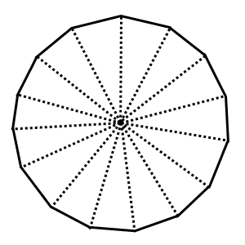
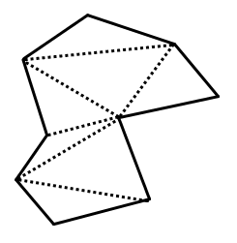
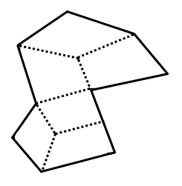
Representing Shapes
Objects in OpenGL are composed of triangles and quads. We can use these to build arbitrary polygons, and approximate smooth shapes.
A complex polygon made of triangle primitives
A complex polygon made of quad primitives
An approximate circle made of triangle primitives

Slide 19
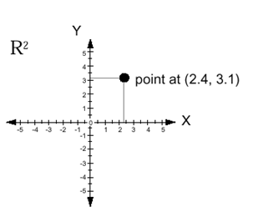
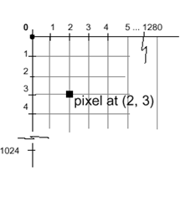
Coordinate Systems (1/6)
Cartesian coordinates in math, engineering
typically modeled as floating point
typically X increasing right, Y increasing up
Display (physical) coordinates
integer only
typically X increasing right, Y increasing down
1 unit = 1 pixel
But we want to be insulated from physical display coordinates
OpenGL is the intermediary

Slide 20
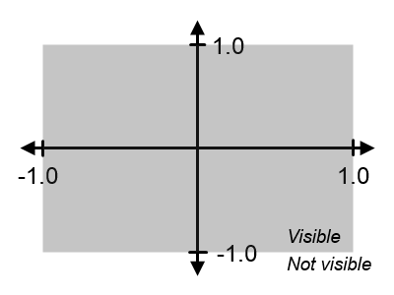
Coordinate Systems (2/6)
OpenGL Coordinates
Choose a convention
For us: X increases right, Y increases up
Units are based on the size of the window or screen
Visible area stretches to fill window
Units are percentage of window size, don’t correspond to physical units or pixels
Define coordinate system using the projection matrix glMatrixMode(GL_PROJECTION_MATRIX); // Select the projection matrix glOrtho(-1, // X coordinate of left edge 1, // X coordinate of right edge -1, // Y coordinate of bottom edge 1, // Y coordinate of top edge 1, // Z coordinate of the “near” plane -1); // Z coordinate of the “far” plane
These settings are also the OpenGL defaults

Slide 21
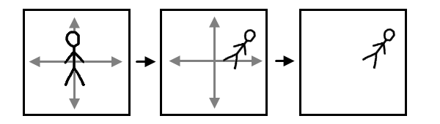
Coordinate Systems (3/6)
Two choices on how to think
Draw everything in OpenGL coordinate system
This is inconvenient: instead choose your own abstract object coordinate system to suit your needs, then specify all the primitives in your object to OpenGL using these coordinates. Specify a transformation to map the object coordinates to OpenGL coordinates.
Latter coords called “application coordinates” in 2D, “world coordinates” in 3D
When we say “transformation,” we usually mean a composition of scale, rotate and translate transforms
Object
Coordinates
Display
OpenGL Coordinates

Slide 22

Coordinate Systems (4/6)
We will illustrate the use of OpenGL by going through step-by-step how to create a simple clock application
Start by drawing a square for the clock face:
The result is a square centered in the window:
glBegin(GL_QUADS);
glVertex2f(-.7, -.7);
glVertex2f( .7, -.7);
glVertex2f( .7, .7);
glVertex2f(-.7, .7);
glEnd();

Slide 23
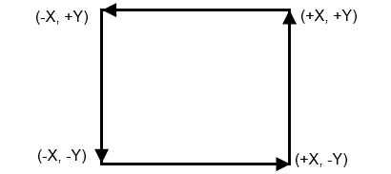
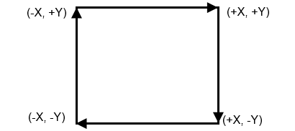
Winding Order
Order is important: vertices must be specified in counter-clockwise order relative to the viewer. Otherwise nothing shows up!
Winding order determines the direction of the lighting normal vector; if the normal is pointing the wrong way, we won’t see anything
Counter-clockwise winding consistent with the right-hand rule
glVertex2f(-.7, -.7);
glVertex2f( .7, -.7);
glVertex2f( .7, .7);
glVertex2f(-.7, .7);
glVertex2f(-.7, -.7);
glVertex2f(-.7, .7);
glVertex2f( .7, .7);
glVertex2f( .7, -.7);
N
✓
N
X

Slide 24
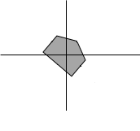
Transformations
Geometric Transformations in 2D (relative to a center for Scale and Rotate!)
Positive angles rotate counter-clockwise
Transformations can be composed (matrix composition) but are NOT commutative, so proper order is vital
Original
Rotate
Original
Translate
glTranslatef(.1, .1, 0);
glRotatef(-45, 0, 0, 1);
Original
Scale
glScalef(2, 2, 1);

Slide 25
Coordinate Systems (5/6)
To map from object coordinates to OpenGL coordinates, use the modelview matrix: glMatrixMode(GL_MODELVIEW); // glTranslatef / glRotatef / etc calls go here
OpenGL provides a stack data structure so you can erase an object’s modelview transforms after you’re done drawing the object: glMatrixMode(GL_MODELVIEW); glPushMatrix(); // Save the current modelview matrix // <apply transforms to the modelview matrix (glTranslatef, etc)> // <draw an object (glBegin, glVertex, etc)> glPopMatrix(); // Restore the saved modelview matrix // Repeat for other objects

Slide 26
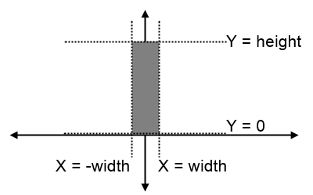
Coordinate Systems (6/6)
We’ll draw an hour hand on the clock using a quad rotated around the origin. One could do the same thing to draw minute and second hands: float hourAngle = -45; // Rotate 45 degrees clockwise float width = .01, height = .4; glMatrixMode(GL_MODELVIEW); glPushMatrix(); glRotatef(hourAngle, 0, 0, 1); // Rotate around the Z axis glBegin(GL_QUADS); glVertex2f(-width, 0); glVertex2f( width, 0); glVertex2f( width, height); glVertex2f(-width, height); glEnd(); glPopMatrix();

Slide 27
Outline of the Clock Example
// Set up coordinate system
glMatrixMode(GL_PROJECTION);
glOrtho(-1, 1, -1, 1, 1, -1); // window extents: (-1, -1) to (1, 1)
// Draw base of clock
glMatrixMode(GL_MODELVIEW); glPushMatrix(); glColor3f(.7, .7, .7); // light gray
// <draw a quad for the base of the // clock (glBegin, glVertex, glEnd)> glPopMatrix();
// Draw the hour hand // (no need to call glMatrixMode again, // it’s still GL_MODELVIEW)
glPushMatrix();
glRotatef(...);
glColor3f(0, 0, .5); // Navy blue
// <draw a quad for the hour hand>
glPopMatrix();

Slide 28
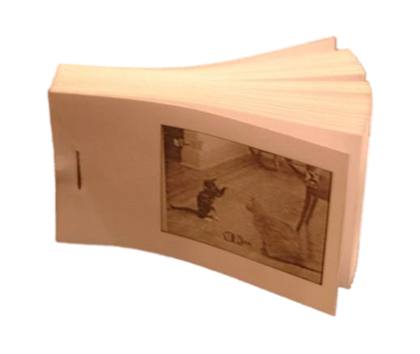
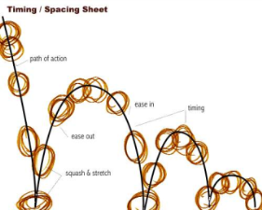
Animation (1/3)
Rapidly displaying sequence of images to create an illusion of movement
Flipbook (http://www.youtube.com/watch?v=AslYxmU8xlc)
Keyframe animation: spec keyframes, computer interpolates (e.g., ball bouncing)
Flipbook
Keyframe Animation

Slide 29
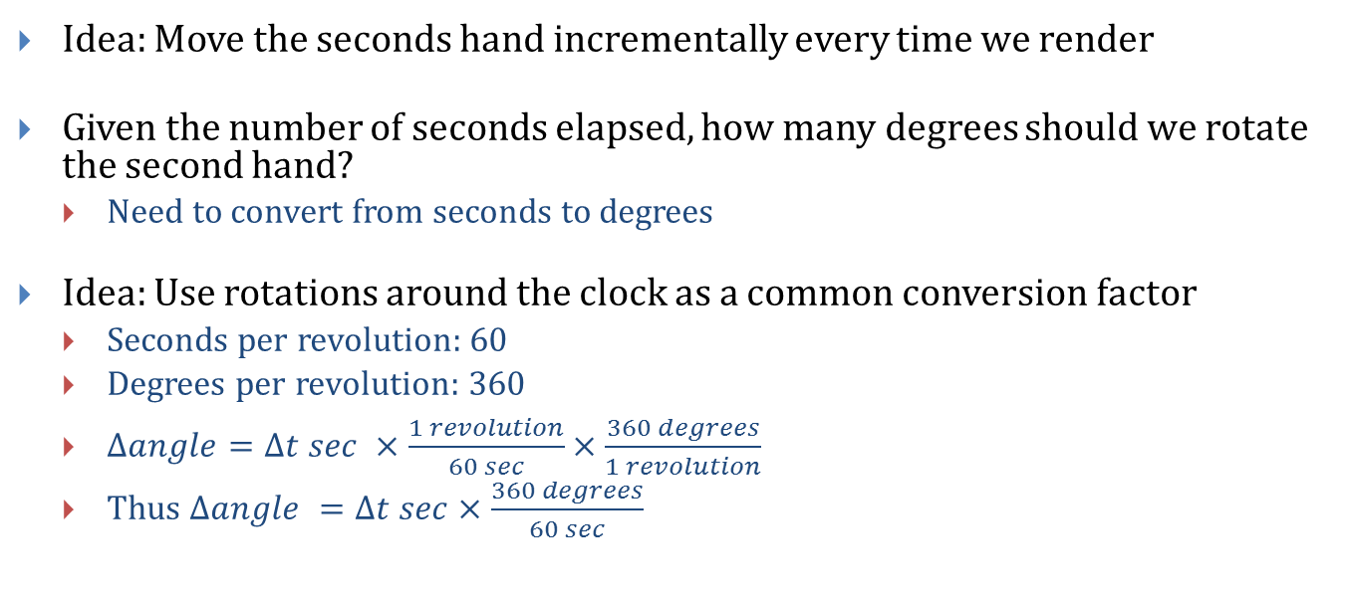
Animation (2/3)
Idea: Move the seconds hand incrementally every time we render
Given the number of seconds elapsed, how many degrees should we rotate the second hand?
Need to convert from seconds to degrees
Idea: Use rotations around the clock as a common conversion factor
Seconds per revolution: 60
Degrees per revolution: 360
$Δangle=Δt sec ×\frac{1 revolution}{60 sec}×\frac{360 degrees}{1 revolution}$
Thus $Δangle =Δt sec×\frac{360 degrees}{60 sec}$

Slide 30
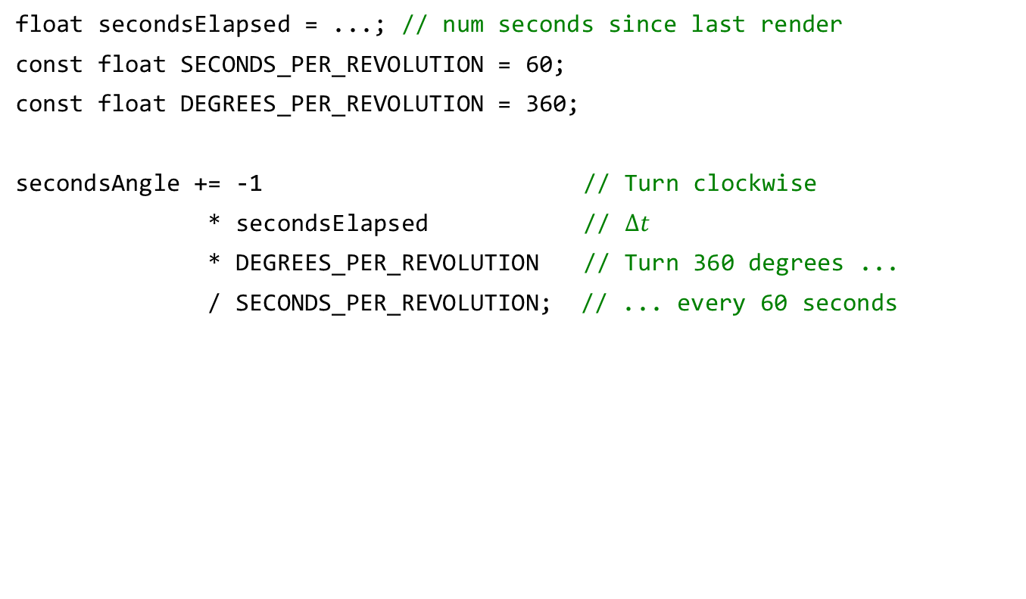
Animation (3/3)
float secondsElapsed = ...; // num seconds since last render
const float SECONDS_PER_REVOLUTION = 60;
const float DEGREES_PER_REVOLUTION = 360;
secondsAngle += -1 // Turn clockwise
* secondsElapsed // $Δt$
* DEGREES_PER_REVOLUTION // Turn 360 degrees ...
/ SECONDS_PER_REVOLUTION; // ... every 60 seconds
Clock lablet:
Run /course/cs123/bin/cs123_clock_demo
Source code: /course/cs123/src/clock_demo

Slide 31

OpenGL 2D Lab
We will have a 2D lab that will be held next week: Pong!
Generate graphics and UI for the classic game using OpenGL

Slide 32
Book Sections
Preface, Intro
Chapter 2

