Slide 1
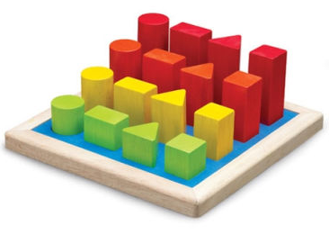
Describing Shape
Constructing Objects in Computer Graphics

Slide 2
2D Object Definition (1/3)
Lines and polylines:
Polylines: lines drawn between ordered points
A closed polyline is a polygon, a simple polygon has no self-intersections
Convex and concave polygons:
Convex: Line between any two points is inside polygon
Concave: At least one line between two points crosses outside polygon
not closed,
simple polyline
simple polygon,
closed polyline
not simple polygon,
closed polyline
convex
concave

Slide 3
2D Object Definition (2/3)
Special Polygons:
Circles:
Set of all points equidistant
from one point called the center
The distance from the center
is the radius r
The equation for a circle centered
at (0, 0) is r² = x² + y²
Triangle
Square
Rectangle
(x, y)
(0, y)
r
(0, 0)
(0, x)

Slide 4
2D Object Definition (3/3)
A circle can be approximated by a polygon with many sides.
Axis aligned ellipse: a circle scaled in the x and/or y direction
6
6
5
5
4
4
3
3
2
2
1
1
0
0
1
2
3
4
5
6
7
8
9
10
1
2
3
4
5
6
7
8
9
10
Scaled by a factor of 2 in the x direction and not scaled in the y direction. Width changes from 3.5 to 7.

Slide 5
Representing Shape
Vertex and edge tables:
General purpose, minimal overhead, reasonably efficient
Each vertex listed once
Each edge is an ordered pair of indices to the vertex list
Sufficient to draw shape and perform simple operations (transforms, point inside/outside)
Edges listed in counterclockwise order by convention
Vertices
0 | (0, 0)
1 | (2, 0)
2 | (0, 1)
3 | (2, 1)
4 | (1, 1.5)
Edges
0 | (0, 1)
1 | (1, 3)
2 | (3, 4)
3 | (4, 2)
4 | (2, 0)
E₃
V₄
E₂
V₂
V₃
E₄
E₁
E₀
V₀
V₁

Slide 6
Splines (1/5) - Representing General Curves
We can represent any polyline with vertices and edges. What about curves?
Don’t want to store curves as raster graphics (aliasing, not scalable, memory intensive). We need a more efficient mathematical representation
Store control points in a list, find some way of smoothly interpolating between them
Piecewise Linear Approximation
Not smooth, looks awful without many control points
Trigonometric functions
Difficult to manipulate and control, computationally expensive to compute
Higher order polynomials
Relatively cheap to compute, only slightly more difficult to operate on than polylines

Slide 7
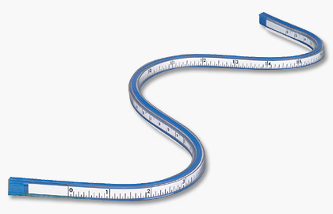
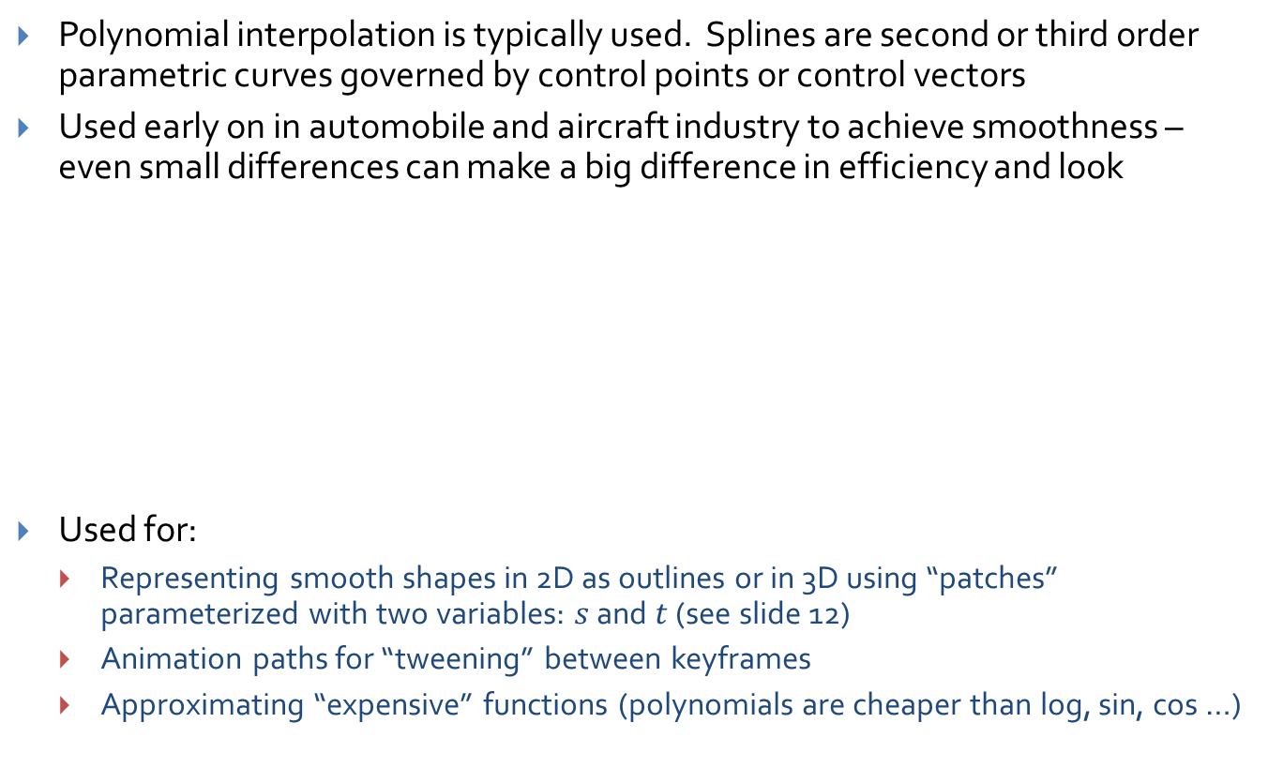
Splines (2/5) – Spline Types and Uses
Polynomial interpolation is typically used. Splines are second or third order parametric curves governed by control points or control vectors
Used early on in automobile and aircraft industry to achieve smoothness – even small differences can make a big difference in efficiency and look
Used for:
Representing smooth shapes in 2D as outlines or in 3D using “patches” parameterized with two variables: $s$ and $t$ (see slide 12)
Animation paths for “tweening” between keyframes
Approximating “expensive” functions (polynomials are cheaper than log, sin, cos …)
V₀
approximating
spline
V₂
V₃
interpolating
spline
V₅
polyline
approximation
V₁
V₄
Splines still exist outside of computers.
They’re now called flexible curves.

Slide 8

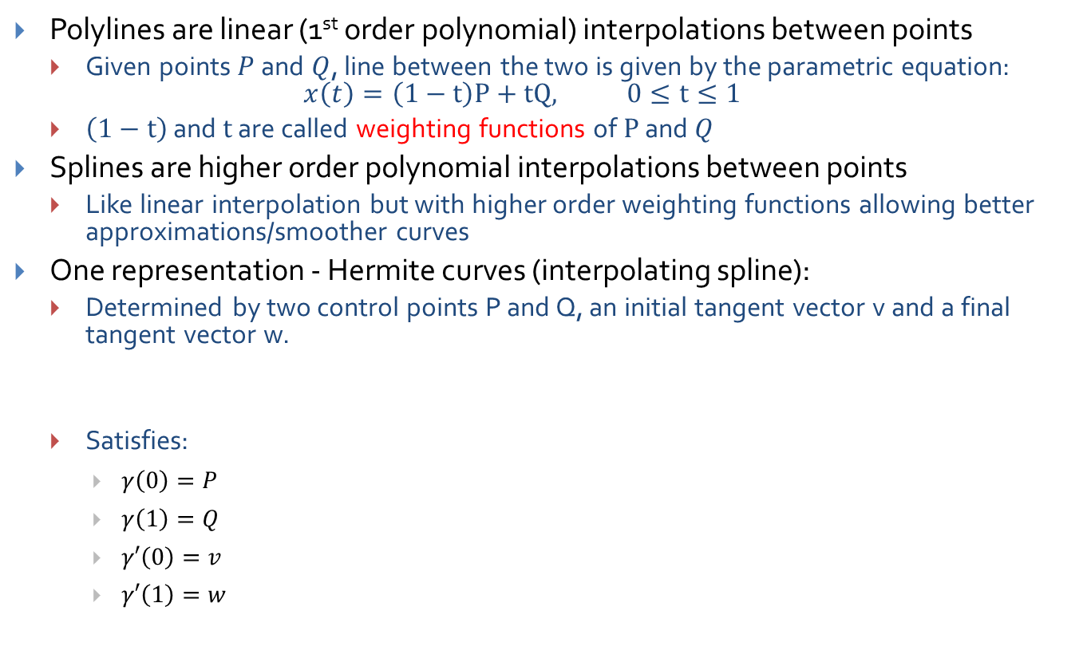

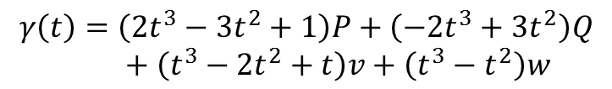

Splines (3/5) – Hermite Curves
Polylines are linear (1st order polynomial) interpolations between points
Given points $P$ and $Q$, line between the two is given by the parametric equation: $x\left(t\right)=\left(1−t\right)P+tQ, 0≤t≤1$
$\left(1−t\right)$ and $t$ are called weighting functions of $P$ and $Q$
Splines are higher order polynomial interpolations between points
Like linear interpolation but with higher order weighting functions allowing better approximations/smoother curves
One representation - Hermite curves (interpolating spline):
Determined by two control points P and Q, an initial tangent vector v and a final tangent vector w.
Satisfies:
$γ\left(0\right)=P$
$γ\left(1\right)=Q$
$γ′\left(0\right)=v$
$γ′\left(1\right)=w$
$$γ\left(t\right)=\left(2t^{3}−3t^{2}+1\right)P+\left(−2t^{3}+3t^{2}\right)Q$$
$$+ \left(t^{3}−2t^{2}+t\right)v+\left(t^{3}−t^{2}\right)w$$
$$Q: t=1$$
$$P: t=0$$
w
$$γ$$
v

Slide 9
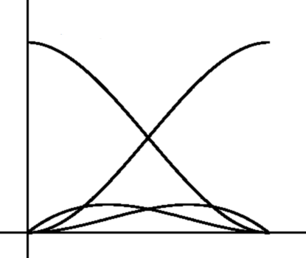
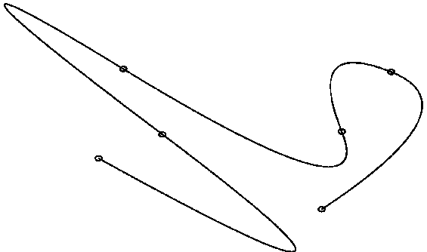

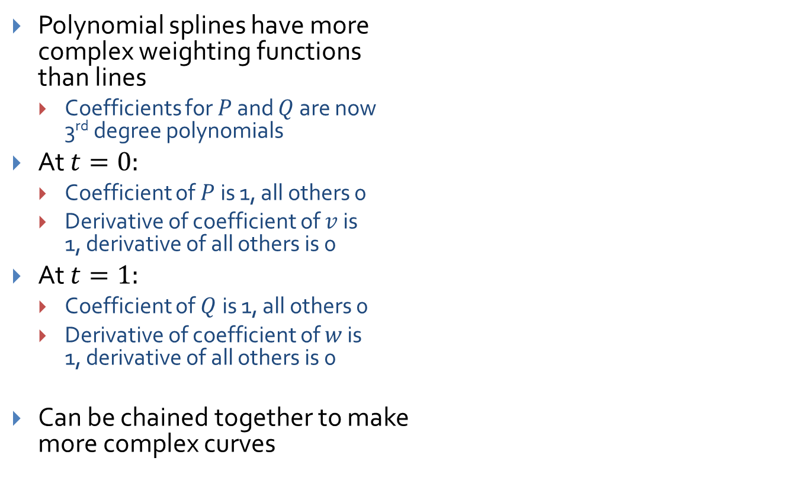




Splines (4/5) – Hermite Weighting Explained
Polynomial weighting functions in Hermite curve equation
Polynomial splines have more complex weighting functions than lines
Coefficients for $P$ and $Q$ are now 3rd degree polynomials
At $t=0:$
Coefficient of $P$is 1, all others 0
Derivative of coefficient of $v$ is 1, derivative of all others is 0
At $t=1:$
Coefficient of $Q$is 1, all others 0
Derivative of coefficient of $w$ is 1, derivative of all others is 0
Can be chained together to make more complex curves
1
$P$’s coefficient
$Q$’s coefficient
$v$’s coefficient
$w$’s coefficient
(0, 0)
1
$$t$$

Slide 10
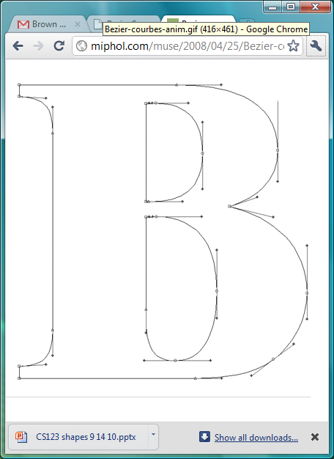
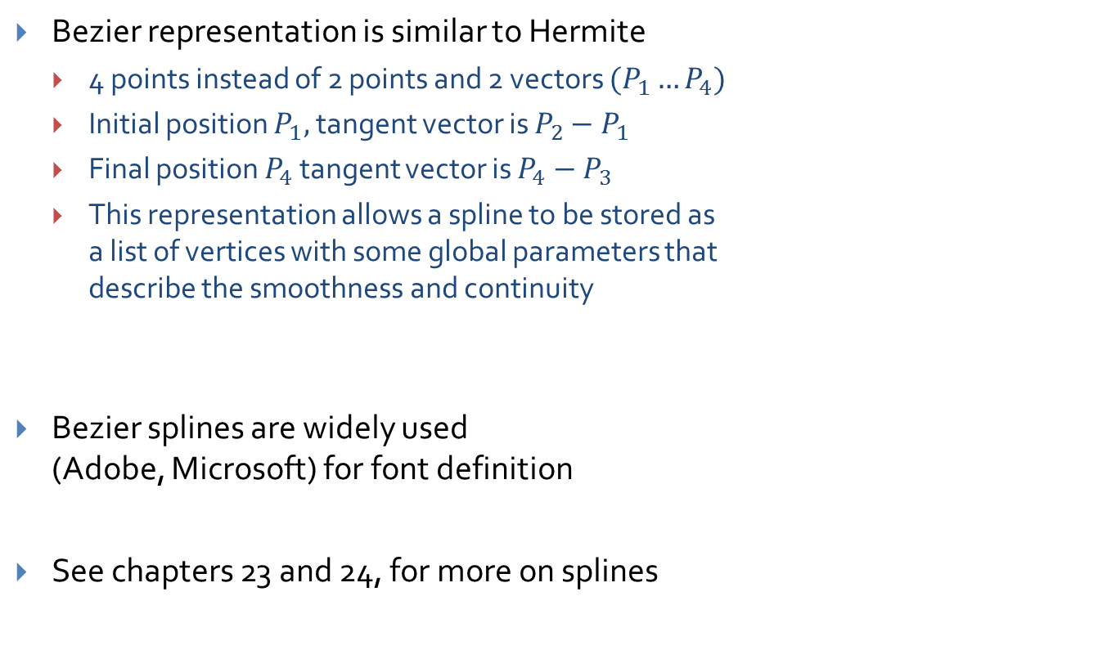
Splines (5/5) – Bezier Curves
Bezier representation is similar to Hermite
4 points instead of 2 points and 2 vectors $(P_{1}…P_{4})$
Initial position $P_{1},$ tangent vector is $P_{2}−P_{1}$
Final position $P_{4}$ tangent vector is $P_{4}−P_{3}$
This representation allows a spline to be stored as a list of vertices with some global parameters that describe the smoothness and continuity
Bezier splines are widely used (Adobe, Microsoft) for font definition
See chapters 23 and 24, for more on splines
www.cs.brown.edu/exploratories/freeSoftware/repository/edu/brown/cs/exploratories/applets/bezierSplines/bezier_splines_guide.html
Image credit:
http://miphol.com/muse/2008/04/25/Bezier-courbes-anim.gif

Slide 11
“Vertices in Motion” - Object Definition
A line is drawn by tracing a point as it moves (one dimension added)
A rectangle is drawn by tracing the vertices of a line as it moves perpendicularly to itself (2nd dimension added)
A rectangular prism is drawn by tracing the vertices of a rectangle as it moves perpendicularly to itself (3rd dimension
A circle is drawn by tracing a point swinging at a fixed distance around a center point.

Slide 12
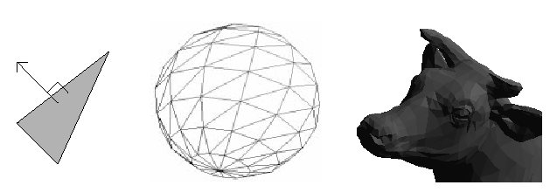
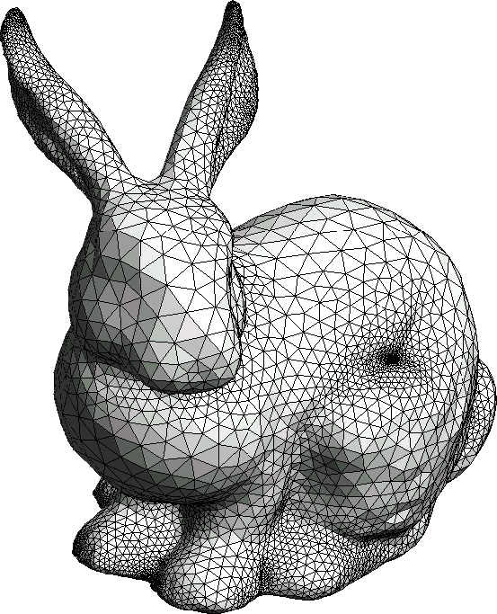
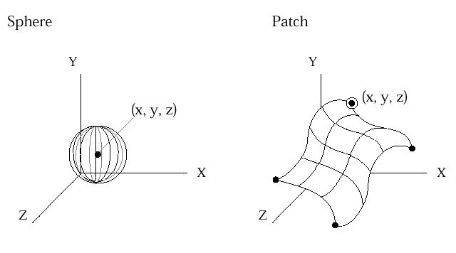
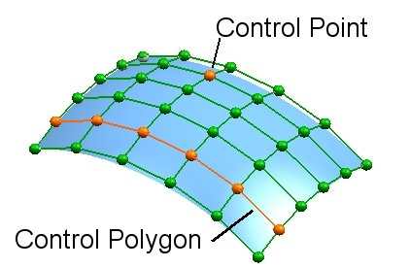
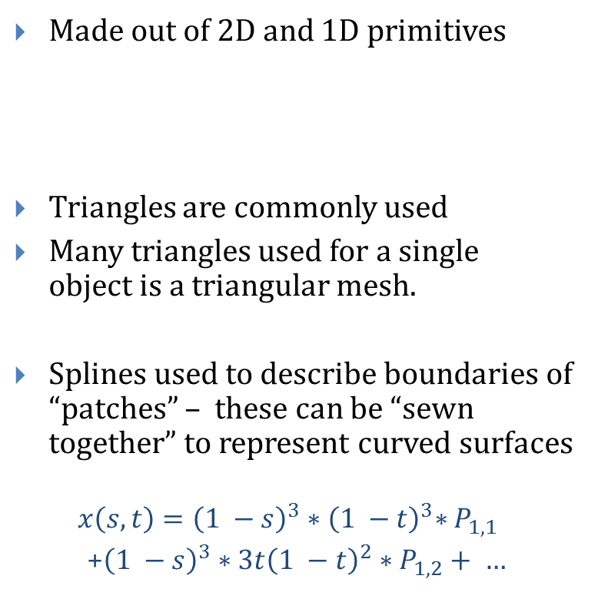
Building 3D Primitives
Made out of 2D and 1D primitives
Triangles are commonly used
Many triangles used for a single object is a triangular mesh.
Splines used to describe boundaries of “patches” – these can be “sewn together” to represent curved surfaces
$$x\left(s, t\right)={{\left(1 −s\right)}^{3}{∗\left(1 −t\right)}^{3}∗P}_{1,1}$$
+${\left(1 −s\right)}^{3}∗3t{\left(1 −t\right)}^{2}∗P_{1,2}+ …$
Image credit (Stanford Bunny):
http://mech.fsv.cvut.cz/~dr/papers/Habil/img1007.gif

Slide 13
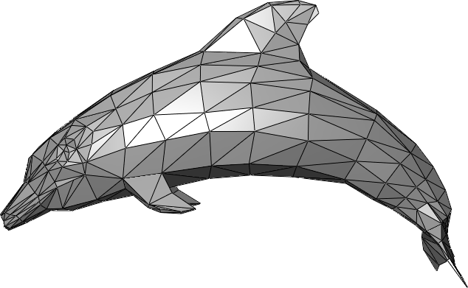
Triangle Meshes
Most common representation of shape in three dimensions
All vertices of triangle are guaranteed to lie in one plane (not true for quadrilaterals or other polygons)
Uniformity makes it easy to perform mesh operations such as subdivision, simplification, transformation etc.
Many different ways to represent triangular meshes
See chapters 8 and 25 in book, en.wikipdia.org/wiki/polygon_mesh
Mesh transformation and deformation
Procedural generation techniques (upcoming labs on simulating terrain)
Image credit:
http://upload.wikimedia.org/wikipedia/en/f/fb/Dolphin_triangle_mesh.png

Slide 14
Triangular Mesh Representation
 | Vertex List
v0 | 0, 0, 0 | f0 f1 f12 f15 f7
v1 | 1, 0, 0 | f2 f3 f13 f12 f1
v2 | 1, 1, 0 | f4 f5 f14 f13 f3
v3 | 0, 1, 0 | f6 f7 f15 f14 f5
v4 | 0, 0, 1 | f6 f7 f0 f8 f11
v5 | 1, 0, 1 | f0 f1 f2 f9 f8
v6 | 1, 1, 1 | f2 f3 f4 f10 f9
v7 | 0, 1, 1 | f4 f5 f6 f11 f10
v8 | .5, .5, 0 | f8 f9 f10 f11
v9 | .5, .5, 1 | f12 f13 f14 f15
 | Face List
f0 | v0 v4 v5
f1 | v0 v5 v1
f2 | v1 v5 v6
f3 | v1 v6 v2
f4 | v2 v6 v7
f5 | v2 v7 v3
f6 | v3 v7 v4
f7 | v3 v4 v0
f8 | v8 v5 v4
f9 | v8 v6 v5
f10 | v8 v7 v6
f11 | v8 v4 v7
f12 | v9 v5 v4
f13 | v9 v6 v5
f14 | v9 v7 v6
f15 | v9 v4 v7
Vertex and face tables, analogous to 2D vertex and edge tables
Each vertex listed once, triangles listed as ordered triplets of indices into the vertex table
Edges inferred from triangles
It’s often useful to store associated faces with vertices (i.e. computing normals: vertex normal average of surrounding face normals)
Vertices listed in counter clockwise order in face table.
No longer just because of convention. CCW order differentiates front and back of face
v4
v7
f11
f8
v8
f10
f9
v6
f0
v5
f2
f1
v0
f3
v1
v2
Diagram licensed under Creative Commons Attribution license. Created by Ben Herila based on http://upload.wikimedia.org/wikipedia/en/thumb/2/2d/Mesh_fv.jpg/500px-Mesh_fv.jpg

Slide 15
Book Sections
Chapter 8
Chapters 22 and 23 for splines (warning: pretty heavy math)
Chapter 24 for implicit shapes
Chapter 25 for meshes

