Slide 1
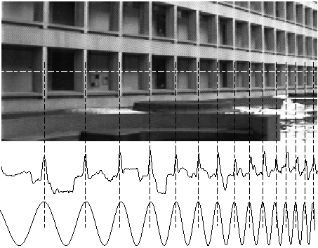
Image Processing & Antialiasing
Part II (Aliasing, Sampling, Convolution, and Filtering)
Notes:
Image from http://en.wikipedia.org/wiki/Chirp

Slide 2
Outline
Overview
Example Applications
Jaggies & Aliasing
Sampling & Duals
Convolution
Filtering
Scaling
Reconstruction
Scaling, continued
Implementation

Slide 3
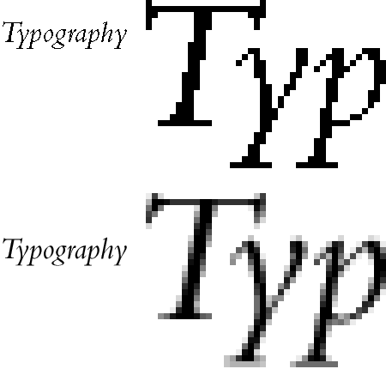
Jaggies & Aliasing
“Jaggies” an informal name for artifacts from poorly representing geometry by a 2D grid of pixels
Jaggies are a manifestation of sampling error and loss of information (aliasing)
Effect of jaggies can be reduced by anti-aliasing, which smoothes out the pixels around the jaggies
Shades of gray instead of sharp black/white transitions
Diminishes HVS’ response to sharp transitions (Mach banding)
Notes:
Image from http://webstyleguide.com/wsg2/type/graphics.html

Slide 4
Representing lines: Point sampling, single pixel
Midpoint algorithm: in each column, pick the pixel with the closest center to the line
A form of point sampling: sample the line at each of the integer X values
Pick a single pixel to represent the line’s intensity, full on or full off
Doubling resolution in x and y only lessens the problem, but costs 4 times memory, bandwidth, and scan conversion time!
Note: This works for -1 < slope < 1, use rows instead of columns for the other case or there will be gaps in the line
Line approximation using point sampling
Approximating same line at 2x the resolution

Slide 5
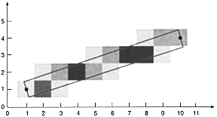
Representing lines: Area sampling
Represent the line as a unit width rectangle, use multiple pixels overlapping the rectangle (for now we think of pixels as squares)
Instead of full on/off, calculate each pixel intensity proportional to the area covered by the unit rectangle
A form of unweighted area sampling:
Only pixels covered by primitive can contribute
Distance of pixel center to line doesn’t matter
Typically have more than one pixel per column

Slide 6
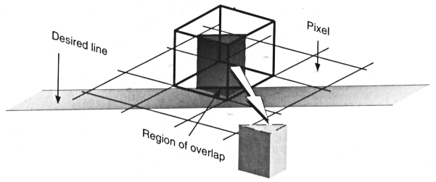
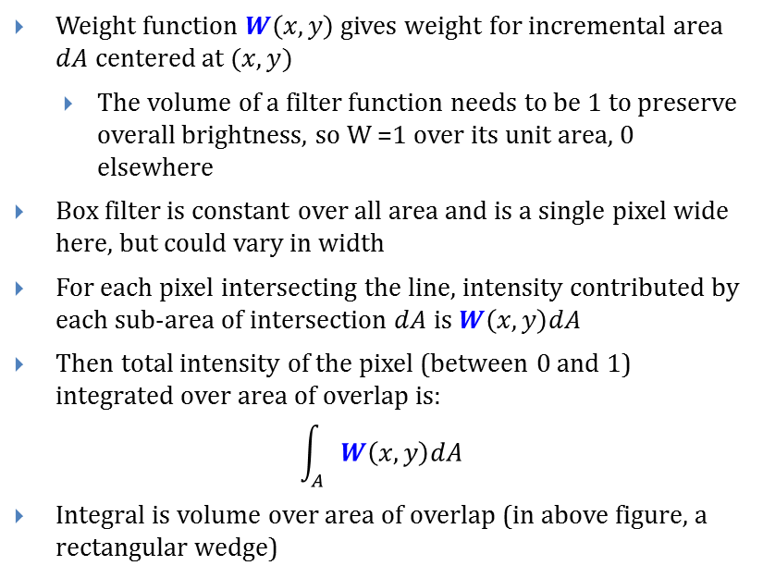

“Box Filter” Represents Unweighted Area Sampling
Weight function $W\left(x, y\right)$ gives weight for incremental area $dA$ centered at $(x, y)$
The volume of a filter function needs to be 1 to preserve overall brightness, so W =1 over its unit area, 0 elsewhere
Box filter is constant over all area and is a single pixel wide here, but could vary in width
For each pixel intersecting the line, intensity contributed by each sub-area of intersection $dA$ is $W\left(x,y\right)dA$
Then total intensity of the pixel (between 0 and 1) integrated over area of overlap is:
$$\int_{A}{W\left(x,y\right)dA}$$
Integral is volume over area of overlap (in above figure, a rectangular wedge)
$$W$$

Slide 7
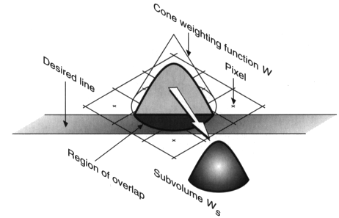
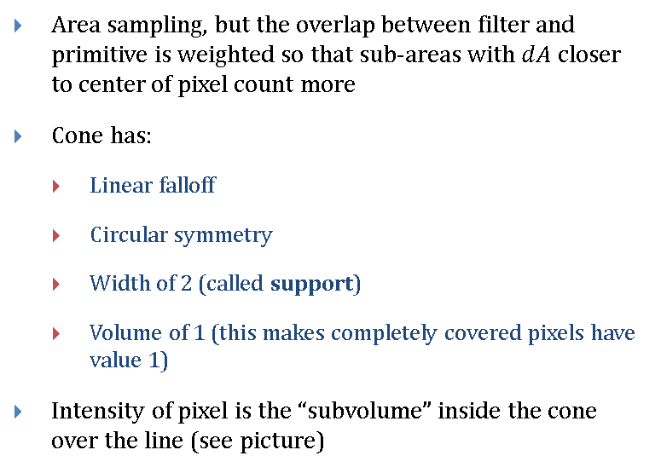
“Cone Filter” for Weighted Area Sampling
Area sampling, but the overlap between filter and primitive is weighted so that sub-areas with $dA$ closer to center of pixel count more
Cone has:
Linear falloff
Circular symmetry
Width of 2 (called support)
Volume of 1 (this makes completely covered pixels have value 1)
Intensity of pixel is the “subvolume” inside the cone over the line (see picture)

Slide 8
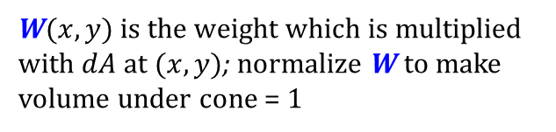
Weighted Area Sampling Continued
W
Pixel center (+)
2-unit circular support of filter
Area of overlap between support and primitive
Differential area dA₁
Differential area dA₂
Primitive
W$(x,y)$ is the weight which is multiplied with $dA$ at $(x,y)$; normalize W to make volume under cone = 1

Slide 9
Another Look at Point Sampling
A
C
D
B
Point-sampling problems. Samples are shown as black dots. Object A and C are sampled, but corresponding objects B and D are not.
This simplistic scan conversion algorithm only asks if a mathematical point is inside the primitive or not
Bad for sub-pixel detail which is very common in high-quality rendering where there may be many more micro-polygons than pixels!

Slide 10
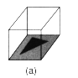
Another Look at Unweighted Area Sampling (Box filter)
Box filter
Support: 1 pixel
Sets intensity proportional to area of overlap
Creates “winking” of adjacent pixels
(b)
Unweighted area sampling. (a) All sub-areas in the pixel are weighted equally. (b) Changes in computed intensities as an object moves between pixels.

Slide 11
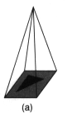
Another Look at Weighted Area Sampling (Pyramid filter)
Pyramid filter
Support: 1 pixel
Approximates circular cone to emphasize area of overlap close to center of pixel
(b)
Weighted area sampling. (a) sub-areas in the pixel are weighted differently as a function of distance to the center of the pixel. (b) Changes in computed intensities as an object moves between pixels.

Slide 12
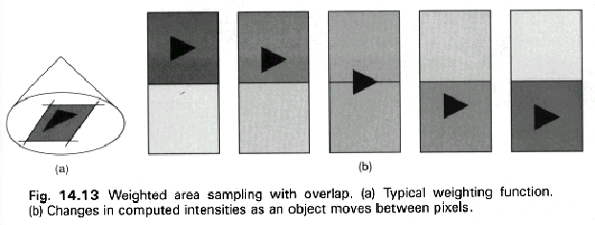
Another Look at Weighted Area Sampling (Cone filter)
Cone filter
Support: 2 pixels
Greater smoothness in the changes of intensity
(b)
Weighted area sampling with overlap. (a) Typical weighting function. (b) Changes in computed intensities as an object moves between pixels.

Slide 13
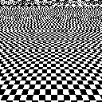
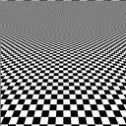
Pseudocode and Results
for each pixel p:
place filter centered over p
for each pixel q under filter:
weight = filter value over q
p.intensity += weight * q.intensity
Aliased
Anti-aliased
Crawlies demo!
Notes:
Temporal aliasing: http://www.youtube.com/watch?v=t81FDjCd8qo

Slide 14

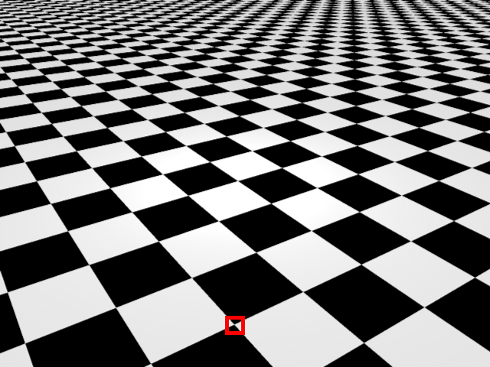
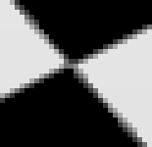
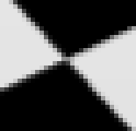
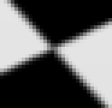
Anti-Aliasing Example
Close-up of original, aliased render
Antialiasing Techniques:
Blur filter – weighted average of neighboring pixels
Supersampling - sample multiple points within a given pixel and average the result
Checkerboard with Supersampling
Supersampling and Blurring

Slide 15
Outline
Overview
Example Applications
Jaggies & Aliasing
Sampling & Duals
Convolution
Filtering
Scaling
Reconstruction
Scaling, continued
Implementation

Slide 16
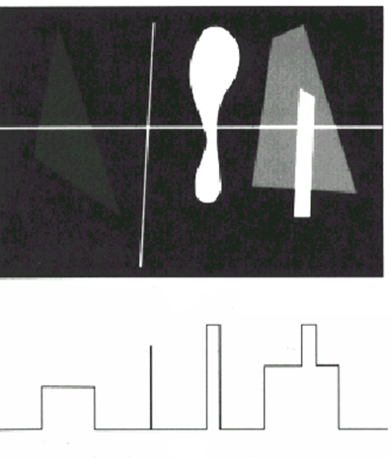
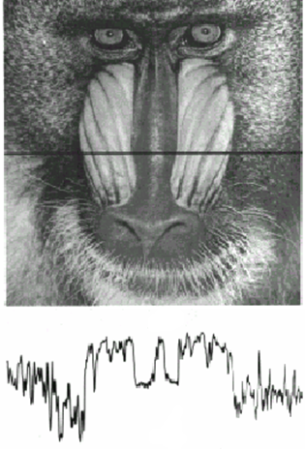
Sampling of Images
Scan converting an image is digitizing (sampling) a series of continuous intensity functions, one per scan line
We will use single scan lines for simplicity, but everything still applies to images
Scan line from synthetic scene
Scan line from natural scene

Slide 17
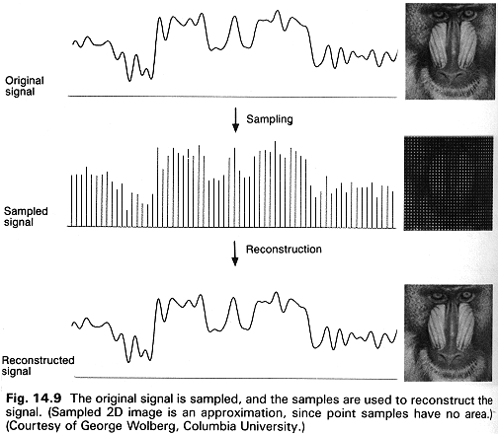
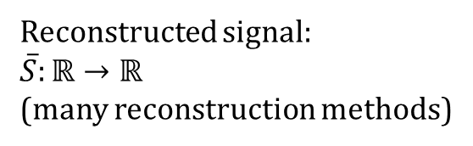
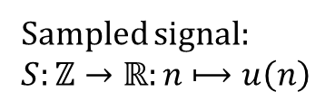
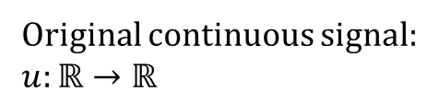
The Sampling/Reconstruction/Display Pipeline
Original continuous signal:
$$u:ℝ→ℝ$$
Sampled signal:
$$S:ℤ→ℝ:n⟼u\left(n\right)$$
Reconstructed signal:
$$\overline{S}:ℝ→ℝ$$
(many reconstruction methods)
One reconstruction method (linear interpolation):
$\overline{S}\left(x\right)=\left(n+1−x\right)∙S\left(n\right)+\left(x−n\right)∙S\left(n+1\right),$ $n=\left\lfloor x\right\rfloor$

Slide 18
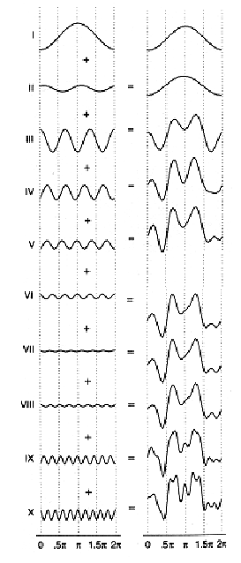
Fourier Waveform Synthesis
A signal can be approximated by summing sine (and cosine) waves of different frequencies, phases, and amplitudes
A signal has 2 representations. We’re familiar with the spatial domain, but every signal also exists in the frequency domain
Approximation of scan line from image improves with more sine waves

Slide 19
Digression: Music
Intensity of sound is pressure wave amplitude
Frequency of pressure wave is “pitch”
Lowest frequency is “fundamental frequency”
Integer multiples of the fundamental frequency are called “harmonics”
Power of two multiples of the fundamental frequency are called “octaves”
For more, applets to interact with these concepts:
http://homepages.gac.edu/~huber/fourier/index.html
http://www.phy.ntnu.edu.tw/ntnujava/index.php?topic=17
http://www.chem.uoa.gr/Applets/AppletFourier/Appl_Fourier2.html

Slide 20
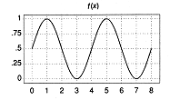
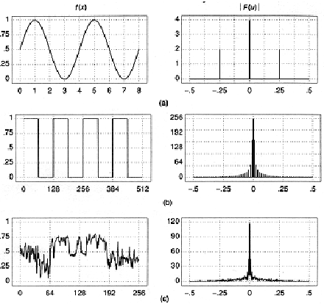
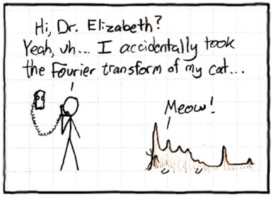
Frequency Spectrum of a Signal
Signal Domain
Frequency Domain
Sine wave is characterized by amplitude and frequency
Frequency of a sine wave is number of cycles per second for audio, or number of cycles per unit length (e.g., inter-pixel distance) for images
Can characterize any waveform by enumerating amplitude and frequency of all its component sine waves (Fourier transform – see chapter 18 in book)
This can be plotted as a “frequency spectrum”, a.k.a. power spectrum, (we ignore negative frequencies, but they are needed for mathematical correctness)
To see spatial and frequency domains of simple signals: http://www.cs.brown.edu/exploratories/freeSoftware/repository/edu/brown/cs/exploratories/applets/fft1DApp/1d_fast_fourier_transform_guide.html

Slide 21
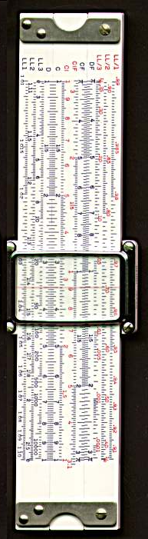
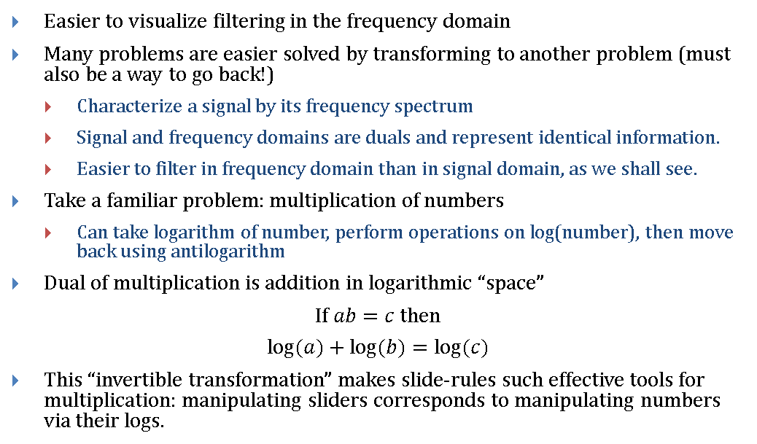
Analogous Operations, Duals
Easier to visualize filtering in the frequency domain
Many problems are easier solved by transforming to another problem (must also be a way to go back!)
Characterize a signal by its frequency spectrum
Signal and frequency domains are duals and represent identical information.
Easier to filter in frequency domain than in signal domain, as we shall see.
Take a familiar problem: multiplication of numbers
Can take logarithm of number, perform operations on log(number), then move back using antilogarithm
Dual of multiplication is addition in logarithmic “space”
If $ab=c$ then
$$log⁡(a)+log⁡(b)=log⁡(c)$$
This “invertible transformation” makes slide-rules such effective tools for multiplication: manipulating sliders corresponds to manipulating numbers via their logs.

Slide 22
Sampling: The Nyquist Limit
In order to capture all frequencies in a signal, we must sample at a rate that is higher than 2 times the highest frequency in the signal (the Nyquist limit)
Here is an approximate analog sine wave:
The sine wave sampled at an acceptable rate (4 times the highest frequency):
Reconstructed wave based on these samples:

Slide 23



Aliasing: Know Thine Enemy
Aliasing occurs when we sample a signal at less than twice maximum frequency
Here is our analog sine wave again:
Here is the sine wave sampled at too low a rate:
Here is the reconstructed wave based on these samples:
The reconstruction isn’t even close!

Slide 24

Aliasing: In Real Life
Ever seen tires spin in a movie? Have you ever noticed that sometimes, they seem to be spinning backwards?
Its because the video frame-rate is lower than twice the frequency at which the wheels spin. This is temporal aliasing!
You see this a lot in movies because the effect is so striking. It’s known as the stage-coach effect.
Porsche Dyno Test
Notes:
Picture from http://farm4.static.flickr.com/3515/4078342137_9a63d7e5f8.jpg. Creative Commons License.

Slide 25


Sampling at the Nyquist Limit
Sampling right at the Nyquist limit can also be problematic
Here is our perfect analog sine wave again:
Here is the sine wave sampled at the Nyquist limit. This time it works fine:
Here is the same sine wave sampled at the Nyquist limit, with the sample points shifted. Now we get no signal:
For an applet dedicated to illustrating the Nyquist Limit:
http://www.cs.brown.edu/exploratories/freeSoftware/repository/edu/brown/cs/exploratories/applets/nyquist/nyquist_limit_guide.html

Slide 26
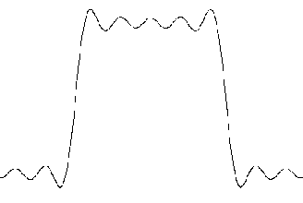
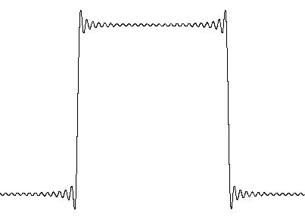
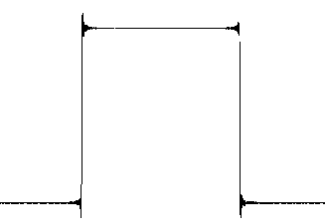
The Enemy is Recognized
Aliasing is shown in bottom diagrams on previous slides – Signals that are sampled at too low a rate can reconstruct high frequencies as low frequencies
These low frequencies are “aliases” of high frequencies
The low sampling rate data could not adequately represent the high frequency components, so it represented them incorrectly, as low frequencies
So, we just sample above the Nyquist limit, right?
Regrettably, we can’t always do that
What about this?
Let’s try using Fourier Synthesis
Number of sine waves:
5
25
125

Slide 27
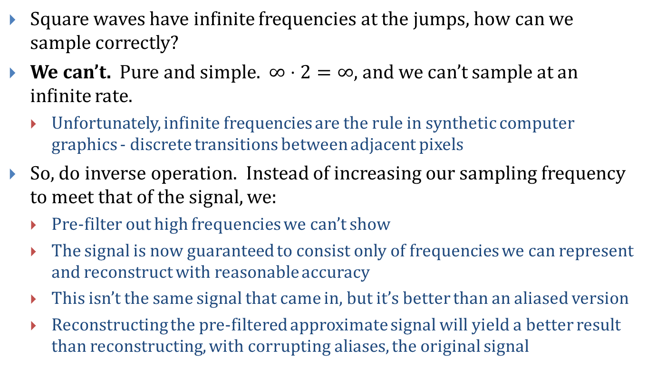
Infinite Frequencies
Square waves have infinite frequencies at the jumps, how can we sample correctly?
We can’t. Pure and simple. $∞⋅2=∞$, and we can’t sample at an infinite rate.
Unfortunately, infinite frequencies are the rule in synthetic computer graphics - discrete transitions between adjacent pixels
So, do inverse operation. Instead of increasing our sampling frequency to meet that of the signal, we:
Pre-filter out high frequencies we can’t show
The signal is now guaranteed to consist only of frequencies we can represent and reconstruct with reasonable accuracy
This isn’t the same signal that came in, but it’s better than an aliased version
Reconstructing the pre-filtered approximate signal will yield a better result than reconstructing, with corrupting aliases, the original signal

Slide 28
Infinite Frequencies
The more high frequencies we pre-filter out, the lower the sampling frequency needed but the less the filtered signal resembles original.
Note: pre-filtering is often just abbreviated as filtering, but the prefix “pre” helps remind us that post-filtering (i.e., another stage of filtering after image computation or transformation) is also practiced. If it is done on the reconstructed samples of the original signal, it will blur in the aliases present in the corrupted reconstruction!

Slide 29
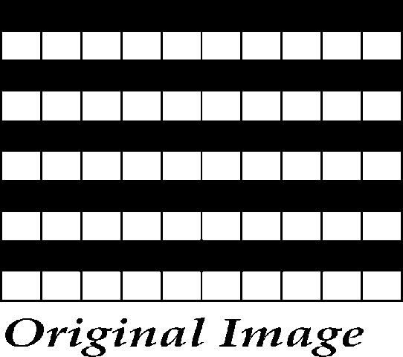
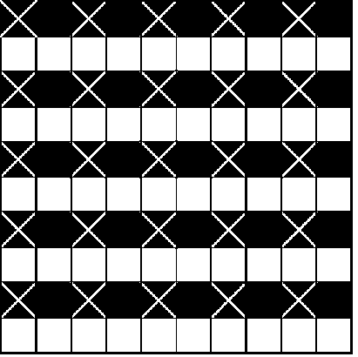
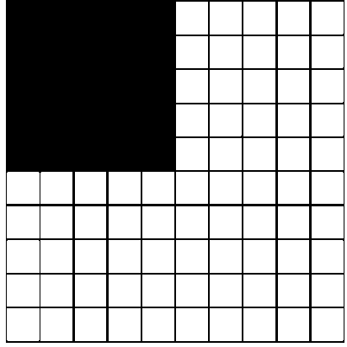
Scale Aliasing, or “Why do we have to pre-filter?”
Image with sample points marked
Image scaled using point samples
Original Image
This doesn’t look right at all. There are no stripes and the image now has a blacker average.

Slide 30

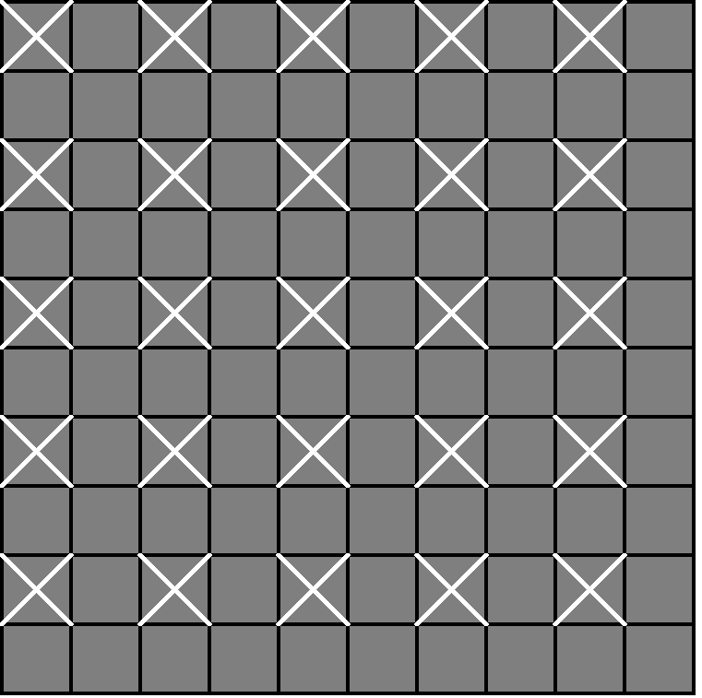
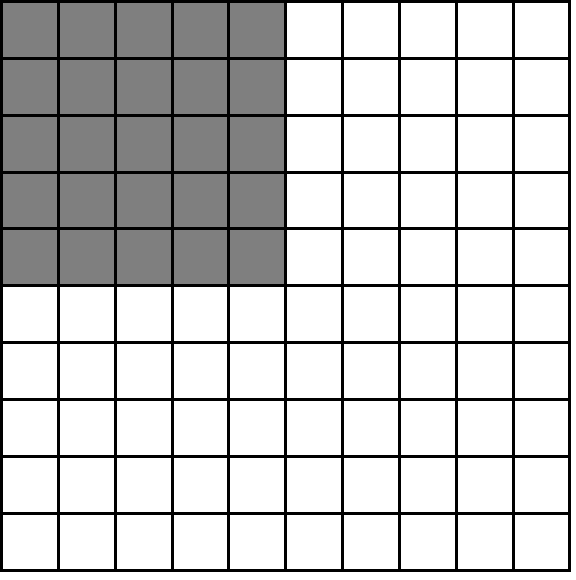
Scale Aliasing II, or “Close, but no cigar?”
Prefiltered image with samples marked
Prefiltered image scaled
Original Image
Better, but not perfect

Slide 31
Scale Aliasing III, or “Why is it still wrong?”
The scaled image with pre-filtering looked a little better, but we still couldn’t see any stripes
The filter made scaled image have same relative brightness, but no stripes
Filter removed “high frequencies” from image
Discontinuities that were stripes
Given number of points to represent image once scaled, not enough points to represent high frequencies
We’ll never be able to represent frequencies higher than ½ our sampling rate. We can’t do better than this blurred approximation
Remember Nyquist limit

Slide 32
Outline
Overview
Example Applications
Jaggies & Aliasing
Sampling & Duals
Convolution
Filtering
Scaling
Reconstruction
Scaling, continued
Implementation

Slide 33
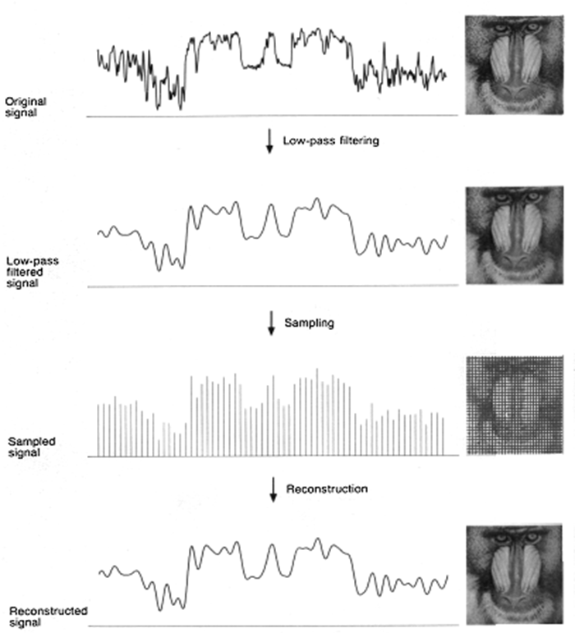
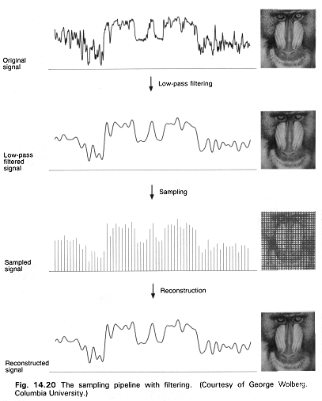
Low-Pass Filtering (Spatial Domain)

Slide 34
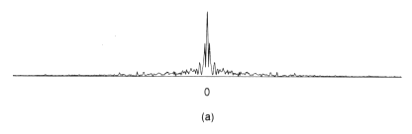
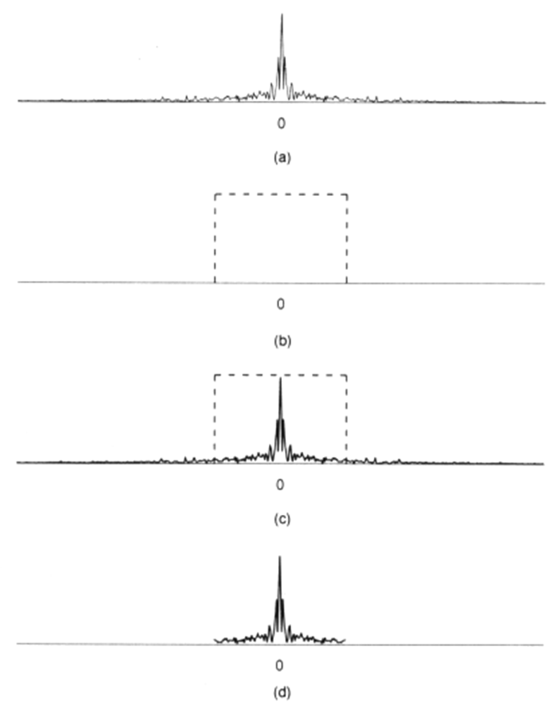
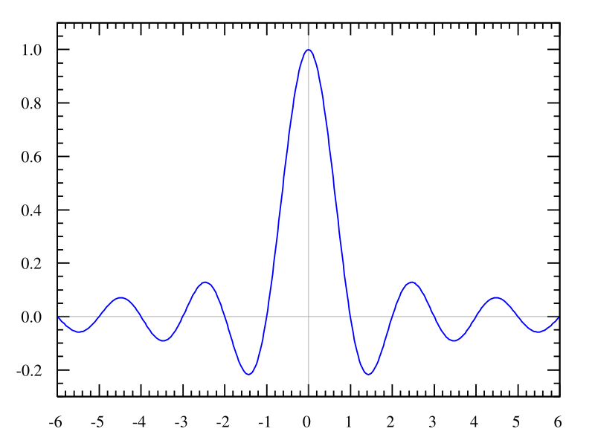
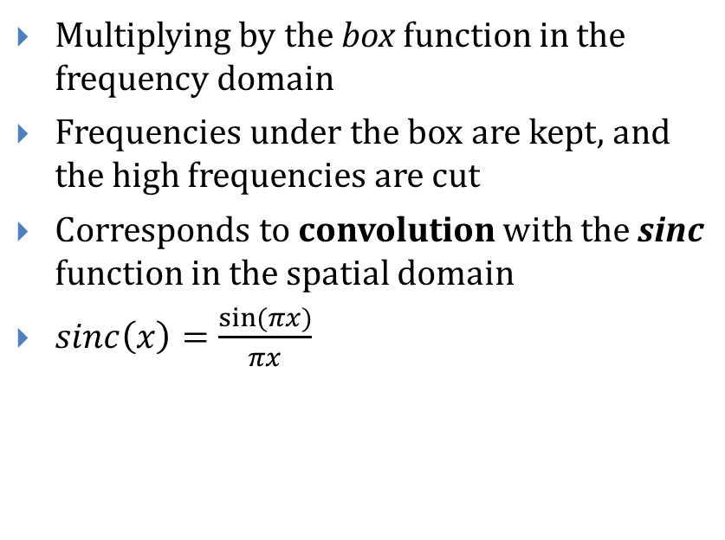
Ideal Low-Pass Filtering (Frequency Domain)
Multiplying by the box function in the frequency domain
Frequencies under the box are kept, and the high frequencies are cut
Corresponds to convolution with the sinc function in the spatial domain
$sinc\left(x\right)=\frac{sin⁡(πx)}{πx}$
Notes:
Sinc image from http://commons.wikimedia.org/wiki/File:Sinc_function_(normalized).svg

Slide 35
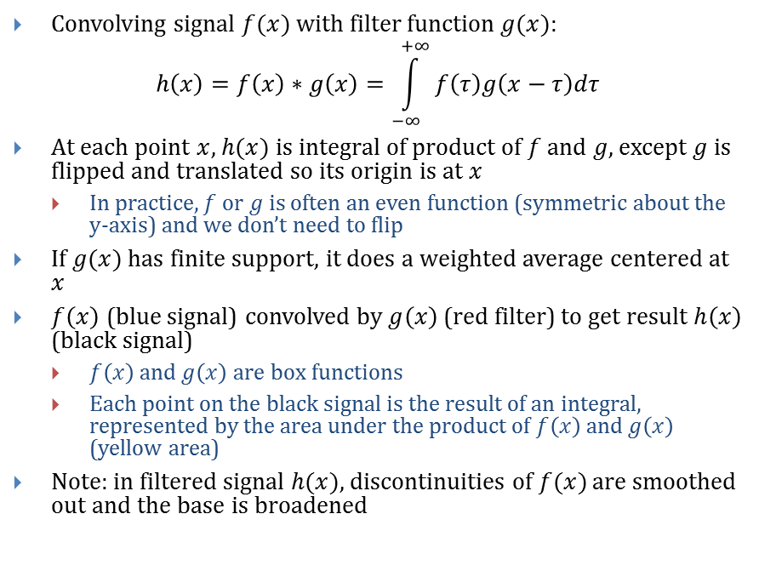
Convolution
Convolving signal $f(x)$ with filter function $g(x)$:
$$h\left(x\right)=f\left(x\right)∗g\left(x\right)=\int_{−∞}^{+∞}{f\left(τ\right)g\left(x−τ\right)dτ}$$
At each point $x$, $h(x)$ is integral of product of $f$ and $g$, except $g$ is flipped and translated so its origin is at $x$
In practice, $f$ or $g$ is often an even function (symmetric about the y-axis) and we don’t need to flip
If $g(x)$ has finite support, it does a weighted average centered at $x$
$f\left(x\right)$ (blue signal) convolved by $g\left(x\right)$ (red filter) to get result $h\left(x\right)$ (black signal)
$f\left(x\right)$ and $g\left(x\right)$ are box functions
Each point on the black signal is the result of an integral, represented by the area under the product of $f\left(x\right)$ and $g\left(x\right)$ (yellow area)
Note: in filtered signal $h(x)$, discontinuities of $f(x)$ are smoothed out and the base is broadened
http://www.cs.brown.edu/exploratories/freeSoftware/repository/edu/brown/cs/exploratories/applets/convolution/convolution_guide.html
Notes:
Image from http://en.wikipedia.org/wiki/Convolution

Slide 36

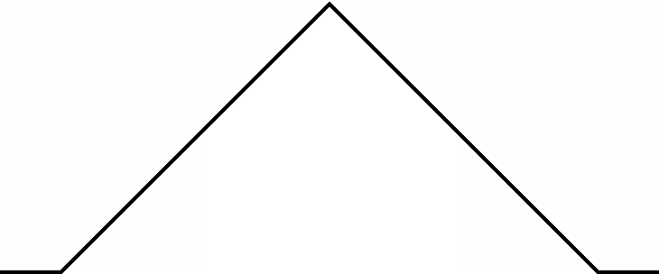
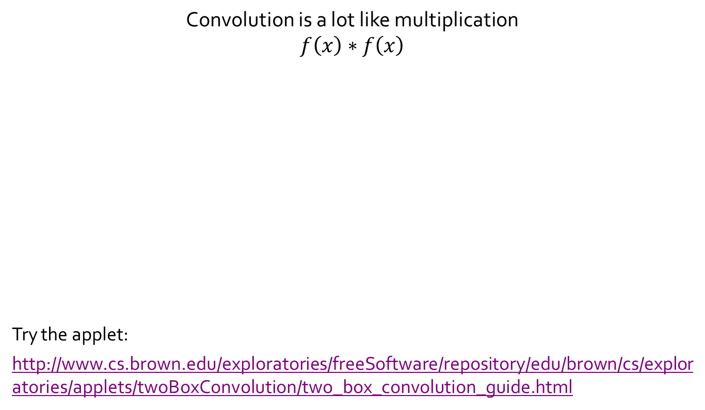
Simple Convolution Example
Convolution is a lot like multiplication
$$f\left(x\right)∗f\left(x\right)$$
Try the applet:
http://www.cs.brown.edu/exploratories/freeSoftware/repository/edu/brown/cs/exploratories/applets/twoBoxConvolution/two_box_convolution_guide.html
1111
×1111
1111
1111
1111
+1111
1234321
*

Slide 37


Properties of Convolution
Commutative
$$f∗g=g∗f$$
Associative
$$f∗\left(g∗h\right)=\left(f∗g\right)∗h$$
Distributive
$$f∗\left(g+h\right)=\left(f∗g\right)+\left(f∗h\right)$$
Identity
$$f∗δ=f$$
$δ$ is the Dirac delta function
$0$ everywhere except at $δ\left(0\right)=∞$
Area under $δ$ is $1$
$$\int{δ\left(x\right)dx}=1$$
Can be thought of as the limit as a Gaussian narrows
$$δ\left(x\right)=\lim_{a→0}{\frac{1}{a\sqrt{π}}e^{{−x^{2}}/{a^{2}}}}$$

Slide 38
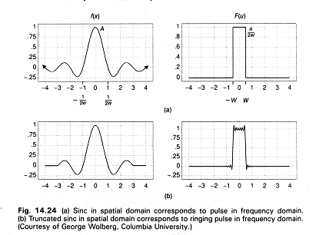
Duals
Sinc in spatial domain corresponds to box/pulse in frequency domain
Truncated sinc in spatial domain corresponds to ringing pulse in frequency domain – decent approximation to perfect pulse

Slide 39
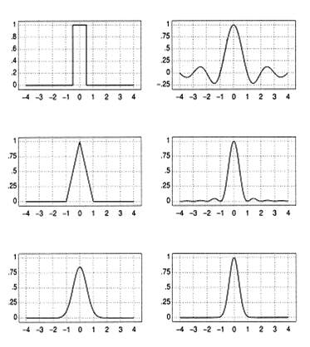
Common Filters and Their Duals
Bad filter in practice: gradual attenuation, negative lobes, infinite extent, all corrupting signal. But still beats point sampling!
Box
Sinc
Spatial domain
Frequency domain
Triangle
Sinc²
Finite Gaussian
Gaussian

Slide 40
Duals
Spatial | Frequency
Multiplication | Convolution
Convolution | Multiplication
Box | Sinc
Sinc | Box

Slide 41
Outline
Overview
Example Applications
Jaggies & Aliasing
Sampling & Duals
Convolution
Filtering
Scaling
Reconstruction
Scaling, continued
Implementation

Slide 42

Low-Pass Filtering: Convolving with sinc
In theory sinc has infinite extent, however small the contributions and negative lobes, but weights contributions at the center most heavily.
Practically, sinc is decently approximated with gaussian (normal) distribution, or even triangle, with finite extents and weights greater than or equal to zero.
Original signal
Sinc filter
Filter operation at origin shown as black dot
Filtered signal

Slide 43

What Does Filtering/Convolution Do?
Select points at which to sample, e.g., pixel centers
Slide the filter over each successive sample point and compute convolution integral at that point (the area under product curve)
This is weighted average of current pixel and its nearby neighbors
Most useful graphics filters are symmetric about their origin and fall off rapidly from their center)
Weighted average is value of pixel for filtered image
Our illustrations are 2D, but for pixels one should think of sinc as three-dimensional weighting map
Of course, we don’t actually compute the integral, we merely compute discrete values of filter function and do discrete multiplication and summing to approximate.
Term “filter” used strictly in signal-processing sense (filter can also used to mean arbitrary transformations of an image, like in Photoshop)
Sinc in 3D

Slide 44

Filtering Summary
Filtering is nothing more than weighted averaging around a sample point on the image
Dual of sinc function in spatial domain is box function in frequency domain
Dual of box function in spatial domain is sinc function in frequency domain
Multiplying frequency distribution with box function in frequency domain provides exact low-pass filtering (filtering out all high frequencies past a specified one)
Hence, optimal low-pass filter is sinc in spatial domain
Conversely, convolving with a box filter in the spatial domain corresponds to multiplying with sinc in the frequency domain, which does attenuate high frequencies but not perfectly, and introduces artifacts because of the negative lobes
Multiplication of $F(x)$ and $G(x)$ in frequency domain corresponds to convolution of their duals, $f(x)$ and $g(x)$, in spatial domain, and vice versa
$$F\left(x\right)G\left(x\right)⇔f\left(x\right)∗g\left(x\right)$$
$$F\left(x\right)∗G\left(x\right)⇔f\left(x\right)g\left(x\right)$$

Slide 45
Filtering Summary
To get low-pass filtering (i.e., filter out high frequencies), we often use convolution with triangle function in spatial domain to approximate ideal sinc
Properties of triangle function:
Easy to compute, unlike sinc, which has an infinite support (or even a Gaussian approximation to sinc)
Its dual, sinc², is acceptable approximation to a box function although it has infinite extent (see slide 36)
Will cause inaccurate representation of all frequencies and therefore some degree of corruption/aliasing must occur.
Not as bad as using box as a filter with sinc as its dual in the frequency domain
In other words, weighted area sampling of any kind, providing it is roughly cone-shaped, is better than unweighted area sampling with a box filter, which is better in turn than point sampling

Slide 46

The Filtering Pipeline
To filter, we have used three-step pipeline:
Construct continuous function $f\left(x\right)$ (e.g., rectangles representing lines, polygons)
Geometric primitives lead to infinite frequencies at edges
Low-pass filter function to generate $\hat{f}\left(x\right)$
Ideally, in the frequency domain: Multiply dual of $f\left(x\right)$ with box in the frequency domain
Equivalently, in spatial domain: Convolve $f\left(x\right)$ with $sinc$ (i.e., evaluate integral at an infinite number of points)
Sample pre-filtered continuous function $\hat{f}\left(x\right)$to generate discrete function $\hat{f}\left(k\right)$
As programmers, we save work:
Construct a continuous function
Simultaneously sample and filter to generate sampled image $\hat{f}\left(k\right)$
Equivalent to generating new function, then evaluating it only at sample points (i.e., at pixels)
We also need to reconstruct the signal from the filtered/sampled image
next slide deck

