Slide 1
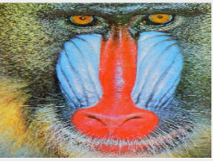
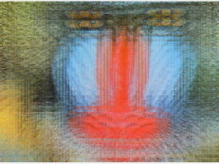
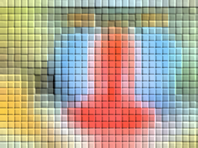
Image Processing & Antialiasing
Part III (Scaling and Reconstruction)

Slide 2
Outline
Overview
Example Applications
Jaggies & Aliasing
Sampling & Duals
Convolution
Filtering
Scaling
Reconstruction
Scaling, continued
Implementation

Slide 3
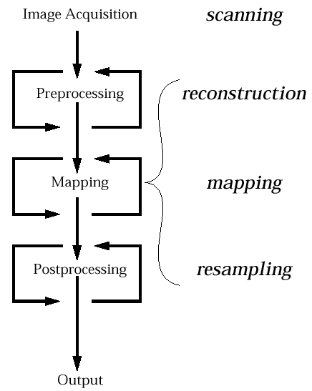
Image Scaling
Back to image scaling, in particular, problem of resampling
To get continuous image definition (corrupted version of signal )
Image scaling, rotation, …
To get pixel values for new discrete image
How should the image be resampled?
Different sampling methods depending on whether the image is to be scaled up or down
(includes sampling)‏

Slide 4
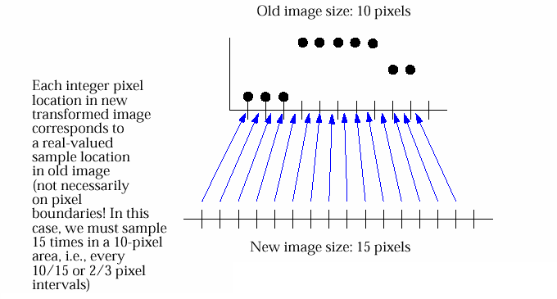
Mapping: Samples, Reconstruction, and Filters
When we scale, we are trying to make a transformed version of the old image
N new pixels will be derived from M old pixels. They will probably not line up exactly. How to get new pixels?
Solution: Sample old image. Exactly where we sample is determined by size of old and new image
Example: scaling up. Old image: 10 x 10 pixels; New image: 15 x 15 pixels
need to generate 15 x 15 sample points; have 10 x 10 pixels
given 15 x 15 samples across 10 x 10 pixels, must sample “in between” some pixels in old image: 10/15 = 2/3 units apart

Slide 5
Sampling
Each pixel in new image will correspond to a sample point in old image
If sample point lies exactly on pixel in old image, then we can use that pixel value
But what if our sample point lies somewhere between two old pixels?
Answer #1: if we had “original” continuous picture represented by our 10 x 10 image, then we could resample it 15 x 15 times instead (take another picture). However, we only have a discrete version
Answer #2: take our best guess at what original picture would have looked like. Using old data, try to reconstruct value at any arbitrary sample point on, or in between, our 10 x 10 pixels

Slide 6
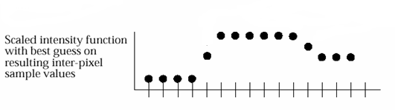
Resampling Reconstructed Image (1/3)
Resampling original image between integer pixel locations: best guess
Old Image: 10 Pixels
New Image: 15 Pixels
Good guesses
No guess needed
_{SWAG: “simple wild-ass guess”}

Slide 7

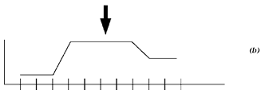
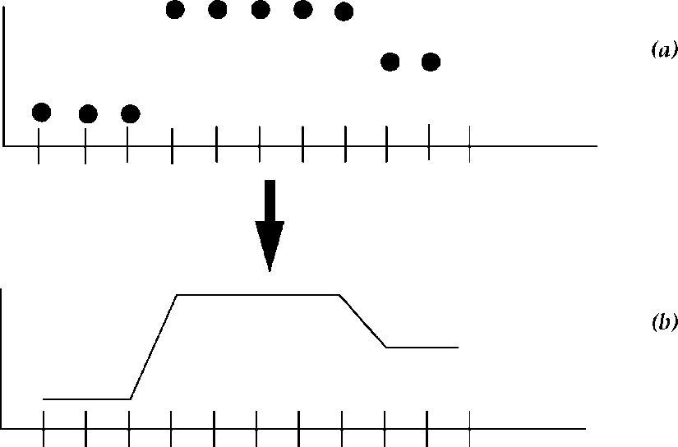
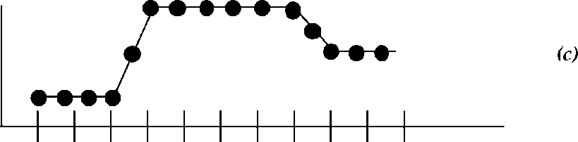
Resampling Reconstructed Image (2/3)
Can think of image sampling as two distinct steps
Reconstruct “original” continuous picture information from our discrete samples; although probably not correct, it’s the best we can do
Then, resample continuous data at mapped locations.
Note: new sample points don’t necessarily line up with old ones

Slide 8
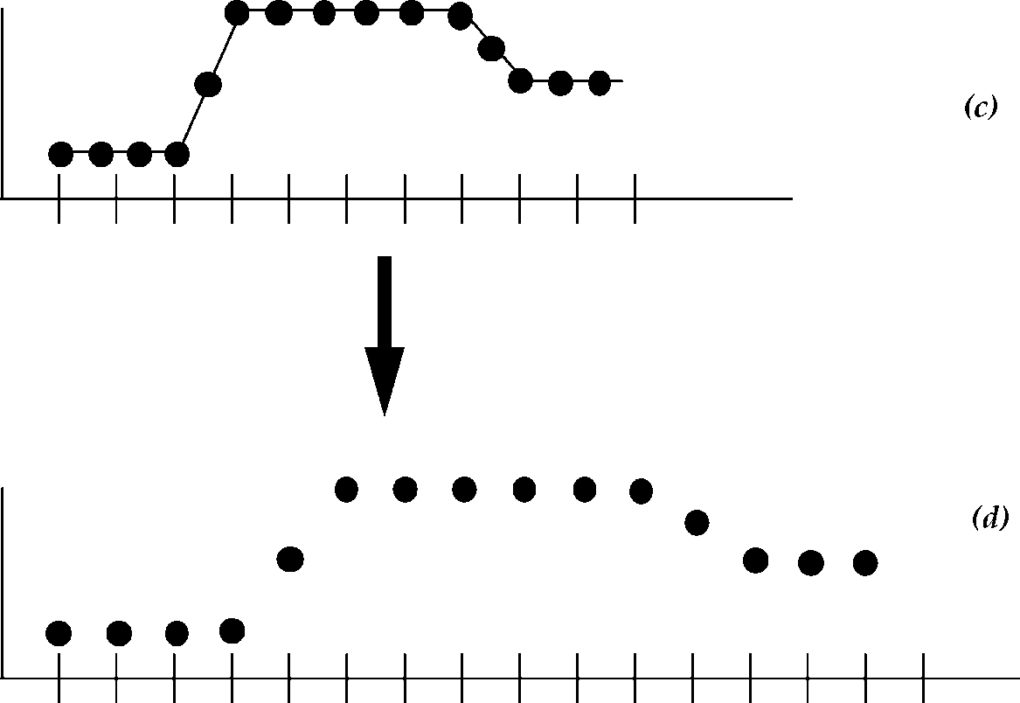
Resampling Reconstructed Image (3/3)
Display sampled values at their proper pixel locations in the transformed image (we have scaled the image)‏

Slide 9
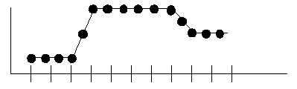
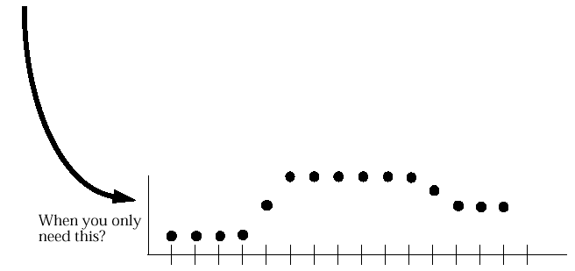
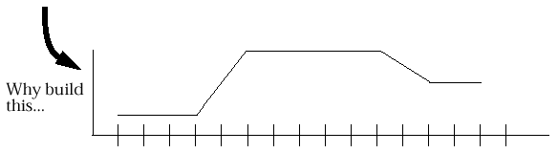
Discrete Reconstruction
As shown later, we can do reconstruction/re-sampling stages in one step
we can only do it analytically for special cases
“Original” function is reconstructed at sample points needed for our new image. Why reconstruct entire continuous “original” image if we only need to sample at a few locations? Stay tuned…
To get this…

Slide 10
Outline
Images & Hardware
Example Applications
Jaggies & Aliasing
Sampling & Duals
Convolution
Filtering
Scaling
Reconstruction
Scaling, continued
Implementation

Slide 11
Filters for reconstructing the continuous function from discrete samples (1/2)
How to perform reconstruction to get new continuous image from sampled signal?
Use same filters as for pre-filtering, i.e., removing high frequencies from continuous signals
Take as input a point we want to sample in the old image (sample points can lie between pixels)‏
best guess at what new value should be, using old image’s nearby pixel values.
To approximate convolution, take weighted average of discrete pixel values, much easier than integrating over continuous differential areas
This all sounds reasonable, but…problem is worse than you would think – don’t just have to do a good reconstruction, but the samples represent a badly corrupted signal due to sampling with normal CCD array…
First review filters, then show the problem of CCD-sampling

Slide 12
Reconstruction Filters
In general, the better a filter will estimate the original signal, the more expensive it is.
we want to find a good middle ground between cost and quality
Review of general traits of filters:
take weighted sum of pixel values near sampled point
pixels further away are less influential
area covered by filter—called support—is centered around sample point and usually finite in extent
normalize area under filter to sum to 1
ensures transformed image will have same overall brightness as original image
play with different filter shapes using scaling applet
http://www.cs.brown.edu/exploratories/freeSoftware/repository/edu/brown/cs/exploratories/applets/filterShape/filter_shape_guide.html

Slide 13
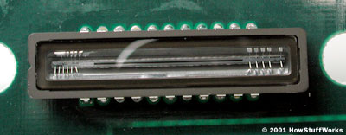
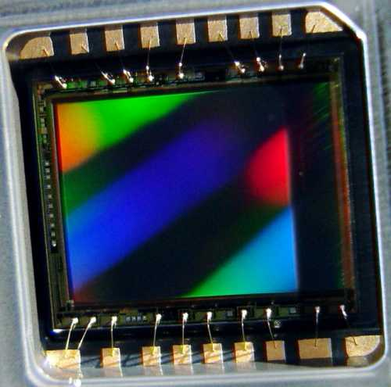
Digression on Scanning (1/2)
In our idealized pipeline, sample original image to store as a pixel array, and then reconstruct image to resample and scale to get new, scaled image
Look at scanning a photo using CCD (Charge-coupled device) scanner to understand sampling/reconstruction in spatial and frequency domains
a CCD is comprised of a collection of diodes that convert photons into electrons. Each diode on the CCD has an electrical charge corresponding to the amount of light falling on it (Photoelectric effect).
Scanning “continuous” photograph results in unweighted area sampling: each rectangular element responds to total amount of light falling on it, without regard for how the light is distributed across the sensor. This constitutes pre-filtering with a box filter – introduces corruption because box filtering is multiplication with sinc!
Scanner CCD array (1 dimensional)
Camera CCD array (2 dimensional)

Slide 14
Digression on Scanning (2/2)
Look conceptually at the process of scanning a continuous image using theoretical model of pre-filtering each scan line’s f(x), followed by sampling.
Pre-filtering (bad box filter):
Scanner convolves with box function (un-weighted area sampling) in spatial domain (CCD’s fault; not continuous, not ideal filter)
Dual is sinc multiplication in the frequency domain
Produces intermediary continuous signal f’(x): mostly band-limited to maintain frequencies near zero, but corrupting negative lobes and doesn’t completely eliminate high frequencies
Sampling:
Sample f’(x); yield discrete pixels P_{i,} (information we store about image)
Intensity of P_{i} determined by signal from i^{th} CCD element
Sample P_{i} is corrupted version of original intensity of that area; cannot represent original exactly, so do best we can

Slide 15
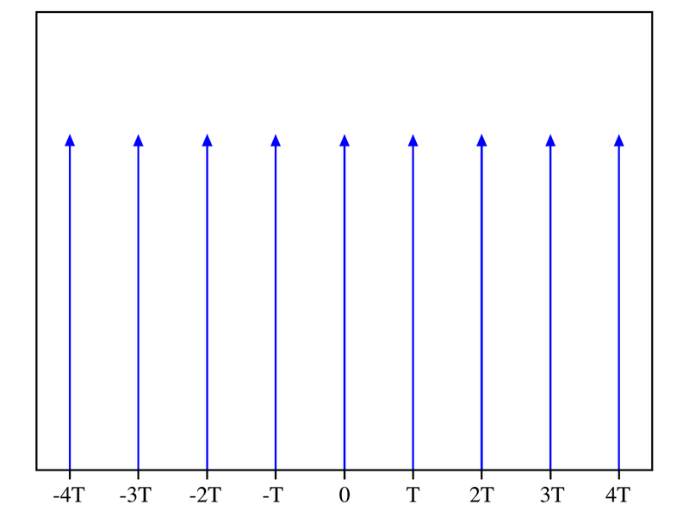
Sampling introduces infinite replicas of a spectrum
Why? Sampling is basically multiplication (in the spatial domain) of the original signal by a comb function (infinite sequence of impulses at the sample points).
Fourier analysis says that a comb in the spatial domain transforms into another comb in the frequency domain.
Unit comb in spatial domain maps to unit comb in frequency domain; squeezing to increase sampling frequency in the spatial domain maps to stretching in the frequency domain.
Multiplication in the spatial domain means convolution in the frequency domain.
Convolving any function with a single impulse just replicates the function.
Note: we never use the amplitude of the impulse but only the property that it integrates to 1
Convolving with a comb replicates the function at every “tooth” of the comb
Thus when we sample by multiplying the spatial function by a comb function, we convolve its frequency function with another comb, which leads to infinitely repeating frequencies.

Slide 16
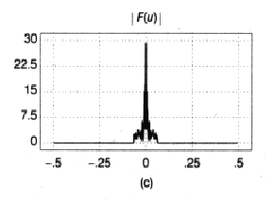
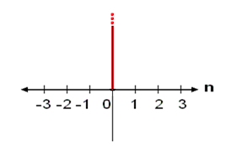

Sampling With a Dirac Impulse Reproduces the Spectrum
Original Function (frequency domain)
Unit Impulse (frequency domain)
Area = 1
=
Original Function (frequency domain)
Impulse is 0 everywhere except at one point. Thus product of function and impulse would only have a value at that point (since rest of the product would be zero). Impulse integrates to 1. Thus multiplying it by a value and integrating over it will just yield that value

Slide 17
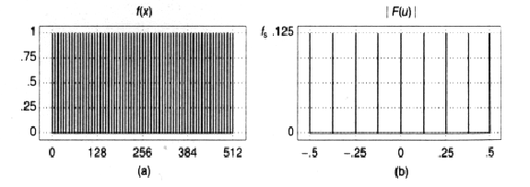
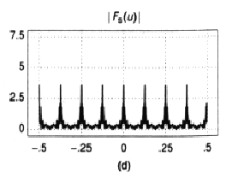
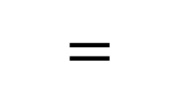
Sampling with a Dirac Impulse Comb Replicates Spectrum
Original Function (frequency domain)
Comb function (frequency domain)
Sampled Function (frequency domain)

Slide 18
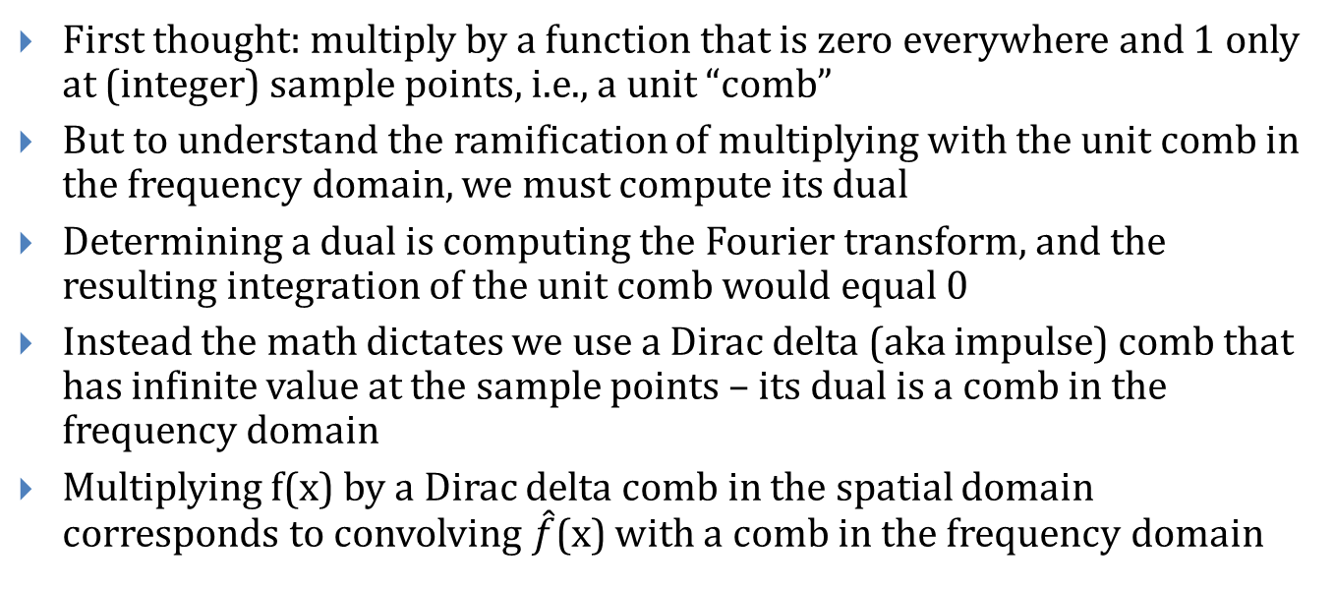
Sampling f(x) with a Dirac delta comb
First thought: multiply by a function that is zero everywhere and 1 only at (integer) sample points, i.e., a unit “comb”
But to understand the ramification of multiplying with the unit comb in the frequency domain, we must compute its dual
Determining a dual is computing the Fourier transform, and the resulting integration of the unit comb would equal 0
Instead the math dictates we use a Dirac delta (aka impulse) comb that has infinite value at the sample points – its dual is a comb in the frequency domain
Multiplying f(x) by a Dirac delta comb in the spatial domain corresponds to convolving $\hat{f}$(x) with a comb in the frequency domain

Slide 19
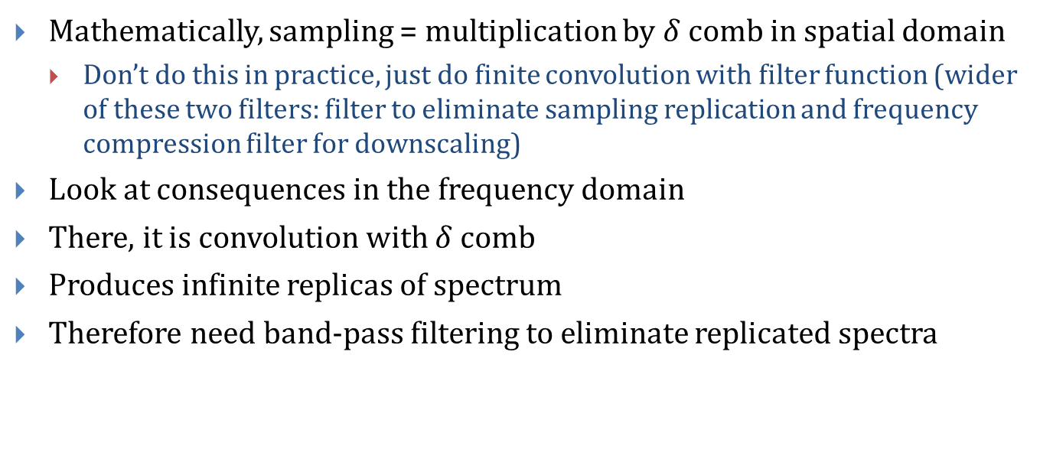
Review
Mathematically, sampling = multiplication by $δ$ comb in spatial domain
Don’t do this in practice, just do finite convolution with filter function (wider of these two filters: filter to eliminate sampling replication and frequency compression filter for downscaling)
Look at consequences in the frequency domain
There, it is convolution with $δ$ comb
Produces infinite replicas of spectrum
Therefore need band-pass filtering to eliminate replicated spectra

Slide 20
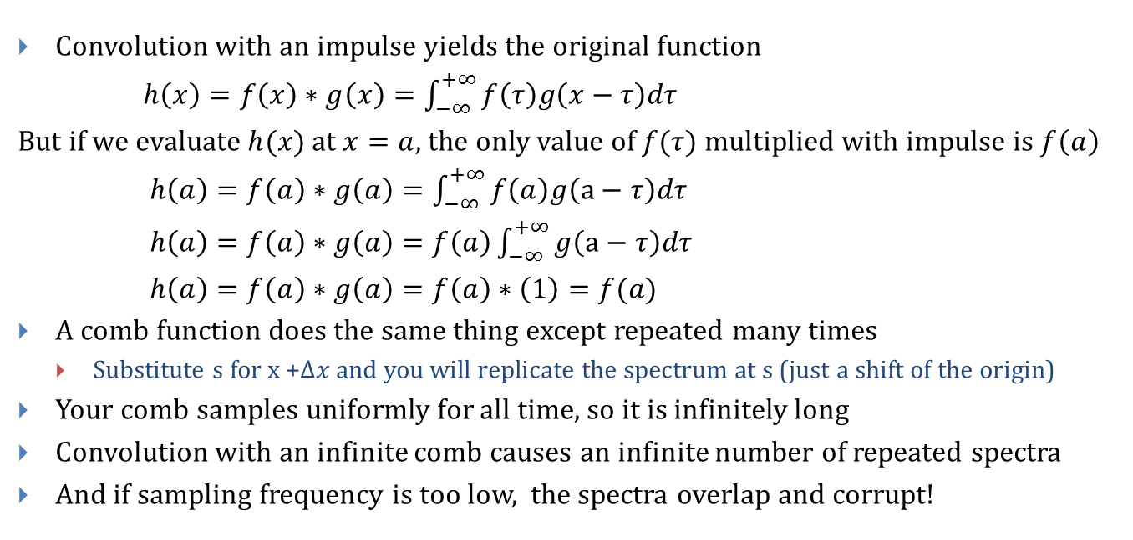
Why sampling introduces infinitely replicated spectrum
Convolution with an impulse yields the original function
$h\left(x\right)=f\left(x\right)∗g\left(x\right)=\int_{−∞}^{+∞}{f\left(τ\right)g\left(x−τ\right)dτ}$
But if we evaluate $h(x)$ at $x=a$, the only value of $f(τ)$ multiplied with impulse is $f\left(a\right)$
$h\left(a\right)=f\left(a\right)∗g\left(a\right)=\int_{−∞}^{+∞}{f\left(a\right)g\left(a−τ\right)dτ}$
$h\left(a\right)=f\left(a\right)∗g\left(a\right)=f\left(a\right)\int_{−∞}^{+∞}{g\left(a−τ\right)dτ}$
$h\left(a\right)=f\left(a\right)∗g\left(a\right)=f\left(a\right)∗\left(1\right)=f(a)$
A comb function does the same thing except repeated many times
Substitute s for x +$∆x$ and you will replicate the spectrum at s (just a shift of the origin)
Your comb samples uniformly for all time, so it is infinitely long
Convolution with an infinite comb causes an infinite number of repeated spectra
And if sampling frequency is too low, the spectra overlap and corrupt!

Slide 21
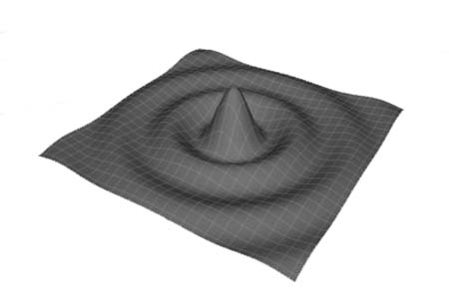
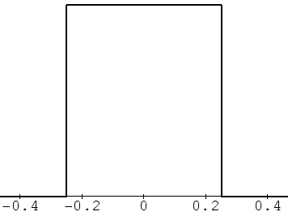
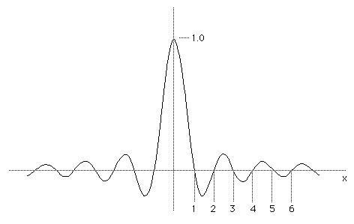
How do We Kill All Replicas Due to Sampling?
We remove all but original band-limited spectrum ideally by multiplying with low-pass box filter in the frequency domain, which once again corresponds to convolving with sinc in the spatial domain
Sinc filter

Slide 22
Reconstruction Filters to Kill Replicas
Practically, use cheaper filter such as truncated Gaussian or triangle to remove replicas in the frequency domain
Approximate reconstruction filtering with triangle in spatial domain:
leaves higher frequencies
will cause some aliasing, but comparatively insignificant
Later: pre-filtering to undo effects of box filtering and reconstruction filtering can be condensed to single filtering step
Note: we do discrete convolution of samples with filter by placing filter at consecutive sample points (at pixels or in between them, if image is scaled) and doing weighted averaging – small filter supports means relatively few pixels contribute

Slide 23
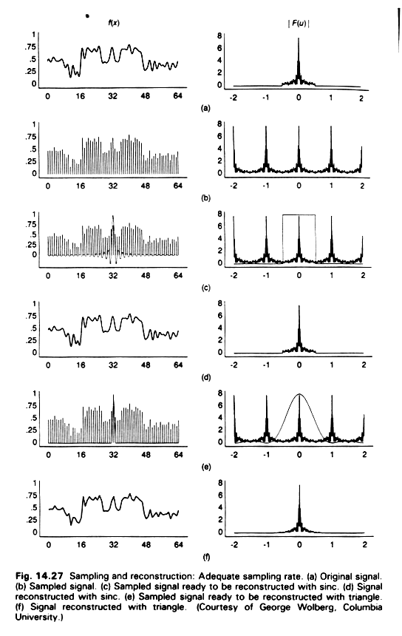
Sampling and Reconstruction Filters: Sinc
Adequate sampling rate, spectra are replicated but overlap little, minimizing corruption
a) Original signal
b) Sampled signal, replicated spectra
c) Sampled signal ready to be reconstructed with sinc.
d) Signal reconstructed with sinc (good approximation)
‏

Slide 24
Sampling and Reconstruction Filters: Triangle
a) Original signal
b) Sampled signal, replicated spectra
c) Sampled signal ready to be reconstructed with triangle
d) Signal reconstructed with triangle
(Courtesy of George Wolberg, Columbia University.)‏

Slide 25
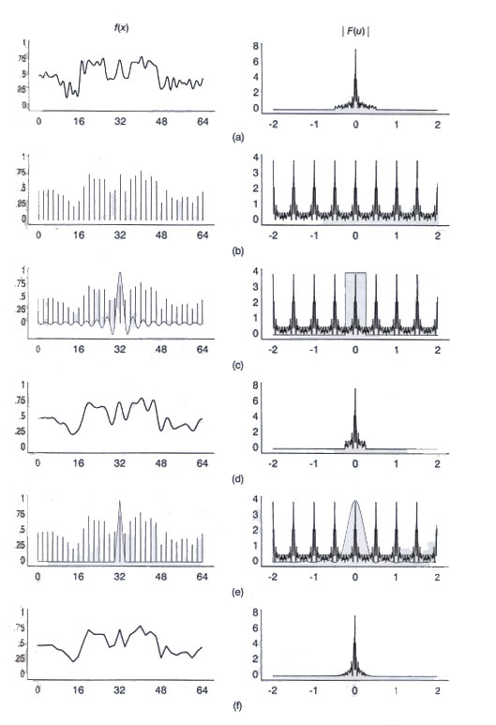
Reconstruction Filters: Inadequate Sampling Rate: Sinc
Inadequate sampling rate so spectra overlap and significant corruption/aliases (compare a and d)
a) Original signal
b) Sampled signal
c) Sampled signal ready to be reconstructed with sinc
d) Signal reconstructed with sinc

Slide 26
Reconstruction Filters: Inadequate Sampling Rate: Triangle
Inadequate sampling rate so spectra overlap and significant corruption/aliases (compare a and d)
a) Original signal
b) Sampled signal
c) Sampled signal ready to be reconstructed with triangle
d) Signal reconstructed with triangle
*sinc from previous slide

Slide 27
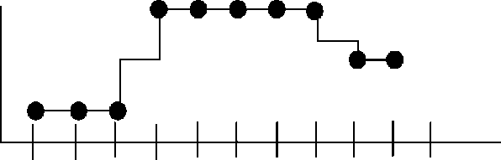

Box Filter with 2 unit support (1/2)
We can create a 2 unit box filter B:
Graph representation of B:
Reconstructing with B as filter “draws bars”:
Box filter has discontinuities at boundaries, discrete convolution must be special cased:
at old pixel locations: just use pixel values
everywhere else: use box filter (covers two pixels); value is just unweighted average of two neighboring pixels
Not bad for signals with large constant areas
=
⎧
1/2
-1 < x < 1
B
(
x
)‏
⎨
⎩
0
elsewhere
1/2
1/2
-1
1

Slide 28
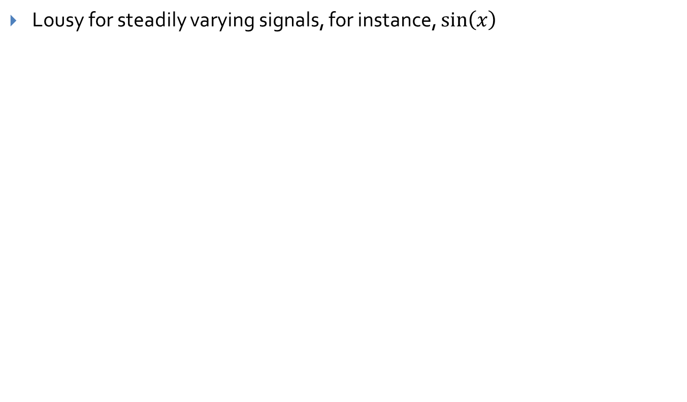
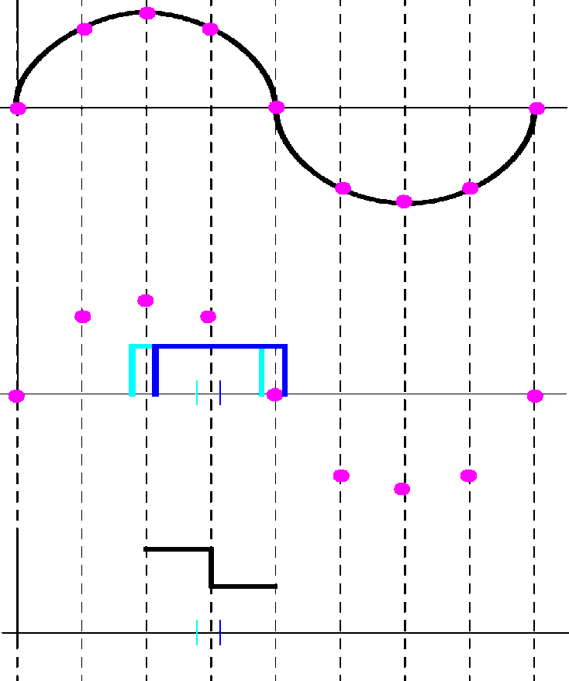
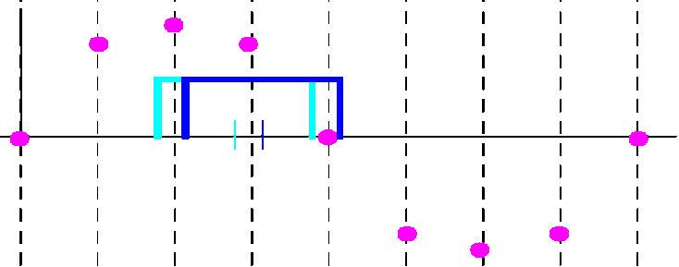
Box Filter with 2 unit support (2/2)

Slide 29
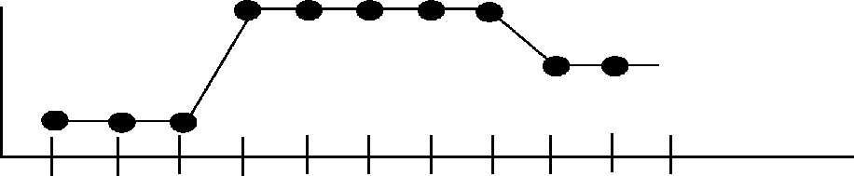
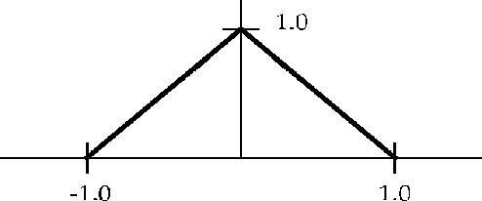
Triangle Filter (1/3)
Triangle filter T:
This normalized filter, with 2 unit support, approximates sinc filter of optimal width 2 to remove replicas
Acts as linear interpolation filter. Takes weighted average of neighboring pixel values according to distance from sample point, i.e., “connect the dots”

Slide 30
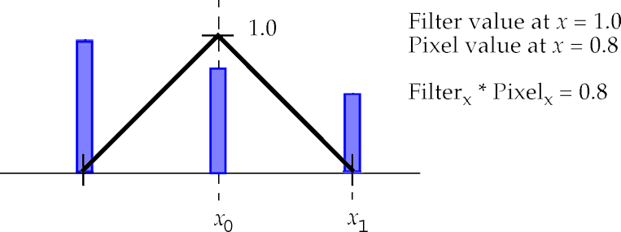
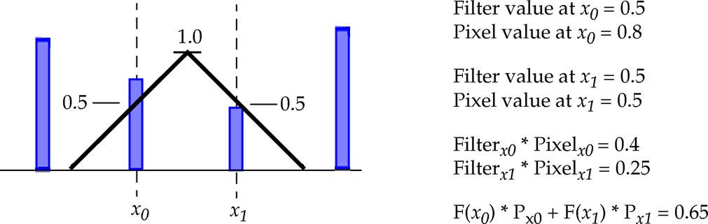
Triangle Filter (2/3)
If we center triangle filter directly over pixel in source image, it returns that pixel’s value:
What happens when we sample halfway between pixels in source image?
Intuition: would expect it to return average of two pixel values. Intuition is correct:
_{1.0}
Filter value at x₀ = 1.0 Pixel value at x₀ = 0.8 Filter_{x0} • Pixel_{x0} = 0.8
Filter value at x₀ = 0.5, Pixel value at x₀ = 0.8
Filter value at x₁ = 0.5, Pixel value at x₁ = 0.5
Filter_{x0} • Pixel_{x0} = 0.4, Filter_{x1} • Pixel_{x1} = 0.25
F_{x0} • P_{x0} + F_{x1} • P_{x1} = 0.65

Slide 31
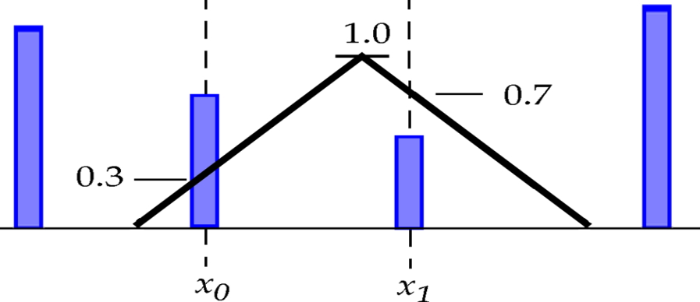
Triangle Filter (3/3)‏
Similarly, if filter is 70% towards one pixel and 30% towards another, will return average of two pixels weighted by 70% and 30%; it linearly interpolates
See the discrete convolution applet:
http://www.cs.brown.edu/exploratories/freeSoftware/repository/edu/brown/cs/exploratories/applets/discreteConvolution/discrete_convolution_guide.html
Weight = 0.3•P₀ + 0.7•P₁

Slide 32
Avoiding Continuous Convolution
Whatever reconstruction filter we use, save work by combining reconstruction filtering with resampling the reconstructed signal at only a discrete number of sample points determined by the image transformation, e.g. scaling
Do this by placing the reconstruction filter at sample points only and evaluating discrete convolution there
But what ARE those sample points for scaling? We saw scaling up involves sampling “in between” image pixels
Scaling down adds additional complexity, as we’ll soon see

Slide 33
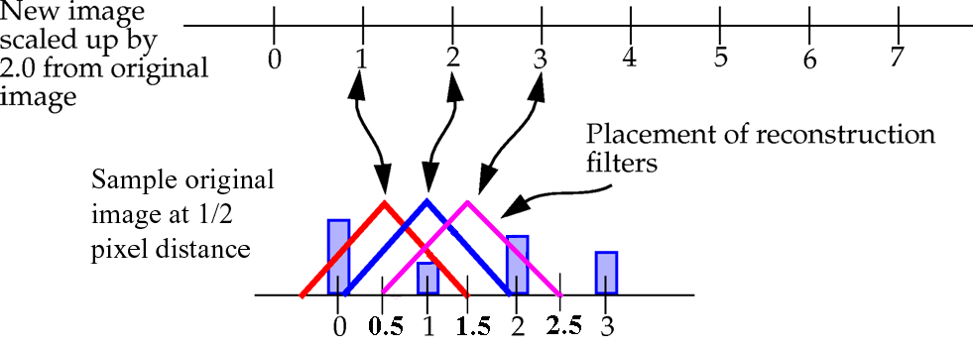
Scaling: Forwards Mapping
Scaling up by 2.0: source(x) → dest(2x)‏
In forward direction, filtering is many-to-many, i.e. multiple pixels in source contribute to each pixel in destination, and each pixel in source contributes to multiple pixels in destination
Many-to-many mapping
pixel “1” in source contributes to pixels “1,” “2,” and “3” in destination
pixel “3” in destination is contributed to by both pixels “1” and “2” in source

Slide 34
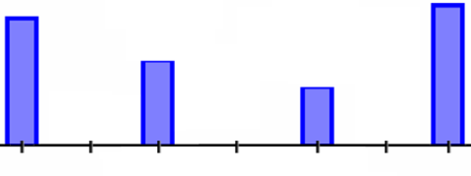
Scaling: Backwards Mapping
Where to place filter in source image?
Compute sample points by back-mapping from destination back to source image
Then mapping is one-to-many instead of many-to-many
for each pixel in destination, which pixels in source contribute to it?
determined by placing filter in source image as function of scale factor
Source Image
Backwards mapping is inverse of the image transformation, e.g., if we scale source up by 2.0, then map each pixel x in destination from pixel x/2 in source image
For each pixel, x, in destination image, sample x/2 from source image
Sample points
Scaling up by factor r:
We don’t forward map this way:
Instead, we back-map this way:
source(x) → dest(r*x)‏
dest(x) → source(x/r)‏

Slide 35
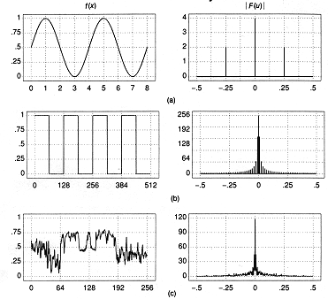
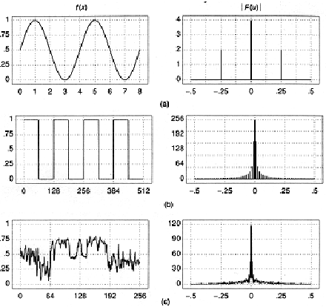
Timeout – review of some fundamental concepts (1/4)
We can characterize signals either in their original domain or by their component frequencies and amplitude – thus we get the notion of dual domains (spatial and frequency) and dual operations (convolution and multiplication)
The simplest wave form is a periodic sine
Ignore the mathematically induced negative part of the spectrum, and the term at the origin: this "DC" (for direct current, as opposed to AC, alternating current) term is the average energy in the signal - real spatial or acoustic energy has sine waves not centered at y=0 but y=c.
Can decompose more complex wave forms (both periodic and aperiodic) in a (infinite) sum of sines and cosines (Fourier analysis/synthesis)
Signal Domain
DC
Frequency Domain

Slide 36
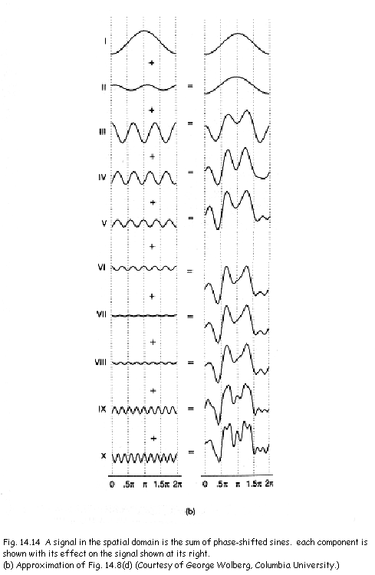
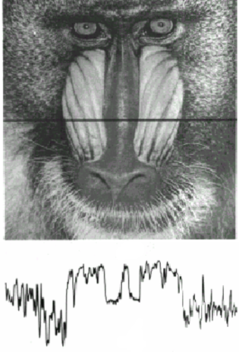
Timeout – review of some fundamental concepts (2/4)
Frequency spectrum plots amplitude at each frequency, typically a fundamental and its harmonics in the acoustic domain
These frequencies and their amplitudes are determined by Fourier Analysis, a process to complex to explain in this course
a sine in the spatial or signal domain is represented by a single frequency in the frequency spectrum, and each sine in the sum will be represented by one amplitude at that frequency
These signals are all in the spatial domain and we do not show the frequency domain here
Note that image wave forms don’t show periodicity typically even though they can be decomposed into periodic functions!

Slide 37
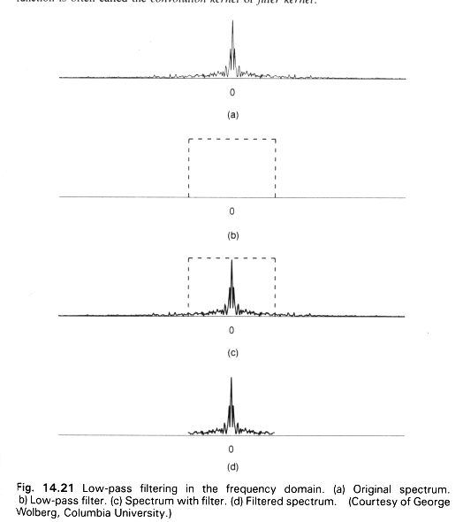
Timeout – review of some fundamental concepts (3/4)
In general, rapid fall-off of amplitude with higher frequencies, so filtering them out doesn't lose vital information from the signal
Leaving them in would cause aliases that corrupt the reconstructed waveform
Multiplied by perfect box filter in the frequency domain (convolution with sinc in the spatial domain)

Slide 38
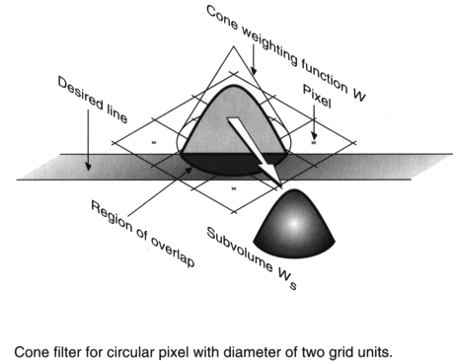
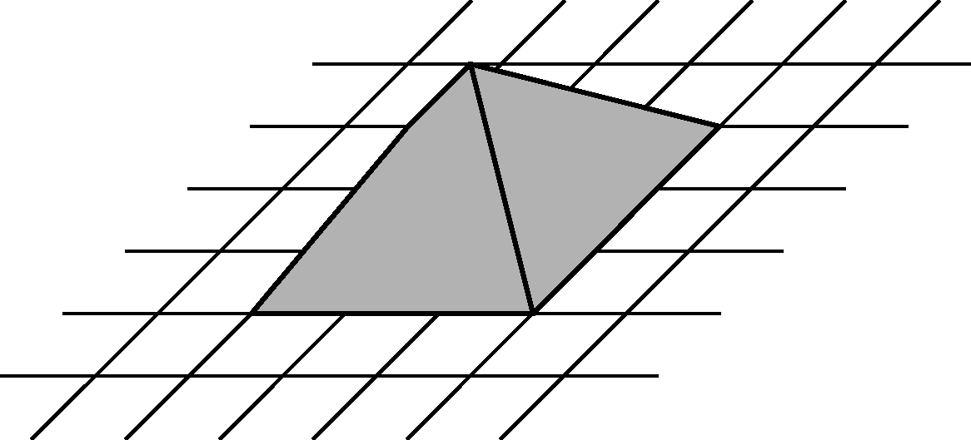
Timeout – review of some fundamental concepts (4/4)
We look at signals as intensity functions (waveforms) of space (images) or time (acoustic)
Filters similarly are 2D, but for images, the filters are actually 3 dimensional (e.g., triangle becomes circular cone or rectangular pyramid, Gaussian has its 3D shape, etc.)
W
Circular cone and Gaussian filter
Sinc filter
Pyramid filter

