Slide 1
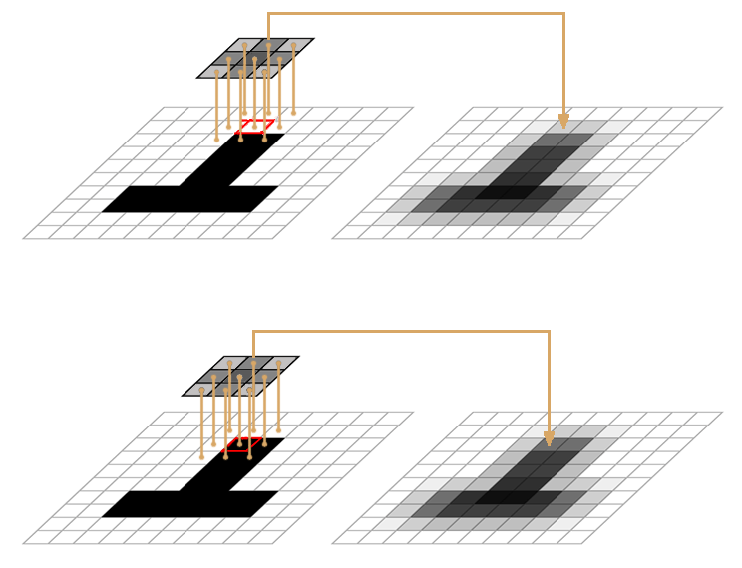
Image Processing & Antialiasing
Part IV (Scaling)

Slide 2
Outline
Images & Hardware
Example Applications
Jaggies & Aliasing
Sampling & Duals
Convolution
Filtering
Scaling
Reconstruction
Scaling, continued
Implementation

Slide 3
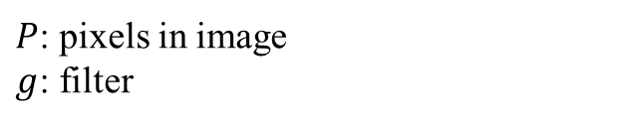

Roadmap
Apply mapping to source image to produce destination image
for each pixel value in destination image, calculate sample point location on source
calculate destination pixel value for each sample point: evaluate convolution of reconstruction filter with pixels in old image at those points
some subsequent mapping may include manipulating computed intensity value; we will use it as-is for scaling
We represent convolution with an asterisk:
Convolution is integrating the product of two continuous functions. Only apply filter at discrete points in old image and evaluate image function only for image pixels, but still call it convolution. Later we’ll show this “discrete” convolution computation.
Next: make each step more concrete
$P$: pixels in image
$g$: filter
$H$ = $P$ * $g$: convolution of filter and image

Slide 4
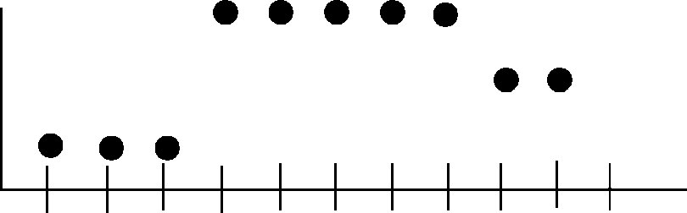
1D Image Filtering/Scaling Again
Once again, consider the following scan-line:
As we saw, if we want to scale by any rational number r, we must sample every 1/r pixel intervals in the source image
Having shown qualitatively how various filter functions help us resample, let’s get more quantitative: show how one does convolution in practice, using 1D image scaling as driving example

Slide 5
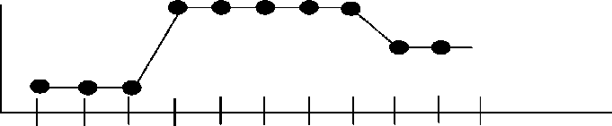
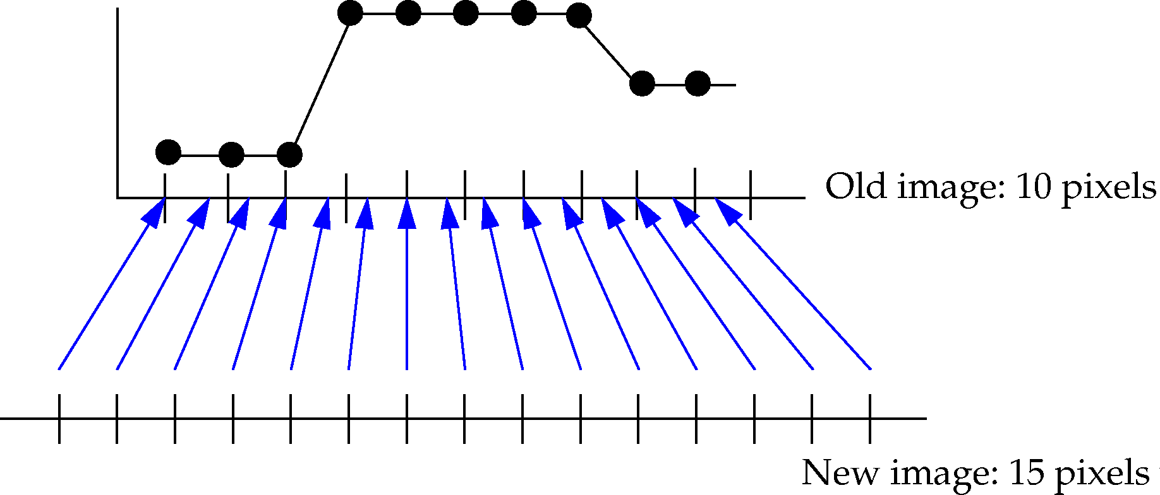
Resampling (1/2)
Call continuous reconstructed image intensity function h(x). For triangle filter, it looks as before:
To get intensity of integer pixel k in 15/10 scaled destination image, h’(x), sample reconstructed image h(x) at point
Therefore, intensity function transformed for scaling is:
h
(
x
)‏
k
x
=
1
.
5
=
⎛
k
⎞
h’
(
k
)‏
h
⎜
⎟
⎝
1
.
5
⎠

Slide 6
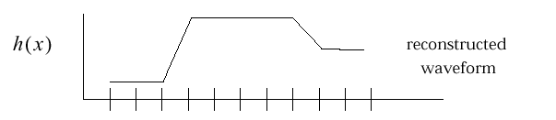
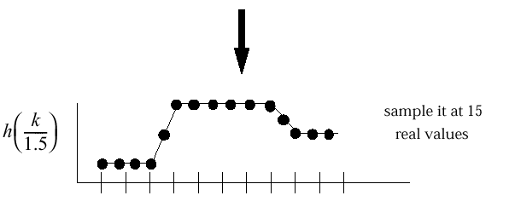
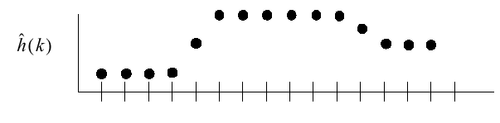
Resampling (2/2)
As before, to build transformed function h’(k), take samples of h(x) at non-integer locations.
reconstructed waveform
h(x)
sample it at 15 real values
h(k/1.5)
plot it on the integer grid
h’(x)
‏

Slide 7
Resampling: An Alternate Approach (1/3)
Previous slide shows scaling up by following conceptual process:
reconstruct original continuous intensity function from discrete number of samples, e.g. 10 samples
resample reconstructed function at higher sampling rate, e.g. 15 samples across original 10
stretch our inter-pixel samples back into integer-pixel-spaced range, i.e. , map 15 samples onto 15 pixel range in scaled-up output image
Thus, we first resample reconstructed continuous intensity function at inter-pixel locations. Then we stretch out our samples to produce integer-spaced pixels in scaled output image
Alternate conceptual approach: we can change when we scale and still get same result: first stretch out reconstructed intensity function, then sample at integer pixel intervals

Slide 8
Resampling: An Alternate Approach (2/3)‏
This new method performs scaling in second step rather than third: stretches out the reconstructed function rather than the sample locations
as before, reconstruct original continuous intensity function from discrete number of samples, e.g. 10 samples
scale up reconstructed function by desired scale factor, e.g. 1.5
sample (now 1.5 times broader) reconstructed function at integer pixel locations, e.g. 15 samples

Slide 9
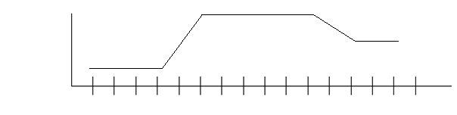
Resampling: An Alternate Approach (3/3)‏
Alternate conceptual approach (compare to slide 6)‏; practically, we’ll do both steps at the same time anyhow
h(x)
reconstructed waveform
scaled up reconstructed waveform
h(x/1.5)
plot it on the integer grid
h’(x)

Slide 10
Scaling Down (1/6)
Why scaling down is more complex than scaling up
Try same approach as scaling up
reconstruct original continuous intensity function from discrete number of samples, e.g., 15 samples in source (different case from that of 10 samples of source we just used)‏
scale down reconstructed function by desired scale factor, e.g., 3
sample (now 3 times narrower) reconstructed function at integer pixel locations, e.g. 5 samples
Unexpected and unwanted side effect: by compressing waveform into 1/3 its original interval, spatial frequencies tripled, which extends (somewhat) band-limited spectrum by factor of 3 in frequency domain. Can’t display these higher frequencies without aliasing!
Back to low pass filtering again. Multiply by box in frequency domain to limit to original frequency band, e.g., when scaling down by 3, low-pass filter to limit frequency band to 1/3 its new width

Slide 11
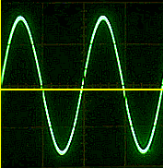
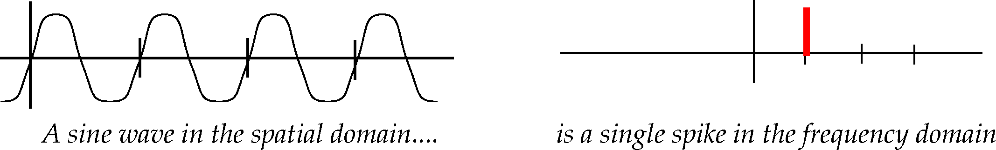
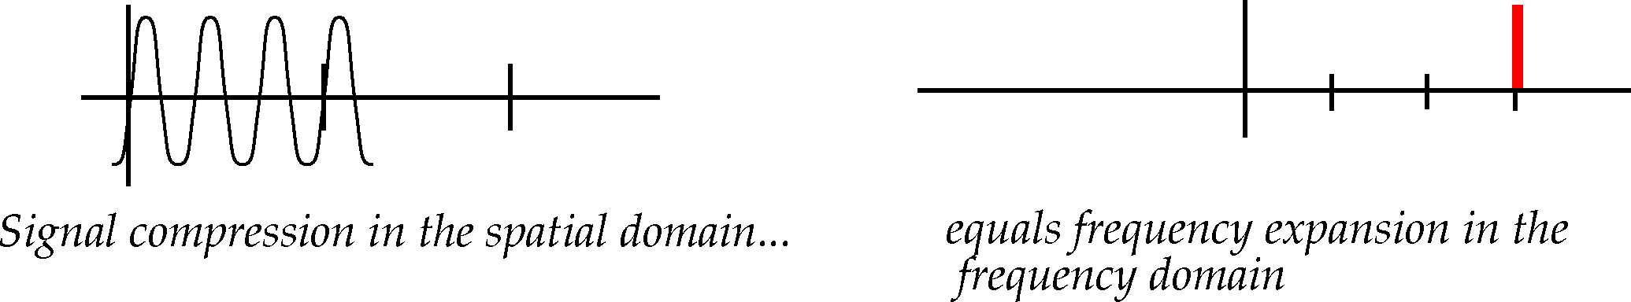
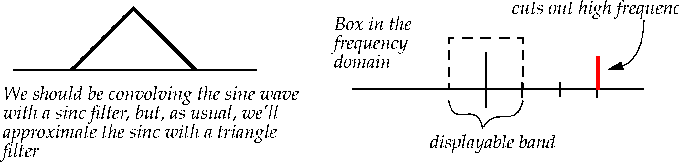
Scaling Down (2/6)
Simple sine wave example
First we start with sine wave:
1/3 Compression of sine wave and expansion of frequency band:
Get rid of new high frequencies (only one here) with low-pass box filter in frequency domain
Only low frequencies will remain
A sine in the spatial domain… is a spike in the frequency domain
Signal compression in the spatial domain… equals frequency expansion in the frequency domain
Ideally,
cuts out high frequencies

Slide 12
Scaling Down (3/6)
Same problem for a complex signal
(shown in frequency domain)
Filtered, band-limited signal
Sampled band-limited signal – convolution with comb produces replicas
If we shrink the signal in the spatial domain, there is more activity in a smaller space, which increases the frequencies, thus widening the frequency domain representation
Filtered, scaled-down band-limited signal
_{Note signal addition}
_{(terrible} _{aliasing)!}
Sampled scaled-down signal convolved with comb – replicas overlap badly

Slide 13
Scaling Down (4/6)
Revised (conceptual) pipeline for scaling down image:
reconstruction filter: Low-pass filter to reconstruct continuous intensity function from old scanned (box-filtered and sampled) image, also gets rid of replicated spectra due to sampling
scale down reconstructed function
scale-down filter: low-pass filter to get rid of newly introduced high frequencies due to scaling down (but it can’t really deal with corruption due to overlapped replications if frequency too high due to inadequate sampling rate )
sample scaled reconstructed function at pixel intervals
Now we’re filtering explicitly twice (after scanner implicitly box filtered)
first to reconstruct signal (filter g1)
then to low-pass filter high frequencies in scaled-down version (filter g2)‏

Slide 14
Scaling Down (5/6)
In actual implementation, can combine reconstruction and frequency band-limiting into one filtering step. Why?
Associativity of convolution:
Convolve our reconstruction and low-pass filters together into one combined filter!
Result is simple: convolution of two sinc functions is just larger sinc. In our case, approximate larger sinc with larger triangle, and convolve only once with it.
Theoretical optimal support for scaling up is 2, but for down-scaling by a is 2/a, i.e., >2,
Why does support >2 for down-scaling make sense from an information preserving PoV?

Slide 15
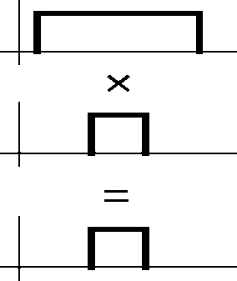
Scaling Down (6/6)
Why does complex-sounding convolution of two differently-scaled sinc filters have such simple solution?
Convolution of two sinc filters in spatial domain sounds complicated, but remember that convolution in the spatial domain means multiplication in the frequency domain!
A sinc in the spatial domain is a box in the frequency domain. Multiplication of two boxes is easy— product is narrower of two pulses:
Narrower pulse in frequency domain is wider sinc in spatial domain (lower frequencies)
Thus, instead of filtering twice (once for reconstruction, once for low-pass), just filter once with wider of two filters to do the same thing
True for sinc or triangle approximation—it is the width of the support that matters

Slide 16
Outline
Images & Hardware
Example Applications
Jaggies & Aliasing
Sampling & Duals
Convolution
Filtering
Scaling
Reconstruction
Scaling, continued
Implementation

Slide 17
Algebraic Reconstruction (1/2)‏
So far textual explanations; let’s get algebraic!
Let f’(x) be the theoretical, continuous, box-filtered (thus corrupted) version of original continuous image function f(x)
produced by scanner just prior to sampling
Reconstructed, doubly-filtered image intensity function h(x) returns image intensity at sample location x, where x is real (and determined by backmapping using the scaling ratio); it is convolution of f’(x) with filter g(x) that is the wider of the reconstruction and scaling filters, centered at x :
But we want to do the discrete convolution, and regardless of where the back-mapped x is, only look at nearby integer locations where we have actual pixel values

Slide 18
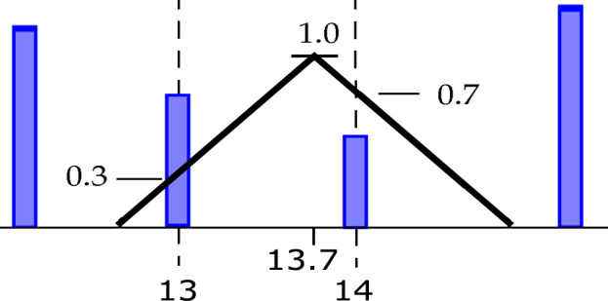
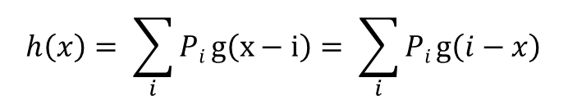
Algebraic Reconstruction (2/2)
Only need the sampled values at the pixels, so can just evaluate the filtering at each pixel location
Replace integral with finite sum over pixel locations covered by filter g(x) centered at x.
Thus convolution reduces to:
Note: sign of argument of g does not matter since filters are symmetric
Note 2: Since convolution is commutative, can also think of P_{i} as weight and g as function
e.g., if x = 13.7, and a triangle filter has scale-up support of 2, evaluate g(13 -13.7) = 0.3 and g(14 – 13.7) = 0.7 and multiply those weights by pixel 13 and pixel 14’s values respectively
$$h\left(x\right)= \sum_{i}{Pi}g\left(x−i\right)= \sum_{i}{Pi}g\left(i−x\right)$$
For all pixels i falling under filter support centered at x
_{Pixel value at i}
Filter value at pixel location i

Slide 19
Unified Approach to Scaling Up and Down
Scaling up has constant reconstruction filter, support = 2
Scaling down has support 2/a where a is the scale factor
Can parameterize image functions with scale: write a generalized formula for scaling up and down
g(x, a) is parameterized filter function;
h(x, a) is reconstructed, filtered intensity function (either ideal continuous, or discrete approximation)
h(k, a) is scaled version of h(x, a) dealing with image scaling, sampled at pixel values of x = k

Slide 20
Reconstruction for Scaling
Just as filter is a continuous function of x and a (scale factor), so too is the filtered image function h(x, a)
Recall: back-map destination pixel at k to (non-integer) source location k/a
Can almost write this sum out as code but still need to figure out summation limits and filter function
For all pixels i where i is in support of g
Filter g, centered at sample point x, evaluated at i
_{Pixel at integer i}

Slide 21
Nomenclature Summary
Nomenclature summary:
f’(x) is original scanned-in mostly band-limited continuous intensity function – never produced in practice!
P_{i} is sampled (box-filtered, comb multiplied) f’(x) stored as pixel values
g(x, a) is parameterized filter function, wider of the reconstruction and scaling filters, removing both replicas due to sampling and higher frequencies due to frequency multiplication if downscaling
h(x, a) is reconstructed, filtered intensity function (either ideal continuous or discrete approximate)
h’(k, a) is scaled version of h(x, a) dealing with image scaling
a is scale factor
k is index of a pixel in the destination image
In code, you will be starting with P_{i} (input image) and doing the filtering and mapping in one step to get h’(x, a), the output image
f(x)
CCD Sampling
f’(x)
Store as discrete pixels
P_{i}
Filter with g(x,a) to remove replicas
h(x,a)
Scale to desired size
h’(k,a)
Output
Notes:
Should we put before or after equations?

Slide 22
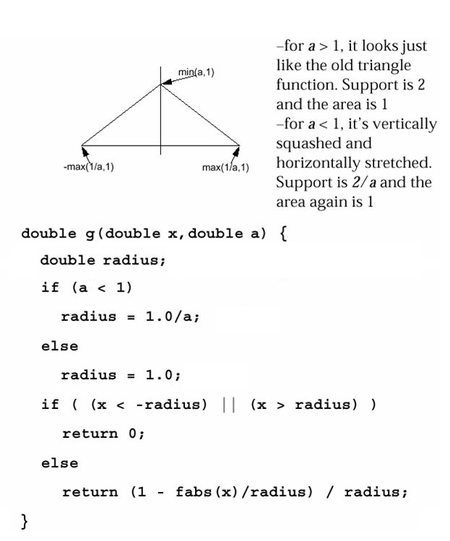
Two for the Price of One (1/2)‏
Min(a,1)
Triangle filter, modified to be reconstruction for scaling by factor of a:
for a > 1, looks just like the old triangle function. Support is 2 and the area is 1
For a < 1, it’s vertically squashed and horizontally stretched. Support is 2/a and the area again is 1.
Careful…
this function will be called a lot. Can you optimize it?
remember: fabs() is just floating point version of abs()‏
-Max(1/a,1)
Max(1/a,1)

Slide 23
Two for the Price of One (2/2)
The pseudocode tells us support of g
a < 1 : (-1/a) ≤ x ≤ (1/a)
a ≥ 1 : -1 ≤ x ≤ 1
Can talk about leftmost and rightmost pixels that we need to examine for pixel k in destination image as delimiting a window around k/a. Window is size 2 for scaling up, and size 2/a for scaling down
Note k/a is not, in general, an integer. Yet we want to use integer indices for leftmost and rightmost pixels. Use floor() and ceiling()
If a > 1 (scale up)
If a < 1 (scale down)
_
_{k}
Scale up
_{left = ceil( – 1)‏}
_{a}
_
Scale down
_{k}
_{right = floor( + 1)‏}
_{a}
_
_{k}
_
₁
_{k/a - 1/a}
_{k/a}
_{left = ceil( – )‏}
_{k/a +1/a}
_{a}
_{a}
_
k/a - 1
k/a + 1
_{k}
₁
_
_{right = floor( + )‏}
_{a}
_{a}

Slide 24
Triangle Filter Pseudocode
double h-prime(int k, double a) {
double sum = 0, weights_sum = 0;
int left, right;
if (a > 1) {
left = ceil(k/a – 1.0);
right = floor(k/a + 1.0);
} else {
left = ceil(k/a – 1.0/a);
right = floor(k/a + 1.0/a);
}
for (int i = left; i <= right, i++) {
sum += g(i – k/a, a) * orig_image.P_{i};
weights_sum += g(i – k/a, a);
}
result = sum/weights_sum;
}
To ponder: When don’t you need to normalize sum? Why? How can you optimize this code?

Slide 25
The Big Picture, Algorithmically Speaking
For each pixel in destination image:
determine which pixels in source image are relevant
by applying techniques described above, use values of source image pixels to generate value of current pixel in destination image

Slide 26
Normalizing Sum of Filter Weights (1/5)‏
Notice in pseudocode that we sum filter weights, then normalize sum of weighted pixel contributions by dividing by filter weight sum. Why?
Because non-integer width filters produce sums of weights which vary as a function of sampling position. Why is this a problem?
“Venetian blinds” – sums of weights increase and decrease away from 1.0 regularly across image.
These “bands” scale image with regularly spaced lighter and darker regions.
First we will show example of why filters with integer radii do sum to 1 and then why filters with real radii may not

Slide 27
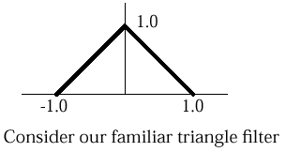
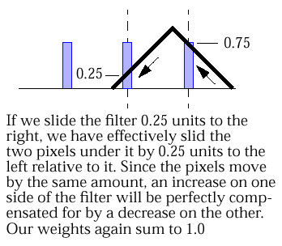
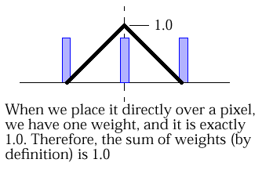
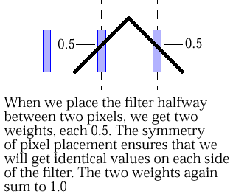

Normalizing Sum of Filter Weights (2/5)
Verify that integer-width filters have weights that always sum to one: notice that as filter shifts, one weight may be lowered, but it has a corresponding weight on opposite side of filter, a radius apart, that increases by same amount
Consider our familiar triangle filter
When we place it directly over a pixel, we have one weight, and it is exactly 1.0. Therefore, the sum of weights (by definition) is 1.0
When we place the filter halfway between two pixels, we get two weights, each 0.5. The symmetry of pixel placement ensures that we will get identical values on each side of the filter. The two weights again sum to 1.0
If we slide the filter 0.25 units to the right, we have effectively slid the two pixels under it by 0.25 units to the left relative to it. Since the pixels move by the same amount, an increase on one side of the filter will be perfectly compensated for by a decrease on the other. Our weights again sum to 1.0.

Slide 28
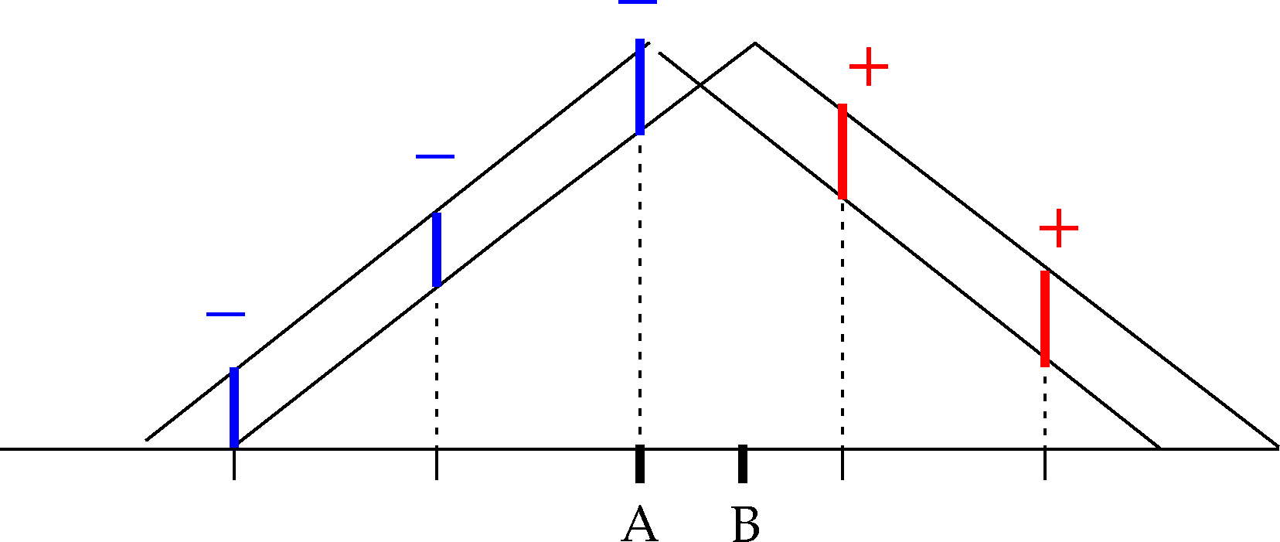
Normalizing Sum of Filter Weights (3/5)‏
But when filter radius is non-integer, sum of weights changes for different filter positions
In this example, first position filter (radius 2.5) at location A. Intersection of dotted line at pixel location with filter determines weight at that location. Now consider filter placed slightly right of A, at B.
Differences in new/old pixel weights shown as additions or subtractions. Because filter slopes are parallel, these differences are all same size. But there are 3 negative differences and 2 positive, hence two sums will differ

Slide 29
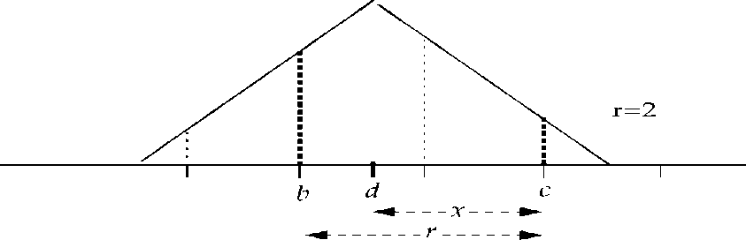
Normalizing Sum of Filter Weights (4/5)‏
When radius is an integer, contributing pixels can be paired and contribution from each pair is equal. The two pixels of a pair are at a radius distance from each other
Proof: see equation for value of filter with radius r centered at non-integer location d:
Suppose pair is (b, c) as in figure to right. Contribution sum becomes:
(Note |d – c| = x and |d – b| = r – x)
r=2
b
d
c

Slide 30
Normalizing Sum of Filter Weights (5/5)‏
Sum of contributions from two pixels in a pair does not depend on d (location of filter center)
Sum of contributions from all pixels under filter will not vary, no matter where we’re reconstructing
For integer width filters, we do not need to normalize
When scaling up, we always have integer-width filter, so we don’t need to normalize!
When scaling down, our filter width is generally non-integer, and we do need to normalize.
Can you rewrite the pseudocode to take advantage of this knowledge?

Slide 31
Scaling in 2D – Two Methods
We know how to do 1D scaling, but how do we generalize to 2D?
Do it in 2D “all at once” with one generalized filter
Harder to implement
More general
Generally more “correct” – deals with high frequency “diagonal” information
Do it in 1D twice – once to rows, once to columns
Easy to implement
For certain filters, works pretty decently
Requires intermediate storage
What’s the difference? 1D is easier, but is it a legitimate solution?
Notes:
Put these slides after pyramid filter

Slide 32
Digression on Separable Kernels (1/2)
The 1D two-pass method and the 2D method will give the same result if and only if the filter kernel (pixel mask) is separable
A separable kernel is one that can be represented as a product of two vectors. Those vectors would be your 1D kernels.
Mathematically, a matrix is separable if it’s rank (number of linearly independent rows/columns) is 1
Examples: box, Gaussian, Sobel (edge detection), but not cone and pyramid
Otherwise, there is no way to split a 2D filter into 2 1D filters that will give the same result

Slide 33
Digression on Separable Kernels (2/2)
For your assignment, the 1D two-pass approach suffices and is easier to implement. It does not matter whether you apply the filter in the x or y direction first.
Recall that ideally we use a sinc for the low pass filter, but can’t in practice, so use, say, pyramid or Gaussian.
Pyramid is not separable, but Gaussian is
Two 1D pyramid (i.e. triangle) kernels will not make a square 2D pyramid, but it will be close
If you multiply [0.25, 0.5, 0.25]^{T} * [0.25, 0.5, 0.25], you get the kernel on slide 38, which is not a pyramid – the pyramid would have identical weights around the border! See also next slide…
Feel free to use 1D triangles as an approximation to an approximation in your project

Slide 34
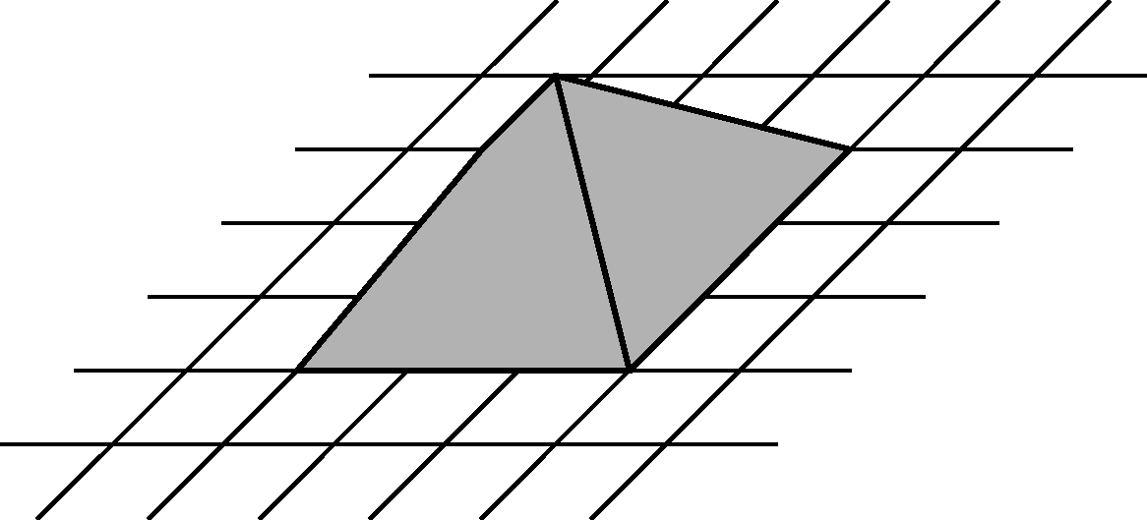
Pyramid vs. Triangles
Not the same, but close enough for a reasonable approximation
2D Pyramid kernel
2D kernel from two 1D triangles

Slide 35
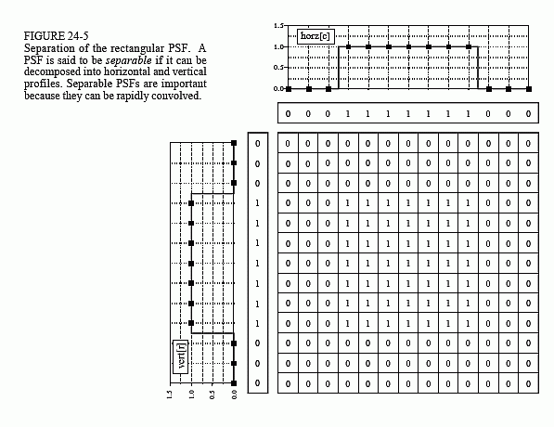
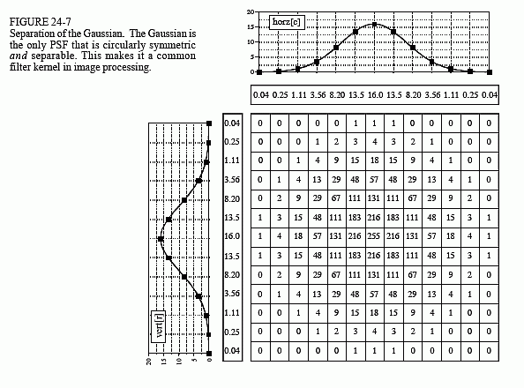
Examples of Separable Kernels
Box
Gaussian
PSF is the Point Spread Response, same as your filter kernel
http://www.dspguide.com/ch24/3.htm

Slide 36
Why is Separable Faster?
Why is filtering twice with 1D filters faster than once with 2D?
Consider your image with size W x H and a 1D filter kernel of width F
Your equivalent 2D filter with have a size F²
With your 1D filter, you will need to do F multiplications and adds per pixel and run through the image twice (e.g., first horizontally (saved in a temp) and then vertically)
Roughly 2FWH calculations
With your 2D filter, you need to do F² multiplications and adds per pixel and go through the image once
Roughly F²WH calculations
Using a 1d filter, the difference is about 2/F times the computation time
As your filter kernel size gets larger, the gains from a separable kernel become more significant! (at the cost of the temp, but that’s not an issue for most systems these days…)

Slide 37
Digression on Precomputed Kernels
Certain mapping operations (such as image blurring, sharpening, edge detection, etc.) change values of destination pixels, but don’t remap pixel locations, i.e., don’t sample between pixel locations. Their filters can be precomputed as a “kernel” (or “pixel mask”)‏
Other mappings, such as image scaling, require sampling between pixel locations and therefore calculating actual filter values at those arbitrary non-integer locations. For these operations, often easier to approximate pyramid filter by applying triangle filters twice, once along x-axis of source, once along y-axis

Slide 38
Precomputed Filter Kernels (1/3)‏
Filter kernel is filter value precomputed at predefined sample points
Kernels are usually square, odd number by odd number size grids (center of kernel can be at pixel that you are working with [e.g. 3x3 kernel shown here]):
Why does precomputation only work for mappings which sample only at integer pixel intervals in original image?
If filter location is moved by fraction of a pixel in source image, pixels fall under different locations within filter, correspond to different filter values.
Can’t precompute for this since indefinitely many non-integer values
Since scaling will almost always require non-integer pixel sampling, you cannot use precomputed kernels. However, they will be useful for image processing algorithms such as edge detection.
1/16 | 2/26 | 1/16
2/16 | 4/16 | 2/16
1/16 | 2/16 | 1/16

Slide 39
Precomputed Filter Kernels (2/3)‏
Evaluating the kernel
Filter kernel evaluated as normal filters are: multiply pixel values in source image by filter values corresponding to their location within filter
Place kernel’s center over integer pixel location to be sampled. Each pixel covered by kernel is multiplied by corresponding kernel value; results are summed
Note: have not dealt with boundary conditions. One common tactic is to act as if there is a buffer zone where the edge values are repeated

Slide 40
Precomputed Filter Kernels (3/3)‏
Filter kernel in operation
Pixel in destination image is weighted sum of multiple pixels in source image

Slide 41
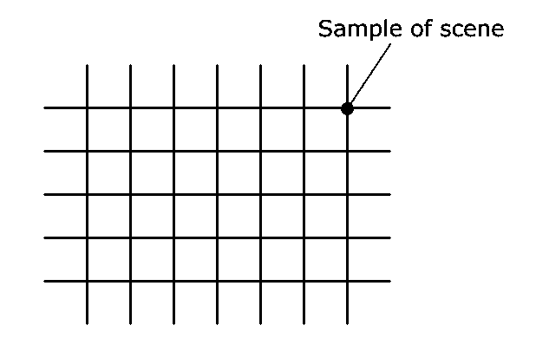
Supersampling for Image Synthesis (1/2)
Anti-aliasing of primitives in practice
Bad Old Days: Generate low-res image and post-filter the whole image, e.g. with pyramid – blurs image (with its aliases – bad crawlies)
Alternative: super-sample and post-filter, to approximate pre-filtering before sampling
Pixel’s value computed by taking weighted average of several point samples around pixel’s center. Again, approximating (convolution) integral with weighted sum
Stochastic (random) point sampling as an approximation converges faster and is more correct than equi-spaced grid sampling
Pixel at row/column intersection
Center of current pixel
samples can be taken in grid around pixel center…
or they can be taken at random locations

Slide 42
Supersampling for Image Synthesis (2/2)
Why does supersampling work?
Sampling a higher frequency pushes the replicas apart, and since spectra fall off approximately a 1/f ^{p} for (1 < p < 2) (i.e. somewhere between linearly and quadratically), the tails overlap much less, causing much less corruption before the low-pass filtering
With fewer than 128 distinguishable levels of intensity, being off by one step is hardly noticeable
Stochastic sampling may introduce some random noise, but if you make multiple passes it will eventually converge on the correct answer
Since you need to take multiple samples and filter them, this process is computationally expensive

Slide 43
Modern Anti-Aliasing Techniques – Postprocessing
Ironically, current trends in graphics are moving back toward anti-aliasing as a post processing step
AMD’s MLAA (Morphological Anti-Aliasing) and nVidia’s FXAA (Fast Approximate Anti-Aliasing) plus many more
General idea: find edges/silhouettes in the image, slightly blur those areas
Faster and lower memory requirements compared to supersampling
Scales better with larger resolutions
Compared to just plain blur filtering, looks better due to intelligently filtering along contours in the image. There is more filtering in areas of bad aliasing while still preserving crispness.

Slide 44
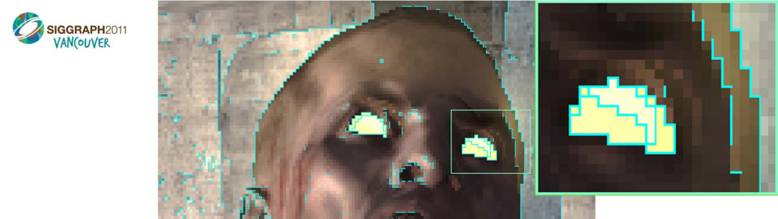
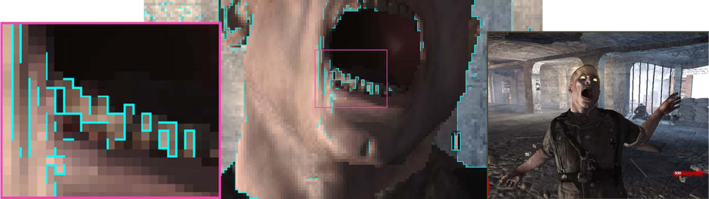
MLAA Example

Slide 45
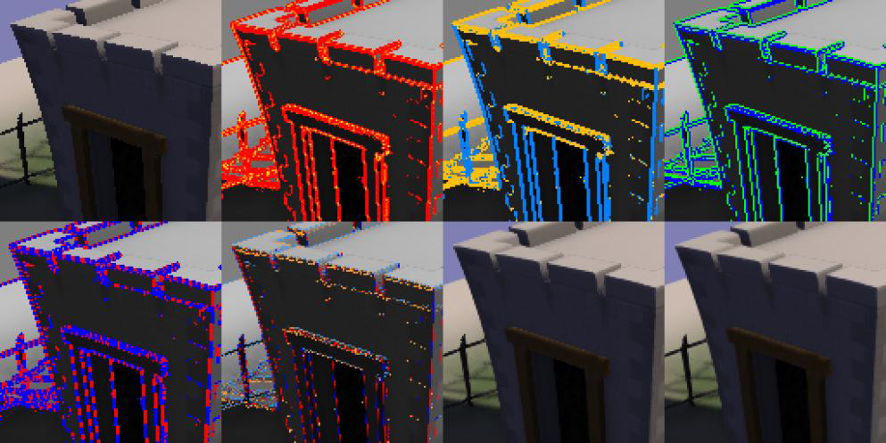
FXAA Example

Slide 46
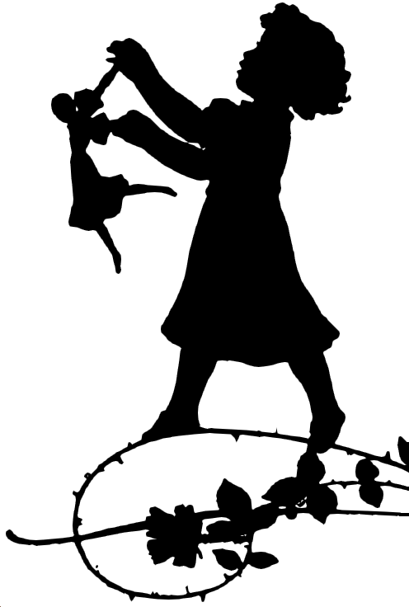

MLAA vs. Blur Filter

