Slide 1



Geometric Transformations
2D and 3D
Tuesday 10/4/2011

Slide 2
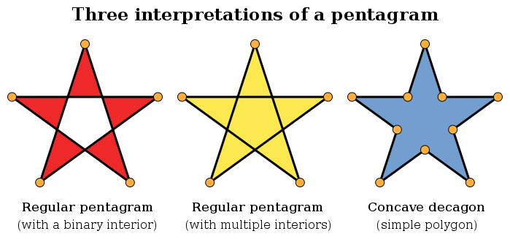
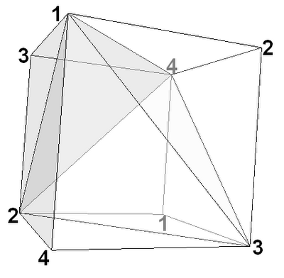
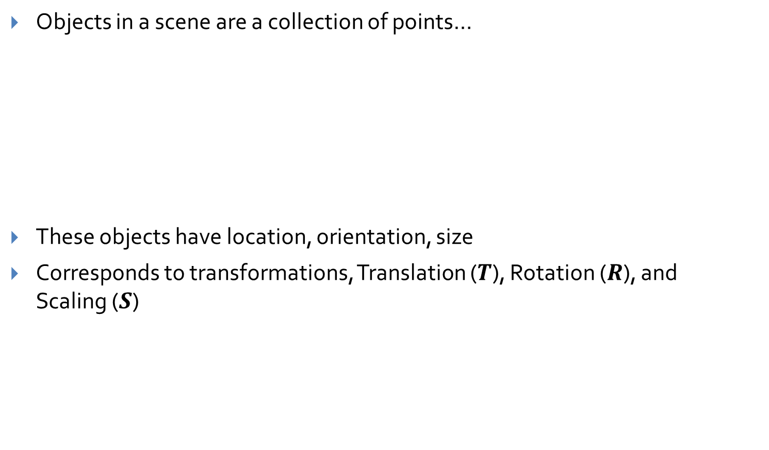
How do we use Geometric Transformations? (1/2)
Objects in a scene are a collection of points…
These objects have location, orientation, size
Corresponds to transformations, Translation ($T$), Rotation ($R$), and Scaling ($S$)

Slide 3
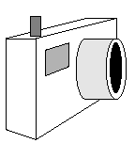
How do we use Geometric Transformations? (2/2)
A scene has a camera/view point from which the scene is viewed
The camera has some location and some orientation in 3-space …
These correspond to Translation and Rotation transformations
Need other types of viewing transformations as well - learn about them shortly

Slide 4
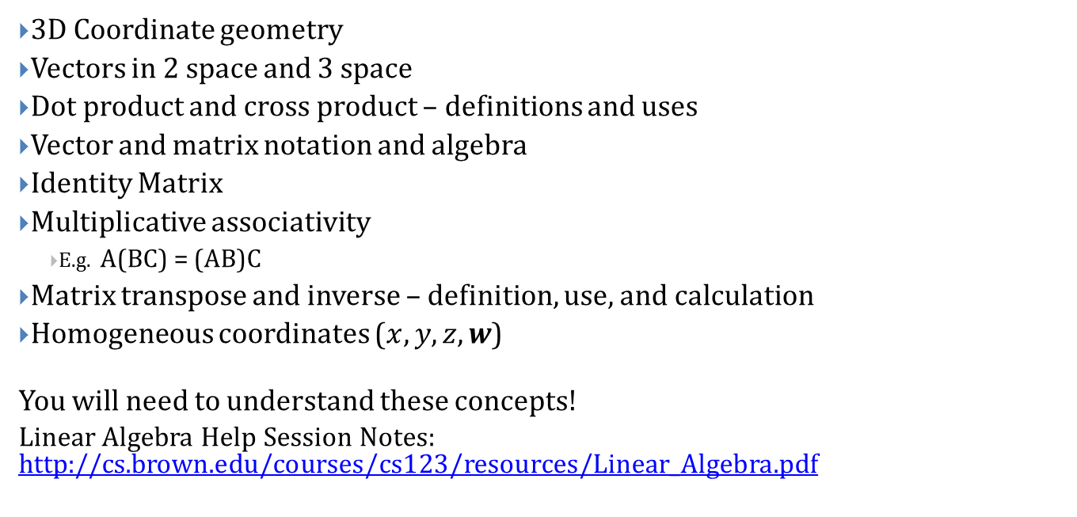
Some Linear Algebra Concepts...
3D Coordinate geometry
Vectors in 2 space and 3 space
Dot product and cross product – definitions and uses
Vector and matrix notation and algebra
Identity Matrix
Multiplicative associativity
E.g. A(BC) = (AB)C
Matrix transpose and inverse – definition, use, and calculation
Homogeneous coordinates ($x, y, z, w$)
You will need to understand these concepts!
Linear Algebra Help Session Notes: http://cs.brown.edu/courses/cs123/resources/Linear_Algebra.pdf

Slide 5
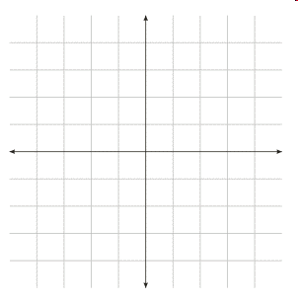
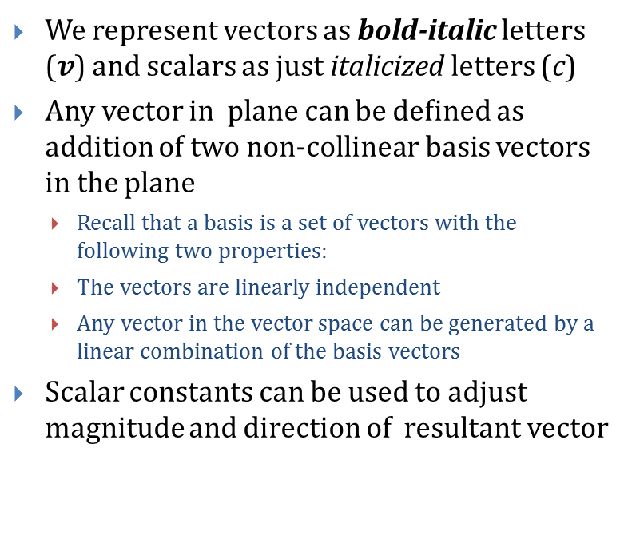

Linear Transformations (1/3)
We represent vectors as bold-italic letters ($v$) and scalars as just italicized letters (c)
Any vector in plane can be defined as addition of two non-collinear basis vectors in the plane
Recall that a basis is a set of vectors with the following two properties:
The vectors are linearly independent
Any vector in the vector space can be generated by a linear combination of the basis vectors
Scalar constants can be used to adjust magnitude and direction of resultant vector
b
a
$v$ = a + b
Notes:
Diagram here

Slide 6
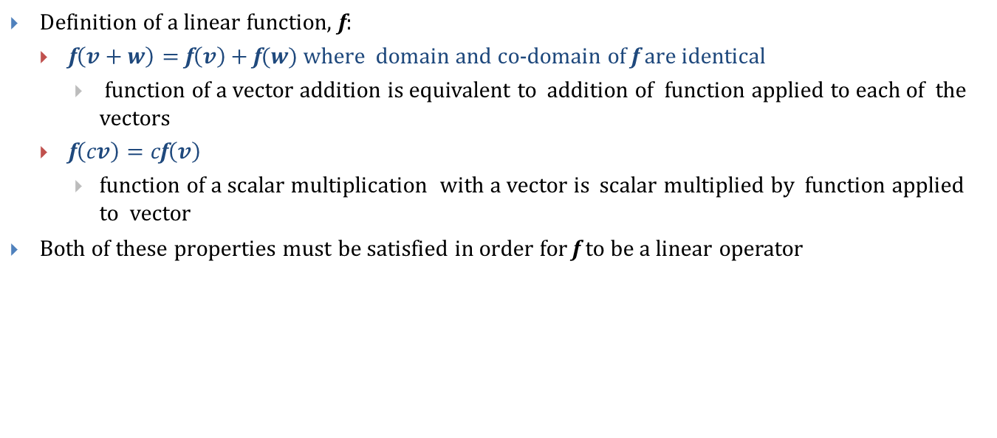
Linear Transformations (2/3)
Definition of a linear function, f:
f$\left(v+w\right)=\text{f}\left(v\right)+\text{f}(w)$where domain and co-domain of f are identical
function of a vector addition is equivalent to addition of function applied to each of the vectors
$\text{f}\left(cv\right)=c\text{f}\left(v\right)$
function of a scalar multiplication with a vector is scalar multiplied by function applied to vector
Both of these properties must be satisfied in order for f to be a linear operator

Slide 7
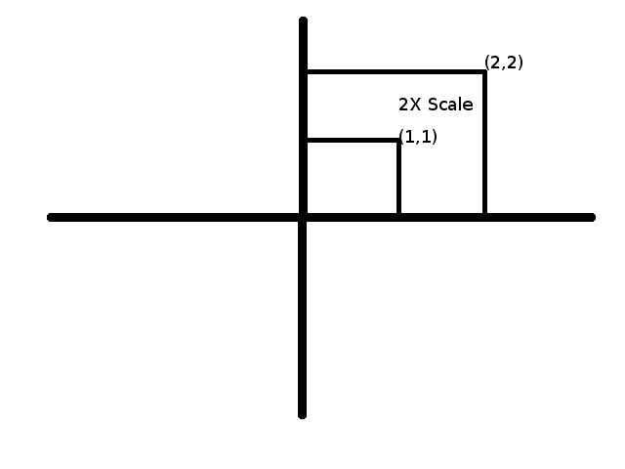
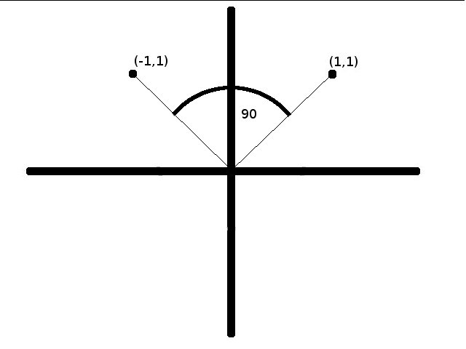
Linear Transformations (3/3)
Graphical Use: transformations of points around the origin (leaves the origin invariant)
These include Scaling and Rotations (but not translation),
Translation is not a linear function (moves the origin)
Any linear transformation of a point will result in another point in the same coordinate system, transformed about the origin

Slide 8
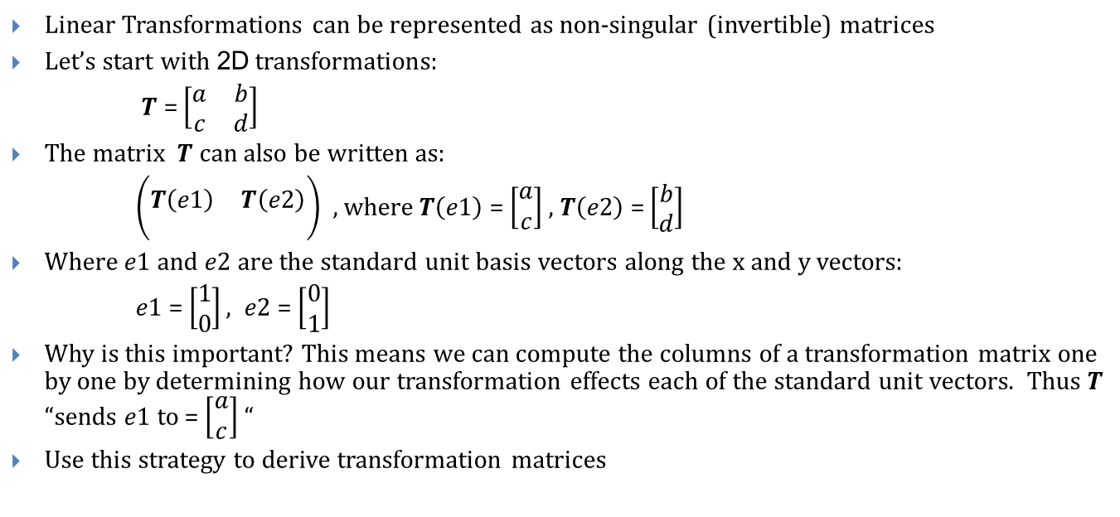
Linear Transformations as Matrices (1/2)
Linear Transformations can be represented as non-singular (invertible) matrices
Let’s start with 2D transformations:
$T$ = $\left[\begin{matrix}a & b \\ c & d\end{matrix}\right]$
The matrix $T$ can also be written as:
$\left(\begin{matrix} & \\ T\left(e1\right) & T\left(e2\right) \\ & \end{matrix}\right)$ , where $T\left(e1\right)$ = $\left[\begin{matrix}a \\ c\end{matrix}\right]$ , $T\left(e2\right)$ = $\left[\begin{matrix}b \\ d\end{matrix}\right]$
Where $e1$ and $e2 are$ the standard unit basis vectors along the x and y vectors:
$e1$ = $\left[\begin{matrix}1 \\ 0\end{matrix}\right], e2$= $\left[\begin{matrix}0 \\ 1\end{matrix}\right]$
Why is this important? This means we can compute the columns of a transformation matrix one by one by determining how our transformation effects each of the standard unit vectors. Thus $T$ “sends $e1$ to = $\left[\begin{matrix}a \\ c\end{matrix}\right]$ “
Use this strategy to derive transformation matrices

Slide 9
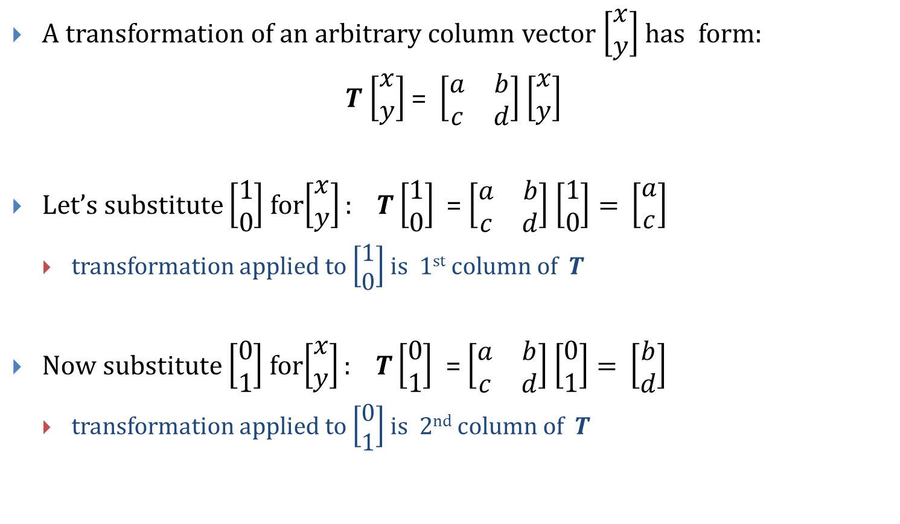
Linear Transformations as Matrices (2/2)
A transformation of an arbitrary column vector $\left[\begin{matrix}x \\ y\end{matrix}\right]$ has form:
$T$ $\left[\begin{matrix}x \\ y\end{matrix}\right]$ = $\left[\begin{matrix}a & b \\ c & d\end{matrix}\right]$ $\left[\begin{matrix}x \\ y\end{matrix}\right]$
Let’s substitute $\left[\begin{matrix}1 \\ 0\end{matrix}\right]$for$\left[\begin{matrix}x \\ y\end{matrix}\right]:$ $T\left[\begin{matrix}1 \\ 0\end{matrix}\right]$ = $\left[\begin{matrix}a & b \\ c & d\end{matrix}\right]$ $\left[\begin{matrix}1 \\ 0\end{matrix}\right]=$ $\left[\begin{matrix}a \\ c\end{matrix}\right]$
transformation applied to $\left[\begin{matrix}1 \\ 0\end{matrix}\right]$ is 1st column of $T$
Now substitute $\left[\begin{matrix}0 \\ 1\end{matrix}\right]$for$\left[\begin{matrix}x \\ y\end{matrix}\right]:$ $T\left[\begin{matrix}0 \\ 1\end{matrix}\right]$ = $\left[\begin{matrix}a & b \\ c & d\end{matrix}\right]$ $\left[\begin{matrix}0 \\ 1\end{matrix}\right]=$ $\left[\begin{matrix}b \\ d\end{matrix}\right]$
transformation applied to $\left[\begin{matrix}0 \\ 1\end{matrix}\right]$ is 2nd column of $T$

Slide 10
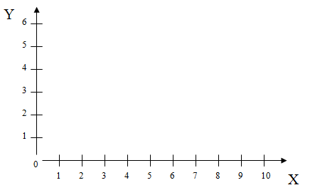
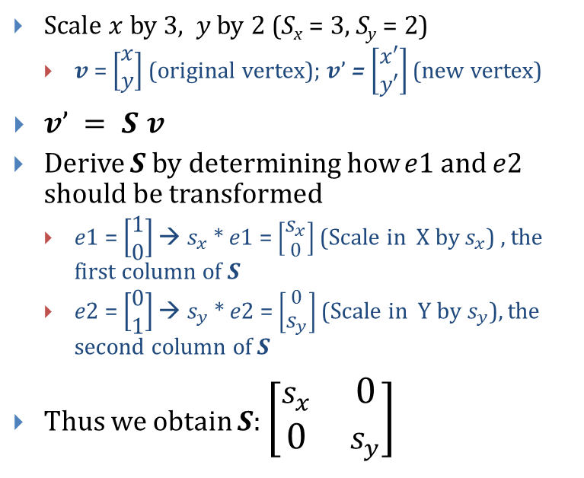
Scaling in 2D (1/2)
Scale $x$ by 3, $y$ by 2 (S_{x} = 3, S_{y} = 2)
$v$ = $\left[\begin{matrix}x \\ y\end{matrix}\right]$ (original vertex); $v’$= $\left[\begin{matrix}x′ \\ y′\end{matrix}\right]$ (new vertex)
$v’ = S v$
Derive $S$ by determining how $e1$ and $e2$ should be transformed
$e1$ = $\left[\begin{matrix}1 \\ 0\end{matrix}\right]$ → $s_{x}$ * $e1$ = $\left[\begin{matrix}s_{x} \\ 0\end{matrix}\right]$ (Scale in X by $s_{x}$) , the first column of $S$
$e2$ = $\left[\begin{matrix}0 \\ 1\end{matrix}\right]$ → $s_{y}$ * $e2$ = $\left[\begin{matrix}0 \\ s_{y}\end{matrix}\right]$ (Scale in Y by${ s}_{y}$), the second column of $S$
Thus we obtain $S$: $\left[\begin{matrix}s_{x} & 0 \\ 0 & s_{y}\end{matrix}\right]$
Side effect: House shifts position relative to origin
Notes:
Do the same for y

Slide 11
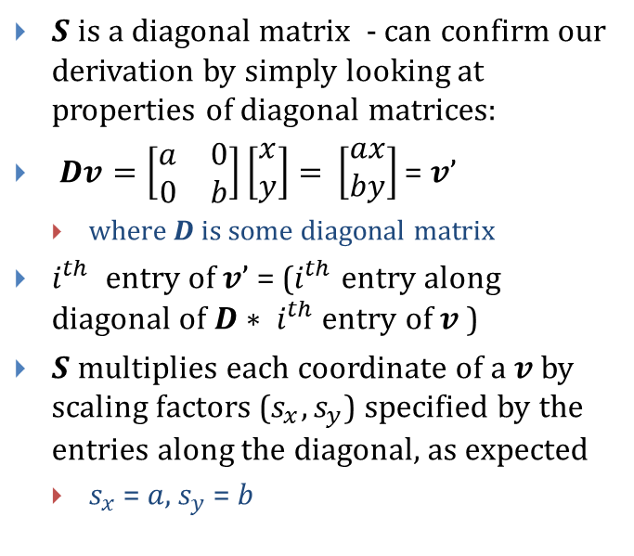
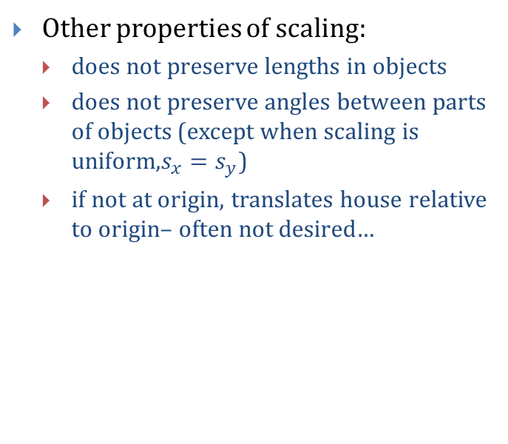
Scaling in 2D (2/2)
$S$ is a diagonal matrix - can confirm our derivation by simply looking at properties of diagonal matrices:
$Dv=\left[\begin{matrix}a & 0 \\ 0 & b\end{matrix}\right]\left[\begin{matrix}x \\ y\end{matrix}\right]=$ $\left[\begin{matrix}ax \\ by\end{matrix}\right]$ = $v’$
where $D$ is some diagonal matrix
$i^{th}$ entry of $v’$ = ($i^{th}$ entry along diagonal of$D∗ i^{th}$ entry of $v$ )
$S$ multiplies each coordinate of a $v$by scaling factors ($s_{x}, s_{y}$) specified by the entries along the diagonal, as expected
$s_{x}$ = $a$, $s_{y}$ = $b$
Other properties of scaling:
does not preserve lengths in objects
does not preserve angles between parts of objects (except when scaling is uniform,$s_{x}=s_{y}$)
if not at origin, translates house relative to origin– often not desired…

Slide 12
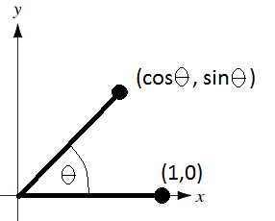
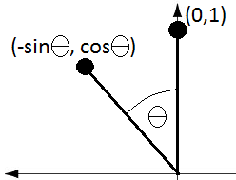
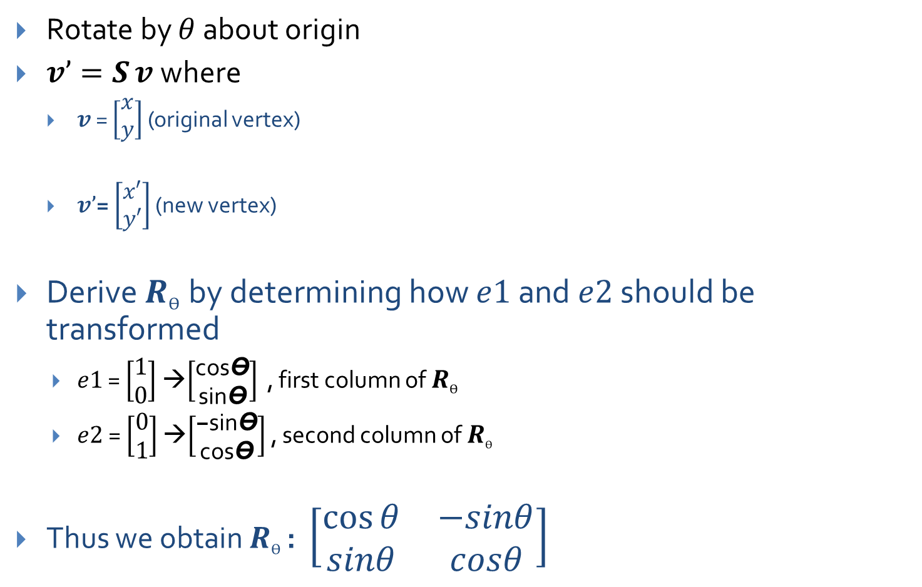
Rotation in 2D (1/2)
Rotate by $θ$ about origin
$v’=S v$where
$v$ = $\left[\begin{matrix}x \\ y\end{matrix}\right]$ (original vertex)
$v’$= $\left[\begin{matrix}x′ \\ y′\end{matrix}\right]$ (new vertex)
Derive $R_{Ө}$by determining how $e1$ and $e2$ should be transformed
$e1$ = $\left[\begin{matrix}1 \\ 0\end{matrix}\right]$ →$\left[\begin{matrix}\text{cos}\text{Ө} \\ \text{sin}\text{Ө}\end{matrix}\right]$ , first column of $R_{Ө}$
$e2$= $\left[\begin{matrix}0 \\ 1\end{matrix}\right]$ →$\left[\begin{matrix}\text{−}\text{sin}\text{Ө} \\ \text{cos}\text{Ө}\end{matrix}\right]$ , second column of $R_{Ө}$
Thus we obtain $R_{Ө}$: $\left[\begin{matrix}cos⁡θ & −sinθ \\ sinθ & cosθ\end{matrix}\right]$

Slide 13
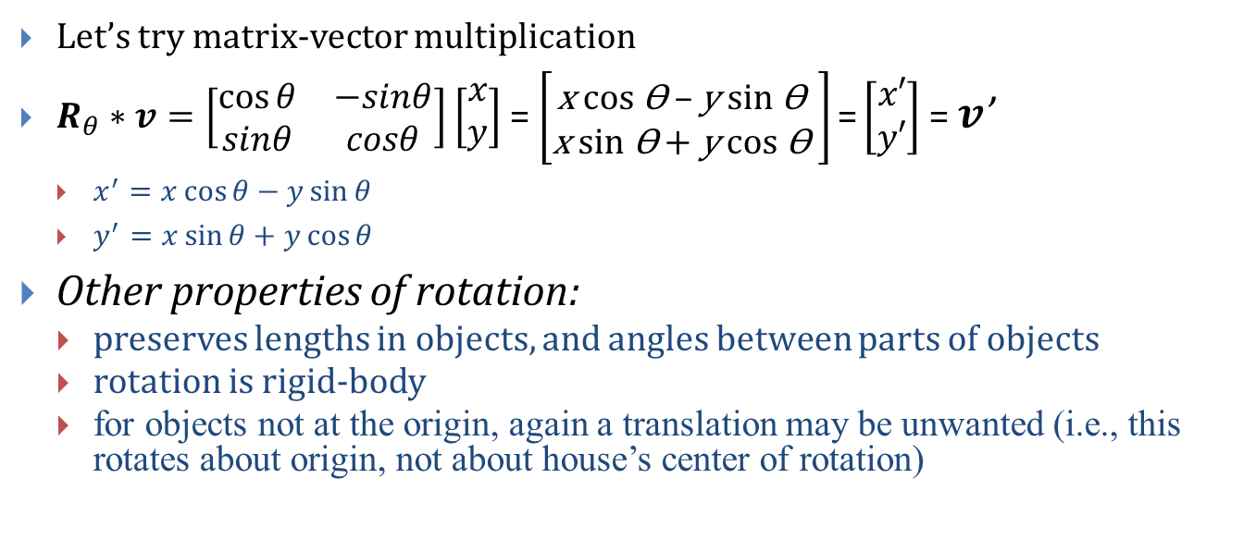
Rotation in 2D (2/2)
Let’s try matrix-vector multiplication
$R_{θ}∗v=\left[\begin{matrix}cos⁡θ & −sinθ \\ sinθ & cosθ\end{matrix}\right]$ $\left[\begin{matrix}x \\ y\end{matrix}\right]$ = $\left[\begin{matrix}\text{x} \text{cos} \text{Ө}\text{ – }\text{y} \text{sin} \text{Ө} \\ \text{x} \text{sin} \text{Ө}\text{ + }\text{y} \text{cos} \text{Ө} \end{matrix}\right]\text{=}\left[\begin{matrix}x′ \\ y′\end{matrix}\right]$ = $v$’
$x^{′}=x\cos{θ}−y\sin{θ}$
$y^{′}=x\sin{θ}+y\cos{θ}$
Other properties of rotation:
preserves lengths in objects, and angles between parts of objects
rotation is rigid-body
for objects not at the origin, again a translation may be unwanted (i.e., this rotates about origin, not about house’s center of rotation)

Slide 14
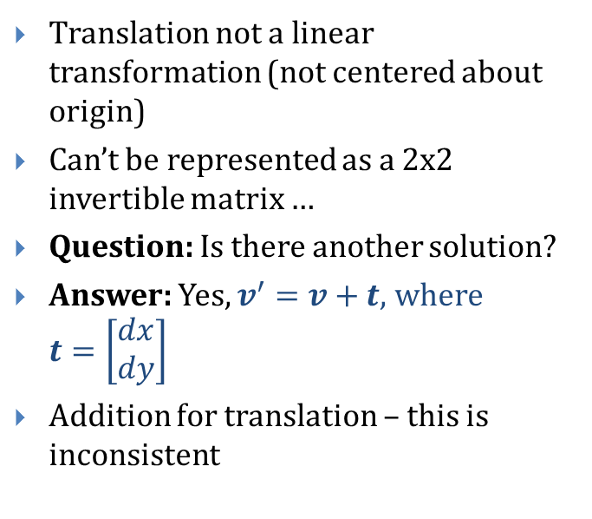
What about translation?
Translation not a linear transformation (not centered about origin)
Can’t be represented as a 2x2 invertible matrix …
Question: Is there another solution?
Answer: Yes, $v^{′}=v+t$, where $t=\left[\begin{matrix}dx \\ dy\end{matrix}\right]$
Addition for translation – this is inconsistent
If we could treat all transformations in a consistent manner, i.e., with matrix representation, then could combine transformations by composing their matrices
Let’s try using a Matrix again
How? Homogeneous Coordinates: add an additional dimension, the w-axis, and an extra coordinate, the w-component
thus 2D -> 3D (effectively the hyperspace for embedding 2D space)

Slide 15
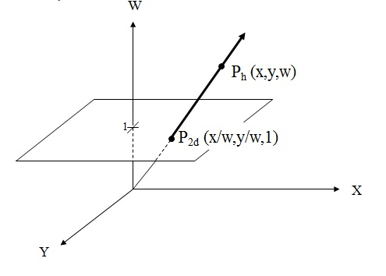

Homogeneous Coordinates (1/3)
Allows expression of all three 2D transformations as 3x3 matrices
We start with the point $P_{2d}$ on the $xy$ plane and apply a mapping to bring it to the $w$-plane in hyperspace
$P_{2d}\left(x,y\right)→P_{h}\left(wx,wy,w\right), w≠0$
The resulting ($x$’, $y$’) coordinates in our new point $P_{h}$ are different from the original ($x$, $y$) , where $x$’ = $wx$, $y$’ = $wy$
$P_{h}\left(x^{′},y^{′},w\right), w≠0$

Slide 16
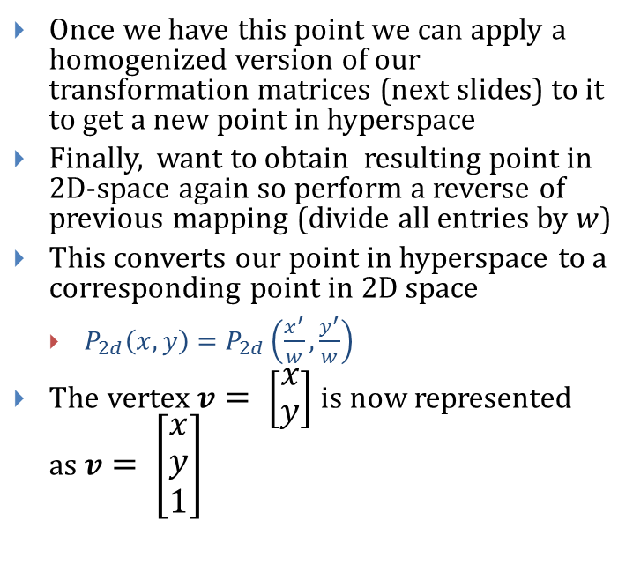
Homogeneous Coordinates (2/3)
Once we have this point we can apply a homogenized version of our transformation matrices (next slides) to it to get a new point in hyperspace
Finally, want to obtain resulting point in 2D-space again so perform a reverse of previous mapping (divide all entries by $w$)
This converts our point in hyperspace to a corresponding point in 2D space
$P_{2d}\left(x,y\right)=P_{2d}\left(\frac{x^{′}}{w},\frac{y^{′}}{w}\right)$
The vertex$v= \left[\begin{matrix}x \\ y\end{matrix}\right]$ is now represented as$v= \left[\begin{matrix}x \\ y \\ 1\end{matrix}\right]$

Slide 17
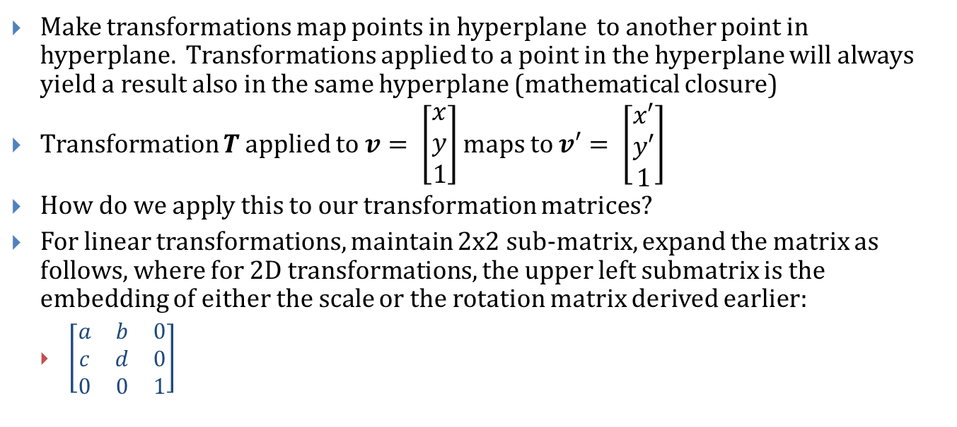
Homogeneous Coordinates (3/3)
Make transformations map points in hyperplane to another point in hyperplane. Transformations applied to a point in the hyperplane will always yield a result also in the same hyperplane (mathematical closure)
Transformation $T$ applied to $v= \left[\begin{matrix}x \\ y \\ 1\end{matrix}\right]$ maps to $v′= \left[\begin{matrix}x′ \\ y′ \\ 1\end{matrix}\right]$
How do we apply this to our transformation matrices?
For linear transformations, maintain 2x2 sub-matrix, expand the matrix as follows, where for 2D transformations, the upper left submatrix is the embedding of either the scale or the rotation matrix derived earlier:
$\left[\begin{matrix}a & b & 0 \\ c & d & 0 \\ 0 & 0 & 1\end{matrix}\right]$

Slide 18
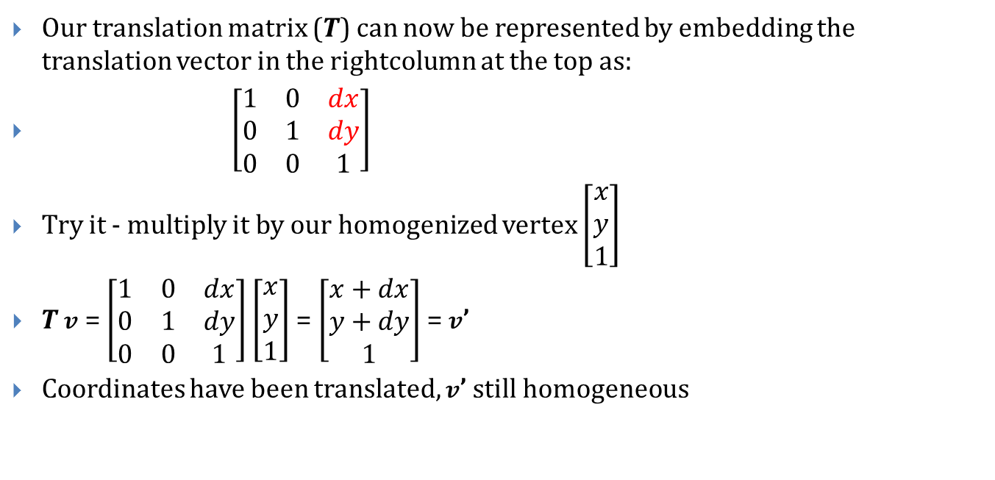
Back to Translation
Our translation matrix ($T$) can now be represented by embedding the translation vector in the rightcolumn at the top as:
$\left[\begin{matrix}1 & 0 & dx \\ 0 & 1 & dy \\ 0 & 0 & 1\end{matrix}\right]$
Try it - multiply it by our homogenized vertex $\left[\begin{matrix}x \\ y \\ 1\end{matrix}\right]$
$T$ $v$ = $\left[\begin{matrix}1 & 0 & dx \\ 0 & 1 & dy \\ 0 & 0 & 1\end{matrix}\right]$ $\left[\begin{matrix}x \\ y \\ 1\end{matrix}\right]$ = $\left[\begin{matrix}x+dx \\ y+dy \\ 1\end{matrix}\right]$ = $v$’
Coordinates have been translated, $v$’ still homogeneous
Notes:
Change T’s

Slide 19
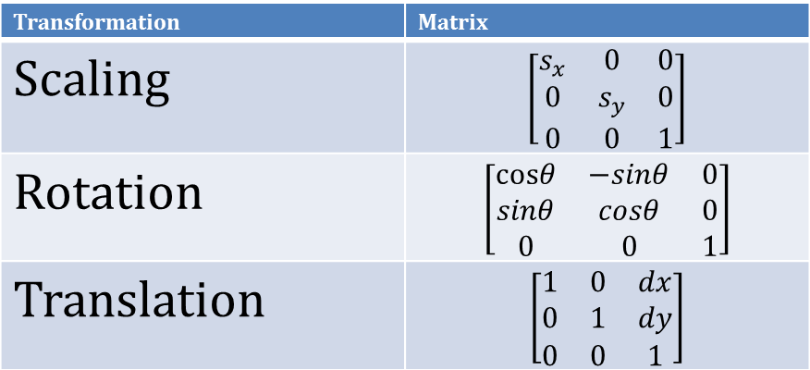
Transformations Homogenized
Translation uses a 3x3 Matrix, but Scaling and Rotation are 2x2 Matrices
Let’s homogenize! Doesn’t affect linearity property of scaling and rotation
Our new transformation matrices look like this…
Note: These 3 transformations are called affine transformations
Transformation | Matrix
Scaling | $\left[\begin{matrix}s_{x} & 0 & 0 \\ 0 & s_{y} & 0 \\ 0 & 0 & 1\end{matrix}\right]$
Rotation | $\left[\begin{matrix}\text{cos}θ & −sinθ & 0 \\ sinθ & cosθ & 0 \\ 0 & 0 & 1\end{matrix}\right]$
Translation | $$\left[\begin{matrix}1 & 0 & dx \\ 0 & 1 & dy \\ 0 & 0 & 1\end{matrix}\right]$$

Slide 20
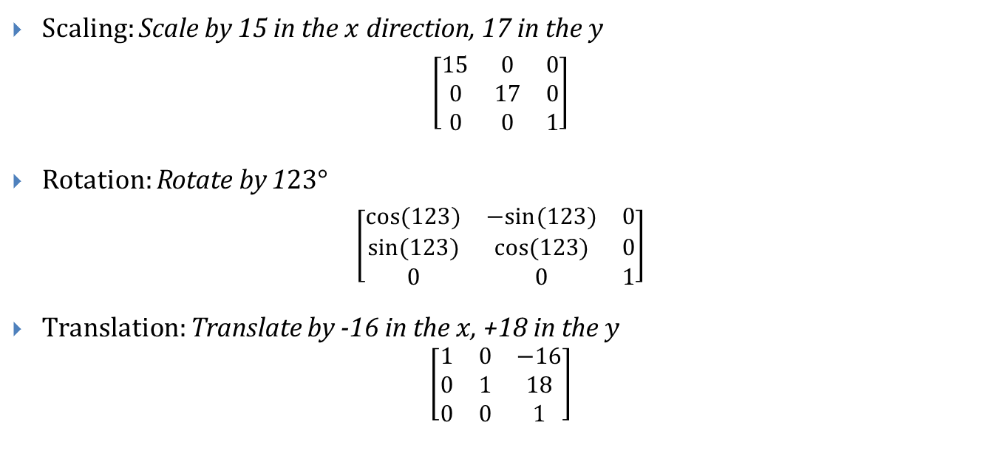
Examples
Scaling: Scale by 15 in the $x$ direction, 17 in the $y$
$\left[\begin{matrix}\text{15} & 0 & 0 \\ 0 & \text{17} & 0 \\ 0 & 0 & 1\end{matrix}\right]$
Rotation: Rotate by 1$23°$
$\left[\begin{matrix}\text{cos}(123) & −sin⁡(123) & 0 \\ sin⁡(123) & cos⁡(123) & 0 \\ 0 & 0 & 1\end{matrix}\right]$
Translation: Translate by -16 in the $x$, +18 in the $y$
$$\left[\begin{matrix}1 & 0 & −16 \\ 0 & 1 & 18 \\ 0 & 0 & 1\end{matrix}\right]$$

Slide 21
Before we continue! Vectors vs. Points
Up until now, we’ve only used the notion of a point in our 2D space
We now present a distinction between points and vectors
We used Homogeneous coordinates to more conveniently represent translation; hence points are represented as (x, y, 1)^{T}
A vector can be rotated/scaled, not translated (always starts at origin), don’t use the Homogeneous coordinate, (x, y, 0)^{T}
For now, let’s focus on just our points (typically vertices)

Slide 22
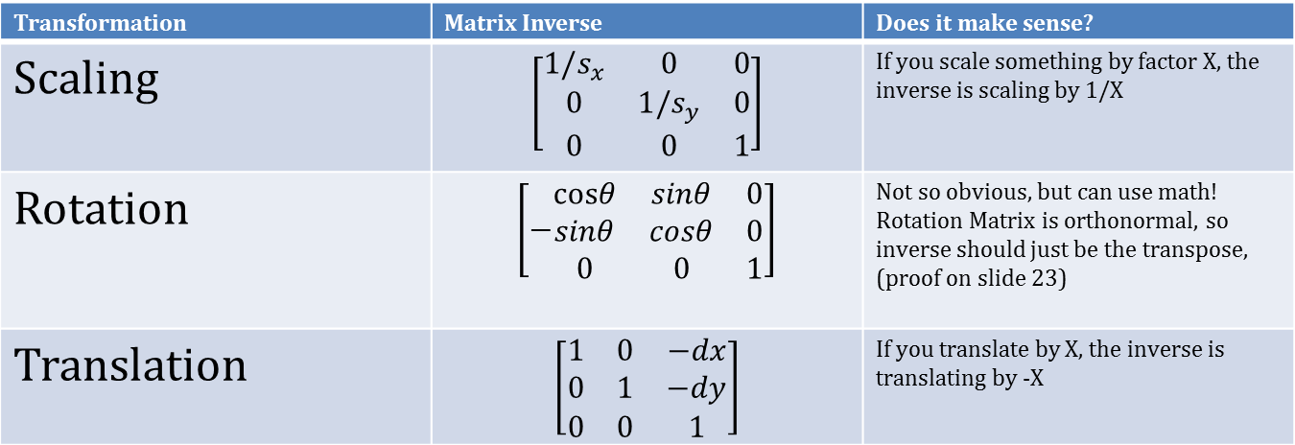
Inverses
How do we find the inverse of a transformation?
Take the inverse of the transformation matrix (thanks to homogenization, they’re all invertible!):
Transformation | Matrix Inverse | Does it make sense?
Scaling | $$\left[\begin{matrix}\text{1/}s_{x} & 0 & 0 \\ 0 & 1/s_{y} & 0 \\ 0 & 0 & 1\end{matrix}\right]$$ | If you scale something by factor X, the inverse is scaling by 1/X
Rotation | $\left[−\begin{matrix}\text{cos}θ & sinθ & 0 \\ sinθ & cosθ & 0 \\ 0 & 0 & 1\end{matrix}\right]$ | Not so obvious, but can use math! Rotation Matrix is orthonormal, so inverse should just be the transpose, (proof on slide 23)
Translation | $$\left[\begin{matrix}1 & 0 & −dx \\ 0 & 1 & −dy \\ 0 & 0 & 1\end{matrix}\right]$$ | If you translate by X, the inverse is translating by -X

Slide 23
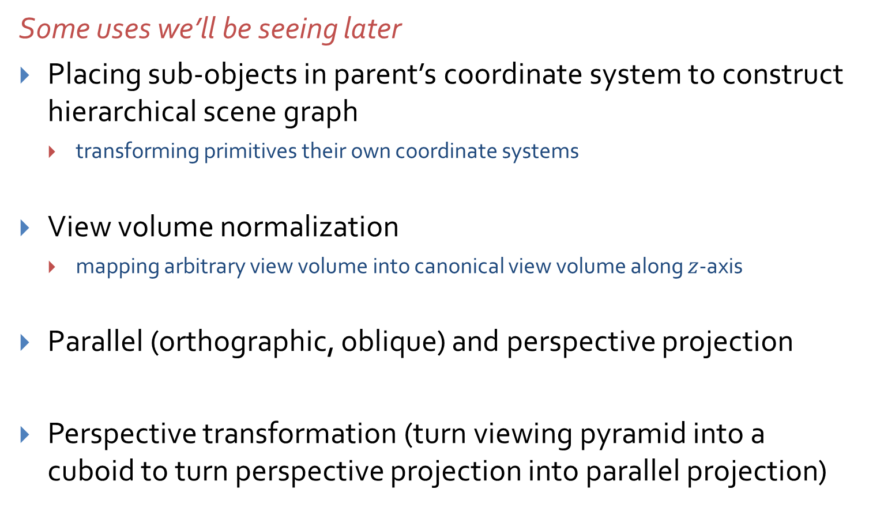
More with Homogeneous Coordinates
Some uses we’ll be seeing later
Placing sub-objects in parent’s coordinate system to construct hierarchical scene graph
transforming primitives their own coordinate systems
View volume normalization
mapping arbitrary view volume into canonical view volume along $z$-axis
Parallel (orthographic, oblique) and perspective projection
Perspective transformation (turn viewing pyramid into a cuboid to turn perspective projection into parallel projection)

Slide 24
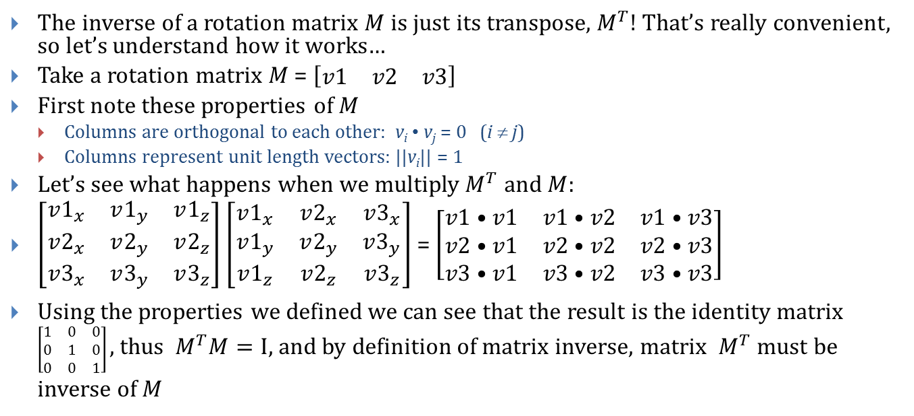
A moment of appreciation for linear algebra
The inverse of a rotation matrix $M$ is just its transpose, $M^{T}!$That’s really convenient, so let’s understand how it works…
Take a rotation matrix $M$ = $\left[\begin{matrix}v1 & v2 & v3\end{matrix}\right]$
First note these properties of $M$
Columns are orthogonal to each other: v_{i} • v_{j} = 0 (i ≠ j)
Columns represent unit length vectors: ||v_{i}|| = 1
Let’s see what happens when we multiply${ M}^{T} and M:$
$\left[\begin{matrix}v1_{x} & v1_{y} & v1_{z} \\ v2_{x} & v2_{y} & v2_{z} \\ v3_{x} & v3_{y} & v3_{z}\end{matrix}\right]$ $\left[\begin{matrix}v1_{x} & v2_{x} & v3_{x} \\ v1_{y} & v2_{y} & v3_{y} \\ v1_{z} & v2_{z} & v3_{z}\end{matrix}\right]$ = $\left[\begin{matrix}v1•v1 & v1•v2 & v1•v3 \\ v2•v1 & v2•v2 & v2•v3 \\ v3•v1 & v3•v2 & v3•v3\end{matrix}\right]$
Using the properties we defined we can see that the result is the identity matrix $\left[\begin{matrix}1 & 0 & 0 \\ 0 & 1 & 0 \\ 0 & 0 & 1\end{matrix}\right]$ , thus ${ M}^{T}M=I$, and by definition of matrix inverse, matrix ${ M}^{T}$must be inverse of $M$

Slide 25
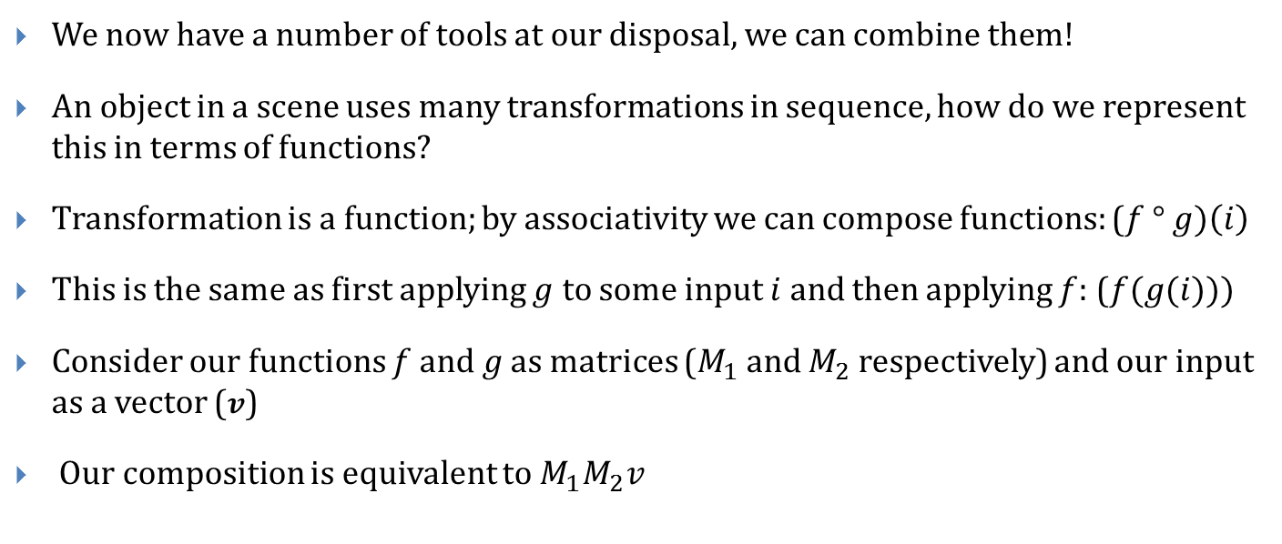
Composition of Transformations (2D) (1/2)
We now have a number of tools at our disposal, we can combine them!
An object in a scene uses many transformations in sequence, how do we represent this in terms of functions?
Transformation is a function; by associativity we can compose functions: ($f$ $° g)\left(i\right)$
This is the same as first applying $g$ to some input $i$and then applying $f$: ($f(g(i)))$
Consider our functions $f$ $and g$as matrices ($M_{1}$ and $M_{2}$ respectively) and our input as a vector ($v$)
Our composition is equivalent to $M_{1}M_{2}v$

Slide 26
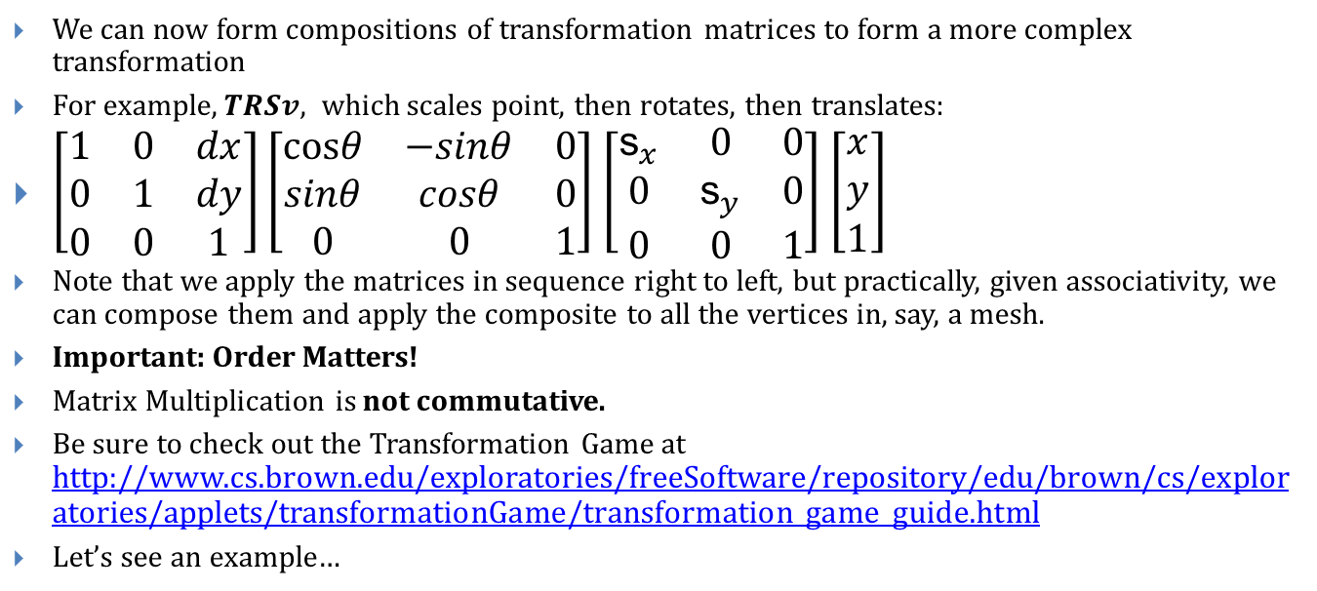
Composition of Transformations (2D) (2/2)
We can now form compositions of transformation matrices to form a more complex transformation
For example,$TRSv$, which scales point, then rotates, then translates:
$\left[\begin{matrix}1 & 0 & dx \\ 0 & 1 & dy \\ 0 & 0 & 1\end{matrix}\right]$ $\left[\begin{matrix}\text{cos}θ & −sinθ & 0 \\ sinθ & cosθ & 0 \\ 0 & 0 & 1\end{matrix}\right]$ $\left[\begin{matrix}{\text{s}}_{x} & 0 & 0 \\ 0 & {\text{s}}_{y} & 0 \\ 0 & 0 & 1\end{matrix}\right]$ $\left[\begin{matrix}x \\ y \\ 1\end{matrix}\right]$
Note that we apply the matrices in sequence right to left, but practically, given associativity, we can compose them and apply the composite to all the vertices in, say, a mesh.
Important: Order Matters!
Matrix Multiplication is not commutative.
Be sure to check out the Transformation Game at http://www.cs.brown.edu/exploratories/freeSoftware/repository/edu/brown/cs/exploratories/applets/transformationGame/transformation_game_guide.html
Let’s see an example…

Slide 27
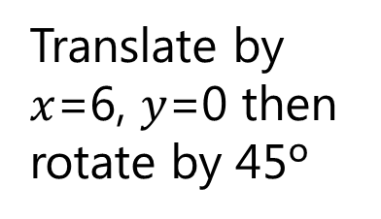
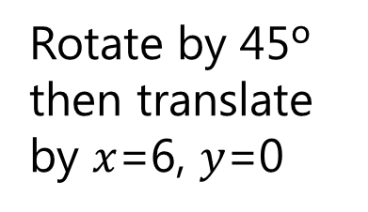
Not commutative
Translate by $x$=6, $y$=0 then rotate by 45º
6
5
4
3
2
1
0
1
2
3
4
5
6
7
8
9
10
Y
6
Rotate by 45º then translate by $x$=6, $y$=0
5
4
3
2
1
0
1
2
3
4
5
6
7
8
9
10
X

Slide 28
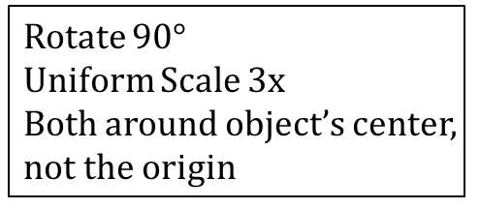

Composition (an example) (2D) (1/2)
Start: Goal:
Important concept: Make the problem simpler
Translate object to origin first, scale , rotate, and translate back:
$T^{−1}RST$ $= \left[\begin{matrix}1 & 0 & 3 \\ 0 & 1 & 3 \\ 0 & 0 & 1\end{matrix}\right]\left[\begin{matrix}\text{cos}90 & −sin90 & 0 \\ sin90 & cos90 & 0 \\ 0 & 0 & 1\end{matrix}\right]\left[\begin{matrix}3 & 0 & 0 \\ 0 & 3 & 0 \\ 0 & 0 & 1\end{matrix}\right]\left[\begin{matrix}1 & 0 & −3 \\ 0 & 1 & −3 \\ 0 & 0 & 1\end{matrix}\right]$
Apply to all vertices
Rotate 90$°$
Uniform Scale 3x
Both around object’s center,
not the origin

Slide 29

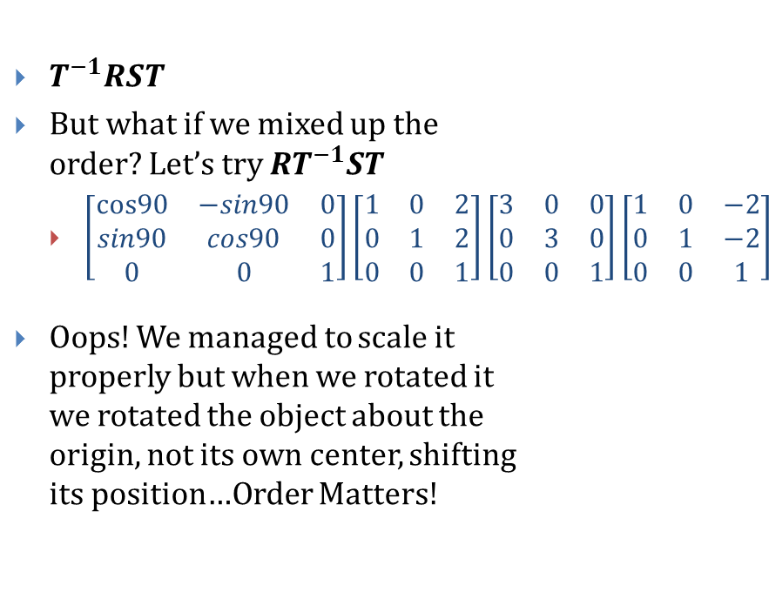
Composition (an example) (2D) (2/2)
$T^{−1}RST$
But what if we mixed up the order? Let’s try ${RT}^{−1}ST$
$\left[\begin{matrix}\text{cos}90 & −sin90 & 0 \\ sin90 & cos90 & 0 \\ 0 & 0 & 1\end{matrix}\right]\left[\begin{matrix}1 & 0 & 2 \\ 0 & 1 & 2 \\ 0 & 0 & 1\end{matrix}\right]\left[\begin{matrix}3 & 0 & 0 \\ 0 & 3 & 0 \\ 0 & 0 & 1\end{matrix}\right]\left[\begin{matrix}1 & 0 & −2 \\ 0 & 1 & −2 \\ 0 & 0 & 1\end{matrix}\right]$
Oops! We managed to scale it properly but when we rotated it we rotated the object about the origin, not its own center, shifting its position…Order Matters!

Slide 30
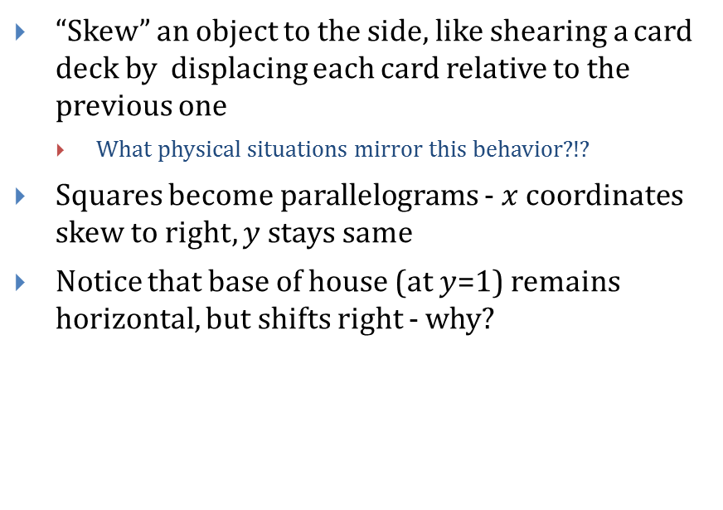
Aside: Skewing/shearing
Y
6
5
“Skew” an object to the side, like shearing a card deck by displacing each card relative to the previous one
What physical situations mirror this behavior?!?
Squares become parallelograms - $x$ coordinates skew to right, $y$ stays same
Notice that base of house (at $y$=1) remains horizontal, but shifts right - why?
4
3
2
1
0
1
2
3
4
5
6
7
8
9
10
X
2D non-Homogeneous
2D Homogeneous
Notes:
Size of matrix

Slide 31
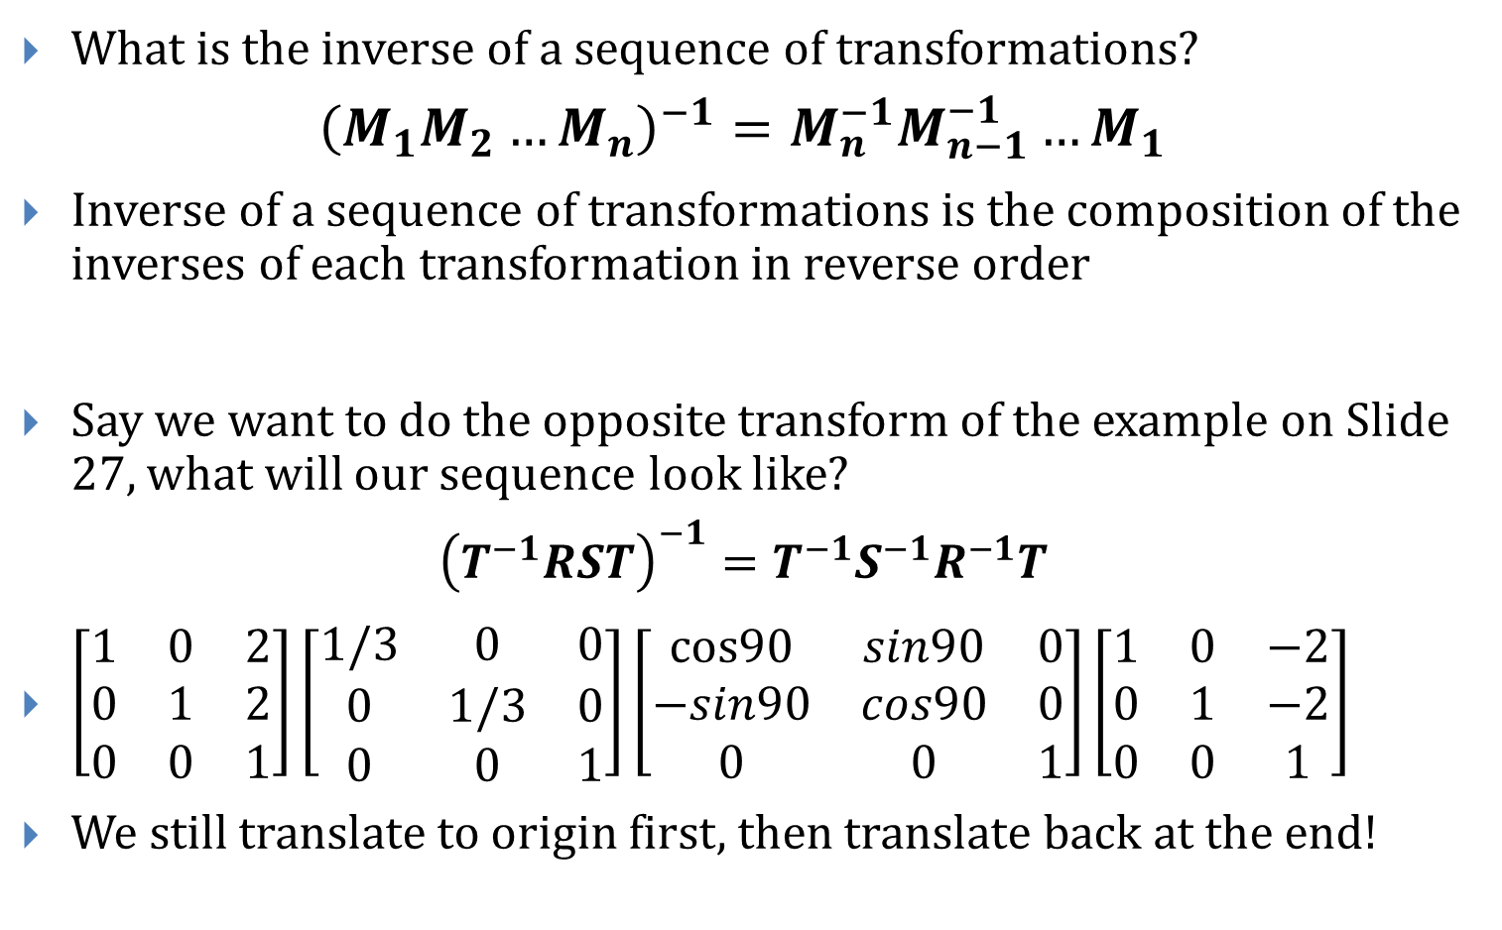
Inverses Revisited
What is the inverse of a sequence of transformations?
$${\left(M_{1}M_{2}…M_{n}\right)}^{−1}=M_{n}^{−1}M_{n−1}^{−1}…M_{1}$$
Inverse of a sequence of transformations is the composition of the inverses of each transformation in reverse order
Say we want to do the opposite transform of the example on Slide 27, what will our sequence look like?
$${\left(T^{−1}RST\right)}^{−1}=T^{−1}S^{−1}R^{−1}T$$
$\left[\begin{matrix}1 & 0 & 2 \\ 0 & 1 & 2 \\ 0 & 0 & 1\end{matrix}\right]\left[\begin{matrix}1/3 & 0 & 0 \\ 0 & 1/3 & 0 \\ 0 & 0 & 1\end{matrix}\right]\left[\begin{matrix}\text{cos}90 & sin90 & 0 \\ −sin90 & cos90 & 0 \\ 0 & 0 & 1\end{matrix}\right]\left[\begin{matrix}1 & 0 & −2 \\ 0 & 1 & −2 \\ 0 & 0 & 1\end{matrix}\right]$
We still translate to origin first, then translate back at the end!

Slide 32
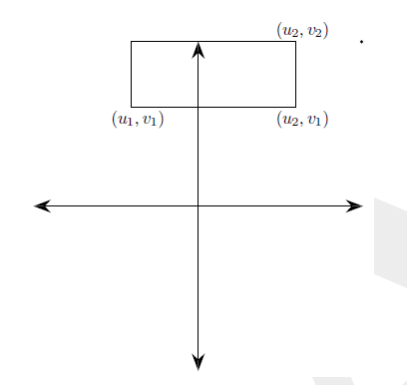
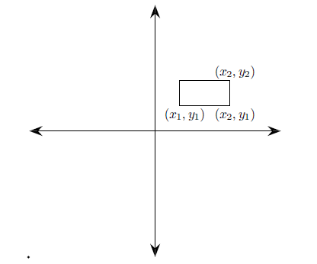
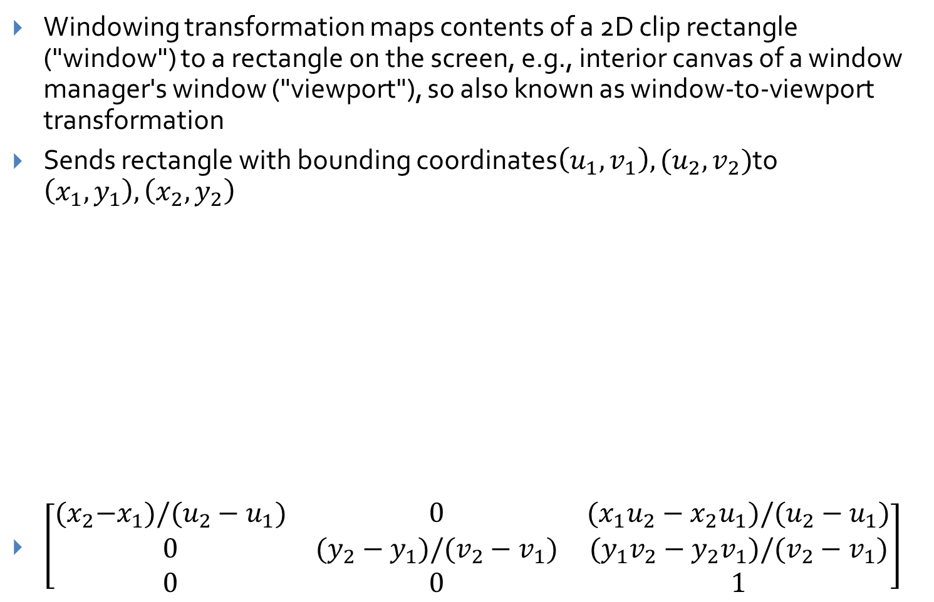
Aside: Windowing Transformations
Windowing transformation maps contents of a 2D clip rectangle ("window") to a rectangle on the screen, e.g., interior canvas of a window manager's window ("viewport"), so also known as window-to-viewport transformation
Sends rectangle with bounding coordinates$\left(u_{1},v_{1}\right),(u_{2},v_{2})$to $\left(x_{1}, y_{1}\right), \left(x_{2},y_{2}\right)$
$\left[\begin{matrix}{(x}_{2}−x_{1})/(u_{2}−u_{1}) & 0 & (x_{1}u_{2}−x_{2}u_{1})/(u_{2}−u_{1}) \\ 0 & (y_{2}−y_{1})/(v_{2}−v_{1}) & (y_{1}v_{2}−y_{2}v_{1})/(v_{2}−v_{1}) \\ 0 & 0 & 1\end{matrix}\right]$

Slide 33
Aside: Transforming Coordinate Axes
We understand linear transformations as changing the position of vertices relative to the standard axes
Can also think of transforming the coordinate axes themselves
Just as in matrix composition, be careful of which order you modify your coordinate system
Rotation
Scaling
Translation

Slide 34
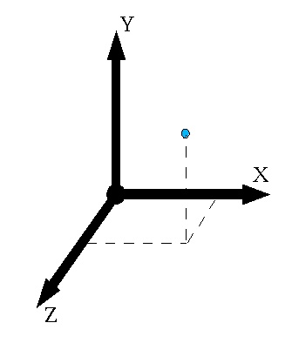
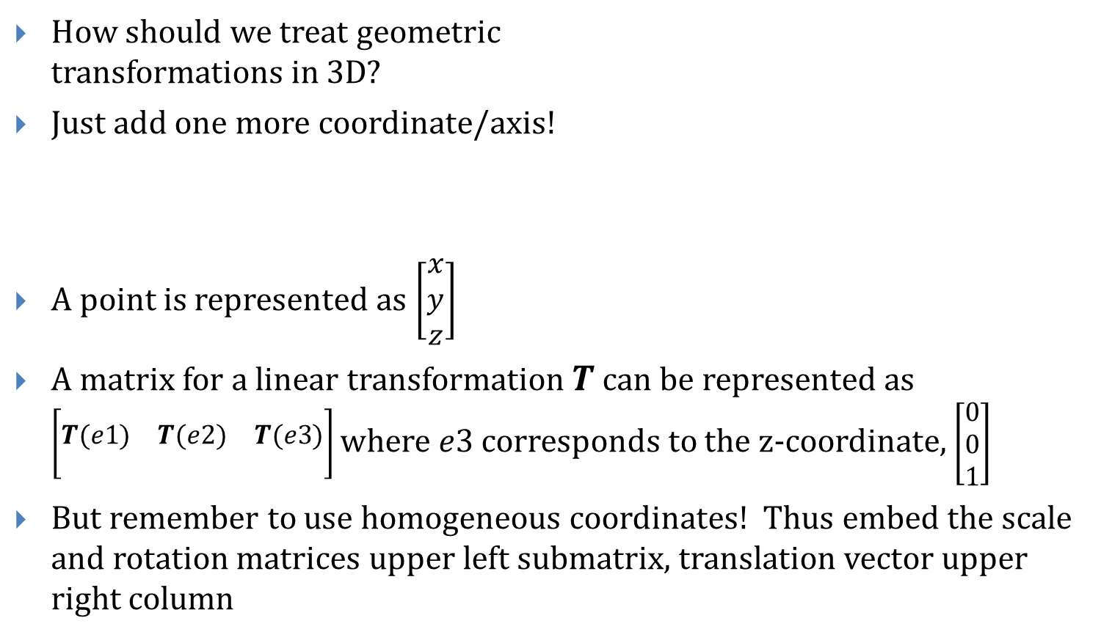
Dimension++ (3D!)
How should we treat geometric transformations in 3D?
Just add one more coordinate/axis!
A point is represented as $\left[\begin{matrix}x \\ y \\ z\end{matrix}\right]$
A matrix for a linear transformation $T$ can be represented as $\left[\begin{matrix} & & \\ T(e1) & T(e2) & T(e3) \\ & & \end{matrix}\right]$ where $e3$ corresponds to the z-coordinate, $\left[\begin{matrix}0 \\ 0 \\ 1\end{matrix}\right]$
But remember to use homogeneous coordinates! Thus embed the scale and rotation matrices upper left submatrix, translation vector upper right column

Slide 35
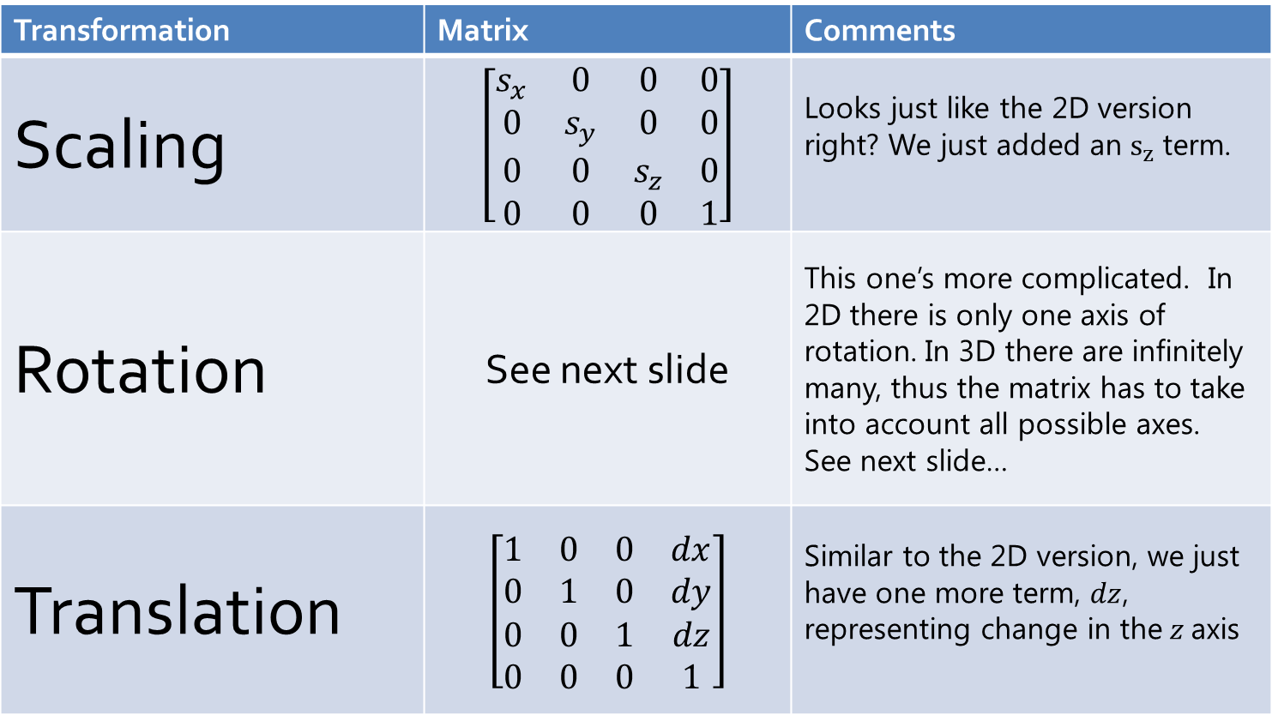
Transformations in 3D
Transformation | Matrix | Comments
Scaling | $$\left[\begin{matrix}s_{x} & 0 & 0 & 0 \\ 0 & s_{y} & 0 & 0 \\ 0 & 0 & s_{z} & 0 \\ 0 & 0 & 0 & 1\end{matrix}\right]$$ | Looks just like the 2D version right? We just added an $s_{z}$term.
Rotation | See next slide | This one’s more complicated. In 2D there is only one axis of rotation. In 3D there are infinitely many, thus the matrix has to take into account all possible axes. See next slide…
Translation | $$\left[\begin{matrix}1 & 0 & 0 & dx \\ 0 & 1 & 0 & dy \\ 0 & 0 & 1 & dz \\ 0 & 0 & 0 & 1\end{matrix}\right]$$ | Similar to the 2D version, we just have one more term, $dz$, representing change in the$z$axis

Slide 36
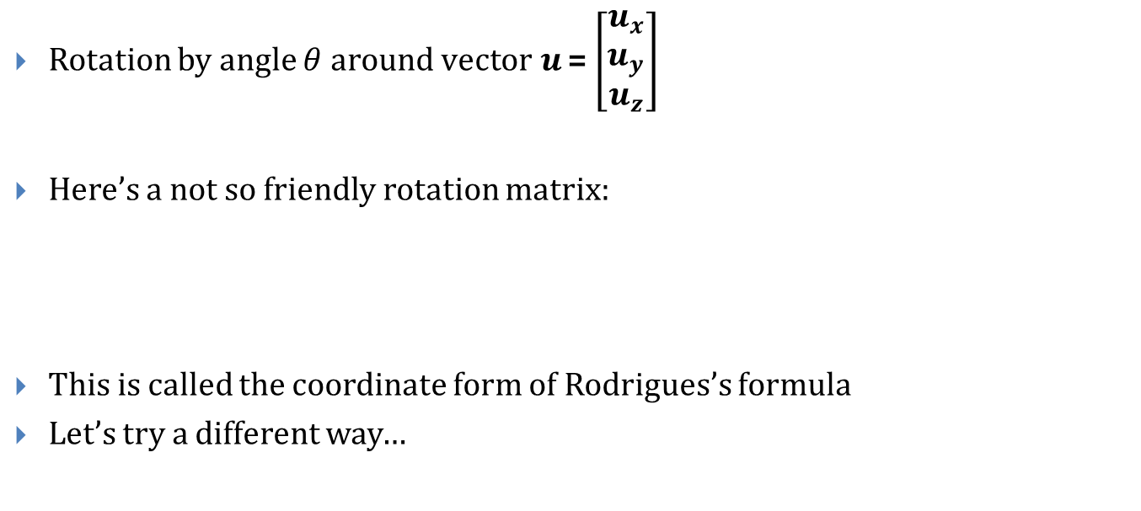
Rodrigues’s Formula…
Rotation by angle $θ$ around v$ector u$ = $\left[\begin{matrix}u_{x} \\ u_{y} \\ u_{z}\end{matrix}\right]$
Here’s a not so friendly rotation matrix:
This is called the coordinate form of Rodrigues’s formula
Let’s try a different way…
Note: This is an arbitrary unit vector $u$ in $xyz$ space

Slide 37

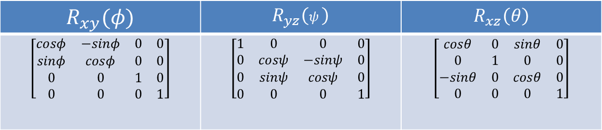
Rotating axis by axis (1/2)
Every rotation can be represented as the composition of 3 different angles of counter-clockwise rotation around 3 axes, namely
$x$-axis in the $yz$ plane by $ψ$
$y$-axis in the $xz$ plane by $θ$
$z$-axis in the $xy$ plane by $φ$
Also known as Euler angles, makes problem of rotation much easier
$R_{yz}$ : rotation around $x$ axis, $R_{xz}$ : rotation about $y$ axis, $R_{xy}$ : rotation about $z$ axis
Note these differ only in where the 3x3 submatrix is embedded in the homogeneous matrix
You can compose these matrices to form a composite rotation matrix
$$R_{xy}(φ)$$ | $$R_{yz}\left(ψ \right)$$ | $$R_{xz}\left(θ\right)$$
$$\left[\begin{matrix}cosφ & −sinφ & 0 & 0 \\ sinφ & cosφ & 0 & 0 \\ 0 & 0 & 1 & 0 \\ 0 & 0 & 0 & 1\end{matrix}\right]$$ | $$\left[\begin{matrix}1 & 0 & 0 & 0 \\ 0 & cosψ & −sinψ & 0 \\ 0 & sinψ & cosψ & 0 \\ 0 & 0 & 0 & 1\end{matrix}\right]$$ | $$\left[\begin{matrix}cosθ & 0 & sinθ & 0 \\ 0 & 1 & 0 & 0 \\ −sinθ & 0 & cosθ & 0 \\ 0 & 0 & 0 & 1\end{matrix}\right]$$
Notes:
italic

Slide 38
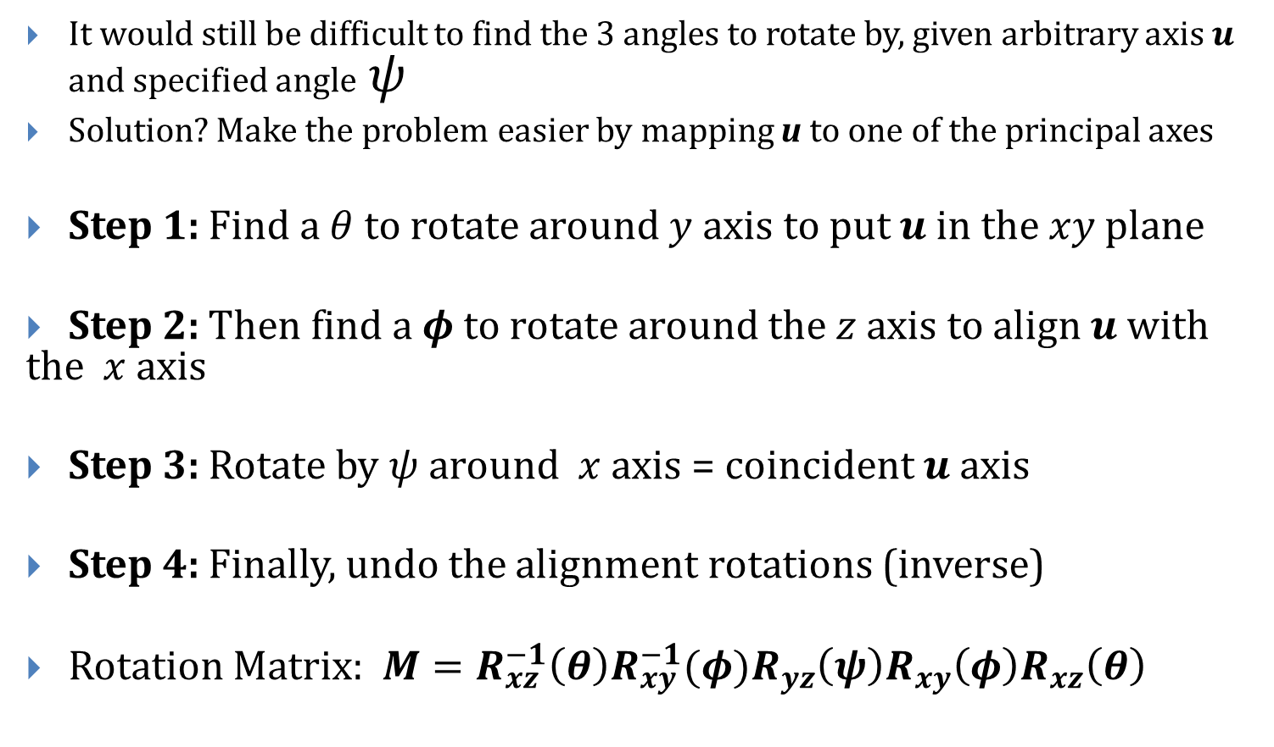
Rotating axis by axis (2/2)
It would still be difficult to find the 3 angles to rotate by, given arbitrary axis $u$ and specified angle$ψ$
Solution? Make the problem easier by mapping u to one of the principal axes
Step 1: Find a $θ$to rotate around $y$ axis to put $u$ in the $xy$ plane
Step 2: Then find a $φ$ to rotate around the $z$ axis to align $u$ with the $x$ axis
Step 3: Rotate by $ψ$ around $x$ axis = coincident $u$ axis
Step 4: Finally, undo the alignment rotations (inverse)
Rotation Matrix: $M={R_{xz}^{−1}\left(θ\right)R_{xy}^{−1}(φ)R}_{yz}\left(ψ\right)R_{xy}\left(φ\right)R_{xz}\left(θ\right)$

Slide 39

Inverses and Composition in 3D!
Inverses are once again parallel to their 2D versions…
Composition works exactly the same way…
Transformation | Matrix Inverse
Scaling | $$\left[\begin{matrix}\text{1/}s_{x} & 0 & 0 & 0 \\ 0 & 1/s_{y} & 0 & 0 \\ 0 & 0 & 1/s_{z} & 0 \\ 0 & 0 & 0 & 1\end{matrix}\right]$$
Rotation | $$\left[\begin{matrix}1 & 0 & 0 & 0 \\ 0 & cosψ & sinψ & 0 \\ 0 & −sinψ & cosψ & 0 \\ 0 & 0 & 0 & 1\end{matrix}\right]\left[\begin{matrix}cosφ & sinφ & 0 & 0 \\ −sinφ & cosφ & 0 & 0 \\ 0 & 0 & 1 & 0 \\ 0 & 0 & 0 & 1\end{matrix}\right]\left[\begin{matrix}cosθ & 0 & −sinθ & 0 \\ 0 & 1 & 0 & 0 \\ sinθ & 0 & cosθ & 0 \\ 0 & 0 & 0 & 1\end{matrix}\right]$$
Translation | $$\left[\begin{matrix}1 & 0 & 0 & −dx \\ 0 & 1 & 0 & −dy \\ 0 & 0 & 1 & −dz \\ 0 & 0 & 0 & 1\end{matrix}\right]$$

Slide 40

Example in 3D!
Let’s take some 3D object, say a cube, centered at (2,2,2)
Rotate in object’s space by 30$°$ around $x$ axis, 60$°$ around $y$ and 90$°$around $z$
Scale in object space by 1 in the $x$, 2 in the $y$, 3 in the $z$
Translate by (2,2,4) in world space
Transformation Sequence: $TT_{0}^{−1}S_{xy}R_{xy}R_{xz}R_{yz}T_{0}$ , where $T_{0}$ translates to $(0,0)$
$\left[\begin{matrix}1 & 0 & 0 & 2 \\ 0 & 1 & 0 & 2 \\ 0 & 0 & 1 & 4 \\ 0 & 0 & 0 & 1\end{matrix}\right]$ $\left[\begin{matrix}1 & 0 & 0 & 2 \\ 0 & 1 & 0 & 2 \\ 0 & 0 & 1 & 2 \\ 0 & 0 & 0 & 1\end{matrix}\right]$ $\left[\begin{matrix}1 & 0 & 0 & 0 \\ 0 & 2 & 0 & 0 \\ 0 & 0 & 3 & 0 \\ 0 & 0 & 0 & 1\end{matrix}\right]$ $\left[\begin{matrix}cos90 & sin90 & 0 & 0 \\ −sin90 & cos90 & 0 & 0 \\ 0 & 0 & 1 & 0 \\ 0 & 0 & 0 & 1\end{matrix}\right]$ $\left[\begin{matrix}cos60 & 0 & sin60 & 0 \\ 0 & 1 & 0 & 0 \\ −sin60 & 0 & cos60 & 0 \\ 0 & 0 & 0 & 1\end{matrix}\right]\left[\begin{matrix}1 & 0 & 0 & 0 \\ 0 & cos30 & sin30 & 0 \\ 0 & −sin30 & cos30 & 0 \\ 0 & 0 & 0 & 1\end{matrix}\right]\left[\begin{matrix}1 & 0 & 0 & −2 \\ 0 & 1 & 0 & −2 \\ 0 & 0 & 1 & −2 \\ 0 & 0 & 0 & 1\end{matrix}\right]$

Slide 41
Transformations and the scene graph (1/4)
Objects can be complex:
3D scenes are often stored in a directed acyclic graph (DAG) called a scene graph
WPF
Open Scene Graph (used in the Cave)
Sun’s Java3D™
X3D ™ (VRML ™ was a precursor to X3D)
Typical scene graph format:
objects (cubes, sphere, cone, polyhedra etc.): stored as nodes (default: unit size at origin)
attributes (color, texture map, etc.) stored as separate nodes
transformations are also nodes
Scene Graph
ROBOT
upper body
lower body
head
trunk
arm
arm
stanchion
base

Slide 42

Transformations and the scene graph (2/4)
For your assignments use simplified format:
Attributes stored as a components of each object node (no separate attribute node)
Transform node affects its subtree
Only leaf nodes are graphical objects
All internal nodes that are not transform nodes are group nodes
Step 1: Various transformations are applied to each of the leaves (object primitives—head, base, etc.)
Step 2: Transformations are then applied to groups of these objects as a whole (upper body, lower body)
Together this hierarchy of transformations forms the “robot” scene as a whole
Represents a
transformation

Slide 43







Transformations and the scene graph (3/4)
Notion of a cumulative transformation matrix that builds as you move up the tree ($CTM$), appending higher level transformation matrices to the front of your sequence
Example:
For o1, $CTM =M_{1}$
For o2, $CTM={ M}_{2}M_{3}$
For o3, $CTM={ M}_{2}M_{4}M_{5}$
For a vertex v in o3, position in world (root) coordinate system is:
$CTM v = (M_{2}M_{4}M_{5}) v$
$$M_{1}$$
$$M_{2}$$
$$M_{3}$$
$$M_{4}$$
$$M_{5}$$
object nodes (geometry)
transformation nodes
group nodes

Slide 44








Transformations and the scene graph (4/4)
You can reuse groups of objects (sub-trees) if they have been defined
Group 3 has been used twice here
Transformations defined within group 3 itself are the same
Different $CTM$s for each use of group 3 as a whole
$T_{0}T_{1} vs. T_{0}T_{2}T_{4}$
root
group3
$T_{0}$
$$T_{5}$$
$$T_{6}$$
group1
obj4
obj3
$$T_{1}$$
$$T_{2}$$
obj1
group3
group2
$$T_{3}$$
$$T_{4}$$
obj2
group3

Slide 45
Further Reading
More information can be found in the textbook (linked from the docs page of the website)
Read Chapters 10 and 11 for more detail and advanced topics on transformations
Chapter 7 discusses the 2D/3D coordinate space geometry
Chapter 12 goes into more detail about some of the linear algebra involved in graphics

