Slide 1
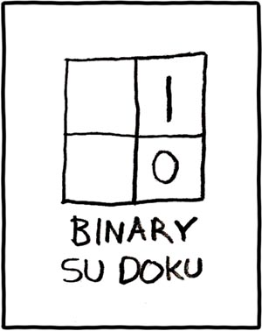
Viewing III
It looks like a matrix…
Sort of…
Projection in Practice

Slide 2
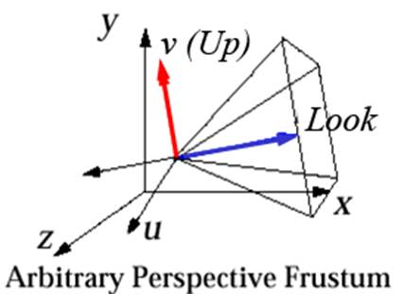

Arbitrary 3D views
Now that we have familiarity with terms we can say that these view volumes can be specified by placement and shape
Placement:
Position (a point)
Look and Up vectors
Shape:
horizontal and vertical view angles (for a perspective view volume)
front and back clipping planes
Note camera coordinate system (u, v, w) is defined in the world (x, y, z) coordinate system
$$w$$

Slide 3
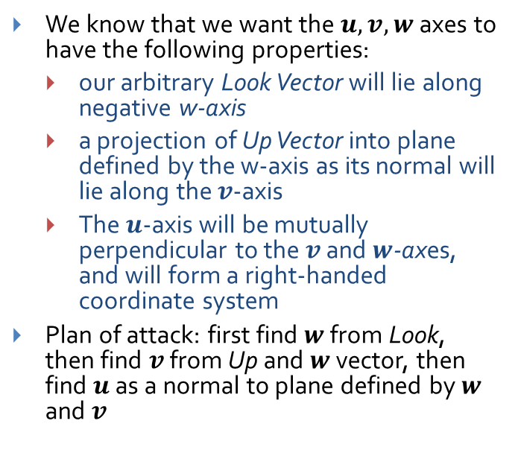
Finding $u, v$, and $w$ from Position, Look, and Up (1/5)
We know that we want the $u, v, w$axes to have the following properties:
our arbitrary Look Vector will lie along negative w-axis
a projection of Up Vector into plane defined by the w-axis as its normal will lie along the $v$-axis
The $u$-axis will be mutually perpendicular to the $v$ and $w$-axes, and will form a right-handed coordinate system
Plan of attack: first find $w$ from Look, then find $v$ from Up and $w$ vector, then find $u$ as a normal to plane defined by $w$ and $v$
v
Look
Up
u
w

Slide 4
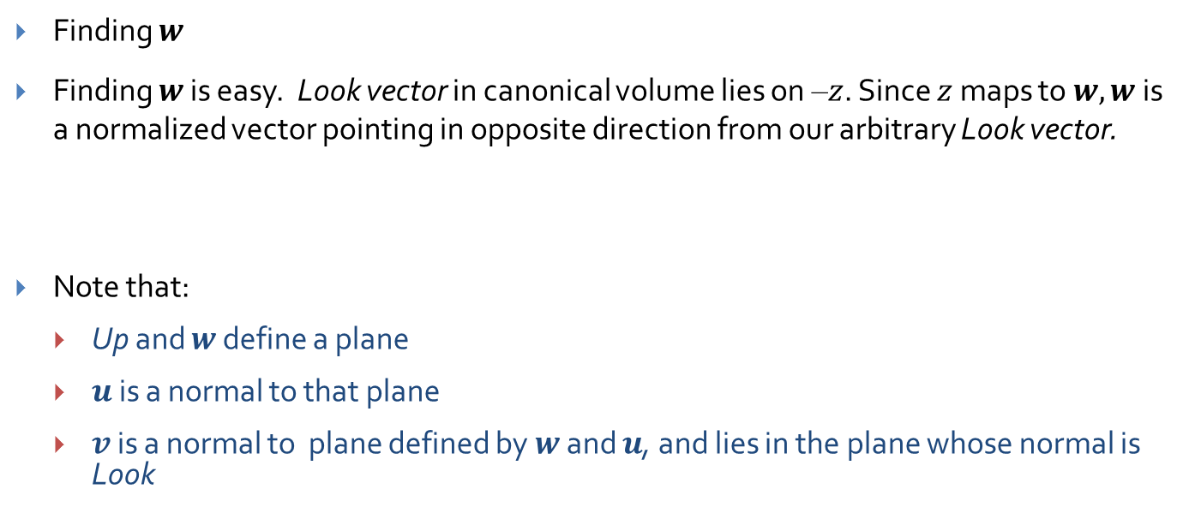
Finding $u, v,$and $w$ (2/5)
Finding $w$
Finding $w$ is easy. Look vector in canonical volume lies on –$z$. Since $z$ maps to $w, w$is a normalized vector pointing in opposite direction from our arbitrary Look vector.
Note that:
Up and $w$ define a plane
$u$ is a normal to that plane
$v$ is a normal to plane defined by $w$ and $u$, and lies in the plane whose normal is Look
v
Look
Up
u
w

Slide 5
Finding $u, v,$and $w$ (3/5)
Finding v
Problem: find a vector v, perpendicular to unit vector w
Solution: subtract the w component of the Up vector and normalize; to get the w component we get the projection of Up on w and scale w with it
v
Look
Up
u
w

Slide 6
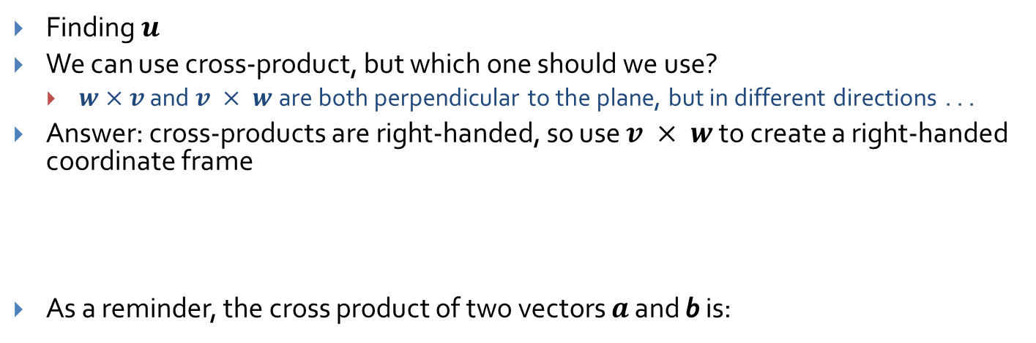
Finding $u, v$, and $w$ (4/5)
Finding $u$
We can use cross-product, but which one should we use?
$w×v$ and $v × w$are both perpendicular to the plane, but in different directions . . .
Answer: cross-products are right-handed, so use $v × w$to create a right-handed coordinate frame
As a reminder, the cross product of two vectors $a$ and b is:
v
Look
Up
u
w

Slide 7
Finding $u, v,$and $w$ (5/5)
To Summarize:
v
Look
Up
u
w
Given camera coordinate system, how to calculate projection?

Slide 8
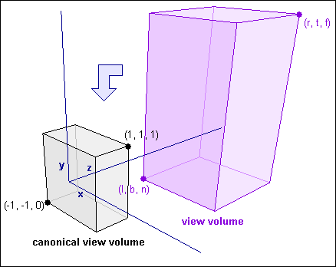
The canonical view volume
How exactly do we take contents of an arbitrary view volume and project them to a 2D surface?
Arbitrary view volume is too complex…
Reduce it to a simpler problem! The canonical view volume!
Can also be called the standard or unit view volume
Specific orientation, position, height and width that make operations like projecting and clipping much easier, as we will see
Transform complex view volume and all objects in volume to the canonical volume (normalizing transformation) and then project contents onto normalized film plane
Not to be confused with animation where camera may move relative to objects! Normalization applies to an arbitrary camera view at a given instant
Let’s start with easiest case: parallel view volume
Image credit: http://www.codeguru.com/cpp/misc/misc/math/article.php/c10123__2/

Slide 9
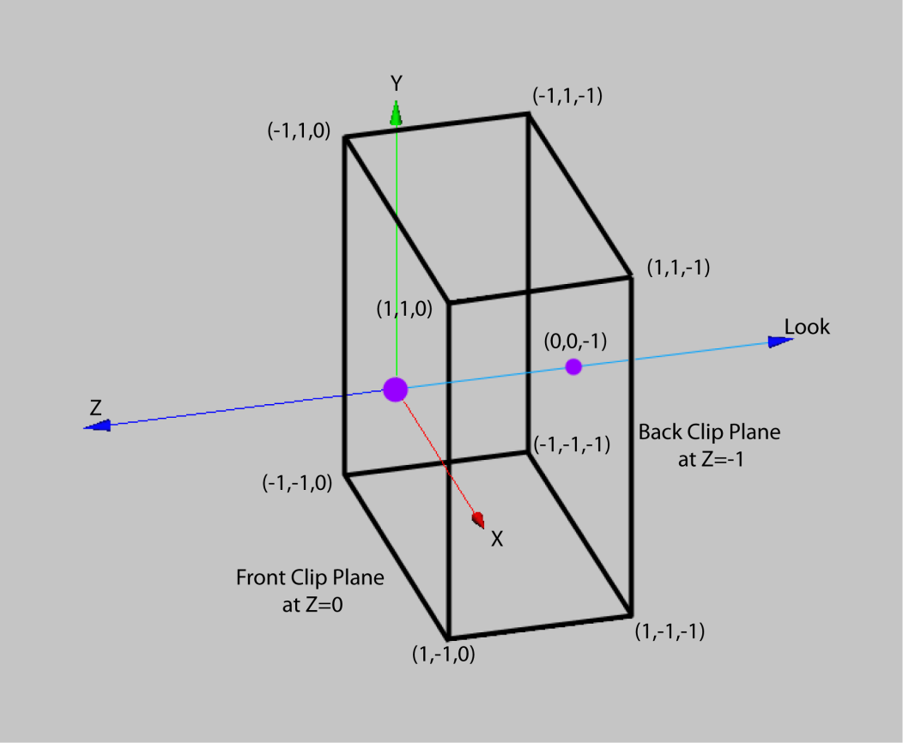
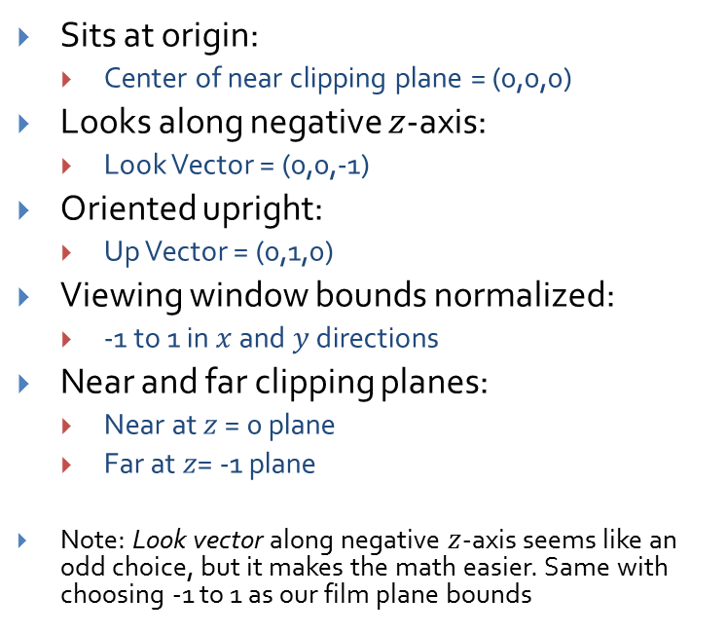
The canonical parallel view volume
Sits at origin:
Center of near clipping plane = (0,0,0)
Looks along negative $z$-axis:
Look Vector = (0,0,-1)
Oriented upright:
Up Vector = (0,1,0)
Viewing window bounds normalized:
-1 to 1 in $x$ and $y$ directions
Near and far clipping planes:
Near at $z$ = 0 plane
Far at$z$= -1 plane
Note: Look vector along negative $z$-axis seems like an odd choice, but it makes the math easier. Same with choosing -1 to 1 as our film plane bounds
Up
z

Slide 10
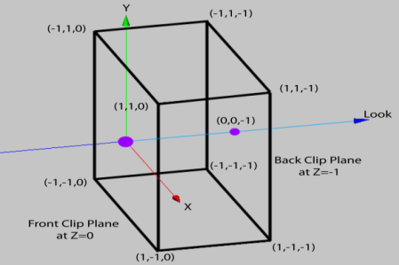

The normalizing transformation
Goal: transform arbitrary view and scene to canonical view volume, maintaining relationship between view volume and scene, then render.
For a parallel view volume, need only translation to the origin, rotation to align $u,v,w$with $x, y, z$, and scaling to size
The composite transformation composed of these scales, rotations and translations is a 4x4 homogenous matrix called the normalizing transformation (the inverse is called the viewing transformation and turns a canonical view volume into an arbitrary one)
Note: the scene resulting from normalization will not appear any different from the original - every vertex is transformed in the same way. The goal is to simplify our view volume, not change what we see.
Normalizing demo: http://www.cs.brown.edu/people/auguray/spacemonkey/
Up
Remember that our camera
is just a model, there is no
actual camera in our scene.
The normalizing matrix
needs to be applied to every
vertex in our scene to
simulate this transformation
z

Slide 11
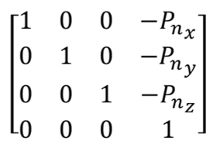
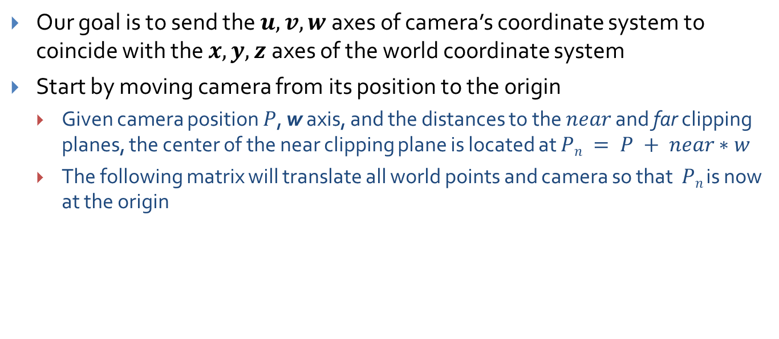
View Volume Translation
Our goal is to send the $u, v, w$axes of camera’s coordinate system to coincide with the $x, y, z$axes of the world coordinate system
Start by moving camera from its position to the origin
Given camera position $P$, w axis, and the distances to the $near$ and far clipping planes, the center of the near clipping plane is located at $Pn = P + near∗w$
The following matrix will translate all world points and camera so that $Pn$ is now at the origin

Slide 12
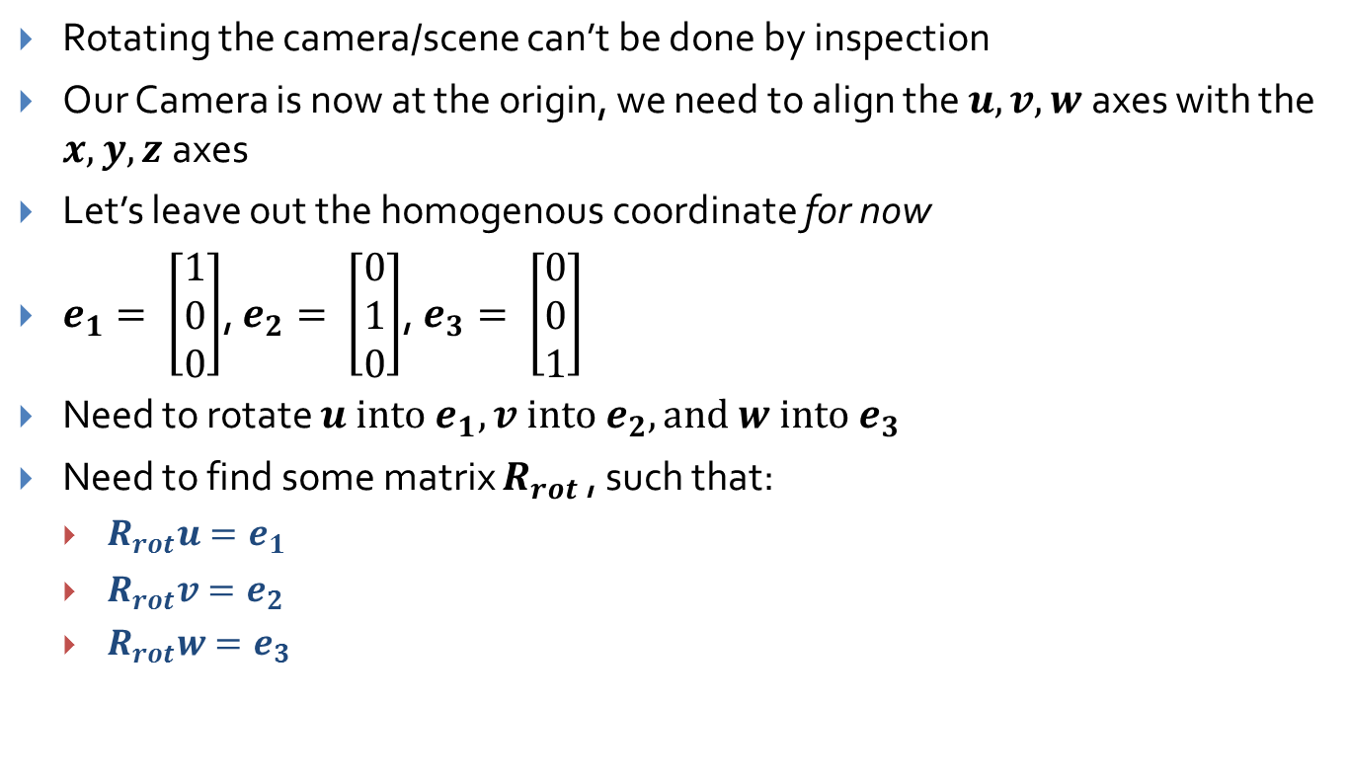
View Volume Rotation (1/3)
Rotating the camera/scene can’t be done by inspection
Our Camera is now at the origin, we need to align the $u,v,w$axes with the $x, y, z$axes
Let’s leave out the homogenous coordinate for now
$e_{1}= \left[\begin{matrix}1 \\ 0 \\ 0\end{matrix}\right]$, $e_{2}= \left[\begin{matrix}0 \\ 1 \\ 0\end{matrix}\right]$, $e_{3}= \left[\begin{matrix}0 \\ 0 \\ 1\end{matrix}\right]$
Need to rotate $u into e_{1}, v into e_{2}, and w into e_{3}$
Need to find some matrix $R_{rot}$ , such that:
$R_{rot}u=e_{1}$
$R_{rot}v=e_{2}$
$R_{rot}w=e_{3}$
Notes:
Rrot?

Slide 13
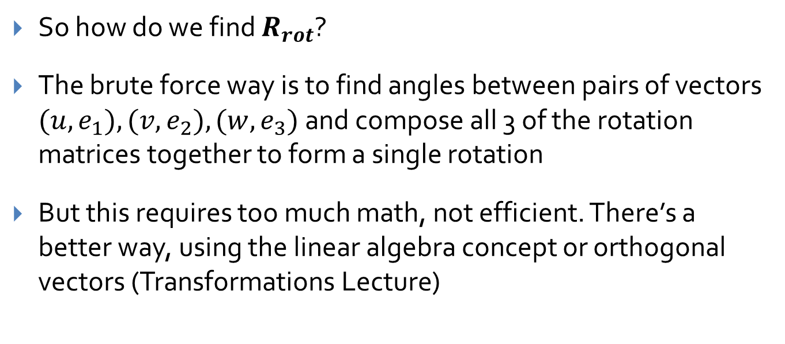
View Volume Rotation (2/3)
So how do we find $R_{rot}$?
The brute force way is to find angles between pairs of vectors $(u, e_{1}), (v, e_{2}), (w, e_{3})$and compose all 3 of the rotation matrices together to form a single rotation
But this requires too much math, not efficient. There’s a better way, using the linear algebra concept or orthogonal vectors (Transformations Lecture)

Slide 14
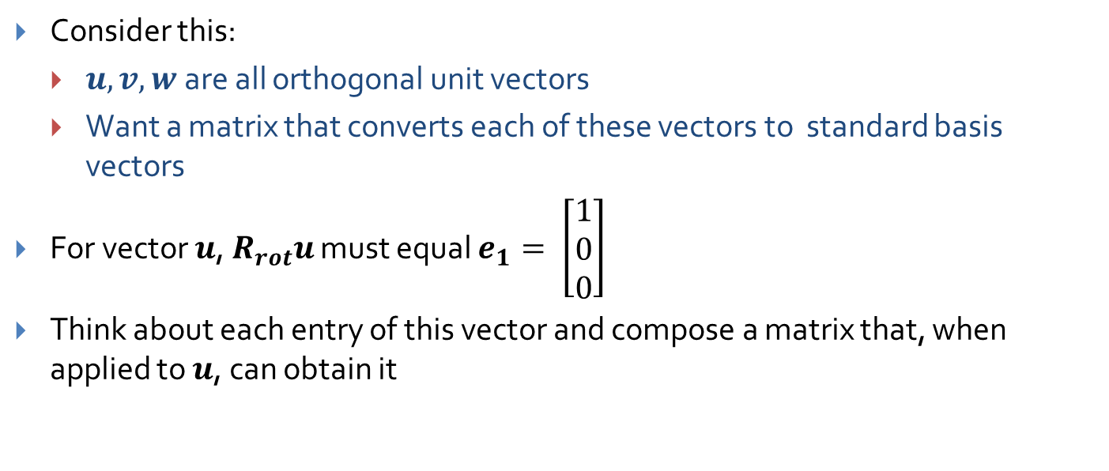
View Volume Rotation (2/3)
Consider this:
$u,v,w$are all orthogonal unit vectors
Want a matrix that converts each of these vectors to standard basis vectors
For vector $u$,${ R}_{rot}u$ must equal $e_{1}= \left[\begin{matrix}1 \\ 0 \\ 0\end{matrix}\right]$
Think about each entry of this vector and compose a matrix that, when applied to $u$, can obtain it

Slide 15
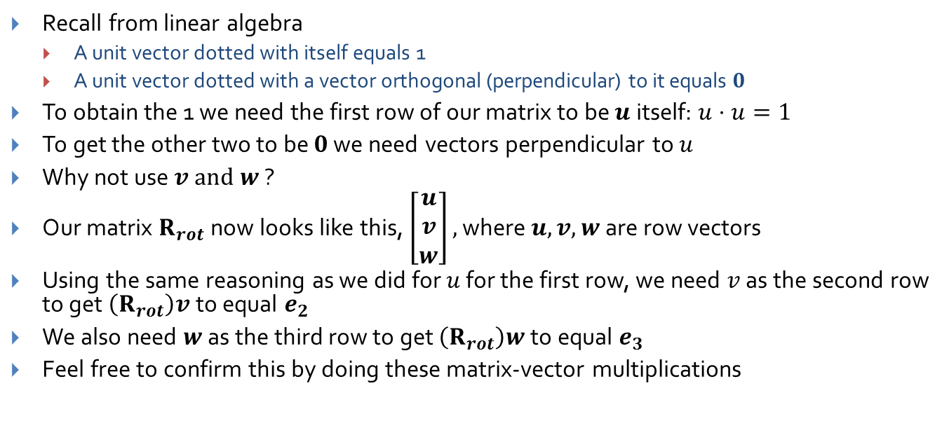
View Volume Rotation (3/3)
Recall from linear algebra
A unit vector dotted with itself equals 1
A unit vector dotted with a vector orthogonal (perpendicular) to it equals $0$
To obtain the 1 we need the first row of our matrix to be $u$ itself: $u⋅u=1$
To get the other two to be $0$ we need vectors perpendicular to $u$
Why not use$v and w$?
Our matrix $R_{rot}$ now looks like this, $\left[\begin{matrix}u \\ v \\ w\end{matrix}\right],$ where $u, v, w$are row vectors
Using the same reasoning as we did for $u$ for the first row, we need $v$ as the second row to get$\left(R_{rot}\right)v$ to equal $e_{2}$
We also need $w$ as the third row to get $\left(R_{rot}\right)w$ to equal $e_{3}$
Feel free to confirm this by doing these matrix-vector multiplications

Slide 16

Final Rotation Matrix
Our Rotation Matrix with homogenous coordinates:
$$\left[\begin{matrix}u_{x} & u_{y} & u_{z} & 0 \\ v_{x} & v_{y} & v_{z} & 0 \\ w_{x} & w_{y} & w_{z} & 0 \\ 0 & 0 & 0 & 1\end{matrix}\right]$$

Slide 17
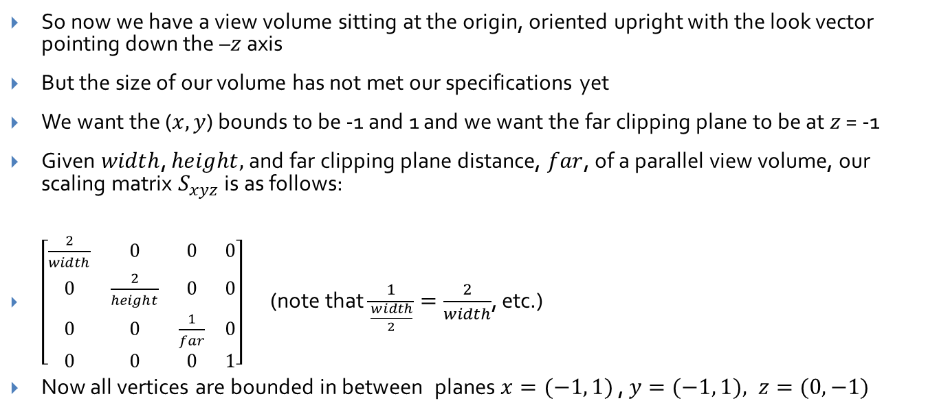
Scaling the view volume
So now we have a view volume sitting at the origin, oriented upright with the look vector pointing down the –$z$ axis
But the size of our volume has not met our specifications yet
We want the ($x,y$) bounds to be -1 and 1 and we want the far clipping plane to be at $z$ = -1
Given $width$, $height,$ and far clipping plane distance, $far$, of a parallel view volume, our scaling matrix $S_{xyz}$ is as follows:
$\left[\begin{matrix}\frac{2}{width} & 0 & 0 & 0 \\ 0 & \frac{2}{height} & 0 & 0 \\ 0 & 0 & \frac{1}{far} & 0 \\ 0 & 0 & 0 & 1\end{matrix}\right]$ (note that $\frac{1}{\frac{width}{2}}=\frac{2}{width}$, etc.)
Now all vertices are bounded in between planes $x=(−1, 1)$, $y=(−1, 1), z=(0, −1)$

Slide 18
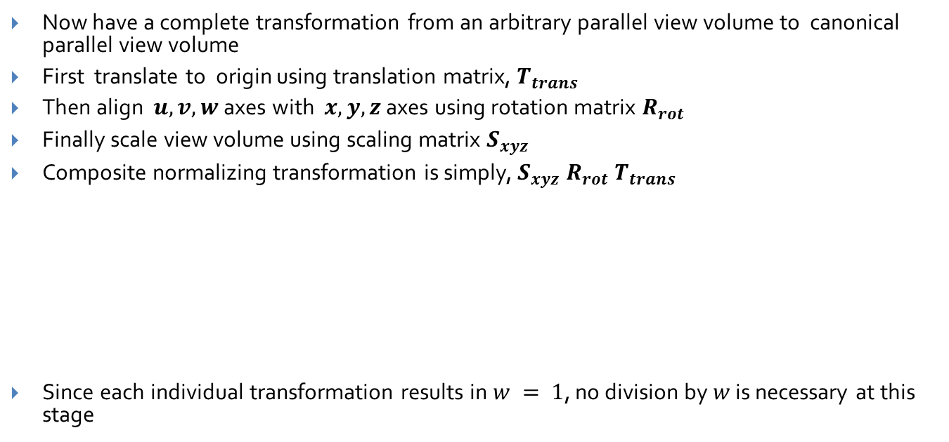



The normalizing transformation (parallel) and re-homogenization
Now have a complete transformation from an arbitrary parallel view volume to canonical parallel view volume
First translate to origin using translation matrix, $T_{trans}$
Then align $u,v,w$axes with $x,y,z$axes using rotation matrix $R_{rot}$
Finally scale view volume using scaling matrix $S_{xyz}$
Composite normalizing transformation is simply, $S_{xyz} R_{rot} T_{trans}$
Since each individual transformation results in $w = 1$, no division by $w$ is necessary at this stage
$$\left[\begin{matrix}\frac{2}{width} & 0 & 0 & 0 \\ 0 & \frac{2}{height} & 0 & 0 \\ 0 & 0 & \frac{1}{far} & 0 \\ 0 & 0 & 0 & 1\end{matrix}\right]$$
$$\left[\begin{matrix}u_{x} & u_{y} & u_{z} & 0 \\ v_{x} & v_{y} & v_{z} & 0 \\ w_{x} & w_{y} & w_{z} & 0 \\ 0 & 0 & 0 & 1\end{matrix}\right]$$
$$\left[\begin{matrix}1 & 0 & 0 & −{P_{n}}_{x} \\ 0 & 1 & 0 & −{P_{n}}_{y} \\ 0 & 0 & 1 & −{P_{n}}_{z} \\ 0 & 0 & 0 & 1\end{matrix}\right]$$

Slide 19
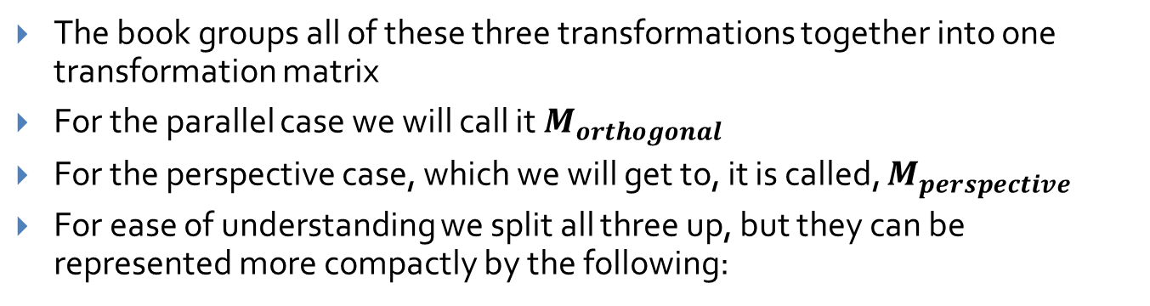
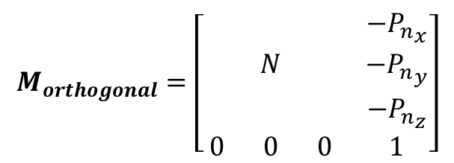


Notation
The book groups all of these three transformations together into one transformation matrix
For the parallel case we will call it $M_{orthogonal}$
For the perspective case, which we will get to, it is called, $M_{perspective}$
For ease of understanding we split all three up, but they can be represented more compactly by the following:
$$N = \left[\begin{matrix}\frac{2}{width} & 0 & 0 \\ 0 & \frac{2}{height} & 0 \\ 0 & 0 & \frac{1}{far}\end{matrix}\right]$$
$$\left[\begin{matrix}u_{x} & u_{y} & u_{z} \\ v_{x} & v_{y} & v_{z} \\ w_{x} & w_{y} & w_{z}\end{matrix}\right]$$
N is the 3x3 matrix
representing rotations
and scaling
$$M_{orthogonal}=\left[\begin{matrix} & & & −{P_{n}}_{x} \\ & N & & −{P_{n}}_{y} \\ & & & −{P_{n}}_{z} \\ 0 & 0 & 0 & 1\end{matrix}\right]$$

Slide 20
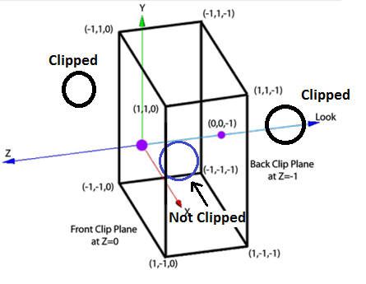
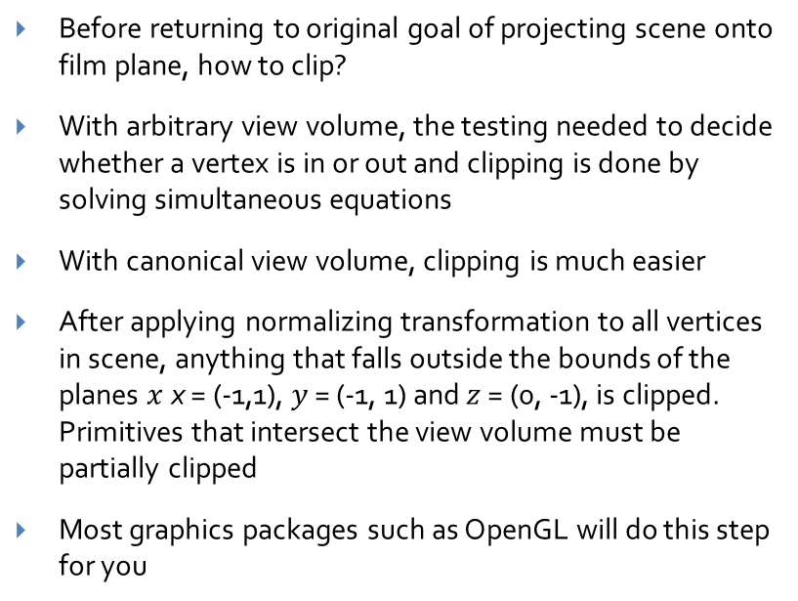
Clipping against the parallel view volume
Before returning to original goal of projecting scene onto film plane, how to clip?
With arbitrary view volume, the testing needed to decide whether a vertex is in or out and clipping is done by solving simultaneous equations
With canonical view volume, clipping is much easier
After applying normalizing transformation to all vertices in scene, anything that falls outside the bounds of the planes $x$ x = (-1,1), $y$ = (-1, 1) and $z$ = (0, -1), is clipped. Primitives that intersect the view volume must be partially clipped
Most graphics packages such as OpenGL will do this step for you
Note: Clipping edges that intersect
the boundaries of view volume
is another step explored in next lecture
Notes:
Sphere…

Slide 21
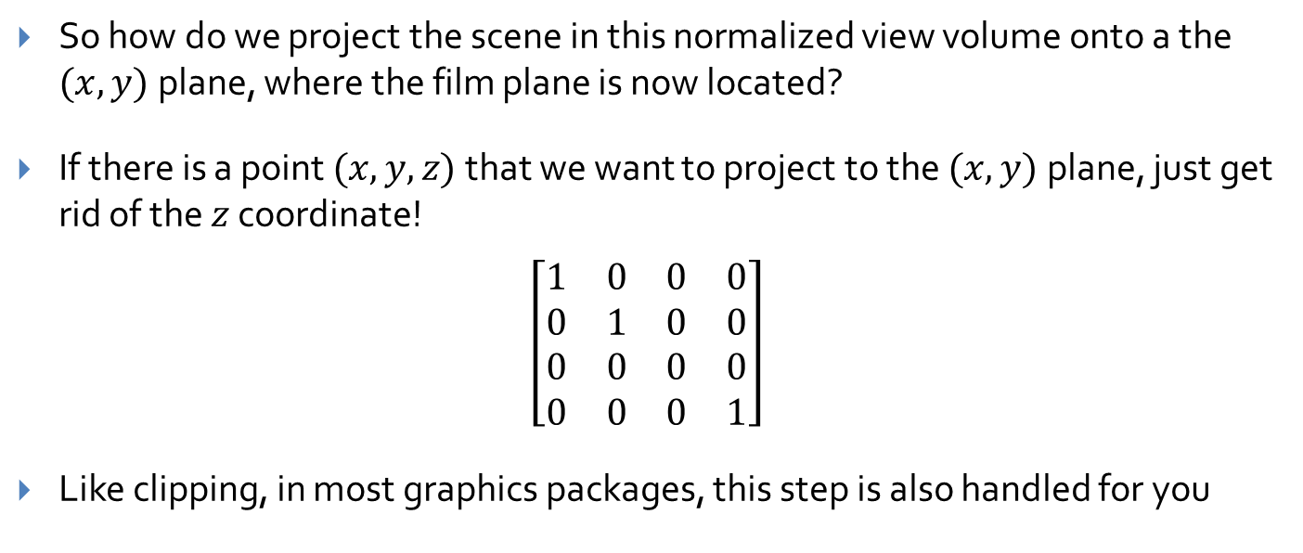
Projecting in the normalized view volume
So how do we project the scene in this normalized view volume onto a the $(x,y)$plane, where the film plane is now located?
If there is a point $(x,y,z)$that we want to project to the $(x,y)$plane, just get rid of the $z$ coordinate!
$$\left[\begin{matrix}1 & 0 & 0 & 0 \\ 0 & 1 & 0 & 0 \\ 0 & 0 & 0 & 0 \\ 0 & 0 & 0 & 1\end{matrix}\right]$$
Like clipping, in most graphics packages, this step is also handled for you

Slide 22




The Perspective View Volume
Need to find a transformation to turn an arbitrary perspective view volume into a canonical (unit) perspective view volume
Canonical view volume (frustum):
$$y$$
Far clipping plane
(-1,1,-1)
$$z$$
$$Z=−1$$
$$x$$
(1,-1,-1)
Near clipping plane

Slide 23
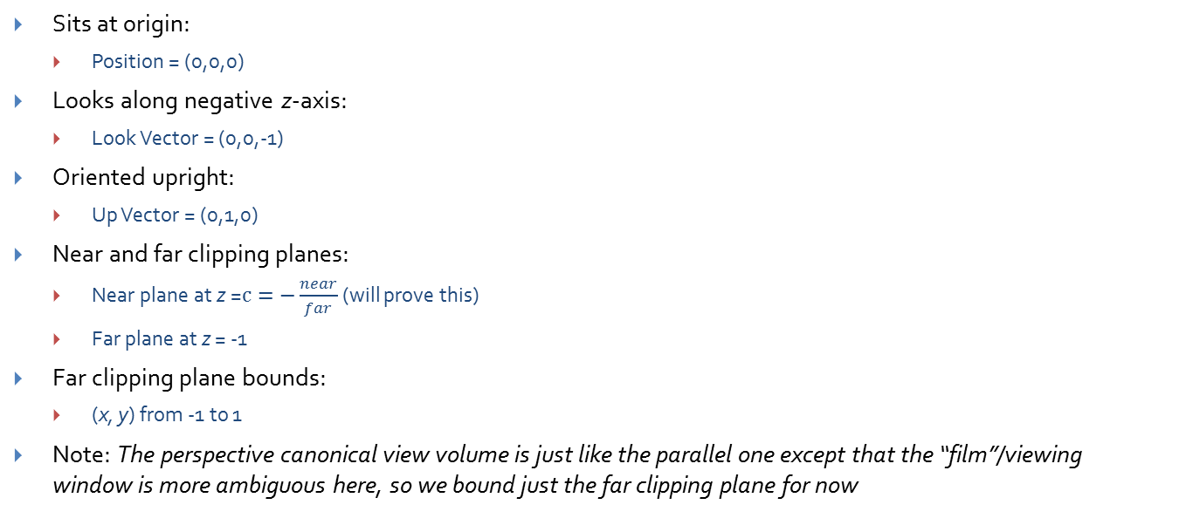

Properties of the canonical view volume
Sits at origin:
Position = (0,0,0)
Looks along negative z-axis:
Look Vector = (0,0,-1)
Oriented upright:
Up Vector = (0,1,0)
Near and far clipping planes:
Near plane at z =$c=−\frac{near}{far}$ (will prove this)
Far plane at z = -1
Far clipping plane bounds:
(x, y) from -1 to 1
Note: The perspective canonical view volume is just like the parallel one except that the “film”/viewing window is more ambiguous here, so we bound just the far clipping plane for now
$$y$$
Far clipping plane
(-1,1,-1)
$$z$$
$$Z=−1$$
$$x$$
(1,-1,-1)
Near clipping plane

Slide 24

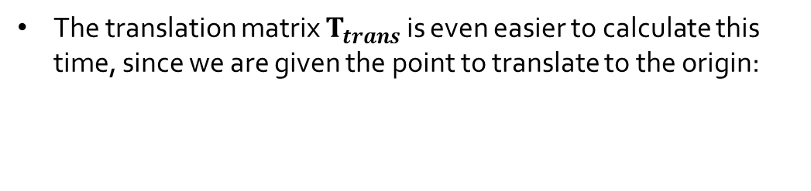
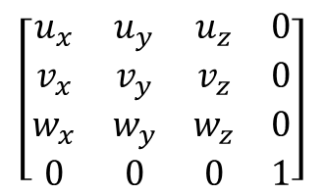
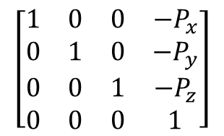
Translation and Rotation
For our normalizing transformation, the first two steps are the same
$$\left[\begin{matrix}1 & 0 & 0 & −P_{x} \\ 0 & 1 & 0 & −P_{y} \\ 0 & 0 & 1 & −P_{z} \\ 0 & 0 & 0 & 1\end{matrix}\right]$$
The translation matrix $T_{trans}$ is even easier to calculate this time, since we are given the point to translate to the origin:
And we use the same matrix $R_{rot}$ to align the camera axes:
$$\left[\begin{matrix}u_{x} & u_{y} & u_{z} & 0 \\ v_{x} & v_{y} & v_{z} & 0 \\ w_{x} & w_{y} & w_{z} & 0 \\ 0 & 0 & 0 & 1\end{matrix}\right]$$
Our current situation:

Slide 25
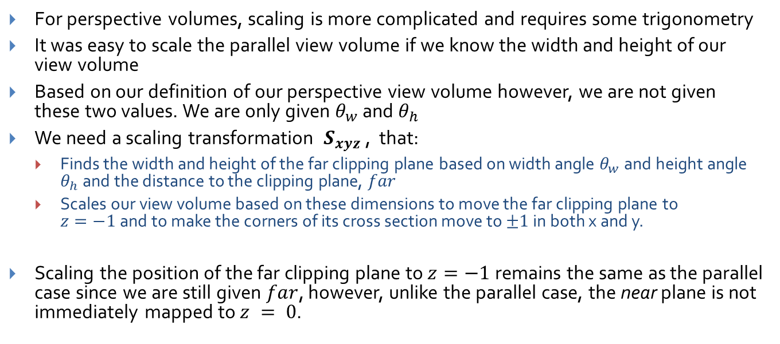
Problems with Scaling
For perspective volumes, scaling is more complicated and requires some trigonometry
It was easy to scale the parallel view volume if we know the width and height of our view volume
Based on our definition of our perspective view volume however, we are not given these two values. We are only given $θ_{w}$ and $θ_{h}$
We need a scaling transformation $S_{xyz}$, that:
Finds the width and height of the far clipping plane based on width angle $θ_{w}$ and height angle $θ_{h}$ and the distance to the clipping plane, $far$
Scales our view volume based on these dimensions to move the far clipping plane to $z=−1$and to make the corners of its cross section move to $±1$ in both x and y.
Scaling the position of the far clipping plane to $z=−1$remains the same as the parallel case since we are still given $far$, however, unlike the parallel case, the near plane is not immediately mapped to $z = 0$.

Slide 26
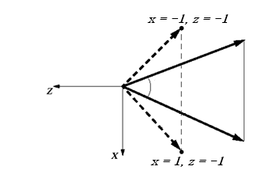
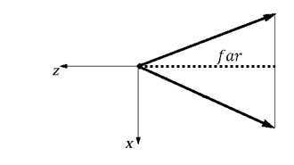
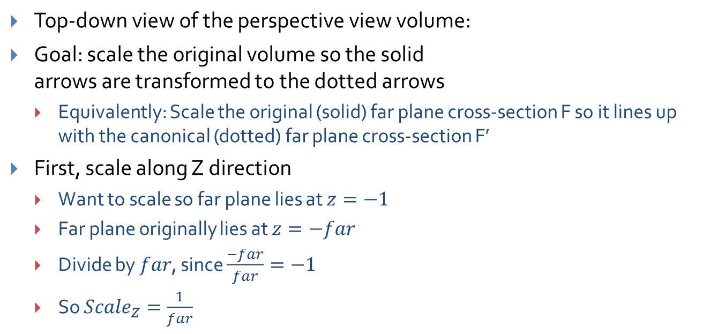
Scaling the perspective view volume (1/4)
F’
F
Top-down view of the perspective view volume:
Goal: scale the original volume so the solid arrows are transformed to the dotted arrows
Equivalently: Scale the original (solid) far plane cross-section F so it lines up with the canonical (dotted) far plane cross-section F’
First, scale along Z direction
Want to scale so far plane lies at $z=−1$
Far plane originally lies at $z=−far$
Divide by $far$, since $\frac{−far}{far}=−1$
So ${Scale}_{Z}=\frac{1}{far}$

Slide 27
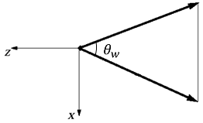
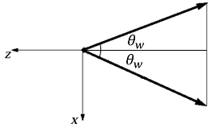


Scaling the perspective view volume (2/4)
Next, scale along X direction
Use the same trick: divide by size of volume along the X axis
How long is the side of the volume along X? Find out using trig…
Start with the original volume
Cut in half along the Z axis
$$θ_{w}$$
$$θ_{w}/2$$
$$θ_{w}/2$$

Slide 28
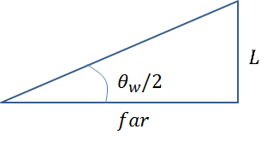
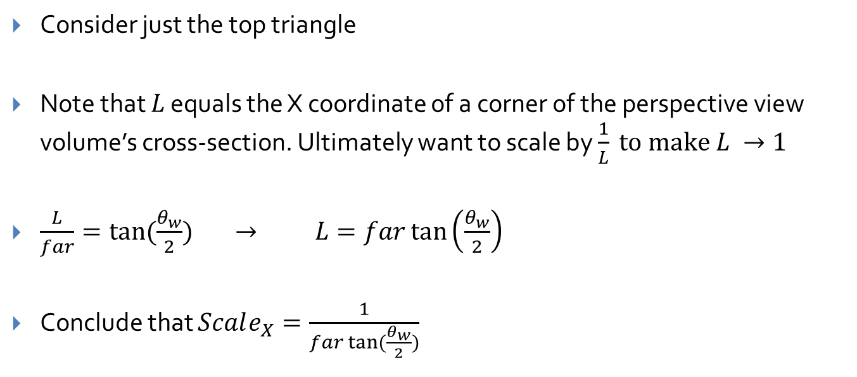
Scaling the perspective view volume (3/4)
Consider just the top triangle
Note that $L$ equals the X coordinate of a corner of the perspective view volume’s cross-section. Ultimately want to scale by $\frac{1}{L} to make L →1$
$\frac{L}{far}=tan⁡(\frac{θ_{w}}{2})$ $→$ $L=far\tan\left(\frac{θ_{w}}{2}\right)$
Conclude that $Scale_{X}=\frac{1}{far tan⁡(\frac{θ_{w}}{2})}$

Slide 29


Scaling the perspective view volume (4/4)
Finally, scale along Y direction
Use the same trig as X direction, but use the height angle $θ_{h}$ instead of $θ_{w}$
Result: $Scale_{Y}=\frac{1}{far tan⁡(\frac{θ_{h}}{2})}$
The final result is this scale matrix:
$$\left[\begin{matrix}\frac{1}{\tan\left(\frac{θ_{w}}{2}\right)far} & 0 & 0 & 0 \\ 0 & \frac{1}{\tan\left(\frac{θ_{h}}{2}\right)far } & 0 & 0 \\ 0 & 0 & \frac{1}{far} & 0 \\ 0 & 0 & 0 & 1\end{matrix}\right]$$

Slide 30




The normalizing transformation (perspective)
Our current perspective transformation takes on the same form as the parallel case: $S_{xyz}$ $R_{rot} T_{trans}$
$Ttrans$ takes the camera’s Position and moves the camera to the world origin
$Rrot$ takes the Look and Up vectors and orients the camera to look down the –z axis
$Sxyz$ takes and scales the view volume so that the corners are at (±1, ±1) and takes the far clipping plane and scales it to lie on the z=-1 plane
So given point P, if we multiply $S_{xyz}$ $R_{rot} T_{trans}$ * P = P’, the position of resulting point P’ will be translated, rotated and scaled to match our normalization but, as required, the projected scene will still look the same as if we had projected our scene using the arbitrary frustum since we apply the same composite to all the objects in the scene.
$$\left[\begin{matrix}\frac{1}{\tan\left(\frac{θ_{w}}{2}\right)far} & 0 & 0 & 0 \\ 0 & \frac{1}{\tan\left(\frac{θ_{h}}{2}\right)far } & 0 & 0 \\ 0 & 0 & 1/far & 0 \\ 0 & 0 & 0 & 1\end{matrix}\right]$$
$$\left[\begin{matrix}u_{x} & u_{y} & u_{z} & 0 \\ v_{x} & v_{y} & v_{z} & 0 \\ w_{x} & w_{y} & w_{z} & 0 \\ 0 & 0 & 0 & 1\end{matrix}\right]$$
$$\left[\begin{matrix}1 & 0 & 0 & −P_{x} \\ 0 & 1 & 0 & −P_{y} \\ 0 & 0 & 1 & −P_{z} \\ 0 & 0 & 0 & 1\end{matrix}\right]$$

Slide 31
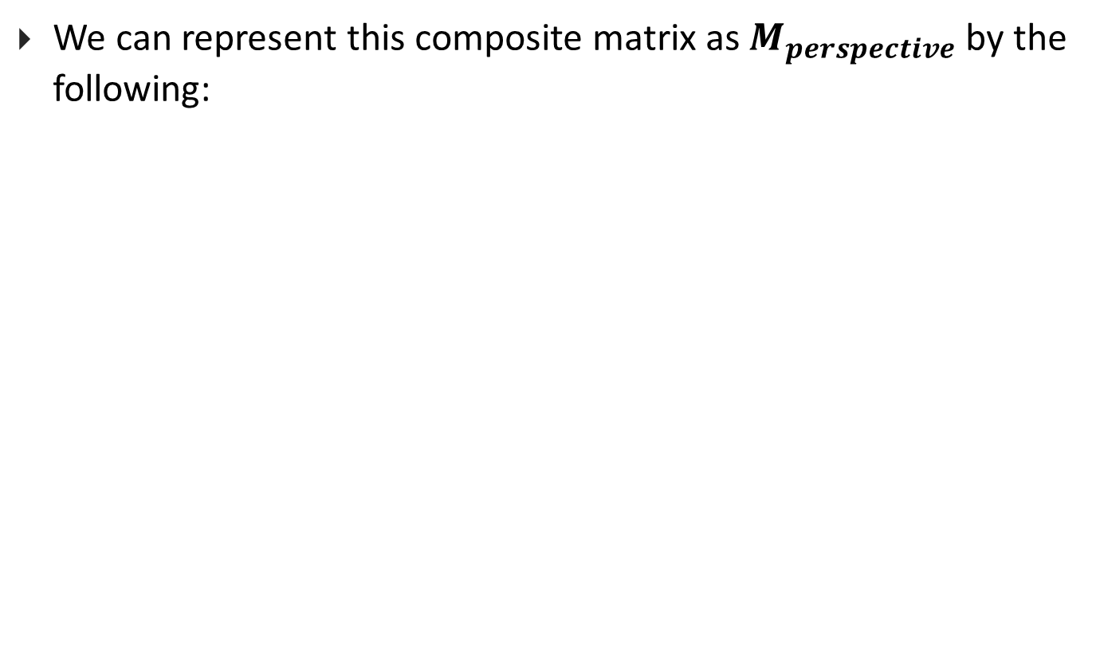



Notation
We can represent this composite matrix as $M_{perspective}$ by the following:
$$N=\left[\begin{matrix}\frac{1}{\tan\left(\frac{θ_{w}}{2}\right)far} & 0 & 0 \\ 0 & \frac{1}{\tan\left(\frac{θ_{h}}{2}\right)far } & 0 \\ 0 & 0 & \frac{1}{far}\end{matrix}\right]$$
$$\left[\begin{matrix}u_{x} & u_{y} & u_{z} \\ v_{x} & v_{y} & v_{z} \\ w_{x} & w_{y} & w_{z}\end{matrix}\right]$$
N is the 3x3 matrix
representing rotations
and scaling
$$M_{perspective}=\left[\begin{matrix} & & & −P_{x} \\ & N & & −P_{y} \\ & & & −P_{z} \\ 0 & 0 & 0 & 1\end{matrix}\right]$$

Slide 32


Perspective and Projection
Now we have our canonical perspective view volume
However, projecting a perspective view volume on to a 2D plane is more difficult than it was in the parallel case – we used similar triangles in the transformation lecture
The solution? Reduce it to a simpler problem!
The final step of our normalizing transformation, transforming the perspective view volume into a parallel one
Think of this perspective transformation $pt$as the unhinging transformation, represented by matrix $M_{pt}$

Slide 33

Effect of Perspective Transformation on near plane (1/2)
We’ve put the perspective view volume into canonical position, orientation and size
We’ll see that $M_{pt}$ leaves the far clip plane at z=-1, and the cross-section undistorted, with corners at $±1$
Let’s look at a particular point on the original near clipping plane lying on the Look vector:
It gets moved to a new location:
on the negative z-axis, say:

Slide 34



Effect of Perspective Transformation on near plane (1/2)
What is the value of $c$? Trace through the steps.
p first gets moved to just near * Look
This point is then rotated to $−near∗e_{3}$
The $xy$ scaling has no effect, and the far scaling changes this to $\left(−\frac{near}{far}\right)e_{3}$, so $c=(−\frac{near}{far})$
P
P`
P`

Slide 35





Unhinging View Volume to Become a Parallel View Volume (1/4)
$$Z=−1$$
Note from figure that far clipping plane cross-section is already in right position with right size
Near clipping plane at $−$ $\frac{near}{far}$ s$hould transform to z=0$
$$Z=−\frac{near}{far}$$
-z
$$(0,0)$$
$$Z=−\frac{near}{far}$$
$$Z=−1$$

Slide 36


Unhinging View Volume to Become a Parallel View Volume(2/4)
The derivation of our unhinging transformation matrix is complex. Instead, we will give you the matrix and show that it works by example
Our unhinging transformation matrix,${ M}_{pt}$
$$\left[\begin{matrix}1 & 0 & 0 & 0 \\ 0 & 1 & 0 & 0 \\ 0 & 0 & \frac{1}{c+1} & \frac{−c}{c+1} \\ 0 & 0 & −1 & 0\end{matrix}\right]$$

Slide 37



Unhinging View Volume to Become a Parallel View Volume(3/4)
Our perspective transformation does the following:
Sends all points on the$z$= -1 far clipping plane to themselves
We’ll check top-left (-1, 1, -1, 1) and bottom-right (1, -1, -1, 1) corners
Sends all points on the z = c near clipping plane onto the $z=0$plane
Note that the corners of the cross section of the near clipping plane in the frustum are $\left(−c,c,c,1\right), (c,−c,c,1), (c,c,c,1) and (−c, −c,c,1)$
We’ll check to see that $(−c, c, c, 1)$gets sent to (-1, 1, 0, 1) and that $(c, −c, c, 1)$gets sent to (1, -1, 0, 1)
Let’s t$ry c = −\frac{1}{2}$
$\left[\begin{matrix}1 & 0 & 0 & 0 \\ 0 & 1 & 0 & 0 \\ 0 & 0 & \frac{1}{c+1} & \frac{−c}{c+1} \\ 0 & 0 & −1 & 0\end{matrix}\right]$ =
$$\left[\begin{matrix}1 & 0 & 0 & 0 \\ 0 & 1 & 0 & 0 \\ 0 & 0 & 2 & 1 \\ 0 & 0 & −1 & 0\end{matrix}\right]$$

Slide 38














Unhinging View Volume to Become a Parallel View Volume(4/4)
$$\left[\begin{matrix}1 & 0 & 0 & 0 \\ 0 & 1 & 0 & 0 \\ 0 & 0 & 2 & 1 \\ 0 & 0 & −1 & 0\end{matrix}\right]$$
$$\left[\begin{matrix}−1 \\ 1 \\ −1 \\ 1\end{matrix}\right]$$
$$\left[\begin{matrix}−1 \\ 1 \\ −1 \\ 1\end{matrix}\right]$$
$$\left[\begin{matrix}1 & 0 & 0 & 0 \\ 0 & 1 & 0 & 0 \\ 0 & 0 & 2 & 1 \\ 0 & 0 & −1 & 0\end{matrix}\right]$$
$$\left[\begin{matrix}1 \\ −1 \\ −1 \\ 1\end{matrix}\right]$$
$$\left[\begin{matrix}1 \\ −1 \\ −1 \\ 1\end{matrix}\right]$$
Don’t forget to
homogenize!
$$\left[\begin{matrix}1 & 0 & 0 & 0 \\ 0 & 1 & 0 & 0 \\ 0 & 0 & 2 & 1 \\ 0 & 0 & −1 & 0\end{matrix}\right]$$
$$\left[\begin{matrix}−1/2 \\ 1/2 \\ −1/2 \\ 1\end{matrix}\right]$$
$$\left[\begin{matrix}−1/2 \\ 1/2 \\ 0 \\ 1/2\end{matrix}\right]$$
$$\left[\begin{matrix}−1 \\ 1 \\ 0 \\ 1\end{matrix}\right]$$
$$\left[\begin{matrix}1 & 0 & 0 & 0 \\ 0 & 1 & 0 & 0 \\ 0 & 0 & 2 & 1 \\ 0 & 0 & −1 & 0\end{matrix}\right]$$
$$\left[\begin{matrix}1/2 \\ −1/2 \\ −1/2 \\ 1\end{matrix}\right]$$
$$\left[\begin{matrix}1/2 \\ −1/2 \\ 0 \\ 1/2\end{matrix}\right]$$
$$\left[\begin{matrix}1 \\ −1 \\ 0 \\ 1\end{matrix}\right]$$

Slide 39





Practical Considerations: z-buffer for Visible Surface Determination
Hardware depth testing is done to compare a point on a polygon being rendered to one already stored at the corresponding x-y pixel location using a z-buffer that stores normalized z-values of points (future lecture on VSD)
The expected range for these values are from 0.0 to 1.0 where 0.0 is the closest an object can be before getting clipped away, and 1.0 is the farthest
Alternate form of $M_{pt}$ that does the same unhinging as the original but negates the z-term to make the volume point down the positive Z-axis:
$$\left[\begin{matrix}1 & 0 & 0 & 0 \\ 0 & 1 & 0 & 0 \\ 0 & 0 & −1 & 0 \\ 0 & 0 & 0 & 1\end{matrix}\right]$$
$\left[\begin{matrix}1 & 0 & 0 & 0 \\ 0 & 1 & 0 & 0 \\ 0 & 0 & \frac{1}{c+1} & \frac{−c}{c+1} \\ 0 & 0 & −1 & 0\end{matrix}\right]$ =
$$\left[\begin{matrix}1 & 0 & 0 & 0 \\ 0 & 1 & 0 & 0 \\ 0 & 0 & \frac{−1}{c+1} & \frac{c}{c+1} \\ 0 & 0 & −1 & 0\end{matrix}\right]$$
Use this one in Camtrans, but we’ll use the un-flipped version for the remainder of the lecture
Note: cross-sections inside the view volume are scaled up more the closer they are to the near plane

Slide 40





The normalizing transformation (perspective)
We now have our final normalizing transformation, call it $N_{perspective},$ to convert and arbitrary perspective view volume into a canonical parallel view volume
$N_{perspective}= M_{pt}S_{xyz}R_{rot}T_{trans}$ or $M_{pt}M_{perspective}$
Remember to homogenize your points after you apply this transformation
We can now project our points to the viewing window easily since we’re using a parallel view volume: Just get rid of the $z$-coordinate! Avoids having to pick a film/projection plane!
After that we can map contents of our viewing window to the viewport using the windowing transformation
$$\left[\begin{matrix}1 & 0 & 0 & 0 \\ 0 & 1 & 0 & 0 \\ 0 & 0 & \frac{−1}{c+1} & \frac{c}{c+1} \\ 0 & 0 & −1 & 0\end{matrix}\right]$$
$$\left[\begin{matrix}\frac{1}{\tan\left(\frac{θ_{w}}{2}\right)far} & 0 & 0 & 0 \\ 0 & \frac{1}{\tan\left(\frac{θ_{h}}{2}\right)far } & 0 & 0 \\ 0 & 0 & 1/far & 0 \\ 0 & 0 & 0 & 1\end{matrix}\right]$$
$$\left[\begin{matrix}u_{x} & u_{y} & u_{z} & 0 \\ v_{x} & v_{y} & v_{z} & 0 \\ w_{x} & w_{y} & w_{z} & 0 \\ 0 & 0 & 0 & 1\end{matrix}\right]$$
$$\left[\begin{matrix}1 & 0 & 0 & −P_{x} \\ 0 & 1 & 0 & −P_{y} \\ 0 & 0 & 1 & −P_{z} \\ 0 & 0 & 0 & 1\end{matrix}\right]$$

Slide 41



The windowing transformation (1/2)
The last step in our rendering process after projecting is to take our film/viewing window, and resize it to match the dimensions of the viewport so that we can easily map the contents of our film plane to our viewport
To do this, we want to have a viewing/clipping window with it’s lower left corner at $(0,0)$ and w$ith a width and height$ of the viewport
This can be done using the windowing transformation:
$$M_{wind}=\left[\begin{matrix}width & 0 & 0 \\ \begin{aligned}0 \\ 0\end{aligned} & \begin{aligned}height \\ 0\end{aligned} & \begin{aligned}0 \\ 1\end{aligned}\end{matrix}\right]$$
$$\left[\begin{matrix}1/2 & 0 & 1/2 \\ \begin{aligned}0 \\ 0\end{aligned} & \begin{aligned}1/2 \\ 0\end{aligned} & \begin{aligned}1/2 \\ 1\end{aligned}\end{matrix}\right]$$

Slide 42












The windowing transformation (2/2)
We first scale our viewing window to be between –½ and ½ in X and Y. Then we translate the window by ( ½, ½ ) to put the window’s lower left corner at the origin
Then we scale the viewing window by the $width$ and $height$ of the viewport to get our desired result
$$(1,1)$$
$$(1,1)$$
$$(0,0)$$
$$(−1,−1)$$
$$\left[\begin{matrix}1/2 & 0 & 1/2 \\ \begin{aligned}0 \\ 0\end{aligned} & \begin{aligned}1/2 \\ 0\end{aligned} & \begin{aligned}1/2 \\ 1\end{aligned}\end{matrix}\right]$$
$$(w,h)$$
$$(1,1)$$
$$(0,0)$$
$$(0,0)$$
$$\left[\begin{matrix}width & 0 & 0 \\ \begin{aligned}0 \\ 0\end{aligned} & \begin{aligned}height \\ 0\end{aligned} & \begin{aligned}0 \\ 1\end{aligned}\end{matrix}\right]$$
Note: You can confirm this matches the more general windowing transformation in the transformations lecture, with the exception that this transformation doesn’t use the homogenous coordinate
This step is also usually handled by most graphics packages

Slide 43


Why it works (1/2)
You may question, how exactly does this transformation result in a perspective scene?
The key is in the unhinging step
We can take an intuitive approach to see this
The closer the object is to the near clipping plane, the more it is enlarged during the unhinging step
Thus, closer objects are larger and farther away objects are smaller, as is to be expected
Another way to see it is to use the parallel lines
Draw parallel lines in a perspective volume
When we unhinge the volume, the lines fan out at the near clipping
The result is converging lines, the railroad track
$$(0,0)$$
$$(0,0)$$

Slide 44

Why it works (2/2)
Yet another way to demonstrate how this works is to use occlusion (when elements in the scene are blocked by other elements)
Looking at the top view of the frustum, we see a square
Draw a line from your eye point to the left corner of the square, we can see that points behind this corner are obscured
Now unhinge the perspective and draw a line again to the left corner, we can see that all points obscured before are still obscured and all points that were visible before are still visible

Slide 45






Perspective Transform Causes Compression (1/3)
Points are compressed towards the far clipping plane
Let’s look at the general case of multiplying
First note that x and y are both shrunk for z > 1, which is perspective foreshortening.
Now focus on the new $z$-term called $z’.$ This represents the new depth of the point along the z-axis after normalization and homogenization
$z’ = \frac{\frac{c}{z}−1}{c+1}$ , now let’s hold c constant and plug in some values for $z$
Let’s have $near=−0.1, far=−1, so c=0.1$
The following is a graph of $z’$dependent on$z$:
$$M_{pt}∗\left[\begin{matrix}x \\ y \\ z \\ 1\end{matrix}\right]$$
$\left[\begin{matrix}−x/z \\ −y/z \\ \frac{\frac{c}{z}−1}{c+1} \\ 1\end{matrix}\right]$
$$\left[\begin{matrix}1 & 0 & 0 & 0 \\ 0 & 1 & 0 & 0 \\ 0 & 0 & \frac{1}{c+1} & \frac{−c}{c+1} \\ 0 & 0 & −1 & 0\end{matrix}\right]$$
$\left[\begin{matrix}x \\ y \\ z \\ 1\end{matrix}\right]$ =
$\left[\begin{matrix}x \\ y \\ \frac{z−c}{c+1} \\ −z\end{matrix}\right]$

Slide 46

Perspective Transform Causes Compression(2/3)
z
We can see that if the z-values of points are being compressed towards z = -1 in our canonical view volume, the compression is more noticeable for points originally closer to the far clipping plane
If you try playing around with the near and far clipping planes, another important observation is that as you bring the near clipping plane closer to $z=0$, or extend the far clipping plane out more, the compression becomes more severe
Caution: If z-compression is too severe, Z-buffer depth testing becomes more inaccurate near the back of the view volume and errors in rounding can cause objects to be rendered out of order, i.e., “bleed-through” of pixels occurs
z’

Slide 47

Perspective Transform Causes Compression(3/3)
It might seem tempting to place the near clipping plane at $z=0$or place the far clipping plane very far away ($z = ∞$)
First note that the value of $c=−\frac{near}{far}$ as either $near$ approaches $0$ or $far$ approaches $∞$, approaches $0$
Applying this to our value for $z′ = \frac{\frac{c}{z}−1}{c+1}$ , we sub in $0$for c to get $z^{′}=−\frac{1}{1}=−1$
From this we can see that if our far clipping plane approaches infinity, or if our near clipping plane approaches $0$, points will cluster at $z=−1$ (at the far clipping plane of our canonical view volume) and depth-buffering essentially fails

Slide 48


Aside: Projection and Interpolation(1/3)
This converging of points at the far clipping also poses problems when trying to interpolate values, such as color, between points
Say for example we color the midpoint M between two vertices, A and B, in a scene as the average of the two colors of A and B (assume we’re looking at a polygon edge-on or just an edge of a tilted polygon)
Note that if we were just using a parallel view volume, it would be safe to just set the midpoint to the average and be done
Unfortunately, we can’t do this for perspective transformations since the point that was originally the midpoint gets compressed towards the far clipping plane. It isn’t the actual midpoint anymore
Another way to say this is that the color, call it $G$, does not interpolate between the points linearly anymore. We can’t just assign the new midpoint the average color.

Slide 49

Aside: Projection and Interpolation(2/3)
However, while $G$ does not interpolate linearly, $G/w$ does, where $w$ is the homogenous coordinate after being multiplied by our normalizing transformation, but before being homogenized
In our case $w$ will always be $−z$
Knowing this, how can we find the color at this new midpoint?
When we transform A and B, we get two $w$values, $w_{a}and w_{b}$
We also know the values of $G_{a} and G_{b}$
If we interpolate linearly between $\frac{G_{a}}{w_{a}}$and $\frac{G_{b}}{w_{b}}$ (which in this case is just taking the average), we will know the $\frac{G}{w}$ value for the new midpoint $\frac{G_{m}}{w_{m}}$
We can also find the average of ${1/w}_{a}$ and ${1/w}_{b}$ to get ${1/w}_{m}$ by itself
Dividing$\frac{G_{m}}{w_{m}}$ by $\frac{1}{w_{m}}$, we can get our new value of $G_{m}$

Slide 50

Aside: Projection and Interpolation(3/3)
Let’s make this slightly more general
Say we have a function $f$ that represents a property of a point (we used color in our example)
The point P between points A and B that we want to apply the function to is: $\left(1−t\right)A+tB$
$t$ ranges from 0 to 1, and represents the fraction of the way from point A’ to point B’ your point of interest is (in our example, $t$ = .5)
Goal: Compute$f(P)$
$$\frac{1}{W_{t}} = \left(1−t\right)\left(\frac{1}{w_{a}}\right)+t\left(\frac{1}{w_{b}}\right)$$
$$\frac{f\left(P\right)}{w_{t}}=(1−t)∗\frac{f\left(A\right)}{w_{a}}+t∗\frac{f\left(B\right)}{w_{b}}$$
So to find the value of our function at the point specified by $t$ we compute: $\frac{f\left(P\right)}{w_{t}}$ / $\frac{1}{W_{t}}$=$f\left(P\right)$

Slide 51

Proof by example
Let’s revisit the setup from this image:
Say we want the $f(A) = 0, f(B) = 1$, and thus $f(M) = .5$
After unhinging transformation:
The new midpoint, $M’,$is 4/5 of the way from $A’$ to $B’$ , which can be found by dividing: $(A’M’)/(A’B’)$
Like $f\left(M\right), f(M’)$should be .5
$w_{a}= ¼ and w_{b} = 1$
$\frac{1}{W_{t}} = \left(1−.8\right)\left(\frac{1}{.25}\right)+.8(\frac{1}{1})$ = 1.6
$\frac{f\left(P\right)}{w_{t}}=\left(1−.8\right)∗\frac{0}{.25}+.8∗\frac{1}{1}$ = .8
$f\left(M′\right)=\frac{f\left(P\right)}{w_{t}}$/ $\frac{1}{W_{t}}= .5$

Slide 52

Final Words (1/2)
We know about camera and object modeling transformations now, let’s put them together:
1) $N_{perspective}=M_{pt}M_{perspective}$
2) $CMTM=SRT$
The CMTM (Composite Modeling Transformation Matrix) is a composite matrix of all of our object modeling transformations (Scaling, Rotating, Translating, etc)
3) $CTM=N_{perspective}∗CMTM$
The CTM (Composite Transformation Matrix) is the combination of all our camera and modeling transformations
In OpenGL it is referred to as the ModelView Projection Matrix
Model: Modeling Transformations
View: Camera translate/rotate
Projection: Frustum scaling/unhinging

Slide 53
Final Words (2/2)
With our CTM we now have a complete, start to finish view of our rendering process:
1) Apply the CTM to all points in the scene
2) Project normalized scene on to film plane (into viewing window)
3) Resize viewing window to match viewport size
4) Map colors at (x,y) coordinates of viewing window to (u,v) pixels of viewport and our rendering is complete!
Applications in CS123:
Camtrans:
You will be computing the normalizing transformation for adjustable camera settings
Sceneview:
You will extend your camtrans code and object transformations to build the CMTM from a scene-graph and then the CTM for each primitive in the scene

