Slide 1
Scan Conversion
CS123
Notes:
- Video CS224 BALSA
- algorithm simulations of polygon scan conversion (complicated polygon)
- (may want the part that does race between rendering algorithms but that probably comes during Hidden Surface Removal)

Slide 2
Scan Converting Lines
Line Drawing
Draw a line on a raster screen between two points
Why is this a difficult problem?
What is “drawing” on a raster display?
What is a “line” in raster world?
Efficiency and appearance are both important
Problem Statement
Given two points P and Q in XY plane, both with integer coordinates, determine which pixels on raster screen should be on in order to draw a unit-width line segment starting at P and ending at Q

Slide 3
What is Scan Conversion?
Final step of rasterisation (process of taking geometric shapes and converting them into an array of pixels stored in the framebuffer to be displayed)
Takes place after clipping occurs
All graphics packages do this at the end of the rendering pipeline
Takes triangles and maps them to pixels on the screen
Also takes into account other properties like lighting and shading, but we’ll focus first on algorithms for line scan conversion

Slide 4
Finding the next pixel:
Special cases:
Horizontal Line:
Draw pixel P and increment x coordinate value by 1 to get next pixel.
Vertical Line:
Draw pixel P and increment y coordinate value by 1 to get next pixel.
Diagonal Line:
Draw pixel P and increment both x and y coordinate by 1 to get next pixel.
What should we do in general case?
Increment x coordinate by 1 and choose point closest to line.
But how do we measure “closest”?

Slide 5


Vertical Distance
Why can we use vertical distance as a measure of which point is closer?
… because vertical distance is proportional to actual distance
Similar triangles show that true distances to line (in blue) are directly proportional to vertical distances to line (in black) for each point
Therefore, point with smaller vertical distance to line is closest to line
$$(x_{1},y_{1})$$
$$(x_{2},y_{2})$$

Slide 6
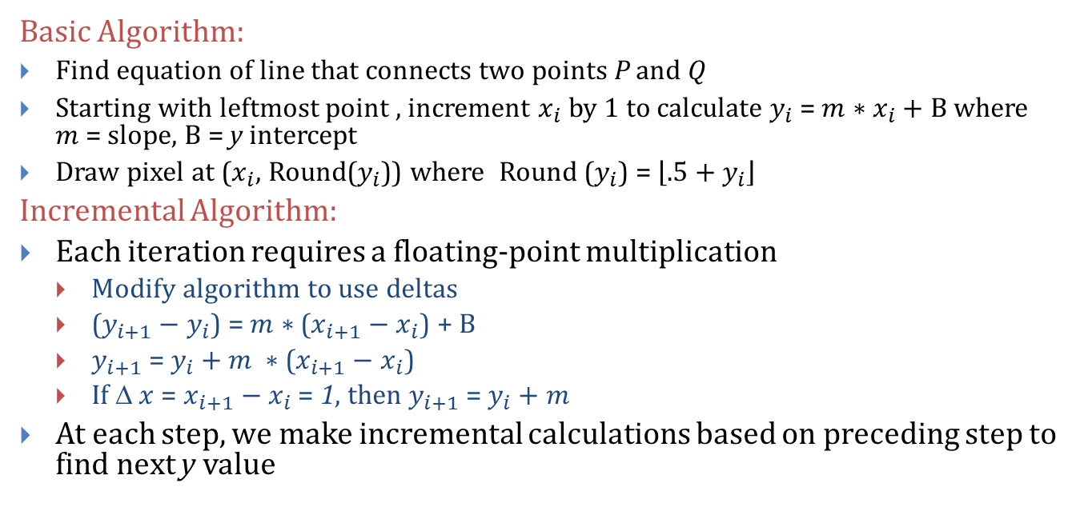
Strategy 1 – Incremental Algorithm (1/3)
Basic Algorithm:
Find equation of line that connects two points P and Q
Starting with leftmost point , increment $x_{i}$ by 1 to calculate $y_{i}$ = $m∗x_{i}+B$where $m$= slope, $B$ = y intercept
Draw pixel at ($x_{i}$, Round($y_{i}$)) where Round ($y_{i}$) = $\left\lfloor .5+y_{i}\right\rfloor$
Incremental Algorithm:
Each iteration requires a floating-point multiplication
Modify algorithm to use deltas
($y_{i+1}−$ $y_{i}$) = $m∗$($x_{i+1}−$ $x_{i}$) + $B$
$y_{i+1}$= $y_{i}+m ∗$($x_{i+1}−x_{i}$)
If Δ $x$ = $x_{i+1}−x_{i}$ = 1, then $y_{i+1}$ = $y_{i}+m$
At each step, we make incremental calculations based on preceding step to find next y value

Slide 7




Strategy 1 – Incremental Algorithm (2/3)
$$(x_{i}+1, Round\left(y_{i}+m\right))$$
$$(x_{i},y_{i})$$
$$(x_{i}+1,y_{i}+m)$$
$$(x_{i},Round\left(y_{i}\right))$$

Slide 8
Sample Code and Problems (3/3)
void Line(int x0, int y0, int x1, int y1) {
int x, y;
float dy = y1 – y0;
float dx = x1 – x0;
float m = dy / dx;
y = y0;
for (x = x0; x < x1; ++x) {
WritePixel( x, Round(y) );
y = y + m;
}
}
Since slope is fractional, need special case for vertical lines (dx = 0)
Rounding takes time

Slide 9
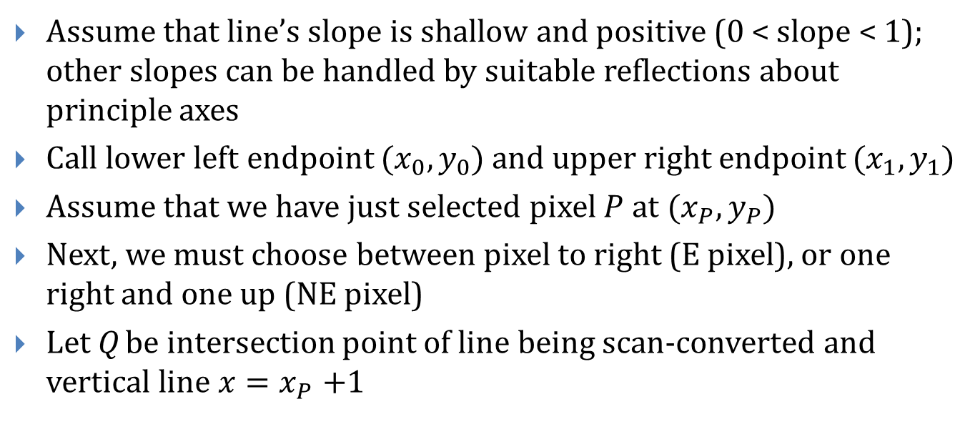
Strategy 2 – Midpoint Line Algorithm (1/3)
Assume that line’s slope is shallow and positive (0 < slope < 1); other slopes can be handled by suitable reflections about principle axes
Call lower left endpoint $(x_{0},y_{0})$ and upper right endpoint $(x_{1},y_{1})$
Assume that we have just selected pixel $P$ at $(x_{P},y_{P})$
Next, we must choose between pixel to right (E pixel), or one right and one up (NE pixel)
Let Q be intersection point of line being scan-converted and vertical line $x{=x}_{P}+1$

Slide 10


Strategy 2 – Midpoint Line Algorithm (2/3)
NE pixel
Previous pixel
Q
Midpoint M
$$P=(x_{P},y_{P})$$
E pixel
$$x=x_{P}+1 \text{(}\text{dashed}\text{)}$$

Slide 11

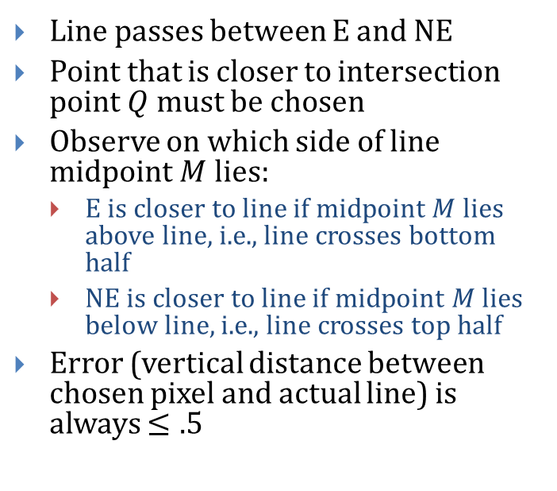

Strategy 2- Midpoint Line Algorithm (3/3)
Line passes between E and NE
Point that is closer to intersection point $Q$ must be chosen
Observe on which side of line midpoint $M$ lies:
E is closer to line if midpoint $M$ lies above line, i.e., line crosses bottom half
NE is closer to line if midpoint $M$ lies below line, i.e., line crosses top half
Error (vertical distance between chosen pixel and actual line) is always $≤.5$
NE pixel
$$Q$$
$$M$$
E pixel
For line shown, algorithm chooses NE as next pixel.
Now, need to find a way to calculate on which side of line midpoint lies

Slide 12
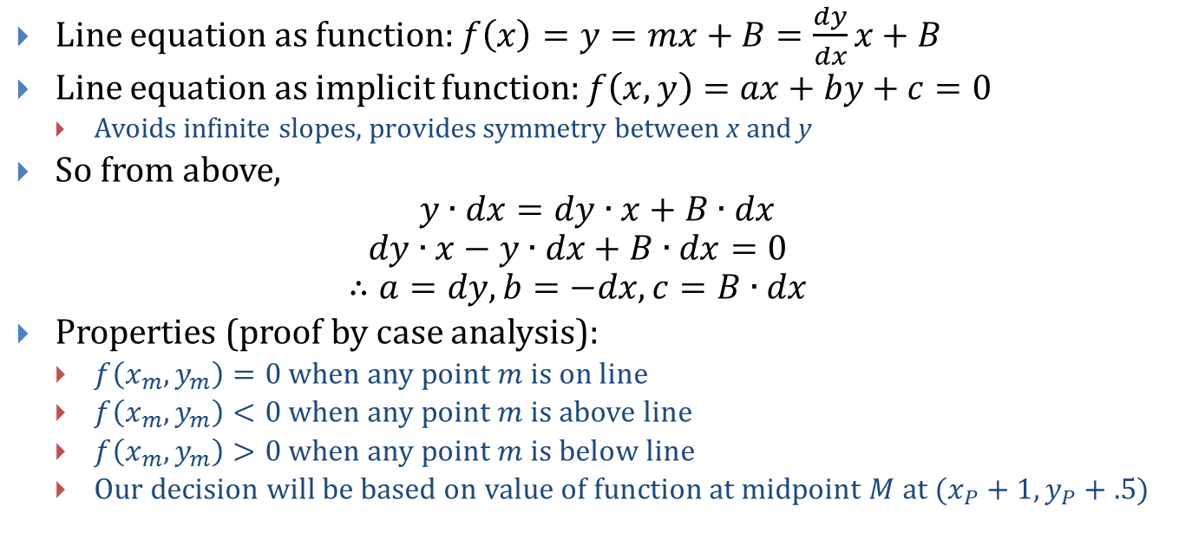
General Line Equation
Line equation as function: $f\left(x\right)=y=mx+B=\frac{dy}{dx}x+B$
Line equation as implicit function: $f\left(x,y\right)=ax+by+c=0$
Avoids infinite slopes, provides symmetry between x and y
So from above,
$$y∙dx=dy∙x+B∙dx$$
$$dy∙x−y∙dx+B∙dx=0$$
$$∴a=dy, b=−dx,c=B∙dx$$
Properties (proof by case analysis):
$f\left(x_{m},y_{m}\right)=0$ when any point $m$ is on line
$f\left(x_{m},y_{m}\right)<0$ when any point $m$ is above line
$f\left(x_{m},y_{m}\right)>0$ when any point $m$ is below line
Our decision will be based on value of function at midpoint $M$ at $(x_{P}+1, y_{P}+.5)$

Slide 13
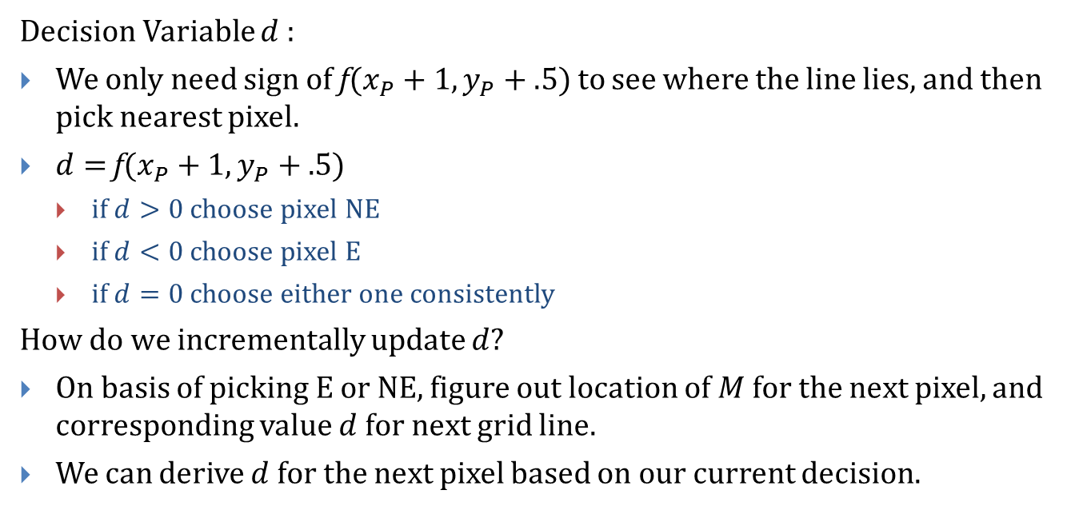
Decision Variable
Decision Variable $d$:
We only need sign of f$(x_{P}+1, y_{P}+.5)$ to see where the line lies, and then pick nearest pixel.
$d=$f$(x_{P}+1, y_{P}+.5)$
if $d>0$ choose pixel NE
if $d<0$ choose pixel E
if $d=0$ choose either one consistently
How do we incrementally update $d$?
On basis of picking E or NE, figure out location of $M$ for the next pixel, and corresponding value $d$for next grid line.
We can derive $d$for the next pixel based on our current decision.

Slide 14
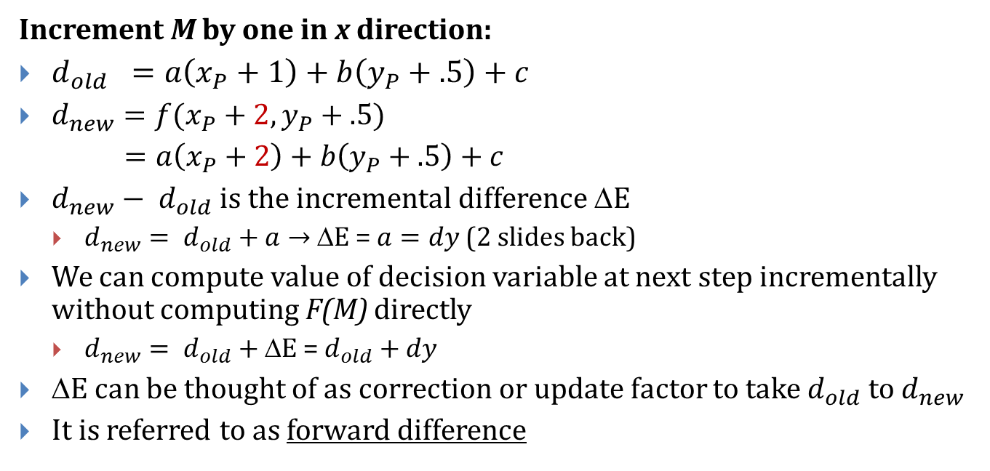
Incrementing Decision Variable if E was chosen:
Increment M by one in x direction:
$d_{old} =a\left(x_{P}+1\right)+b\left(y_{P}+.5\right)+c$
$d_{new}=f(x_{P}+2,y_{P}+.5)$
$=a\left(x_{P}+2\right)+b\left(y_{P}+.5\right)+c$
$d_{new}− d_{old}$ is the incremental difference ΔE
$d_{new}= d_{old}+a→$ΔE = $a=dy$ (2 slides back)
We can compute value of decision variable at next step incrementally without computing F(M) directly
$d_{new}= d_{old}+$ ΔE = $d_{old}+dy$
ΔE can be thought of as correction or update factor to take $d_{old}$ to $d_{new}$
It is referred to as forward difference

Slide 15
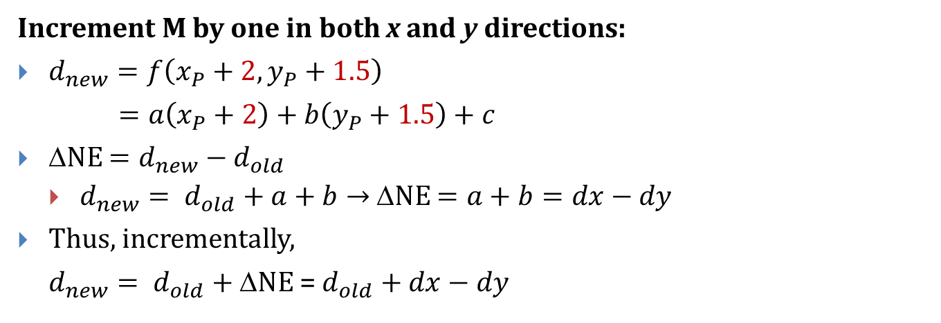
If NE was chosen:
Increment M by one in both x and y directions:
$d_{new}=f\left(x_{P}+2,y_{P}+1.5\right)$
$=a\left(x_{P}+2\right)+b\left(y_{P}+1.5\right)+c$
ΔNE $=d_{new}−d_{old}$
$d_{new}= d_{old}+a+b→$ ΔNE $=a+b=dx−dy$
Thus, incrementally,
$d_{new}= d_{old}+$ΔNE = $d_{old}+dx−dy$

Slide 16
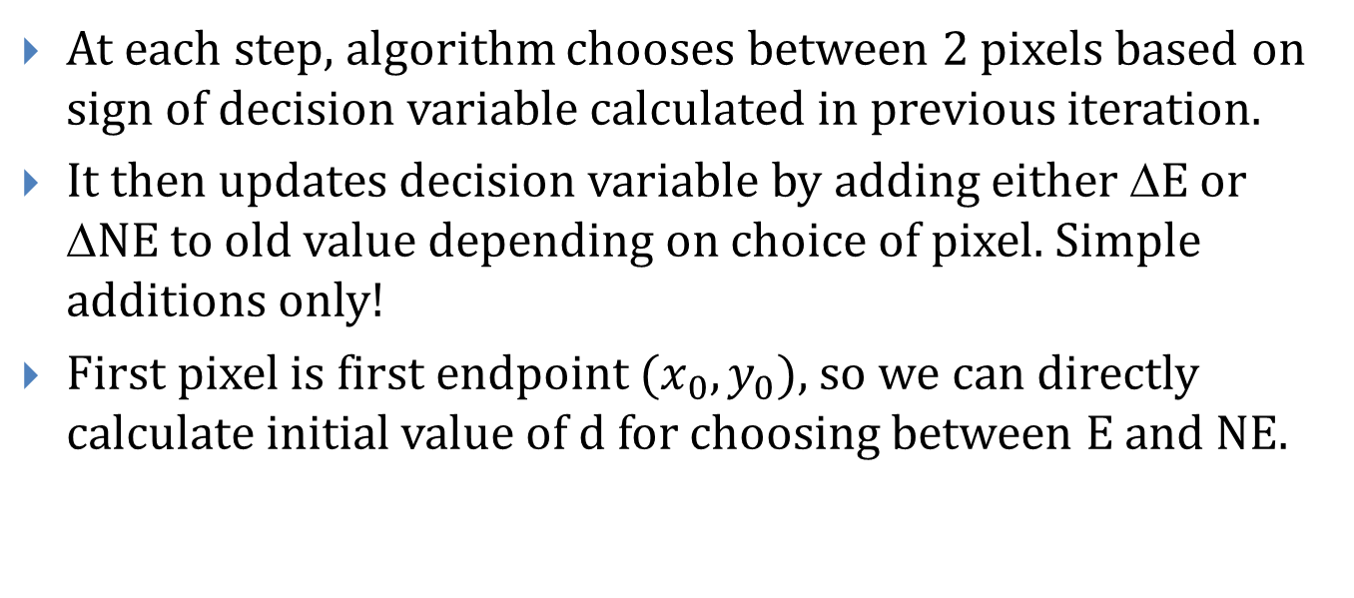
Summary (1/2)
At each step, algorithm chooses between 2 pixels based on sign of decision variable calculated in previous iteration.
It then updates decision variable by adding either ΔE or ΔNE to old value depending on choice of pixel. Simple additions only!
First pixel is first endpoint $(x_{0}, y_{0}),$so we can directly calculate initial value of d for choosing between E and NE.

Slide 17
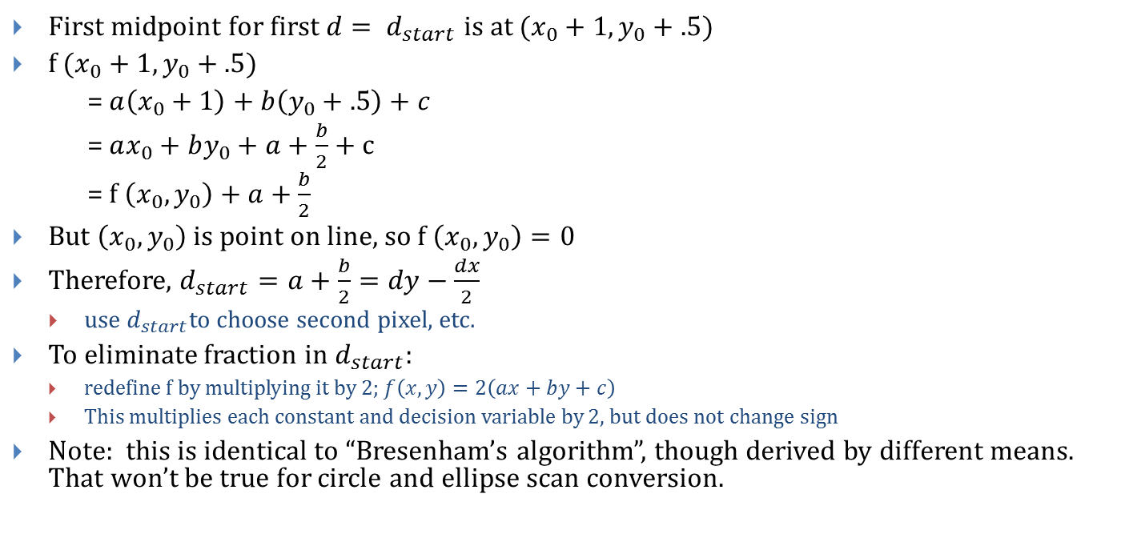
Summary (2/2)
First midpoint for first$d= d_{start}$ is at $(x_{0}+1, y_{0}+.5)$
f $(x_{0}+1, y_{0}+.5)$
= $a\left(x_{0}+1\right)+b\left(y_{0}+.5\right)+c$
= $ax_{0}+by_{0}+a+\frac{b}{2}+c$
= f $\left(x_{0},y_{0}\right)+a+\frac{b}{2}$
But $\left(x_{0},y_{0}\right)$is point on line, so f $\left(x_{0},y_{0}\right)=0$
Therefore, $d_{start}=a+\frac{b}{2}=dy−\frac{dx}{2}$
use $d_{start}$to choose second pixel, etc.
To eliminate fraction in $d_{start}$:
redefine f by multiplying it by 2; $f\left(x,y\right)=2\left(ax+by+c\right)$
This multiplies each constant and decision variable by 2, but does not change sign
Note: this is identical to “Bresenham’s algorithm”, though derived by different means. That won’t be true for circle and ellipse scan conversion.

Slide 18
Example Code
void MidpointLine(int x0, int y0, int x1, int y1) {
int dx = (x1 - x0), dy = (y1 - y0);
int d = 2 * dy - dx;
int incrE = 2 * dy;
int incrNE = 2 * (dy - dx);
int x = x0, y = y0;
WritePixel(x, y);
while (x < x1) {
if (d <= 0) d = d + incrE; // East Case
else { d = d + incrNE; ++y; } // Northeast Case
++x;
WritePixel(x, y);
}
}

Slide 19
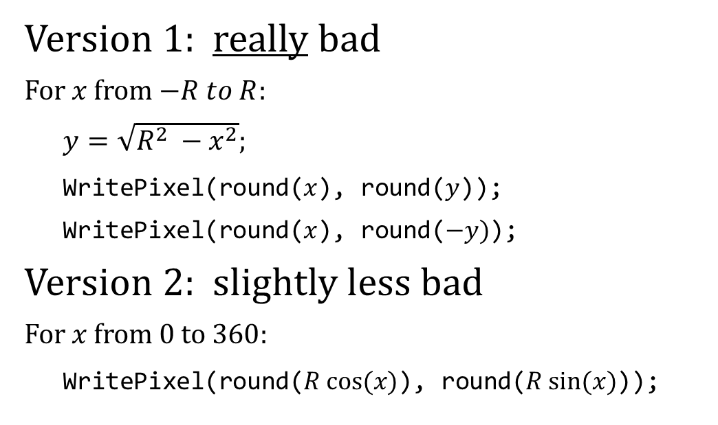
Scan Converting Circles
(0, 17)
Version 1: really bad
For $x$ from $−R to R$:
$y=\sqrt{R^{2} −x^{2}};$
WritePixel(round($x$), round($y$));
WritePixel(round($x$), round($−y)$);
Version 2: slightly less bad
For $x$ from $0 \text{to} 360$:
WritePixel(round($R cos⁡(x)$), round($R sin⁡(x)$));
(17, 0)
(0, 17)
(17, 0)

Slide 20
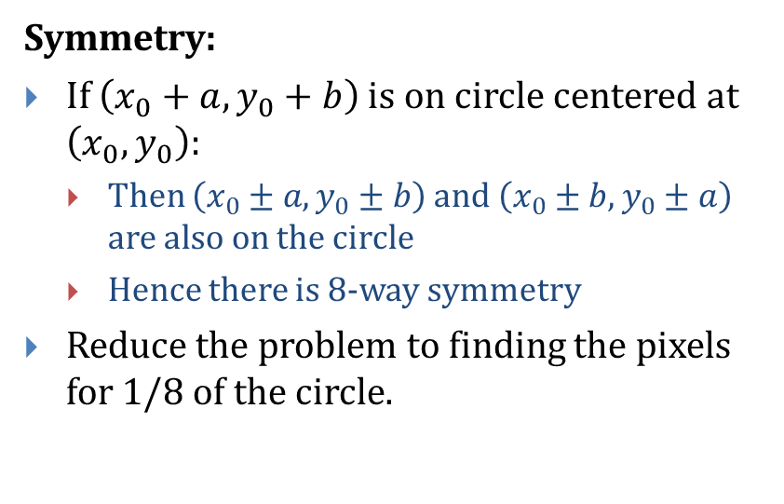
Version 3 — Use Symmetry
Symmetry:
If $\left(x_{0}+a,y_{0}+b\right)$is on circle centered at $\left(x_{0}, y_{0}\right):$
Then $\left(x_{0}±a,y_{0}±b\right)$ and $\left(x_{0}±b,y_{0}±a\right)$ are also on the circle
Hence there is 8-way symmetry
Reduce the problem to finding the pixels for 1/8 of the circle.
(x₀ + a, y₀ + b)
R
(x₀, y₀)
(x-x₀)² + (y-y₀)² = R²

Slide 21
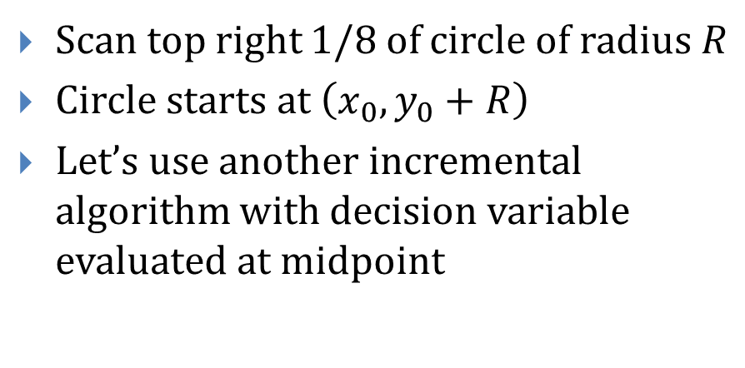
Using the Symmetry
Scan top right 1/8 of circle of radius $R$
Circle starts at $\left(x_{0},y_{0}+R\right)$
Let’s use another incremental algorithm with decision variable evaluated at midpoint
(x₀, y₀)

Slide 22
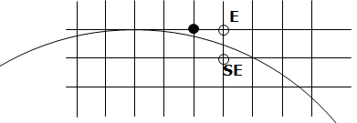
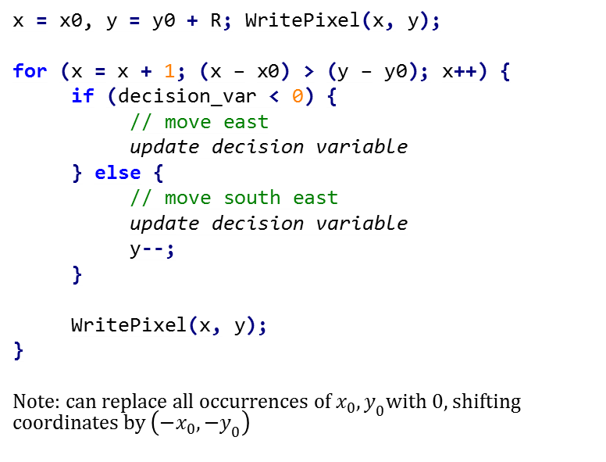
The incremental algorithm – a sketch
x = x0, y = y0 + R; WritePixel(x, y);
for (x = x + 1; (x – x0) > (y – y0); x++) {
if (decision_var < 0) {
// move east
update decision variable
} else {
// move south east
update decision variable
y--;
}
WritePixel(x, y);
}
Note: can replace all occurrences of $x_{0},y_{0}$with 0, shifting coordinates by $\left({−x}_{0},−y_{0}\right)$

Slide 23
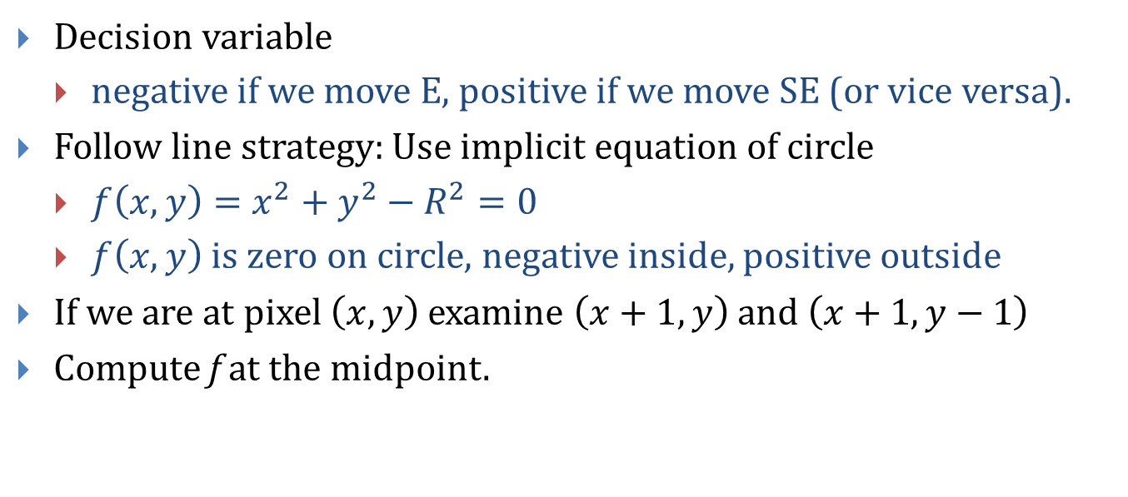
What we need for the Incremental Algorithm
Decision variable
negative if we move E, positive if we move SE (or vice versa).
Follow line strategy: Use implicit equation of circle
$f\left(x,y\right)=x^{2}+y^{2}−R^{2}=0$
$f\left(x,y\right)$ is zero on circle, negative inside, positive outside
If we are at pixel $\left(x,y\right)$ examine $\left(x+1,y\right)$ and $\left(x+1,y−1\right)$
Compute f at the midpoint.

Slide 24
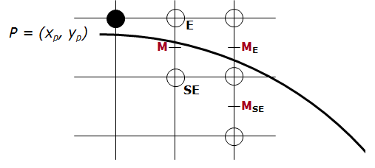
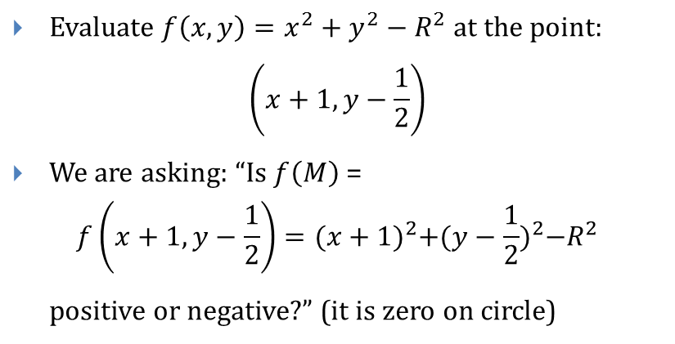
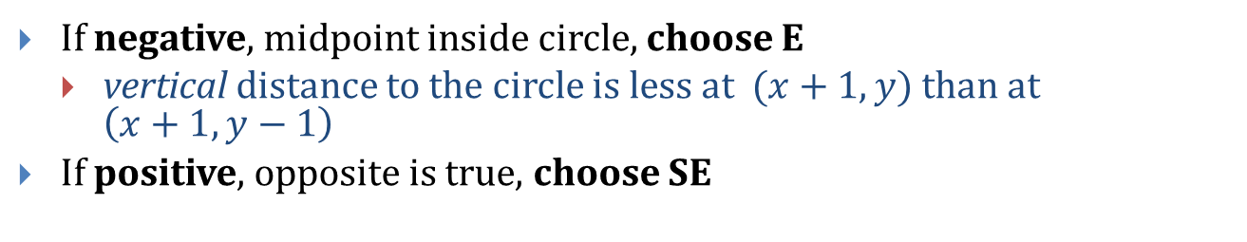
The Decision Variable
Evaluate $f\left(x,y\right)=x^{2}+y^{2}−R^{2}$ at the point:
$$\left(x+1,y−\frac{1}{2}\right)$$
We are asking: “Is $f\left(M\right)$ =
$$f\left(x+1,y−\frac{1}{2}\right)={(x+1)}^{2}+{(y−\frac{1}{2})}^{2}−R^{2}$$
positive or negative?” (it is zero on circle)
If negative, midpoint inside circle, choose E
vertical distance to the circle is less at $(x+1,y)$ than at $\left(x+1,y−1\right)$
If positive, opposite is true, choose SE

Slide 25
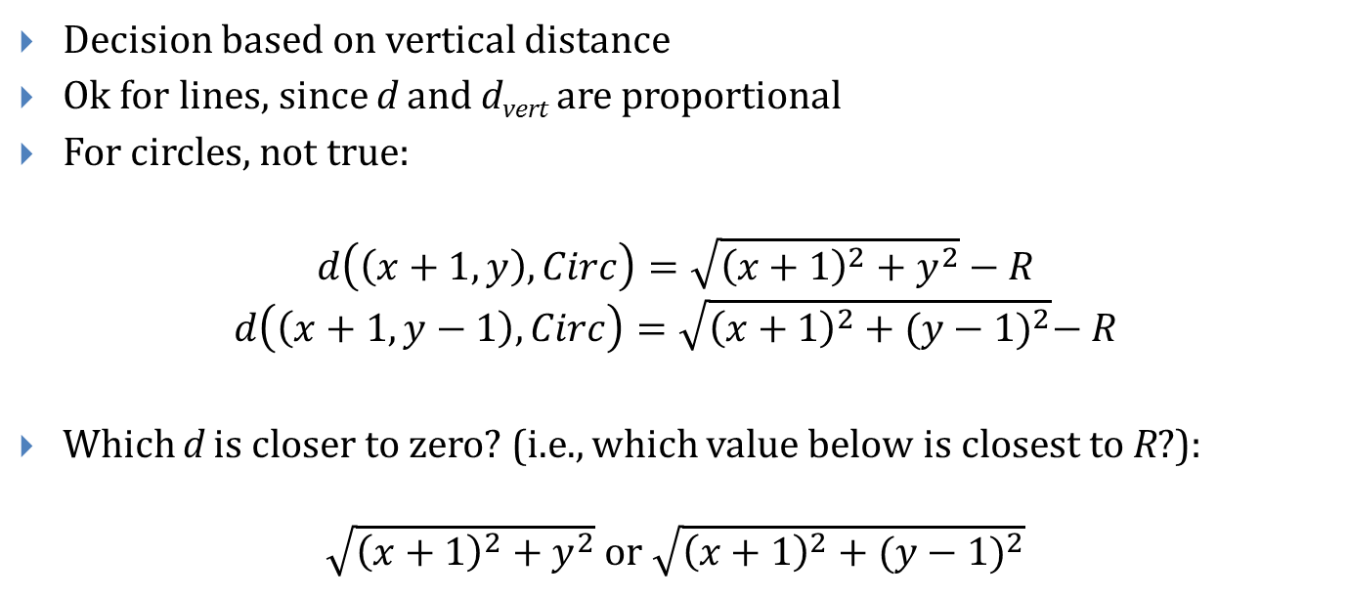
The right decision variable?
Decision based on vertical distance
Ok for lines, since d and d_{vert} are proportional
For circles, not true:
$$d\left(\left(x+1, y\right),Circ\right)=\sqrt{{\left(x+1\right)}^{2}+y^{2}}−R$$
$$d\left(\left(x+1,y−1\right),Circ\right)=\sqrt{{\left(x+1\right)}^{2}+{(y−1)}^{2}}−R$$
Which d is closer to zero? (i.e., which value below is closest to R?):
$\sqrt{{\left(x+1\right)}^{2}+y^{2}}$ or $\sqrt{{\left(x+1\right)}^{2}+{(y−1)}^{2}}$

Slide 26
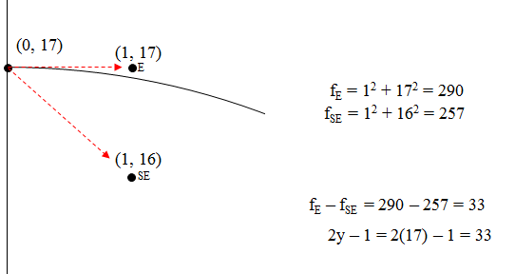
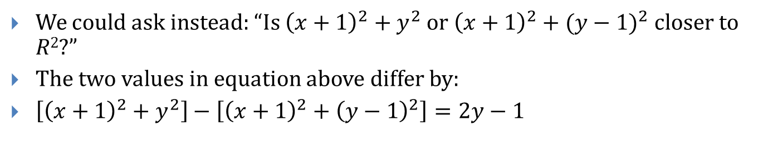
Alternate Phrasing (1/3)
We could ask instead: “Is ${\left(x+1\right)}^{2}+y^{2}$ or ${\left(x+1\right)}^{2}+{(y−1)}^{2}$closer to $R2$?”
The two values in equation above differ by:
$\left[{\left(x+1\right)}^{2}+y^{2}\right]−\left[{\left(x+1\right)}^{2}+{\left(y−1\right)}^{2}\right]=2y−1$

Slide 27
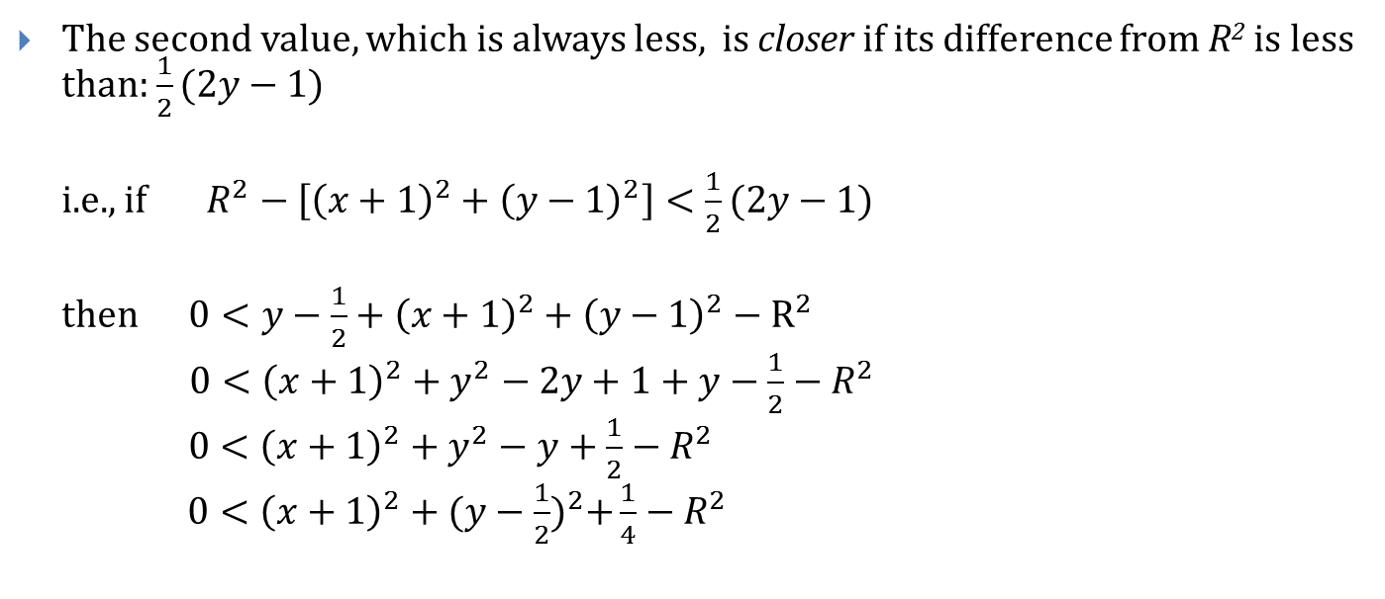
Alternate Phrasing (2/3)
The second value, which is always less, is closer if its difference from R² is less than: $\frac{1}{2}(2y−1)$
i.e., if $R^{2}−\left[{\left(x+1\right)}^{2}+{\left(y−1\right)}^{2}\right]<\frac{1}{2}(2y−1)$
then $0<y−\frac{1}{2}+{\left(x+1\right)}^{2}+{\left(y−1\right)}^{2}−R^{2}$
$0<{\left(x+1\right)}^{2}+y^{2}−2y+1+y−\frac{1}{2}−R^{2}$
$0<{\left(x+1\right)}^{2}+y^{2}−y+\frac{1}{2}−R^{2}$
$0<{\left(x+1\right)}^{2}+{(y−\frac{1}{2})}^{2}+\frac{1}{4}−R^{2}$

Slide 28
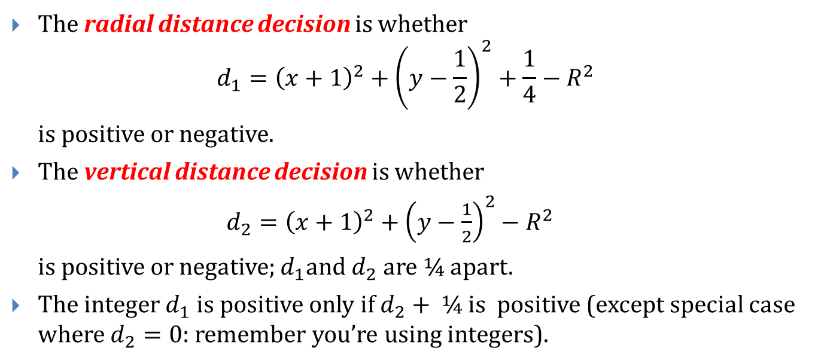
Alternate Phrasing (3/3)
The radial distance decision is whether ${d_{1}=\left(x+1\right)}^{2}+{\left(y−\frac{1}{2}\right)}^{2}+\frac{1}{4}−R^{2}$
is positive or negative.
The vertical distance decision is whether
${d_{2}=\left(x+1\right)}^{2}+{\left(y−\frac{1}{2}\right)}^{2}−R^{2}$
is positive or negative; $d_{1}$and $d_{2}$ are ¼ apart.
The integer $d_{1}$ is positive only if $d_{2}+$ ¼ is positive (except special case where $d_{2}=0$: remember you’re using integers).

Slide 29
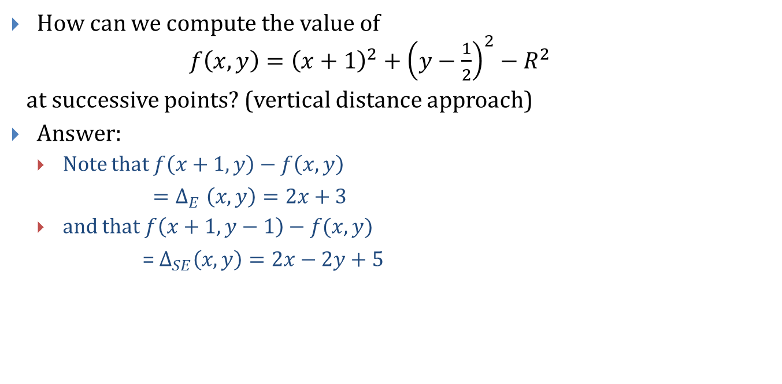
Incremental Computation Revisited (1/2)
How can we compute the value of $f\left(x,y\right)={\left(x+1\right)}^{2}+{\left(y−\frac{1}{2}\right)}^{2}−R^{2}$
at successive points? (vertical distance approach)
Answer:
Note that $f\left(x+1,y\right)−f\left(x,y\right)$
${=Δ}_{E}\left(x,y\right)=2x+3$
and that$f\left(x+1,y−1\right)−f(x,y)$
= $Δ_{SE}\left(x,y\right)=2x−2y+5$

Slide 30
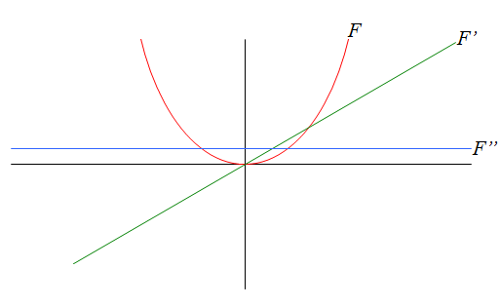
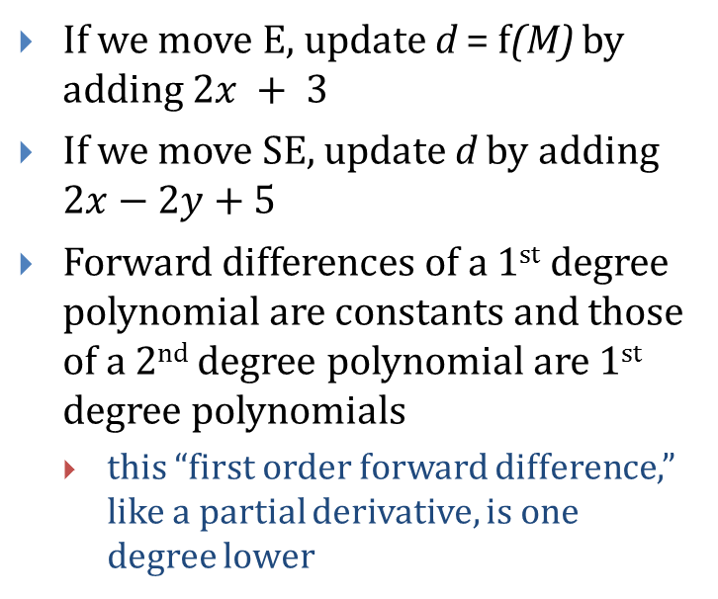
Incremental Computation (2/2)
If we move E, update d = f(M) by adding $2x + 3$
If we move SE, update d by adding $2x−2y+5$
Forward differences of a 1st degree polynomial are constants and those of a 2nd degree polynomial are 1st degree polynomials
this “first order forward difference,” like a partial derivative, is one degree lower

Slide 31
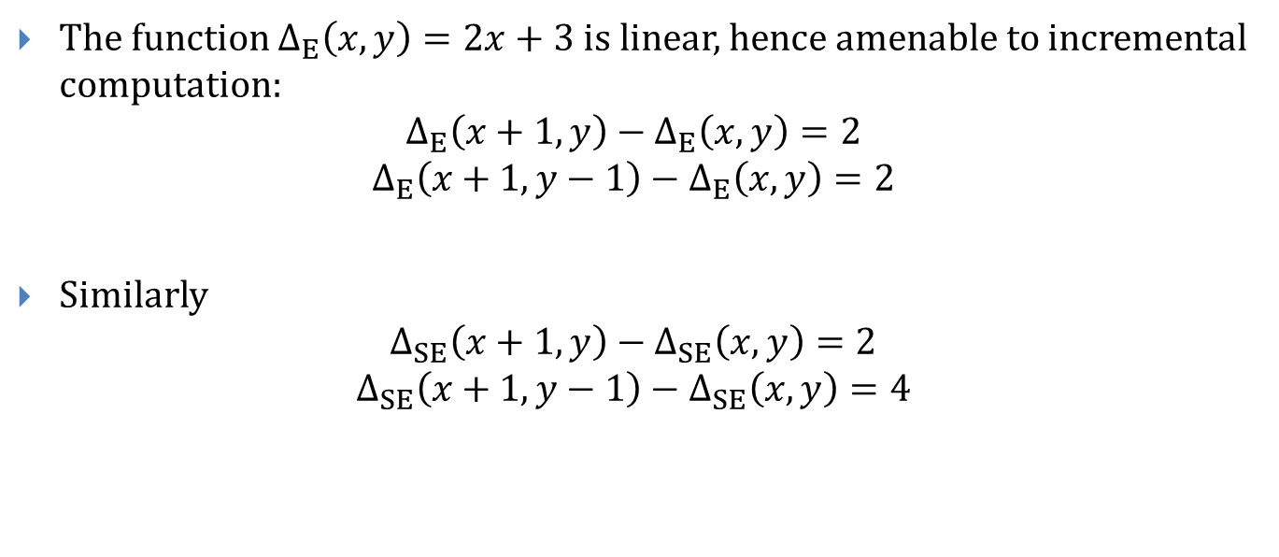
Second Differences (1/2)
The function $Δ_{E}\left(x,y\right)=2x+3$is linear, hence amenable to incremental computation:
$$Δ_{E}\left(x+1,y\right)−Δ_{E}\left(x,y\right)=2$$
$$Δ_{E}\left(x+1,y−1\right)−Δ_{E}\left(x,y\right)=2$$
Similarly
$$Δ_{SE}\left(x+1,y\right)−Δ_{SE}\left(x,y\right)=2$$
$$Δ_{SE}\left(x+1,y−1\right)−Δ_{SE}\left(x,y\right)=4$$

Slide 32
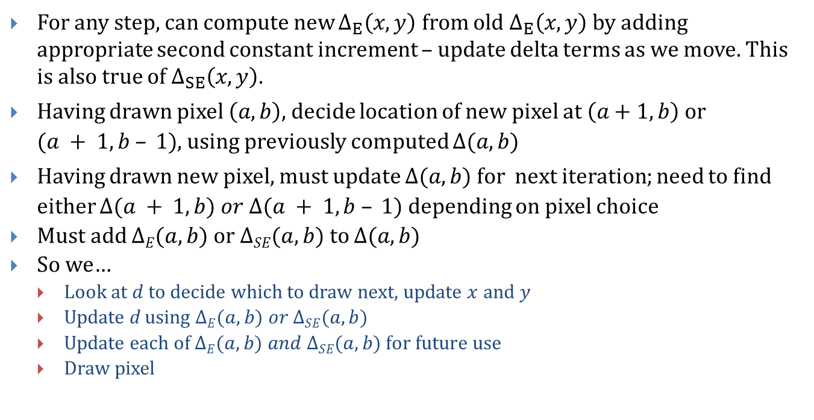
Second Differences (2/2)
For any step, can compute new $Δ_{E}\left(x,y\right)$ from old $Δ_{E}\left(x,y\right)$ by adding appropriate second constant increment – update delta terms as we move. This is also true of $Δ_{SE}\left(x,y\right).$
Having drawn pixel $\left(a,b\right)$, decide location of new pixel at $\left(a+1,b\right)$ or $(a + 1, b – 1)$, using previously computed $Δ(a, b)$
Having drawn new pixel, must update $Δ(a, b)$ for next iteration; need to find either $Δ(a + 1, b) or Δ(a + 1, b – 1)$depending on pixel choice
Must add $ΔE(a, b)$or $ΔSE(a, b)$to $Δ(a, b)$
So we…
Look at $d$ to decide which to draw next, update $x$ and $y$
Update d using $ΔE(a,b) or ΔSE(a,b)$
Update each of $ΔE(a,b) and ΔSE(a,b)$for future use
Draw pixel

Slide 33
Midpoint Eighth Circle Algorithm
MidpointEighthCircle(R) { /* 1/8th of a circle w/ radius R */
int x = 0, y = R;
int deltaE = 2 * x + 3;
int deltaSE = 2 * (x - y) + 5;
float decision = (x + 1) * (x + 1) + (y - 0.5) * (y - 0.5) – R*R;
WritePixel(x, y);
while ( y > x ) {
if (decision > 0) { // Move East
x++; WritePixel(x, y);
decision += deltaE;
deltaE += 2; deltaSE += 2; // Update delta
} else { // Move SouthEast
y--; x++; WritePixel(x, y);
decision += deltaSE;
deltaE += 2; deltaSE += 4; // Update delta
}
}
}

Slide 34
Analysis
Uses floats!
1 test, 3 or 4 additions per pixel
Initialization can be improved
Multiply everything by 4: No Floats!
Makes the components even, but sign of decision variable remains same
Questions
Are we getting all pixels whose distance from the circle is less than ½?
Why is y > x the right criterion?
What if it were an ellipse?

Slide 35
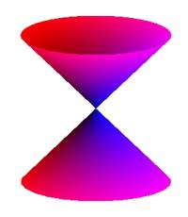
Other Scan Conversion Problems
Aligned Ellipses
Non-integer primitives
General conics
Patterned primitives

Slide 36

Aligned Ellipses
Equation is $\frac{x^{2}}{a^{2}}+\frac{y^{2}}{b^{2}}=1$ i.e., $b^{2}x^{2}+a^{2}y^{2}=a^{2}b^{2}$
Computation of $Δ_{E}$ and $Δ_{SE}$ is similar
Only 4-fold symmetry
When do we stop stepping horizontally and switch to vertical?

Slide 37
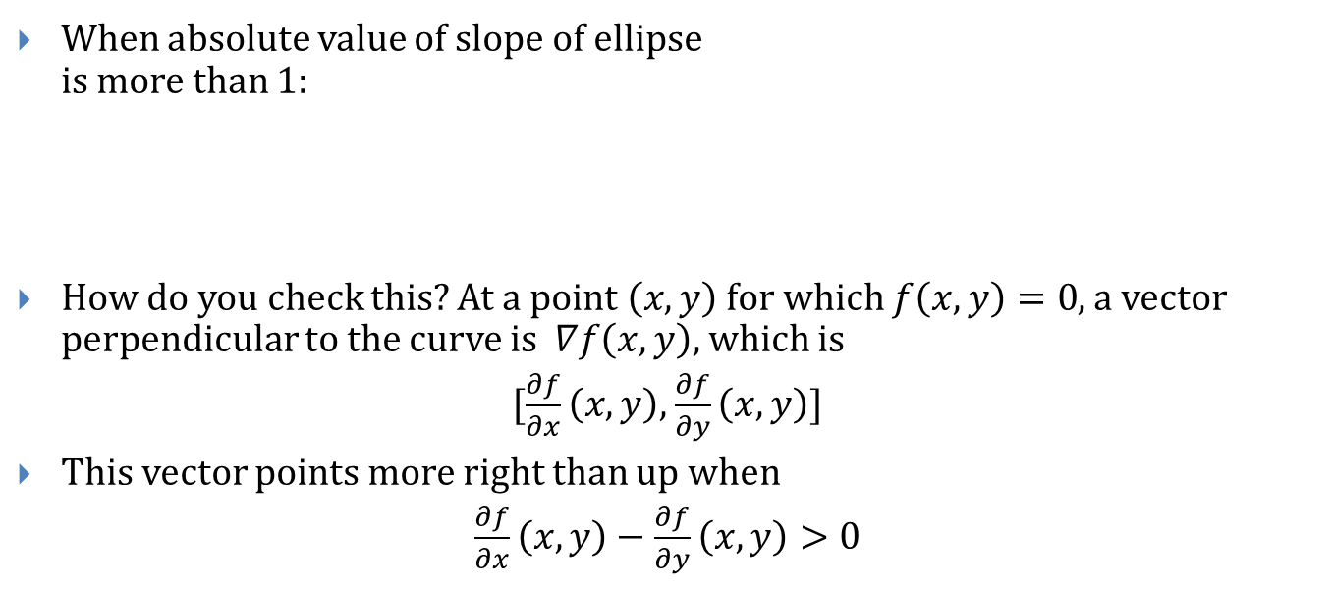
Direction Changing Criterion (1/2)
When absolute value of slope of ellipse is more than 1:
How do you check this? At a point $\left(x,y\right)$ for which $f\left(x,y\right)=0$, a vector perpendicular to the curve is $∇f\left(x,y\right),$ which is
$[\frac{∂f}{∂x}\left(x,y\right),$ $\frac{∂f}{∂y}\left(x,y\right)]$
This vector points more right than up when
$\frac{∂f}{∂x}\left(x,y\right)−$ $\frac{∂f}{∂y}\left(x,y\right)>0$

Slide 38

Direction Changing Criterion (2/2)
In our case, $\frac{∂f}{∂x}\left(x,y\right)=2b^{2}x$ and $\frac{∂f}{∂y}\left(x,y\right)=2a^{2}y$
so we check for
$$2b^{2}x−2a^{2}y>0$$
$b^{2}x−a^{2}y>0$
This, too, can be computed incrementally

Slide 39



Problems with aligned ellipses
Now in ENE octant, not ESE octant
This problem is an artifact of aliasing, remember filter?

Slide 40
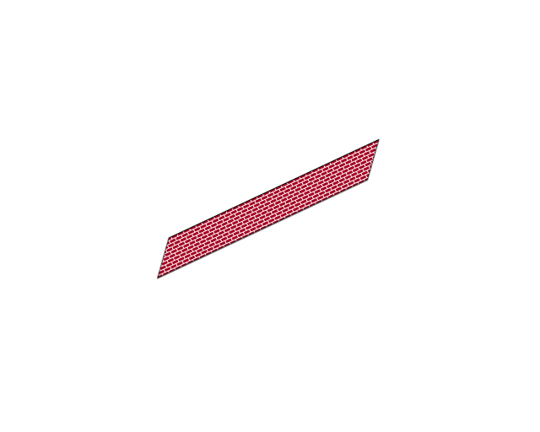
Patterned Lines
Patterned line from P to Q is not same as patterned line from Q to P.
Patterns can be cosmetic or geometric
Cosmetic: Texture applied after transformations
Geometric: Pattern subject to transformations
Cosmetic patterned line
Geometric patterned line
P
Q
P
Q

Slide 41
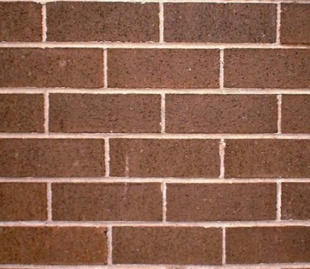
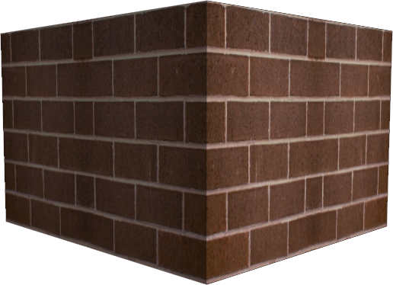
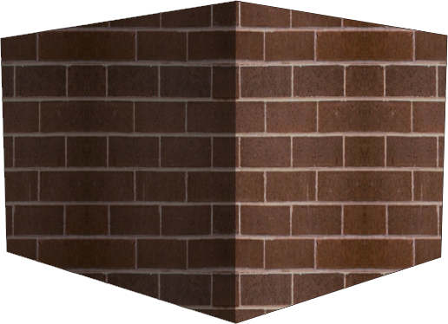
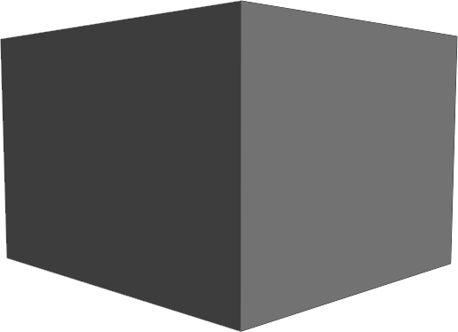
Geometric vs. Cosmetic
+
Cosmetic (Real-World Contact Paper)
Geometric (Perspectivized/Filtered)

Slide 42

Non-Integer Primitives and General Conics
Non-Integer Primitives
Initialization is harder
Endpoints are hard, too
making Line $(P,Q)$and Line $(Q,R)$join properly is a good test
Symmetry is lost
General Conics
Very hard – the octant-changing test is tougher, the difference computations are tougher, etc.
Do it only if you have to

Slide 43
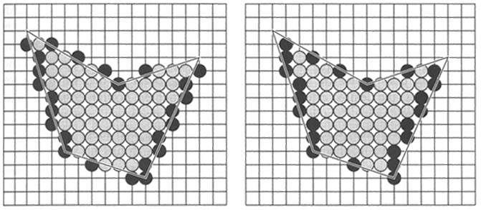
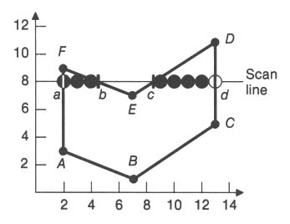
Generic Polygons
What's the difference between these two solutions? Under which circumstances is the right one "better"?
Balsa Demo

Slide 44
Scan Converting Arbitrary Solids
Rapid Prototyping is becoming cheaper and more prevalent
3D printers lay down layer after layer to produce solid objects
We have an RP lab across the street in Barus and Holley
http://www.youtube.com/watch?v=ZboxMsSz5Aw
http://www.youtube.com/watch?v=Ah1067HXNdM&NR=1

