Slide 1
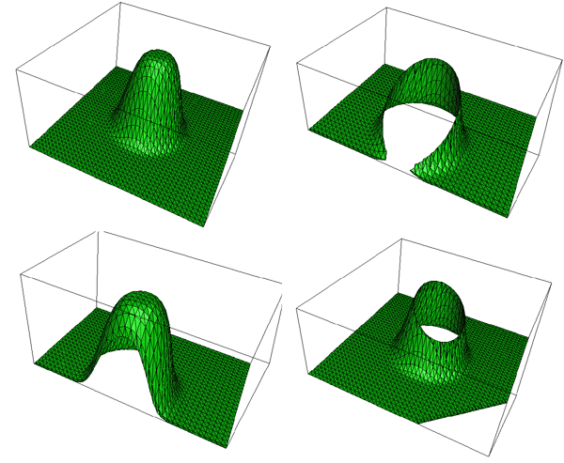
Clipping
Concepts, Algorithms for line clipping
Clipping - 10/16/12

Slide 2
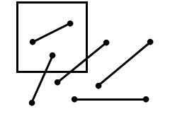
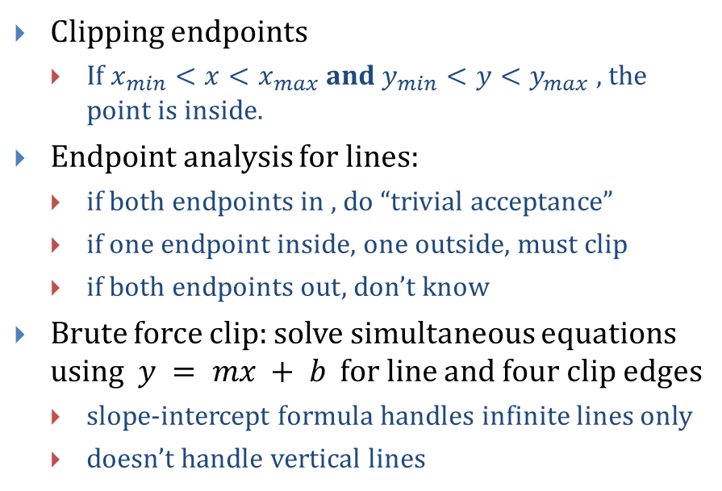



Line Clipping
$$(x_{max},y_{max})$$
Clipping endpoints
If $x_{min}<x<x_{max}$ and $y_{min}<y<y_{max}$, the point is inside.
Endpoint analysis for lines:
if both endpoints in , do “trivial acceptance”
if one endpoint inside, one outside, must clip
if both endpoints out, don’t know
Brute force clip: solve simultaneous equations using $y = mx + b$ for line and four clip edges
slope-intercept formula handles infinite lines only
doesn’t handle vertical lines
$$(x,y)$$
$$(x_{min},y_{min})$$

Slide 3
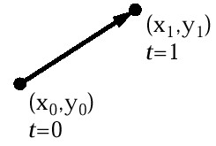
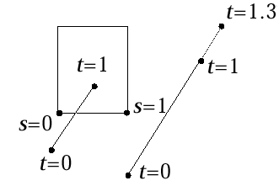




Parametric Line Formulation For Clipping
Parametric form for line segment
Line in clip rectangle if parametric variables s_{edge} and t_{line} both in [0,1] for intersection point between an edge and a line
Slow, must intersect lines with all edges
$$X=x_{0}+t(x_{1}−x_{0})$$
$$Y=y_{0}+t(y_{1}−y_{0})$$
$$0≤t≤1$$
$P\left(t\right)=P_{0}+t\left(P_{1}−P_{0}\right)=\left(1−t\right)P_{0}$ + $t\left(P_{1}\right)$

Slide 4
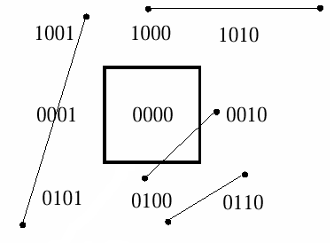
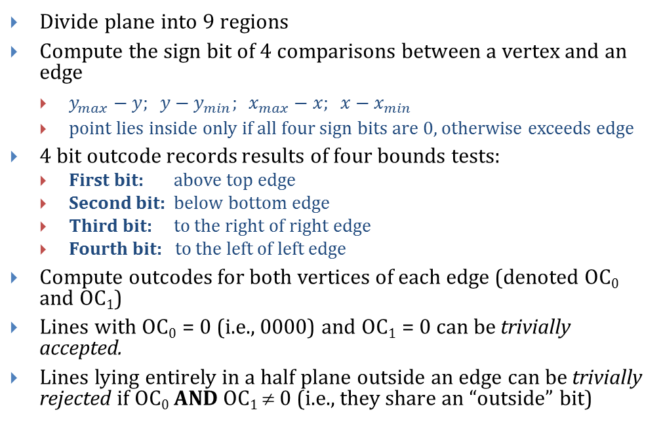
Cohen-Sutherland Line Clipping in 2D
Divide plane into 9 regions
Compute the sign bit of 4 comparisons between a vertex and an edge
$y_{max}−y; y−y_{min}; x_{max}−x; x−x_{min}$
point lies inside only if all four sign bits are 0, otherwise exceeds edge
4 bit outcode records results of four bounds tests:
First bit: above top edge
Second bit: below bottom edge
Third bit: to the right of right edge
Fourth bit: to the left of left edge
Compute outcodes for both vertices of each edge (denoted OC₀ and OC₁)
Lines with OC₀ = 0 (i.e., 0000) and OC₁ = 0 can be trivially accepted.
Lines lying entirely in a half plane outside an edge can be trivially rejected if OC₀ AND OC₁ ≠ 0 (i.e., they share an “outside” bit)
Clip Rectangle

Slide 5
Cohen-Sutherland Line Clipping in 3D
Very similar to 2D
Divide volume into 27 regions (Picture a Rubik’s cube)
6-bit outcode records results of 6 bounds tests
First bit: behind back plane
Second bit: in front of front plane
Third bit: above top plane
Fourth bit: below bottom plane
Fifth bit: to the right of right plane
Sixth bit: to the left of left plane
Again, Lines with OC₀ = 0 and OC₁ = 0 can be trivially accepted
Lines lying entirely in a volume outside of a plane can be trivially rejected: OC₀ AND OC₁ ≠ 0 (i.e., they share an “outside” bit)
Bottom plane
000000 (above)
000100 (below)
Back plane
000000 (in front)
100000 (behind)
Right plane
000000 (to left of)
000010 (to right of)
Front plane
010000 (in front)
000000 (behind)
Left plane
000001 (to left of)
000000 (to right of)
Top plane
001000 (above)
000000 (below)

Slide 6
Cohen-Sutherland Algorithm (1/2)
If we can neither trivially accept/reject (T/A, T/R), divide and conquer
Subdivide line into two segments; then T/A or T/R one or both segments:
use a clip edge to cut line
use outcodes to choose edge that is crossed
for a given edge, if a line’s two outcodes differ for the corresponding bit, it has one vertex in, one out, thus crosses
pick an order for checking edges: top – bottom – right – left
compute the intersection point
the clip edge fixes either x or y
can substitute into the line equation
iterate for the newly shortened line, “extra” clips may happen (e.g., E-I at H)
D
Clip rectangle
C
B
I
A
H
G
F
E

Slide 7

Cohen-Sutherland Algorithm (2/2)
$y=y_{0}+slope×(x −x_{0})$ and $x=x_{0}+\left(\frac{1}{slope}\right)×(y −y_{0})$
Algorithm:
ComputeOutCode(x0, y0, outcode0);
ComputeOutCode(x1, y1, outcode1);
repeat
check for trivial reject or trivial accept
pick the point that is outside the clip rectangle
if TOP then
x = x0 + (x1 – x0) * (ymax – y0) / (y1 – y0);
y = ymax;
else if BOTTOM then
x = x0 + (x1 – x0) * (ymin – y0) / (y1 – y0);
y = ymin;
else if RIGHT then
y = y0 + (y1 – y0) * (xmax – x0) / (x1 – x0);
x = xmax;
else if LEFT then
y = y0 + (y1 – y0) * (xmin – x0) / (x1 – x0);
x = xmin;
if (x0, y0 is the outer point) then
x0 = x; y0 = y; ComputeOutCode(x0, y0, outcode0)
else
x1 = x; y1 = y; ComputeOutCode(x1, y1, outcode1)
until done

Slide 8



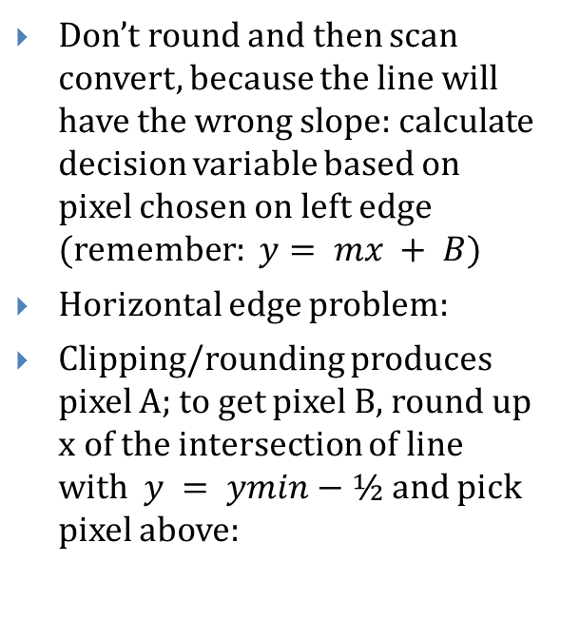




Scan Conversion after Clipping
Clip rectangle
$$x=x_{ min}$$
Don’t round and then scan convert, because the line will have the wrong slope: calculate decision variable based on pixel chosen on left edge $($remember: $y= mx + B)$
Horizontal edge problem:
Clipping/rounding produces pixel A; to get pixel B, round up x of the intersection of line with $y = ymin−½$and pick pixel above:
$(x_{min}$, $Round(mx_{min}+B))$
$$NE$$
$$M$$
$(x_{min}$, $mx_{min}+B)$
$$E$$
$$y=y_{ min}$$
x = x_{min}
B
A
y = y_{min}
y = y_{min} – 1/2
y = y_{min} – 1

Slide 9
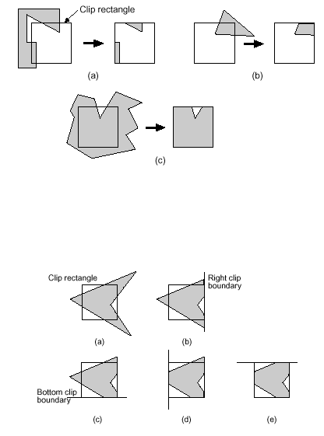
Sutherland-Hodgman Polygon Clipping

Slide 10
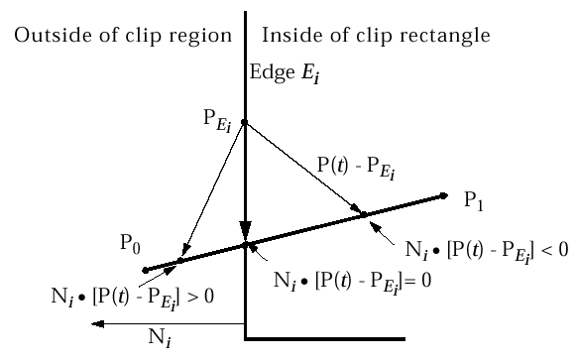

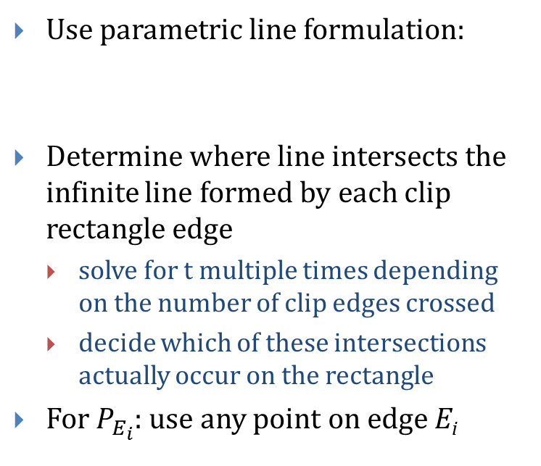
Cyrus-Beck/Liang-Barsky Parametric Line Clipping (1/3)
Use parametric line formulation:
Determine where line intersects the infinite line formed by each clip rectangle edge
solve for t multiple times depending on the number of clip edges crossed
decide which of these intersections actually occur on the rectangle
For $P_{E_{i}}$: use any point on edge E_{i}
$$P\left(t\right)=P_{0}+\left(P_{1}−P_{0}\right)t$$

Slide 11


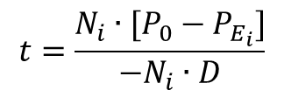

Cyrus-Beck/Liang-Barsky Parametric Line Clipping (2/3)
Now solve for the value of t at the intersection of P₀ P₁ with the edge E_{i}:
First, substitute for P(t):
Next, group terms and distribute dot product:
Let D be the vector from P₀ to P₁ = (P₁ – P₀), and solve for t:
note that this gives a valid value of t only if the denominator of the expression is nonzero.
For this to be true, it must be the case that:
N_{i} ≠ 0 (that is, the normal should not be 0; this could occur only as a mistake)
D ≠ 0 (that is, P₁ ≠ P₀)
N_{i} • D ≠ 0 (edge E_{i} and line D are not parallel; if they are, no intersection).
The algorithm checks these conditions.
$$N_{i}∙\left[P\left(t\right)−P_{E_{i}}\right]=0$$
$$N_{i}∙[P_{0}+\left(P_{1}−P_{0}\right)t−P_{E_{i}}]=0$$
$$N_{i}∙\left[P_{0}−P_{E_{i}}\right]+N_{i}∙\left[P_{1}−P_{0}\right]t=0$$
$$t=\frac{N_{i}∙[P_{0}−P_{E_{i}}]}{−N_{i}∙D}$$

Slide 12
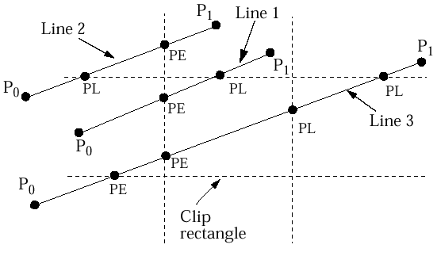
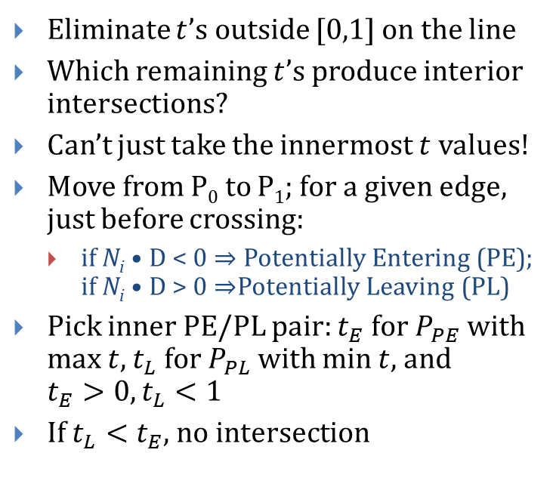
Cyrus-Beck/Liang-Barsky Parametric Line Clipping (3/3)
Eliminate $t$’s outside [0,1] on the line
Which remaining $t$’s produce interior intersections?
Can’t just take the innermost $t$ values!
Move from P₀ to P₁; for a given edge, just before crossing:
if N_{i} • D < 0 $⇒$ Potentially Entering (PE); if N_{i} • D > 0 $⇒$Potentially Leaving (PL)
Pick inner PE/PL pair: $t_{E}$ for $P_{PE}$ with max $t$, $t_{L}$ for $P_{PL}$ with min $t$, and $t_{E}>0, t_{L}<1$
If $t_{L}<t_{E}$, no intersection

Slide 13
Cyrus-Beck/Liang-Barsky Line Clipping Algorithm
Pre-calculate N_{i} and select P_{Ei} for each edge;
for each line segment to be clipped
if P₁ = P₀ then line is degenerate so clip as a point;
else
begin
t_{E} = 0; t_{L} = 1;
for each candidate intersection with a clip edge
if Ni • D ≠ 0 then {Ignore edges parallel to line}
begin
calculate t; {of line and clip edge intersection}
use sign of N_{i} • D to categorize as PE or PL;
if PE then t_{E} = max(t_{E},t);
if PL then t_{L} = min(t_{L},t);
end
if t_{E} > t_{L} then return nil
else return P(t_{E}) and P(t_{L}) as true clip intersections
end

Slide 14
Parametric Line Clipping for Upright Clip Rectangle (1/2)
D = P₁ – P₀ = (x₁ – x₀, y₁ – y₀)
Leave P_{Ei} as an arbitrary point on clip edge: it’s a free variable and drops out
Calculations for Parametric Line Clipping Algorithm
Clip Edge_{i}
Normal N_{i}
P_{Ei}
P₀-P_{Ei}
left: x = x_{min}
(-1,0)
(x_{min}, y)
(x₀- x_{min},y₀-y)
right: x = x_{max}
(1,0)
(x_{max},y)
(x₀- x_{max},y₀-y)
bottom: y = y_{min}
(0,-1)
(x, y_{min})
(x₀-x,y₀- y_{min})
top: y = y_{max}
(0,1)
(x, y_{max})
(x₀-x,y₀- y_{max})

Slide 15
Parametric Line Clipping for Upright Clip Rectangle (2/2)
Examine t:
Numerator is just the directed distance to an edge; sign corresponds to OC
Denominator is just the horizontal or vertical projection of the line, dx or dy; sign determines PE or PL for a given edge
Ratio is constant of proportionality: “how far over” from P₀ to P₁ intersection is relative to dx or dy

Slide 16
Embedded Font
ABCDEFGHIJKLMNOPQRSTUVWXYZ
a b c d e f g h i j k l m n o p q r s t u v w x y z
1234567890
ABCDEFGHIJKLMNOPQRSTUVWXYZ
a b c d e f g h i j k l m n o p q r s t u v w x y z
1234567890
ABCDEFGHIJKLMNOPQRSTUVWXYZ
a b c d e f g h i j k l m n o p q r s t u v w x y z
1234567890
(Hidden slide, to ensure that all characters are embedded for future editing)
!@#$%^&*()_+-=~`,./;’[]{}:”>?<

