Slide 1
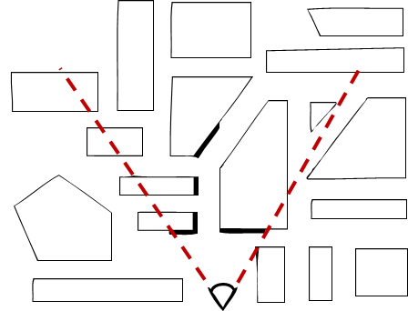
Visible Surface Determination (VSD)
To render or not to render, that is the question…

Slide 2
What is it?
Given a set of 3-D objects and a view specification (camera), determine which lines or surfaces of the object are visible
why might objects not be visible? occlusion vs. clipping
clipping works on the object level (clip against view volume)
occlusion works on the scene level (compare depth against other objects)
Also called Hidden Surface Removal (HSR)
We begin with some history of previously used VSD algorithms

Slide 3
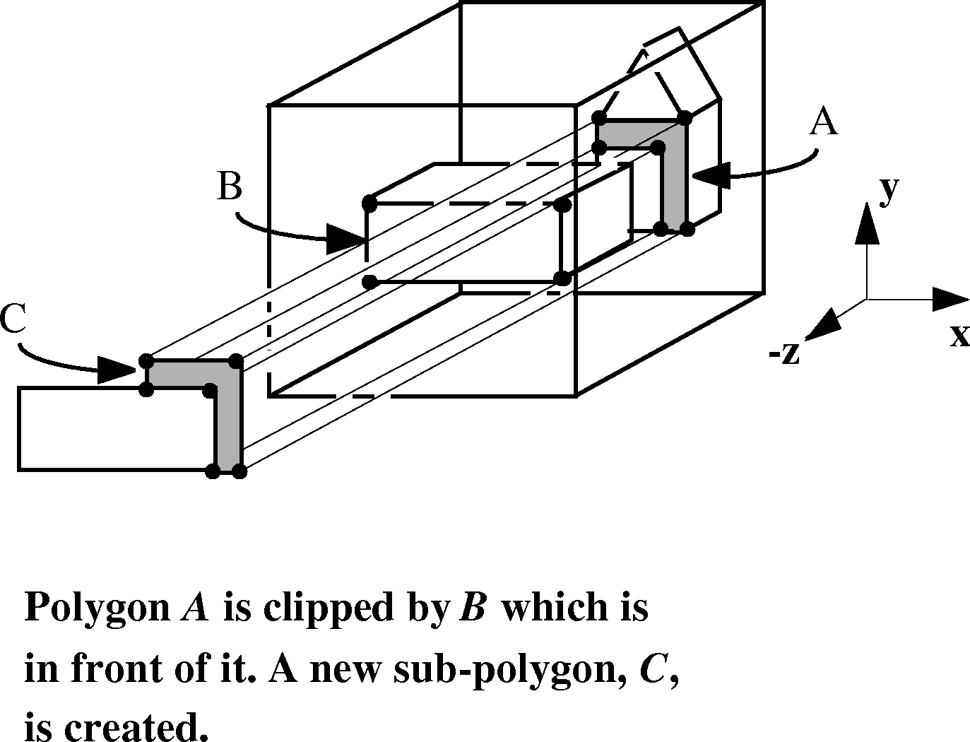
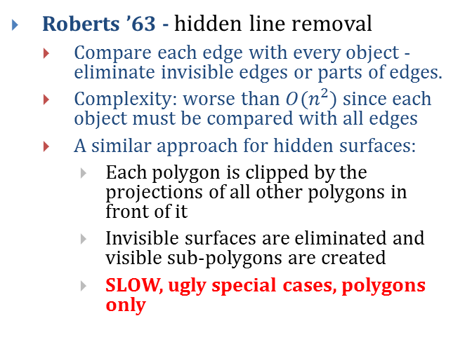
Object-Precision Algorithms
Sutherland categorized algorithms as to whether they work on objects in the world (object precision) or with projections of objects in screen coordinates (image precision) and refer back to the world when z is needed
Roberts ’63 - hidden line removal
Compare each edge with every object - eliminate invisible edges or parts of edges.
Complexity: worse than $O(n^{2})$ since each object must be compared with all edges
A similar approach for hidden surfaces:
Each polygon is clipped by the projections of all other polygons in front of it
Invisible surfaces are eliminated and visible sub-polygons are created
SLOW, ugly special cases, polygons only

Slide 4
Painter’s Algorithm – Image Precision
Back-to-front algorithm was used in the first hardware-rendered scene, the 1967 GE Flight Simulator by Schumacher et al using a video drum to hold the scene
Create drawing order so each polygon overwrites the previous one. This guarantees correct visibility at any pixel resolution
Strategy is to work back to front; find a way to sort polygons by depth (z), then draw them in that order
do a rough sort of polygons by smallest (farthest) z-coordinate in each polygon
scan-convert most distant polygon first, then work forward towards viewpoint (“painters’ algorithm”)
We can either do a complete sort and then scan-convert, or we can paint as we go – see 3D depth-sort algorithm by Newell, Newell, and Sancha
Can this back-to-front strategy always be done?
problem: two polygons partially occluding each other – need to split polygons

Slide 5
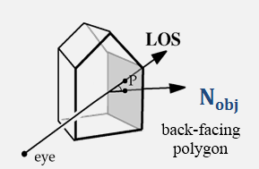
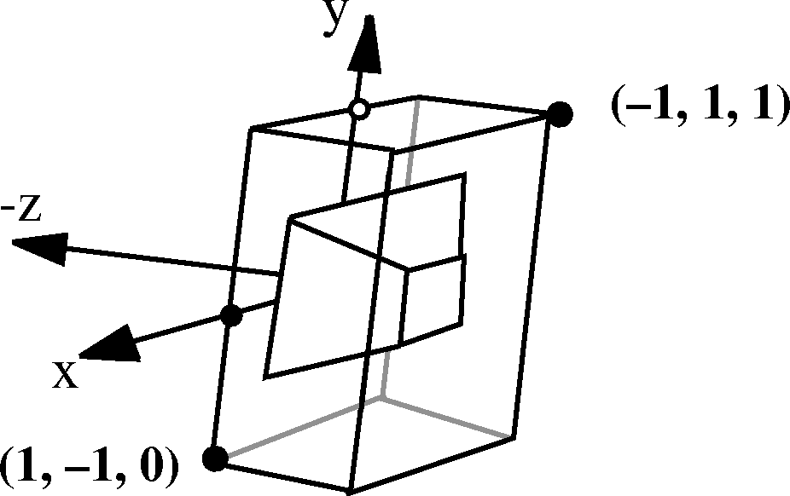
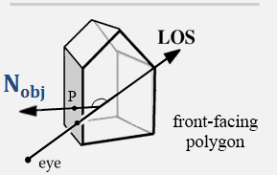
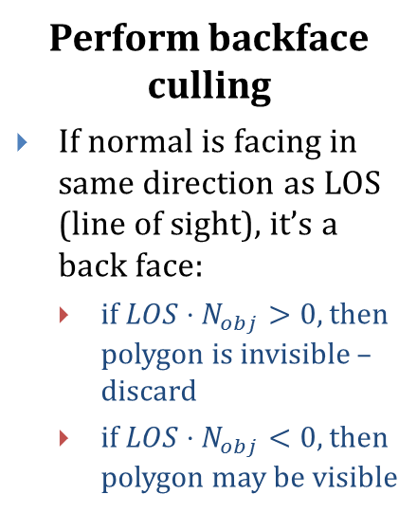
Hardware Scan Conversion: VSD (1/4)
Perform backface culling
If normal is facing in same direction as LOS (line of sight), it’s a back face:
if $LOS⋅N_{obj}>0$, then polygon is invisible – discard
if $LOS⋅N_{obj}<0$, then polygon may be visible
2
1
Canonical perspective-transformed
view volume with cube
Finally, clip against normalized view volume
(-1 < x < 1), (-1 < y < 1), (0 < z < 1)
3

Slide 6
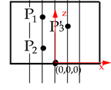
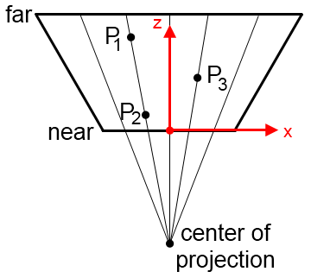
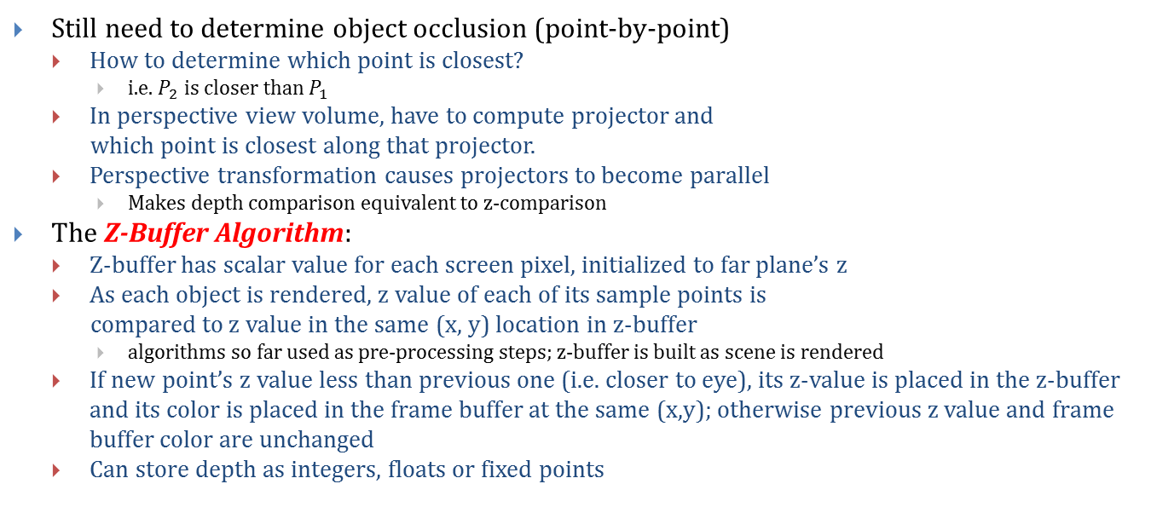
Hardware Scan Conversion: VSD (2/4)
Still need to determine object occlusion (point-by-point)
How to determine which point is closest?
i.e. $P_{2}$ is closer than $P_{1}$
In perspective view volume, have to compute projector and
which point is closest along that projector.
Perspective transformation causes projectors to become parallel
Makes depth comparison equivalent to z-comparison
The Z-Buffer Algorithm:
Z-buffer has scalar value for each screen pixel, initialized to far plane’s z
As each object is rendered, z value of each of its sample points is
compared to z value in the same (x, y) location in z-buffer
algorithms so far used as pre-processing steps; z-buffer is built as scene is rendered
If new point’s z value less than previous one (i.e. closer to eye), its z-value is placed in the z-buffer and its color is placed in the frame buffer at the same (x,y); otherwise previous z value and frame buffer color are unchanged
Can store depth as integers, floats or fixed points

Slide 7
Z-Buffer Algorithm
void zBuffer() {
int x, y;
for (y = 0; y < YMAX; y++)
for (x = 0; x < XMAX; x++) {
WritePixel (x, y, BACKGROUND_VALUE);
WriteZ (x, y, 1);
}
for each polygon {
for each pixel in polygon’s projection {
double pz = Z-value at pixel (x, y); //plane eqn
if (pz < ReadZ (x, y)) {
// New point is closer to front of view
WritePixel (x, y, color at pixel (x, y))
WriteZ (x, y, pz);
}
}
}
}
Draw every polygon that we can’t reject trivially (totally outside view volume)
If we find a piece (one or more pixels) of a polygon that is closer to the front, we paint over whatever was behind it
Use plane eqn for z = f(x, y)
Applet: http://www.cs.technion.ac.il/~cs234325/Applets/applets/zbuffer/GermanApplet.html

Slide 8
Hardware Scan Conversion: VSD (3/4)
Requires two “buffers”
Intensity Buffer: our familiar RGB pixel buffer, initialized to background color
Depth (“Z”) Buffer: depth of scene at each pixel, initialized to 255
Polygons are scan-converted in arbitrary order. When pixels overlap, use Z-buffer to decide which polygon “gets” that pixel
255 | 255 | 255 | 255 | 255 | 255 | 255 | 255
255 | 255 | 255 | 255 | 255 | 255 | 255 | 255
255 | 255 | 255 | 255 | 255 | 255 | 255 | 255
255 | 255 | 255 | 255 | 255 | 255 | 255 | 255
255 | 255 | 255 | 255 | 255 | 255 | 255 | 255
255 | 255 | 255 | 255 | 255 | 255 | 255 | 255
255 | 255 | 255 | 255 | 255 | 255 | 255 | 255
255 | 255 | 255 | 255 | 255 | 255 | 255 | 255
64 | 64 | 64 | 64 | 64 | 64 | 64
64 | 64 | 64 | 64 | 64 | 64
64 | 64 | 64 | 64 | 64
64 | 64 | 64 | 64
64 | 64 | 64
64 | 64
64
64 | 64 | 64 | 64 | 64 | 64 | 64 | 255
64 | 64 | 64 | 64 | 64 | 64 | 255 | 255
64 | 64 | 64 | 64 | 64 | 255 | 255 | 255
64 | 64 | 64 | 64 | 255 | 255 | 255 | 255
64 | 64 | 64 | 255 | 255 | 255 | 255 | 255
64 | 64 | 255 | 255 | 255 | 255 | 255 | 255
64 | 255 | 255 | 255 | 255 | 255 | 255 | 255
255 | 255 | 255 | 255 | 255 | 255 | 255 | 255
+
=
integer Z-buffer with
near = 0, far = 255
64 | 64 | 64 | 64 | 64 | 64 | 64 | 255
64 | 64 | 64 | 64 | 64 | 64 | 255 | 255
64 | 64 | 64 | 64 | 64 | 255 | 255 | 255
64 | 64 | 64 | 64 | 255 | 255 | 255 | 255
64 | 64 | 64 | 255 | 255 | 255 | 255 | 255
64 | 64 | 255 | 255 | 255 | 255 | 255 | 255
64 | 255 | 255 | 255 | 255 | 255 | 255 | 255
255 | 255 | 255 | 255 | 255 | 255 | 255 | 255
127
127 | 127
127 | 127 | 127
127 | 127 | 127 | 127
127 | 127 | 127 | 127 | 127
64 | 64 | 64 | 64 | 64 | 64 | 64 | 255
64 | 64 | 64 | 64 | 64 | 64 | 255 | 255
64 | 64 | 64 | 64 | 64 | 255 | 255 | 255
64 | 64 | 64 | 64 | 255 | 255 | 255 | 255
64 | 64 | 64 | 255 | 255 | 255 | 255 | 255
64 | 64 | 127 | 255 | 255 | 255 | 255 | 255
64 | 127 | 127 | 127 | 255 | 255 | 255 | 255
127 | 127 | 127 | 127 | 127 | 255 | 255 | 255
+
=

Slide 9
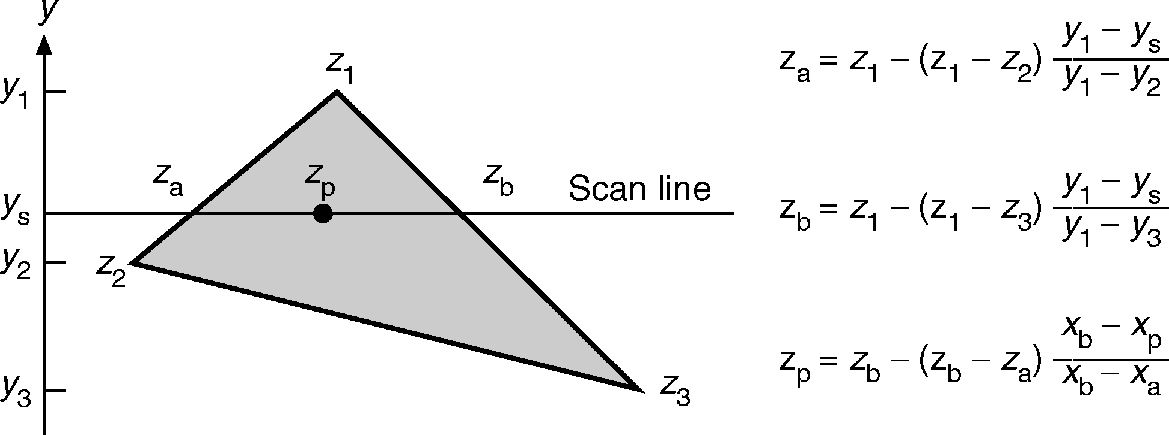
Hardware Scan Conversion: VSD (4/4)
After our scene gets projected onto our film plane we know the depths only at locations in our depth buffer that our vertices got mapped to
So how do we efficiently fill in all the “in between” z-buffer information?
Simple answer: incrementally!
Remember scan conversion/polygon filling? As we move along Y-axis, track x position where each edge intersects scan line
Do the same for z coordinate with y-z slope instead of y-x slope
Knowing z₁, z_{2,} and z₃ we can calculate z_{a} and z_{b} for each edge, and then incrementally calculate z_{p} as we scan.
Similar to interpolation to calculate color per pixel (Gouraud shading)

Slide 10
Advantages of Z-buffer
Dirt-cheap and fast to implement in hardware, despite brute force nature and potentially many passes over each pixel
Requires no pre-processing, polygons can be treated in any order!
Allows incremental additions to image – store both frame buffer and z-buffer and scan-convert the new polygons
Lost coherence/pixel’s polygon id, so can’t do incremental deletes of obsolete information.
Technique extends to other surface descriptions that have (relatively) cheap z= f(x, y) computations (preferably incremental)

Slide 11
Disadvantages of Z-Buffer
near
far
z
Perspective foreshortening (see slides 45-47 in Viewing III)
Compression in z-axis in post-perspective space
Objects far away from camera have z-values very close to each other
Depth information loses precision rapidly
Leads to z-ordering bugs called z-fighting
x
Before
0
1
z
x
After

Slide 12

Z-Fighting (1/3)
Because of limited z-buffer precision (e.g. only 16 bits), z-values must be rounded
Due to floating point rounding errors, world-coordinate z-values end up in different integer “bins” in the z-buffer
Z-fighting occurs when two primitives have similar values in the z-buffer
Coplanar polygons (two polygons occupy the same space)
One is arbitrarily chosen over the other, but z varies across the polygons and binning will cause artifacts, as shown on next slide
Behavior is deterministic: the same camera position gives the same z-fighting pattern
Two intersecting cubes
Notes:
Image from http://en.wikipedia.org/wiki/Z-fighting

Slide 13
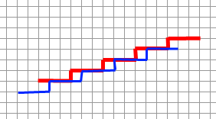
Z-Fighting (2/3)
Eye at origin,
Looking down Z axis
Red in front of blue
Blue, which is drawn after red, ends up in front of red¹
x axis of image (each column is a pixel)
Here the red and blue lines represent cross-sections of the red and blue coplanar polygons from the previous slide
z-value bins
¹ Using the glDepthFunc(GL_LEQUAL) depth mode, which will overwrite
a fragment if the z-value is $≤$ the value in the z-buffer

Slide 14

Z-Fighting (3/3)

