Slide 1
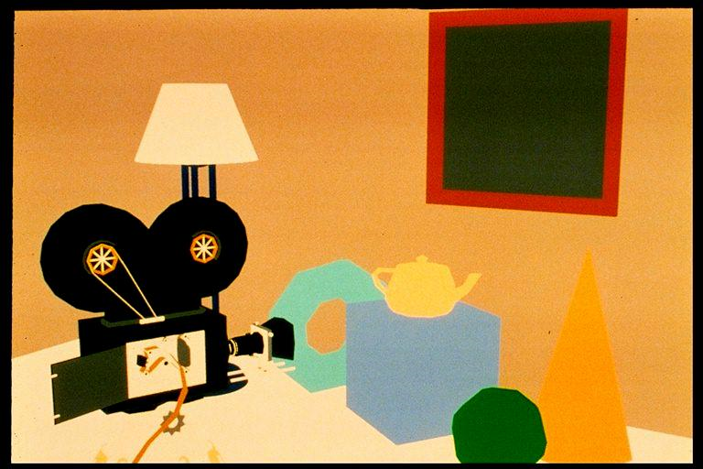
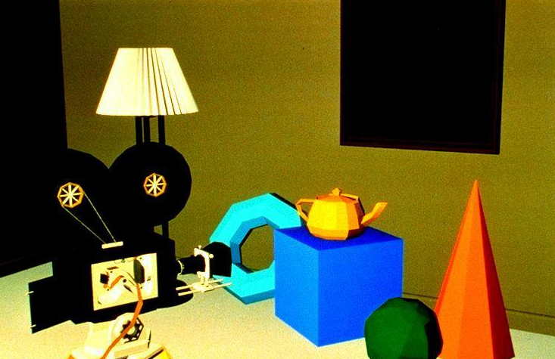
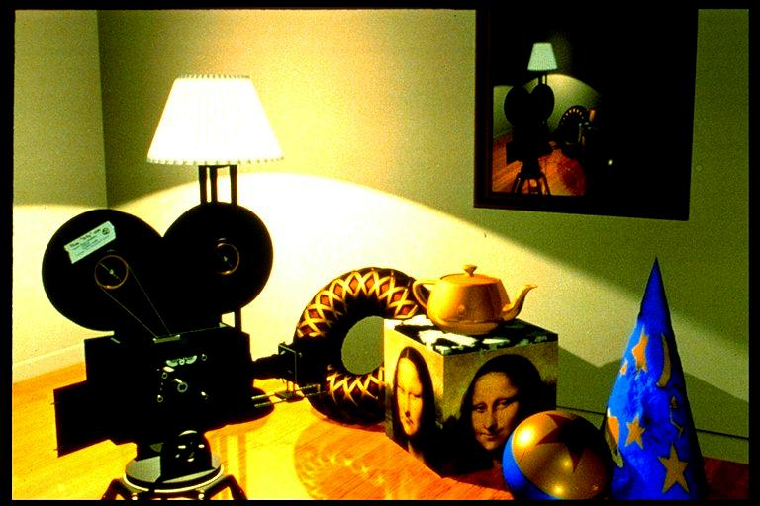
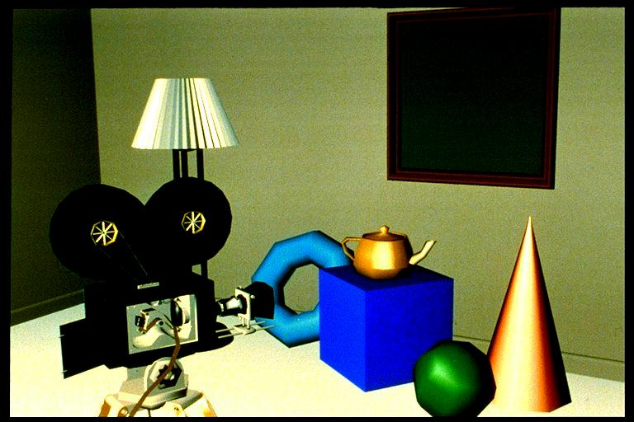
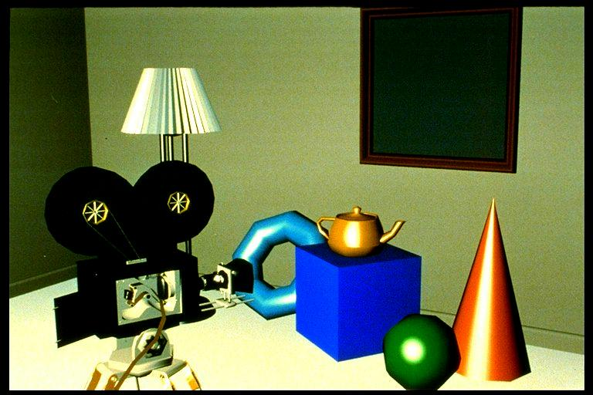
Polygon Rendering
Swapping the Loops

Slide 2
Review: Ray Tracing Pipeline
Ray tracer produces visible samples of scene
Samples are convolved with a filter to form pixel image
Ray tracing pipeline:
-Traverse scene graph
-Accumulate CTM
-Spatially organize objects
Object database
suitable for ray
tracing
Preprocessing
Scene Graph
Evaluate lighting
equation at sample
-for all objects in scene:
-intersect each with ray
-keep track of nearest
-intersection
Ray Tracing
Generate ray
for each sample
Generate reflection rays
Post processing
All samples
Convolve with filter
Final image pixels

Slide 3
Rendering Polygons
Often need to render triangle meshes
Ray tracing works well for implicitly defined surfaces
Many existing models and modeling apps are based on polygon meshes – can we render them by ray tracing the polygons?
Easy to do: ray-polygon intersection is a simple calculation
Very inefficient: It’s common for an object, to have thousands of triangles, for a scene therefore hundreds of thousands or even millions of triangles – each needs to be considered in collision tests
Traditional hardware pipeline is more efficient for many triangles:
Process the scene polygon by polygon, using “z-buffer” to determine visibility
Local illumination model
Use crude shading approximation to compute the color of most pixels

Slide 4
Traditional Fixed Function Pipeline (disappearing)
Polygons (usually triangles) approximate the desired geometry
One polygon at a time:
Each vertex is transformed into screen space, illumination model evaluated at each vertex. NO GLOBAL ILLUMINATION (except through ambient term hack)
One pixel of the polygon at a time:
Depth is compared against z-buffer; if the pixel is visible, color value is computed using either linear interpolation between vertex color values (Gouraud shading) or (better) a crude local lighting model for each pixel (e.g., Phong shading)
Geometry Processing
World Coordinates
Rendering/Pixel Processing
Screen Coordinates
Selective traversal of object database (or traverse scene graph to get CTM)
Transform vertices to canonical view volume
Lighting: calculate light intensity at vertices (lighting model of choice)
Back-face culling (next slide)
View volume clipping
Image-precision VSD: compare pixel depth (z-buffer)
Shading: interpolate vertex color values (Gouraud) or normals (Phong)

Slide 5
Visible Surface Determination
Back face culling:
We often don’t need to render triangles “facing away” from us
We know that the triangle’s vertices are listed in a particular order (usually counter clockwise, by convention)
If screen space vertex positions aren’t in counter clockwise order, the camera is facing the back of the triangle and the triangle can be skipped
View volume clipping:
If a triangle lies entirely outside of the view volume, it does not need to be rendered because it can’t be seen
Some special cases requiring polygon clipping: large triangles, triangles near edges of the view volume (i.e., triangles that intersect or overlap faces of the view volume.) Analogous to 2D case where we cannot trivially accept or reject using simple outcode tests comparing vertex coordinates against clip bounds
Occlusion culling, triangles that are behind other opaque triangles don’t need to be rendered

Slide 6
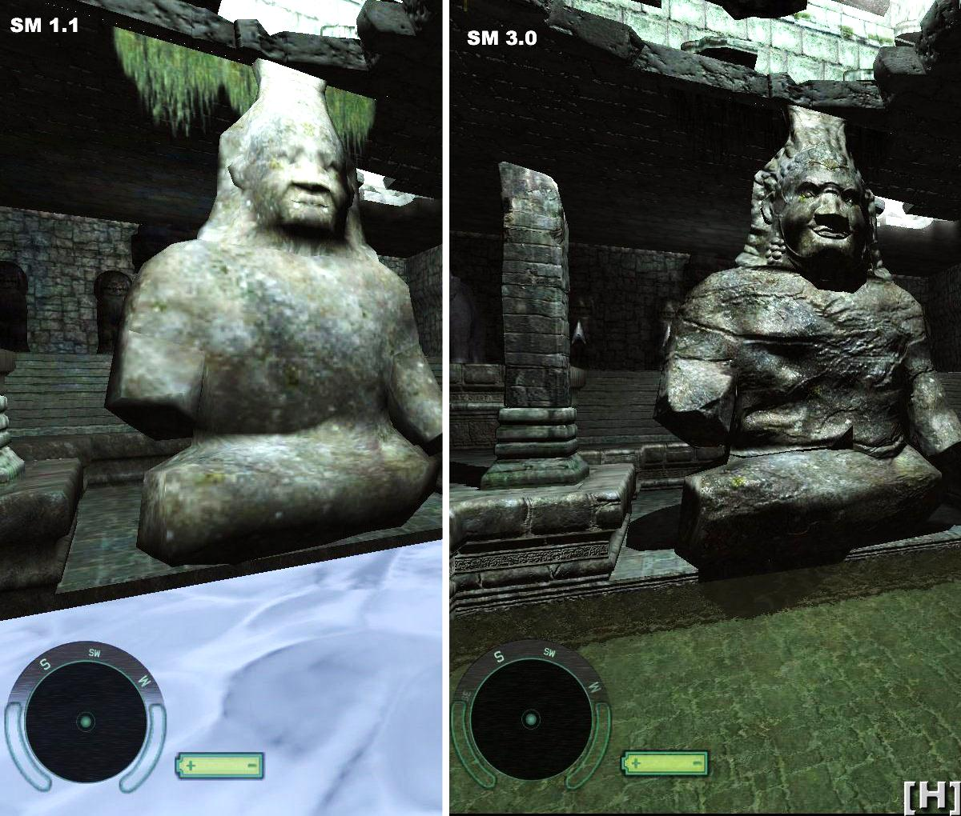
Programmable Shader Based Pipeline
To allow the programmer to fine tune and optimize rendering, various stages of the pipeline are customizable
You’ve played with shaders in lab
Shaders are fast! Using shaders even all of the more advanced techniques mentioned in this lecture can be done in real time.
Physical phenomena such as shadows (slides 18, 19) and light refraction can be emulated using shaders.
The image on the right is rendered with a custom shader. Note that only the right image has realistic shadows. A normal map is also used to add detail to the model.

Slide 7
Shading Models Compared
Constant shading: no interpolation, pick a single representative intensity and propagate it over entire object. Loses almost all depth cues.
Pixar “Shutterbug” images from:
www.siggraph.org/education/materials/HyperGraph
/scanline/shade_models/shading.htm

Slide 8


Shading Models Compared
Flat or Faceted Shading: constant intensity over each face
Constant Shading

Slide 9
Shading Models Compared
Gouraud Shading: Linear Interpolation of intensity across triangles to eliminate edge discontinuity
Flat Shading

Slide 10
Shading Models Compared
Phong Shading: Interpolation of vertex surface normals
Note: specular highlights but no shadows. Still a pure local illumination model
Gouraud Shading

Slide 11

Shading Models Compared
Global Illumination: Objects enhanced using shadow, texture, bump, and reflection mapping (see S20)
Phong Shading

Slide 12
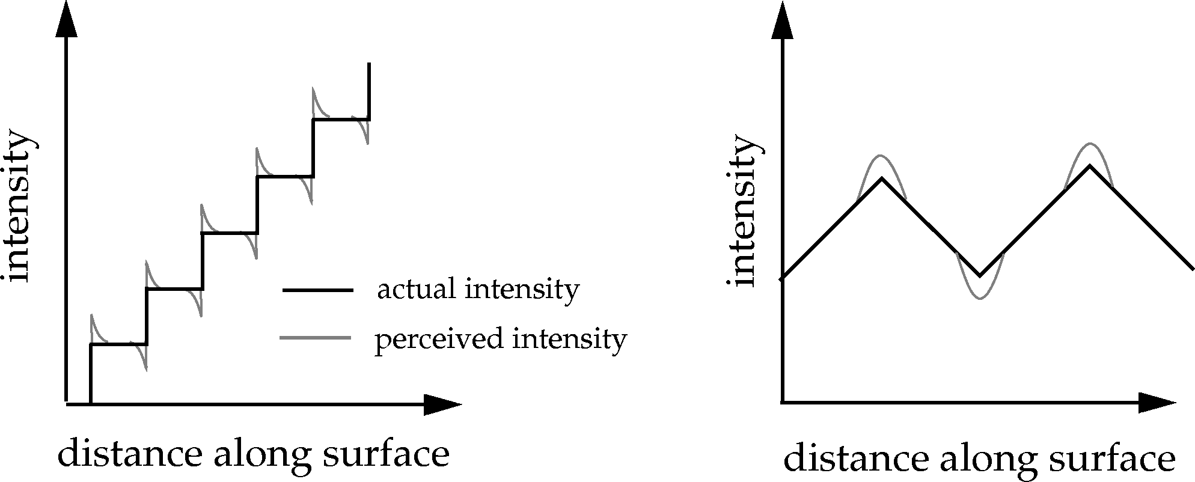
Shading Models (1/6: Faceted)
Faceted Shading:
Single illumination value per polygon
With many polygons approximating a curved surface, this creates an undesirable faceted look.
Facets exaggerated by “Mach banding” effect

Slide 13



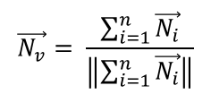
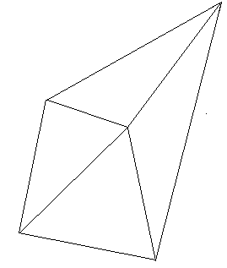


Shading Models (2/6: Gouraud)
Illumination intensity interpolation
Illumination values are computed at vertices, linearly interpolated across the pixels of the polygon
Eliminates intensity discontinuities at polygon edges; still have gradient discontinuities.
Mach banding is largely ameliorated, not eliminated
Must differentiate desired creases from tesselation artifacts (edges of cube vs. edges on tesselated sphere)
Step 1: Compute vertex normals by averaging surrounding polygon normals
$$\vec{N_{v}}= \frac{\sum_{i=1}^{n}{\vec{N_{i}}}}{\left\|\sum_{i=1}^{n}{\vec{N_{i}}}\right\|}$$
$$\vec{N_{2}}$$
$$\vec{N_{v}}$$
$$\vec{N_{3}}$$
$$\vec{N_{1}}$$
$$\vec{N_{4}}$$

Slide 14

Shading Models Explained (3/6: Gouraud cont.)
Step 2: Evaluate illumination at each vertex using lighting model $(I_{1},I_{2}$, $I_{3})$
Step 3: Interpolate illumination along polygon edges $(I_{a},I_{b})$
Step 4: Interpolate illumination along scan lines $(I_{p})$
scan line

Slide 15
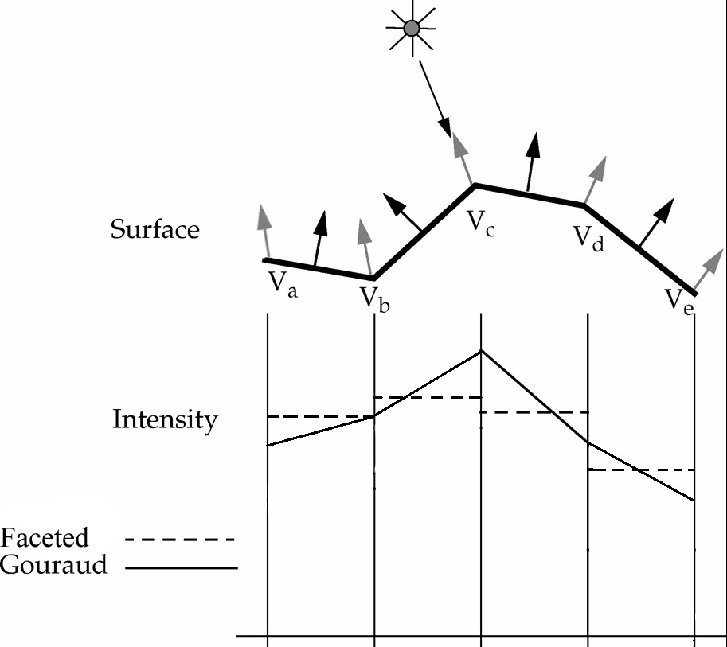

Shading Models (4/6: Gouraud cont.)
Takes advantage of scan line algorithm for efficiency
$\frac{∆I}{∆y}$ is constant along polygon edge, $\frac{∆I}{∆x}$is constant along scan line
Gouraud vs. Faceted shading:

Slide 16
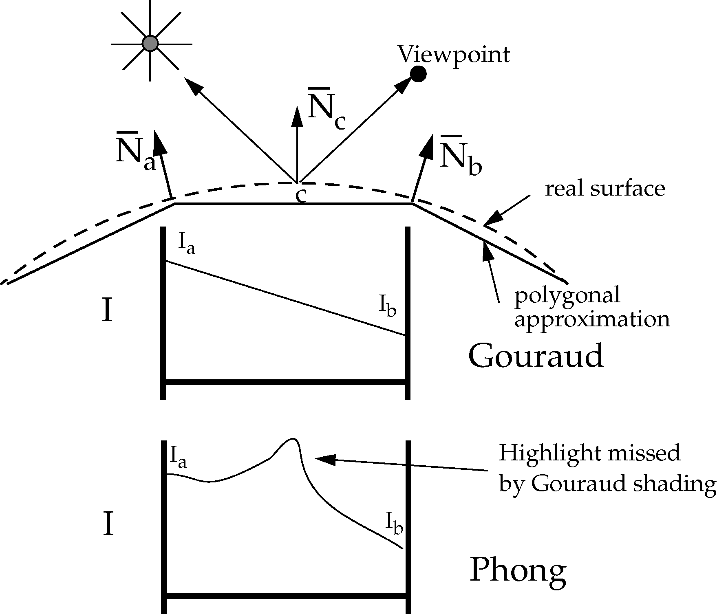
Shading Models (5/6: Gouraud cont.)
Gouraud shading can miss specular highlights because it interpolates vertex colors instead of calculating intensity directly at each point, or even interpolating vertex normals (Phong shading)
N_{a} and N_{b} would cause no appreciable specular component, whereas N_{c} would. Interpolating between I_{a} and I_{b} misses the highlight that evaluating I at c would catch
Phong shading:
Interpolated normal comes close to the actual normal of the true curved surface at a given point
Reduces temporal “jumping” affect of highlight, e.g., when rotating sphere during animation (example on next slide)

Slide 17
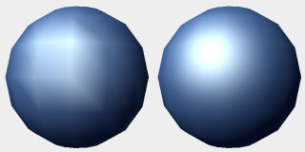
Shading Models (6/6: Phong Shading)
Phong Model: normal vector interpolation
Interpolate N rather than I
Always captures specular highlights, but computationally expensive
At each pixel, N is recomputed and normalized (requires sq. root operation)
Then I is computed at each pixel (lighting model is more expensive than interpolation algorithms)
This is now implemented in hardware, very fast
Looks much better than Gouraud, but still no global effects
Gouraud
Phong
http://www.cgchannel.com/2010/11/cg-science-for-artists-part-2-the-real-time-rendering-pipeline/
Gouraud
Phong
http://en.wikipedia.org/wiki/Gourad_shading

Slide 18
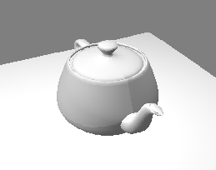
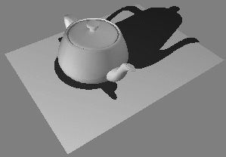
Shadows (1/5) – Simplest Hack
Render each object twice
First pass: render normally
Second pass: use transformations to compress object onto ground plane, render completely black
Pros: Easy, can be convincing. Eye more sensitive to presence of shadow than shadow’s exact shape
Cons: Becomes complex computational geometry problem in anything but simplest case
Easy: projecting onto flat, infinite ground plane
How to implement for stairs? Rolling hills?
http://web.cs.wpi.edu/~matt/courses/cs563/talks/shadow/shadow.html

Slide 19
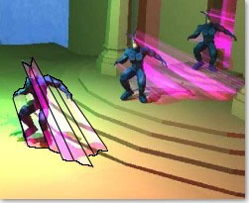
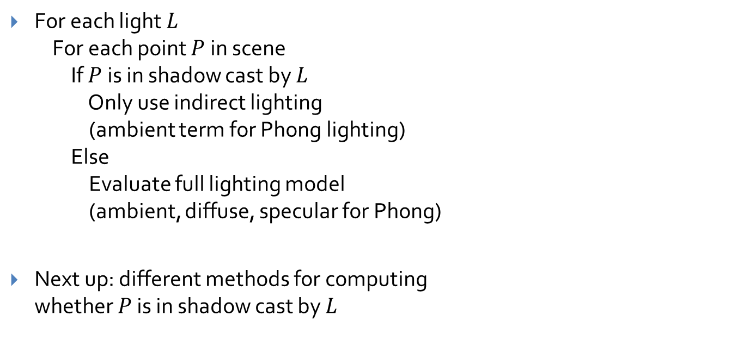
Shadows (2/5) – More Advanced
For each light $L$ For each point $P$ in scene If $P$ is in shadow cast by $L$ Only use indirect lighting (ambient term for Phong lighting) Else Evaluate full lighting model (ambient, diffuse, specular for Phong)
Next up: different methods for computing whether $P$ is in shadow cast by $L$
Stencil shadow volumes implemented by former cs123 ta and recent Ph.D. Kevin Egan and former PhD student and book co-author Prof. Morgan McGuire, on nVidia chip

Slide 20
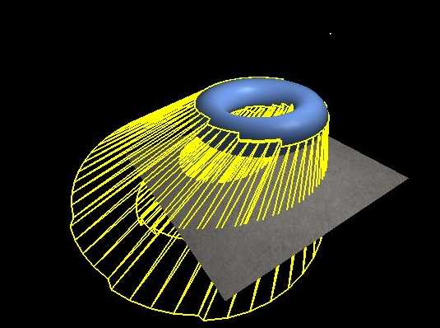
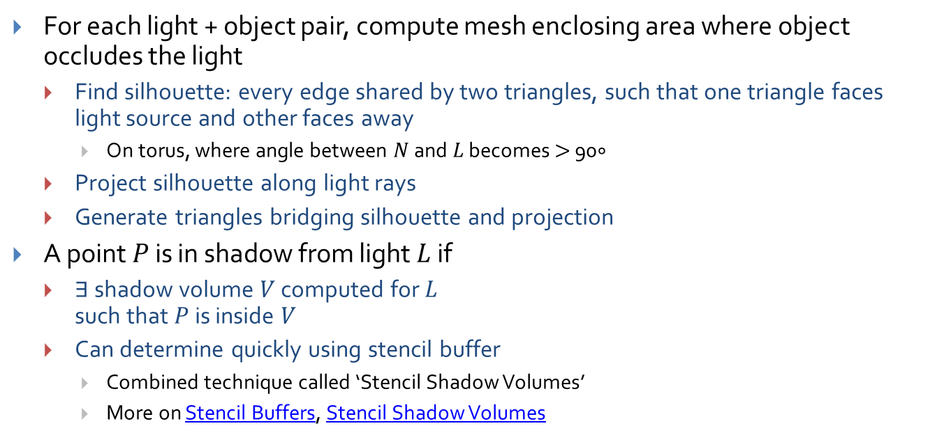
Shadows (3/5) – Shadow Volumes
For each light + object pair, compute mesh enclosing area where object occludes the light
Find silhouette: every edge shared by two triangles, such that one triangle faces light source and other faces away
On torus, where angle between $N$ and $L$ becomes $>$ 90$∘$
Project silhouette along light rays
Generate triangles bridging silhouette and projection
A point $P$ is in shadow from light $L$ if
$∃$ shadow volume $V$ computed for $L$ such that $P$ is inside $V$
Can determine quickly using stencil buffer
Combined technique called ‘Stencil Shadow Volumes’
More on Stencil Buffers, Stencil Shadow Volumes
Original Silhouette
Projected Silhouette
Example shadow volume
(yellow mesh)
http://www.ozone3d.net/tutorials/images/stencil_shadow_volumes/shadow_volume.jpg

Slide 21
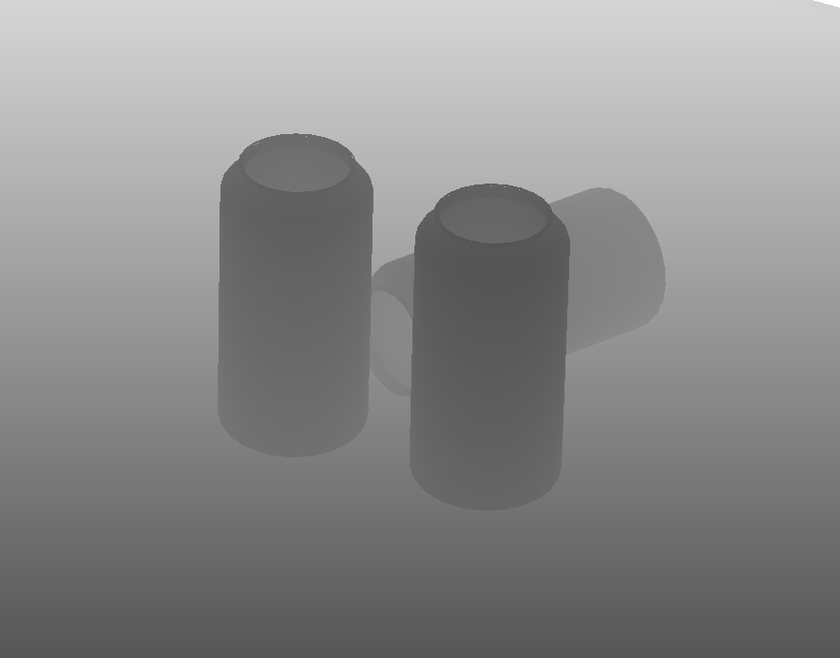
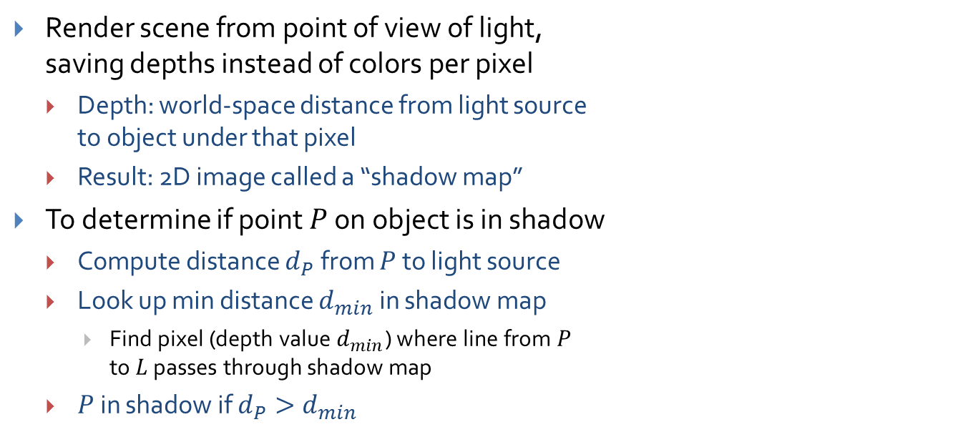
Shadows (4/5) – Shadow Maps
Light
Shadow Map
Render scene from point of view of light, saving depths instead of colors per pixel
Depth: world-space distance from light source to object under that pixel
Result: 2D image called a “shadow map”
To determine if point $P$ on object is in shadow
Compute distance $d_{P}$ from $P$ to light source
Look up min distance $d_{min}$ in shadow map
Find pixel (depth value $d_{min}$) where line from $P$ to $L$ passes through shadow map
$P$ in shadow if $d_{P}>d_{min}$
Visualization of Shadow Map
http://graphics.cs.williams.edu/papers/CSSM/nalgene-Williams-shadowmap.png

Slide 22
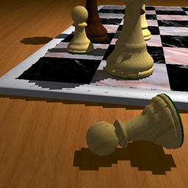
Shadows (5/5) – Shadow Map Tradeoffs
Pro: Can extend to support soft shadows
Stencil shadow volumes only useful for hard-edged shadows
Con: Naïve implementation has impressively bad aliasing problems
Many screen pixels covered by projection of one shadow map pixel
Doesn’t make sense to filter shadow map (interpolating depth samples)
Many workarounds for aliasing issues
Percentage-Closer Filtering: box blur by sampling shadow map in multiple places
Cascaded Shadow Maps: multiple shadow maps, denser resolution closer to viewer
Variance Shadow Maps: use statistical modeling instead of simple depth comparison
http://www-sop.inria.fr/ reves/Marc.Stamminger/psm/

Slide 23
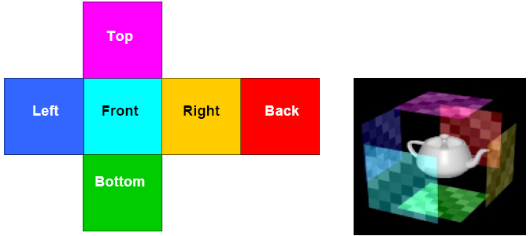
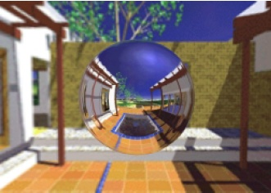
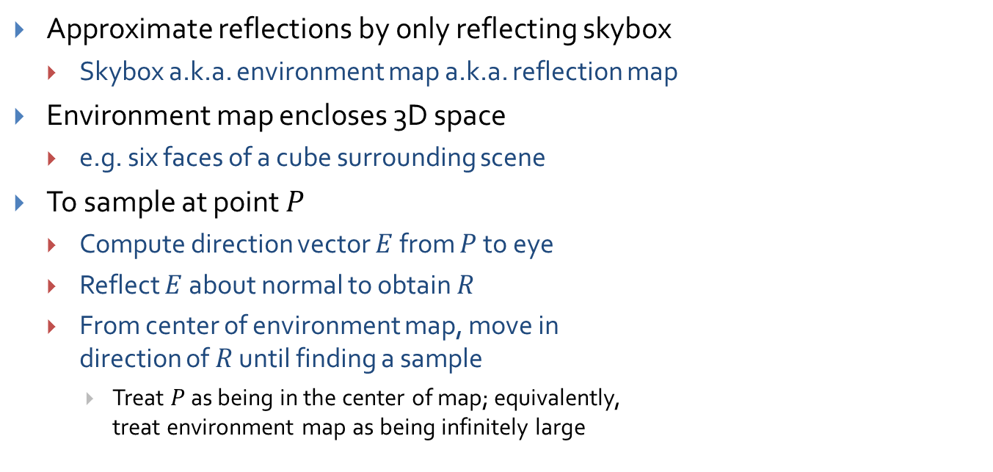
Environment Mapping (for Shiny Objects) (1/2)
Approximate reflections by only reflecting skybox
Skybox a.k.a. environment map a.k.a. reflection map
Environment map encloses 3D space
e.g. six faces of a cube surrounding scene
To sample at point $P$
Compute direction vector $E$ from $P$ to eye
Reflect $E$ about normal to obtain $R$
From center of environment map, move in direction of $R$ until finding a sample
Treat $P$ as being in the center of map; equivalently, treat environment map as being infinitely large
Skybox
Object

Slide 24
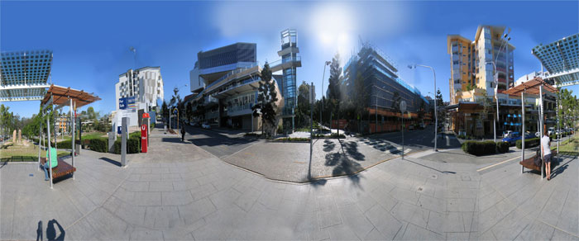
Environment Mapping (2/2)
Non-trivial to reflect other objects in the scene
Achieved by rendering the entire scene, and storing results into faces of the environment map
Can do this offline for static geometry, but must generate at runtime for moving objects
Rendering environment map at runtime is expensive
Not limited to six-sided textured skyboxes
e.g. can use a single 2D map ‘unwrapped’ from surface of a sphere. Choose sample points by calculating longitude and latitude
See “Texture Mapping of Sphere” in Texture Mapping lecture
http://www.juztn.com/CompTut/compTut7.html

Slide 25
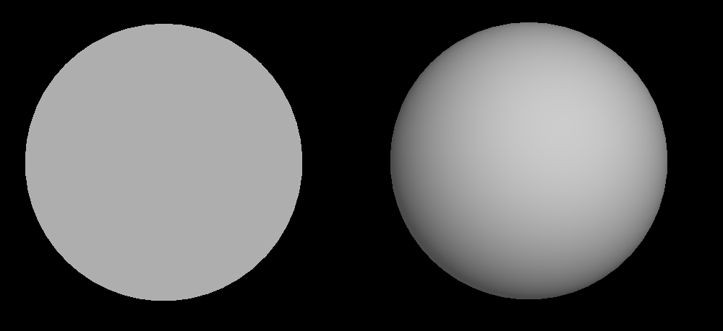
Overview: Surface Detail
These spheres have same geometry:
Observation
What if we replaced the 3D sphere on the right with a 2D circle?
The circle would have fewer triangles (thus renders faster)
If we kept the sphere’s normals, the circle would still look like a sphere!
Works because human visual system infers shape from patterns of light and dark regions (“shape from shading”). Lightness at any point is determined by normal vector, not by actual geometry of model.
Image credit: Dave Kilian, ‘13

Slide 26
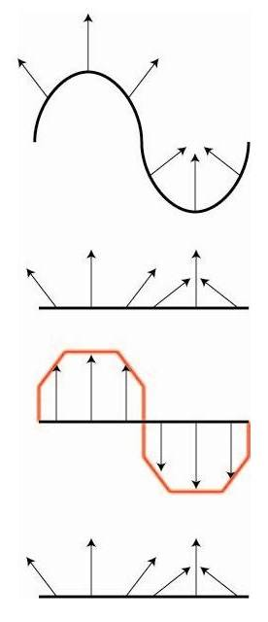
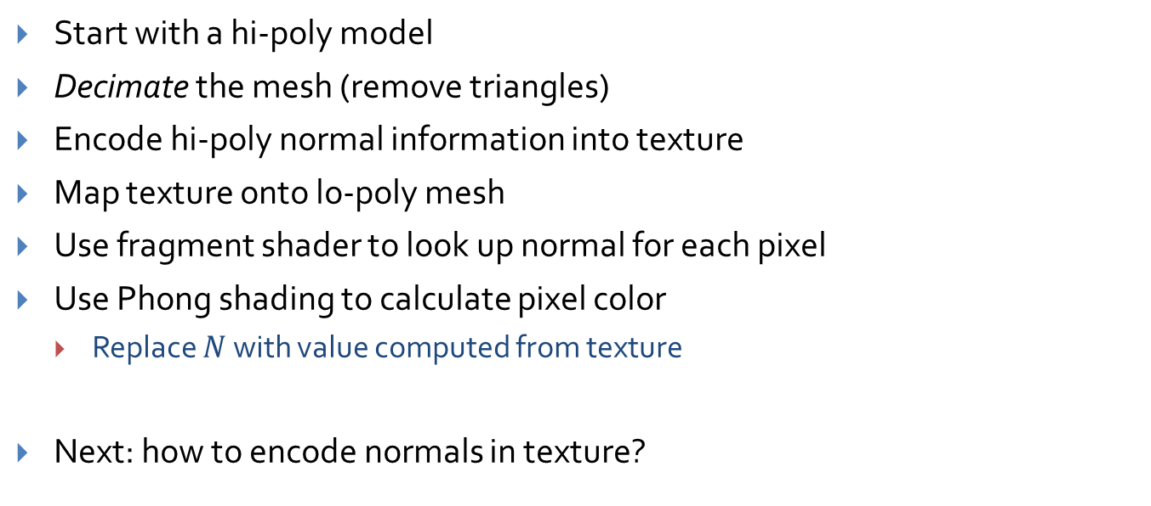
Idea: Surface Detail
Start with a hi-poly model
Decimate the mesh (remove triangles)
Encode hi-poly normal information into texture
Map texture onto lo-poly mesh
Use fragment shader to look up normal for each pixel
Use Phong shading to calculate pixel color
Replace $N$ with value computed from texture
Next: how to encode normals in texture?
Original hi-poly model
Lo-poly model with hi-poly model’s normals preserved

Slide 27
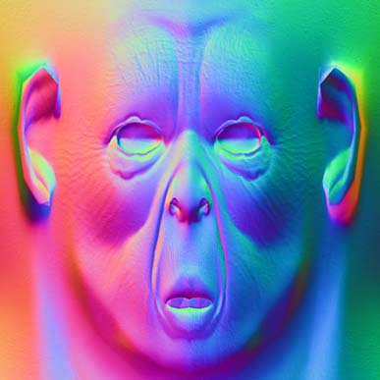
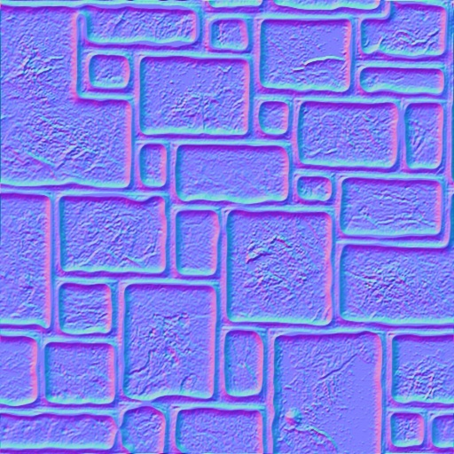
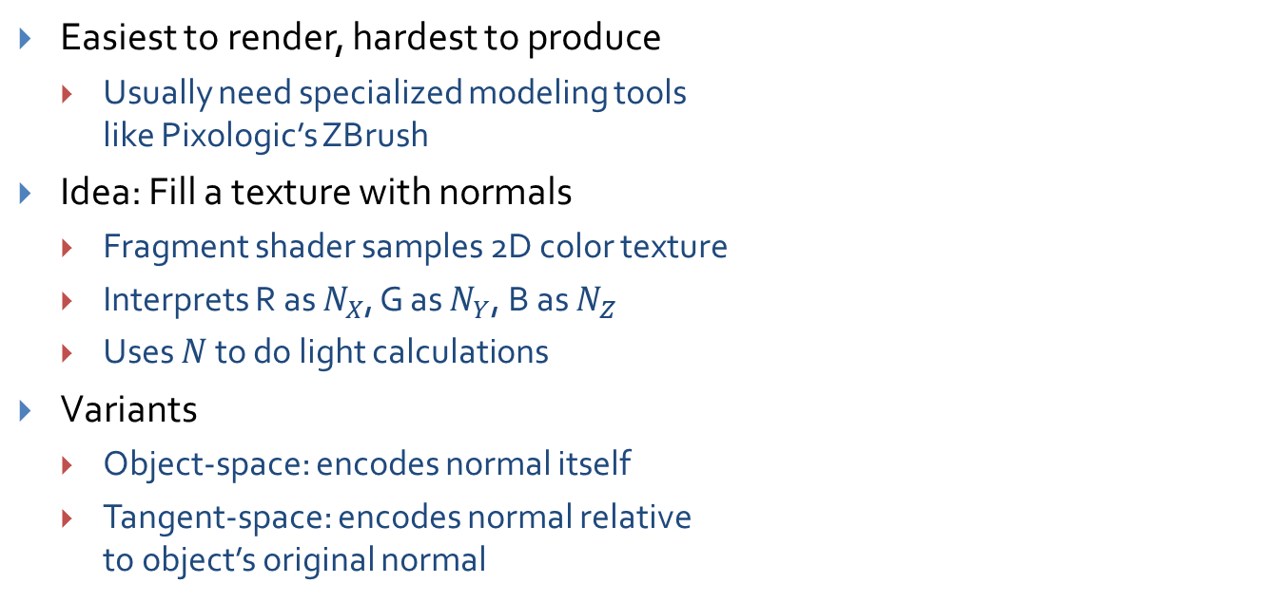
Normal Mapping
Easiest to render, hardest to produce
Usually need specialized modeling tools like Pixologic’s ZBrush
Idea: Fill a texture with normals
Fragment shader samples 2D color texture
Interprets R as $N_{X}$, G as $N_{Y}$, B as $N_{Z}$
Uses $N$ to do light calculations
Variants
Object-space: encodes normal itself
Tangent-space: encodes normal relative to object’s original normal
Object-space normal map
Tangent-space normal map
Images: www3.telus.net, www.bitmanagement.com

Slide 28
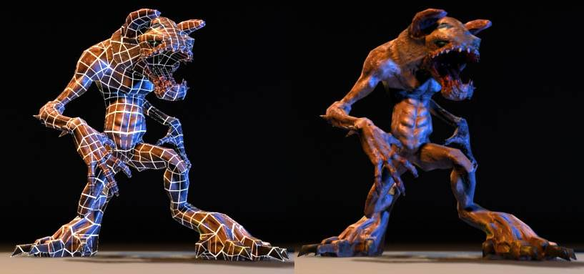
Normal Mapping Example
Render showing simple underlying geometry
Normal map gives model finer detail
Normal mapping can completely alter the perceived geometry of a model
Image courtesy of www.anticz.com

Slide 29
Normal Mapping Video
http://www.youtube.com/watch?v=RSmjxcAhkfE

Slide 30

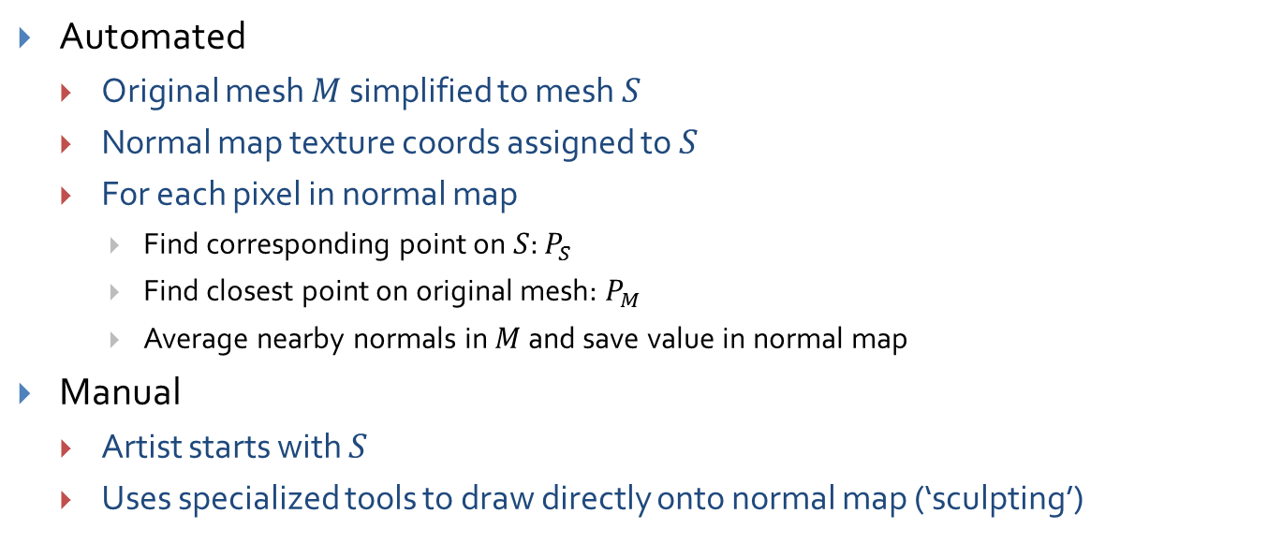



Aside: Creating Normal Maps
Automated
Original mesh $M$ simplified to mesh $S$
Normal map texture coords assigned to $S$
For each pixel in normal map
Find corresponding point on $S$: $P_{S}$
Find closest point on original mesh: $P_{M}$
Average nearby normals in $M$ and save value in normal map
Manual
Artist starts with $S$
Uses specialized tools to draw directly onto normal map (‘sculpting’)
$$S$$
$$P_{S}$$
$$P_{M}$$
$$M$$

Slide 31
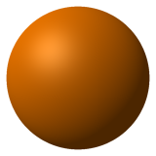
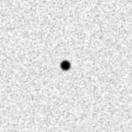
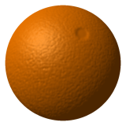
Bump Mapping: Example
+
=
Original object (plain sphere)
Bump map (height map)
Sphere with bump-mapped normals
http://cse.csusb.edu/tong/courses/cs520/notes/texture.php

Slide 32
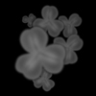
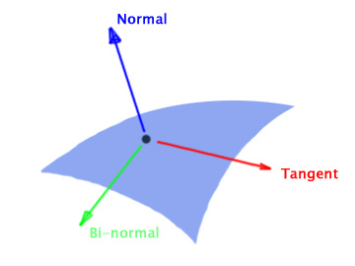
Bump Mapping
Height map
Idea: instead of encoding normals themselves, encode relative heights
Black: minimum height delta, White: maximum height delta
Much easier to create than normal maps
Use height deltas to perturb the normal
To sample bump map
Collect several height samples from texture
Approximate gradient using height samples
Transform from tangent space to object space
Tangent space: XYZ system, where Z is aligned with the original normal
Tangent Space (using left-handed coordinate system)
http://jahovaos.com/groups/kb/wiki/19ed6/Relief_Mapping__Normal_Mapping.html

Slide 33
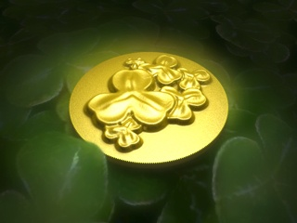
Other Techniques: Displacement Mapping
Move vertices along normals by looking up height deltas in a height map
Doesn’t provide extra detail like normal/bump mapping
Useful for animating surfaces
The displacement map used to render the scene. The intensity value indicates the height at a given point.
http://www.creativemac.com/2004/02_feb/tutorials/koc4ddisplace040224.htm

Slide 34
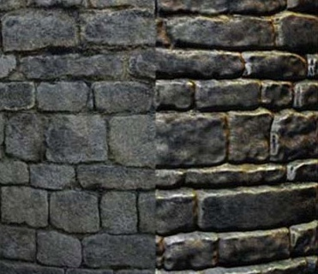
Other Techniques: Parallax Mapping
Extension to normal mapping
Distorts texture coordinates right before sampling, as a function of normal and eye vector
Example image on right: looking down at bricks from above
Texture coordinates stretched near top of brick, where you should be able to ‘see’ the top of the brick
Similarly, texture coordinates compressed near bottom of brick, where you shouldn’t be able to ‘see’ the underside of the brick
Texture Mapped
Texture and Parallax Mapped

Slide 35
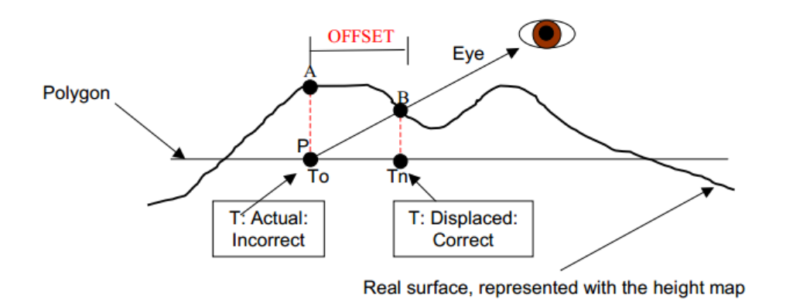
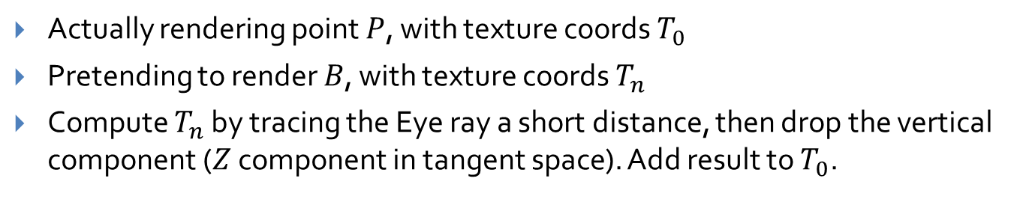
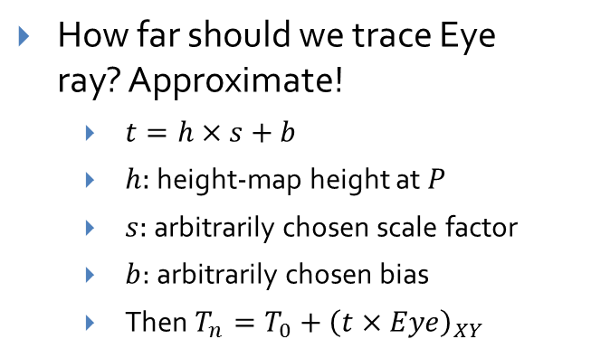
Other Techniques: Parallax Mapping
Actually rendering point $P$, with texture coords $T_{0}$
Pretending to render $B$, with texture coords $T_{n}$
Compute $T_{n}$ by tracing the Eye ray a short distance, then drop the vertical component ($Z$ component in tangent space). Add result to $T_{0}$.
How far should we trace Eye ray? Approximate!
$t=h×s+b$
$h:$ height-map height at $P$
$s:$ arbitrarily chosen scale factor
$b$: arbitrarily chosen bias
Then $T_{n}=T_{0}+{\left(t×Eye\right)}_{XY}$
http://www.opengl.org/sdk/docs/tutorials/TyphoonLabs/Chapter_4.pdf

Slide 36
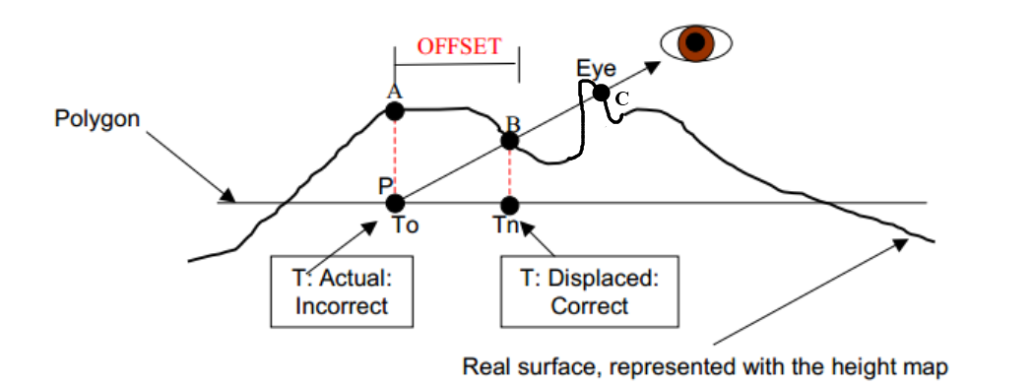
Other Techniques: Steep Parallax Mapping
Extension on Parallax Mapping
Uses ray-marching to intersect ray with parts of heightmap parallax mapping might have missed
Adds support for self-shadowing
Invented by Brown PhD ‘06 Morgan McGuire and Max McGuire
http://www.opengl.org/sdk/docs/tutorials/TyphoonLabs/Chapter_4.pdf (modified)
Notes:
Short description under each screenshot of what to look at to notice the difference between the screenshots

Slide 37
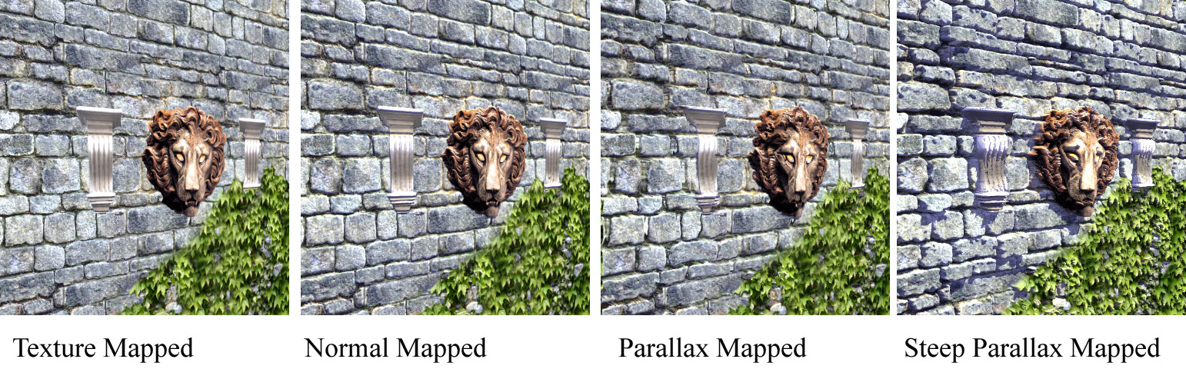
Comparison
Creases between bricks look flat
Creases look progressively deeper
Objects have self-shadowing

