Slide 1
User Interface I
Interface Design and Philosophy
Andries van Dam , James Foley
Notes:
To get animations back, go to Slide show tab -> Set up Slide Show -> uncheck show without animations

Slide 2
Questions
What is the most common use of computer graphics today?
What are we going to use all that ever-increasing compute/graphics power for?!? Most apps now have all they need…
What approximate percentage of a modern app’s code is the UI?
What differentiates apps? Platforms?
What lies beyond WIMP GUIs?

Slide 3
Computer power vs. brain power
Compute
Graphics
UI
Computing Capacity
“Moore’s Law”
Human Capacity
t
t
Use compute power in UI to increase b/w to the brain
Courtesy of Bill Buxton
Notes:
To a first approximation, we have enough computing for most productivity applications.
Its human performance, not computer performance that now matters most.
Therefore, throw most of the extra computing power at the user interface.
In fact, GUIs already are major consumers of both code and computing power.
Need to go way beyond today’s GUIs. That’s what this talk is about! * Punctuated equilibrium
- batch cards
- alpha-numeric terminals
- WIMP GUIs - PARC Alto, commercialization via Mac and PC, Windows
- post-wimp -
o Google's April fools clip.
o Corning clip
o Apple's Knowledge Navigator

Slide 4
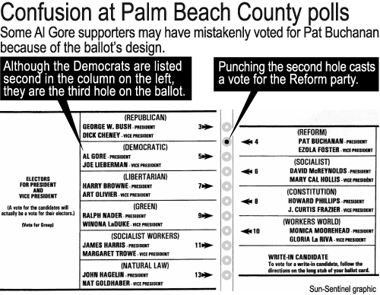
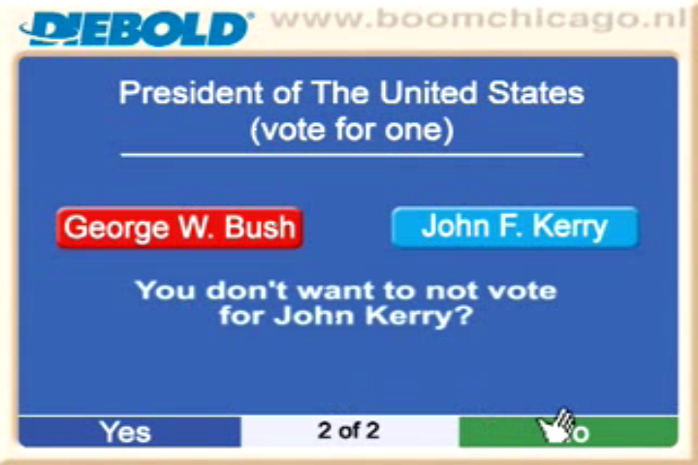
Why Interface Matters…
Not just applicable to computer interfaces!
“Web sites with large liberal followings like Mother Jones, Slate and The Huffington Post highlighted a video that claimed to show a “Romney-loving“ voting machine in Pennsylvania that was converting Obama votes into votes for Mitt Romney.”
http://www.youtube.com/watch?v=QdpGd74DrBM
http://www.youtube.com/watch?v=yUdpj3gJofQ

Slide 5
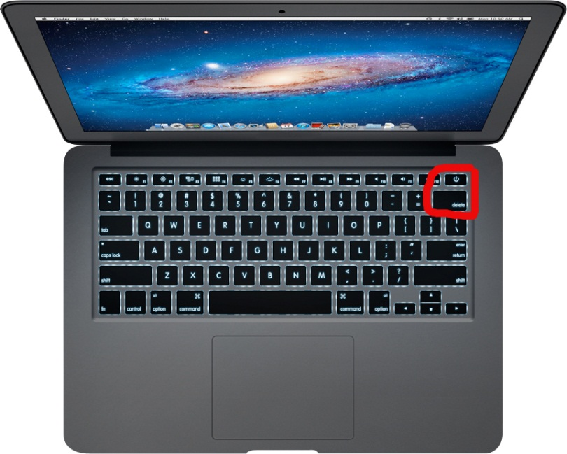
Why Interface Matters…
UI should protect against obvious user error

Slide 6
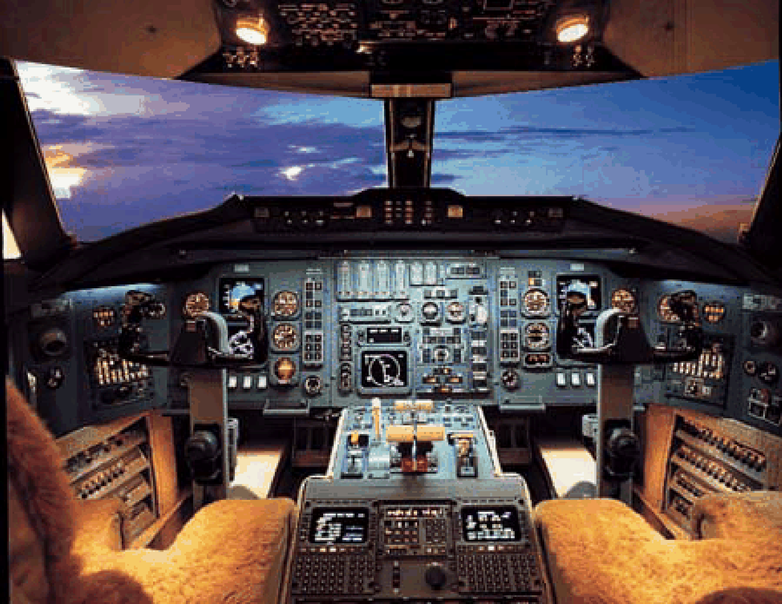
Why Interface Matters…
Sometimes a user interface can be a matter of life and death
Cali, Columbia 757 crash, Dec. 20th 1995; Took the life of CS Prof. Paris Kanellakis and his family, due to an ambiguity in a typed-in command

Slide 7
A Few More Questions
What is the most common complaint about computers?
What are some interfaces you like and dislike?
What are the identifying characteristics of current interface paradigms?
How do technical considerations affect interface considerations and vice-versa?
How could “intelligent” interfaces help or get in the way of users? (NB: Clippy! Is Siri that much better?!?)
Is it possible to accommodate users of all levels with a single interface?
What is your ideal interface?
for general use (operating system / work environment)
for specific applications

Slide 8
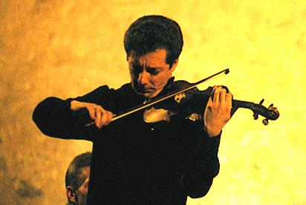

Is there an ideal user interface?
None! UIs are a necessary evil
Counterpoint: aesthetics of a good UI, once mastered
Want to communicate and control as we do in and with the
real world
objects
other participants (real and software agents)
Models for agents: Wodehouse’s Jeeves, HAL-9000
understand context: physical, personal, social, ...
infer intent
Knowledge Navigator
Siri on iPhone as embryonic example
Future: brain-machine interfaces,“cogito ergo fac” (braingate)
Today: transparent, fluid Uis automaticity

Slide 9
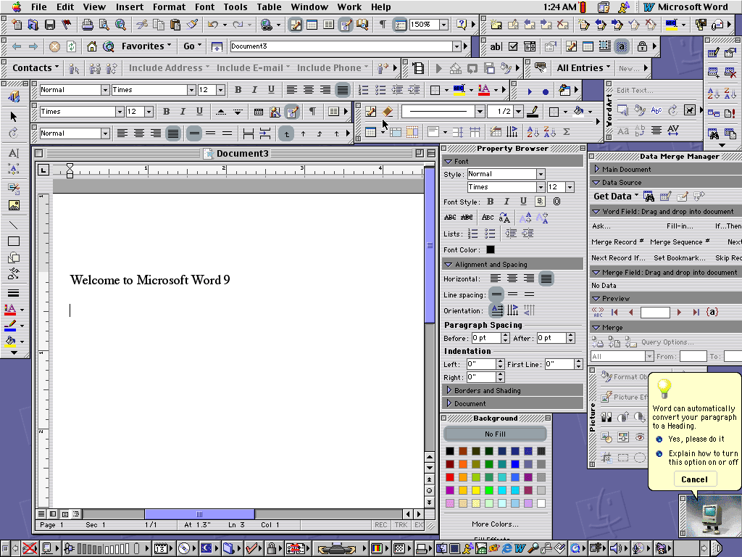
An Extreme
“Microsoft Word” at its worst (pre-”ribbon”)

Slide 10
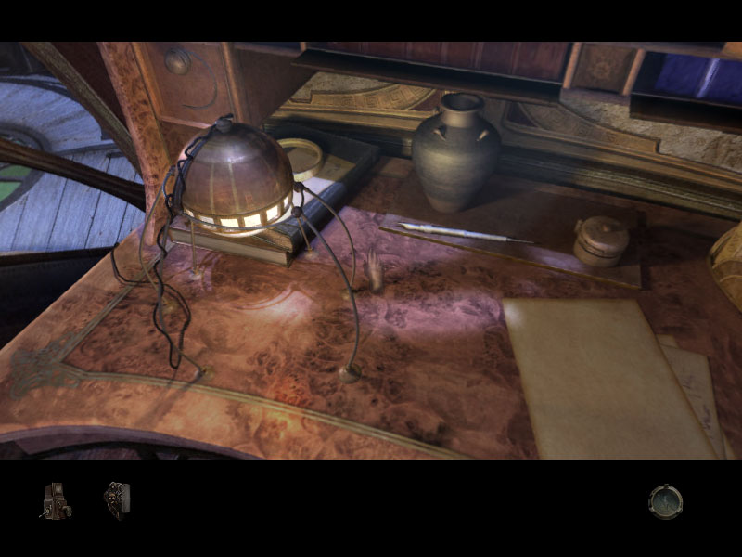
Another Extreme
“Myst: Revelations” (Cyan)

Slide 11
Tradeoffs in Design
What are the pros and cons of these interface styles?
text input
direct manipulation
point & click, drag & drop
“intelligent” interfaces, agents, social interfaces
modality (i.e., vim vs. emacs/kate)
The effectiveness of an interface is determined by the evaluation of its tradeoffs
The usability of a system too often is inversely related to its functionality
A successful interface designer must know her users and their priorities, the computing environment, and the task domain

Slide 12
User Interface Design
Overview
This lecture addresses primarily User-Centered Design for WIMP, i.e. Windows, Icons, Menus and Point-and-click GUI’s using keyboard and mouse/touchpad
This style of interface revolutionized computing and made it accessible to the masses, even toddlers
Much applies as well to non-WIMP/post WIMP interfaces, e.g., those interfaces using gestures (based on input via pen/stylus, multi-touch, VR data wands, computer vision (e.g., Kinect), …) or speech recognition. Corning Video
Outline
General observations and overview of user interfaces
User interface design methodology and principles
Summary of guidelines and main concepts in user interface design

Slide 13
Purpose of UI Design (1/2)
The user interface is the key to productivity
Provide usable, functional, safe, efficient systems for people
Concentrate on user-centered design:
design for your user, not your hardware
UI now much more important than features
feature bloat
90/10 rule: 10% of features used 90% of time
High Level goals of UI
Make easy things easy; make hard things possible
Optimize human factors and ergonomics
Make your interface comfortable and inviting, as well as attractive
Maximize speed of learning
Including the transition from novice to expert user
Maximize speed and ease of use
Minimize error rate
Enhance the User Experience!
Consistency with user’s expectation: “law of least astonishment!”

Slide 14
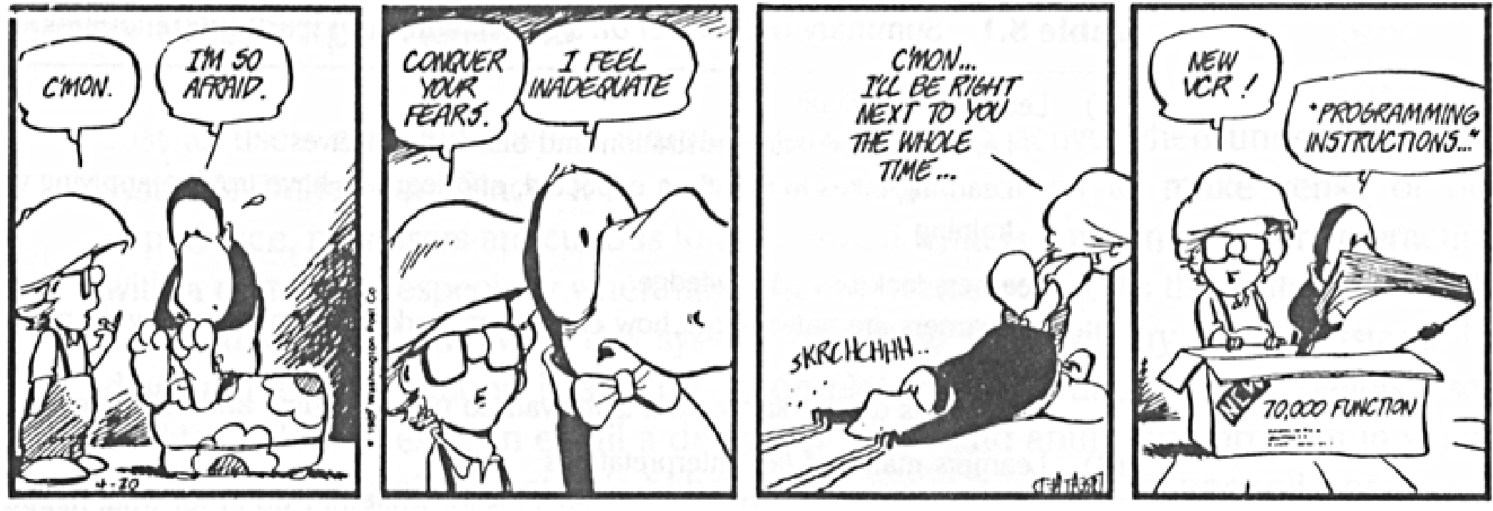
Purpose of UI Design (2/2)
Note: These goals cannot all be fully accommodated in the same interface. We must determine which goals are most important for the user and the purpose of the application.

Slide 15
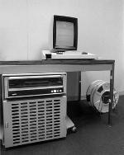
Brief History of UI - Major Events and Innovations (1/3)
1963, Ivan Sutherland published the landmark graphics system Sketchpad, which had lots of physical buttons, keys, panning, and zooming.
1968, Engelbart demonstrated the NLS/Augment hypermedia document system at the Fall Joint Computer Conference. Featured tiled windows, mouse, chord keyboard, command line interface
1970, Engelbart patented the mouse
Apple “borrowed” the mouse from Xerox PARC
who “borrowed” it from Engelbart

Slide 16
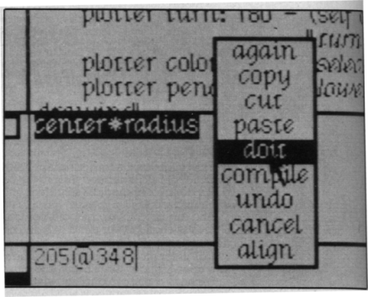
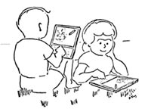
Brief History of UI - Major events and innovations (2/3)
1973, Xerox PARC produced the Alto, the first personal workstation. Based on bit-mapped (raster) display, commercial mouse, Ethernet, and client-server architecture. Had world’s first WYSIWYG text editor, Smalltalk (Alan Kay, Adele Goldberg, et. al.), and WIMP GUI’s including window managers and browsers
1972, Alan Kay envisions the Dynabook, for kids
simulation and graphics-based laptop running Smalltalk
colleague of Mathematician Seymour Pappert
(constructivist learning, Logo)
Smalltalk-80 screenshot

Slide 17
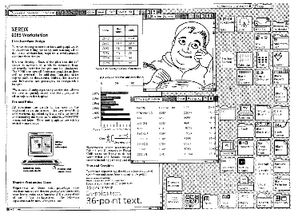
Brief History of UI - Major events and innovations (3/3)
In 1981, Xerox introduced the Star Information System that had overlapping windows
1984, Apple released the Mac as the first commercial graphics desktop microcomputer, based on Alto and Star, featuring 1) messy desktop metaphor with overlapping windows, 2) pull-down menus, 3) icons & toolbars, 4) drag-and-drop file manipulation
1985, Microsoft Windows, considered a Mac imitation with minimal improvements
famous lawsuit, Apple vs. Microsoft over Windows use of icons, pointers, etc.
Foley on behalf of MS, Shneiderman for Apple!
Apple lost all claims
Apple vs. Samsung 2012: Courts uphold Apple patents on “bounceback”, H/V scrolling, translucent overlays,…iPhone design features

Slide 18
Characteristics of UI Design
The nature of the beast
Collaborative
Iterative
Multi-disciplinary
Players in the UI design game
Hardware engineers
devices for graphics, video, audio, force feedback…
Software engineers
Human Factors (ergonomics) engineers
Graphic designers
Linguists
Perceptual psychologists
Cognitive scientists
Adventuresome sociologists and cultural anthropologists (e.g., Danah Boyd, 2001)
and UI/UX designers
Note that industrial design and UI/UX design are intertwined (e.g., iTouch, iPhone, iPad)

Slide 19
Language Model for Command Line and WIMP UI’s – Abstraction Layers (2/4)
A. Meaning of an interface, its semantics
Conceptual level:
cognitive uses, models, and metaphors; application objects and operations
Functional level:
each function’s semantics: including pre-post- and error-conditions
B. Form of an interface, its “look and feel”
Interaction sequencing level:
ordering and interlacing of inputs and outputs, syntax
Binding level:
how input and output units of form are actually created from hardware primitives, lexemes
Conceptual level
Functional/semantic level
Sequencing/syntactical level
Binding/lexical level
Meaning
Look
and
Feel
Form

Slide 20
Language Model for Command Line and WIMP UI’s (3/4)
Key points
Defining lexemes is usually easy for small WIMP interfaces, harder for non-WIMP interfaces, especially Virtual Reality (VR)
creating a user interface for a large application is essentially complexity management
in VR applications we must also deal with the problems of parallelism and time coherence
Command syntax and semantics tend to be more complicated than lexemes
Often helpful to have an Finite State Machine (FSM) to represent a sequencing of lexemes to make a complete command. Huge aggregate FSM for UI as a whole
This design model may seem excessively rigid, but a good UI design is a formal process resulting in a good architecture.

Slide 21
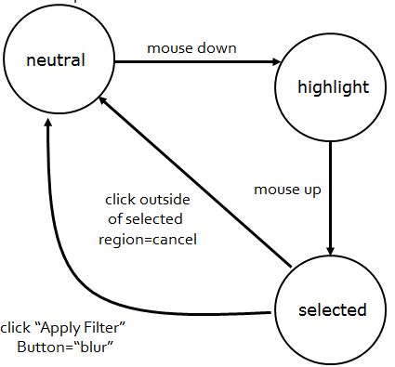
Language Model for Command Line and WIMP UI’s (4/4)
FSM example
Example: UI FSM for blur operation in Filter

Slide 22
Design Methodology (1/4)
The overall steps
Analyze
Formalize
Synthesize
Evaluate
Implement
Test
Note: steps are not all distinct or sequential
(even less so than in software design)
For each step in design
Consider multiple alternatives
Choose the one which best matches
user characteristics
design objectives
functional requirements
Rapid prototype early and often

Slide 23
Design Methodology (2/4)
Analyze
Requirements definition
User(s) definition
novice, casual user, power user…
Working environment
office, home, school…
Formalize
Define design goals
Synthesize
Conceptual design
Semantic design
Dialogue design
Syntactic design
Lexical design
Graphic and other design modalities
Documentation design

Slide 24
Design Methodology (3/4)
Evaluate
Design review
Implement
Prototyping
Implementation
Software debugging
Test
User interface debugging
Usability testing/evaluation (gather and analyze statistics – experimental design)
Again, steps are NOT all distinct or sequential

Slide 25
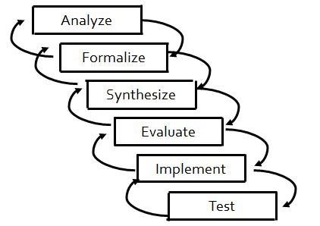
Design Methodology (4/4)
Process model
“Waterfall” model, a step-by-step approach, a pipeline; for user interface design, this model is less linear than software engineering waterfall model and more complex because of human element
Model is not a hierarchy: has feedback loops

Slide 26
User Definition and Work Environment (1/2)
Demographics
age
education
cultural characteristics
disabilities
Intrinsic personality factors:
attitude toward computers
secure/insecure
bold/timid
adaptable/rigid
motivated/apathetic

Slide 27
User Definition and Work Environment (2/2)
Knowledge
previous computer experience
skill level (novice, intermediate, expert)
intelligence
reading ability
typing ability
Work environment
frequency of computer use
time allotted to learn system
mental workload or overload
stress level
executive/management vs. clerical/data entry
ambient conditions: supermarket vs. shop floor vs. traveling salesperson vs. white-collar office

Slide 28

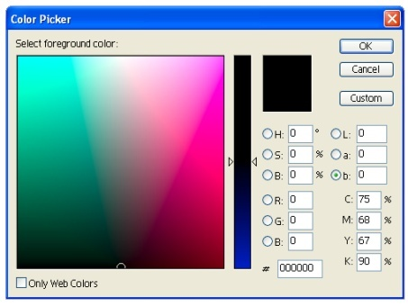
Conceptual Design
Identify real world models and metaphors
Examples:
2D messy desktop, point-and-click, drag-and-drop
color pickers and paintbrushes in art programs
VR virtual world: reach out and touch
Use metaphors only if and when it is appropriate: they constrain and break too easily (e.g., 2D desktop, 3D rooms)
Identify key concepts in application:
Types of objects
Relations between objects
Attributes of objects
Actions on objects, relations, attributes

Slide 29
Functional/Semantic Design
Completely design units of meaning between user and computer, but not form
List what information is used for each operation on each object
Results, errors, boundary conditions
From user to computer
Detailed definition of commands for operating on objects, and attributes of objects
From computer to user
Selection of what information needs to be presented to the user
Identify problems that can occur and engineer them out when possible
Analyze and try to predict possible user actions
Structure semantics to ease learning
Remember 90/10 rule, 10% of the features will be used by the user 90% of the time
Follow “law of least astonishment:” consistency is of the utmost importance

Slide 30
Dialogue Design
Precursor to syntactic and lexical design
An overview of both syntactic and lexical bindings
Some dialogue styles
Question and answer
Form fill in
Command/Scripting language
Menu selection
Direct manipulation
Gestural specification
Natural language (subset)

Slide 31
Dialogue Design
Issues in dialogue design
Prospective user and workspace
factory floor, business office, plane, car…
Initiative: Who has control?
Training requirements
Learning time
to accomplish trivial tasks
to become proficient
Speed of use
for novice
for expert

Slide 32
Direct Manipulation (1/2)
An industry standard and the heart of WIMP interfaces
Direct Manipulation interfaces provide visual metaphors for commands, e.g., drag-and-drop
But is direct manipulation WIMP really better?
“Now, the abortion that happened after PARC was the misunderstanding of the user interface that we did for children, which was the overlapping window interface which we made as naïve as absolutely we possibly could to the point of not having any work flow ideas in it and that was taken over uncritically out into the outside world…. I characterize what we have today as a wonderful bike with training wheels on that nobody knows they are on so nobody is trying to take them off. I just feel like we’re way, way behind where we could have been if it weren’t for the way commercialization turned out.”
http://www.cs.brown.edu/memex/Bush_Symposium_Panels.html
– Alan Kay, a chief researcher at Xerox PARC during the 70’s, inventor of Smalltalk with its window manager, the Dynabook vision…
-at the 50th Anniversary symposium for Vannevar Bush’ “As We May Think” in the Atlantic Monthly – the primary vision of a “Memex” anticipating today’s WWW
NB: multi-point iPhone/iPad, and “touch first” Windows 8 w/ Metro permit even more direct “direct manipulation”!

Slide 33
Direct Manipulation (2/2)
Pros
Novices can learn the system relatively quickly
Less time required of user to learn command syntax
Visually appealing and enjoyable
Easier to retain command set
Cons
Some action commands seem awkward or impossible, e.g., how do you execute a “rm -f n*” in a visual file manager? Is dragging your disk to the trash really intuitive?
In some cases, consumes more system resources
Visually impaired or disabled may have more difficulty with the interface
Ben Schneiderman’s view: direct manipulation empowers users, autonomous agents do not

Slide 34
Syntactic Design
Design of how lexemes are arranged
Placement (this is a graphical UI!)
Sequencing
From user to computer
Sequence of commands and parameter specification
Where commands and parameters are specified
From computer to user
When computer tells user something
Positioning and appearance of information
Prefix, infix, postfix
Order of commands and arguments can lead to excessive use of modes
Minimize modes!

Slide 35
Modes
A state in which just a subset of user-interaction tasks can be performed
Harmful mode
Lasts for a period of time
Not be visible to the user (transparent)
Annoying examples: insert mode, dialogs that force OK’s
Useful mode (typically temporary)
Narrows the choices of what to do next
enables better context information (e.g., help)
Provide feedback
Include obvious and fast means for exiting
The mode is apparent at the locus of attention
Good examples
Window managers
“Button-down-dynamic feedback-button-up” interaction techniques often use temporary modes
muscle tension makes mode apparent

Slide 36
Lexical Design
Bindings
Bind hardware capabilities to primitives (lexemes) of input and output languages
usually done by window system
Define how primitives (lexemes) combine to form tokens
tokens combined by syntax
From user to computer
Input devices and interaction techniques
From computer to user
Output primitives and attributes
May include sound and haptic “display”

Slide 37
Lexical Consistency
Coding consistent with common usage (for a given culture)
Red = bad, green = good
Left = less, right = more
Readable text
Consistent abbreviation rule
equal length, or first set of unambiguous characters
Mnemonic names instead of cryptic codes
Devices used same way in all phases of interaction
Delete key is always the same
Function key meanings are consistent throughout application
Menu command placement is consistent

Slide 38


Graphic Design (1/6)
Visual clarity --- Gestalt Laws
Rule of similarity
Rule of proximity
Rule of common fate
Rule of good continuation
Minimize
Eye movements
Hand movements
Visual “noise” (non-informative decoration)
Visual codings
Difficult to design meaningful visual symbols.
Be aware of contextual and cultural baggage

Slide 39
Graphic Design (2/6)
Visual Consistency
Differences in appearance imply differences in functionality or information content
rule of similarity
Layout principles
Place related controls and info together
minimizes physical and cognitive distance between widget and application objects
remember the rule of proximity
Grids (e.g., “Swiss grids”)
Proportion
Show “affordances” to make widgets self-disclosing
Affordance: perceived or actual properties of an object, primarily those that determine just how object could be used. A chair affords (“is for”) support and therefore “affords” sitting. Doorknobs invite turning, sliders sliding, etc.
Icons are not self-disclosing; neither are sliders unless marked with values/scales
Making modes “show” themselves is especially tricky
Pen, touch and “in air” gestures don’t have any…bigger initial learning curve; Need aids such as Andrew Bragdon’s “gesture bar” that shows animation of a gesture and lets you practice

Slide 40
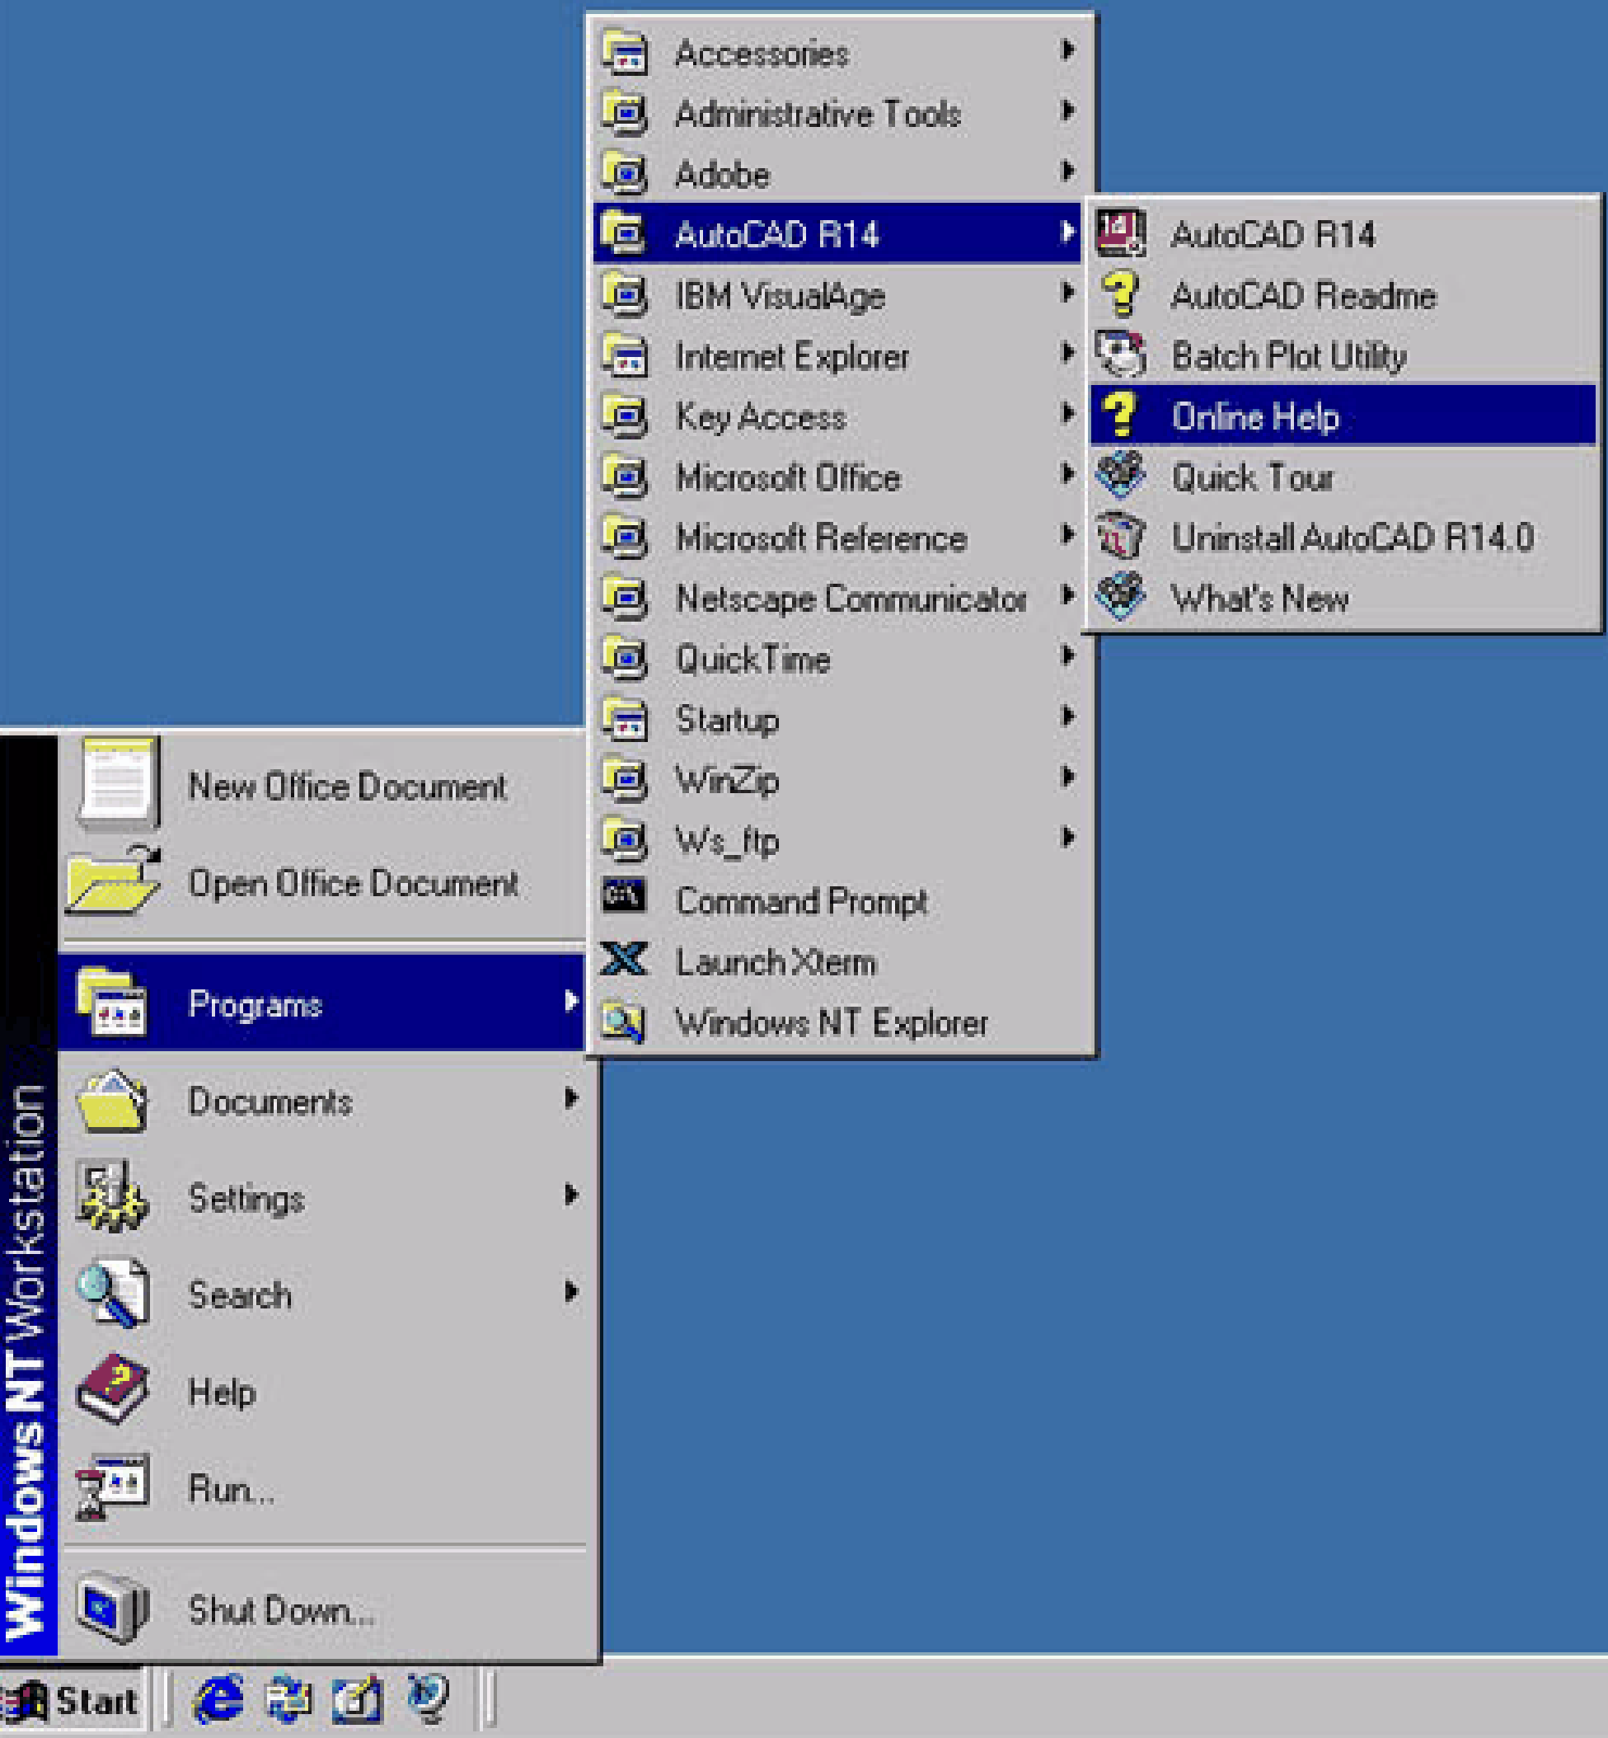
Graphic Design (3/6)
What are the strengths and weaknesses of this interface?

Slide 41
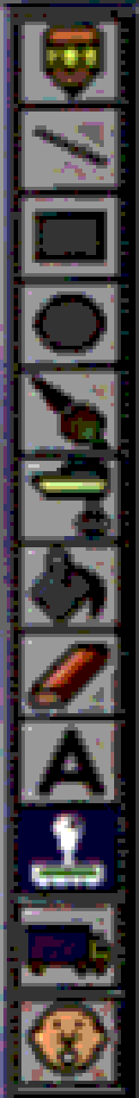
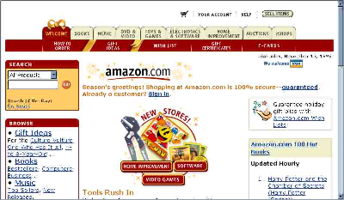
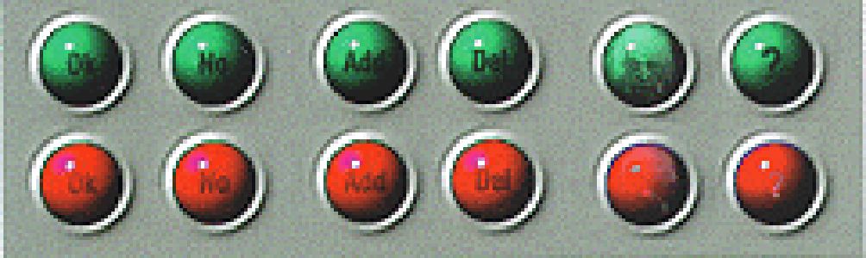
Graphic Design (4/6)
Why is the graphic design of these user interfaces poor?

Slide 42
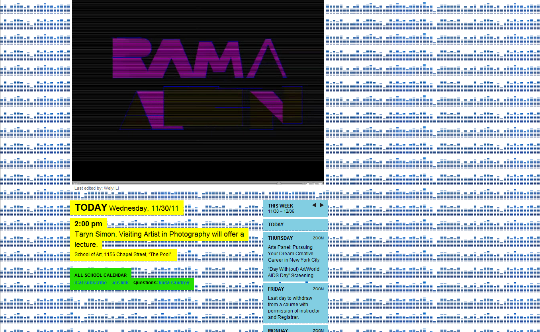
Graphic Design (5/6)
Screenshot from http://art.yale.edu

Slide 43
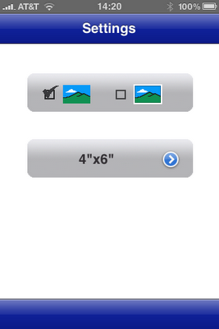
Graphic Design (6/6)
Print Settings view from Epson’s iPrint app for the iPhone:
No BACK button to navigate back! Stuck in settings forever.
The gray areas resemble buttons, even though they are not.
Too much empty space, unpolished look and feel.

Slide 44
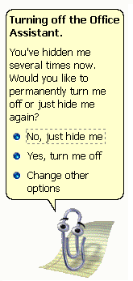
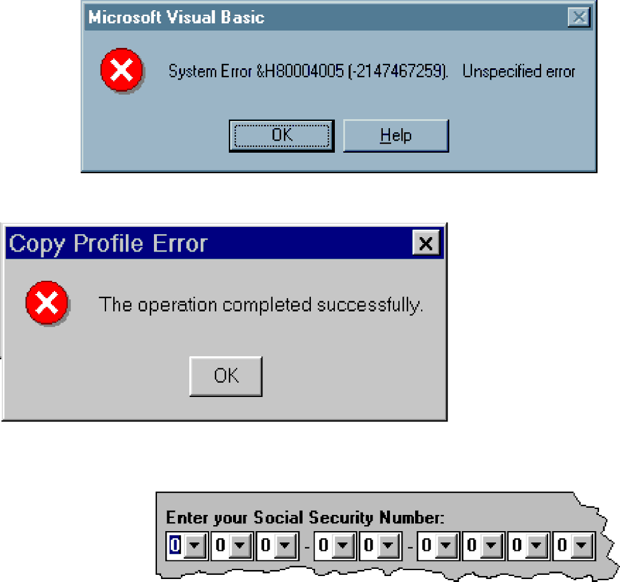
Hall of Shame

Slide 45
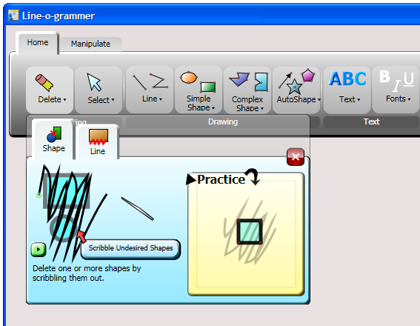
Documentation Design (does anyone still use doc?)
Several types
Guided tour
“Cheat sheet”
Tutorial manual
Reference manual
Help
Andrew Bragdon’s “gesture bar”, a tool bar that animates simple pen/touch gestures
Should be available on-line
Context-sensitive
Hypermedia
e.g., links from reference manual to tutorial to show functionality in context
Doing documentation well is hard
Begin documenting from the outset

Slide 46
Design Review
Review user interface design before implementing
Using prototype
Using detailed, formal design
Analogous to structural walk-through
Walk-through scenarios examine:
what user does
what user sees
what user must know
Evaluate
Against design objectives and guidelines
With measured metrics, such as mouse movements/action counts, time/tasks, error rate, etc.
The time to acquire a target is a function of the distance to and size of the target.
Easy to define metrics for canonical tasks; (e.g., select or track an object)
More difficult to define metrics for less mechanical tasks such as visualization

Slide 47
Prototyping the Design
Objectives and plans for prototype should be understood
By designers
By users
By prototypers
Expect many revisions
Have software tools available so that designers can respond quickly to user requests
Use prototyping early and often!
When user requirements are unclear
When implementation requirements are unclear
To user-test the design before too much effort is spent on it

Slide 48
Prototyping Hints (1/2)
Manage and control the prototype effort
Plan in advance
cost
effort
time limits
Set and enforce explicit procedures
deadlines
documentation
testing criteria
Combine prototype with life-cycle approach, if possible

Slide 49
Prototyping Hints (2/2)
Perceived problems of prototyping
Unrealistic expectations
user
management
marketing
Enthusiasm wanes with time spent working on a prototype
Difficult to manage and control
No rules for where and how to set boundaries for prototyping large systems

Slide 50
Implementation
Structure for change
Use good CASE (Computer Aided Software Engineering) tools
Stress modularity
Object-orientation is well-proven in building user-interfaces
many Object Oriented interface toolkits around
Linux: Qt, X11
Mac/iOS: Cocoa, Cocoa Touch
Windows: WPF
Web: jQuery, Cappuccino Web Framework, Flex (Adobe), Silverlight (MSFT)
Make skeletal user interface available for next step as soon as possible
UI code is hard to write
Reuse as much as you can
Toolkits are your friends
Good Software Engineering is a Must!

Slide 51
User Interface Evaluation
Involve real users
Both new and experienced users
Designers or implementers do not make good testers
“It works fine when I use it.”
Designers present at usability testing
But gagged in background, or at least can’t use their hands
To listen, observe, learn, and sweat!
Experimental design methodology (stats-based)
What to test and how to test it takes ingenuity and experimentation
granularity spectrum: individual interaction techniques to task performance
significant statistics background required (“design of experiments”)
Plan on major investments
Particularly for commercial products – UI may cost as much as the rest of the system

Slide 52
Lecture Summary (1/3)
UI design is the skill of developing a dialogue between the user and the computer
UI design is a collaborative, multi-disciplinary art
“Know thy user!”
The study of computer interfaces is still a relatively new discipline, and not widely enough taught
For those interested in computer user interface design some Universities have established separate groups for this study, often under the title of Human Computer Interaction (HCI)
Human Interface Technology Lab (University of Washington)
Berkeley Institute of Design (UC Berkeley)
Human Computer Interaction Institute (Carnegie Mellon)
Graphics, Visualization, and Usability Center (Georgia Tech)
Stanford HCI group

Slide 53
Lecture Summary (2/3)
UI is the component most critical to user satisfaction, and probably the largest component of today's interactive apps
User-centered design is mandatory
Rapid prototyping and usability testing is paramount
There are linguistic “abstraction layers” just like for programming languages, and each layer has design choices to be made
Conceptual level
Functional/semantic level
Sequencing/syntactical level
Binding/lexical level
Meaning
Look
and
Feel
Form

Slide 54
Lecture Summary (3/3)
WIMP interfaces are dominant, but more human-centered post-WIMP styles are gaining in importance (e.g., voice- and gesture-recognition-based, multi-modal and “natural user interfaces” (NUIs).
WIMP's "One size fits all" doesn't work for all circumstances and form factors (including the need for "universal design" principles to allow computers and info appliances to be used by those with disabilities or those who are illiterate)
UI design is a separate field that overlaps with software engineering, human studies and art/design, with its own design discipline and literature

