Slide 1
Cracking passwords with Hashcat

Slide 2
What is Hashcat?
How to set up Hashcat:
Hashcat is the self-proclaimed free fastest password recovery tool.
I’ll be using legacy-hashcat on my laptop which doesn’t have GPU.
You can clone the git repo and follow along or try this demo on your own. More detailed instructions can be found: https://cs.brown.edu/courses/cs166/demos/

Slide 3
Benchmark Hashcat
Run:
./hashcat-cli64.bin -b
What can hashcat do?
./hashcat-cli64.bin -help

Slide 4
Setup
STEP 1: Make a plaintext BAD password file, wordlist:
roberto12345 letmein juliaqwerty
STEP 2: Generate MD5 hashes:
for i in $(cat wordlist); do echo -n "$i"| md5sum | tr -d " *-" >> hashes; done
STEP 3: Get a dictionary file: I used rockyou.txt which lists most common passwords from the RockYou hack a couple years back...

Slide 5
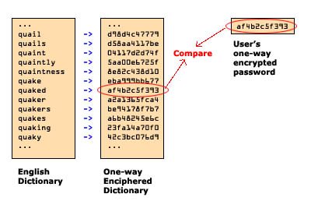
Dictionary attack
./hashcat-cli64.bin -m 0 -a 0 hashes rockyou.txt
Source: http://web.mit.edu/dheera/www/blur_dictattack.jpg

Slide 6
Hashtypes: -m [NUM]
0 : MD5 [8743b52063cd84097a65d1633f5c74f5]
100 : SHA1 [b89eaac7e61417341b710b727768294d0e6a277b]
1400 : SHA256
500: md5crypt, Cisco-IOS $1$ (MD5) [$1$28772684$iEwNOgGugqO9.bIz5sk8k/]
https://hashcat.net/wiki/doku.php?id=example_hashes

Slide 7
Attack Modes: -a [NUM]
0: Straight (Dictionary attack) 1: Combination (concatenating words from multiple wordlists) 2: Toggle-Case (toggling case of characters. You can use rules for this) 3: Brute-force (trying all characters from given charsets, per position) 4: Permutation (dictionary generates permutations of itselt) 5: Table-Lookup (Disabled in later hashcat implementations) 8: Prince (Intelligent guessing implemented by hashcat)
https://hashcat.net/wiki/doku.php?id=hashcat

Slide 8
Cracking MD5Crypt with Salt
Setup:
Use the word list from the previous demo, create a new hash file this time by adding a salt to your password. For our example the salt will be the same for all passwords. This is BAD. Do not do this: for i in $(cat wordlist); do openssl passwd -1 -salt "supersecretsalt" "$i" | tr -d " -" >> salthashes; done What does this do: -1: md5-based password algorithm -salt [SALT]: salts the password

Slide 9
Cracking MD5Crypt with Salt (cont.)
This time we will be using md5crypt, MD5 (Unix), Cisco-IOS $1$ (MD5) so the flag will be: -m 500.
Run:
./hashcat-cli64.bin -m 500 salthashes rockyou.txt
Note: The default attack mode is 0 (dictionary attack)

Slide 10
Mask Attack
Built-in charsets: ?l = abcdefghijklmnopqrstuvwxyz ?u = ABCDEFGHIJKLMNOPQRSTUVWXYZ ?d = 0123456789 ?s = !"#$%&'()*+,-./:;<=>?@[\]^_`{|}~ ?a = ?l?u?d?s ?b = 0x00 - 0xff
Run:
./hashcat-cli64.bin -a 3 hashes ?l?l?l?l?l
Source: https://www.4armed.com/blog/perform-mask-attack-hashcat/

Slide 11
Rule Based Attack
Rule 1) Substitute 'a' for '@'
p@ssword
Rule 2) Add 123 to end: password123 mysecret123 qwerty123
Rule 3) Capitalize first word: Password Mysecret Qwerty
If you have a list of passwords: password mysecret qwerty What kind of rules are there?
You can create a rule file with these rules: sa@
$c $1 $2 $3
Source: https://www.4armed.com/blog/hashcat-rule-based-attack/

Slide 12
Rule Based Attack
Run:
./hashcat-cli64.bin -m 0 hashes rockyou.txt -r ruledemo --debug-mode=1 --debug-file=matched.rule
Running cat matched.rule will show you all the rules that matched so you can build better rules.
There also lots of built-in rule files here: ls -l /usr/share/hashcat/rules/

Slide 13
eHarmony Hack
In 2012, 1.5 Million passwords were stolen from eHarmony and published online. As a CS166 student you can now hack like the pros and recover some eHarmony passwords using hashcat.
Weird things about this set:
eHarmony uses MD5: so try -m 0
For some reason eHarmony decided to store all the passwords uppercase. So this eliminates a lot of variety and saves us a lot of work.
Source: http://www.nydailynews.com/life-style/eharmony-passwords-hacked-1-5-million-users-dating-site-data-compromised-article-1.1091568

Slide 14
eHarmony Hack
Things to try:
Dictionary attack: ./hashcat-cli64.bin -m 0 eharmony.hash rockyou.txt Rule based attack: ./hashcat-cli64.bin -m 0 -r rules/rockyou-30000.rule eharmony.hash rockyou.txt Mask attack: ./hashcat-cli64.bin -m 0 -a 3 -1 ?u?d --remove eharmony.hash ?1?1?1?1?1?1?1
Source: http://www.adeptus-mechanicus.com/codex/hcateasy/hcateasy.php

Slide 15
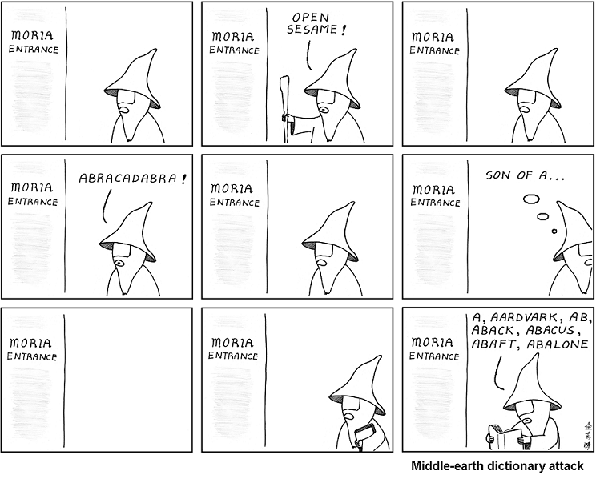
Fun stuff
https://haveibeenpwned.com/Passwords
http://time.com/5071176/worst-passwords-2017/
Try a dictionary attack on passwords in a different language:
пароль
parola
Not so easy is it? :( You need a new charset and/or dictionary.

