Slide 1

Intro to Alignment Algorithms:
Global and Local
Algorithmic Functions of Computational Biology
_{Professor Istrail}

Slide 2
Sequence Comparison
Algorithmic Functions of Computational Biology
_{Professor Istrail}
Biomolecular sequences
DNA sequences (string over 4 letter alphabet {A, C, G, T})
RNA sequences (string over 4 letter alphabet {ACGU})
Protein sequences (string over 20 letter alphabet {Amino Acids})
Sequence similarity helps in the discovery of genes, and the prediction of structure and function of proteins.

Slide 3
The Basic Similarity Analysis Algorithm
Algorithmic Functions of Computational Biology –
_{Professor Istrail}
Global Similarity
  Scoring Schemes
  Edit Graphs
  Alignment = Path in the Edit Graph
  The Principle of Optimality
  The Dynamic Programming Algorithm
  The Traceback

Slide 4
Sequence Alignment
Algorithmic Functions of Computational Biology –
_{Professor Istrail}
Input: two sequences over the same alphabet
Output: an alignment of the two sequences
Example:
GCGCATTTGAGCGA
TGCGTTAGGGTGACCA
A possible alignment:
- GCGCATTTGAGCGA - -
TGCG - - TTAGGGTGACC
match
mismatch
indel

Slide 5
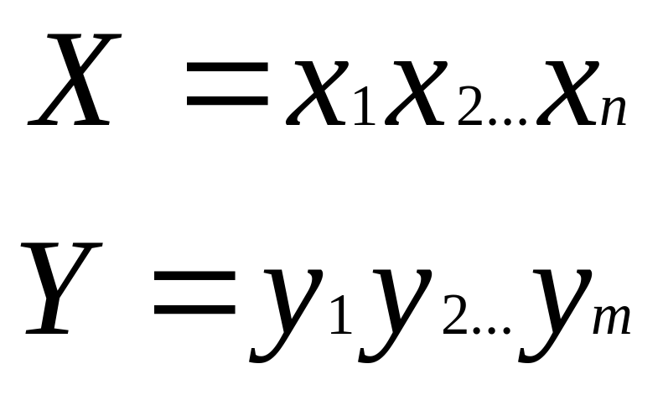
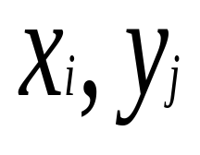


Algorithmic Functions of Computational Biology –
_{Professor Istrail}
Consider two sequences
belong to
Over the alphabet

Slide 6

Scoring Schemes
Algorithmic Functions of Computational Biology –
_{Professor Istrail}
Unit-score
A
C
G
T
-
A
1
0
0
0
0
C
0
1
0
0
0
G
0
0
1
0
0
T
0
0
0
1
0
-
0
0
0
0
0

Slide 7
Alignment
Algorithmic Functions of Computational Biology –
_{Professor Istrail}
A is aligned with A
ACG
| | |
AGG
C is aligned with G
A
|
A
C
|
G
G
|
G
G is aligned with G
Unit-cost
Score =
(A,A)
(C,G)
(G,G)
+
+
= 1 + 0 + 1 = 2

Slide 8
Gaps
Algorithmic Functions of Computational Biology –
_{Professor Istrail}
“-” is the gap symbol
ACATGGAAT
ACAGGAAAT
ACAT GG - AAT ACA - GG AAAT
SCORE
7
8
OPTIMAL
ALIGNMENTS
AAAGGG
GGGAAA
- - - AAAGGG
GGGAAA - - -
SCORE
0
3

Slide 9
Algorithmic Functions of Computational Biology –
_{Professor Istrail}
(x,y) = the score for aligning x with y
(x,-) = the score for aligning x with -
(-,y) = the score for aligning - with y

Slide 10
Algorithmic Functions of Computational Biology –
_{Professor Istrail}
Alignment
A-CG - G
ATCGTG
Score
(A,A) +
(-,T) +
(C,C) +
(G,G) +
(-,T ) +
(G,G)
THE SUM OF THE SCORES OF THE PAIRWISE
ALIGNED SYMBOLS

Slide 11
Scoring Scheme
Algorithmic Functions of Computational Biology –
_{Professor Istrail}
Dayhoff score
- A R N D C Q E G H I L K M F P S T W Y V
-8 -8 -8 -8 -8 -8 -8 -8 -8 -8 -8 -8 -8 -8 -8 -8 -8 -8 -8 -8 -8 -8
-8 3 -3 0 0 -3 -1 0 1 -3 -1 -3 -2 -2 -4 1 1 1 -7 -4 0
A
R
N
D
6
...
4
PTIPLSRLFDNAMLRAHRLHQ
SAIENQRLFNIAVSRVQHLHL
Partial alignment for Monkey and Trout somatotropin proteins

Slide 12
Scoring Functions
Algorithmic Functions of Computational Biology –
_{Professor Istrail}
Mutations= Substitutions, Insertions, Deletions
Scoring function = a sum of a terms each for a pair of
aligned residues, and for each gap
The meaning = log of the relative likelihood that the
sequences are related, compared to being unrelated
Identities and conservative substitutions are
Positive terms
Non-conservative substitutions are
Negative terms

Slide 13
The Edit Graph
Algorithmic Functions of Computational Biology –
_{Professor Istrail}
Suppose that we want to align
AGT with AT
We are going to construct a graph where alignments between the two sequences correspond to paths between the begin and and end nodes of the graph.
This is the Edit Graph

Slide 14
Algorithmic Functions of Computational Biology –
_{Professor Istrail}
The sequence AGT
The sequence AT
0
1
2
3
0
AGT has length 3
AT has length 2
1
2
The Edit graph has (3+1)*(2+1) nodes

Slide 15
Algorithmic Functions of Computational Biology –
_{Professor Istrail}
A
G
T
Begin
0
1
2
3
0
A
1
T
2
End
AGT indexes the columns, and AT indexes the rows of this “table”

Slide 16
Algorithmic Functions of Computational Biology –
_{Professor Istrail}
A
G
T
Begin
0
1
2
3
0
A
1
T
2
The Graph is directed. The nodes (i,j) will hold values.
End

Slide 17
Algorithmic Functions of Computational Biology
_{Professor Istrail}
A
G
T
Begin
0
1
2
3
0
A
1
T
2
End

Slide 18
Algorithmic Functions of Computational Biology –
_{Professor Istrail}
Directed edges get as labels pairs of aligned letters.
A
G
T
Begin
0
1
2
3
0
G
-
T
-
A
-
A
-
A
-
A
-
A
-
A
A
A
G
A
T
A
-
A
1
A
-
G
-
T
-
-
T
A
T
-
T
G
T
-
T
T
T
-
T
T
2
A
-
G
-
T
-
End

Slide 19
Alignment = Path in the Edit Graph
Algorithmic Functions of Computational Biology –
_{Professor Istrail}
Begin
A
G
T
0
1
2
3
0
A
-
G
-
T
-
A
-
A
-
A
-
A
-
A
AGT
A-T
A
A
G
A
T
A
-
A
1
A
-
G
-
T
-
-
T
A
T
-
T
G
T
-
T
T
T
-
T
T
2
A
-
G
-
T
-
End
Every path from Begin to End corresponds to an alignment
Every alignment corresponds to a path between Begin and End

Slide 20
The Principle of Optimality
Algorithmic Functions of Computational Biology –
_{Professor Istrail}
The optimal answer to a problem
is expressed in terms of optimal
answer for its sub-problems

Slide 21
Dynamic Programming
Algorithmic Functions of Computational Biology –
_{Professor Istrail}
Given: Two sequences X and Y
Find: An optimal alignment of X with Y
Part 1: Compute first the optimal alignment score
Part 2: Construct optimal alignment
We are looking for the optimal alignment =
maximal score path in the Edit Graph from
the Begin vertex to the End vertex

Slide 22
The DP Matrix S(i,j)
Algorithmic Functions of Computational Biology –
_{Professor Istrail}
A
G
T
S(1,0)
0
1
2
3
0
A
1
T
S(2,1)
2

Slide 23
The DP Matrix
Algorithmic Functions of Computational Biology –
_{Professor Istrail}
Matrix S =[S(i,j)]
S(i,j) = The score of the maximal cost path
from the Begin Vertex and the vertex (i,j)
Optimal Path to (i,j)
(i-1,j-1)
(i,j-1)
The optimal path to (i,j)
must pass through one of
the vertices
(i-1,j)
(i-1,j)
(i,j)
(i,j-1)
(i-1,j-1)

Slide 24
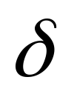
Opt path
Algorithmic Functions of Computational Biology –
_{Professor Istrail}
(i-1,j-1)
(i,j-1)
-
xi
S(i-1,j) +
(- , yj)
(i-1,j)
yj
-
(i,j)
Optimal path to (i-1,j) + (- , yj)

Slide 25
Optimal path
Algorithmic Functions of Computational Biology –
_{Professor Istrail}
(i-1,j-1)
(i-1,j)
S(i-1,j-1) +
(xi , yj)
(i,j-1)
(i,j)
Optimal path to (i-1,j-1)
+ (xi,yj)

Slide 26
Optimal path
Algorithmic Functions of Computational Biology –
_{Professor Istrail}
(i-1,j-1)
(i,j-1)
S(i,j-1) + (xi, -)
(I-1,j)
(i,j)
Optimal path to (i,j-1)
+ (xi,-)

Slide 27
The Basic ALGORITHM
Algorithmic Functions of Computational Biology –
_{Professor Istrail}
S(i-1, j-1) + (xi, yj)
S(i,j) =
MAX
S(i-1, j) + (xi, -)
S(i, j-1) + (-, yj)

Slide 28
Algorithmic Functions of Computational Biology –
_{Professor Istrail}
Optimal Alignment and Tracback
A
G
T
0
1
2
3
0
0
G
-
0
T
-
0
A
-
0
A
-
A
-
A
-
A
-
A
A
A
G
A
T
A
-
A
0
1
1
1
1
A
-
G
-
T
-
-
T
A
T
-
T
G
T
-
T
T
T
-
T
T
2
0
A
-
1
G
-
1
T
-
2
AGT
A - T
Optimal Alignment

Slide 29
The Basic ALGORITHM: Local Similarity
Algorithmic Functions of Computational Biology –
_{Professor Istrail}
0,
We add this
S(i-1, j-1) + (xi, yj),
S(i,j) =
MAX
S(i-1, j) + (xi, -),
S(i, j-1) + (-, yj)

Slide 30
General Scoring Schemes
Algorithmic Functions of Computational Biology –
_{Professor Istrail}
Assumptions
1. Independence of mutations at different sites
Additive scoring scheme
2. Gaps of any length are considered one mutation
All of the efficient alignment algorithms -- employing on the dynamic
programming method --are based fundamentally on the of the fact
that the scoring function is additive.

